Slide 1
Booknook
Mengwen Li(ml4643)

Slide 2
Problems and idea
Readers are overwhelmed by massive books
Struggle for searching book available nearby.
BookNook
Helps user discover books
Connect readers to physical retailers

Slide 3
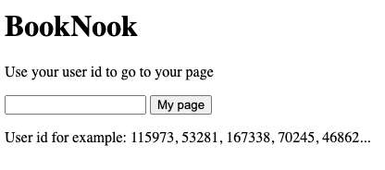
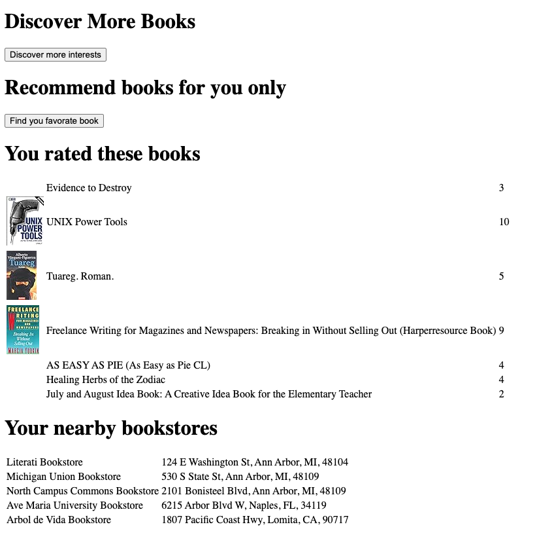

Slide 4
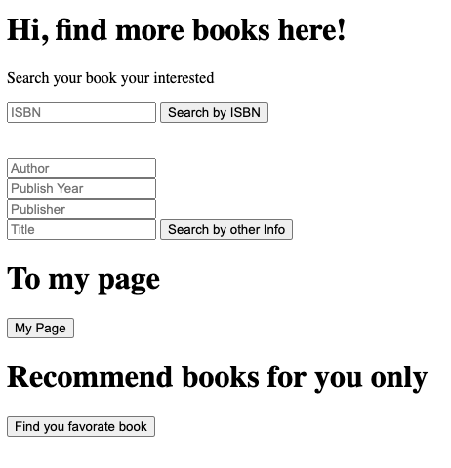

Slide 5
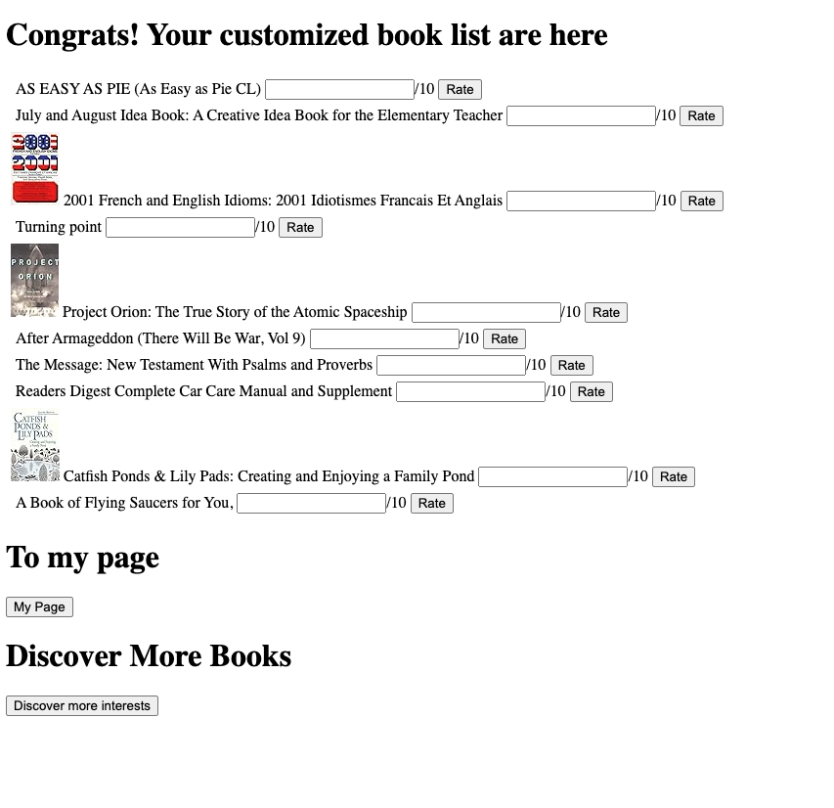

Slide 6
Service component
Frontend
Javascript
DynamoDB
S3
Lambda
API Gateway
AWS Location service

Slide 7
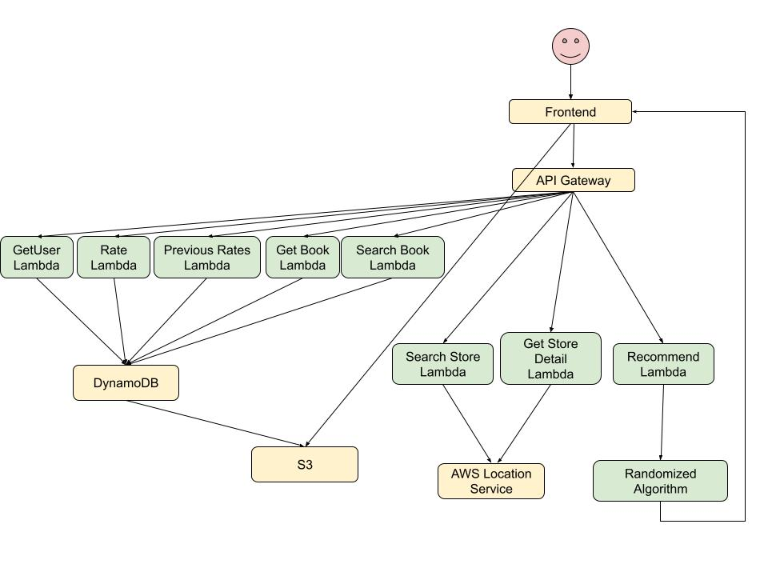
Architecture

