Slide 1
Home Credit Default Risk
Course:
ENEL 645 (Winter 2022) - Data Mining & Machine Learning
Instructor:
Dr. Roberto Souza
Presented by group 20:
Kayode Awe
Maliha Zakir
Melissa Liao Chen
Serhiy Chaykovskyy
April 2022

Slide 2
ABSTRACT

Slide 3
INTRODUCTION

Slide 4
RELATED WORK
Research on Prediction of Loan Default
A study on predicting loan default based on random forest algorithm
RandomForestClassifier - 98%
Logistic Regression - 73%
Support Vector Machines - 75%
Business analytics using random forest for credit risk prediction
Competitive classification Accuracy
Business advantages
Loan prediction analysis using decision tree
Credit score of mortgage loans
Higher Acceptance Rate: Low-income applicants
An exploratory data analysis for loan prediction
Nature of loan applicants
Short-term loans
Loan sanctioning prediction system
Data-preprocessing
Feature Selection

Slide 5
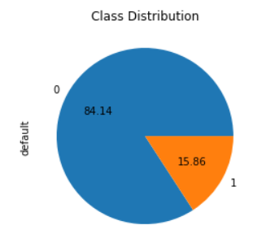
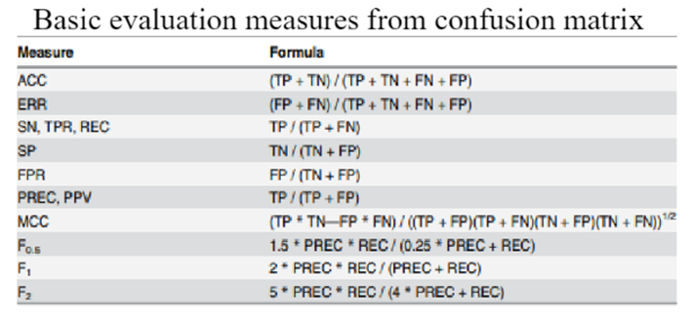
MATERIALS AND METHODS
Exploratory Data Analysis
Home Credit Default Risk dataset
84% False
16% True
Data Pre-processing
Eliminated bias
Replaced missing values & NaN
Model Building & Selection
LogisticRegression
RandomForestClassifier
GradientBoostingClassifier
XGBoost
Models for imbalance Dataset
EasyEnsembleClassifier
RUSBoosterClassifier
BalancedBaggingClassifier
BalancedRandomForestClassifier
Metrics Calculation
Prediction
‘predict_proba’ method
class probabilities

Slide 6
RESULTS

Slide 7
DISCUSSION

Slide 8
CONCLUSIONS

Slide 9
REFERENCES
[1] Zhu L, Qiu D, Ergu D, Ying C and Liu K 2019 A study on predicting loan default based on the random forest algorithm The 7th Int. Conf. on Information Technol. and Quantitative Management
[2] Ghatasheh N 2014 Business analytics using random forest trees for credit risk prediction: a comparison study Int. Journal of Advanced Science and Technology
[3] Madane N and Nanda S 2019 Loan prediction analysis using decision tree Journal of The Gujarat Research Society
[4] Jency X F, Sumathi V P and Sri J S 2018 An exploratory data analysis for loan prediction based on nature of the clients Int. Journal of Recent Technol. and Engineering
[5] Kacheria A, Shivakumar N, Sawkar S and Gupta A 2016 Loan sanctioning prediction system Int. Journal of Soft Computing and Engineering

