Slide 1
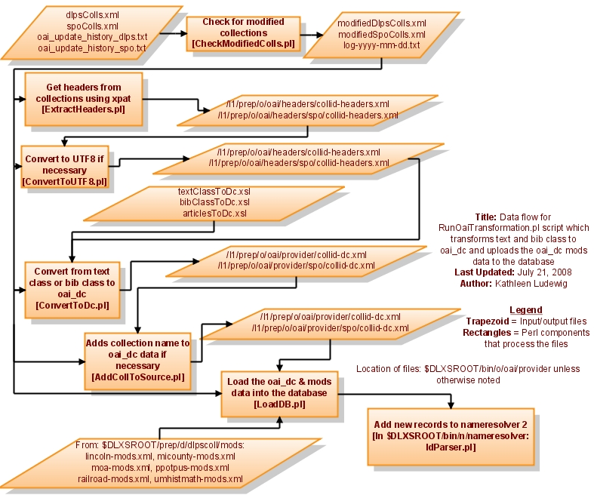
Transform text (and bib) class collections

Slide 2
Other examples: serial to oai_dc
(articlesToDc.xsl)
Node becomes dc:identifier
<DIV1 NODE="taj1895.0001.001:1">
<BIBL>
<TITLE>Advertisement</TITLE>
<BIBLSCOPE TYPE="vol">1</BIBLSCOPE>
<BIBLSCOPE TYPE="iss">1</BIBLSCOPE>
<BIBLSCOPE TYPE="mo">April</BIBLSCOPE>
<BIBLSCOPE TYPE="year">1895</BIBLSCOPE>
</BIBL> ….
</DIV1>
Article title becomes dc:title
Coll name, vol and issue
are put in dc:source
Month and year
are put in dc:date
Full oai_dc record

Slide 3
Other examples: bib class to oai_dc
(bibClassToDc.xsl)
<A ID="AM0429" DT="2005-09-16">
<B>
<K>Post-Laureate Idyls and other poems by Oscar Fay Adams</K>
<L>Oscar Fay Adams, 1855-1919</L>
</B> …
<E>
<U>Boston</U>
<T>D. Lothrop and Company</T>
<YR>1886</YR>
<W A="acc.no">AM0429</W>
</E> ...
</A>
K becomes dc:title
L becomes dc:creator
U & T becomes dc:publisher
YR becomes dc:date
W becomes dc:identifier
Full oai_dc record

Slide 4
Other examples: image class to oai_dc
(image2oai_dc.pl)
Image Class Field | Value | oai_dc field
dc_ti | The General Planting Scheme of Nichols Arboretum | dc:title
dc_cr | Dep’t of Landscape Design | dc:creator
dc_su | Nichols Arboretum (University of Michigan) -- Maps, Topographic | dc:subject
dc_id | IC-UMARB1IC-X-15%5DARB27PLN.TIF | dc:identifier
Full oai_dc record

Slide 5
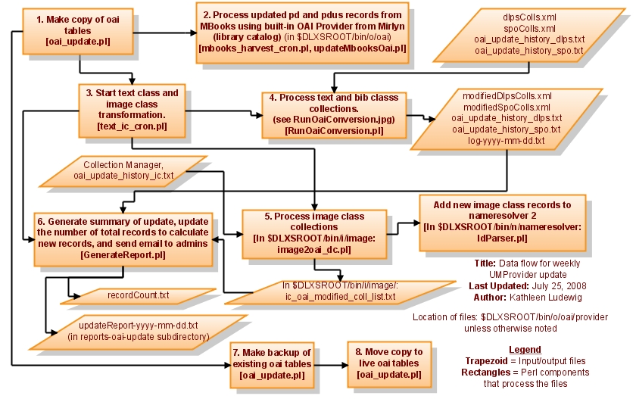
Automatically check for modified collections

Slide 6
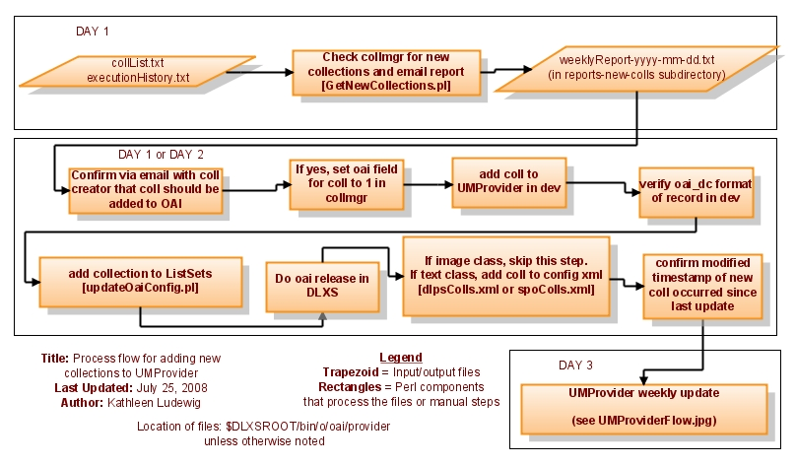
Add new collections

