Slide 1

Epidemiologic Measurements Used to Describe Disease Occurrence
CHAPTER 3

Slide 2
Learning Objectives
Define three mathematical terms applied to epidemiology and provide examples of each.
Compare incidence and prevalence and explain how they are interrelated.
State one epidemiologic measure of mortality, giving its formula.
Distinguish between a fertility rate and a birth rate.
State the limitations of crude rates and define alternative measures.

Slide 3
Introduction
Four key mathematical terms
Related to basic epidemiologic measures
Pertain to frequency of disease in populations
Pertain to risks associated with exposures to disease agents
Alternative conclusions from different measures

Slide 4
Mathematical Terms Used in Epidemiology
Types of ratios
Rate
Proportion
Percentage

Slide 5
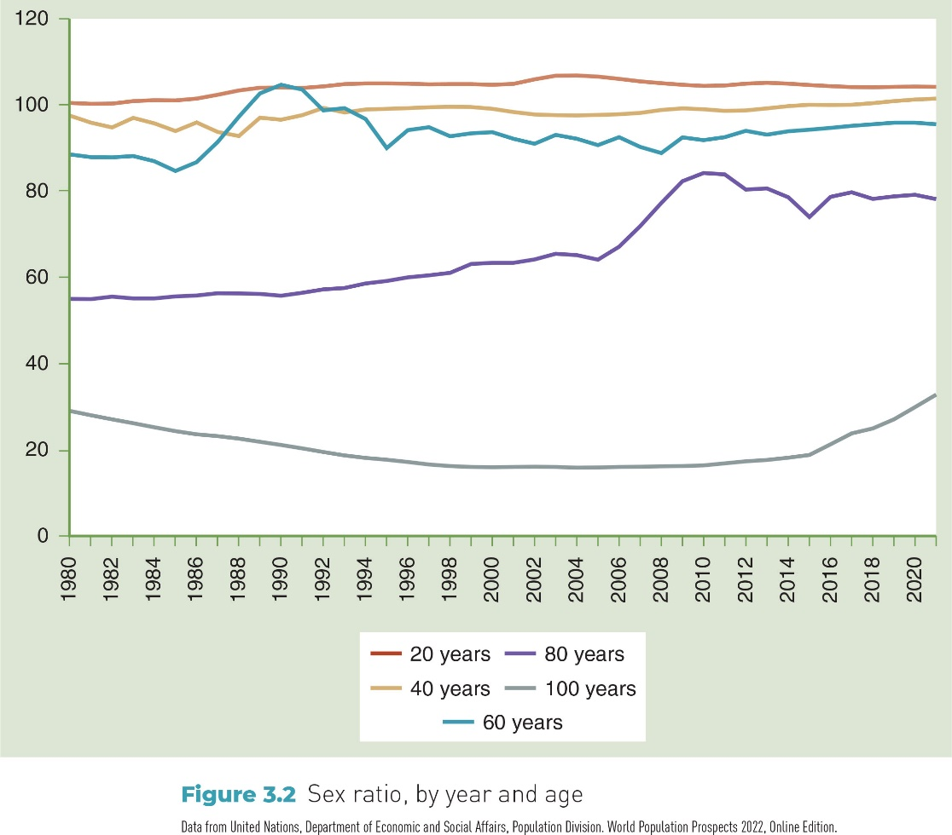
Figure 3-1 Definitions of mathematical terms that are used in epidemiology

Slide 6
Ratio
Ratio is “the value obtained by dividing one quantity by another.”

Slide 7
Example of a Ratio Calculation
With respect to COVID-19 mortality, sex ratio of deaths (male to female deaths) = X/Y, where:
X = 511,000
Y = 421,000
Sex ratio = 511,000/421,000 = 1.2 to 1 (approximately)

Slide 8
Proportion
Type of ratio in which numerator is part of denominator
May be expressed as percentage

Slide 9
Example of a Proportion
Calculate proportion of deaths from COVID-19 that occurred among males.
A | B | Total (A + B)
Number of deaths from COVID-19 among males | Number of deaths from COVID-19 among females | Total
511,000 | 421,860 | 511,000+421,860
Proportion = A/(A + B) = 511,000/(511,000 + 421,860) = 0.55

Slide 10
Percentage
Proportion that has been multiplied by 100.
Formula is (A/A + B) × 100.
From previous slide:
Percentage of COVID-19 deaths that occurred among males was (0.55 × 100) = 55%.

Slide 11
Rate
Another type of ratio but differs from proportion because denominator involves a measure of time
Numerator: Number of health events
Denominator: Population in which events occur
Measure of time

Slide 12
General Information Regarding Epidemiologic Measures
Epidemiologic measures provide the following types of information
Frequency of a disease or condition
Associations between exposures and health outcomes
Strength of relationship between an exposure and health outcome

Slide 13
Types of Epidemiologic Measures
Quantitative terms are useful in epidemiology to characterize occurrence of disease, morbidity, and mortality in populations.
Quantitative terms
Counts
Incidence
Prevalence

Slide 14
Count
Number of cases of a disease or other health phenomenon being studied
Reports of single cases may have public health significance.
Case reports of patients with particularly unusual presentations or combinations of symptoms often spur epidemiologic investigations.
Example: One case of Ebola viral disease
Lack of denominator information makes interpretation difficult.

Slide 15
Incidence
Occurrence of new disease or mortality within a defined period of observation (e.g., week, month, year, or other time period) in specified population
Can be measured in different ways
Cumulative incidence (proportion)
Incidence rate or incidence density rate (rate)

Slide 16
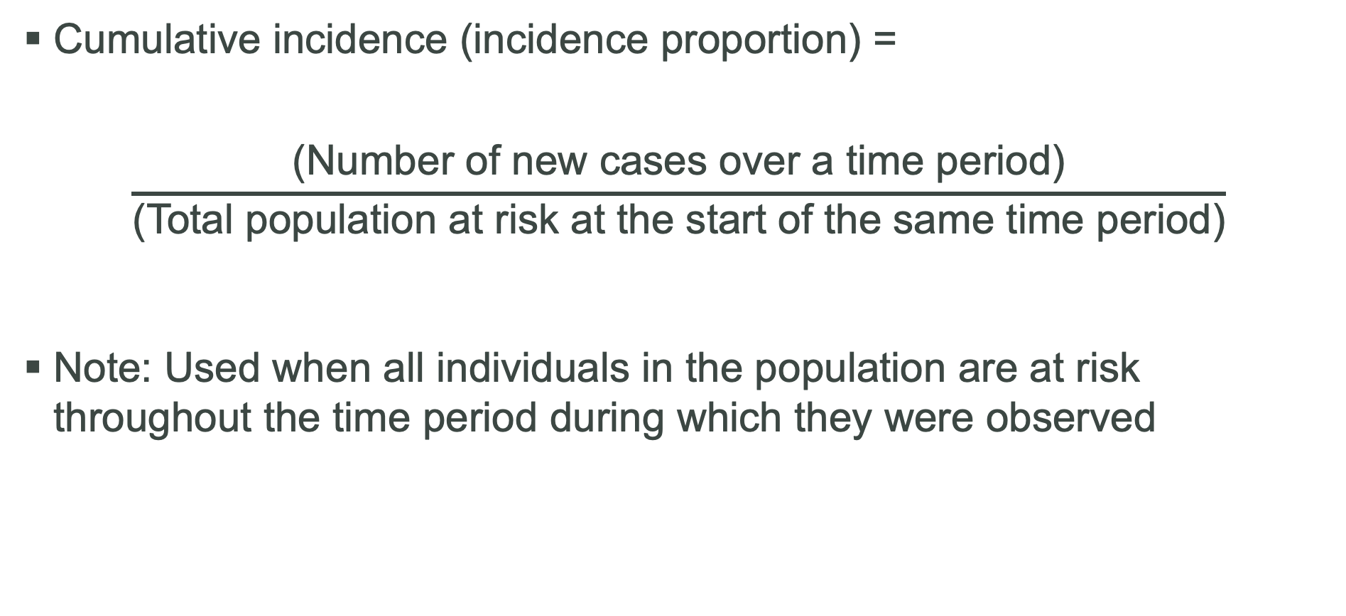
Incidence Proportion
Cumulative incidence (incidence proportion) =
$$\frac{\text{(}\text{Number} \text{of} \text{new} \text{cases} \text{over} \text{a} \text{time} \text{period}\text{)}}{\text{(}\text{Total} \text{population} \text{at} \text{risk} \text{at} \text{the} \text{start} \text{of} \text{the} \text{same} \text{time} \text{period}\text{)}}$$
Note: Used when all individuals in the population are at risk throughout the time period during which they were observed

Slide 17
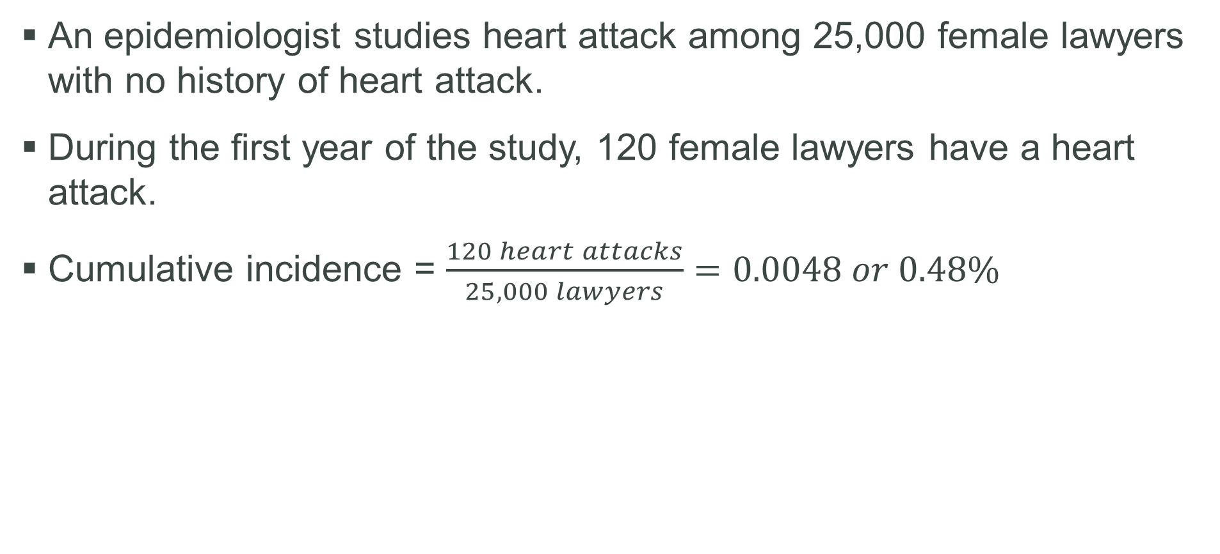
Calculation of Cumulative Incidence: Female Lawyers and Heart Attack
An epidemiologist studies heart attack among 25,000 female lawyers with no history of heart attack.
During the first year of the study, 120 female lawyers have a heart attack.
Cumulative incidence = $\frac{120 heart attacks}{25,000 lawyers}=0.0048 or 0.48\%$

Slide 18
Incidence Rate
Rate formed by dividing number of new cases that occur during a time period by number of individuals in population at risk
Amount of time each individual is at risk is also considered when calculating incidence rate.

Slide 19
Population at Risk
Members of the population who are capable of developing the disease or condition being studied

Slide 20
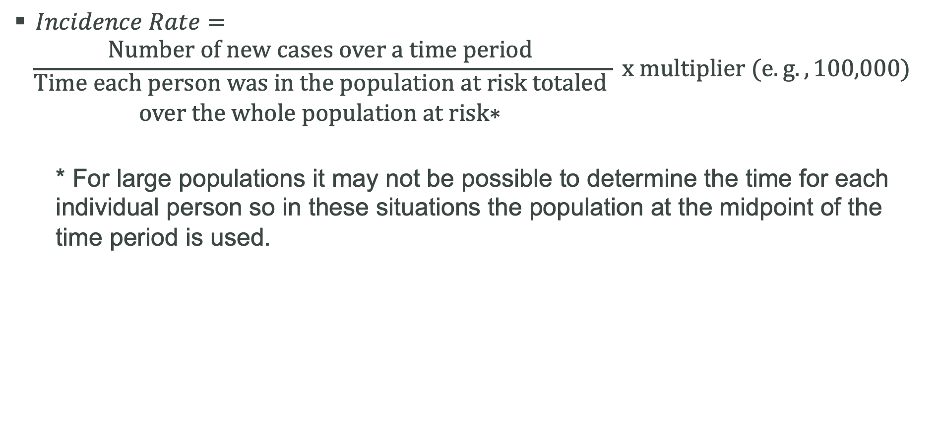
Incidence Rate Formula
$Incidence Rate=$
$$\frac{\text{Number} \text{of} \text{new} \text{cases} \text{over} \text{a} \text{time} \text{period} }{\begin{aligned}\text{Time} \text{each} \text{person} \text{was} \text{in} \text{the} \text{population} \text{at} \text{risk} \text{totaled} \\ \text{over} \text{the} \text{whole} \text{population} \text{at} \text{risk}\text{∗ }\end{aligned}} x multiplier (e.g., 100,000)$$
* For large populations it may not be possible to determine the time for each individual person so in these situations the population at the midpoint of the time period is used.

Slide 21
Calculation of Incidence Rate: Incidence Rate of HIV Infection
Number of new cases in U.S., 2019 (13 years of age and older) = 30,635
Midpoint population on July 1, 2019 = 272,000,000
Incidence rate = 11.3 per 100,000 (rounded)

Slide 22
Prevalence
Number of existing cases of a disease or health condition, or deaths in a population at some designated time
Variations
Point prevalence
Period prevalence
Lifetime prevalence

Slide 23
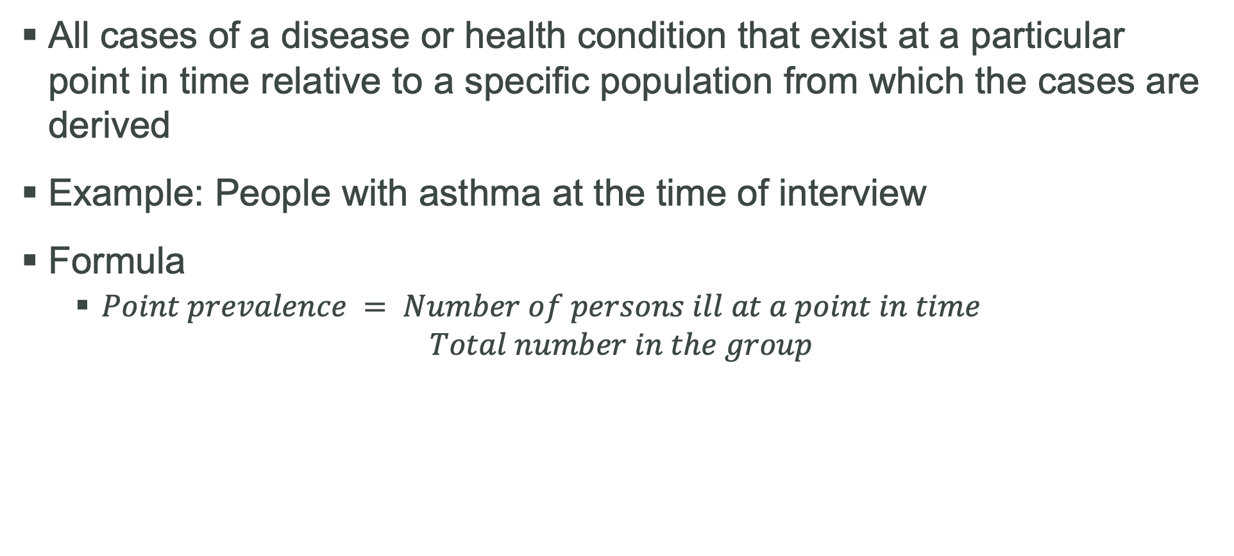
Point Prevalence
All cases of a disease or health condition that exist at a particular point in time relative to a specific population from which the cases are derived
Example: People with asthma at the time of interview
Formula
$Point prevalence = Number of persons ill at a point in time$ $Total number in the group$

Slide 24
Period Prevalence
All cases of a disease or health condition within a period of time
Example: Percentage of people in U.S. who had asthma during past 12 months

Slide 25
Lifetime Prevalence
Cases diagnosed at any time during the person’s lifetime
Example: Lifetime asthma prevalence

Slide 26
Interrelationships Between Incidence and Prevalence (1 of 2)
Incidence and prevalence are interrelated concepts.
Factors that cause prevalence to increase
Increase in incidence
Longer duration of case
In-migration of cases
Prolongation of life of patients without cure

Slide 27
Interrelationships Between Incidence and Prevalence (2 of 2)
Factors that cause prevalence to decrease
Decrease in incidence
Shorter duration of disease
In-migration of healthy people
Improved cure rate of disease

Slide 28
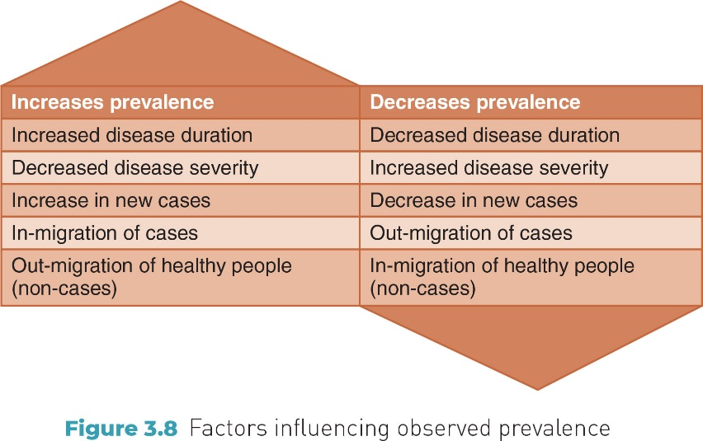
Figure 3-8 Factors influencing observed prevalence

Slide 29
Measures of Disease Occurrence
Over the last several decades in the U.S., mortality (or death) rates have trended downward.
Life expectancy has trended upward.
Life expectancy: Number of additional years that a person is expected to live at any particular age (e.g., at birth)
COVID-19 pandemic and epidemic of drug overdose deaths have led to recent decreases in life expectancy.
Life expectancy varies by race.

Slide 30
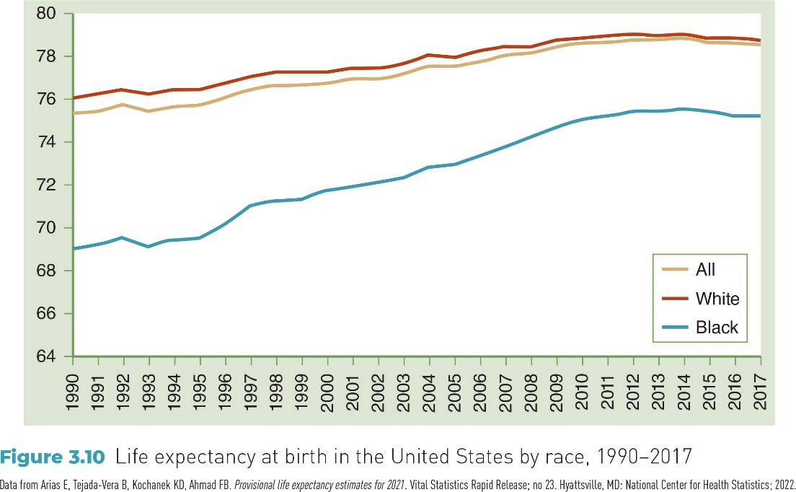
Figure 3-10 Life Expectancy at birth in the United States by Race, 1990–2017

Slide 31
Epidemiologic Measures Related to Mortality
Four measures of mortality (death)
Crude rates
Case-fatality rates
Proportional mortality ratio
Cause-specific rates

Slide 32
Three Categories of Mortality Rates
Crude rates
Specific rates
Adjusted rates

Slide 33
Crude Mortality Rate (1 of 2)
Type of rate that has not been modified to take account of any factors, such as the demographic makeup of the population, that may affect the observed rate
Includes time period during which event occurred (usually 1 year).
Numerator consists of frequency of deaths from all causes over specified period of time.
Denominator is a unit size of population.
Helpful in making comparisons but has limitations

Slide 34
Crude Mortality Rate (2 of 2)
Crude death rate is a type of crude rate.
Can be expressed in terms of any unit size of a population that is convenient
Example: Crude mortality rates are typically expressed per 100,000 population.

Slide 35
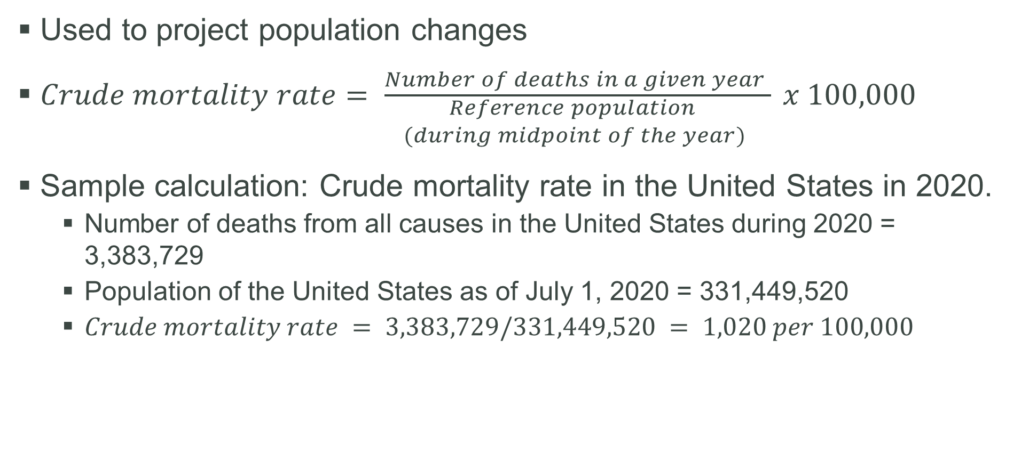
Crude Mortality Rate Calculation
Used to project population changes
$Crude mortality rate= \frac{Number of deaths in a given year }{\begin{aligned}Reference population \\ (during midpoint of the year) \end{aligned}} x 100,000$
Sample calculation: Crude mortality rate in the United States in 2020.
Number of deaths from all causes in the United States during 2020 = 3,383,729
Population of the United States as of July 1, 2020 = 331,449,520
$Crude mortality rate = 3,383,729/331,449,520 = 1,020 per 100,000$

Slide 36
Reference Population
Population from which cases of a disease have been taken
Example: United States for calculation of the annual crude mortality rate in the U.S.

Slide 37

Case Fatality Rate (CFR)
Number of deaths due to a disease that occur among persons who are afflicted with that disease
$CFR \left(\%\right)= \frac{Number of deaths due to disease “X”}{Number of cases of disease “X” } x 100 during a time period$

Slide 38
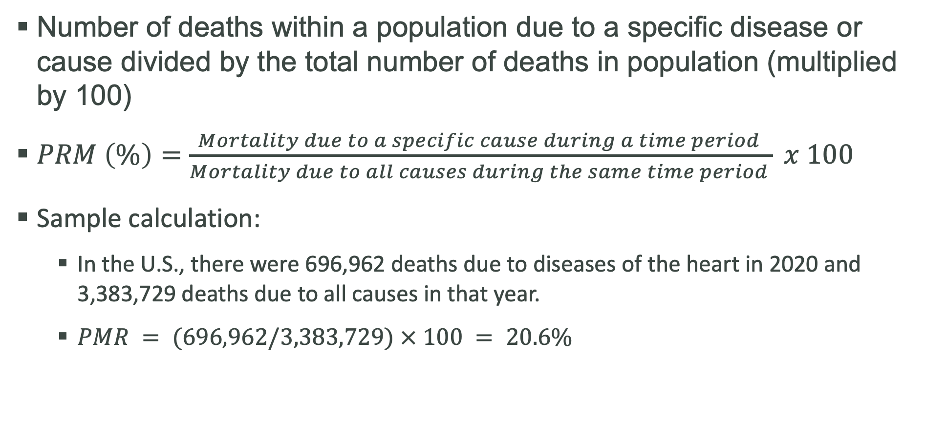
Proportional Mortality Ratio (PMR%)
Number of deaths within a population due to a specific disease or cause divided by the total number of deaths in population (multiplied by 100)
$PRM \left(\%\right)=\frac{Mortality due to a specific cause during a time period }{Mortality due to all causes during the same time period } x 100$
Sample calculation:
In the U.S., there were 696,962 deaths due to diseases of the heart in 2020 and 3,383,729 deaths due to all causes in that year.
$PMR = (696,962/3,383,729) × 100 = 20.6\%$

Slide 39
Specific Mortality Rates
Three examples of specific rates
Cause-specific mortality rates
Age-specific mortality rates
Sex-specific mortality rates

Slide 40

Cause-Specific Mortality Rate
Measure that refers to mortality from a specific cause divided by population size at midpoint of time period times a multiplier
$Cause−specific rate= \frac{Mortality from a specific cause }{\begin{aligned}Population size at midpoint \\ of time period \end{aligned}} x 100,000$

Slide 41
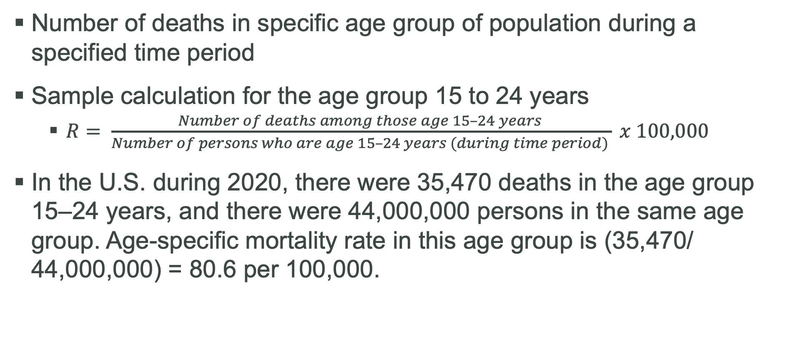
Age-Specific Mortality Rate (R)
Number of deaths in specific age group of population during a specified time period
Sample calculation for the age group 15 to 24 years
$R= \frac{Number of deaths among those age 15–24 years }{Number of persons who are age 15–24 years (during time period) } x 100,000$
In the U.S. during 2020, there were 35,470 deaths in the age group 15–24 years, and there were 44,000,000 persons in the same age group. Age-specific mortality rate in this age group is (35,470/ 44,000,000) = 80.6 per 100,000.

Slide 42
Sex-Specific Mortality Rate
Number of deaths in a sex group divided by total number of persons within that sex group during a time period times a multiplier
Mortality in 2020
Number of deaths among males was 1,691,900.
Estimated number of males in the population as of July 1, 2020, was 164,382,008.
Sex-specific mortality rate for males in 2020 per 100,000 was 1,691,900/164,382,008 × 100,000 = 1,031 per 100,000

Slide 43
Adjusted Mortality Rates
Comparing mortality rates between populations can be difficult due to differences in age and other factors.
Statistical procedures can be used to adjust mortality rates to permit fair comparisons across populations by removing effect of differences in composition of populations.
Direct age adjustment
Indirect age adjustment

Slide 44
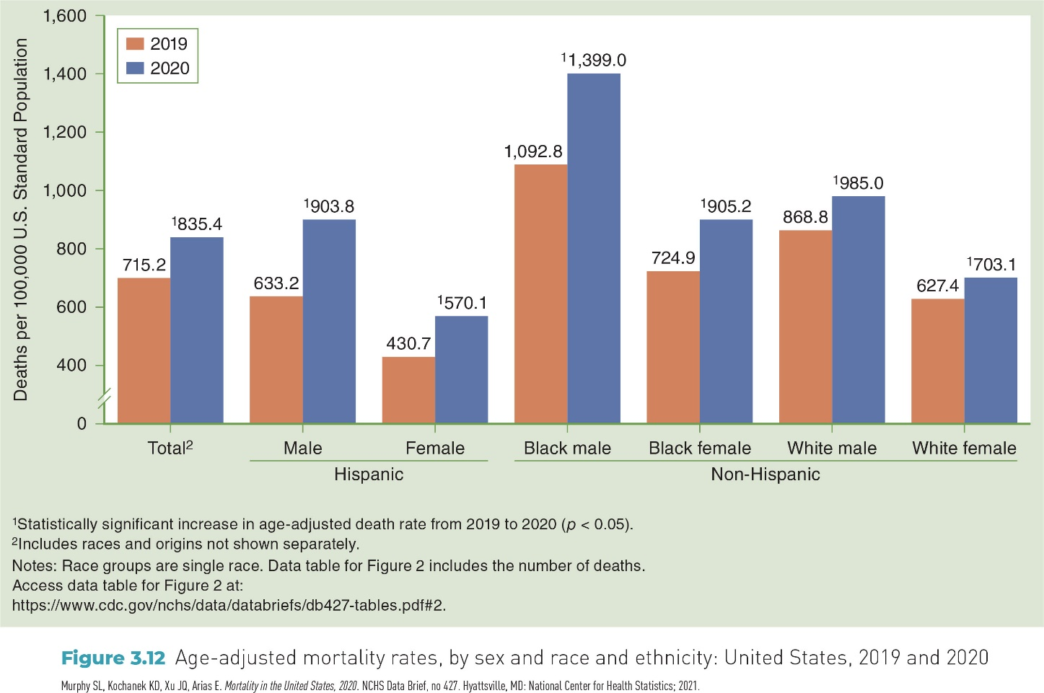
Figure 3-12 Age-adjusted death rates, by sex and race and ethnicity: United States, 2019 and 2020

Slide 45
Natality and Mortality Linked to Natality
Maternal mortality rate
Infant mortality rate
Fetal mortality
Fetal death rate
Late fetal death rate
Birth rate (e.g., crude birth rate)
General fertility rate

Slide 46
Maternal Mortality
Encompasses maternal deaths that result from causes associated with pregnancy
Measure is maternal mortality rate.
Maternal mortality rates have been increasing in the United States and show significant disparities by race.

Slide 47

Maternal Mortality Rate
$Maternal mortality rate \left(\begin{aligned}per 100,000 live births, \\ including multiple births\end{aligned}\right)=\frac{\begin{aligned}Number of deaths assigned \\ to causes related to childbirth \end{aligned}}{Number of live births } x100,000 live births(during a year)$

Slide 48
Infant Mortality Rate
Number of infant deaths among infants aged 0–365 days during a year divided by the number of live births during the same year (expressed as rate per 1,000 live births)
Related to inadequate health care and poor environmental conditions
Substantial racial and ethnic variations

Slide 49

Infant Mortality Rate (Formula)
$Infant Mortality \left(I\right)= \frac{\begin{aligned}Number of infant deaths among \\ infants age 0–365 days during the year \end{aligned}}{Number of live births during the year } x 1,000 live births$
Sample calculation: In the U.S. during 2020, there were 19,582 deaths among infants under 1 year of age and 3,613,647 live births. The infant mortality rate was (19,582/3,613,647) × 1,000 = 5.42 per 1,000 live births.

Slide 50
Fetal Mortality (1 of 2)
Death of the fetus when it is in the uterus and before it has been delivered
Two measures
Fetal death rate
Late fetal death rate

Slide 51
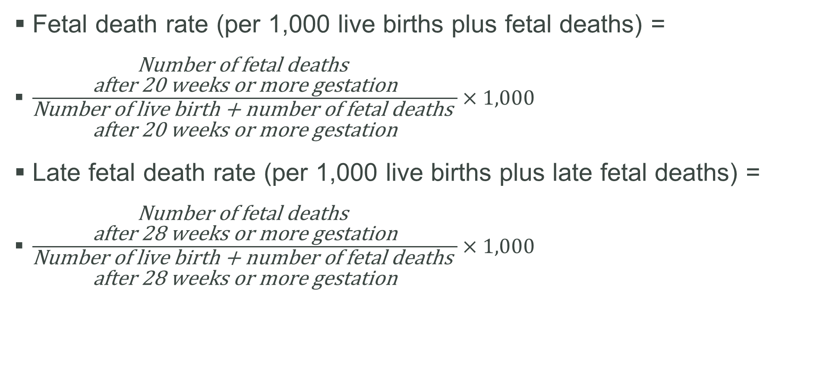
Fetal Mortality (2 of 2)
Fetal death rate (per 1,000 live births plus fetal deaths) =
$\frac{\begin{aligned}\text{Number} \text{of} \text{fetal} \text{deaths} \\ \text{after}\text{ 20 }\text{weeks} \text{or} \text{more} \text{gestation}\end{aligned}}{\begin{aligned}\text{Number} \text{of} \text{live} \text{birth}\text{ + }\text{number} \text{of} \text{fetal} \text{deaths} \\ \text{after}\text{ 20 }\text{weeks} \text{or} \text{more} \text{gestation}\end{aligned}}×1,000$
Late fetal death rate (per 1,000 live births plus late fetal deaths) =
$\frac{\begin{aligned}\text{Number} \text{of} \text{fetal} \text{deaths} \\ \text{after}\text{ 28 }\text{weeks} \text{or} \text{more} \text{gestation}\end{aligned}}{\begin{aligned}\text{Number} \text{of} \text{live} \text{birth}\text{ + }\text{number} \text{of} \text{fetal} \text{deaths} \\ \text{after}\text{ 28 }\text{weeks} \text{or} \text{more} \text{gestation}\end{aligned}}×1,000$

Slide 52
Crude Birth Rate (1 of 2)
Number of live births during a specified period such as a year per the resident population during the midpoint of the year
Affects size of the population

Slide 53

Crude Birth Rate (2 of 2)
$Crude birth rate=\frac{Number of live births within a given period}{Population size at the middle of that period}×1,000 population$
Sample calculation: 3,613,647 babies were born in the U.S. during 2020, when the U.S. population was 331,449,520. Birth rate was 3,613,647/331,449,520 = 10.9 per 1,000.

Slide 54
General Fertility Rate (1 of 2)
Number of live births reported in an area during a given time interval divided by number of women age 15–44 years in the area
Expressed as rate per 1,000 women age 15–44 years

Slide 55
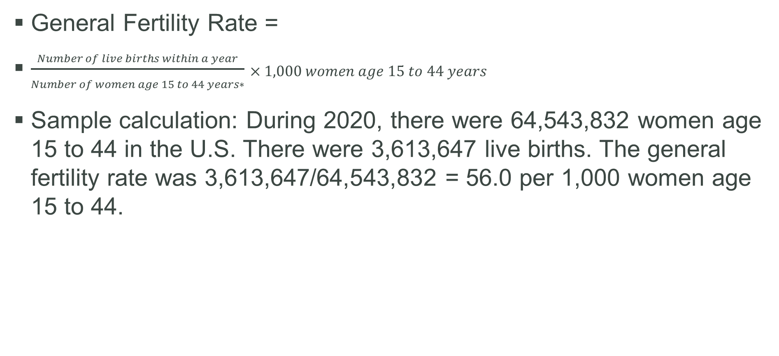
General Fertility Rate (2 of 2)
General Fertility Rate =
$\frac{Number of live births within a year}{Number of women age 15 to 44 years∗}×1,000 women age 15 to 44 years$
Sample calculation: During 2020, there were 64,543,832 women age 15 to 44 in the U.S. There were 3,613,647 live births. The general fertility rate was 3,613,647/64,543,832 = 56.0 per 1,000 women age 15 to 44.

Slide 56
Conclusion (1 of 2)
Ratios used in epidemiologic measures
Rate
Proportion
Percentage
Epidemiologic measures
Morbidity
Count
Incidence
Prevalence
Mortality
Crude mortality rate
Case fatality rate
Proportional mortality ratio

Slide 57
Conclusion (2 of 2)
Epidemiologic measures are helpful in:
Making descriptive statements about morbidity and mortality
Demonstrating risk of adverse health outcomes

