Slide 1

Descriptive Epidemiology: Patterns of Disease—Person, Place, Time
CHAPTER 5

Slide 2
Learning Objectives
Define the term descriptive epidemiology.
Give two examples of uses of descriptive epidemiology.
Compare three types of descriptive epidemiologic studies.
Describe the process of epidemiologic inference in the context of descriptive epidemiology.
Give examples of person, place, and time variables and describe how they relate to the distribution of health outcomes.

Slide 3
Introduction
Unequal distributions of health and disease in populations
To determine why health conditions vary throughout populations, one must answer the following questions:
Who was affected?
Where were people affected?
When were people affected?

Slide 4
Definition: Descriptive Epidemiology
Descriptive epidemiology classifies occurrence of disease according to these variables.
Person (who is affected)
Place (where were people affected)
Time (when and over what time period were people affected)

Slide 5
Descriptive Epidemiologic Study
A study is one that is “...concerned with characterizing the amount and distribution of health and disease within a population.”

Slide 6
Descriptive Epidemiology
Provides valuable information for these activities (among many others):
Prevention of disease
Design of interventions
Conduct of additional research

Slide 7
Example of a Descriptive Epidemiologic Study
People who used telemedicine services during 2021
About 37% of people used telemedicine services in 2021.
Telemedicine usage was more common among females, older individuals, the Northeast and Western regions of the United States, and people living in large metropolitan areas.

Slide 8
Uses of Descriptive Epidemiologic Studies
Aims of descriptive epidemiology
Permit evaluation of trends in health and disease
Provide basis for planning, provision, and evaluation of health services
Identify problems to be studied by analytic methods and suggest areas that may be fruitful for investigation

Slide 9
Types of Descriptive Epidemiologic Studies
Case reports
Case series
Cross-sectional studies (can be both descriptive and analytic)

Slide 10
Case Reports
Accounts of a single occurrence of a noteworthy health-related incident or of a small collection of such events
Examples
Bison encounters—Yellowstone National Park
Cronobacter infection in infants
Human rabies cases

Slide 11
Case Series
In comparison with a case report, a case series is a larger collection of cases of disease, often grouped consecutively and listing common features (i.e., characteristics of affected patients).
Example:
Reported cases of acute flaccid myelitis (AFM) in children
Primary exposure unknown but suspected to be infection with certain viruses

Slide 12
Cross-Sectional Studies
Type of investigation “…that examines the relationship between diseases (or other health-related characteristics) and other variables of interest as they exist in a defined population at one particular time”
Measures prevalence
Exposures and outcomes measured at the same time
Example of a cross-sectional study: The Behavioral Risk Factor Surveillance System (BRFSS).
An illustration of results from the BRFSS is a study of use of e-cigarettes among working adults.

Slide 13
Epidemiologic Inferences from Descriptive Data
Descriptive epidemiology and descriptive studies provide a basis for generating hypotheses.
Epidemiologic inference tested in analytic research is initiated with descriptive observations.

Slide 14
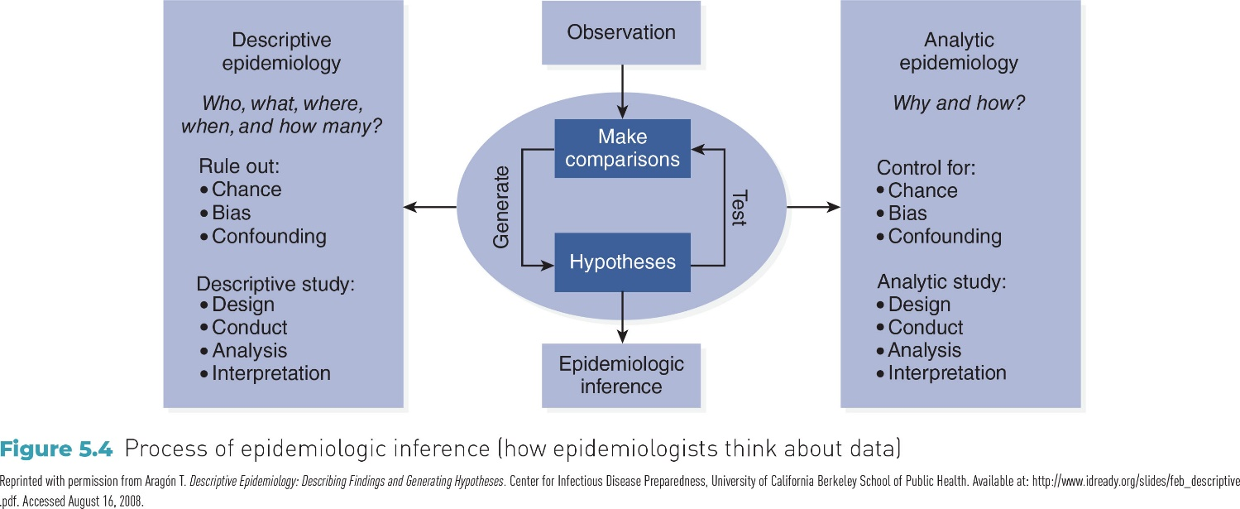
Figure 5-4 Process of epidemiologic inference

Slide 15
Person Variables: Examples
Covered in Chapter 5
Age
Sex
Race/ethnicity
Socioeconomic status
Other examples
Gender
Marital status
Nativity (place of origin)
Religion

Slide 16
Age
Perhaps the most important factor to consider when describing occurrence of disease or illness
Age-specific disease rates usually show greater variation than rates defined by almost any other personal attribute.

Slide 17
Examples of Age Associations
Incidence of and mortality from chronic diseases increase with age.
Some infections (e.g., mumps and chickenpox) occur more commonly during childhood.
Leading cause of death among young adults is unintentional injuries.
Maternal age is associated with rates of diabetes and related complications.

Slide 18
Sex
Epidemiologic studies have shown sex differences in a wide scope of health phenomena including morbidity and mortality.
Examples
All-cause age-specific mortality rates are higher among males.
Differences in cancer rates (e.g., cancers of the genital system)

Slide 19
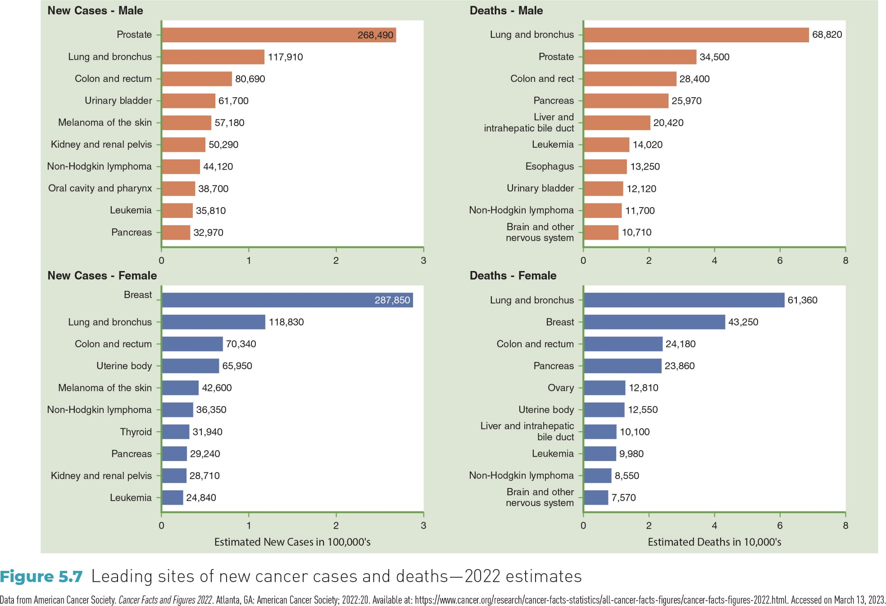
Figure 5-7 Leading sites of new cancer cases and deaths—2022 estimates

Slide 20
Nativity
Place of origin of the individual or relatives
Subdivisions
Foreign-born
Native-born

Slide 21
Race/Ethnicity (1 of 3)
Increasing diversity in U.S.
Five major race categories in Census 2020
White
Black or African American
American Indian and Alaska Native
Asian
Native Hawaiian and other Pacific Islander
Census 2000 first to allow respondents to check multiracial category

Slide 22
Race/Ethnicity (2 of 3)
Somewhat ambiguous classification
Tends to overlap with nativity and religion
Social construct rather than biologic construct
Used to track various health outcomes

Slide 23
Race/Ethnicity (3 of 3)
Examples of racial/ethnic differences in health characteristics:
Lower frequency of asthma reported among Hispanics
Prevalence of cognitive decline highest in American Indian or Alaska Native populations
Higher COVID-19 mortality rates in non-Hispanic Black populations, especially early in the pandemic

Slide 24
Socioeconomic Status (SES) (1 of 2)
Defined as a “descriptive term for a person’s position in society…”
Often formulated as a composite measure of:
Income level
Education level
Type of occupation
Single dimension of SES (e.g., poverty level) may be used.

Slide 25
Socioeconomic Status (SES) (2 of 2)
Impact of SES
Strong, inverse association of SES with levels of morbidity and mortality
Those in lowest SES positions are confronted with excesses of morbidity and mortality from numerous causes.
Example: Access to dental care

Slide 26
Definition: Health Disparities
Differences in occurrence of diseases and adverse health conditions as well as access to health care in population
Example: Differences in cancer incidence, prevalence, mortality, survival, and access to screening services between specific population groups in U.S.
Highlight role of social determinants of health

Slide 27
Social Determinants of Health
Conditions that exist in environment where people are born, live, learn, work, play, and worship
Impact wide variety of health, functioning, and quality of life outcomes and risks

Slide 28
Place Variables
International
National (within-country)
Urban–rural differences
Localized patterns of disease

Slide 29
International
World Health Organization (WHO) studies:
Both infectious and chronic diseases show great variation from one country to another.
Climate, cultural factors, national dietary habits, and access to health care affect disease occurrence.
Variations in life expectancy (U.S. ranked 48th in 2021).

Slide 30
Polio: An Example of an International Variation
Decreasing incidence globally
Between 2020 and 2022, polio cases were reported in Afghanistan, Pakistan, and Malawi.

Slide 31
National (Within Country)
Regional differences may affect prevalence and incidence of disease.
Factors
Climate
Latitude
Environmental pollution
Example: Regional variations in heart attack (see Figure 5-14)

Slide 32
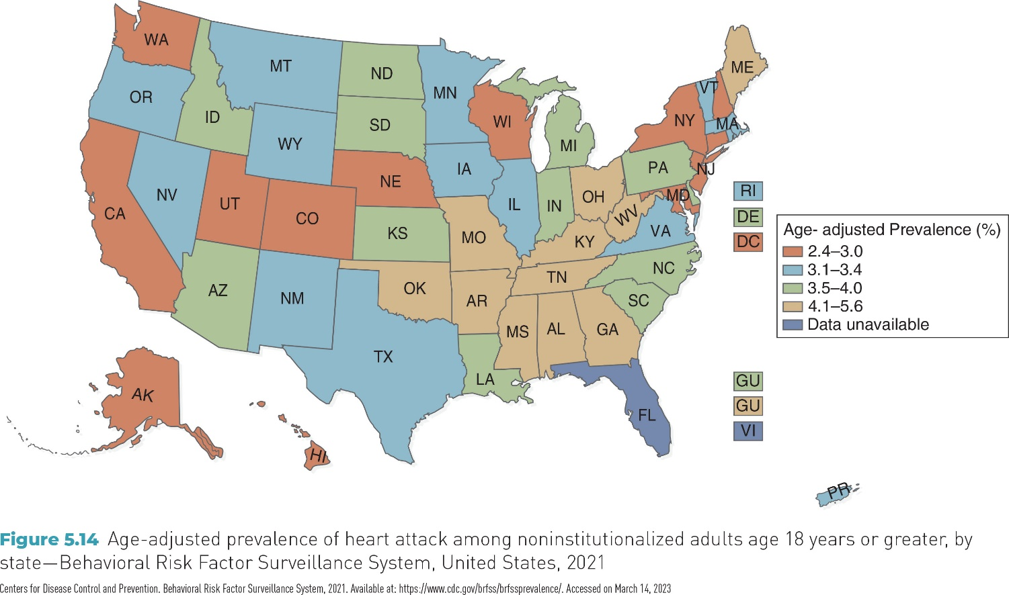
FIGURE 5-14 Age-adjusted prevalence of heart attack among adults aged 18 years or older, by state—Behavioral Risk Factor Surveillance System, United States, 2021

Slide 33
Urban–Rural Differences
Urban and rural sections of U.S. show variations in morbidity and mortality related to environmental and lifestyle issues.
Urban example: Elevated occurrence of lead poisoning among children who live in older buildings
Rural example: Pesticide exposure and farming injuries among agricultural workers

Slide 34
Localized Patterns of Disease
Associated with specific environmental conditions that may exist in a particular geographic area
Examples
Lung cancer and radon gas
Naturally occurring arsenic in water supply
Presence of disease vectors: Lyme disease in U.S.

Slide 35
Time Variables
Secular trends
Cyclic (seasonal) trends
Point epidemics
Clustering

Slide 36
Secular Trends
Gradual changes in the frequency of disease over long time periods
Examples
Drug overdose deaths rates between 2000 and 2020
Rates increased in all groups with non-Hispanic white individuals having the consistently highest rates.
Pace of increases has been highest since 2016 in non-Hispanic Black individuals.
Age-adjusted prevalence of hypertension (no secular trend)

Slide 37
Cyclic (Seasonal) Trends
Increases and decreases in frequency of a disease or other phenomenon over a period of several years or within a year
Example 1: Severe weather events in Atlantic basin
Example 2: Mortality from pneumonia and influenza (peaks during February)

Slide 38
Point Epidemics
Point epidemic may indicate response of a group of from a common place to a common source of infection, contamination, or other etiologic factor to which they were exposed almost simultaneously.
Example: Outbreak of Vibrio infections following Hurricane Katrina in 2005

Slide 39
Clustering (1 of 2)
“A closely grouped series of events or cases of a disease or other health-related phenomena with well-defined distribution patterns in relation to time or place or both…”

Slide 40
Clustering (2 of 2)
Often used to describe aggregation of uncommon conditions such as leukemia
Clustering may reflect:
Common exposure to an etiologic agent
Chance occurrences
Spatial clustering: The aggregation of events in a geographic region
Temporal clustering: The occurrence of events related to time

Slide 41
Conclusion
Descriptive epidemiology classifies the occurrence of disease according to the variables of person, place, and time.
Descriptive epidemiologic studies aid in generating hypotheses that can be explored by analytic epidemiologic studies.
Descriptive studies include case reports, case studies, and cross-sectional studies.

