Slide 1
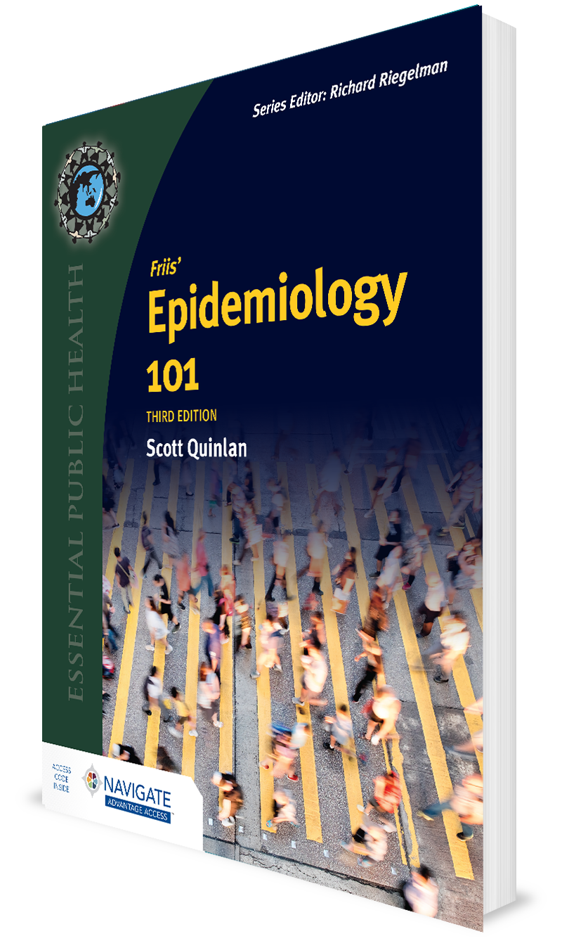
Infectious Diseases and Outbreak Investigation
CHAPTER 10

Slide 2
Learning Objectives
Apply the epidemiologic triangle to the transmission of communicable diseases.
Name and compare three microbial agents associated with infectious diseases.
Explain host differences in infectious disease susceptibility.
Describe the relationship between the environment and infectious disease transmission.
Sequence the procedures for investigating infectious disease outbreaks.

Slide 3
Introduction
Infectious diseases remain important causes of morbidity and mortality in the U.S. and worldwide.
COVID-19 pandemic, MPox
In 2021, COVID-19 was the third leading cause of death in the U.S. and accounted for 10% of overall deaths.

Slide 4
Infectious (Communicable) Disease
Disease due to an infectious agent
Examples of agents: Bacteria, viruses, fungi, parasites
Refer to text for additional terms used to describe infectious diseases

Slide 5
Parasitic Disease
Infection caused by a parasite, which “…is an animal or vegetable organism that lives on or in another and derives its nourishment therefrom”
Example: Amebiasis

Slide 6
The Epidemiologic Triangle
Long-standing model used to describe etiology of infectious diseases
Includes three major factors: agent, host, and environment

Slide 7
Figure 10-2 The epidemiologic triangle

Slide 8
Agent
“A factor (e.g., a microorganism, chemical substance, or form of radiation…) whose presence, excessive presence, or (in deficiency diseases) relative absence is essential for the occurrence of a disease”

Slide 9
Host
“A person or other living animal, including birds and arthropods, that affords subsistence or lodgment to an infectious agent under natural conditions”

Slide 10
Environment
Domain outside of the individual human host in which disease-causing agents may exist, survive, or originate.

Slide 11
Infectious Disease Agents
With respect to infectious and communicable diseases, agents include specific microbes and vectors involved in the cycle of disease transmission.
Examples of infectious agents: Bacteria, rickettsia, viruses, fungi, parasites, and prions

Slide 12
Infectivity
Capacity of an agent to enter and multiply in a susceptible host and thus produce infection or disease

Slide 13
Pathogenicity
Capacity of the infectious agent to cause disease (symptoms) in the host following infection

Slide 14
Virulence
Refers to severity of disease produced, that is, whether the disease has severe clinical manifestations or is fatal in a large number of cases
Sometimes referred to as degree of pathogenicity

Slide 15
Toxin
Some infectious disease agents, instead of acting directly, produce a toxin that causes illness.
Example of illness: Foodborne intoxications such as botulism
Toxin usually refers to a toxic substance made by living organisms.

Slide 16
Host Characteristics
Immunity
Other factors related to host responses
Incubation period
Subclinical illness
Generation time
Carrier status

Slide 17
Immunity
Host’s ability to resist infection by the agent
May be either active or passive

Slide 18
Active Immunity
Immunity that host has developed from natural infection with a microbial agent or injection of a vaccine that contains an antigen.
Antigen: A substance that stimulates antibody formation (e.g., microbial agent)
Takes time to develop but usually of long duration (measured in years)

Slide 19
Passive Immunity
Immunity acquired when antibodies or other immune cells produced by another person or animal are transferred to host.
Example 1: Newborn infant’s natural immunity conferred from its mother
Example 2: Immunity conferred by injections of antibodies contained in immune serums
Develops quicky, but usually is of short duration (days to months)

Slide 20
Herd Immunity
Resistance of an entire community to an infectious agent as a result of a large proportion of individuals in that community being immune to the agent

Slide 21
Incubation Period
Time interval between invasion by an infectious agent and appearance of first sign or symptom of disease

Slide 22
Subclinical Infection
Infection that does not show obvious clinical signs or symptoms
Also called inapparent infection
Example: Infection with SARS-CoV-2 in some people

Slide 23
Generation Time
Time interval between establishment of infection in host and maximal communicability of host

Slide 24
Carrier
“A person or animal that harbors a specific infectious agent without discernible clinical disease, and that serves as a potential source of infection”
Famous example: “Typhoid Mary”

Slide 25
Index Case
Used in an epidemiologic investigation of a disease outbreak to denote first case of a disease to come to the attention of authorities

Slide 26
Quarantine versus Isolation
Quarantine: Well people who been exposed to an infectious disease and may or may not be infected
Isolation: People who have an infectious disease

Slide 27
Environment and Infectious Diseases
External environment comprises:
Physical
Climatologic
Biologic
Social
Economic

Slide 28
Endemic
Infectious disease agent that is habitually present in an environment (either geographic or population group).
Example: Plague is endemic among certain species of rodents in the western U.S.

Slide 29
Reservoir
Place where infectious agents normally live and multiply
Can be human beings, animals, insects, soils, or plants

Slide 30
Zoonosis
“An infection or infectious agent transmissible under natural conditions from vertebrate animals to humans”

Slide 31
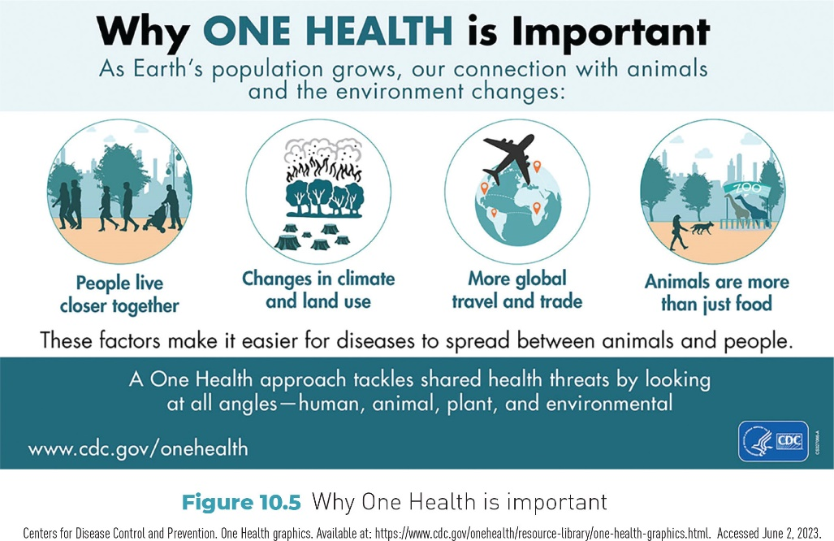
Figure 10-5 Why One Health is important

Slide 32
Means of Transmission of Infectious Disease Agents
Direct transmission
Person to person
Indirect transmission
Vehicle-borne infections
Airborne infections
Vector-borne infections

Slide 33
Portal of Exit
For an infected person, a portal of exit is the site from which the agent leaves that person’s body.
Examples
Respiratory passages
Alimentary canal
Genitourinary system
Skin lesions

Slide 34
Person to Person (Direct Transmission)
“Direct and essentially immediate transfer of infectious agents to a receptive portal of entry through which human or animal infection may take place”

Slide 35
Portal of Entry
Site where agent enters the body
Example: Skin wound

Slide 36
Indirect Transmission
Involves intermediary sources of infection such as vehicles, droplet nuclei (particles), and vectors

Slide 37
Vehicle-Borne Infections
Infections that result from contact with vehicles, which are contaminated, nonmoving objects.
Examples
Fomites
Unsanitary food
Impure water

Slide 38
Fomite
Inanimate object that carries infectious disease agents
Examples
Classroom doorknob
Discarded tissues

Slide 39
Airborne Infections
Involve the spread of droplet nuclei (particles) that are present in the air
Example: COVID-19 and the role of masks and social distancing

Slide 40
Vector-Borne Infections
Vector: Animate, living insect or animal that is involved with transmission of disease agents
Transmission of an infectious disease agent may happen when the vector feeds on a susceptible host.

Slide 41
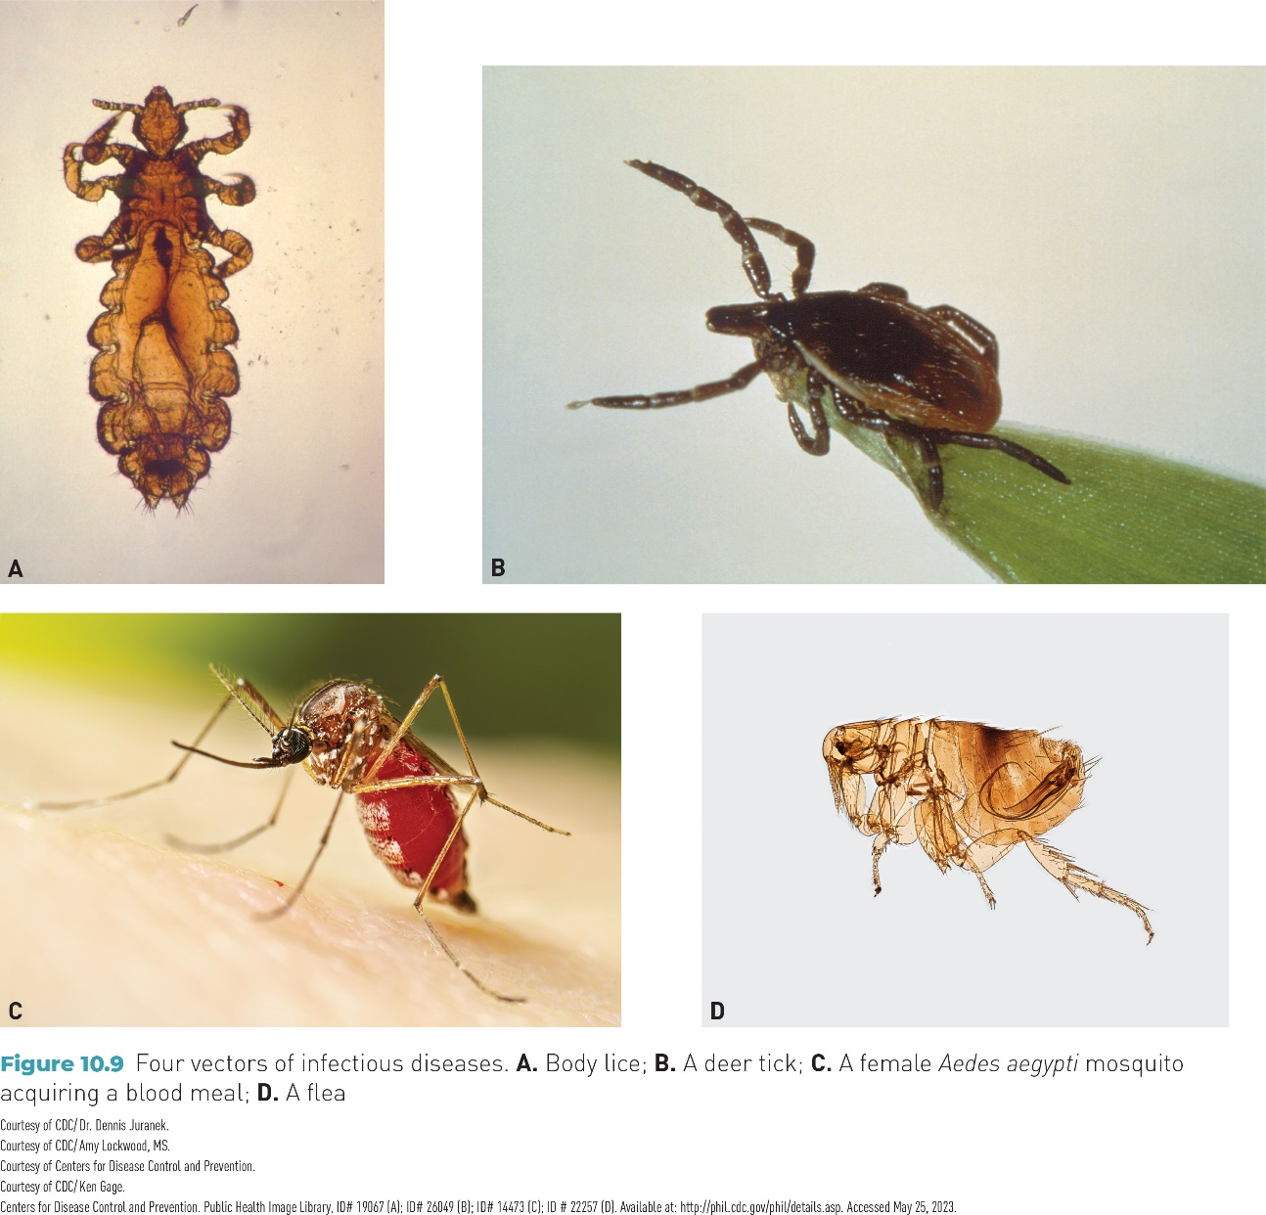
Figure 10-9 Four insect vectors of infectious diseases

Slide 42
Examples of Significant Infectious Diseases
Sexually transmitted diseases
Foodborne diseases
Waterborne diseases
Vector-borne diseases
Vaccine-preventable diseases
Zoonotic diseases
Emerging infections
Bioterrorism-related diseases

Slide 43
Sexually Transmitted Diseases
Also called sexually transmitted infections (STIs)
Examples
HIV/AIDS
Gonococcal infections
Chlamydial genital infections

Slide 44
Foodborne Illness
Biologic agents of foodborne illness include bacteria, parasites, viruses, and prions (linked to mad cow disease).
Examples of bacterial agents
Campylobacter
Clostridium botulinum
Salmonella
Escherichia coli O157:H7

Slide 45
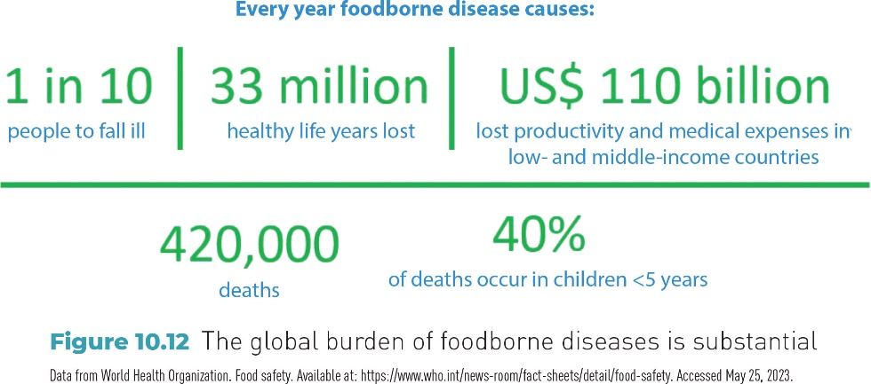
Figure 10-12 The global burden of foodborne diseases is substantial

Slide 46
Vector-Borne Diseases
Examples of diseases (name of vector in parentheses) from Table 10-6
Bacterial diseases
Lyme disease (tick)
Arthropod-borne (arboviral) diseases
Eastern equine encephalitis (mosquito)
Parasitic diseases
Malaria (mosquito)

Slide 47
Vaccine-Preventable Diseases (VPDs)
Conditions that can be prevented by vaccination (immunization)
Examples
Diphtheria
Tetanus
Whooping cough
Hepatitis A and B

Slide 48
Zoonotic Diseases
Diseases transmitted from vertebrate animals to human beings
Examples
Rabies
Anthrax
Avian influenza
Hantavirus pulmonary syndrome
Toxoplasmosis
Tularemia (rabbit fever)

Slide 49
Emerging Infectious Diseases (Emerging Infections)
“An infectious disease that has newly appeared in a population or that has been known for some time but is rapidly increasing in incidence or geographic range”
Examples: Ebola virus disease, MPox (formerly monkeypox), fungal infections

Slide 50
Bioterrorism-Related Diseases
Bioterrorism attack: “…the deliberate release of viruses, bacteria, or other germs (agents) used to cause illness or death in people, animals, or plants”
Example: Release of anthrax as an act of terrorism

Slide 51
Methods of Outbreak Investigation
Define the problem.
Appraise the data, for example, from clinical observations, epidemic curve, incubation period, attack rate, and case mapping (used by John Snow).
Formulate the hypothesis.
Confirm the hypothesis.
Draw conclusions and formulate practical application.

Slide 52
Clinical Observations
Pattern of symptoms suggests possible infectious agents.
Possible symptoms of an outbreak
Fever
Nausea
Diarrhea
Vomiting
Headache
Rashes
Stomach pain

Slide 53
Epidemic Curve
“A graphic plotting of the distribution of cases by time of onset”
May reflect a common-source epidemic or a point-source epidemic

Slide 54
Common-Source Epidemic
“Outbreak due to exposure of a group of persons to a noxious influence that is common to the individuals in the group”

Slide 55
Point-Source Epidemic
Type of common-source epidemic: “[w]hen the exposure is brief and essentially simultaneous, [and] the resultant cases all develop within one incubation period of the disease….”

Slide 56
Incubation Period
In conjunction with information about symptoms, provides clues to possible infectious disease agents
Example: Incubation period for foodborne illness caused by Salmonella ranges from 6 to 72 hours.

Slide 57
Attack Rate
Used frequently to describe occurrence of foodborne illness, infectious diseases, and other acute epidemics
Formula: Attack rate = Ill/(Ill + Well) × 100 during a time period

Slide 58
Final Steps in Outbreak Investigation
Case mapping: Some investigations may use computer software to show the location of cases.
Hypotheses: Using information that has been gathered, the epidemiologist may formulate a hypothesis regarding the causative agent.
Draw a conclusion: Plan for prevention of future outbreaks

Slide 59
Conclusion
Infectious diseases remain a threat for these reasons.
New types of diseases are constantly evolving and imperiling public health.
Outbreaks caused by bioterrorism are a potential threat.
Some infectious disease agents mutate into forms that resist conventional antibiotic treatment.

