Slide 1
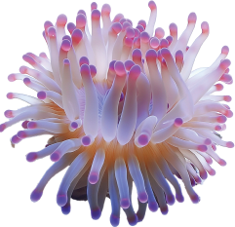


Linking Biodiversity Literature and Data
Persistent Identifier Exchange Between BHL and Wikidata
Mike Lichtenberg
Biodiversity Heritage Library
United States
October 22, 2025
© 2025. This work is openly licensed via CC BY 4.0.
LOGO 2
Notes:
I am the Lead Software Engineer for the Biodiversity Heritage Library, since 2007
Today I will be talking about BHL’s process for exchanging persistent identifiers between BHL and Wikidata
Have to cover this material quickly, but links to this presentation and helpful code samples will be provided

Slide 2

The Biodiversity Heritage Library
An open access digital library for biodiversity literature and archives
Global consortium working to digitize library collections and make them freely available
A key component of the core infrastructure for biodiversity research
Services, data exports, and APIs allow researchers to download and reuse content
Linking Biodiversity Literature and Data: Persistent Identifier Exchange Between BHL and Wikidata
Notes:
Hopefully most are aware of what BHL is and does, but here is a quick reminder
BHL is the world’s largest open access digital library for biodiversity literature and archives
BHL operates as a global consortium of natural history, botanical and national libraries that work together to digitize their library collections and make them freely available
BHL is a key component of the core infrastructure for biodiversity research
In addition, BHL provides a range of services, data exports, and APIs that allow researchers to download content, harvest source data files, and reuse materials

Slide 3

Wikidata
Free and open knowledge base that can be read and edited by both humans and machines
Central storage for the structured data of its Wikimedia sister projects
Content is freely available, exportable in standard formats, and linkable to other open data sets
A hub for persistent identifiers (PIDs) for domains such as publications, authors, and scientific names
Linking Biodiversity Literature and Data: Persistent Identifier Exchange Between BHL and Wikidata
Notes:
Wikidata is a free and open knowledge base, editable by both humans and machines
Wikidata acts as central storage for the structured data of its Wikimedia sister projects, and provides support to many other non-Wikimedia sites and services
Content is available under a free license, can be exported using standard formats, and can be interlinked to other open data sets on the linked data web
A hub for persistent identifiers across diverse domains -> the most relevant for BHL are publications (monographs, journals, and individual articles), authors, and scientific names

Slide 4
Build stronger links between BHL and other biodiversity platforms
Enhance discoverability of biodiversity literature
Make curation and corrections easier
Why Exchange Identifiers?
Linking Biodiversity Literature and Data: Persistent Identifier Exchange Between BHL and Wikidata
Notes:
We exchange identifiers between BHL and Wikidata to:
Add additional human-curated metadata to each platform
Strengthen connections across biodiversity data infrastructures.
Enhance discoverability of biodiversity literature -> Identifiers provide unambiguous references to entities
Make curation and corrections easier.
Improve metadata quality in both platforms.
And the same workflow could help other systems integrate with Wikidata.

Slide 5
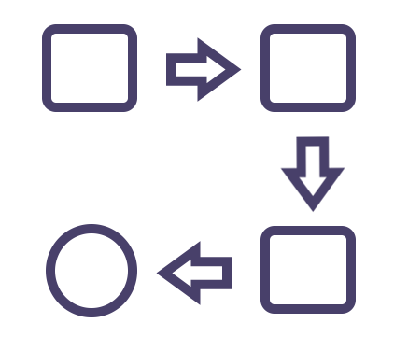
The Workflow
Use SPARQL queries to extract identifiers from Wikidata
Import data into BHL
Extract from BHL lists of identifiers requiring curation
Identifiers missing from Wikidata
Identifiers with irregularities
Use Wikidata tools to examine data extracted from BHL and apply changes to Wikidata
Source: Mike Lichtenberg
Linking Biodiversity Literature and Data: Persistent Identifier Exchange Between BHL and Wikidata
Notes:
Use SPARQL queries to extract data related to BHL entities from Wikidata
Import data into BHL
Extract from BHL identifiers that need to be manually curated
Identifiers missing from Wikidata
Identifiers with irregularities
Volunteers examine identifiers extracted from BHL and apply changes to Wikidata and BHL

Slide 6
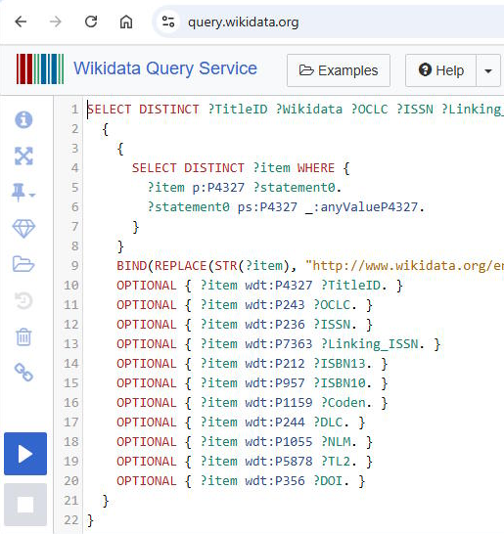
Querying Wikidata With SPARQL
SPARQL is a query language for metadata stored in the Resource Description Framework (RDF) format
SPARQL is similar to SQL
The Wikidata Query Service is a tool for writing and executing SPARQL queries, exporting results, and generating code
Includes templates and tutorials
Use federated queries to include results from all of Wikidata
Linking Biodiversity Literature and Data: Persistent Identifier Exchange Between BHL and Wikidata
Notes:
SPARQL is a query language for data represented in the Resource Description Framework (RDF) format, which is used by Wikidata
SPARQL is similar to SQL; if you have relational database experience you will find it familiar
The Wikidata Query Service (WQS) provides an online workspace for crafting and executing SPARQL queries
Includes templates and tutorials
Supports exporting query results in multiple formats (JSON, XML, TSV, CSV, and others)
Generates code to run queries (Python, Java, Javscript, R, and others)
The screenshot shown here shows a SPARQL query in the Wikidata Query Service workspace
Due to growth, Wikidata has split their data store into two separate graphs
You may need to query both graphs to find all relevant data
Best approach is to use a federated query to return data from both stores in one query
Links to examples and additional supporting information will be provided

Slide 7








Querying Wikidata With SPARQL: An Example Query
SELECT DISTINCT ?TitleID ?Wikidata ?OCLC ?DOI WHERE {
{
{
SELECT DISTINCT ?item WHERE {
?item p:P4327 ?statement0.
?statement0 ps:P4327 _:anyValueP4327.
}
}
BIND(REPLACE(STR(?item), "http://www.wikidata.org/entity/", "") AS ?Wikidata )
OPTIONAL { ?item wdt:P4327 ?TitleID. }
OPTIONAL { ?item wdt:P243 ?OCLC. }
OPTIONAL { ?item wdt:P356 ?DOI. }
}
4
UNION
{ SERVICE wdsubgraph:scholarly_articles {
{
SELECT DISTINCT ?item WHERE {
?item p:P4327 ?statement0.
?statement0 ps:P4327 _:anyValueP43272.
}
}
BIND(REPLACE(STR(?item), "http://www.wikidata.org/entity/", "") AS ?Wikidata )
OPTIONAL { ?item wdt:P4327 ?TitleID. }
OPTIONAL { ?item wdt:P243 ?OCLC. }
OPTIONAL { ?item wdt:P356 ?DOI. }
}
}
}
1
2
3
Linking Biodiversity Literature and Data: Persistent Identifier Exchange Between BHL and Wikidata
Notes:
Here is a SPARQL example
It returns a list of Wikidata IDs, BHL Title IDs and two other related identifiers (OCLC number and DOI)
The BHL Title ID is the key to matching these identifiers to entities within BHL
Anyone wanting to perform a similar data harvesting process will need to find a similar “key” to matching entities in their own system
Parts of the query:
Top line shows that it returns a BHL Title ID, Wikidata Q ID, OCLC #, and DOI
Next section indicates the set of entities from which metadata will be returned; in this case Wikidata entries that have a BHL Title ID (P4327) -> This is equivalent to the FROM portion of a SQL query
These four lines are where the four distinct properties are requested; notice the Property IDs (P4327, P243, P356)
Finally we see the UNION statement, which indicates that this is a federated query; everything after that repeats the first query, but applies it to the scholarly graph

Slide 8
From Wikidata to BHL
TitleID Wikidata OCLC DOI
29753 Q51381722 31896870 10.5962/BHL.TITLE.29753
110114 Q51386632 10.5962/BHL.TITLE.110114
169133 Q97683524 1290604141 10.1206/0003-0082(2006)3539[1:RCIBAN]2.0.CO;2
169133 Q97683524 442549156 10.1206/0003-0082(2006)3539[1:RCIBAN]2.0.CO;2
Wikidata Query Results
BHL import process is fully automated, with no human curation of data
Identifiers are compared to existing BHL data
Any identifiers not already in BHL are added
Others creating similar processes may prefer a different workflow
Linking Biodiversity Literature and Data: Persistent Identifier Exchange Between BHL and Wikidata
Notes:
Once query results have been exported into a Tab-Separated-Value format – as shown here – they can be imported into BHL
BHL opted for a fully automated solution
The simple workflow is:
Compare extracted identifiers to the identifiers already in BHL
Add to BHL any identifiers not found in BHL
If you are creating similar process for your system, you may prefer a different workflow
For example, it may make sense to include a manual review of the data before adding it to your system

Slide 9
BHL does not just take from Wikidata; it also contributes back
After data is added to BHL, a downloadable report is produced
Report includes
BHL data missing from Wikidata
Data requiring curation
Wikimedians make use of the report and Wikidata tools to curate the data and apply changes to Wikidata
Feedback loop with BHL staff for corrections
From BHL To Wikidata
Linking Biodiversity Literature and Data: Persistent Identifier Exchange Between BHL and Wikidata
Notes:
BHL is not just taking from Wikidata, it also contributes back
After data is added to BHL, a report/download is produced
Report includes
BHL data missing from Wikidata
Data requiring curation:
One example is a Wikidata ID attached to more than one BHL entity
Wikimedians make use of the report and Wikidata tools to apply changes to Wikidata and to investigate the anomalies
Sometimes they send issues back to BHL staff, so it becomes a collaborative feedback loop.

Slide 10
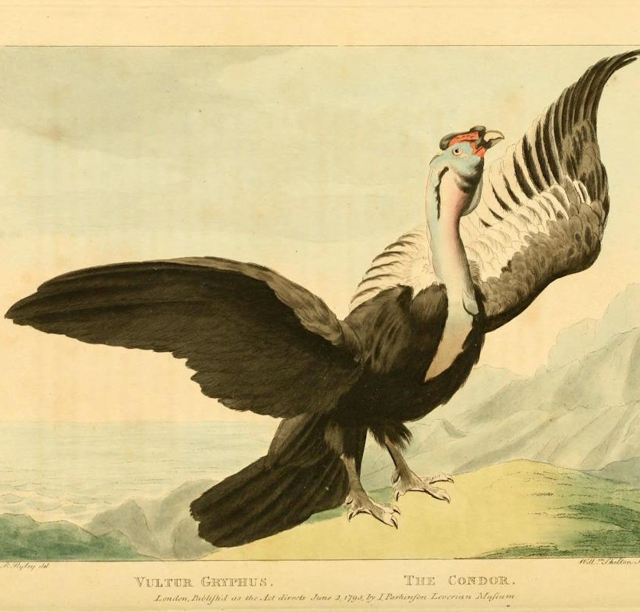

Benefits
Repeatable, adaptable workflow
65000 identifiers added to BHL and 8000 to Wikidata
Improved discoverability
Improved trust in the metadata
All identifiers available via Wikidata SPARQL queries and BHL APIs/Exports
Discoverable data quality issues
Vultur gryphus
https://biodiversitylibrary.org/page/29568719
Photo by Marcos Paulo Prado
Linking Biodiversity Literature and Data: Persistent Identifier Exchange Between BHL and Wikidata
Notes:
So what benefits have we seen?
The workflow is repeatable and adaptable: query, compare, update
Nearly 65,000 new identifiers were added to BHL.
Almost 8,000 BHL identifiers were added to Wikidata.
Discoverability and trust in the data are improved
All identifiers are also available via Wikidata SPARQL queries and BHL APIs and exports, improving machine interfaces
Data quality issues are now easier to identify

Slide 11
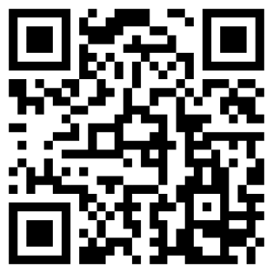
Supporting Information
Presentation Slides and Code
https://github.com/mlichtenberg/LivingData2025
11-Minute Introduction to SPARQL
https://youtu.be/FvGndkpa4K0?si=wLus8Qk1MxF5ycHQ
Wikidata Query Service
https://query.wikidata.org
Wikidata Property Lookup
https://www.wikidata.org/wiki/Wikidata:List_of_properties
Background Information: Wikidata Graph Split
https://meta.wikimedia.org/wiki/WikiCite/WDQS_graph_split
BHL Wikidata Harvest Source Code
https://github.com/gbhl/bhl-us/tree/master/WDHarvest
Thank you!
Please Support BHL!
Linking Biodiversity Literature and Data: Persistent Identifier Exchange Between BHL and Wikidata
Notes:
Thank you for your time
This final slide includes links to the tools that were discussed, as well as more in-depth information about these topics
The first link includes the slides for this presentations, example SPARQL queries, and source code
Please support BHL!

