Slide 1
Biodiversity Heritage
Library
A Source for Big Data Analysis
Mike Lichtenberg
mike.lichtenberg@mobot.org
October 3, 2017 | TDWG Conference
Notes:
Good morning, my name is Mike Lichtenberg, and I am a developer for the Biodiversity Heritage Library. I have been with BHL for about 10 years.
Today I will discuss the various ways in which BHL makes its collection available for re-use.

Slide 2
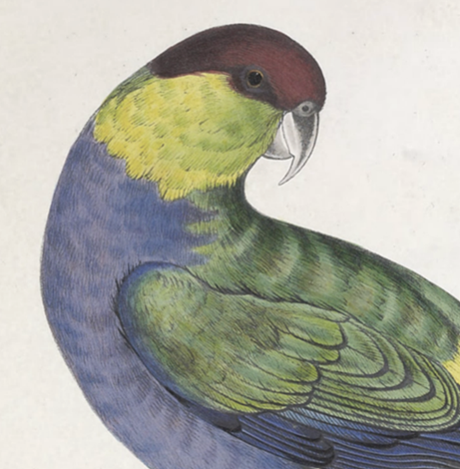
What is BHL?
The Biodiversity Heritage Library provides free and open online access to biodiversity literature from library collections around the world.
Notes:
The Biodiversity Heritage Library (BHL) is a consortium of libraries that cooperate to do two things: 1) digitize the biodiversity literature held in their collections and 2) make that literature available for open access and reuse.
As of September 2017, BHL has 37 Members and Affiliates, and over 60 Partners around the world contributing to BHL.
BHL also collaborates with and contributes content to a wide variety of partners, including:
EOL
Global Biodiversity Information Facility (GBIF)
Europeana
Digital Public Library of America (DPLA)
Internet Archive

Slide 3
Roadmap
Types of Data in BHL
How to Get the Data
Potential Uses of the Data
Notes:
Here are the topics that I will be covering in this talk:
1) Overview of the types of data that make up the BHL collection
2) A discussion of the various ways that BHL makes its data available for reuse and analysis. This is what I really want to show you.
3) How the data might be used

Slide 4
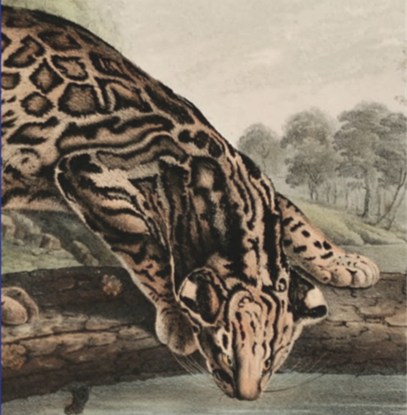
Available Data
Metadata
Page scans
Text
Notes:
What types of data are made available via the BHL data services?
1) Metadata describing the elements in the collection.
2) Page scans… one for every BHL-hosted page in the collection.
3) Text for all 53+ million BHL-hosted pages in the collection.

Slide 5
Available Data
Metadata
Bibliographic information
Pagination data
Scientific names (178+ million instances)
Identifiers (DOIs, etc)
Notes:
The first type of data is the metadata that describes items in the BHL collection. For example:
Bibliographic information for monographs, journals, and articles.
Pagination data.
Scientific names. With the help that of the Global Names project, BHL has recorded 178+ million occurrences of scientific names within the text of the collection.
Identifiers, including DOIs, OCLC number, ISSN, and ISBN.

Slide 6
Available Data
Page Scans
One per page
Generally high-quality scans (JP2 or TIFF)
Served/downloadable as high-resolution JPGs
Notes:
As mentioned earlier, every page of every volume hosted by BHL has an associated page scan.
The source files (hosted by and downloadable from Internet Archive) are typically high-quality JP2 or TIFF files.
Individual scans are served via BHL as high-resolution JPGs.

Slide 7
Available Data
Text (OCR Output)
One document for every scanned page
17 billion individual words
Notes:
Every scanned page image in BHL is processed by an Optical Character Recognition program that converts the words on the page into a text document. Therefore, every page record has associated OCR-created text.
With 53+ million pages in BHL, there are approximately 17 billion individual words contained in the text of the BHL collection.
These text documents represent a rich source of information for Big Data analysis.
(The 17 billion estimate is based on an average book size of 270 pages. A simple algorithm was used to count the words in the 260 books in BHL with exactly 270 pages. The average number of words in those 260 books was 81,000. Applying this average number of words to all books in BHL produces the 17 billion estimate.)

Slide 8

How To Get BHL Data
Data Exports
OAI-PMH
APIs
Notes:
How do you access and use BHL data?
There are multiple methods to do it, and there are multiple formats in which the data is packaged. To get the data, you can:
Download one of the BHL data exports
Harvest data via the Open Archive Initiative Protocol for Metadata Harvesting (OAI-PMH)
Request data via the BHL Application Programming Interfaces (APIs)

Slide 9
Data Exports
Formats
Delimited text
RIS
Metadata Object Description Schema (MODS)
BibTeX
Location
https://biodiversitylibrary.org/data
Notes:
The first method of getting BHL data is the Data Exports.
The exports are updated monthly, on or around the 1st of the month, and they contain data for the entire BHL collection.
There are four export formats available.
The Delimited Text export is a set of tab-delimited text files that contain bibliographic metadata, page metadata, and names. No page text.
Besides the delimited text files, there are exports in three different formats used for bibliographic data exchange. These are:
RIS (typically used by reference managers like Zotero, Mendley, and EndNote)
MODS (an XML schema from Library of Congress that is similar to MARC)
BibTex (an older format rarely used).
None of these include page metadata, names, or page text. They contain only bibliographic metadata.
All of the export files can be downloaded from the BHL “data” link shown here. Simply browse to that link to view the files, and download the ones you need.

Slide 10
OAI-PMH
HTTP GET requests
XML responses
“verbs” used to request data
Identify ListIdentifiers
ListSets GetRecord
ListMetadataFormats ListRecords
Can harvest data incrementally
Supports multiple formats
Notes:
The Open Archives Initiative Protocol for Metadata Harvesting (OAI-PMH) is a protocol for harvesting and publishing metadata from an archive. It is supported by many repositories and software systems.
BHL is an OAI publisher.
OAI requests are sent via HTTP GET requests, and responses are returned as XML.
There are six verbs (or commands) recognized by an OAI publishing server. Three return information about the publisher and data available, and three return the published data.
The OAI protocol supports requests for individual records or for only data that is new or has changed, so data can be harvested incrementally. Other BHL data access methods do not allow for incremental harvesting.
The OAI protocol dictates that data be published in Dublin Core format, but that it can also be published in other formats.

Slide 11
OAI-PMH
Data Formats
Dublin Core
Metadata Object Description Schema (MODS)
Open Literature Exchange Format (OLEF)
http://www.bhle.eu/bhl-schema/v1/
Notes:
The three formats supported by BHL’s OAI publishing service are Dublin Core, MODS, and OLEF.
Dublin Core has a limited set of tags for specifying bibliographic metadata, and no support for page-level information (including names and text).
MODS contains bibliographic information, and again has no support for page-level information.
OLEF is a XML Schema created by BHL-Europe. The advantage of OLEF over the other formats is that it does support page-level metadata, including names and links to page scans. Still no text, though.
Stats:
0.5 million requests per month
75% MODS
25% Dublin Core
< 1% OLEF

Slide 12
OAI-PMH
DEMO
Notes:
Point out the endpoint and explain the various parameters (including “from” and “until”) with the ListRecords example.
Show differences between DC, MODS, and OLEF.
Within OLEF, show page-level metadata, including page types, pagination data, names, and image links.

Slide 13
APIs
HTTP GET requests
Responses as JSON or XML
35+ Individual APIs
Search for Publications, Authors, Names, Subjects
Get Metadata and Text
Registration is required
https://biodiversitylibrary.org/getapikey.aspx
Notes:
The BHL Application Programming Interface is another way to get data from BHL.
The API endpoint accepts HTTP GET requests. Each request includes the name of an operation to perform and may also include one or more parameters. Essentially, each API method implements a query over the BHL data.
Responses by default are in XML, but can also be received as JSON.
There are 35-40 APIs available that allow many different types of requests for BHL data. Searches can be performed, metadata can be retrieved, and page text is available.
Registration is required to use the BHL APIs. Submit a name and email address at the page listed here and you will receive an API key. This key must be submitted with each API request.
Since February 2010, an average of 4.25 million APIs requests are submitted per year. There are an equal number of requests for page text and name metadata as there are for bibliographic metadata.

Slide 14
APIs
DEMO
Notes:
Point out the endpoint and explain the various parameters with the “GetItemMetadata” example.
Show a JSON response to a simple request.

Slide 15
Getting Data - Summary
 | Data Exports | OAI-PMH | API
Data Formats | TSV/MODS/Tagged | XML | XML/JSON
Bibliographic Metadata | Yes | Yes | Yes
Page Metadata | Yes (@) | Yes (*) | Yes
Names | Yes (@) | Yes (*) | Yes
Text |  |  | Yes
Images |  | Yes (*) | Yes
Real-time Data |  | Yes | Yes
Formal Specification |  | Yes
Incremental Harvesting |  | Yes
@ = Delimited text exports only
* = OLEF format only
Notes:
This concludes the discussion of the various ways of getting data from BHL: Data exports, OAI-PMH, and the APIs.
The table presented here summarizes the key points. It shows the types of data that each access method makes available, as well as some other characteristics of each method.
You can see that if you just need metadata (no text or images), then you can use any method, but the data exports might be the easiest approach. The APIs are the most full-featured data access point in terms of what data is available. However, if you would like to do incremental harvesting, retrieving only what is new/changed, then OAI-PMH is the way to go. In some cases, it makes sense to combine one or more of these methods. (For example, use OAI-PMH to get a list of new/changed items, and the APIs to get the details).

Slide 16

Uses of BHL Data
Big Data Analysis
Notes:
What can be done with BHL data?
To date, we have seen BHL data put to use in a variety of ways. Digital libraries have integrated BHL metadata into their catalogs. Individual developers have created interesting visualizations of the data. Individual contributors have created wrappers for the BHL APIs in Ruby and R, so that BHL data can easily be consumed in applications written in those languages.
A common definition of Big Data Analysis is “the process of examining large data sets and uncovering previously unknown patterns, correlations, and trends”. This is an area that has not seen as much development. The 53+ million pages and (roughly) 17 billion words in BHL would seem to be a great data source for such analysis. So, what are some potential “Big Data” uses of the data?

Slide 17
Uses of BHL Data
Improve identification of names
Image recognition
Identify relationships between name occurrences
Extract information about organisms, climate, and geography
Find correlations between metadata and textual data
Notes:
Here are some possibilities for Big Data Analysis of BHL data.
Improved identification of scientific and common names (The Global Names team is already working on this)
Image recognition. That is, programmatically examining an illustration and determining what it is an image of. There are already commercial services for this from the big players (Amazon, Microsoft, IBM).
Identify relationships between occurrences of names
Extract information about organisms, climate, and geography from text, and find correlations between them.
Include page and bibliographic metadata to expand the scope of text analysis. Dates in particular may be valuable.
These are just some ideas that I have though of; I’m sure the audience can come up with many more possibilities.

Slide 18
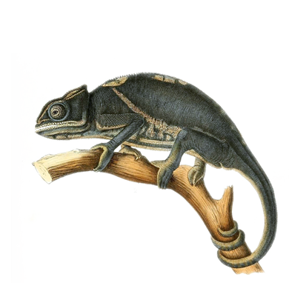
More Information
Presentation material
https://github.com/mlichtenberg/TDWG17
Documentation
https://biodivlib.wikispaces.com/Data+Exports
https://biodivlib.wikispaces.com/Developer+Tools+and+API
https://biodiversitylibrary.org/api2/docs/docs.html
https://openarchives.org/OAI/openarchivesprotocol.html
BHL in GitHub
https://github.com/gbhl
Notes:
This concludes my presentation. I hope you have learned something about the data in BHL and how to get it, and I hope you have interesting ideas about how it can be used.
Here are links to the slides and demos, as well as additional documentation on the topics that were covered. At the bottom is a link to BHL’s GitHub repository, which includes the source code for all things BHL.

Slide 19

Thank You!
Questions?
Mike Lichtenberg
mike.lichtenberg@mobot.org
October 3, 2017 | TDWG Conference
Follow @BioDivLibrary on
Share your thoughts using #BHLib #TDWG17
Notes:
Thank you for your time. Are there any questions?
If you think of anything additional questions after this session, feel free to contact me at the email address listed here.
Enjoy the rest of the conference.

Slide 20
How To Get BHL Data
BHL Entities – A Quick Overview
Title
Item
Part
Page
Notes:
Before talking about how to get the data, I want to take a quick moment to talk about the data entities found in BHL.
Title – Represents a work, such as a monograph or serial. For example, “The Journal of the Linnaen Society”. Does NOT represent an individual manifestation of the work.
Item – Represents a manifestation of an individual serial volume or monograph. For example, Volume 8 of “The Journal of the Linnean Society”.
Part – Represents a subset of an item. In BHL, this is typically an article, but it could also represent a chapter or other subdivision of an item.
Page – Represents a single page in an Item.
Understanding these entities helps to understand the data that is made available via exports, OAI, and APIs.

Slide 21
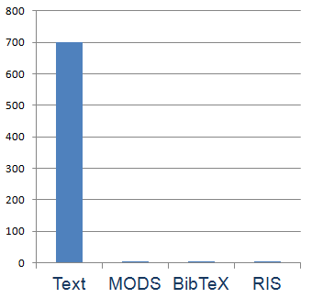
Data Exports
Usage
May 11- August 9, 2017
700 downloads of Delimited Text
< 10 downloads of MODS, BibTeX, RIS
Requests from 460 unique IP addresses
Notes:
There is relatively limited use of the data exports.
As you can see here, there was almost no downloads of MODS, BibTeX, and RIS during the three month period that was measured.
Although there were 700 downloads of Delimited Text files, none of those downloads included Name or Page data. So whoever is using this data seems to be focused on the bibliographic metadata.

Slide 22
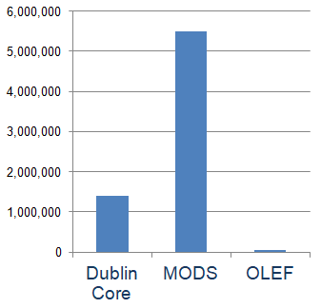
OAI-PMH
Usage
May 11- August 9, 2017
1.45 million total requests
5.9 million records retrieved
Requests from 298 unique IP addresses
Notes:
The number of OAI requests submitted to BHL in a 90-day period are shown here. As you can see, the OAI publisher receives a healthy amount of use; it is far more popular than the Data Exports.
There were 1.45 million total OAI-PMH requests, which returned about 5.9 million individual BHL records. About 25% of those requests were for Dublin Core, and 75% for MODS. Far less than 1% of requests were for OLEF. Understandable, given that it requires custom development to parse the responses, and that most consumers seem to be aggregators such as the Digital Public Libraries of America that are more interested in the bibliographic metadata than page-level metadata and names. Still, OLEF is a rich format, and provides a way to get most everything (except page text) at once, so it is worth a look.
DETAILED STATS
1.45 million total OAI-PMH requests.
899 "Identify“ 7583"ListIdentifiers"
155 "ListSets" 87868 "ListRecords"
51 "ListMetadataFormats“ 1.35 million "GetRecord"
1.4 million requests for Dublin Core data (Mostly GetRecord requests, so about 1.4 million records retrieved)
55591 requests for MODS data (Mostly ListRecords requests, so about 5.5 million records retrieved)
29 requests for data in OLEF format
Requests from 298 unique IP addresses

Slide 23
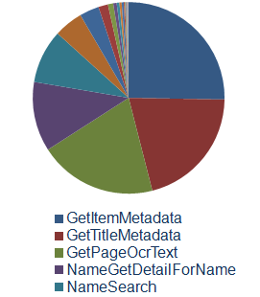
APIs
Usage
236 registered users
60+ with at least 1000 requests
4.25 million total requests per year
Notes:
As mentioned, the APIs are a popular method of getting BHL data. This slide shows annual statistics on users and requests, as well as the most popular API methods.
As of August 2017, there were 236 registered API users, and more than 60 of those had done more than just “kick the tires” and leave… they had submitted at least 1000 requests. Since February 2010, an average of 4.25 million APIs requests have been handled per year. The most popular API methods (as measured by the number of requests) are requests for title, item, page, and name metadata, and page text (OCR). This reflects the difference in audience for the APIs and the OAI-PMH publisher… whereas OAI-PMH users are largely aggregators of bibliographic metadata, API users tend to be more science-oriented, and need name and page metadata and page text.
DETAILED STATS
236 registered users, 60+ have sent at least 1000 requests
104 million requests since February 2010, though 70 million were in one month of 2015. Excluding that month, about 4.25 million requests/year.
Top 7 API methods have all handled more than 1 million requests
GetItemMetadata - 8.8 million NameSearch - 3.1 million
GetTitleMetadata - 7.2 million GetPageMetadata - 1.7 million
GetPageOcrText - 6.9 million NameGetDetailForNameBankID - 1.1 million
NameGetDetailForName - 4.1 million

