Slide 1
Melann Lending System V2
Report Module and Report Types
Collection
Releases
Documentation deck covering purpose, descriptions, advantages, problems, limitations, and recommended next steps.
Maturity
DCR
Reversed
Monitoring
with DCR as separate finance report
Prepared July 14, 2026

Slide 2
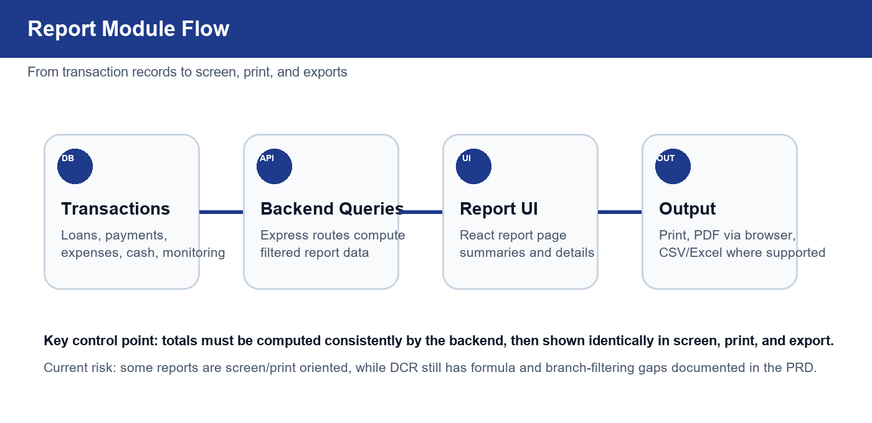
REPORT MODULE DOCUMENTATION
The module turns daily transactions into operational decisions

Slide 3
REPORT MODULE DOCUMENTATION
Current inventory has UI, finance, and backend-only layers
Visible Reports UI
Separate Finance Report
Backend / README Candidates
Collection, Releases, Maturity, Reversed Payments, Full Paid, Collection Sheet, Disclosure, Monitoring.
Daily Cash Report lives outside the Reports sidebar because it has close, cash, bank, and compliance handoff workflows.
Loan Type Summary and Payments Encoded still appear in backend or documentation but are not current sidebar items.
Main documentation risk: users may expect reports that are documented but not currently visible, or miss DCR because it is under Finance.

Slide 4
REPORT MODULE DOCUMENTATION
Collections and releases are the daily operating heartbeat
Collection Report
Releases Report
Shows daily/monthly payments by date range, grouped by collector.
Shows loans released by date or cycle with principal totals and loan type split.
Advantage: fast cash collection review and collector accountability.
Advantage: monitors cash-out and production by collector.
Limit: depends on active payment status, correct collector links, and consistent branch filters.
Limit: release totals may use principal while DCR cash-out should prefer net proceeds.

Slide 5
REPORT MODULE DOCUMENTATION
Exception and lifecycle reports support control work
Maturity Checker / Past Due
Prioritizes accounts by maturity range and remaining balance.
Payments Reversed
Audits reversed payments with user, reason, customer, and amount.
Full Paid Loans
Lists completed accounts for re-loan targeting and completion metrics.
Common limitation: these reports are only as strong as status mapping and date quality from loan/payment records.

Slide 6
REPORT MODULE DOCUMENTATION
Field, client-facing, and monitoring reports cover different audiences
Collection Sheet
Disclosure Statement
Monitoring Summary
Per-collector active loan list for field collection and printed accountability.
Client loan disclosure generated from selected borrower and loan details.
Alerts, escalations, promise-to-pay data, follow-up logs, and resolutions.

Slide 7
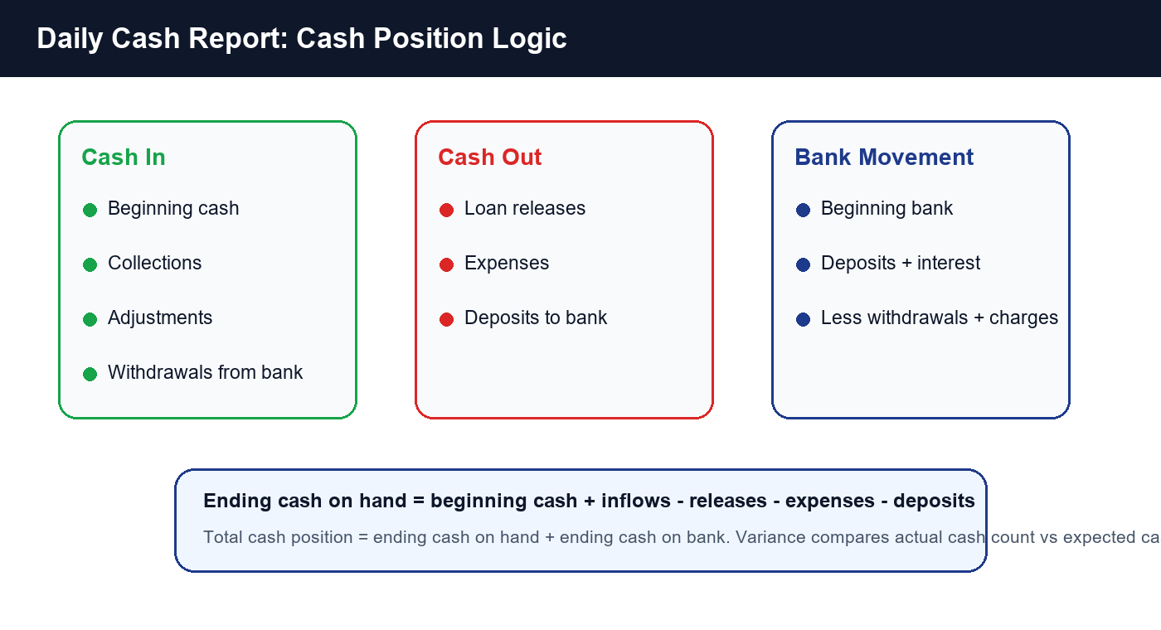
REPORT MODULE DOCUMENTATION
DCR is the accounting-critical report

Slide 8
REPORT MODULE DOCUMENTATION
Advantages and limitations should be managed as one control surface
Advantages: centralized access, collector grouping, print-friendly output, DCR reconciliation, and monitoring visibility.
Limitations: report inventory mismatch across README, backend routes, and visible UI.
DCR gaps: branch filtering, bank formulas, server-side close totals, DCR numbering, and exact legacy parity.
Export risk: browser print works, but critical reports may need controlled server-generated PDF/export paths.
Data risk: statuses, dates, branch, collector, and reversal reasons must be encoded consistently.

Slide 9
REPORT MODULE DOCUMENTATION
Recommended next steps before production hardening
1
Normalize inventory and labels
Align README, Reports UI, backend routes, and DCR placement.
2
Make backend totals authoritative
Use formula services for DCR and cash-impacting reports.
3
Add branch-aware tests
Protect reports used for cash and collector accountability.
4
Decide backend-only reports
Bring Loan Type and Payments Encoded into UI or remove from docs.
Target outcome: screen, print, export, and persisted audit totals all tell the same story.

