Slide 1



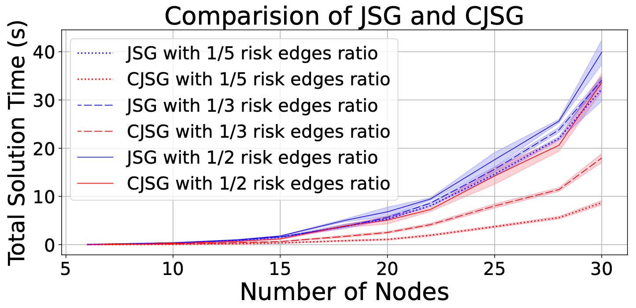
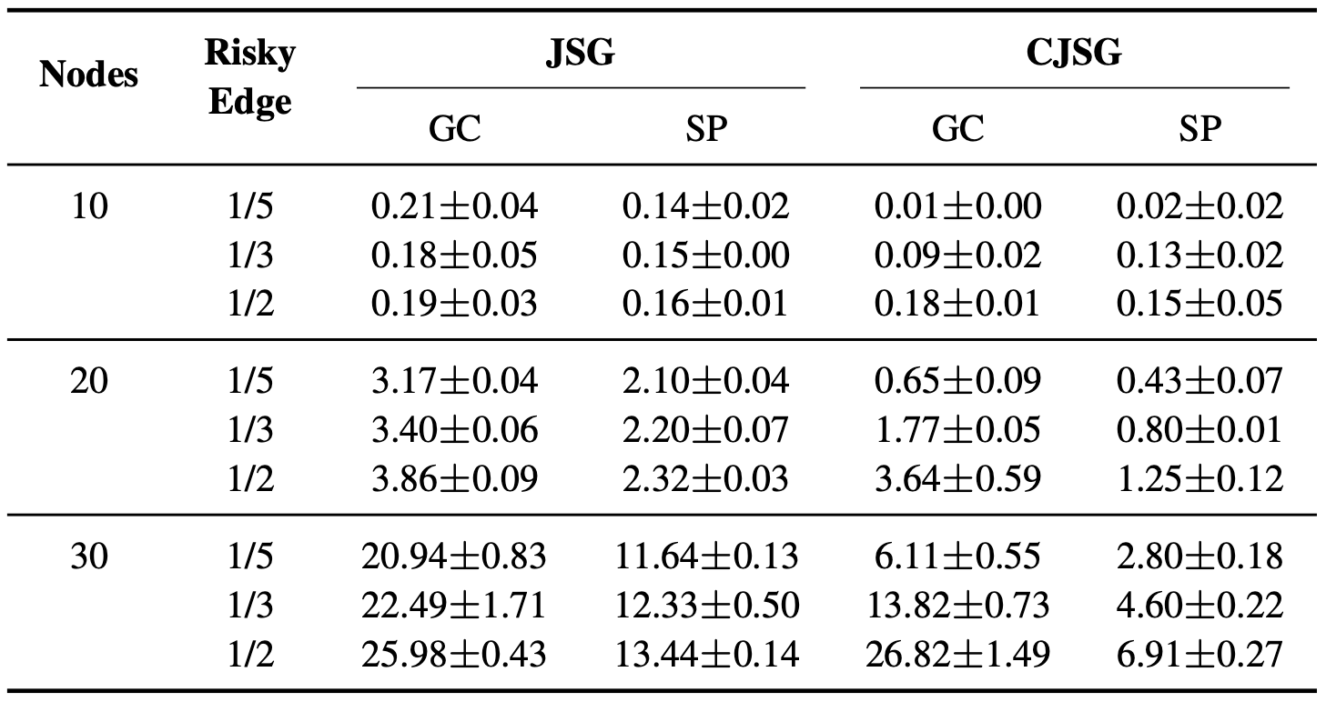
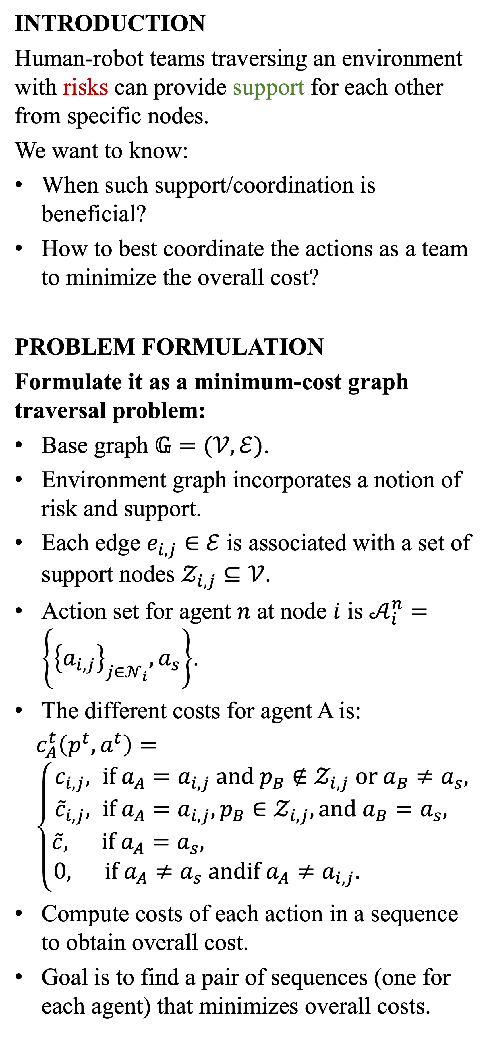
We provide a problem formulation and two methods for solving multi-agent cooperation on a graph with a notion of risk and support.
Team Coordination on Graphs with State-Dependent Edge Costs
Manshi Limbu, Zechen Hu, Sara Oughourli,
Xuan Wang, Xuesu Xiao, and Daigo Shishika
George Mason University
Experiments Results for V4W
INTRODUCTION
Human-robot teams traversing an environment with risks can provide support for each other from specific nodes.
We want to know:
When such support/coordination is beneficial?
How to best coordinate the actions as a team to minimize the overall cost?
PROBLEM FORMULATION
Formulate it as a minimum-cost graph traversal problem:
Base graph $𝔾=(𝒱,ℰ)$.
Environment graph incorporates a notion of risk and support.
Each edge $e_{i,j}∈ℰ$ is associated with a set of support nodes $𝒵_{i,j}⊆𝒱$.
Action set for agent $n$ at node $i$ is $𝒜_{i}^{n}=\left\{{\left\{a_{i,j}\right\}}_{j∈𝒩_{i}}, a_{s}\right\}$.
The different costs for agent A is:
$c_{A}^{t}\left(p^{t},a^{t}\right)= \left\{\begin{aligned}c_{i,j}, if a_{A}=a_{i,j} and p_{B}∉𝒵_{i,j} or a_{B}≠a_{s}, \\ {\tilde{c}}_{i,j}, if a_{A}=a_{i,j}, p_{B}∈𝒵_{i,j}, and a_{B}=a_{s}, \\ \tilde{c}, if a_{A}=a_{s}, \\ 0, if a_{A}≠a_{s} andif a_{A}≠a_{i,j}. \end{aligned}\right.$
Compute costs of each action in a sequence to obtain overall cost.
Goal is to find a pair of sequences (one for each agent) that minimizes overall costs.
METHODS
Joint State Graph (JSG):
Nodes represent the joint states.
Edges represent possible transitions between those joint states.
Cost of each edge is the sum of costs for each agent’s actions.
The point is that JSG subsumes the action selection of the original problem, converting it into a single-agent path planning problem on JSG that can be solved with any standard shortest-path algorithm.
However, it can be computationally expensive with greater graph sizes.
Critical Joint State Graph (CJSG):
To address JSG’s computational inefficiency, we propose to classify the agents’ movements into coupled and decoupled modes:
Coupled movements are planned in JSG, where supporting behavior is possible.
Decoupled movements are independently planned by each agent on base graph.
RESULTS
Joint State Graph for a 5-node environment graph. Red (green) edges represent traversing risk edge without (with) support.
Environment graph with risk edges and support nodes
One agent provides support by holding up the ladder while the other agent climbs.
Fully connected graph where nodes represent joint states where agents initiate/complete support and the start/goal nodes.
Experimentally, we find that CJSG is more efficient overall than JSG in generating optimal path planning solutions.

