Slide 1

Time Series Management
Michele Linardi Ph.D.
michele.linardi@orange.fr

Slide 2

Syllabus
Time series data
Trend, seasonality, cycles and residuals
Stationary processes
Autoregressive processes.
Moving average processes.
ACF & PACF
Fitting AR(p) MA(q) models

Slide 3
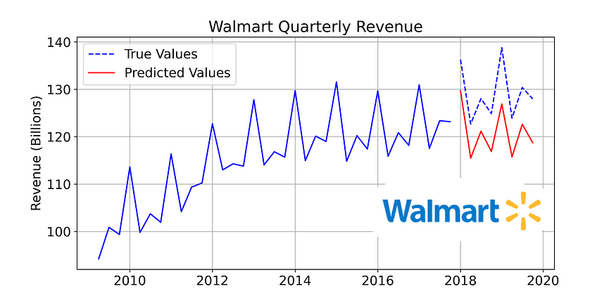
Time series data
A univariate time series is a sequence of measurements of the same variable collected over time. Most often, the measurements are made at regular time intervals.
https://www.kaggle.com/code/anushkaml/walmart-time-series-sales-forecasting

Slide 4
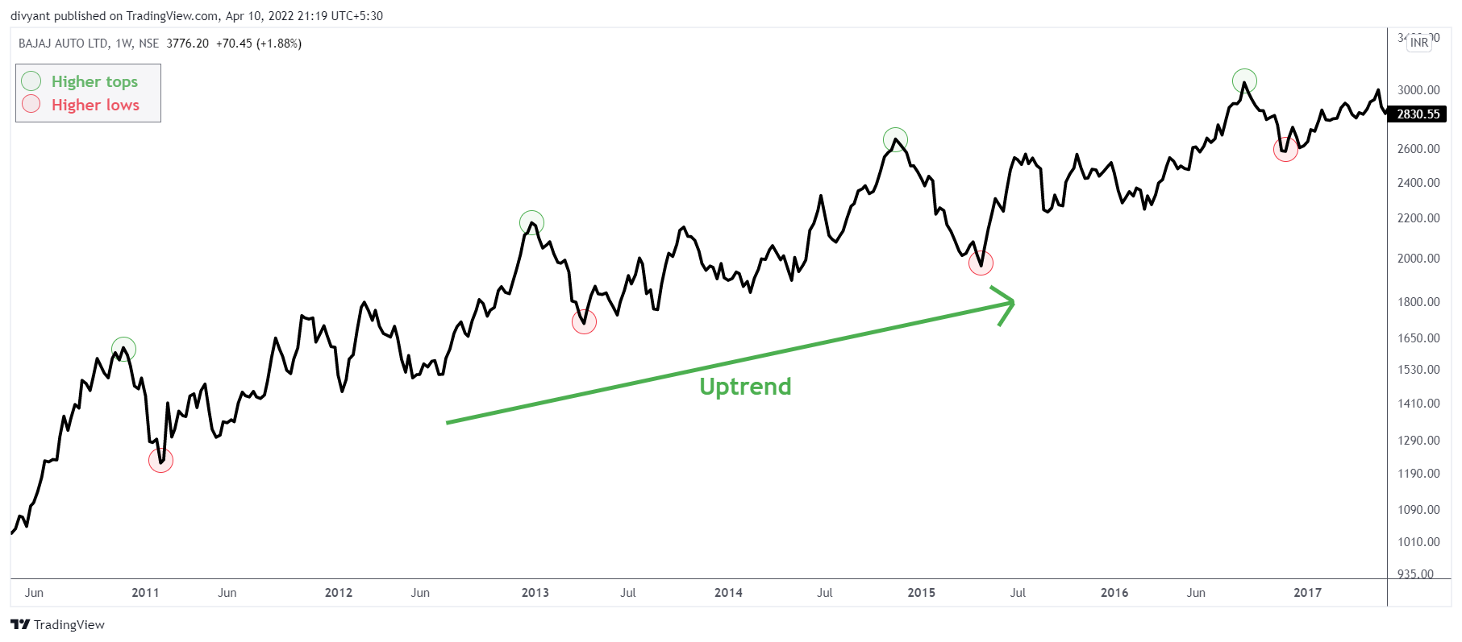
TS Trend
General direction over along period of time

Slide 5
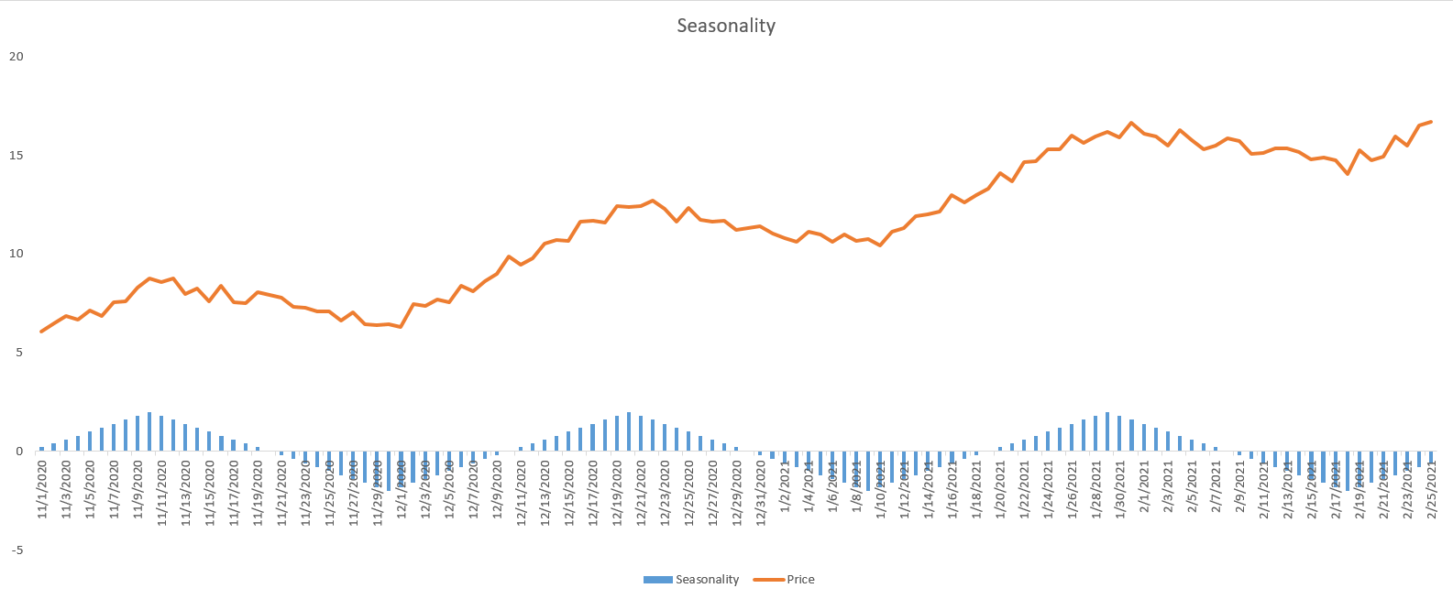
TS Seasonality and Ciclicality

Slide 6
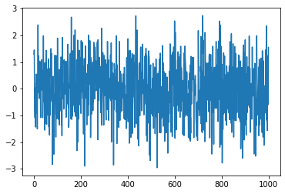
TS Noise

Slide 7
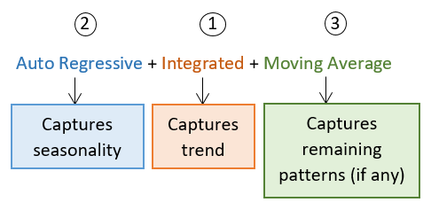
Predictive models
https://www.linkedin.com/pulse/time-series-part-2-introduction-arima-models-using-excel-agarwal

Slide 8
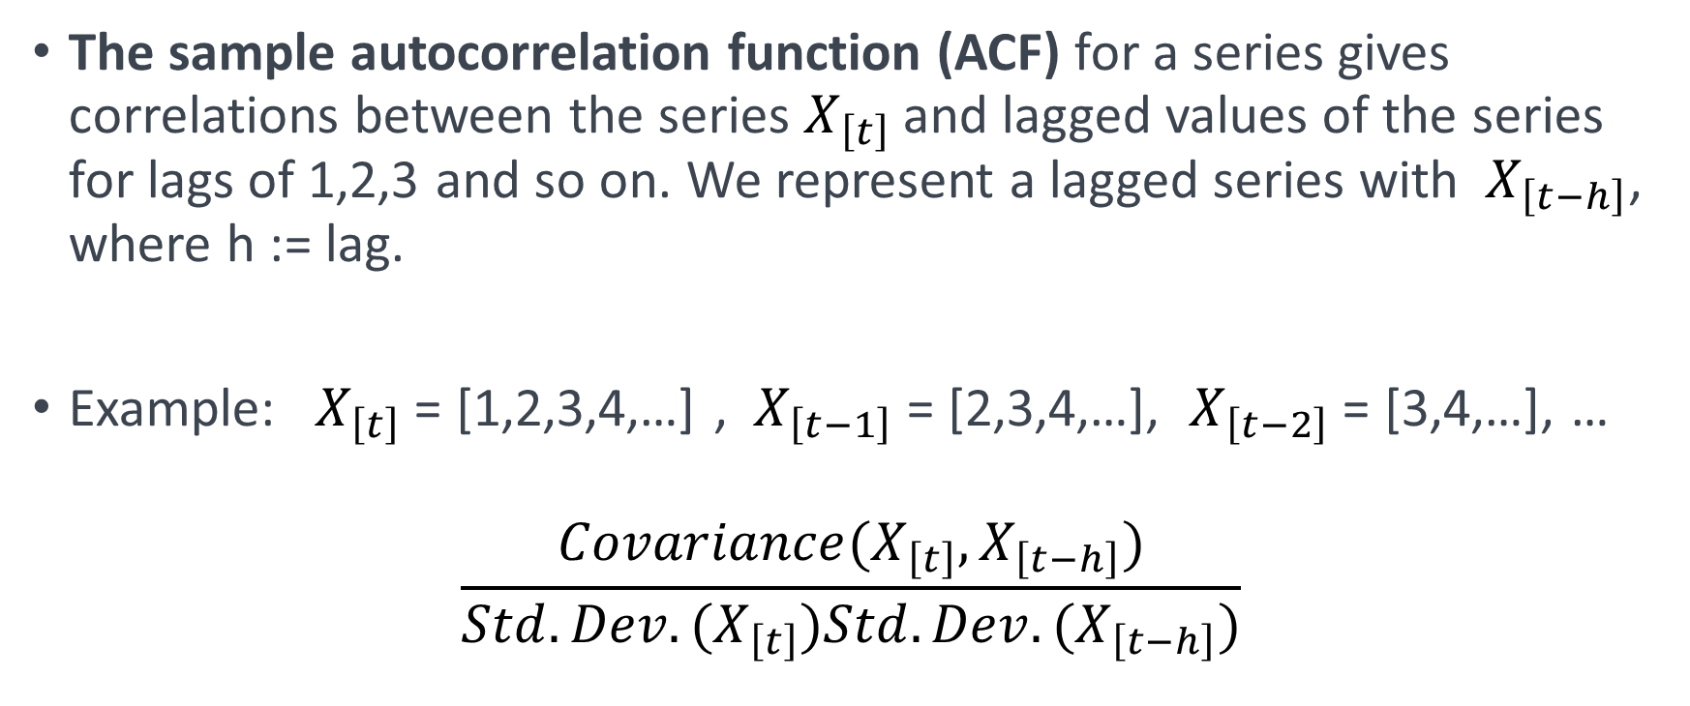
ACF – Autocorrelation function
The sample autocorrelation function (ACF) for a series gives correlations between the series $X_{\left[t\right]}$and lagged values of the series for lags of 1,2,3 and so on. We represent a lagged series with $X_{\left[t−h\right]}$, where h := lag.
Example: $X_{\left[t\right]}$= [1,2,3,4,…] , $X_{\left[t−1\right]}$= [2,3,4,…], $X_{\left[t−2\right]}$= [3,4,…], …
$$\frac{Covariance(X_{\left[t\right]},X_{\left[t−h\right]})}{Std.Dev.(X_{\left[t\right]})Std.Dev.(X_{\left[t−h\right]})}$$

Slide 9
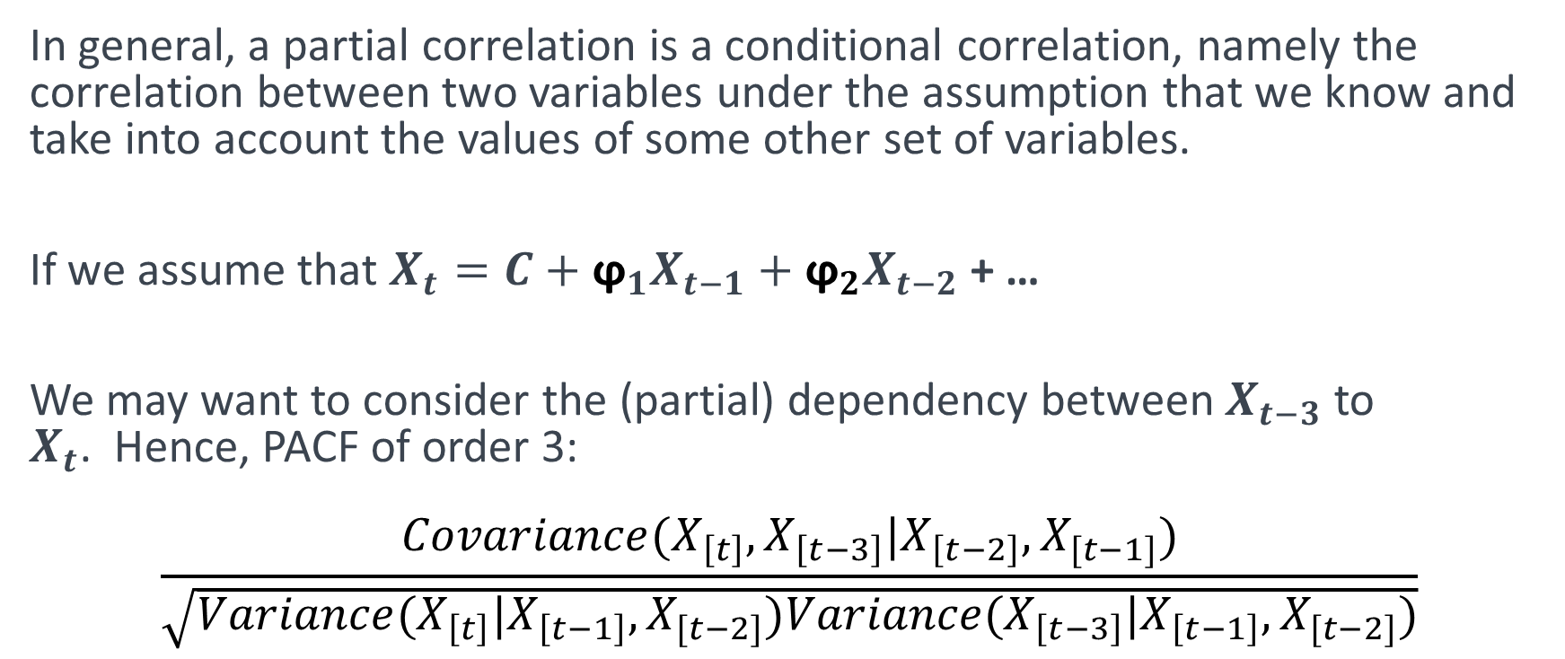
PACF – Partial Autocorrelation function
In general, a partial correlation is a conditional correlation, namely the correlation between two variables under the assumption that we know and take into account the values of some other set of variables.
If we assume that $X_{t}=C+{\text{ϕ}}_{1}X_{t−1}+{\text{ϕ}}_{2}X_{t−2}$+ …
We may want to consider the (partial) dependency between $X_{t−3}$to $X_{t}$. Hence, PACF of order 3:
$$\frac{Covariance(X_{\left[t\right]},X_{\left[t−3\right]}|X_{\left[t−2\right]},X_{[t−1]})}{\sqrt{Variance(X_{\left[t\right]}|X_{\left[t−1\right]},X_{[t−2]})Variance(X_{\left[t−3\right]}|X_{\left[t−1\right]},X_{[t−2]})}}$$

Slide 10
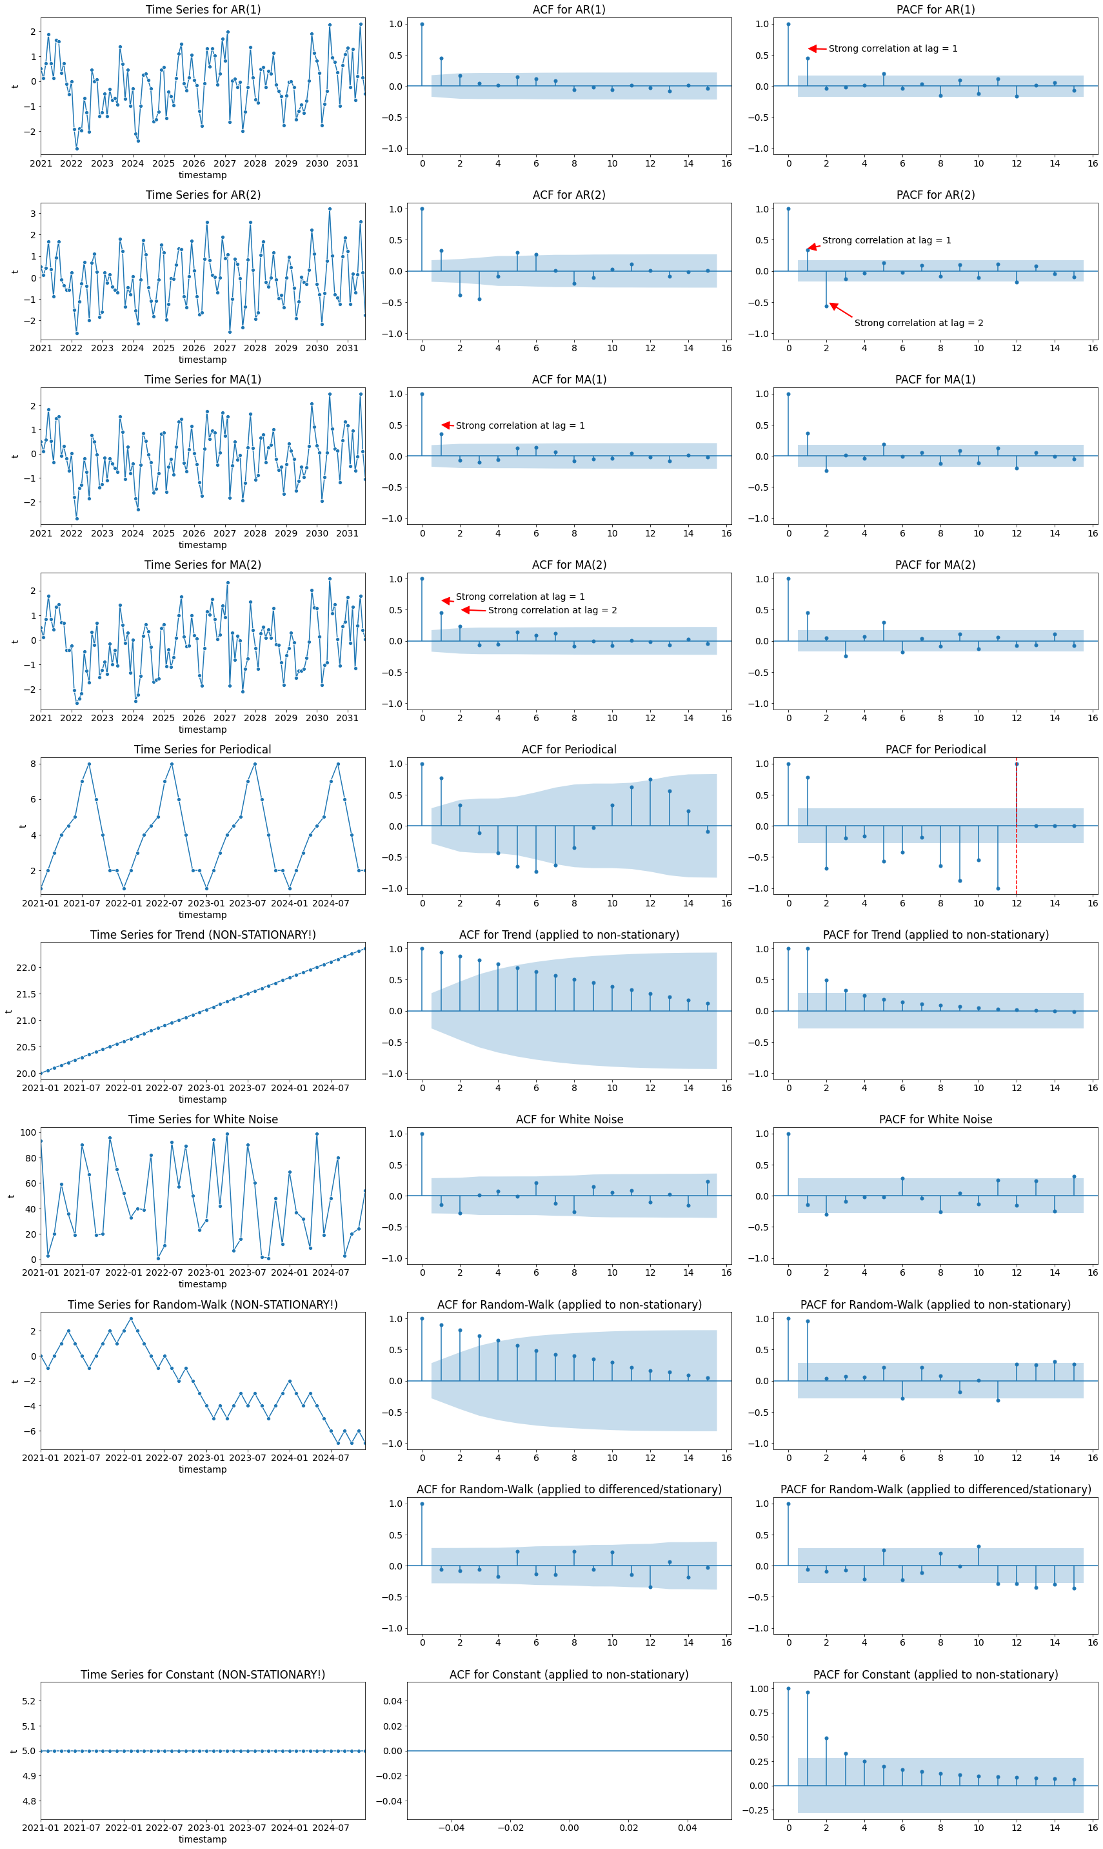
ACF – PACF Examples
AR( p= 1)
ACF Tails off (Geometric decay)
PACF Significant at each lag p / Cuts off after lag p

Slide 11
ACF – PACF Examples
AR( p= 2)
ACF Tails off (Geometric decay)
PACF Significant at each lag p / Cuts off after lag p

Slide 12
ACF – PACF Examples
Significant at lag q� / Cuts off after lag q
MA( q = 1)
ACF Significant at lag q / Cuts off after lag q
PACF Tails off (Geometric decay)

Slide 13
ACF – PACF Examples
MA( q = 2)
ACF Significant at lag q / Cuts off after lag q
PACF Tails off (Geometric decay)

Slide 14
ACF – PACF Examples … continue

Slide 15
References
Andrew V. Metcalfe, Paul S.P. Cowpertwait, Introductory Time Series with R (2009).
Aileen Nielsen, Practical Time Series Analysis: Prediction with Statistics and Machine Learning (2019).

