Slide 1

Time Series Management
Michele Linardi Ph.D.
michele.linardi@orange.fr

Slide 2

Syllabus
ARIMA model
Backshift Notation
Model selection and forecasting
MLE (Maximum likelihood estimation)
AIC Akaike’s Information Criterion

Slide 3
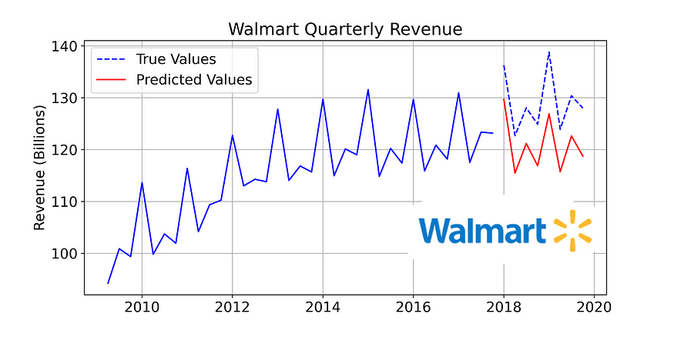
Time series data... quick recap
A univariate time series is a sequence of measurements of the same variable collected over time. Most often, the measurements are made at regular time intervals.
https://www.kaggle.com/code/anushkaml/walmart-time-series-sales-forecasting

Slide 4
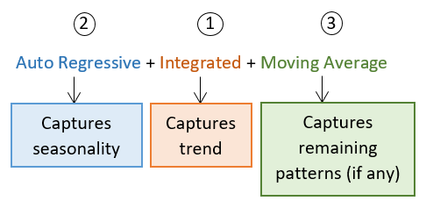
AR.I.MA
https://www.linkedin.com/pulse/time-series-part-2-introduction-arima-models-using-excel-agarwal

Slide 5
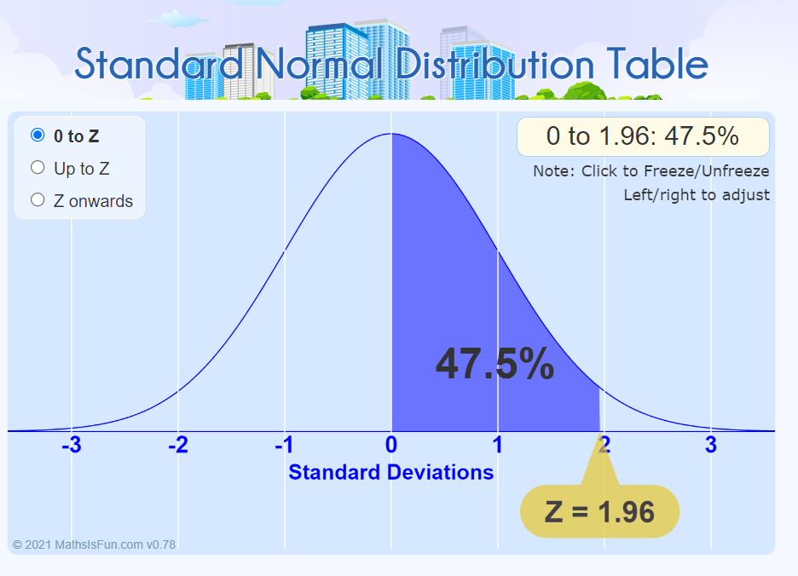

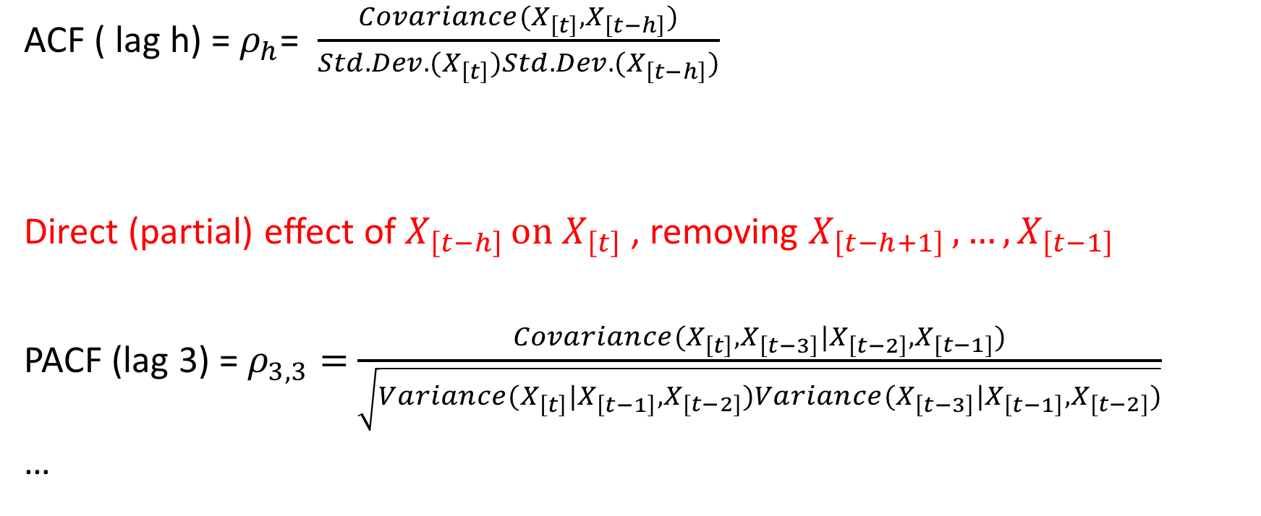



ACF and PACF
Limites de signification ACF et PACF
$$S^{+}= \frac{+Z}{N−h}$$
$$S^{−}= \frac{−Z}{N−h}$$
N$≔time series values$
$$h≔lag$$
Pick Z such that the area of N(0,1)
between (– Z) and (Z) is equal to the
desired amount of confidence
(in general for 95% c.i. , Z = 1.96) https://www.mathsisfun.com/data/standard-normal-distribution-table.html
ACF ( lag h) = $ρ_{h}$= $\frac{Covariance(X_{\left[t\right]},X_{\left[t−h\right]})}{Std.Dev.(X_{\left[t\right]})Std.Dev.(X_{\left[t−h\right]})}$
Direct (partial) effect of $X_{\left[t−h\right] }on$ $X_{\left[t\right]}$ , removing $X_{\left[t−h+1\right] }{,…, X}_{\left[t−1\right] }$
PACF (lag 3) = $ρ_{3,3}=$ $\frac{Covariance(X_{\left[t\right]},X_{\left[t−3\right]}|X_{\left[t−2\right]},X_{[t−1]})}{\sqrt{Variance(X_{\left[t\right]}|X_{\left[t−1\right]},X_{[t−2]})Variance(X_{\left[t−3\right]}|X_{\left[t−1\right]},X_{[t−2]})}}$
…

Slide 6

Levinson and Durbin recursive algorithm (for PACF computation)
$\text{PACF}\text{ (}\text{lag} \text{h}\text{)}$ = $ρ_{h,h}= \frac{ρ_{h }−\sum_{j=1}^{h−1}{ρ_{h−1,j} ρ_{h−j}}}{1−\sum_{j=1}^{h−1}{ρ_{h−1,j} ρ_{j}}}$
where :
$$ρ_{h,j }=ρ_{h,j }−ρ_{h,h }ρ_{h−1,h−j }$$
for :
$$j=1,2,…., h−1$$

Slide 7
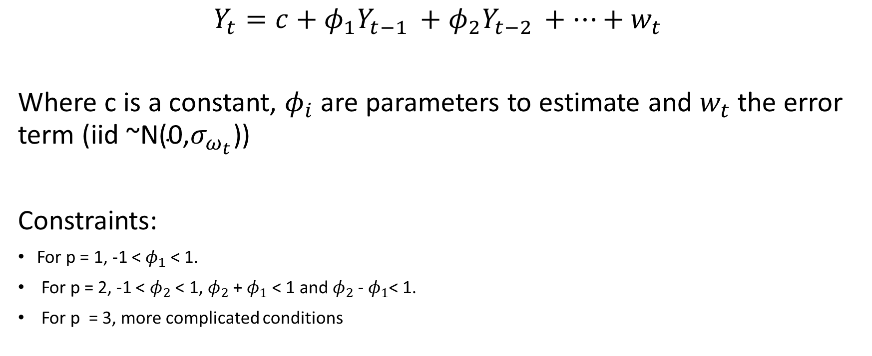
Autoregression (AR) models
$$Y_{t}=c+φ_{1}Y_{t−1 }+φ_{2}Y_{t−2 }+…+w_{t}$$
Where c is a constant, $φ_{i}$ are parameters to estimate and $w_{t}$ the error term (iid ~$\text{N}\text{(0,}σ_{ω_{t}}\text{)}$)
Constraints:
For p = 1, -1 < $φ_{1}$ < 1.
For p = 2, -1 < $φ_{2}$ < 1, $φ_{2}$+ $φ_{1}$ < 1 and $φ_{2}$- $φ_{1}$< 1.
For p = 3, more complicated conditions

Slide 8
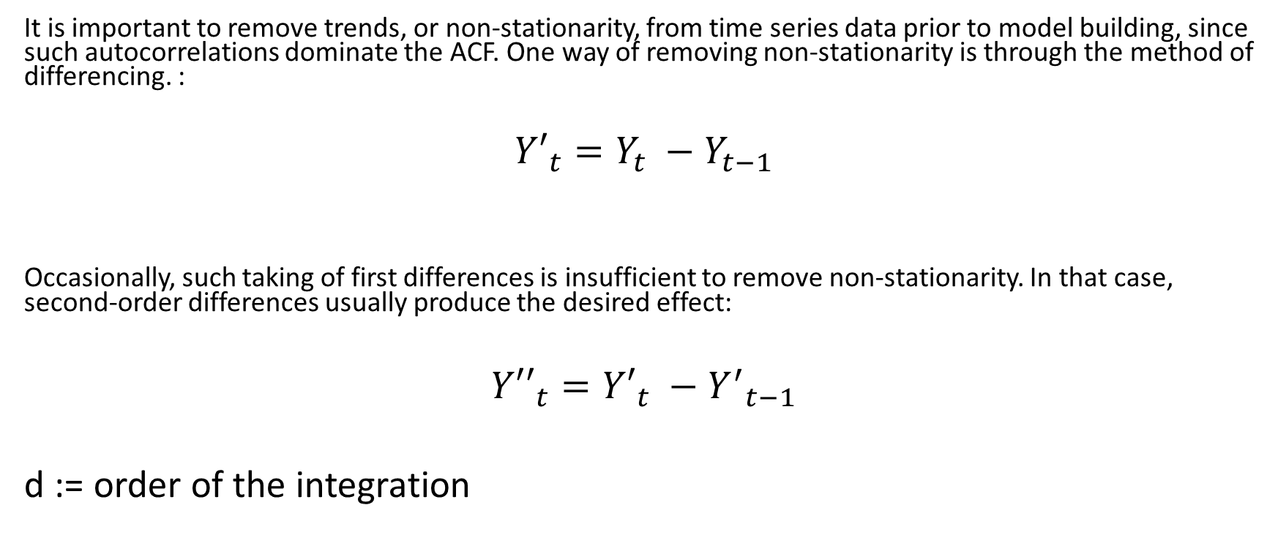
Integrated model (d)
It is important to remove trends, or non-stationarity, from time series data prior to model building, since such autocorrelations dominate the ACF. One way of removing non-stationarity is through the method of differencing. :
$${Y′}_{t}=Y_{t} −Y_{t−1}$$
Occasionally, such taking of first differences is insufficient to remove non-stationarity. In that case, second-order differences usually produce the desired effect:
$${Y′′}_{t}={Y′}_{t} −{Y^{′}}_{t−1}$$
d := order of the integration

Slide 9
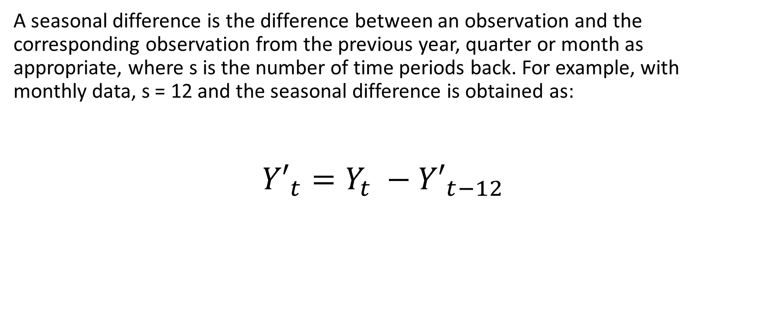
Integrated model (seasonal)
A seasonal difference is the difference between an observation and the corresponding observation from the previous year, quarter or month as appropriate, where s is the number of time periods back. For example, with monthly data, s = 12 and the seasonal difference is obtained as:
$${Y′}_{t}=Y_{t} −{Y′}_{t−12}$$

Slide 10
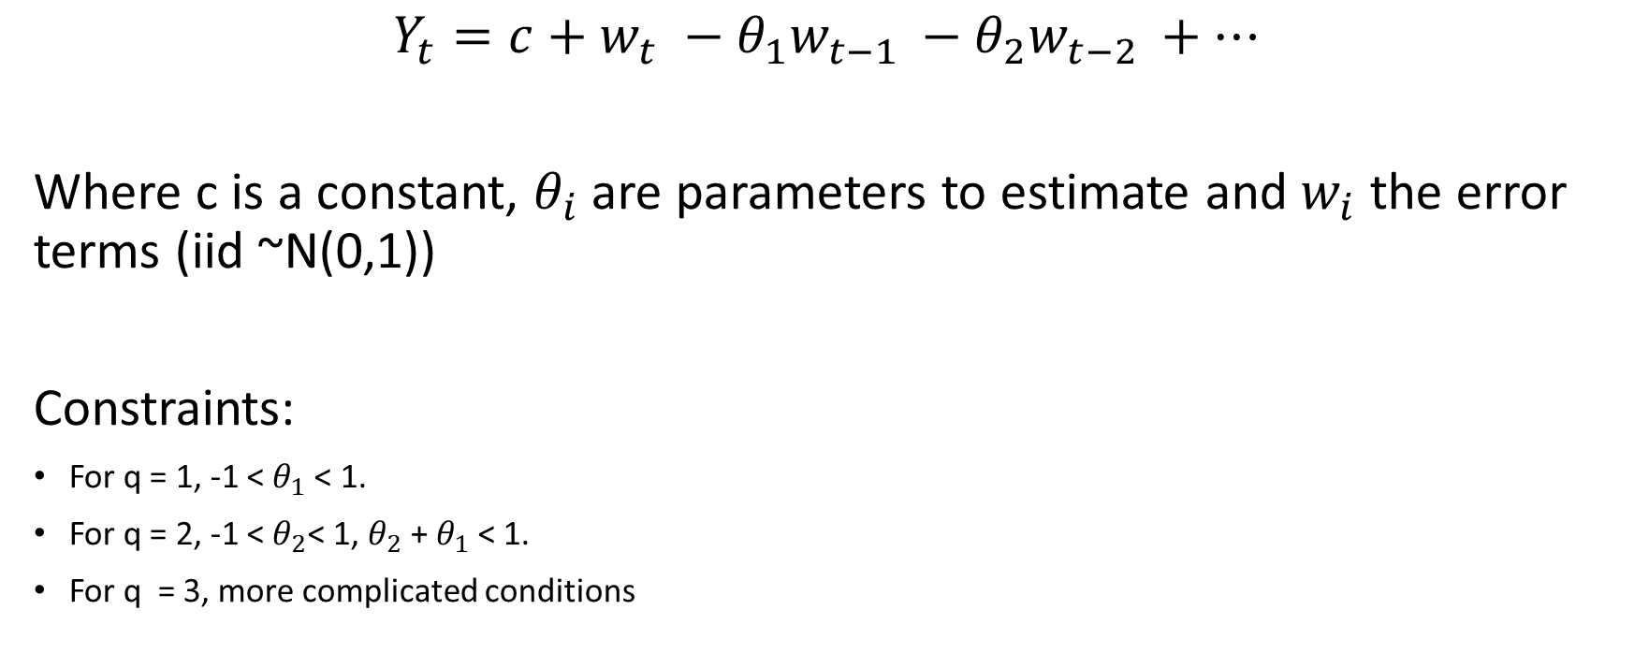
Moving Average (MA) models
$$Y_{t}=c+w_{t} −θ_{1}w_{t−1 }−θ_{2}w_{t−2 }+…$$
Where c is a constant, $θ_{i}$are parameters to estimate and $w_{i}$ the error terms (iid ~N(0,1))
Constraints:
For q = 1, -1 <${ θ}_{1}$ < 1.
For q = 2, -1 <${ θ}_{2}$< 1, $θ_{2}$+ $θ_{1}$ < 1.
For q = 3, more complicated conditions

Slide 11
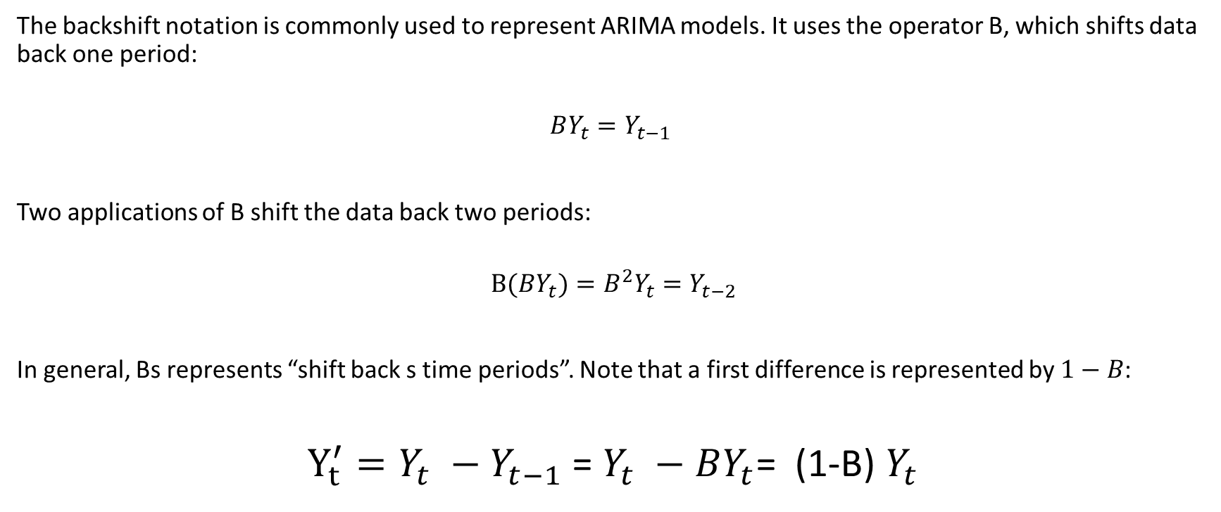
Backshift notation
The backshift notation is commonly used to represent ARIMA models. It uses the operator B, which shifts data back one period:
$$BY_{t}=Y_{t−1}$$
Two applications of B shift the data back two periods:
$$B(BY_{t})=B^{2}Y_{t}=Y_{t−2}$$
In general, Bs represents “shift back s time periods”. Note that a first difference is represented by $1−B$:
$Y_{t}^{′}=Y_{t} −Y_{t−1}$ = $Y_{t} −BY_{t}$= (1-B) $Y_{t}$

Slide 12
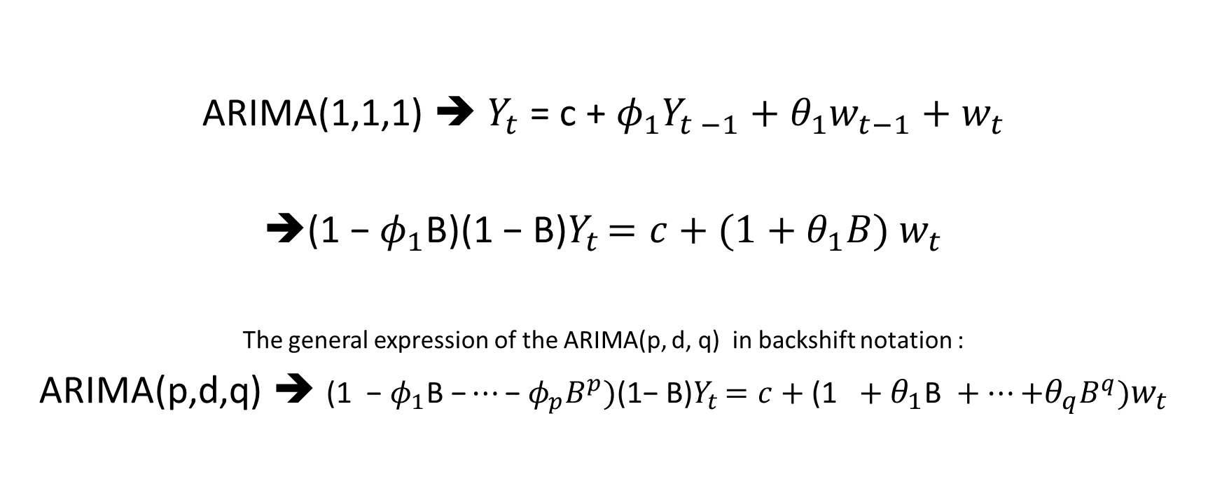
ARIMA(p,d,q) = AR(p) , I(d) , MA(q)
ARIMA(1,1,1) ➔ $Y_{t}$ = c + $φ_{1}Y_{t −1}+θ_{1}w_{t−1}{+ w}_{t}$
${\text{(1 − }φ_{1}\text{B}\text{)(1 − }\text{B}\text{)}Y}_{t }=c+(1+θ_{1}B)$ $w_{t}$
The general expression of the ARIMA(p, d, q) in backshift notation :
ARIMA(p,d,q) ➔ ${\text{(1 }\text{− }φ_{1}\text{B}\text{ −}…\text{− }φ_{p}B^{p}\text{)}\text{(}\text{1− }\text{B}\text{)}Y}_{t }=c+\text{(1 }+θ_{1}\text{B} +…\text{+}θ_{q}B^{q}\text{)}w_{t}$

Slide 13
Model selection and forecasting
Phase 1 (Identification):
Preliminary analysis and data preparation:
Difference data to obtain a stationary series.
Model selection:
Analyse time plots, ACF, PACF to identify potential models.

Slide 14
Model selection and forecasting
Phase 2 (Estimation and testing (1/2)):
Estimate parameters in potential models
Select best model using suitable criterion…
If satisfying model is not found go back to Phase 1
Otherwise…

Slide 15
Model selection and forecasting
Phase 2 (Estimation and testing (1/2)):
Estimate parameters in potential models
Select best model using suitable criterion…
If satisfying model is not found go back to Phase 1
Otherwise…

Slide 16
Likelihood
Likelihood function := L(Model with parameters θ | observed data)
:= Prob(observed data | Model with parameters θ )
The likelihood of a fully-specified model with a set of parameters θ, given some observed data, is equal to the probability of observing these data, given the defined model with those specific parameter values.
Likelihood is a quantitative measure of model fit. Higher likelihoods correspond to a higher probability of the model producing the observed data (the data “fit” the model well).

Slide 17

Maximum Likelihood estimation (MLE)
$${\hat{Θ}}_{MLE}= {arg max \atop Θ}L(Θ)$$
The goal of MLE is to find the parameter $Θ$ that maximizes the likelihood function (or equivalently, the log-likelihood).

Slide 18
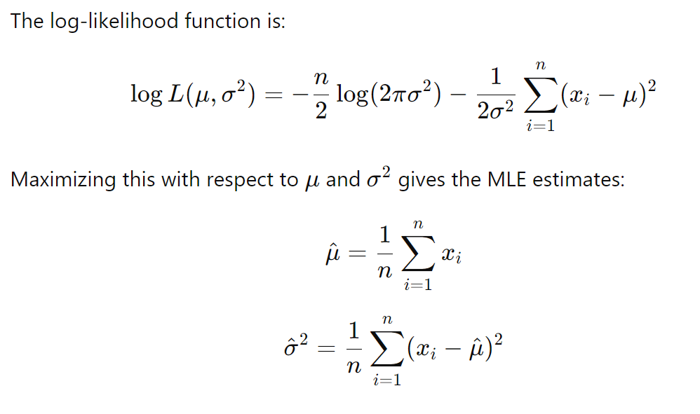

Likelihood of the Normal Distribution
Consider you have a sample of data $x_{1}, x_{2},…,x_{n}$ drawn from a normal distribution with unknown mean $μ$ and variance $σ^{2}$.
$f\left(x | μ,σ^{2}\right)= \frac{1}{\sqrt{2πσ^{2}}}e^{−\frac{{\left(x−μ\right)}^{2}}{2σ^{2}}}$

Slide 19

Sum of squares error (SSE):
$$SSE\left(θ\right)=\sum_{i=1}^{T}{{(Y_{i}−f(Y_{i−1},…;θ))}^{2}}=\sum_{i=1}^{T}{r_{i}^{2}(θ)}$$
Find the values of the parameters which maximise the probability of obtaining the data that we have observed (minimize $SSE\left(θ\right)$)
Parameters
Model prediction

Slide 20
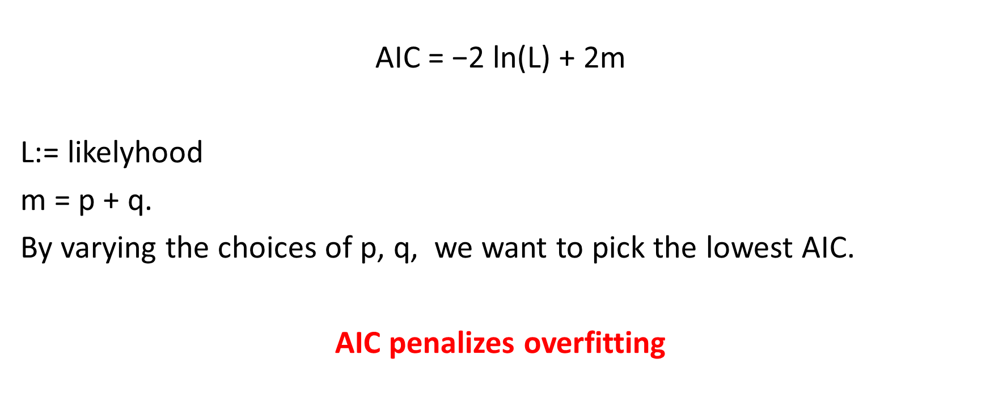
AIC (Akaike’s Information Criterion)
$$\text{AIC}\text{ = −2 }\text{ln}\text{(}\text{L}\text{)}\text{ + 2}\text{m}$$
L:= likelyhood
m = p + q.
By varying the choices of p, q, we want to pick the lowest AIC.
AIC penalizes overfitting

Slide 21
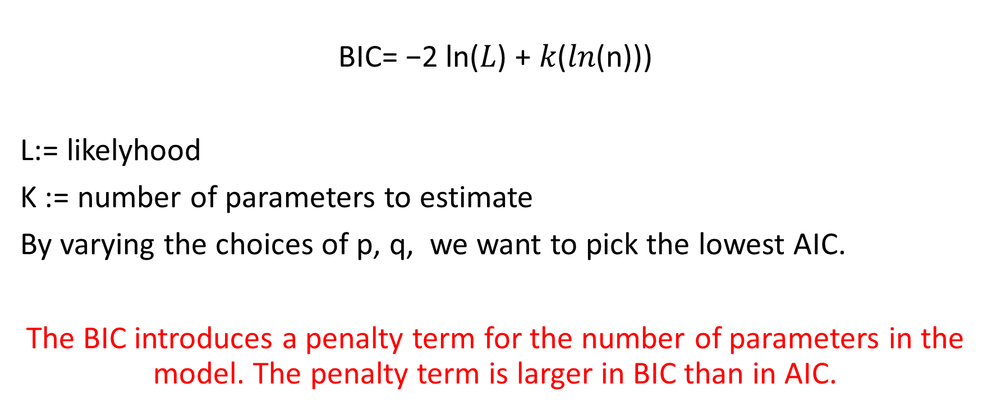
BIC (Bayesian Information Criterion)
$$\text{B}\text{IC}\text{= −2 }\text{ln}\text{(}\text{L}\text{)}\text{ + }\text{k}\text{(}\text{ln}\text{(}\text{n}\text{)))}$$
L:= likelyhood
K := number of parameters to estimate
By varying the choices of p, q, we want to pick the lowest AIC.
The BIC introduces a penalty term for the number of parameters in the model. The penalty term is larger in BIC than in AIC.

Slide 22
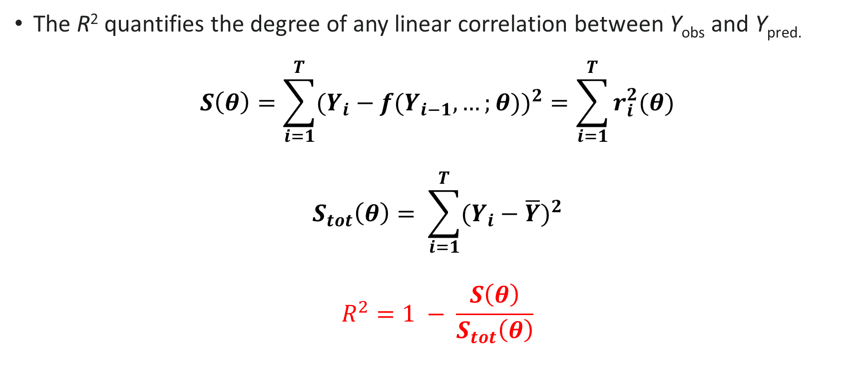
Model quality - R²
The R² quantifies the degree of any linear correlation between Y_{obs} and Y_{pred.}
$$S\left(θ\right)=\sum_{i=1}^{T}{{(Y_{i}−f(Y_{i−1},…;θ))}^{2}}=\sum_{i=1}^{T}{r_{i}^{2}(θ)}$$
$$S_{tot}\left(θ\right)= \sum_{i=1}^{T}{{(Y_{i}−\overline{Y})}^{2}}$$
$$R^{2}=1 − \frac{S\left(θ\right)}{S_{tot}\left(θ\right)}$$

Slide 23
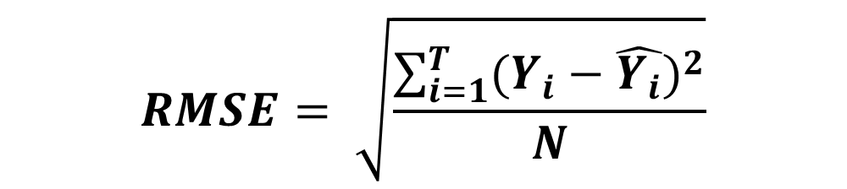
Error
The RMSE (or RMSD) of a sample is the quadratic mean of the differences between the observed values and predicted ones. These deviations are called residuals when the calculations are performed over the data sample that was used for estimation and are called errors (or prediction errors) when computed out-of-sample.
$$RMSE= \sqrt{\frac{\sum_{i=1}^{T}{{(Y_{i}−\hat{Y_{i}})}^{2}}}{N}}$$
Prediction

Slide 24
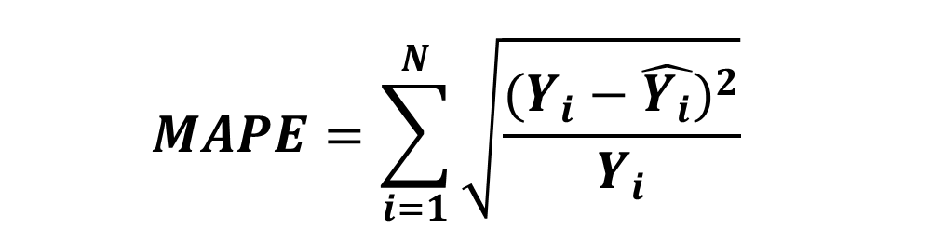
Error
$$MAPE=\sum_{i=1}^{N}{{\sqrt{\frac{{(Y_{i}−\hat{Y_{i}})}^{2}}{Y_{i}}}}^{}}$$
The mean absolute percentage error (MAPE), also known as mean absolute percentage deviation (MAPD), is a measure of prediction accuracy of a forecasting method in statistics.
Prediction

Slide 25
Model selection and forecasting
Phase 2 (Estimation and testing (2/2)):
Testing:
Check ACF/PACF of residuals (errors)
Are residuals white noise ?

Slide 26

Model selection and forecasting
Phase 3 (Application):
Use the model to forecast.

Slide 27


TS Analysis in Python
SciPy
NumPy;
Matplotlib;
Pandas;
https://www.statsmodels.org/stable/index.html https://github.com/statsmodels/statsmodels/)

Slide 28
ACF and PACF
Import the data in a Pandas DataFrame
from pandas import read_excel
series = read_excel([filename], sheet_name='MAdata’, )
https://pandas.pydata.org/docs/reference/api/pandas.read_excel.html

Slide 29
ACF and PACF
Import functions to plot ACF and PACF
from statsmodels.graphics.tsaplots import plot_acf, plot_pacf
from statsmodels.tsa.tsatools import detrend
plot_acf([series], title='', lags=xx)
plot_pacf([series], title='', lags=xx)
https://www.statsmodels.org/stable/generated/statsmodels.graphics.tsaplots.plot_acf.html#statsmodels.graphics.tsaplots.plot_acf

Slide 30
ARIMA MODEL
Compute ARIMA MODEL
from statsmodels.tsa.arima.model import ARIMA.
model = ARIMA([series], order=(p, d, q)),
where p, d, and q represent the parameters of the model
https://www.statsmodels.org/stable/generated/statsmodels.tsa.arima.model.ARIMA.html
https://www.statsmodels.org/stable/dev/generated/statsmodels.base.model.GenericLikelihoodModelResults.aic.html#statsmodels.base.model.GenericLikelihoodModelResults.aic

Slide 31
TD - Consignes
Givent the file priceData.xlsx
Write a Python program to compute the ACF and PACF (test several lags) of the time series contained in priceData.xlsx
Write a Python program to estimate and compute the best ARIMA model of the time series in priceData.xlsx, based on AIC criterion.
Which kind of model is choosen ?

Slide 32
References
Andrew V. Metcalfe, Paul S.P. Cowpertwait, Introductory Time Series with R (2009).
Aileen Nielsen, Practical Time Series Analysis: Prediction with Statistics and Machine Learning (2019).
Changquan Huang , Alla Petukhina, Applied Time Series Analysis and Forecasting with Python (2022)

