Slide 1

Time Series Management
Michele Linardi Ph.D.
michele.linardi@orange.fr

Slide 2
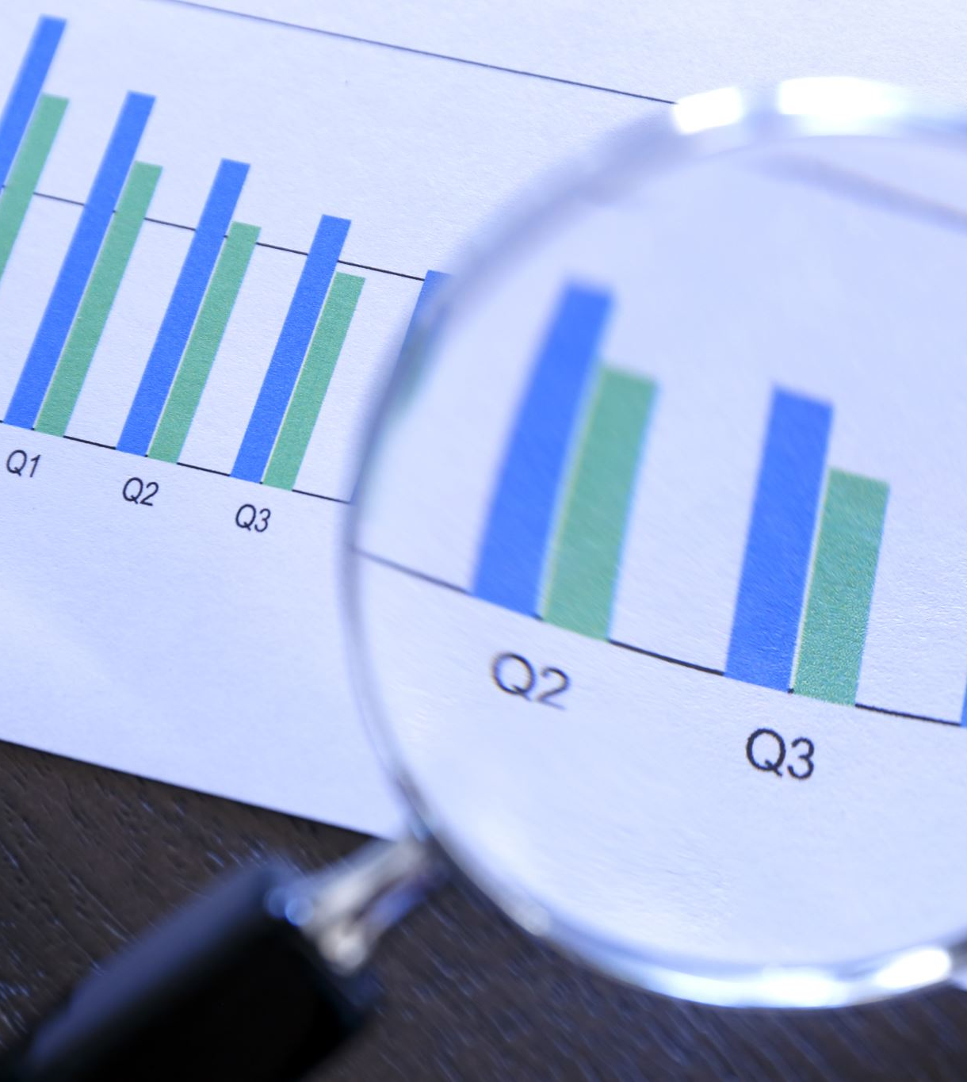

Syllabus
Recap: Time Serie Forecasting and Deep Learning Fundamentals
Introduction to convolutional neural networks (CNN)
Implementation of the models with the Keras Library

Slide 3
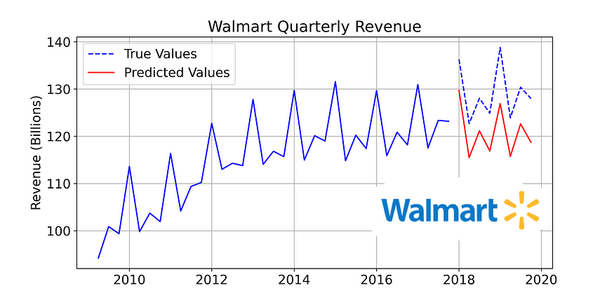
Time series data... quick recap
A univariate time series is a sequence of measurements of the same variable collected over time. Most often, the measurements are made at regular time intervals.
https://www.kaggle.com/code/anushkaml/walmart-time-series-sales-forecasting

Slide 4
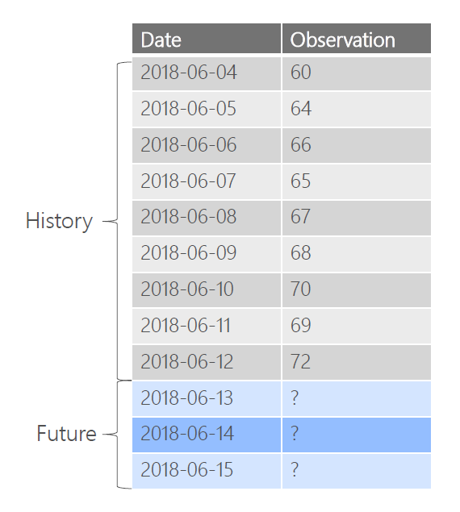
Time Series Forecasting
Predict Future (Values) based on the past (Historical Data)

Slide 5
Question to ask prior to forecast
Can we forecast?
How well we understand the factor influencing the future?
How much data we have?*
How far in the future (horizon) we want to forecast?
What technique, model should we use ?

Slide 6
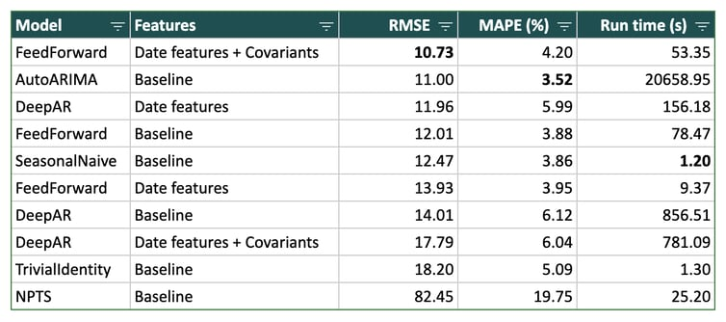
Why Deep Learning models? (1/2)
Deep learning model perform well and better than other methods in many scenarios.
https://blog.dataiku.com/deep-learning-time-series-forecasting
Z. Tang, P.A. Fishwik, Feedforward Neural Nets as Models for Time Series Forecasting, November 1993

Slide 7
Why Deep Learning models? (2/2)
Non-parametric
Flexible and expressive
Easily inject exogenous features into the model
Learn from large time series datasets

Slide 8

DEEP LEARNING
FUNDAMENTALS

Slide 9
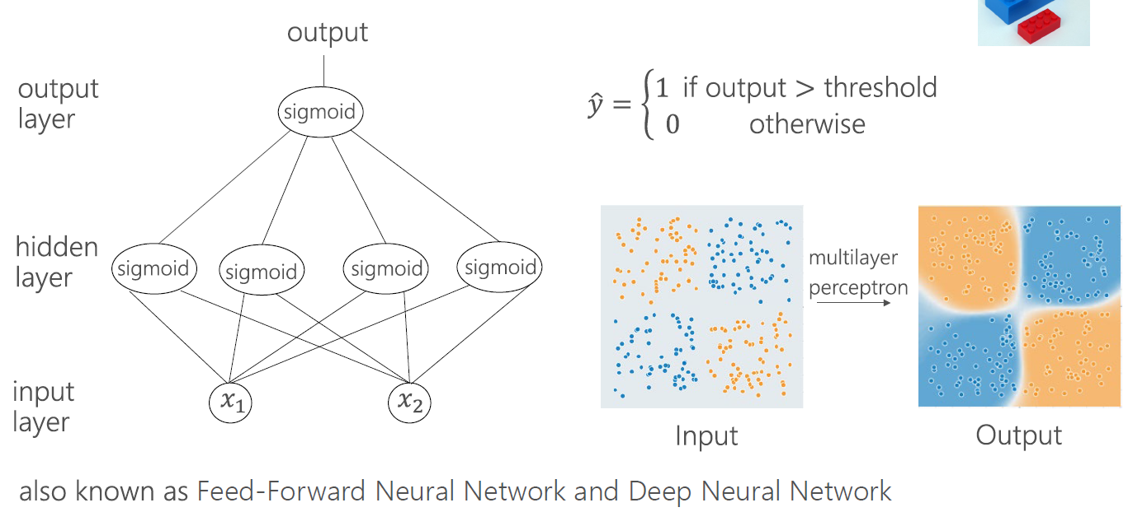
Multilayer Perceptron
Picture credits DeepLearningForTimeSeriesForecasting (Microsoft) https://github.com/Azure/DeepLearningForTimeSeriesForecasting

Slide 10
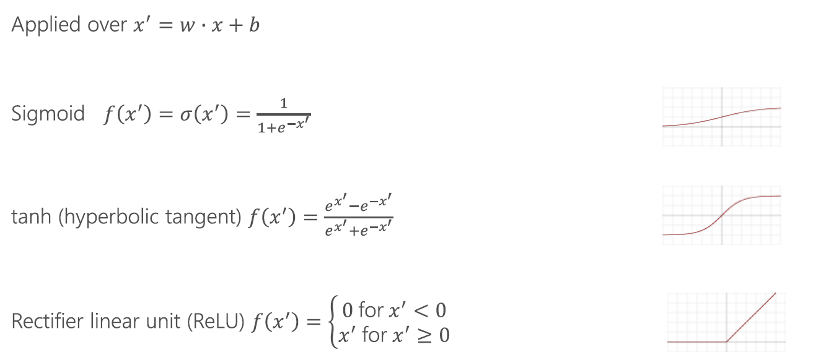
Activation Function

Slide 11



Training: overview
Main Idea: Use training example to find proper weights and biases.
Loss function L(Weights, biases) measure the discrepancy between predicted and true values
We want to optimize weight and biases to reduce the Loss.
$$L(w_{1}, w_{2})$$
$$w_{2}$$
$$w_{1}$$
Picture credits Andrew NG, Coursera

Slide 12
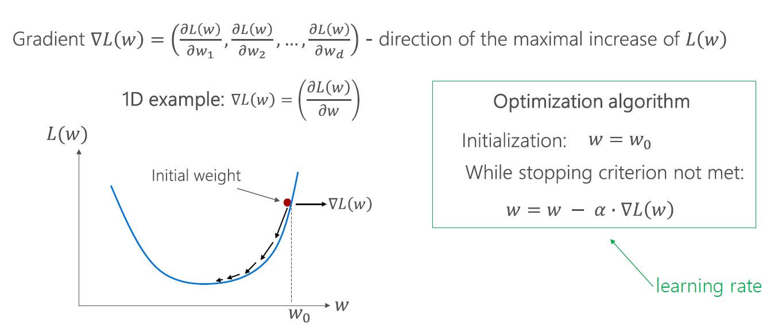
Optimization (batch) Gradient descent
Picture credits DeepLearningForTimeSeriesForecasting (Microsoft) https://github.com/Azure/DeepLearningForTimeSeriesForecasting

Slide 13
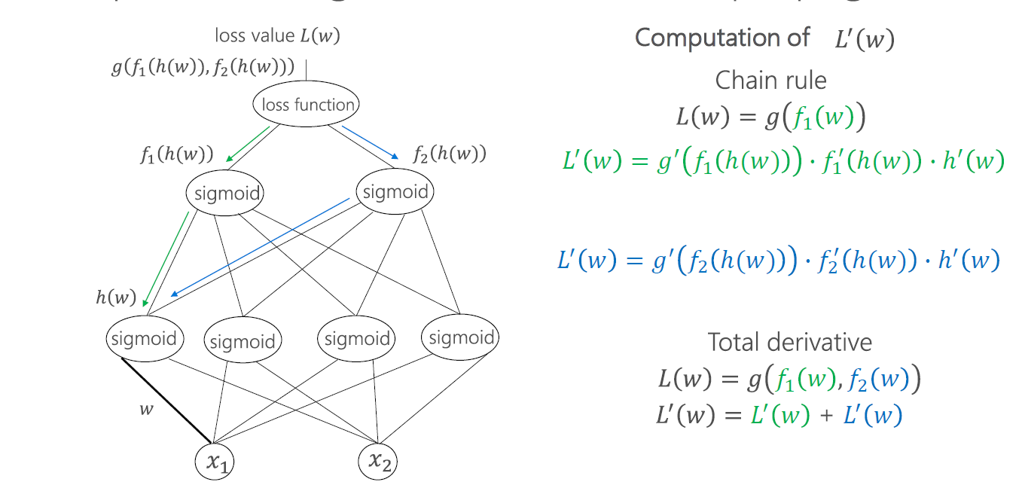
Gradients Computation: Backpropagation

Slide 14
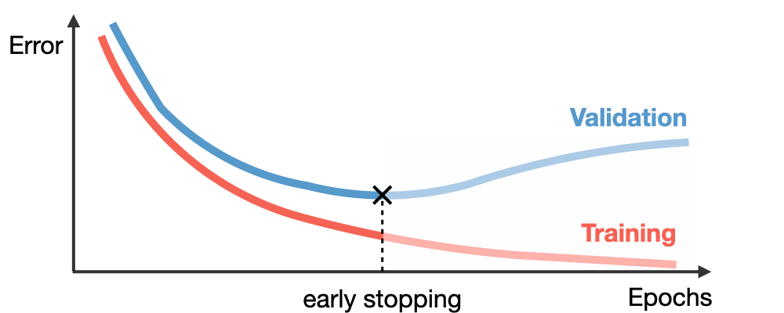
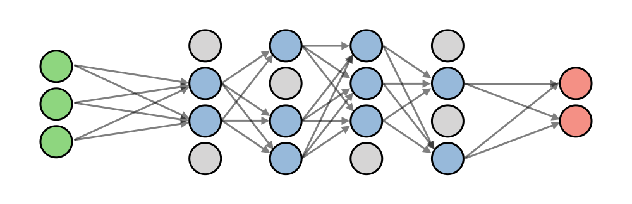
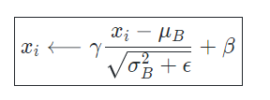
Training improvement strategy
Early stopping
Tuning hyperparameters
Initialization
Weight regularization
Dropout
Batch Normalization
Learning rate decay
https://stanford.edu/~shervine/teaching/cs-230/cheatsheet-deep-learning-tips-and-tricks

Slide 15
Convolutional neural networks (CNN)
for
Time series Forecasting

Slide 16
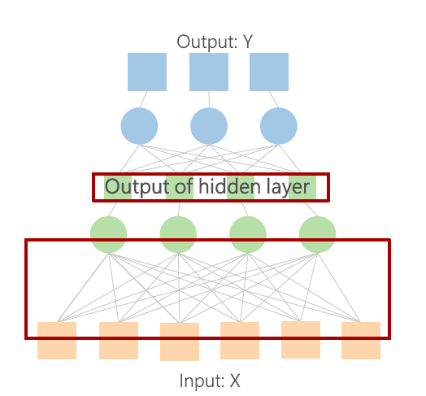
Fully connected VS Convolutional Layer
Fully Connected: Units in hidden layer are connected to every unit in previous layer.

Slide 17
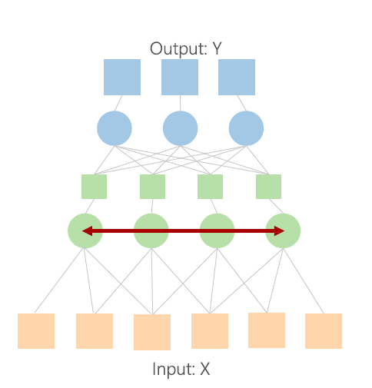
Fully connected VS Convolutional Layer
Convolutional Layer: Units in hidden operate on a field of the input (the weights are shared across the input)

Slide 18
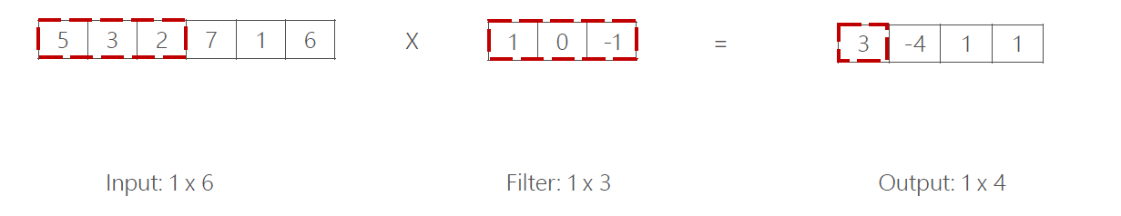
1D Convolution
Apply a 1D filter to all elements of an input time series.
Result: SUM of element-wise product
(5 x 1) + (3 x 0) + (2 x -1) = 3

Slide 19
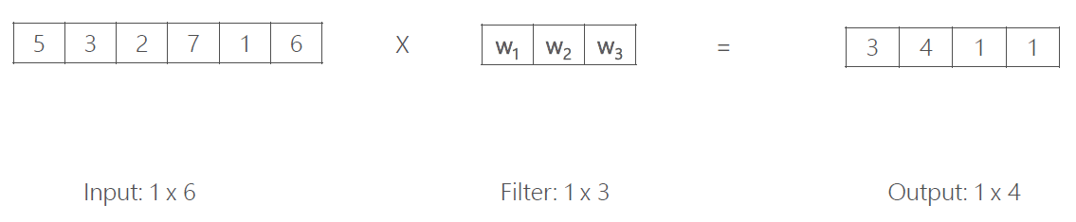
1D Convolution
Filters are trained to detect features in the input sequence.
Features can be detected regardless of where they appear in the input sequence.

Slide 20
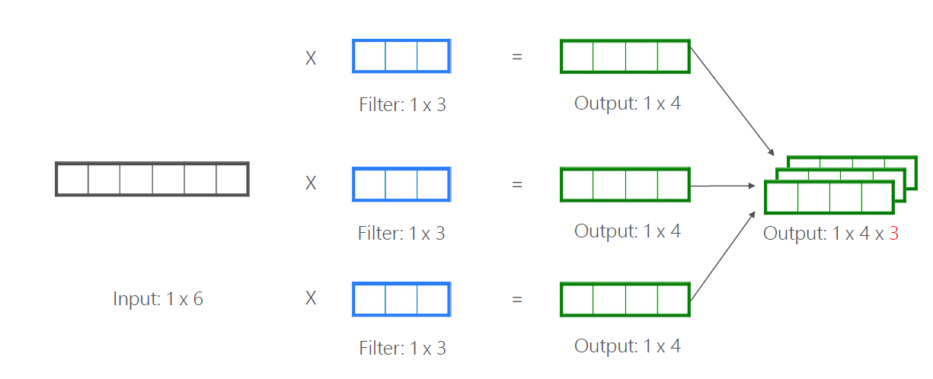
1D Convolution
Apply multiple filters to the input data to detect multiple features.

Slide 21
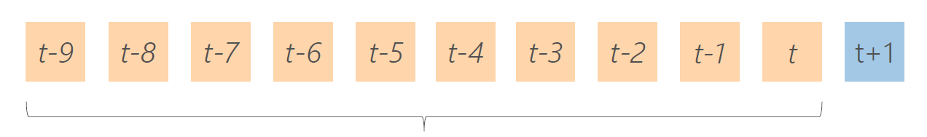
Apply CNN to forecasting time series
At time t :
predict the value at time t+1
Conditioned on the previous T values of the time series
T

Slide 22
Apply CNN to forecasting time series
At time t :
predict the value at time t+1
Conditioned on the previous T values of the time series
T = 10 --- Empirically selected

Slide 23
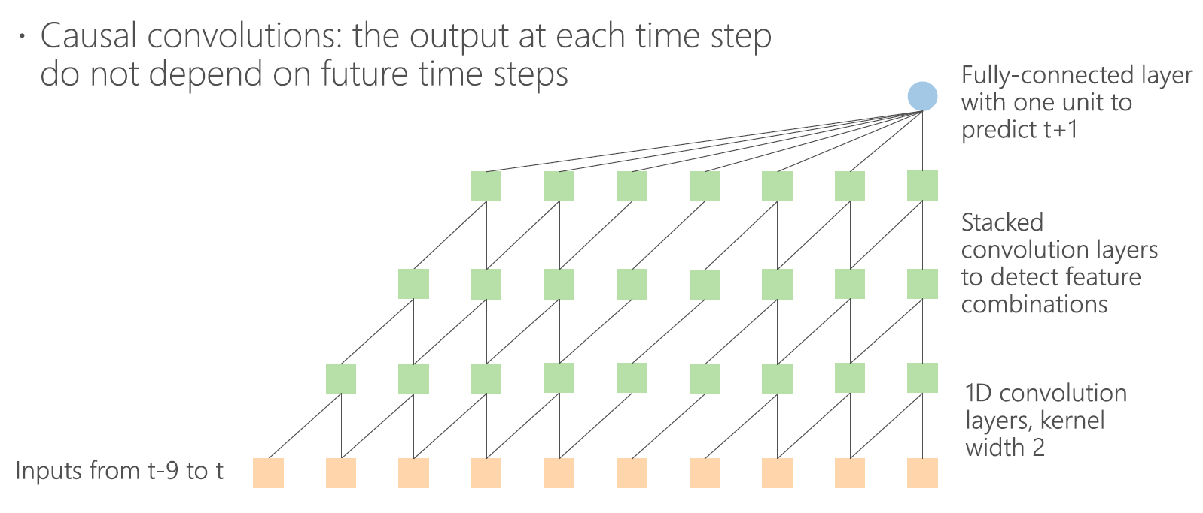
Apply CNN to forecasting time series

Slide 24
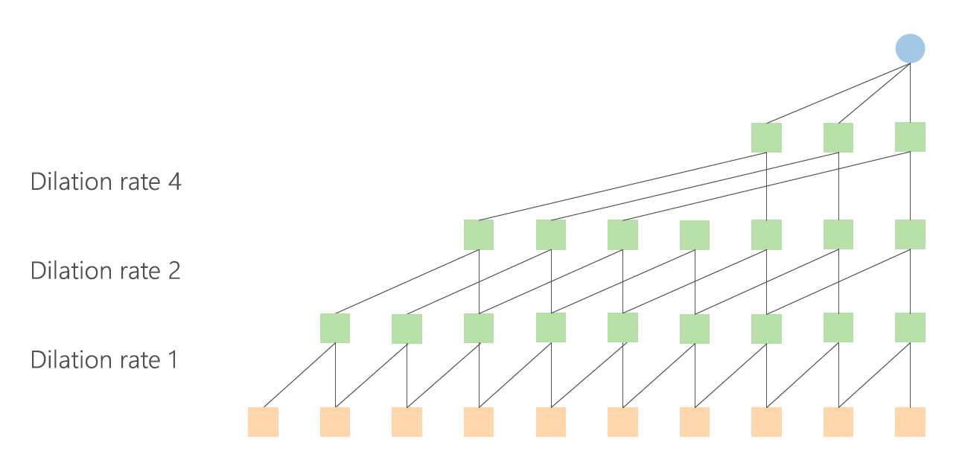
Dilated Convolutions
Skip output from previous layers

Slide 25
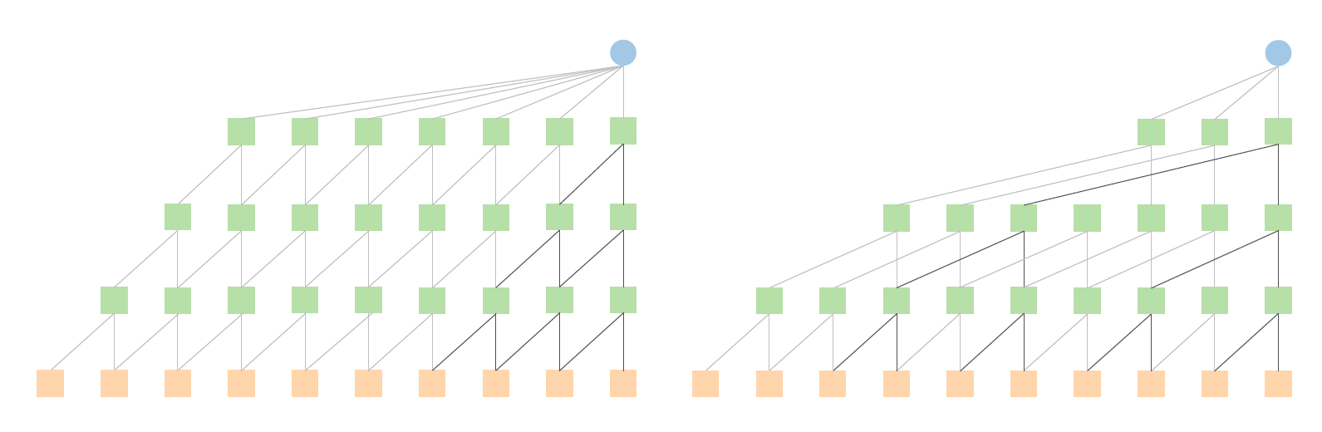
Dilated Convolutions
Normal convolution => more connections =>more weights to train
Reach information from more distant values in the time series (non contigous filter)

Slide 26
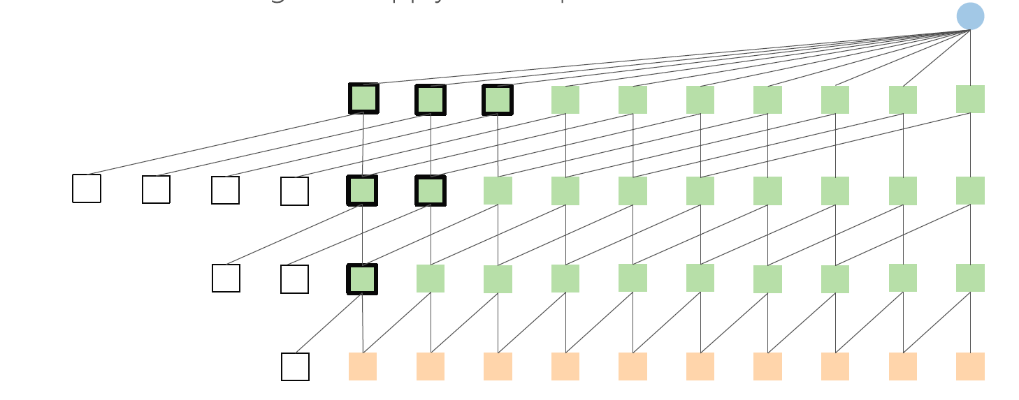
Causal padding
Padding is necessary to keep the right output dimensions

Slide 27
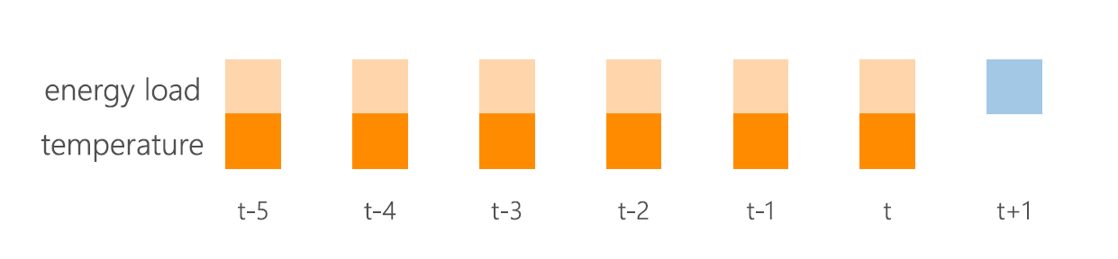
Multivariate Time Series Case
Time series with more than 1 variable evolving along time (aka covariates)
Example

Slide 28
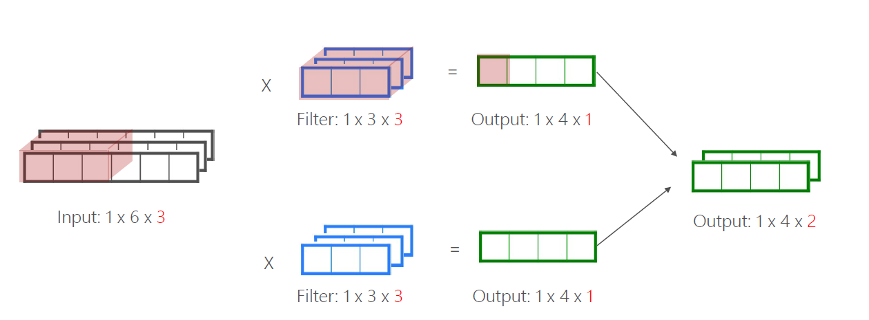
Multivariate Time Series
Feature extraction with multiple filters (per dimension)

Slide 29
Convolutional neural networks (CNN)
with Keras

Slide 30
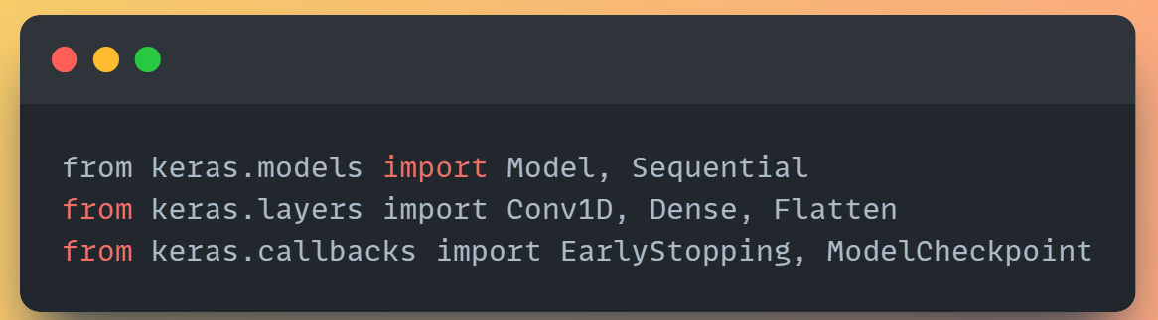
Imports the KERAS modules (NN components)
https://keras.io/

Slide 31
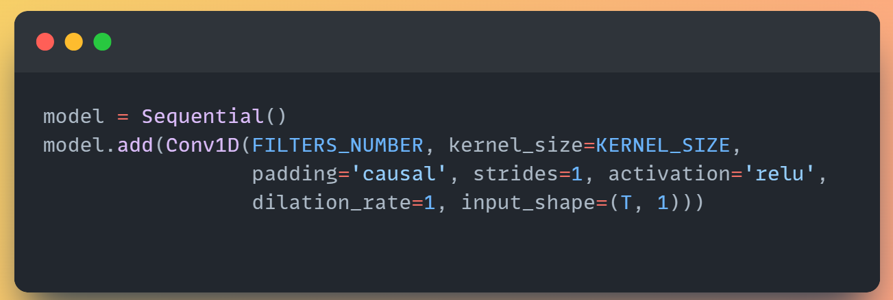
KERAS – 1D convolutional filter
TIME SERIES PAST VALUE WINDOW (T)
https://keras.io/api/layers/convolution_layers/convolution1d/

Slide 32
KERAS – 1D convolutional filter
# TIME SERIES variable (1 = univariate case)
https://keras.io/api/layers/convolution_layers/convolution1d/

Slide 33
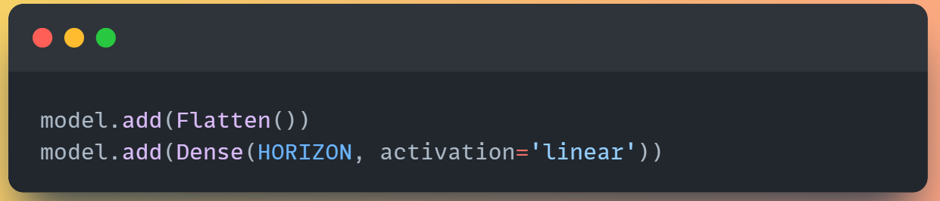
Do not forget…flatten + dense layer for the final prediction
Number of predictions
https://keras.io/api/layers/reshaping_layers/flatten/
https://keras.io/api/layers/core_layers/dense/

Slide 34
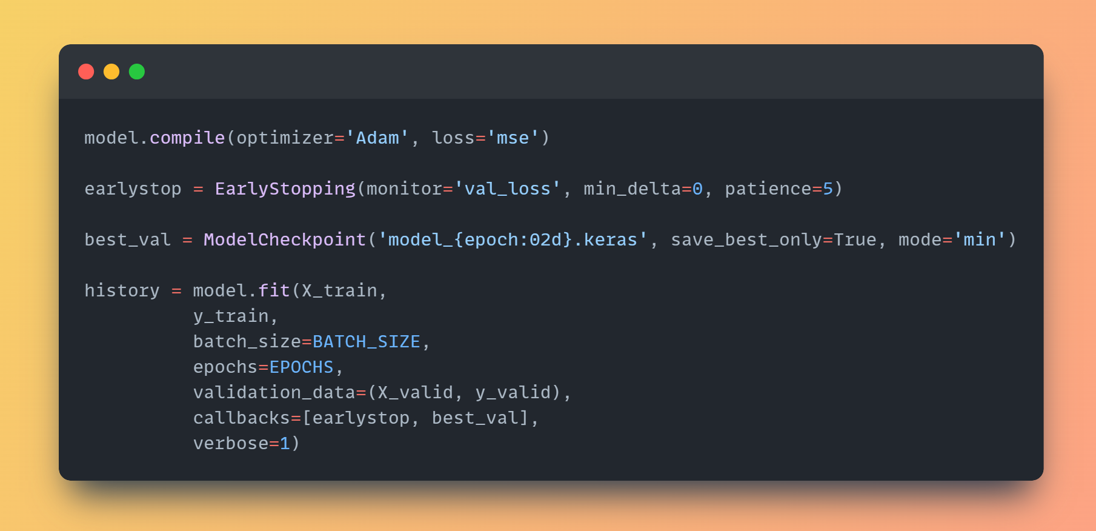
Early stopping + best model save + training
https://keras.io/api/models/model_training_apis/
https://keras.io/api/callbacks/early_stopping/

Slide 35

Presentation du TD

Slide 36
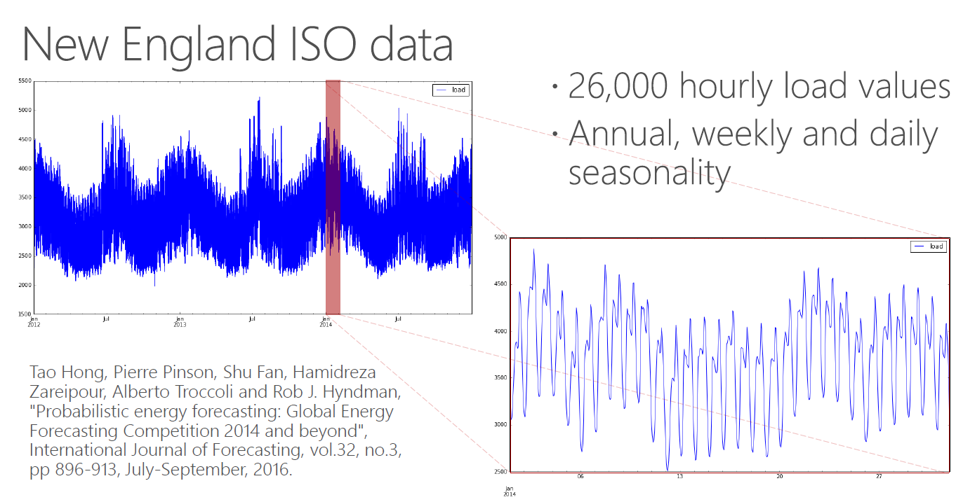
Data

Slide 37
Notebook
Open the file (Python Notebook):
TD_CNN_dilated_TS_FORECASTING.ipynb
Instruction are contained in the notebook

Slide 38


References
https://stanford.edu/~shervine/teaching/cs-230/cheatsheet-deep-learning-tips-and-tricks
DeepLearningForTimeSeriesForecasting (Microsoft) https://github.com/Azure/DeepLearningForTimeSeriesForecasting
Ben Auffarth Machine Learning for Time-Series with Python
https://github.com/PacktPublishing/Machine-Learning-for-Time-Series-with-Python/tree/main/chapter10

