Slide 1

Time Series Management
Michele Linardi Ph.D.
michele.linardi@orange.fr

Slide 2
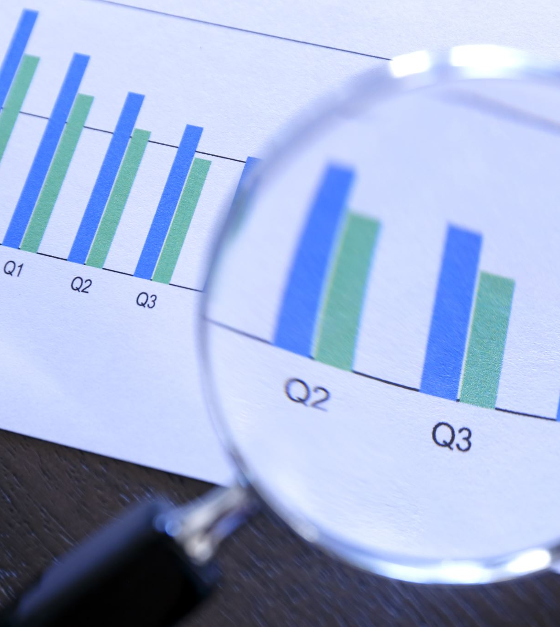

Syllabus
Recap: Time Serie Forecasting and Deep Learning Fundamentals
Introduction to convolutional neural networks (CNN)
Introduction to recurrent neural networks (RNN)
Encoder-decoder RNN model
Implementation of the models with the Keras Library

Slide 3
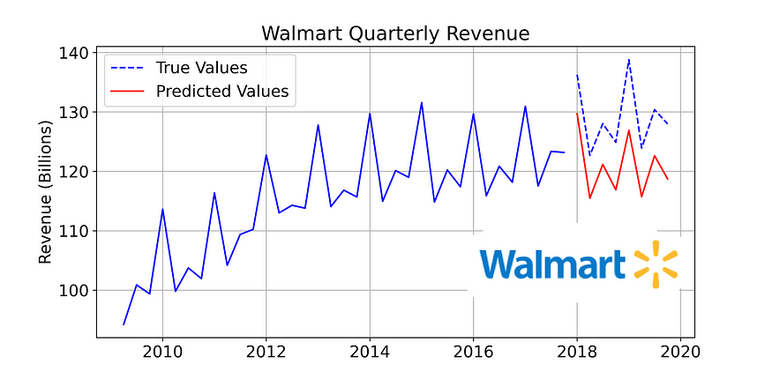
Time series data... quick recap
A univariate time series is a sequence of measurements of the same variable collected over time. Most often, the measurements are made at regular time intervals.
https://www.kaggle.com/code/anushkaml/walmart-time-series-sales-forecasting

Slide 4
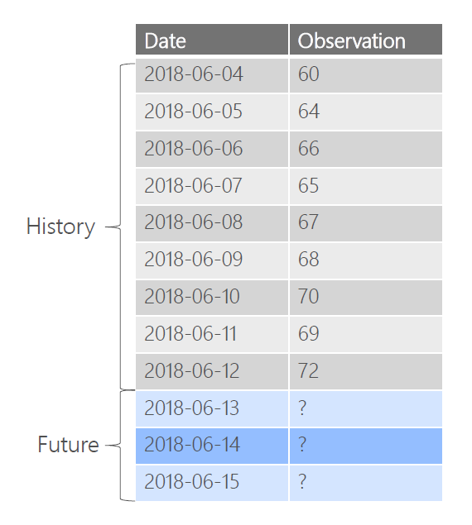
Time Series Forecasting
Predict Future (Values) based on the past (Historical Data)

Slide 5
Question to ask prior to forecast
Can we forecast?
How well we understand the factor influencing the future?
How much data we have?*
How far in the future (horizon) we want to forecast?
What technique, model should we use ?

Slide 6
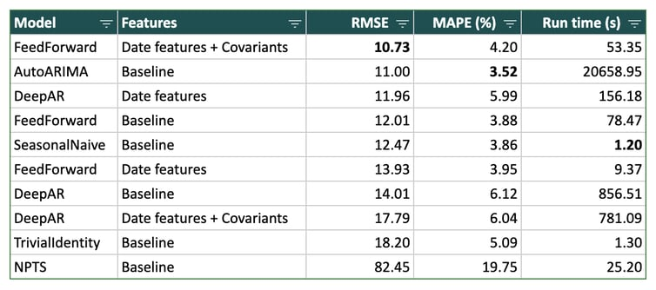
Why Deep Learning models? (1/2)
Deep learning model perform well and better than other methods in many scenarios.
https://blog.dataiku.com/deep-learning-time-series-forecasting
Z. Tang, P.A. Fishwik, Feedforward Neural Nets as Models for Time Series Forecasting, November 1993

Slide 7
Why Deep Learning models? (2/2)
Non-parametric
Flexible and expressive
Easily inject exogenous features into the model
Learn from large time series datasets

Slide 8

Recurrent Neural Network (RNN)
for
Time series Forecasting

Slide 9
Roadmap
What are RNNs?
How RNNs are trained: Backpropagation through time (BPTT).
Vanilla RNN and its gradient problems.
Other RNN units.
RNN architectures:
GRU
LSTM
RNN stacking
RNN for one step time series forecasting
Encode-decoder RNN for multi-step time series forecasting

Slide 10
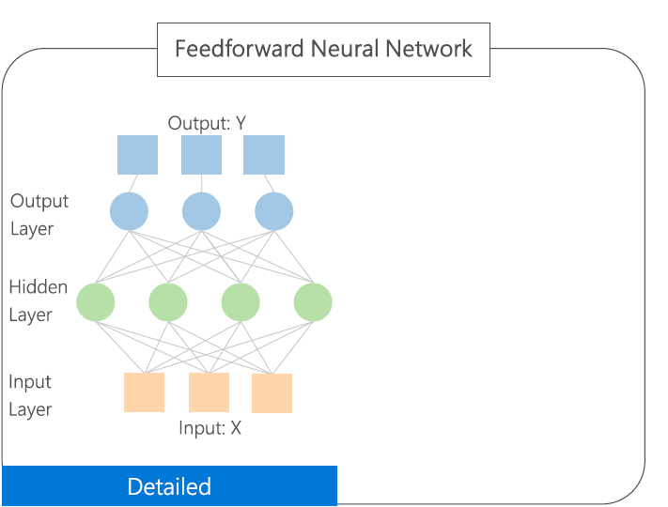
Recurrent Neural Networks (RNN)

Slide 11
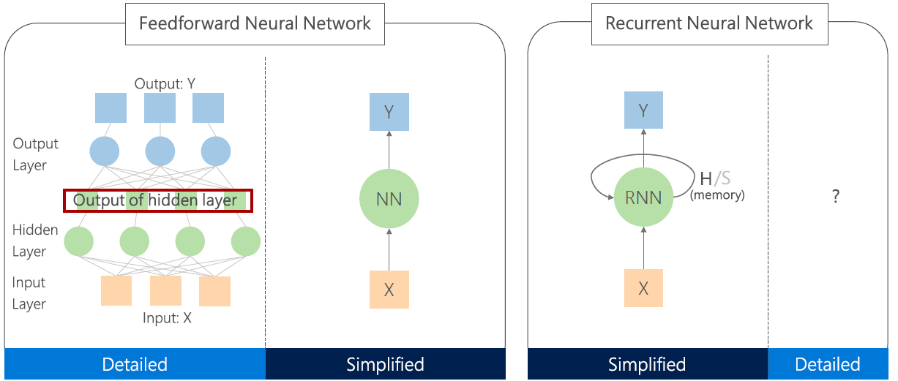
Recurrent Neural Networks (RNN)
RNN has an internal state (H), which can be fed back to the network

Slide 12
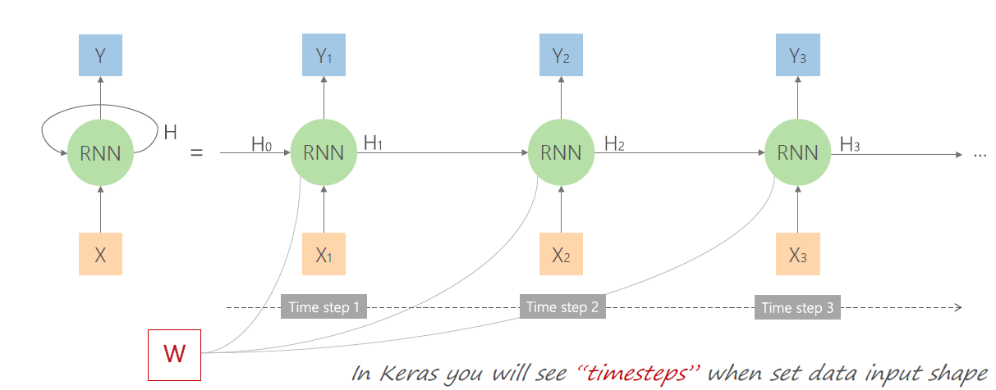
Recurrent Neural Networks (RNN)
The same weight and bias shared across all the network steps
RECURRENT LAYER

Slide 13
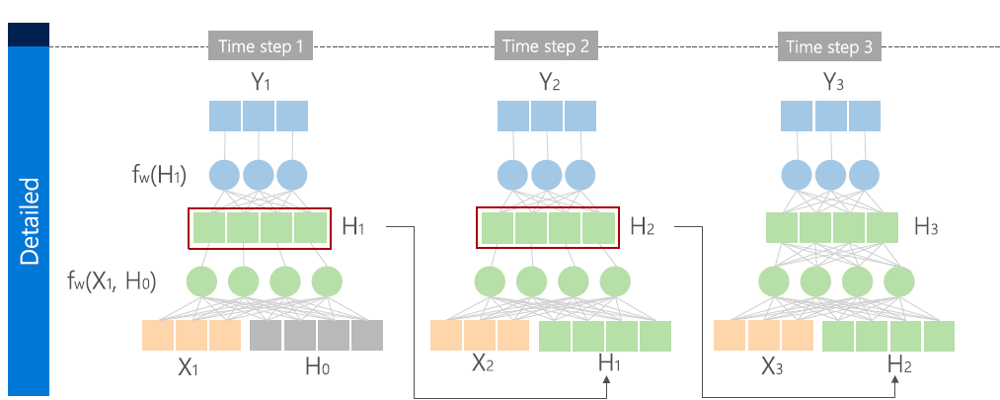

RNN – First Complete Picture
Internal state ( a.k.a. Hidden state at time t $H_{t}∈ℝ^{u}) u≔units$

Slide 14
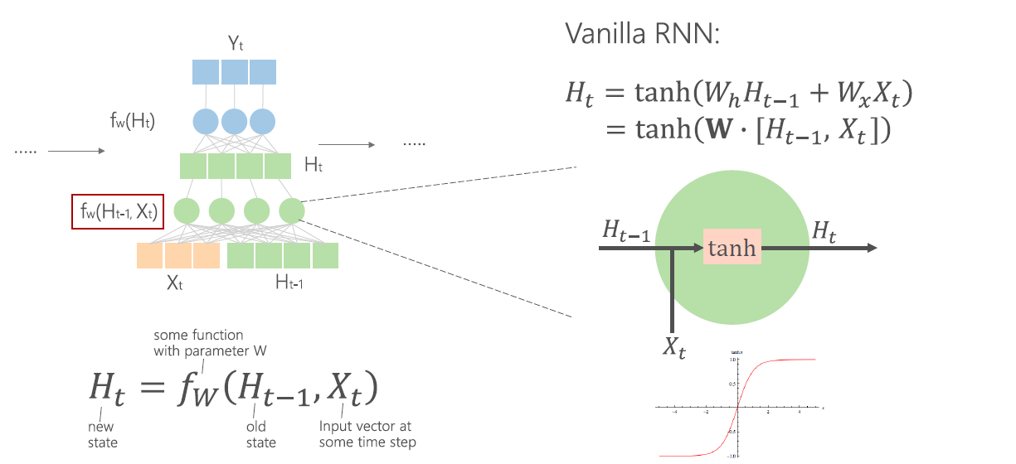
Vanilla RNN Unit

Slide 15
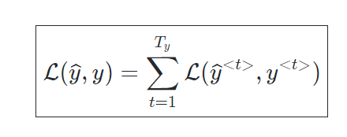
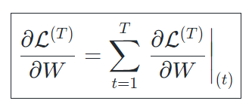
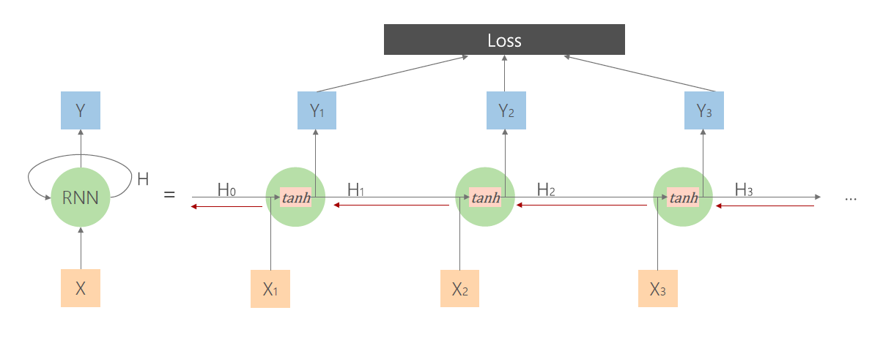
Back propagation (through time) of Hidden states

Slide 16
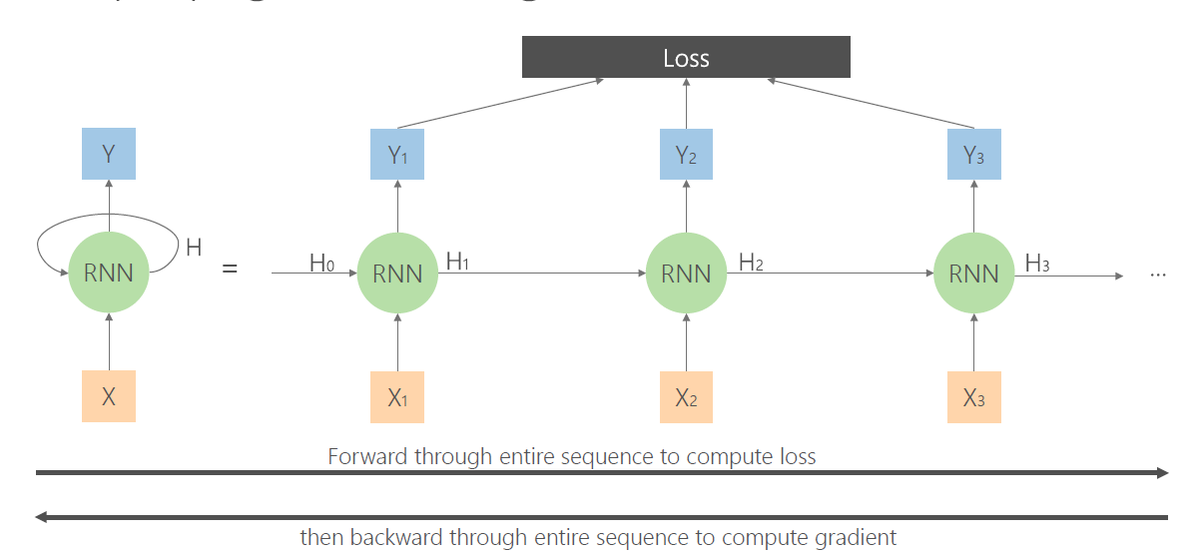
RNN - Backpropagation

Slide 17
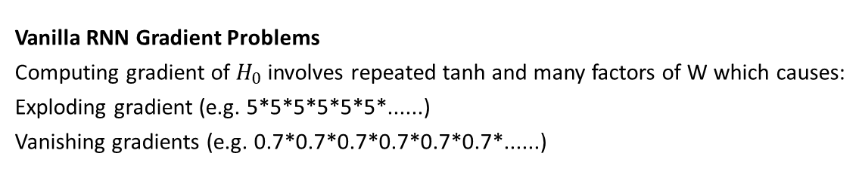
Back propagation of Hidden states
Vanilla RNN Gradient Problems
Computing gradient of $H_{0}$ involves repeated tanh and many factors of W which causes:
Exploding gradient (e.g. 5*5*5*5*5*5*......)
Vanishing gradients (e.g. 0.7*0.7*0.7*0.7*0.7*0.7*......)

Slide 18
Explosion of the gradient (e.g. 5*5*5*5*5*5*......)
Exploding gradients are obvious:
Your gradients will become a large number (e.g., NaN (not a number))
Solution: Gradient clipping
Clip the gradient when it goes higher than a threshold

Slide 19
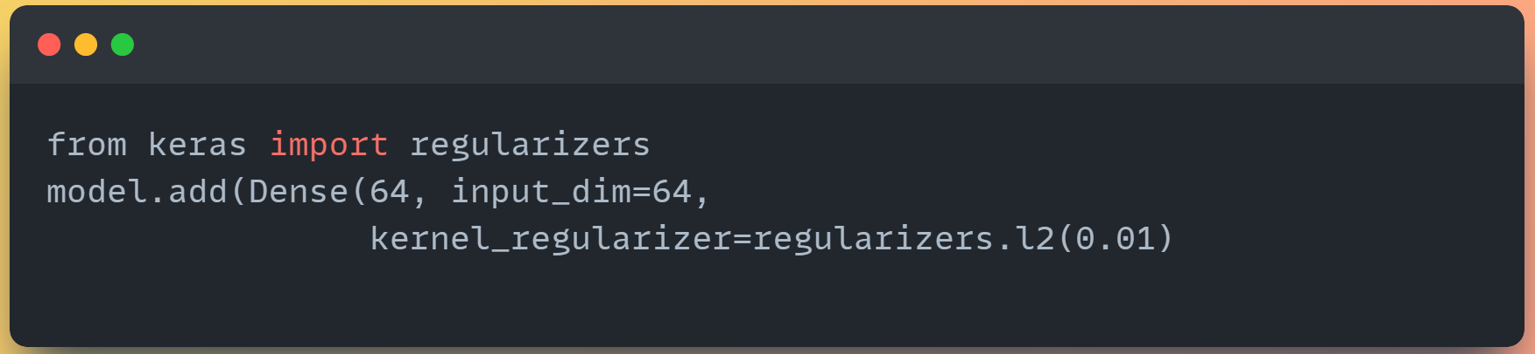
Gradient Vanishing (e.g. 0.7*0.7*0.7*0.7*0.7*0.7*......)
Vanishing gradients are more problematic because it's not obvious when they occur or how to deal with them.
Solutions:
Change activation function to ReLU
Proper initialization
Regularization := [ Cost function = Loss + Regularization terms]
Change architecture to LSTM or GRU
https://keras.io/api/layers/regularizers/

Slide 20
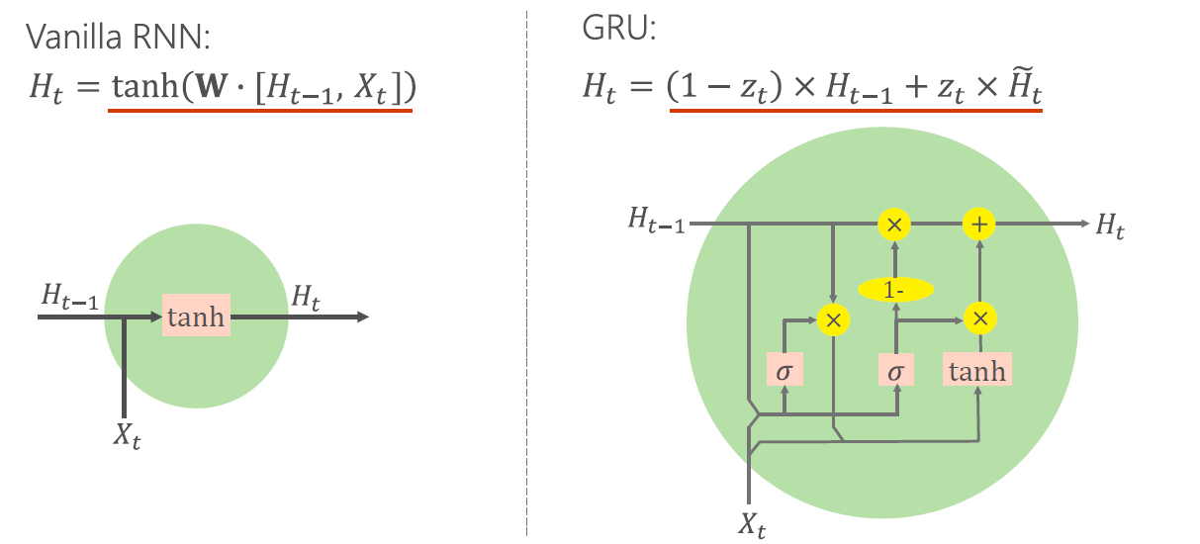
Gated Recurrent Unit (GRU)

Slide 21
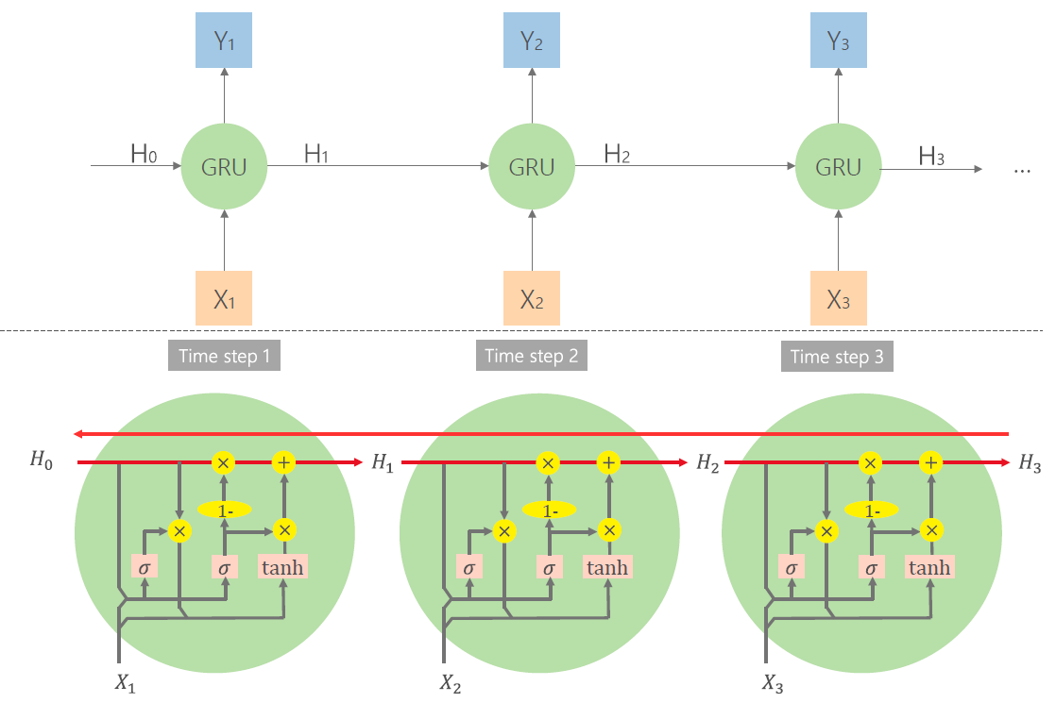
Uninterrupted gradient flow
State runs straight through the entire chain with minor linear interactions which makes information very easy to pass.

Slide 22
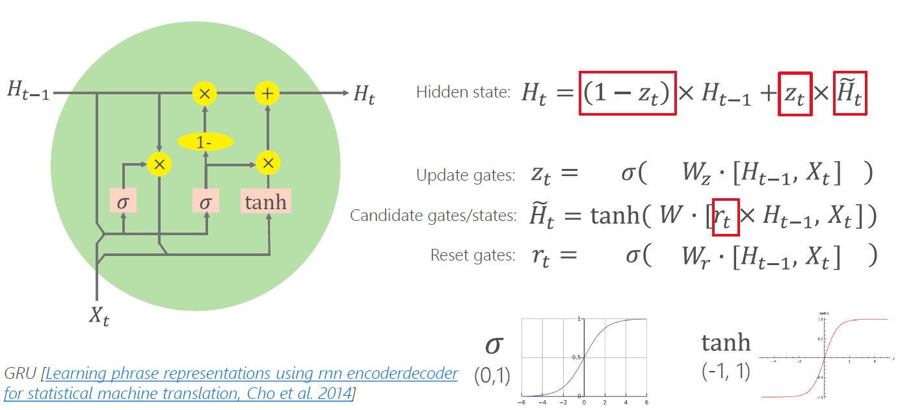
Gated Recurrent Unit (GRU)

Slide 23
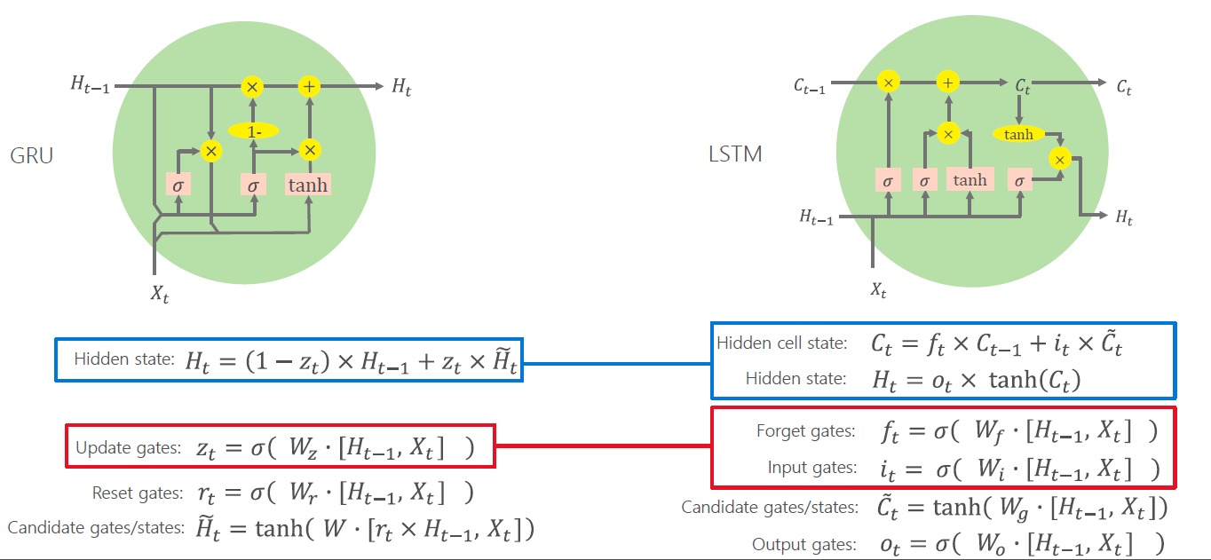
GRU vs LSTM (Long short-term memory) cell

Slide 24
GRU vs LSTM (Long short-term memory) cell
How much of the candidate activation vector to incorporate into the new hidden state

Slide 25
GRU vs LSTM (Long short-term memory) cell
It determines how much of the previous hidden state to forget

Slide 26
GRU vs LSTM (Long short-term memory) cell
It combines information from the input and the previous hidden state

Slide 27
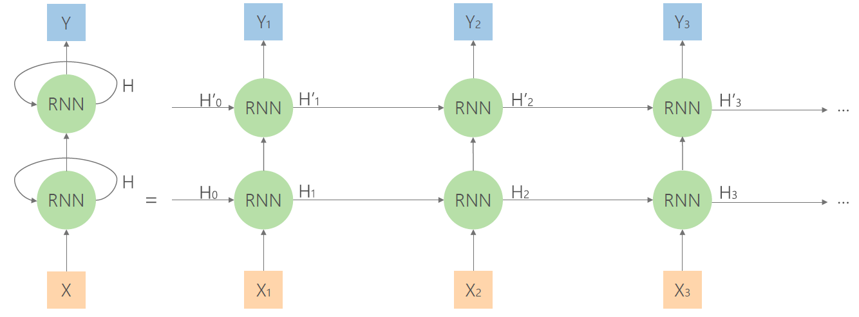
Cells Stacking
To learn more complex relationships, we can stack multiple cells

Slide 28
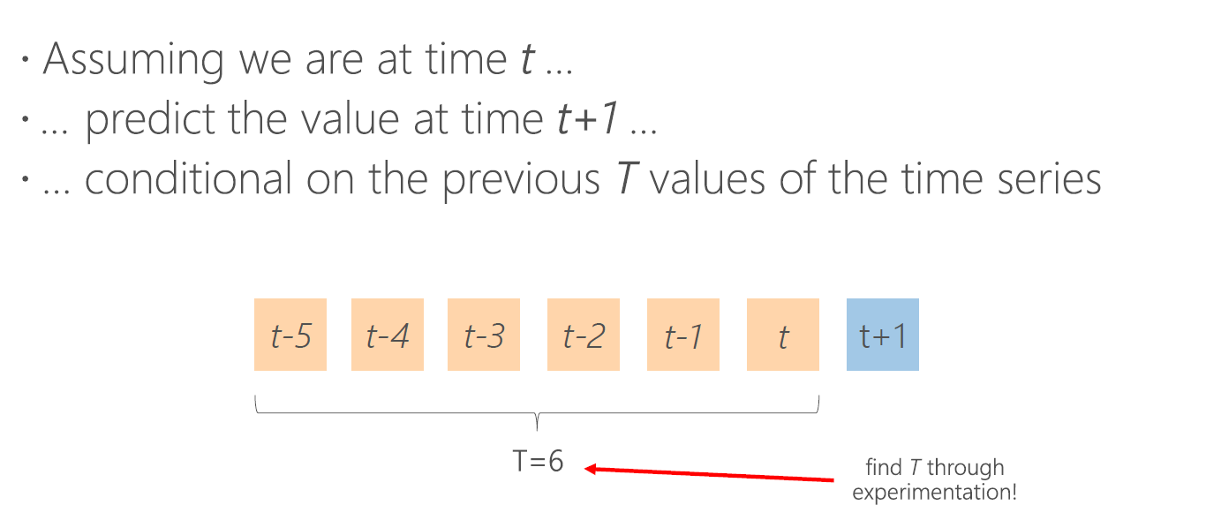
One step forecasting (HORIZON = 1)

Slide 29
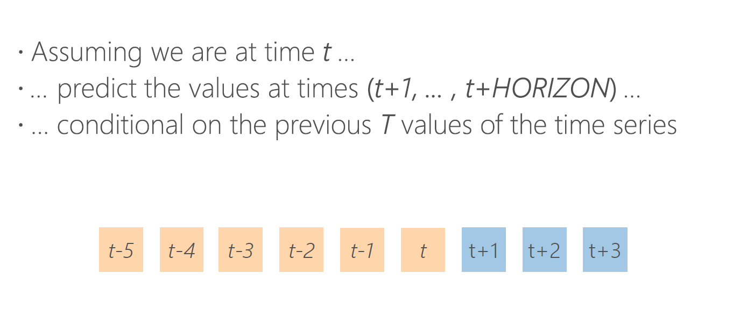
Multi-step forecast

Slide 30
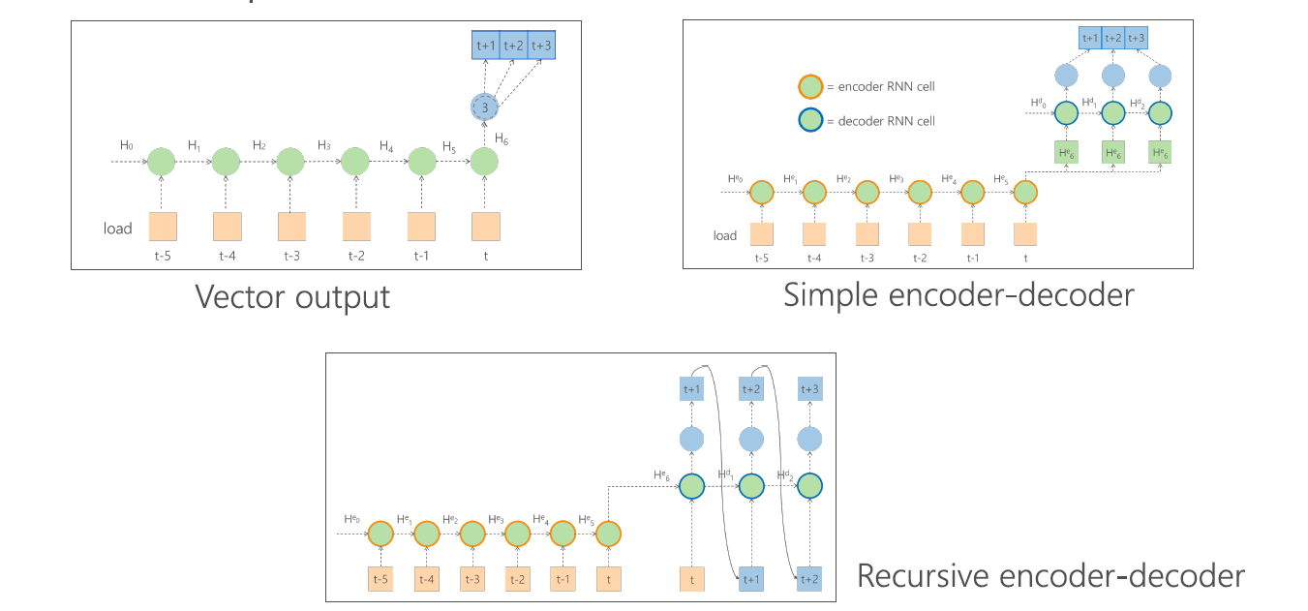
Multi-step forecast

Slide 31
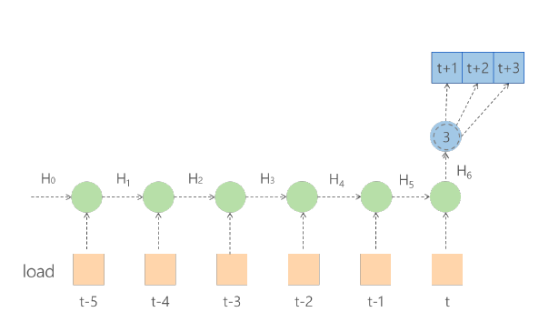
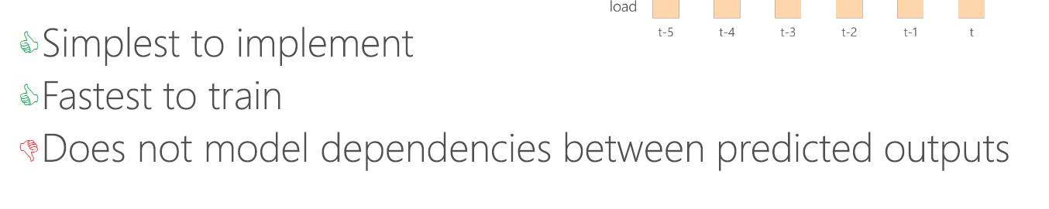
Vector Output

Slide 32
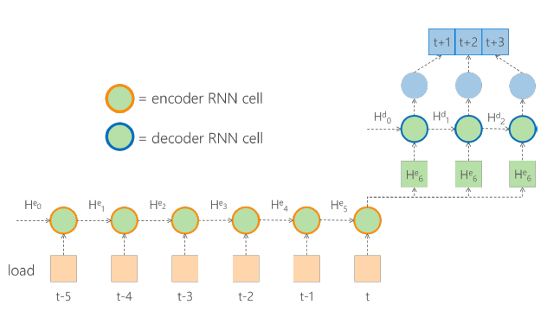
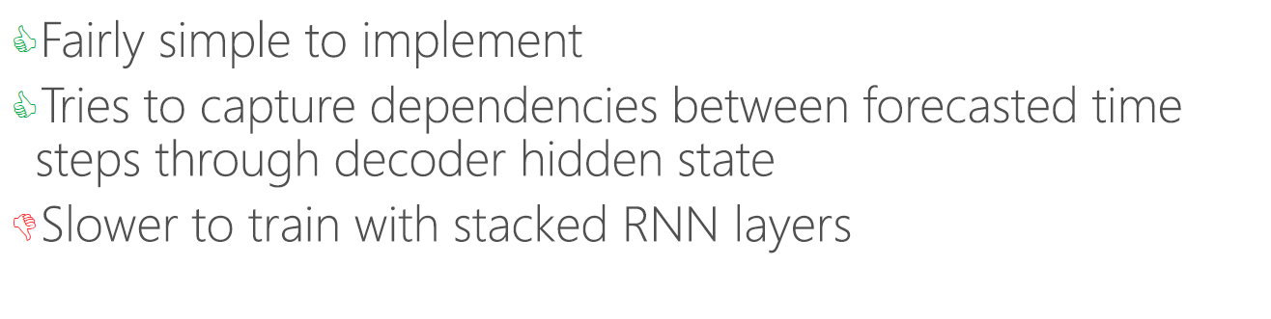
Simple Encoder - Decoder

Slide 33
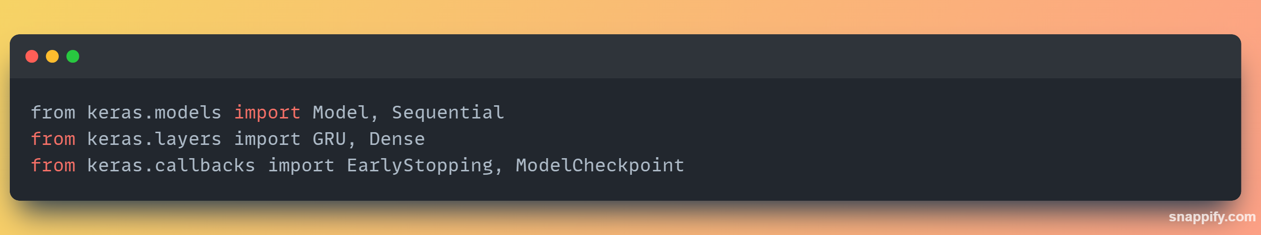
Import in Keras

Slide 34
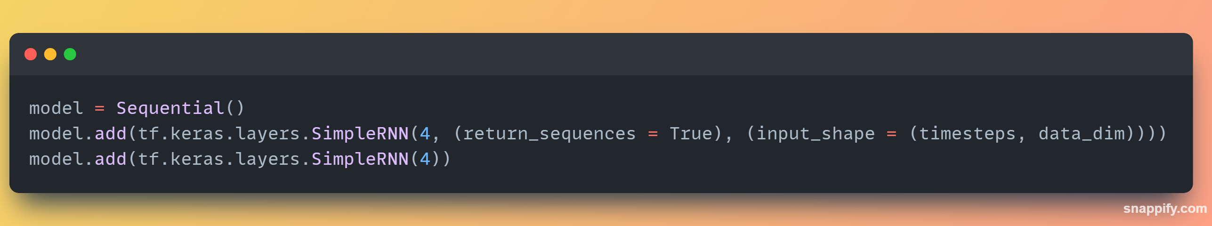

Cells Stacking
To learn more complex relationships, we can stack multiple cells

Slide 35
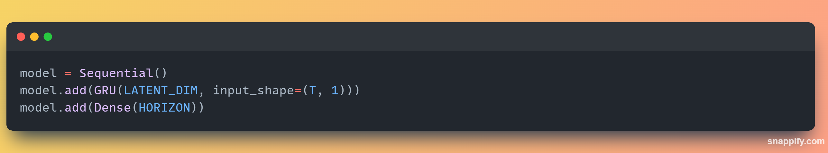
The GRU layer – 1D time series
https://keras.io/api/layers/recurrent_layers/gru/

Slide 36
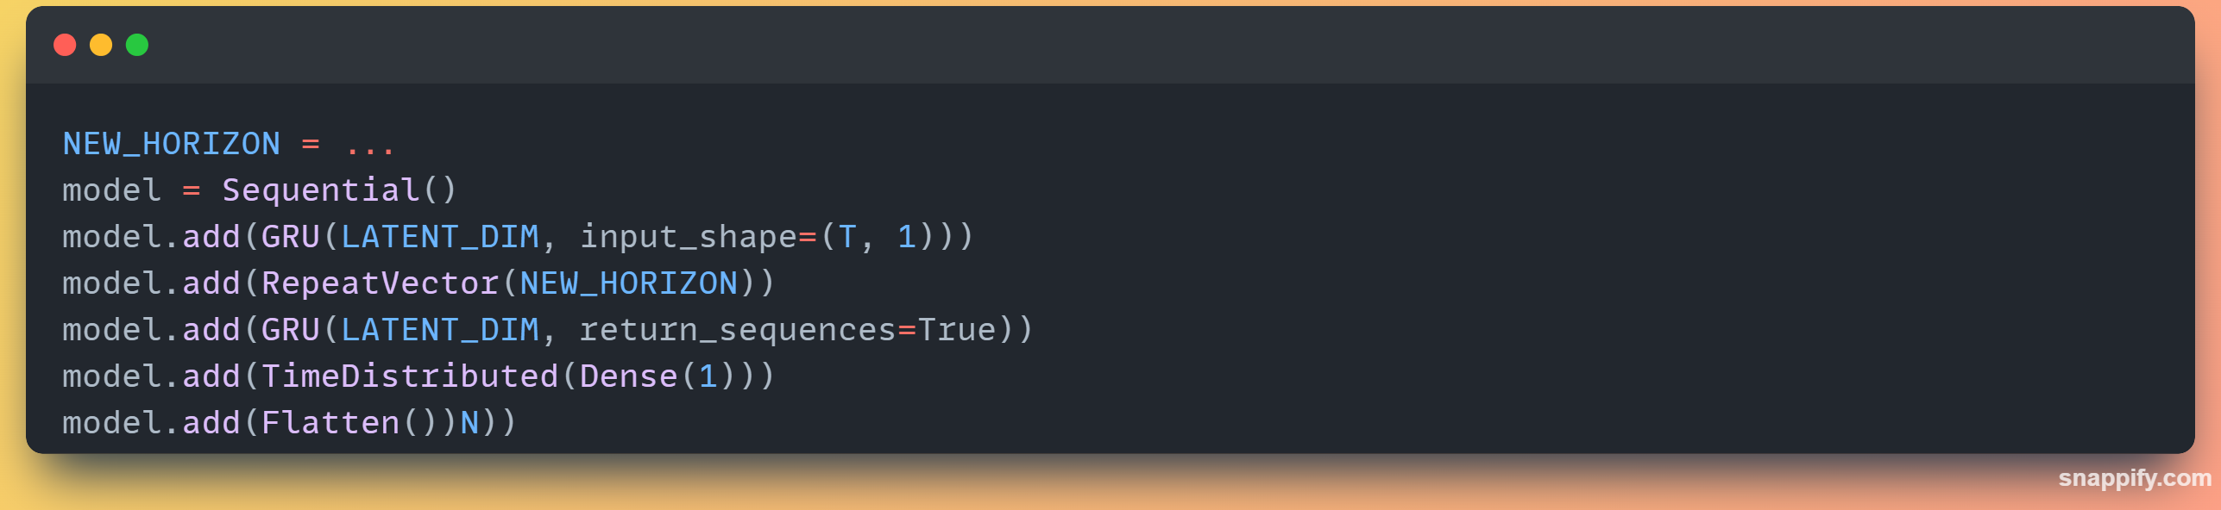
Multistep forecast architecture 1D time series
https://keras.io/api/layers/reshaping_layers/repeat_vector/
https://keras.io/api/layers/recurrent_layers/time_distributed/

Slide 37

Presentation du TD

Slide 38
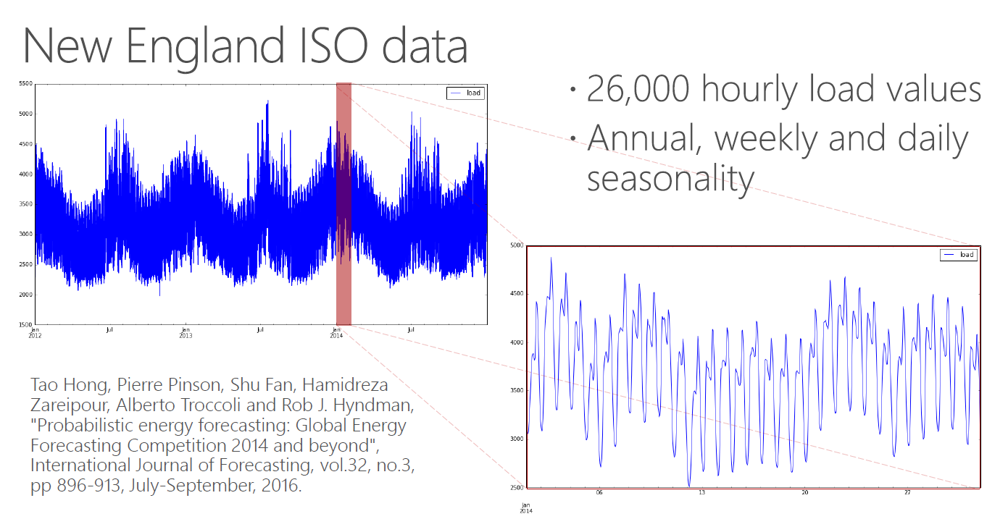
Data

Slide 39
Notebook
Open the file (Python Notebook):
TD_RNN_TS_FORECASTING.ipynb
Instruction are contained in the notebook

Slide 40


References
https://stanford.edu/~shervine/teaching/cs-230/cheatsheet-recurrent-neural-networks
DeepLearningForTimeSeriesForecasting (Microsoft) https://github.com/Azure/DeepLearningForTimeSeriesForecasting
Ben Auffarth Machine Learning for Time-Series with Python
https://github.com/PacktPublishing/Machine-Learning-for-Time-Series-with-Python/tree/main/chapter10

