Slide 1

Time Series Management
Michele Linardi Ph.D.
michele.linardi@orange.fr

Slide 2

Syllabus
Time series data mining
Motif primitive
Discord (Outlier)
Matrix profile Algorithm
Algorithm Python code DEMO

Slide 3
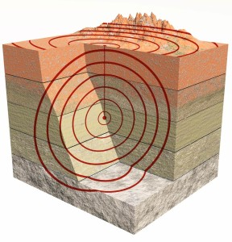
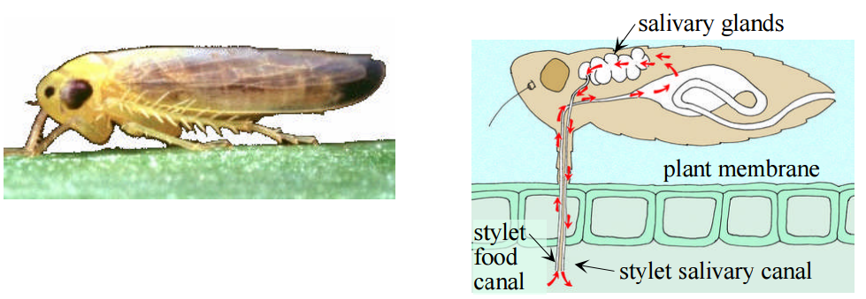
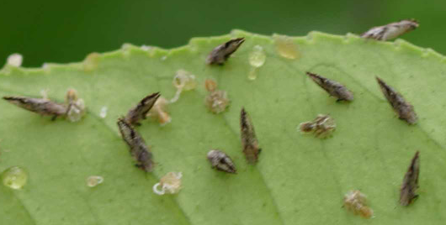
Time Series Motifs
Motif discovery is one of the most useful primitives for data series mining
Given a time series T, a motif is the pair of subsequences of length ℓ with the smallest Euclidean distance.
ℓ
ℓ
T
Stylet passage motif
Asian citrus psyllid
Voltage Source
ℓ
T

Slide 4

Time Series Discords
Discords are used to detect anomalous/interesting patterns
usually represent the most unusual subsequences within a time series
Given a time series T, a discord is the subsequence of length ℓ that has the largest Euclidean distance to its nearest neighbor.
T
ℓ

Slide 5
Matrix Profile - Motif and Discord Discovery
T
j^{th}
T
d_{1,1} | d_{1,2} | … | … | … | d_{1,n-m+1}
d_{2,1} | d_{2,2} | … | … | … | d_{2,n-m+1}
… | … | … | … | … | …
d_{i,1} | d_{i,2} | … | d_{i,j} | … | d_{i,n-m+1}
… | … | … | … | … | …
d_{n-m+1,1} | d_{n-m+1,2} | … | … | … | d_{n-m+1,n-m+1}
Distance Matrix: a symmetric matrix, which contains the pairwise subsequences (of length m) distances in T.
Excluding Trivial matches : = distances of any sequence pair having indexes (e.g., i and j) closer than a given threshold
i^{th}
Min(D₁)
Min(D₂)
Min(D_{i})
Min(D_{n-m+1})
P₁ | P₁ | … | … | ... | P_{n-m+1}
Matrix Profile: a vector of distance between each subsequence and its nearest neighbor

Slide 6
Matrix Profile - Motif and Discord Discovery
data series
matrix profile
A pair of minimum points identifies the Motif

Slide 7
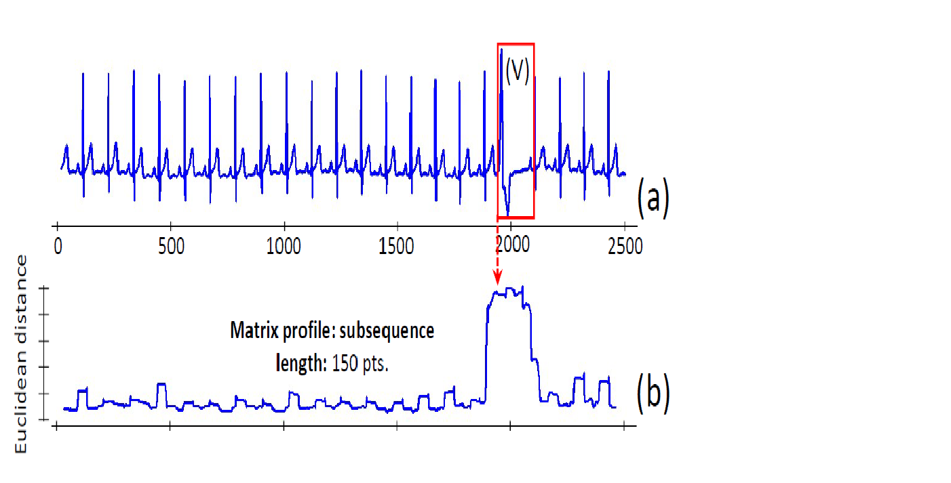
Matrix Profile - Motif and Discord Discovery
Highest Matrix Profile value identifies Discord

Slide 8
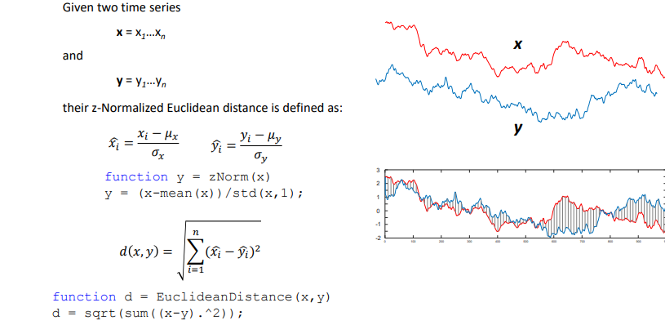
Euclidean distance metrics

Slide 9
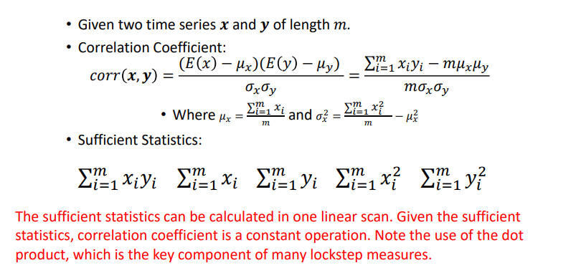
Pearson correlation coefficient

Slide 10
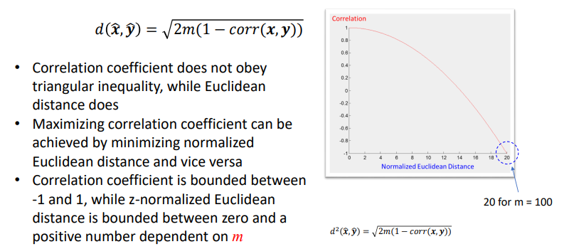
Correlation – Euclidean Distance relationship
Z-normalized Euclideand distance
m := number of data points

Slide 11
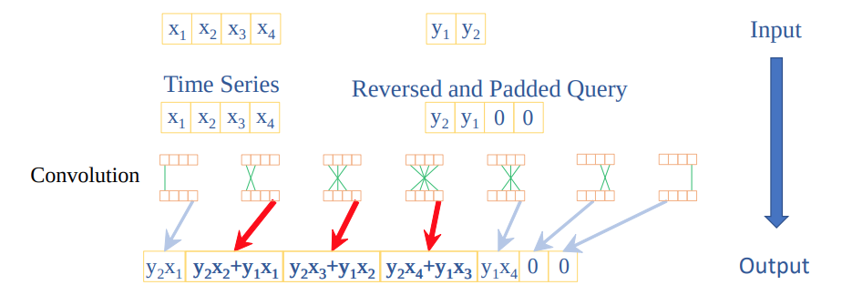
Mueen’s Algorithm for Similarity Search (MASS)
MASS uses a convolution based method to calculate sliding dot products in 𝑂(𝑛 log 𝑛)
Convolution: If x and y are vectors of polynomial coefficients, convolving them is equivalent to multiplying the two polynomials.
We can use convolution to compute all of the sliding dot products between the query and sliding windows.
Convolution can be computed in the frequency domain, using the Fast Fourier Transform.

Slide 12
Matrix profile algorithm – STOMP (1/6) Scalable Time series Ordered Matrix Profile
O(n²) time, O(n) space algorithm to compute the matrix profile.

Slide 13
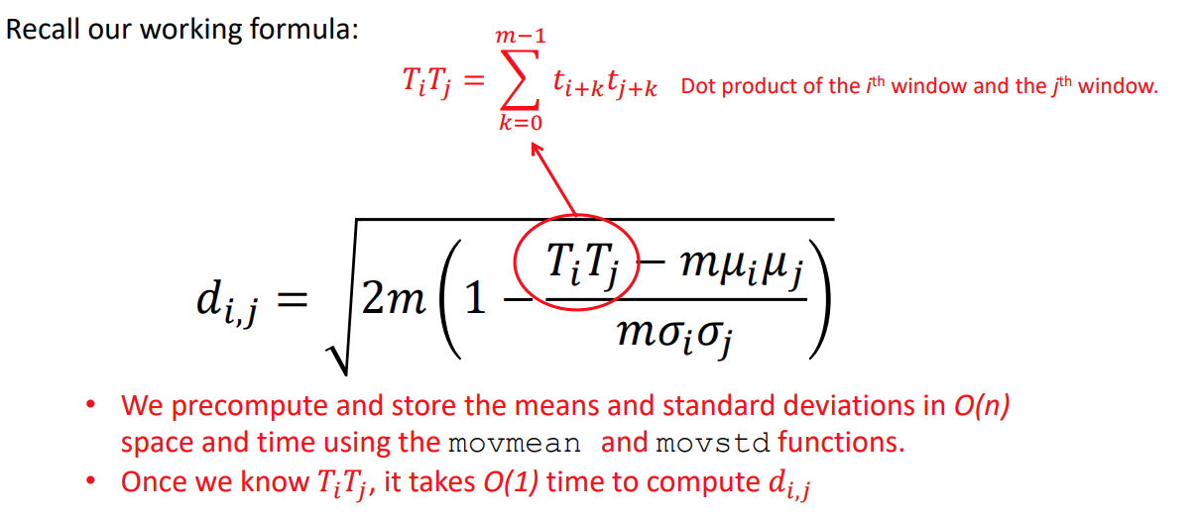
Matrix profile algorithm – STOMP (2/6) Scalable Time series Ordered Matrix Profile
Z-normalized Euclideand distance
m := number of data points
We can precompute and store the means and standard deviations in O(n) space and time
Once we know Ti,Tj , it takes O(1) time to compute the distance di,j

Slide 14
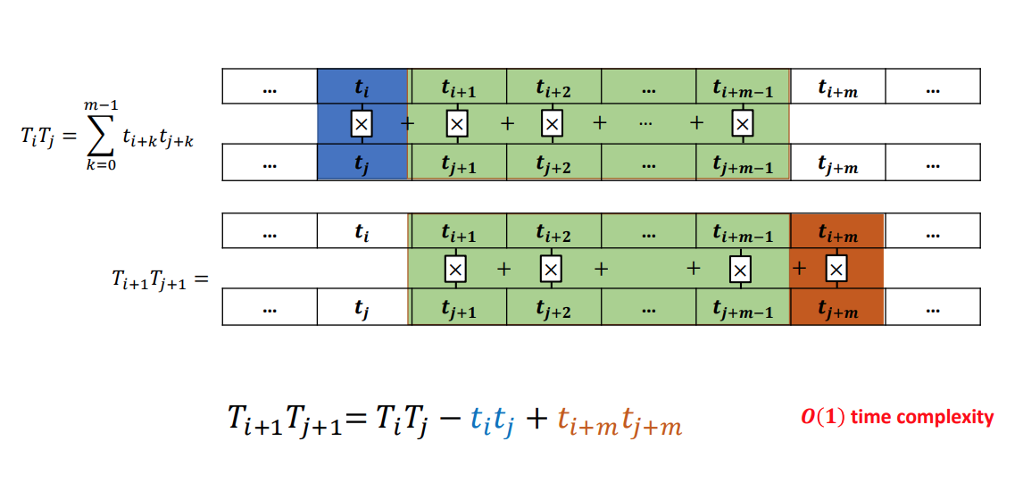
Matrix profile algorithm – STOMP (3/6) Scalable Time series Ordered Matrix Profile
The relationship between 𝑇𝑖𝑇𝑗 and 𝑇𝑖+1𝑇𝑗+1

Slide 15
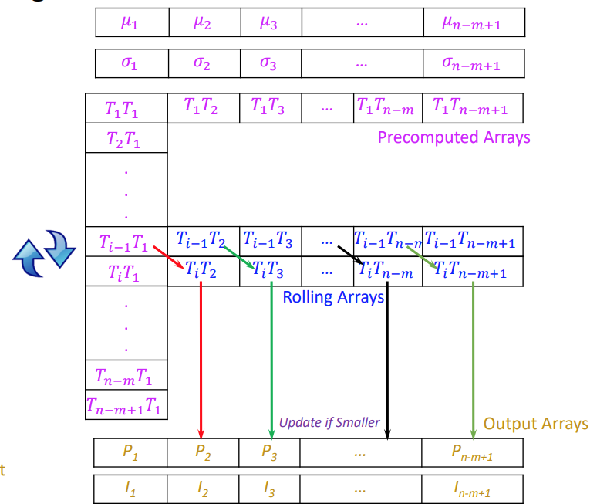
Matrix profile algorithm – STOMP (4/6) Scalable Time series Ordered Matrix Profile
All means and standard deviations are precomputed. This costs linear time and space.

Slide 16
Matrix profile algorithm – STOMP (5/6) Scalable Time series Ordered Matrix Profile
2) The first column and row of the matrix are identical and pre-computed by MASS.

Slide 17
Matrix profile algorithm – STOMP (6/6) Scalable Time series Ordered Matrix Profile
3) The algorithm iterates through the rows. The previous row is maintained as a local array to feed dot products.
MATRIX PROFILE

Slide 18
Notebook motif discovery
https://github.com/target/matrixprofile-ts/blob/master/docs/examples/Motif%20Discovery.ipynb
Matrix Profile library:
https://github.com/target/matrixprofile-ts/tree/master

Slide 19

Presentation du TD

Slide 20
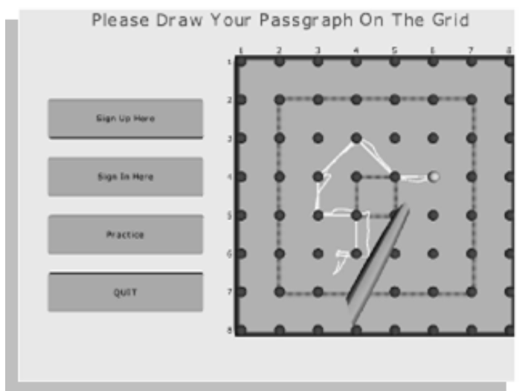
Haptics DATA
Data are taken from 5 people entering their passgraph (a code to access a system protected by a graphical authentication system) on a touchscreen. The data are the x-axis movement only.

Slide 21
Assignment
Open the Python Notebook
TS_MotifDiscovery.ipynb
Load the modules in the folder
Instruction are contained in the notebook

Slide 22
References
Time Series Data Mining Using the Matrix Profile: A Unifying View of Motif Discovery, Anomaly Detection, Segmentation, Classification, Clustering and Similarity Joins www.cs.ucr.edu/~eamonn/MatrixProfile.html
https://stumpy.readthedocs.io/en/latest/Tutorial_The_Matrix_Profile.html
Matrix Profile I: All Pairs Similarity Joins for Time Series: A Unifying View That Includes Motifs, Discords and Shapelets https://ieeexplore.ieee.org/document/7837992
https://github.com/matrix-profile-foundation

