Slide 1

Time Series Management
Michele Linardi Ph.D.
michele.linardi@orange.fr

Slide 2

Syllabus
Time series classification
Shapelet Discovery primitive

Slide 3
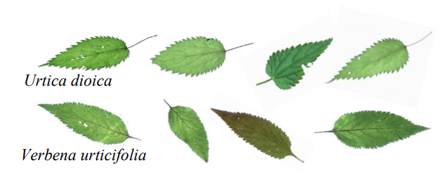
Time series classification – an example
If we aim to design a classifier to differentiate between the time series of two plant species, what features should we focus on? Given that the intra-class variability in color and size significantly exceeds the inter-class differences, a viable strategy consists into analyzing the shapes of the leaves.

Slide 4
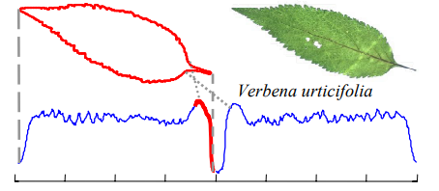
Time series classification – general intuition
However, the global shape differences are quite subtle. Moreover, leaves often exhibit distortions or "occlusions" caused by insect damage, which can confound any global shape-based measurements.
To address this, we propose an alternative approach: converting each leaf into a one-dimensional representation, as demonstrated in the figure below.

Slide 5
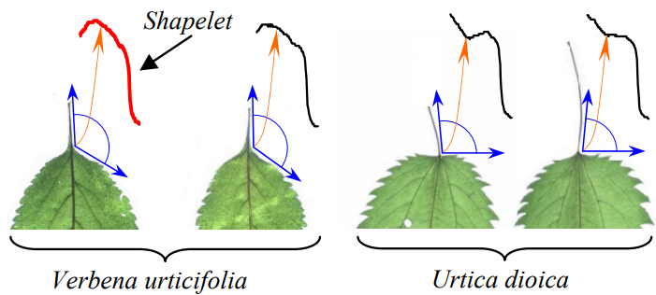
Time series Shapelet
Instead of comparing all the shapes, we can focus on analyzing a small, highly distinctive subsection of the shapes from the two classes.

Slide 6
Time series Shapelet
We call such discriminative subsequence : Time series Shapelet.

Slide 7
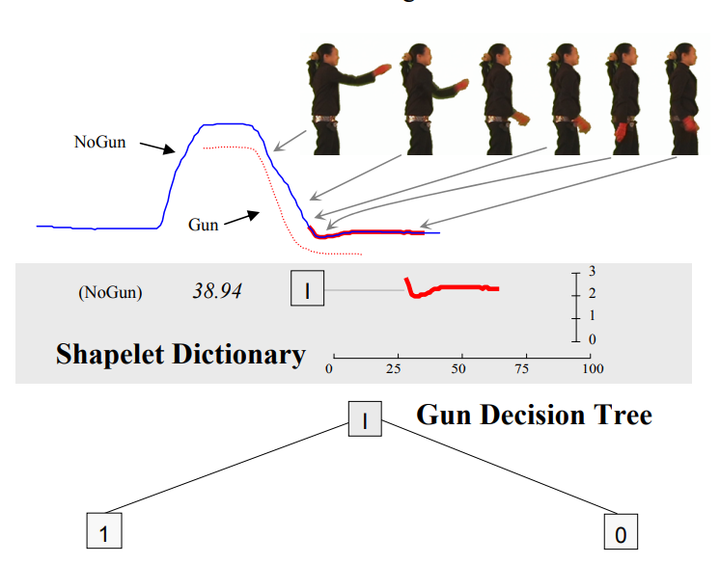
Time series Shapelet
Shapelets were first proposed as time-series segments that maximally predict the target variable. All possible segments were considered as potential candidates. In contrast, the minimum distances of a candidate to all training series were used as a predictor feature for ranking the information gain accuracy of that candidate on the target variable.
Ye, Keogh, Time Series Shapelets: A New Primitive for Data Mining, KDD 2009

Slide 8
Learning Time series shapelet
1) We can consider a mathematical formulation of the shapelet learning task as an optimization of a classification objective function.
2) Shapelets can be learnt such as their distances to the original series can linearly separate the time series instances by their targets.

Slide 9
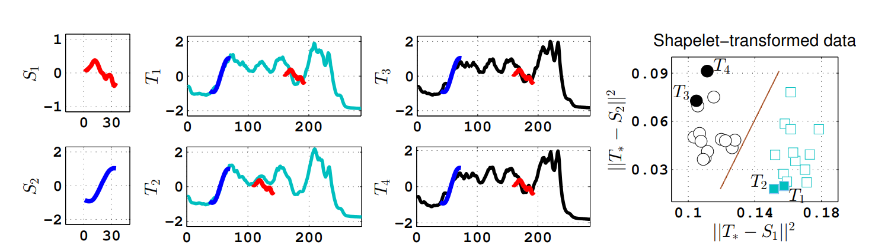
Learning Time series shapelet
Two learned shapelets S1, S2.
Series’ distances to shapelets can optimally project the series into a
2-dimensional space, called the shapelet-transformed representation

Slide 10
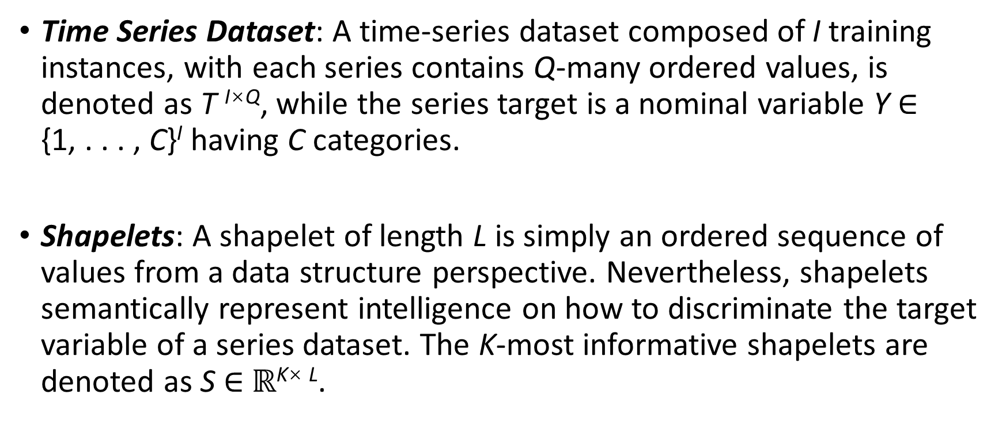
Notation
Time Series Dataset: A time-series dataset composed of I training instances, with each series contains Q-many ordered values, is denoted as T ^{I×Q}, while the series target is a nominal variable Y ∈ {1, . . . , C}^{I} having C categories.
Shapelets: A shapelet of length L is simply an ordered sequence of values from a data structure perspective. Nevertheless, shapelets semantically represent intelligence on how to discriminate the target variable of a series dataset. The K-most informative shapelets are denoted as S ∈ $ℝ$^{K× L}.

Slide 11
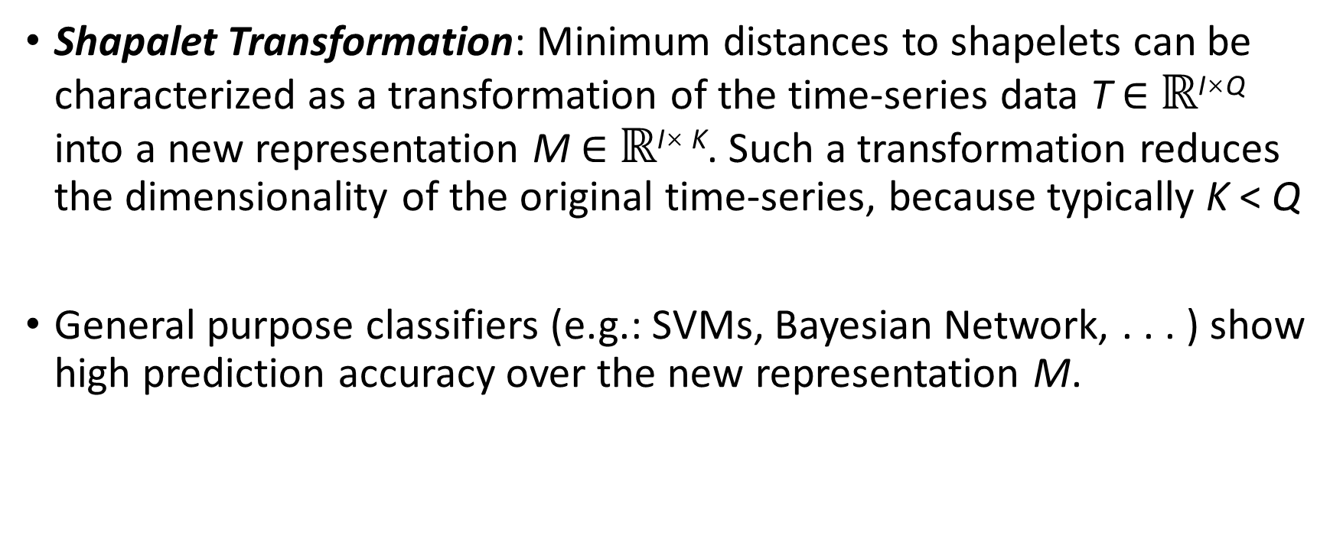
Notation
Shapalet Transformation: Minimum distances to shapelets can be characterized as a transformation of the time-series data T ∈ $ℝ$^{I×Q} into a new representation M ∈ $ℝ$^{I× K}. Such a transformation reduces the dimensionality of the original time-series, because typically K < Q
General purpose classifiers (e.g.: SVMs, Bayesian Network, . . . ) show high prediction accuracy over the new representation M.

Slide 12
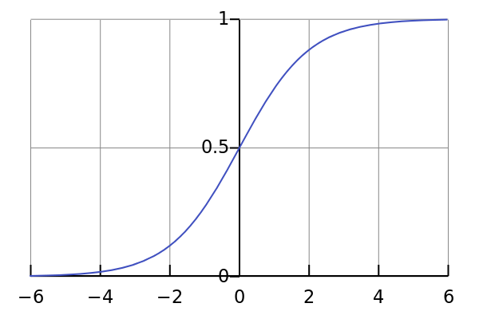
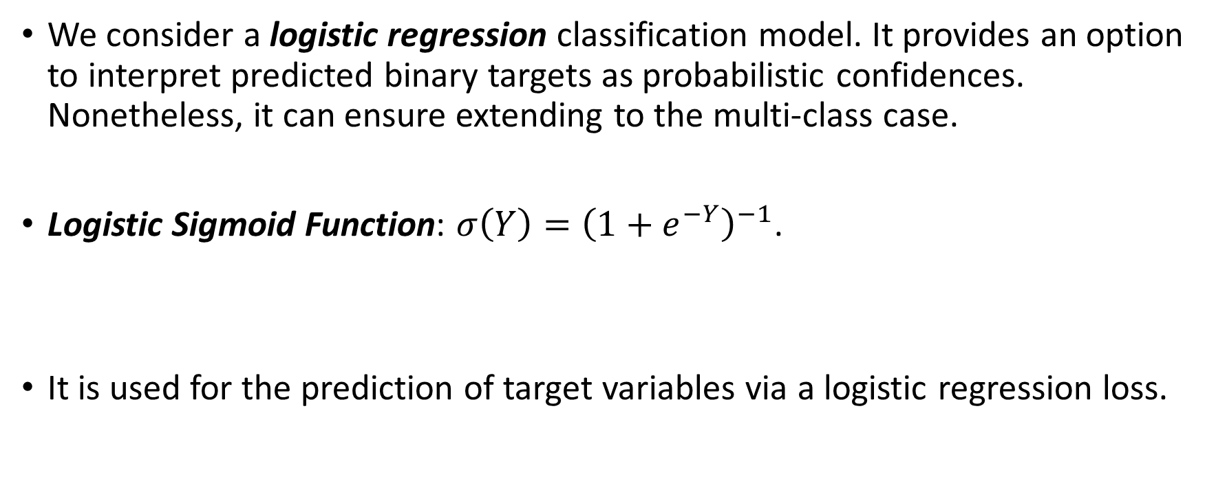
Logistic regression model
We consider a logistic regression classification model. It provides an option to interpret predicted binary targets as probabilistic confidences. Nonetheless, it can ensure extending to the multi-class case.
Logistic Sigmoid Function: $σ\left(Y\right)={\left(1+e^{−Y}\right)}^{−1}$.
It is used for the prediction of target variables via a logistic regression loss.

Slide 13
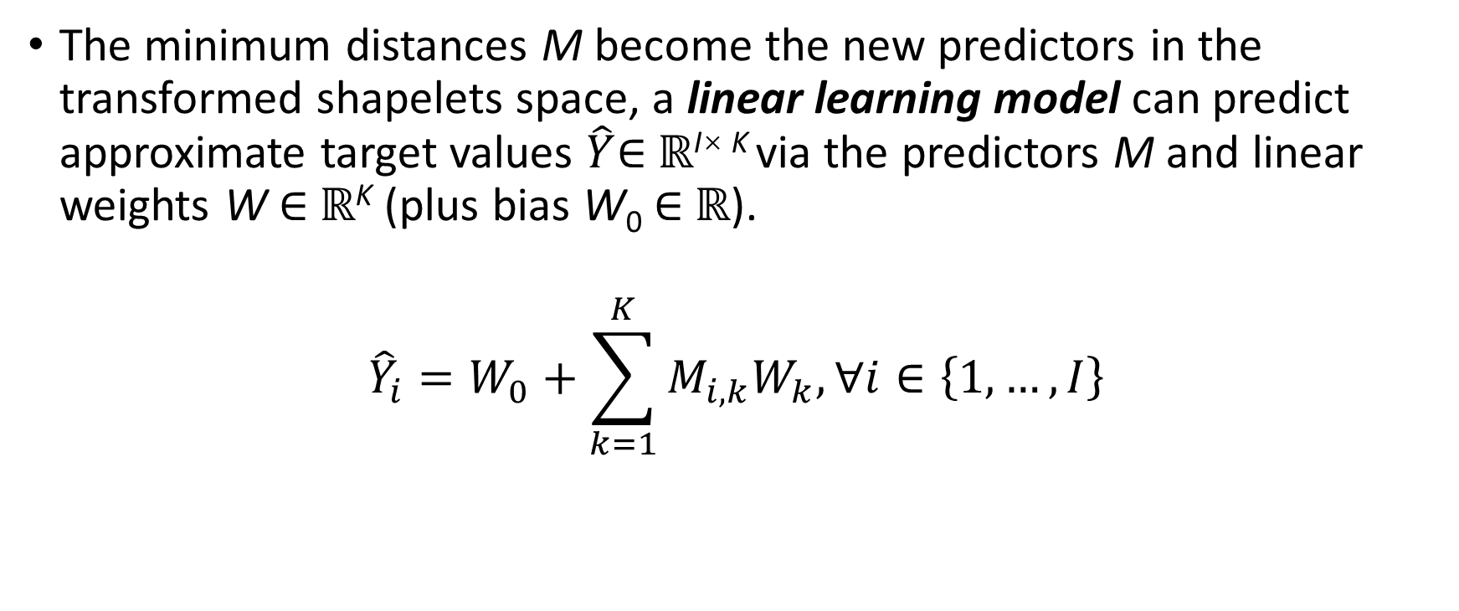
Learning model
The minimum distances M become the new predictors in the transformed shapelets space, a linear learning model can predict approximate target values $\hat{Y}$∈ $ℝ$^{I× K} via the predictors M and linear weights W ∈ $ℝ$^{K} (plus bias W₀ ∈ $ℝ$).
$${\hat{Y}}_{i}=W_{0}+\sum_{k=1}^{K}{M_{i,k}W_{k}, ∀i∈\left\{1, …, I\right\}}$$

Slide 14

Loss Function
The logistic regression operates by minimizing the logistic loss, between true targets Y and estimated ones $\hat{Y}$.
$$ℒ\left(Y,\hat{Y}\right)=−Yln\left(σ\left(\hat{Y}\right)\right)−\left(1−Y\right)ln\left(1−σ\left(\hat{Y}\right)\right)$$

Slide 15
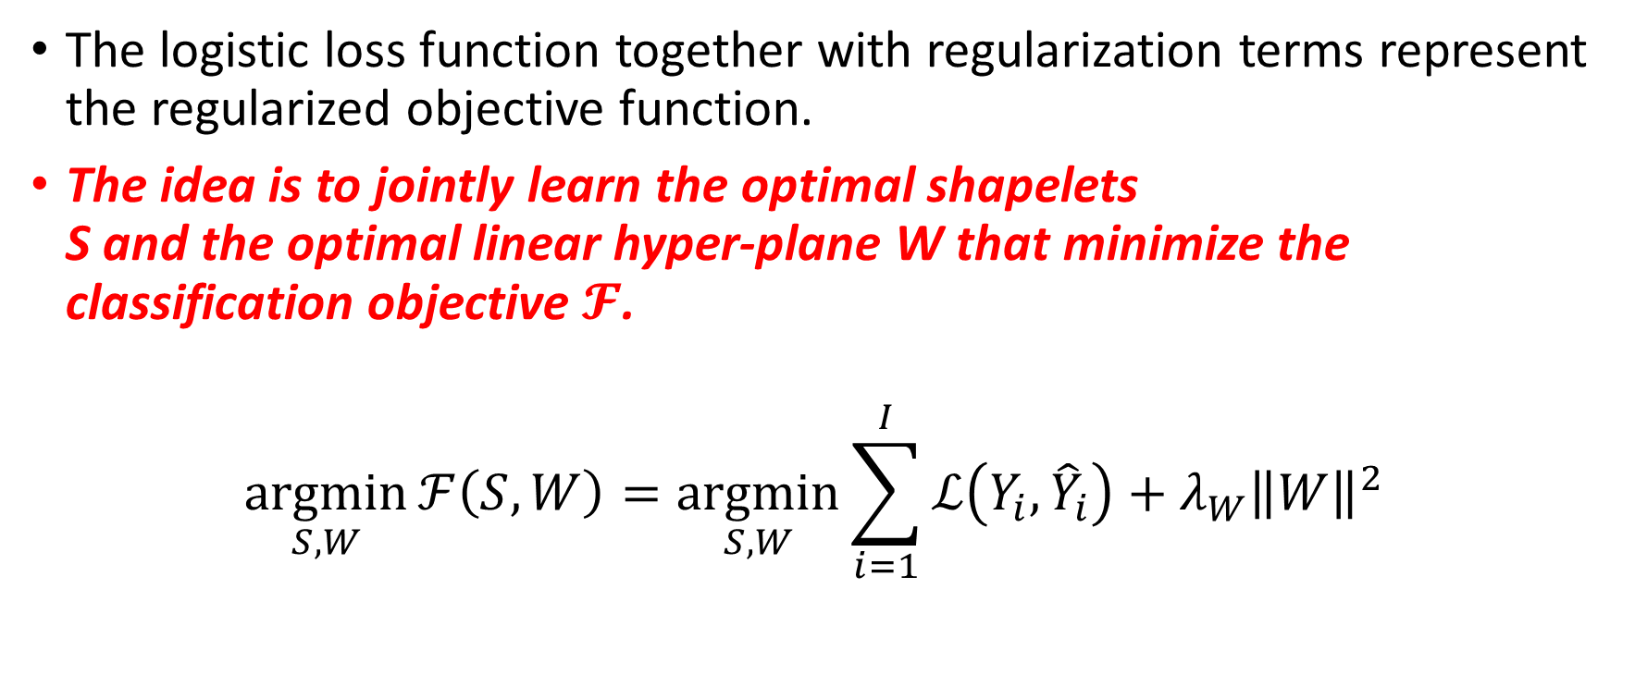
Regularized Objective Function
The logistic loss function together with regularization terms represent the regularized objective function.
The idea is to jointly learn the optimal shapelets S and the optimal linear hyper-plane W that minimize the classification objective $𝓕$.
$$\underset{S,W}{argmin}{ℱ\left(S,W\right)}=\underset{S,W}{argmin}{\sum_{i=1}^{I}{ℒ\left(Y_{i},{\hat{Y}}_{i}\right)}+λ_{W}{\left\|W\right\|}^{2}}$$

Slide 16
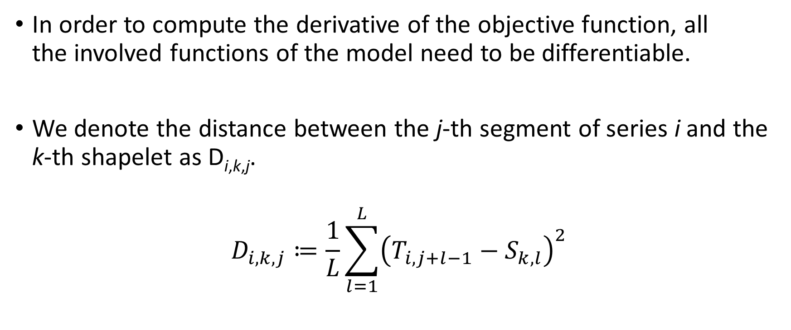
Differentiable Soft-Minimum Function
In order to compute the derivative of the objective function, all the involved functions of the model need to be differentiable.
We denote the distance between the j-th segment of series i and the k-th shapelet as D_{i,k,j}.
$$D_{i,k,j}≔\frac{1}{L}\sum_{l=1}^{L}{{\left(T_{i,j+l−1}−S_{k,l}\right)}^{2}}$$

Slide 17
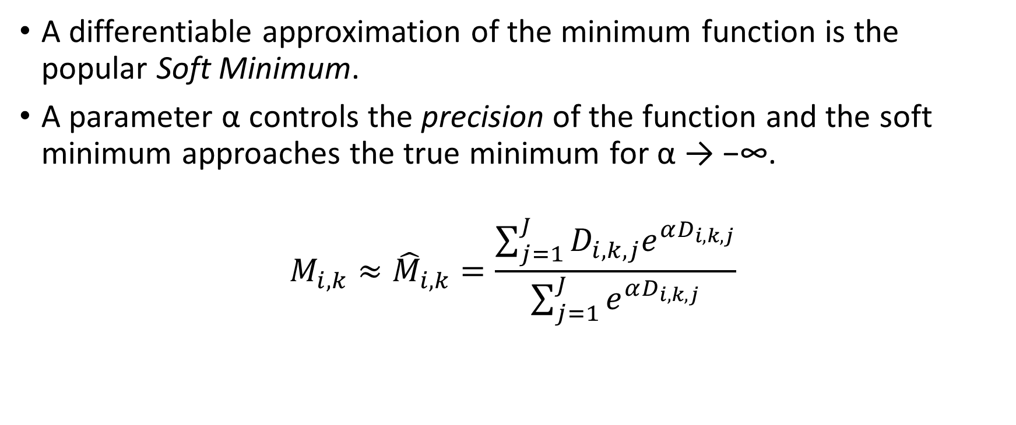
Differentiable Soft-Minimum Function
A differentiable approximation of the minimum function is the popular Soft Minimum.
A parameter α controls the precision of the function and the soft minimum approaches the true minimum for α → −∞.
$$M_{i,k}≈{\hat{M}}_{i,k}=\frac{\sum_{j=1}^{J}{D_{i,k,j}e^{αD_{i,k,j}}}}{\sum_{j=1}^{J}{e^{αD_{i,k,j}}}}$$

Slide 18
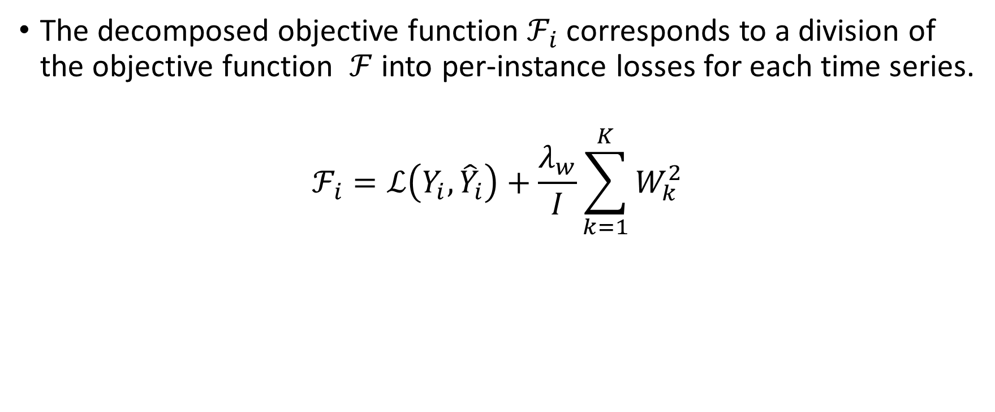
Per-instance objective
The decomposed objective function $ℱ_{i}$ corresponds to a division of the objective function $ℱ$ into per-instance losses for each time series.
$$ℱ_{i}=ℒ\left(Y_{i}, {\hat{Y}}_{i}\right)+\frac{λ_{w}}{I}\sum_{k=1}^{K}{W_{k}^{2}}$$

Slide 19
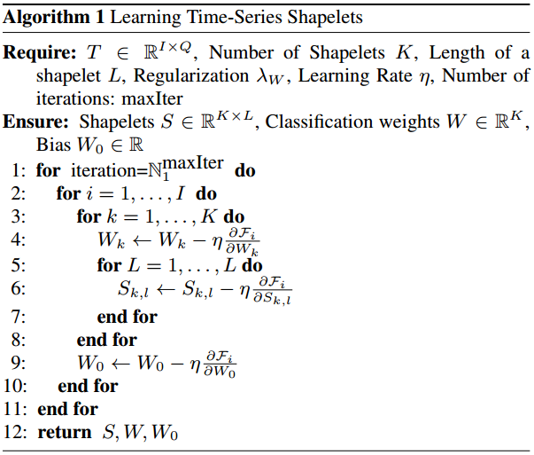
Optimization algorithm - Gradient descent

Slide 20
References
Ye, Keogh, Time Series Shapelets: A New Primitive for Data Mining, KDD 2009 https://dl.acm.org/doi/10.1145/1557019.1557122
Josif Grabocka et al. Learning time-series shapelets Published in Knowledge Discovery and Data 2014, https://www.semanticscholar.org/paper/Learning-time-series-shapelets-Grabocka-Schilling/5900721a7ff9e91782dd4dc33956b09d3adb67f5
https://www.timeseriesclassification.com/algorithmdescription.php?algorithm_id=116

