Slide 1
Is your earning power affected by the school you attend?

Slide 2
Overview
We decided to choose this data to work with in order to explore the possibility that your starting salary could be affected by the type of university or college you attend.
We found two sources that closely compared the same schools while comparing different fields.
2 Data Sources Chosen
https://www.kaggle.com/wsj/college-salaries?select=salaries-by-region.csv
https://data.world/ian/united-states-university-rankings

Slide 3
Extracting our data
We first had to load our data and then read all three CSV files using Pandas.
University Rankings
Salaries by College Type
Salaries by Region

Slide 4
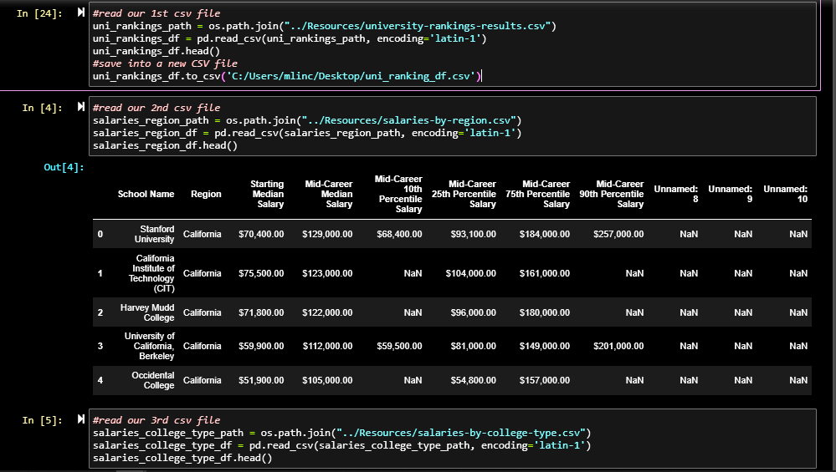
Here you can see our 3 different data frames. Now its time to clean!

Slide 5
Transforming Our Data
We did this in order to get a better visualization of our clean data to then load in and do further transformation using Postgres
We cleaned our data to create a new data frame comparing school rankings. To do this we used:
The “name” column
The “rank” column
The “state” column
We cleaned our 2nd set of data to create a new data frame comparing salaries by school type. To do this we used:
comparing salaries by school type, we used:
The “School Name” column
The “Starting Median Salary” column from our salary by region dataframe.

Slide 6
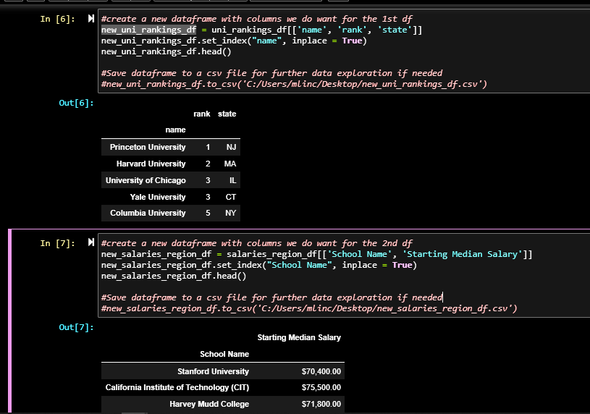
Now that we have cleaned our data frames, we can merge them together!

Slide 7

Time to connect to Postgres

Slide 8
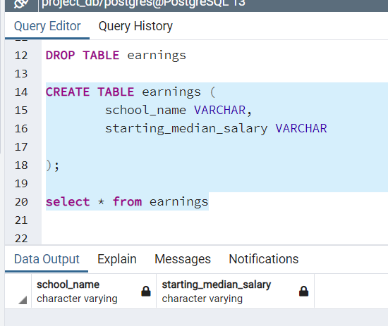
Loading Our Data into Postgres
After we loaded our data into Postgres, and then created our 2 tables to then select the columns we needed.
…..

Slide 9
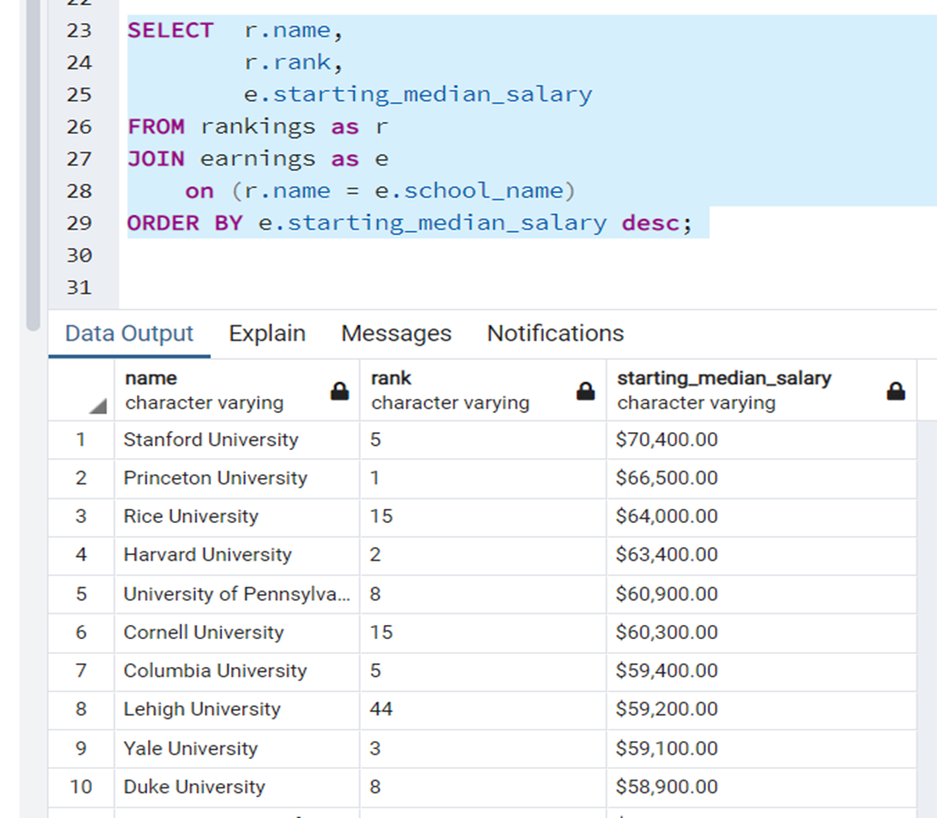
Further Data Cleaning
With our merged our newly created tables using Postgres to then order our salary column by greatest to least depending on school type.

Slide 10
Thank you
Collaborators
Shannan Sharp
Madison Lincks
Anthony Kerins

