Slide 1
Applied Bayesian Data Analysis

Slide 2
Probabilistic Thinking

Slide 3
Uncertainty is everywhere
In life very few things are certain:
What will the weather be like tomorrow?
Who will win the elections?
Who will win the super bowl?
What will the traffic be tomorrow on I-73?
How many people will click on a Budweiser ad on Facebook?
…

Slide 4
Uncertainty is everywhere
Most people are comfortable (only) with certainty statements
Tomorrow it will rain
The Steelers are going to win the super bowl
Unfortunately, the most honest expression of future projections must include uncertainty

Slide 5

Uncertainty is everywhere
Most people are comfortable (only) with certainty statements
Tomorrow it will rain
The Steelers are going to win the super bowl
Unfortunately, the most honest expression of future projections must include uncertainty

Slide 6
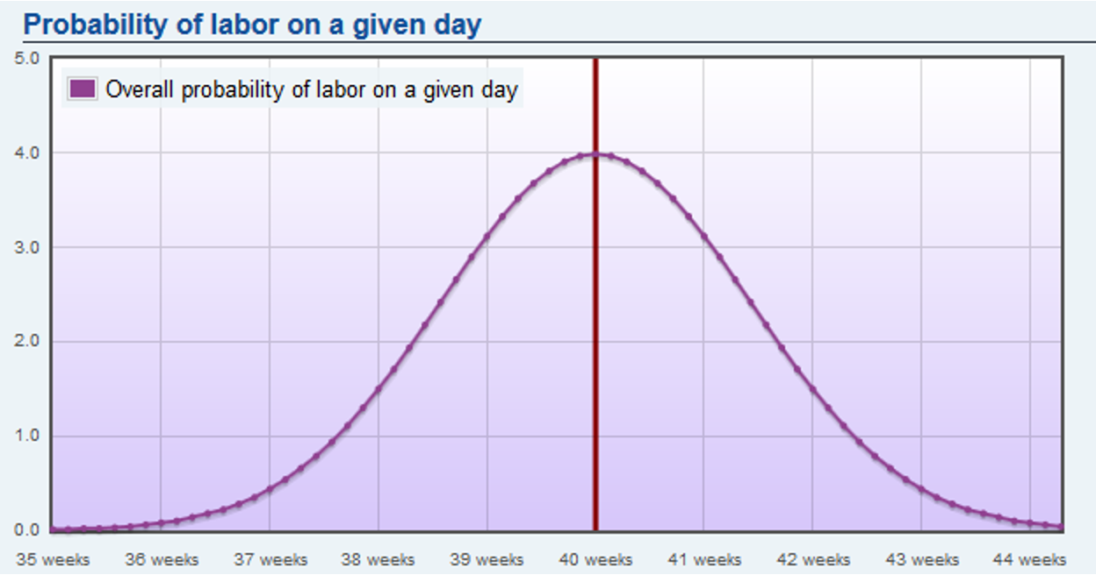

Slide 7
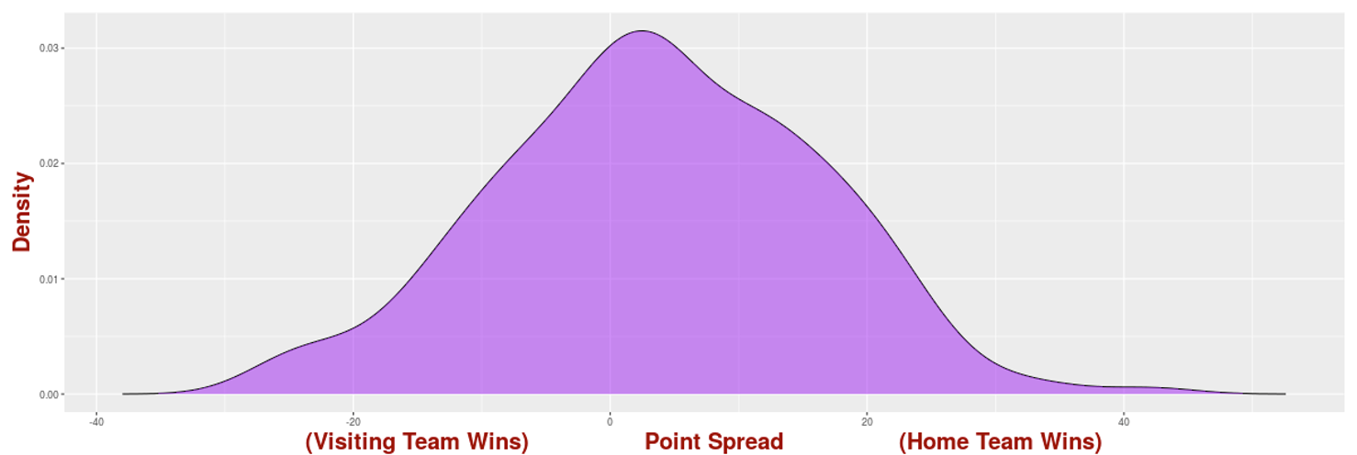
Which team is winning?

Slide 8
Home team win probability
 | Size of Lead
Time Left | 1 Point | 5 Points | 10 Points
Second half | 54% | 57% | 61%
4th quarter | 54% | 58% | 63%
6 minutes | 56% | 64% | 70%
3 minutes | 56% | 69% | 77%
1 minute | 57% | 76% | 91%
Illustrative & hypothetical example

Slide 9
Probabilistic thinking
Nobel laureates Kahneman and Tversky provided evidence that humans cannot objectively translate probabilities to realistic expectations
We think of a 90% probability the same as a 99% or a 99.999% probability
These are vastly different probabilities!
Requires time, effort and practice

Slide 10
What is probability?
Intuition: if an event replays 100 times (under the same conditions) how many times do you expect each possible outcome to occur?
Simplest case: In a system with equally probable states (or outcomes) the probability of an event E is simply the ratio of 2 counts:
The number N of all possible states in the system
The number m of favorable states for the event E
Pr[E] = m/N

Slide 11
Example
Consider throwing a dice twice
The state of the system consists of all the possible combinations of the two dice outcomes
I.e., {1,1}, {1,2}, …, {1,6}, {2,1}, …, {6,6}
These are 36 total
Each state is equally possible
A simple even can be “the sum of the two dice is even”
What is the probability of this event?

Slide 12
Conditional Probability & Bayes Rule

Slide 13
Conditional probability
The notion of conditional probability is central at what we term evidence-based decision making
Many times when we want to estimate the probability of an event happening we collect evidence
These evidence will provide support or not for the even of interest happening

Slide 14
Conditional probability
We want to know the probability that Pitt football is going to win its next game
Some relevant events that could provide signal include:
Is Pitt’s starting QB playing?
Is the opponent starting QB playing?
What is the weather going to be like?
…

Slide 15
Conditional probability
What is the probability of event A happening, given that we know that event B has already happened/is true?

Slide 16

Conditional probability
What is the probability of event A happening, given that we know that event B has already happened/is true?

Slide 17

Conditional probability
What is the probability of event A happening, given that we know that event B has already happened/is true?

Slide 18


Independence
Two events are independent if and only if:
Equivalently:
Intuitively, knowing A does not tell you anything about B and vice-versa
But beware of relying on your intuition; sometimes it fails spectacularly!

Slide 19
Bayes’ rule
This might be is the most important rule in probability
This rule allows us to compute conditional probabilities and the intuition behind the rule is simple:
You can start with a prior, subjective, belief on the probability of the event examined
As you collect relevant data, you use these evidence to update your belief, and get the posterior belief

Slide 20
Bayes’ rule
Bayes rule is everywhere in our lives
We do these calculations every day subconsciously
Is it going to rain the next hour?
Our priors are constructed based on yesterday’s forecast, season etc.
We observe the absence of clouds and adjust our estimate accordingly
While we do not calculate the exact probability, we move our estimate towards the true value

Slide 21
The Prior

Slide 22
Choosing the prior
One of the criticism of Bayes’ rule is the choice of prior
Where do you start from to put a value in your prior belief for the event of interest?
If there are available data for the event’s base rate this is a good starting point
However, even if there is not available data, this does not mean Bayes’ rule cannot be used or it will be biased

Slide 23
Choosing the prior
The presence of the prior is in fact the strongest part of any Bayesian analysis
In effect, we can start with any (subjectively chosen) prior, and if we accumulate enough evidence, we will converge to the true answer
This is how science also works

Slide 24
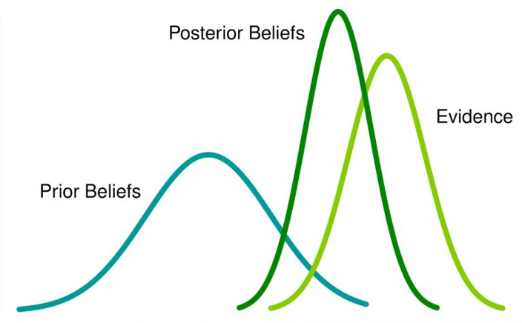
Choosing the prior
The Bayesian approach puts data in context
It allows people to explicitly state that they have prior beliefs / biases
Bayes’ rule gives us a tool to reduce these biases as we collect more evidence

Slide 25



Slide 26

The Bayesian brain
Wolper & Kording’s work on Bayesian Integration put forth the idea that our brain uses Bayesian inference when it comes to motor skills
Bayes rule had already found its way to behavioral psychology and understanding visual processes
Key idea: in order for athletes to make decisions under pressure, they need to make predictions what will unfold

Slide 27
The Bayesian brain
Imagine a tennis player that needs to return a service, or a hitter that needs to decide whether to swing or not at the incoming pitch
The amount of time they have to respond is astronomically small
They cannot afford to wait to fully process the environment and then react
They have to rely on prediction, which is optimized when experience is combined with sensory evidence
Bayes’ rule – prior (experience) and sensory evidence (data)

Slide 28
The Bayesian brain
Of course our brain does not calculate the equation we saw before
The brain needs to integrate all possible things that could have happened and all the possible things that it could have seen in a given state
Our brain makes Bayesian approximations
Not every pitch or serve are judged correctly
Our senses can be unreliable enough to throw off our Bayesian machine altogether

Slide 29
The Bayesian brain
Our brain though is not tricked the easily often
Cubs’ pitcher, Aroldis Chapman, has recorded a throw at 105.1 mph
He threw 26 pitches at 104+ mph
12 of them resulted in contact and only 1 resulted in a swinging strike!
Hitters’ brain was able to handle the uncertainty of the incoming - extremely fast - pitch
Made the right estimation/prediction that compensate for the delays of the sensory and processing system

Slide 30
Random Variables

Slide 31
Random variables
A variable that does not take a single - deterministic - value but it can take a set of different values, each with an associated probability
Discrete & Continuous
E.g., X can be a random variable (r.v.) that counts the number of 6s that we get when we roll 2 dices
Pr[X=2] = P[{6,6}] = 1/36
Pr[X=1] = Pr[{1,6}]+Pr[{2,6}]+...+Pr[{5,6}]+Pr[{6,1}]+...=10/36
Pr[X=0] = 1- (1/36)-(10/36) = 25/36

Slide 32
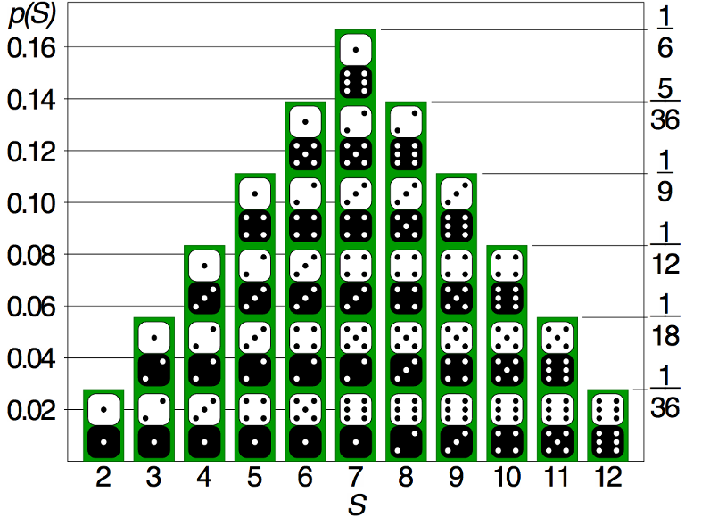
Distribution of r.v.s
A probability mass function (pmf) assigns a probability to each possible value of a discrete random variable

Slide 33
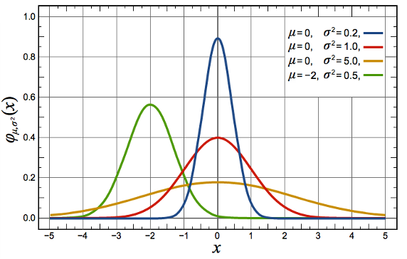

Distribution of r.v.s
A continuous random variable X is described through the probability density function (pdf)
PDF describes the relative likelihood for X to take a given value

Slide 34
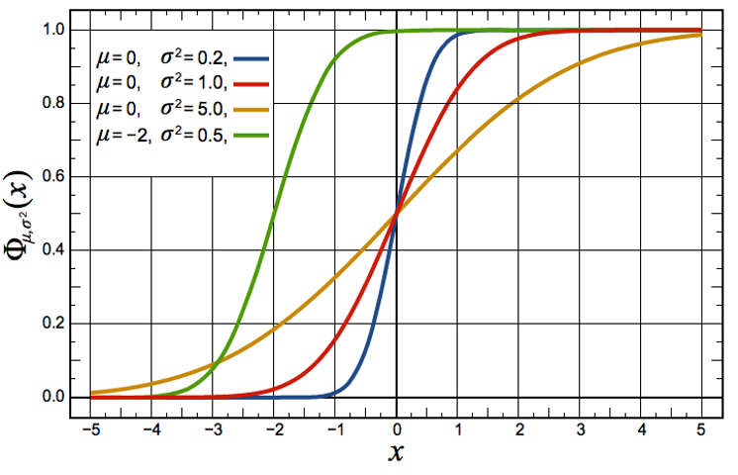

Distribution of r.v.s
The cumulative distribution function (CDF) of a continuous random variable X is:

Slide 35
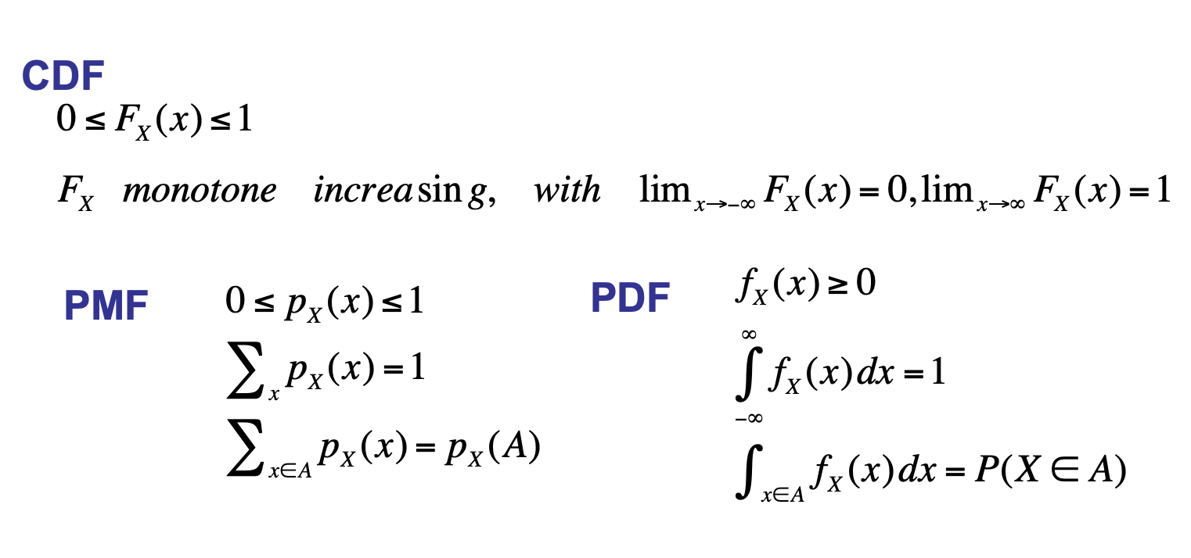
Properties of distributions

Slide 36



Expectation
For a discrete r.v. X with pmf p(x), its expected value is:
For a continuous r.v., we similarly have:
Expectation is linear:

Slide 37
Variance
Variance captures the spread of a random variable around its expected value:
Variance is not linear

