Slide 1
Hands on Hacknight Connecting Netduino's to an Azure cloud service
By: Michael Linnen
Twitter: @mlinnen
Blog: www.protosystem.net

Slide 2



Sponsors

Slide 3


Disclaimer!
This is NOT a real security system!
*This is for education purposes ONLY*
Do NOT use this as your Home Security System!

Slide 4
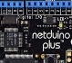


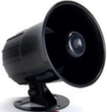


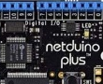
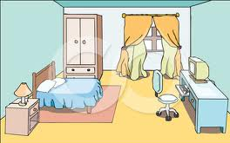

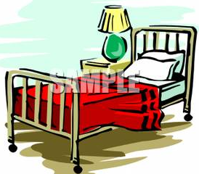




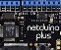
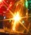
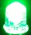
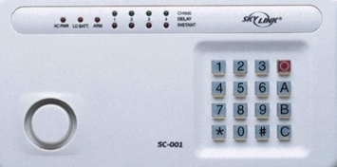




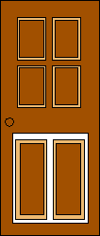

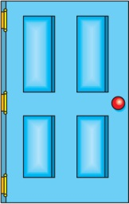


The Big Picture
Talk to me!
Message Broker
Master Control Panel
Worker
Web
Bedroom 1
Master Bedroom
Bedroom 2
Azure
 | Front | Side | Back | Master Bedroom | Bedroom 1 | Bedroom 2 | 1st Floor
Doors
Locked
Windows
Motion
Doorbell
Alarm
Front door
Sleep
Away
Back door
Side door
Master Control Panel Dashboard

Slide 5
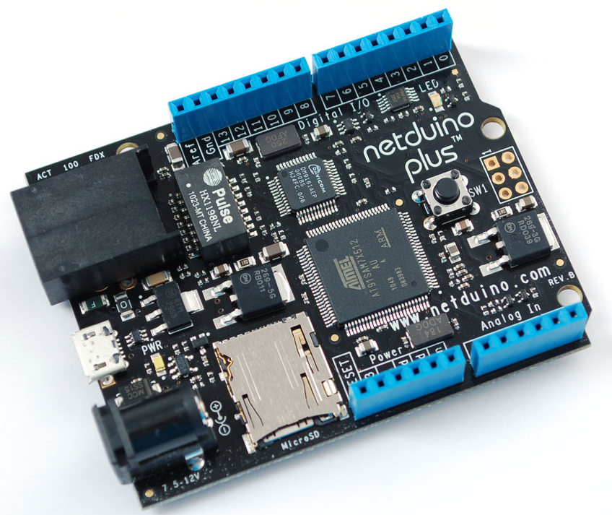
NETDUINO PLUS
Digital i/o Features
All 20 digital and analog pins: GPIO
Digital pins 0-1: UART 1 RX, TX
Digital pins 2-3: UART 2 RX, TX
Digital pins 5-6: PWM, PWM
Digital pins 7-8: UART 2 RTS, CTS
Digital pins 9-10: PWM, PWM
Digital pins 11-13: SPI MOSI, MISO, SPCK
Analog pins 4-5: I2C SDA, SCL
Processor and Memory
Atmel 32-bit microcontroller
Speed: 48MHz, ARM7
Code Storage: 64 KB
without networking: 128 KB
RAM: 42 KB
without networking: 60 KB

Slide 6

Windows AZURE
Unlimited resources
Service Bus (Messaging)
Storage
Computation
Identity
Networking (VPN)
Web sites (10 free)
Virtual Machines (Linux or Windows)
Mobile Services
Media Services
Database Services
Reporting Services
Cache
CDN
Store
Internet Of Things Enabler
Projecting 50 billion devices in 2020

Slide 7
DEMO

Slide 8
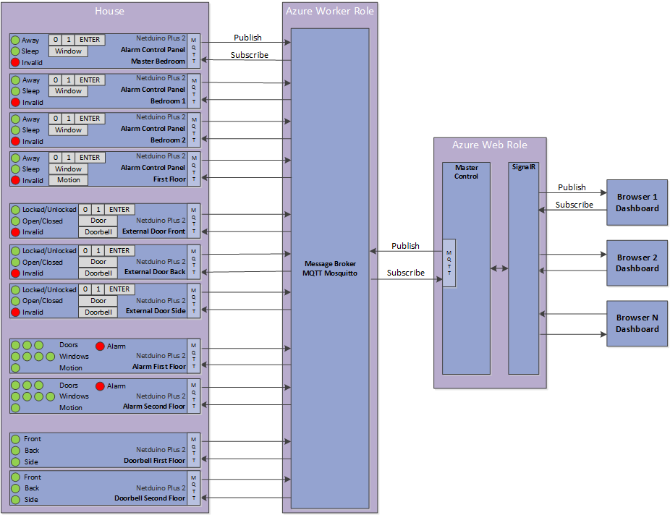
Architecture

Slide 9
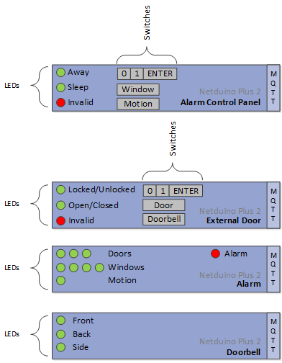
Architecture

Slide 10
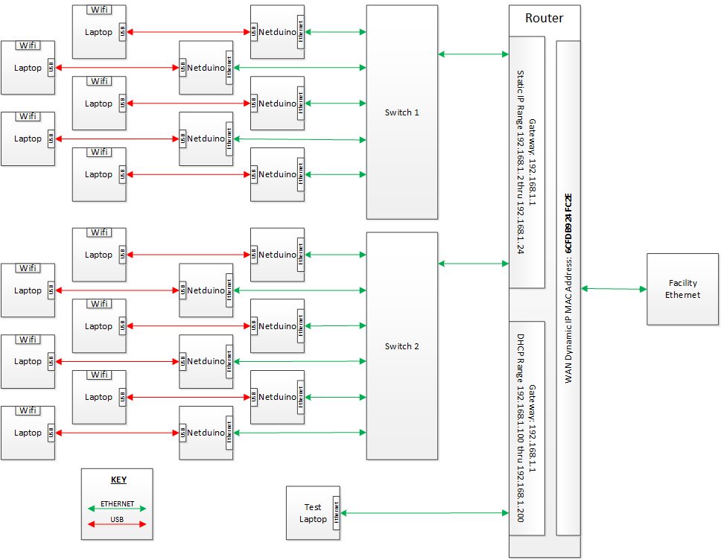
NETWORK

Slide 11
MQTT
“MQTT is a machine-to-machine (M2M)/"Internet of Things" connectivity protocol”
Features
Lightweight
Publish/Subscribe
Open published protocol
How long?
Invented in 1999
Dr Andy Standford-Clark
Arlen Nipper
Used By
Facebook (messenger)
Github
COSM (formerly Pachube)
RabbitMQ (MQTT Adapter)
Websphere MQ

Slide 12

Messages - doorbell
Home
Azure
Remote
External Door
Broker
Hub
Browser
MQTT
SignalR
Dashboard
Doorbell
Master Control Panel

Slide 13
Messages - doorbell
Home
Azure
Remote
External Door
Broker
Hub
Browser
MQTT
SignalR
Dashboard
Subscribe Doorbell
Subscribe Doorbell
Doorbell
Master Control Panel

Slide 14

Messages - doorbell
Home
Azure
Remote
External Door
Broker
Hub
Publish Doorbell pushed
Browser
MQTT
SignalR
Dashboard
Doorbell
Master Control Panel

Slide 15
Messages - doorbell
Remote
Home
Azure
Remote
External Door
Broker
Hub
Browser
Publish Doorbell pushed
MQTT
SignalR
Dashboard
Publish Doorbell pushed
Doorbell
Master Control Panel

Slide 16
Messages - doorbell
Remote
Home
Remote
Home
Azure
Azure
External Door
Broker
Hub
Browser
Update UI
MQTT
SignalR
Dashboard
Doorbell
Master Control Panel

Slide 17
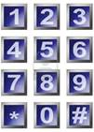
Messages – unlock door
Remote
Home
Azure
Remote
Azure
External Door
Broker
Hub
Browser
MQTT
SignalR
Dashboard
Doorbell
Master Control Panel

Slide 18
Messages – unlock door
Remote
Home
Azure
Remote
Azure
External Door
Subscribe setlock
Broker
Hub
Browser
MQTT
Subscribe lock
SignalR
Dashboard
Subscribe code
Doorbell
Master Control Panel

Slide 19

Messages – unlock door
Remote
Home
Azure
Remote
External Door
Publish code 01
Broker
Hub
Browser
MQTT
SignalR
Dashboard
Doorbell
Master Control Panel

Slide 20
Messages – unlock door
Remote
Home
Remote
Home
Azure
Azure
External Door
Broker
Hub
Browser
MQTT
SignalR
Dashboard
Publish code 01
Doorbell
Master Control Panel

Slide 21

Messages – unlock door
Remote
Home
Remote
Home
Azure
Azure
External Door
Broker
Hub
Browser
MQTT
SignalR
Dashboard
Publish code 01
Doorbell
Master Control Panel

Slide 22
Messages – unlock door
Remote
Home
Remote
Home
Azure
Azure
External Door
Broker
Hub
Browser
MQTT
SignalR
Dashboard
Doorbell
Publish setlock unlock
Master Control Panel

Slide 23
Messages – unlock door
Remote
Home
Remote
Home
Azure
Azure
External Door
Publish setlock unlock
Broker
Hub
Browser
MQTT
SignalR
Dashboard
Doorbell
Master Control Panel

Slide 24
Messages – unlock door
Remote
Home
Remote
Home
Azure
Azure
External Door
Publish lock unlocked
Broker
Hub
Browser
MQTT
SignalR
Dashboard
Doorbell
Master Control Panel

Slide 25
Messages – unlock door
Remote
Home
Azure
Remote
Azure
External Door
Broker
Hub
Browser
MQTT
SignalR
Dashboard
Publish lock unlocked
Doorbell
Master Control Panel

Slide 26
Messages – unlock door
Remote
Home
Azure
Remote
Azure
External Door
Broker
Hub
Browser
MQTT
SignalR
Dashboard
Update UI
Doorbell
Master Control Panel

Slide 27
Hardware
Ground Bus – Exposes more connections
LED’s – Indicators or simulates actuators
Switches – Keyboard, Window/Door/Motion sensors, Alarm mode

Slide 28
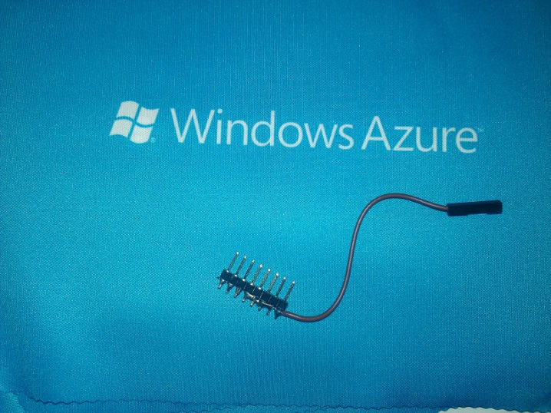
Ground Bus
Connect to LEDs or Switches
Connect to Netduino GND

Slide 29
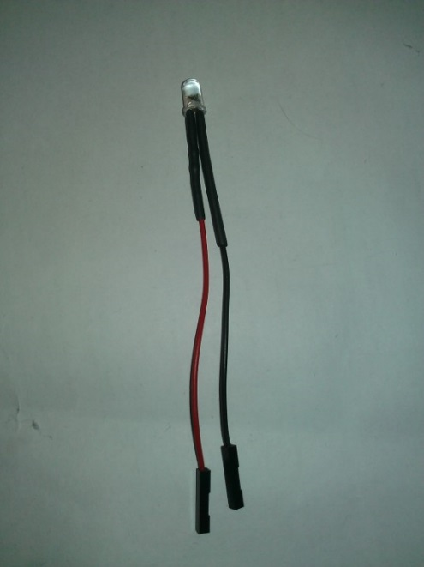
LED’s
Connect to Ground Bus
Connect to Netduino Digital Pin (or 3.3 volt pin to test)

Slide 30
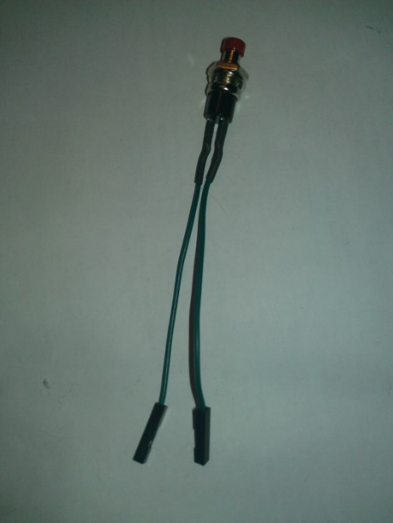
Switches
Connect to Ground Bus
Connect to Netduino Digital Pin

Slide 31
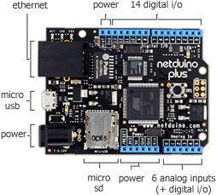
Netduino 3.3 V
Netduino GND

Slide 32
Let’s GET STARTED
Pick a device to build
Doorbell (easiest)
Alarm (a little harder)
External Door (hardest)
Alarm Panel (hardest)
Fill out the signup sheet
Unique Client ID (use your initials)
Get your parts
Code the solution
* Reference: HTTP://www.CloudHomeSecurity.com

Slide 33
Securing Messages
VPN
Restricted IP’s
HTTPS and a gateway broker

Slide 34
Gateway Broker
Home
Azure
Remote
NON SSL
Hub
Browser
NON SSL
MQTT
Broker
SSL
MQTT
Broker
SSL
NON SSL
SignalR
Dashboard
NON SSL
Master Control Panel

Slide 35
Mission Critical
Home
Azure
Remote
NON SSL
Hub
Browser
NON SSL
MQTT
Broker
SSL
MQTT
Broker
SSL
NON SSL
SignalR
Dashboard
NON SSL
NON SSL
Master Control Panel

Slide 36
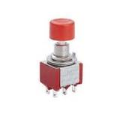
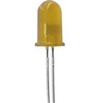
Messaging Patterns
MQTT
Broker
Message
Router

Slide 37
Messaging Patterns
Subscribe DI/0
MQTT
Broker
Message
Router
Subscribe DO/0

Slide 38
Messaging Patterns
Publish DI/0 true
MQTT
Broker
Message
Router

Slide 39
Messaging Patterns
Publish DI/0 true
Publish DI/0 true
MQTT
Broker
Message
Router

Slide 40
Messaging Patterns
Publish DI/0 true
Publish DI/0 true
MQTT
Broker
Message
Router

Slide 41
Messaging Patterns
Publish DI/0 true
Publish DI/0 true
MQTT
Broker
Message
Router
Publish DO/0 true

Slide 42
Messaging Patterns
Publish DI/0 true
Publish DI/0 true
MQTT
Broker
Message
Router
Publish DO/0 true
Publish DO/0 true

