Slide 1






Slide 2
Building an Internet Enabled Security System
Part 1 - The Introduction
By: Mike Linnen
Twitter: @mlinnen
Blog: www.protosystem.net

Slide 3



Sponsors

Slide 4


Disclaimer!
This is NOT a real security system!
*This is for education purposes ONLY*
Do NOT use this as your Home Security System!

Slide 5
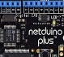


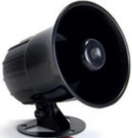


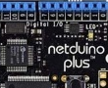
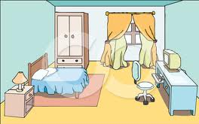






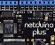
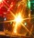
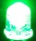
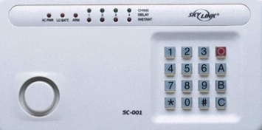






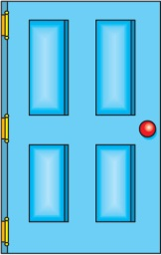


The Big Picture
Talk to me!
Message Broker
Master Control Panel
Worker
Web
Bedroom 1
Master Bedroom
Bedroom 2
Azure
 | Front | Side | Back | Master Bedroom | Bedroom 1 | Bedroom 2 | 1st Floor
Doors
Locked
Windows
Motion
Doorbell
Alarm
Front door
Sleep
Away
Back door
Side door
Master Control Panel Dashboard

Slide 6
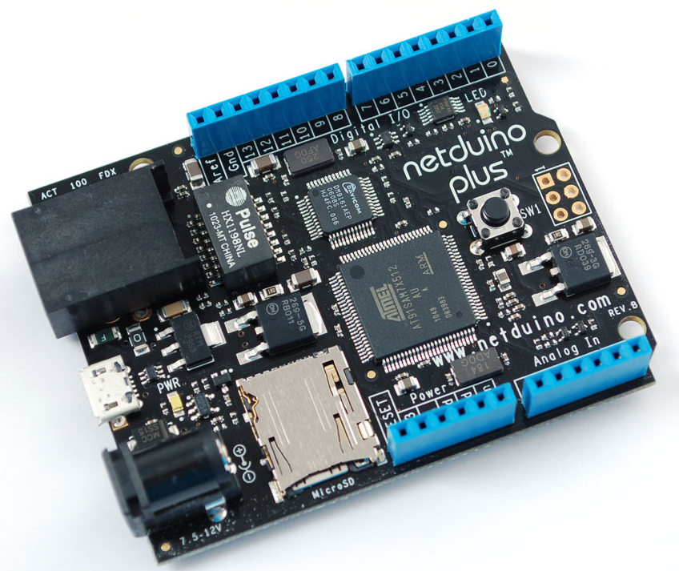

Open Platform
Open-Source .Net Micro Framework
Open-Source Hardware
Open-Source Firmware
Rich Toolset
Visual Studio IDE
Debugging on the Netduino
Unit Testing
Flexible
Arduino Shield Compatible
Netduino
Netduino Plus
Netduino Go

Slide 7
NETDUINO PLUS
Digital i/o Features
All 20 digital and analog pins: GPIO
Digital pins 0-1: UART 1 RX, TX
Digital pins 2-3: UART 2 RX, TX
Digital pins 5-6: PWM, PWM
Digital pins 7-8: UART 2 RTS, CTS
Digital pins 9-10: PWM, PWM
Digital pins 11-13: SPI MOSI, MISO, SPCK
Analog pins 4-5: I2C SDA, SCL
Processor and Memory
Atmel 32-bit microcontroller
Speed: 48MHz, ARM7
Code Storage: 64 KB
RAM: 42 KB

Slide 8

Windows AZURE
Unlimited resources
Service Bus (Messaging)
Storage
Computation
Identity
Networking (VPN)
Web sites (10 free)
Virtual Machines (Linux or Windows)
Mobile Services
Media Services
Database Services
Reporting Services
Cache
CDN
Store
Internet Of Things Enabler
Projecting 50 billion devices in 2020

Slide 9
DEMO

Slide 10
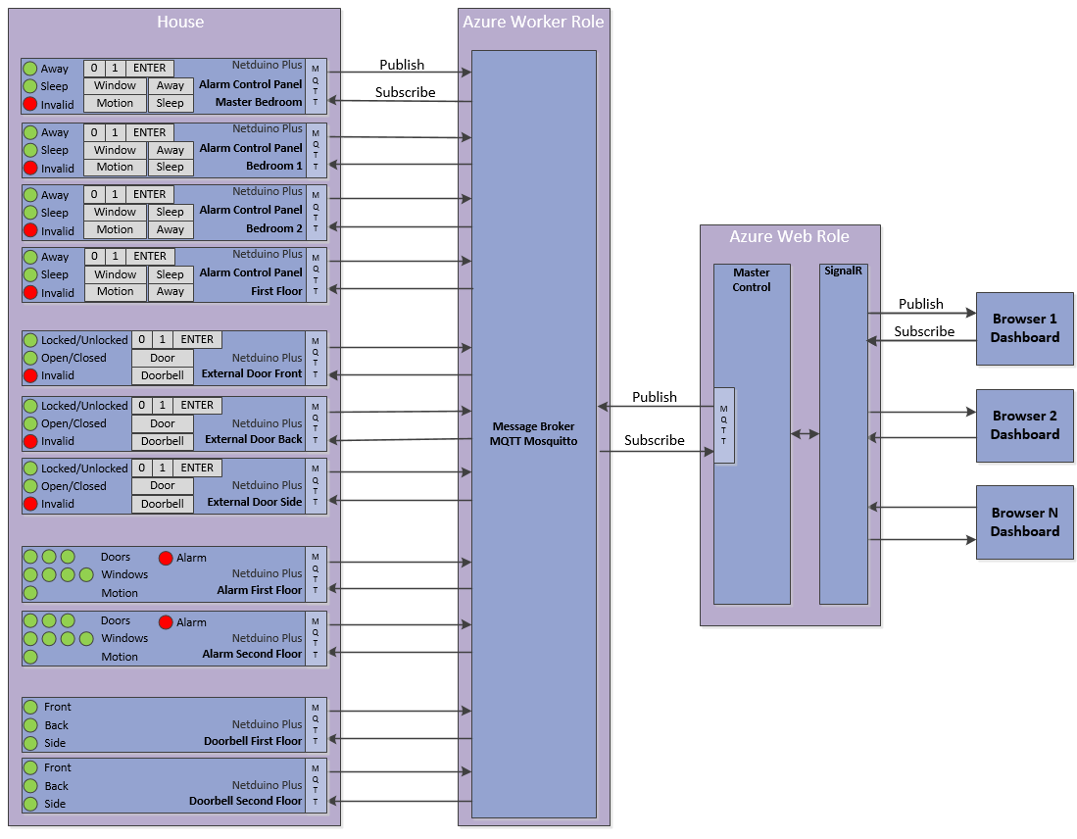
Architecture

Slide 11
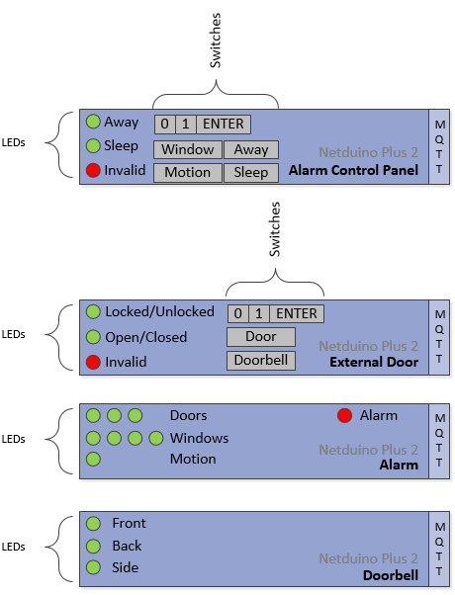
Architecture

Slide 12
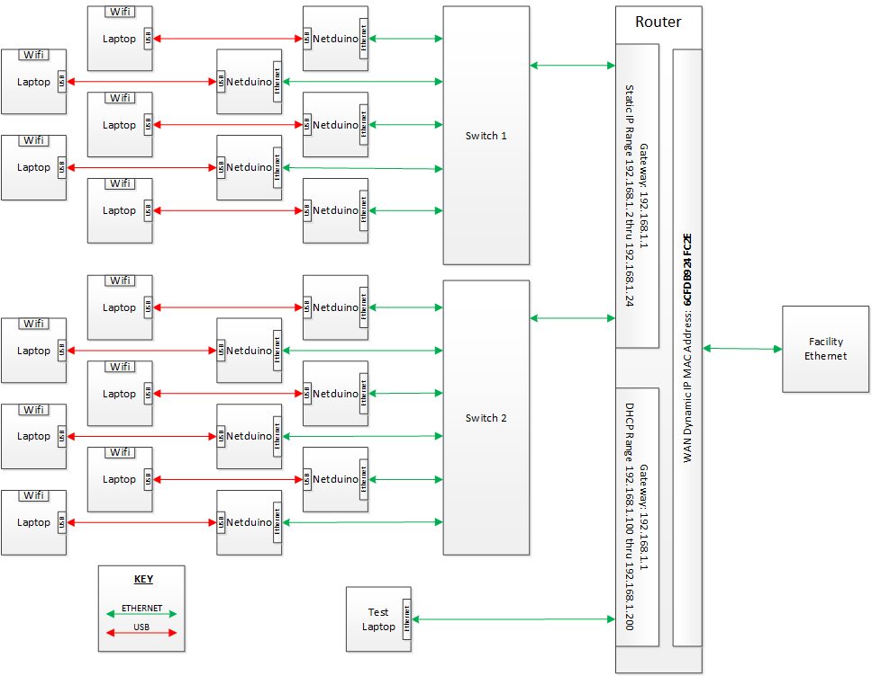
NETWORK

Slide 13
MQTT
“MQTT is a machine-to-machine (M2M)/"Internet of Things" connectivity protocol”
Features
Lightweight
Publish/Subscribe
Open published protocol
How long?
Invented in 1999
Dr Andy Standford-Clark
Arlen Nipper
Used By
Facebook (messenger)
Github
COSM (formerly Pachube)
RabbitMQ (MQTT Adapter)
Websphere MQ
http://mqtt.org

Slide 14
MQTT
Topic
Publish/Subscribe to Topics
Treated as a Hierarchy
Delineated by /
Supports wildcard subscriptions
Message
Represents the payload
Binary or ASCII
TOPIC | PAYLOAD
/house1/externaldoor/front/doorbell | pushed
/house1/alarmpanel/masterbedroom/window | closed
/house1/alarmpanel/masterbedroom/window | opened
/house1/externaldoor/front/lock | unlocked
/house1/externaldoor/front/lock | locked
/house1/alarmpanel/firstfloor/setalarmstate | away
/house1/alarmpanel/firstfloor/setalarmstate | sleep
/house1/alarmpanel/firstfloor/setalarmstate | off

Slide 15

Messages - doorbell
Home
Azure
Remote
External Door
Broker
Hub
Browser
MQTT
SignalR
Dashboard
Doorbell
Master Control Panel

Slide 16
Messages - doorbell
Home
Azure
Remote
External Door
Broker
Hub
Browser
MQTT
SignalR
Dashboard
Subscribe Doorbell
Subscribe Doorbell
Doorbell
Master Control Panel

Slide 17

Messages - doorbell
Home
Azure
Remote
External Door
Broker
Hub
Publish Doorbell pushed
Browser
MQTT
SignalR
Dashboard
Doorbell
Master Control Panel

Slide 18
Messages - doorbell
Remote
Home
Azure
Remote
External Door
Broker
Hub
Browser
Publish Doorbell pushed
MQTT
SignalR
Dashboard
Publish Doorbell pushed
Doorbell
Master Control Panel

Slide 19
Messages - doorbell
Remote
Home
Remote
Home
Azure
Azure
External Door
Broker
Hub
Browser
Update UI
MQTT
SignalR
Dashboard
Doorbell
Master Control Panel

Slide 20
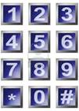
Messages – unlock door
Remote
Home
Azure
Remote
Azure
External Door
Broker
Hub
Browser
MQTT
SignalR
Dashboard
Doorbell
Master Control Panel

Slide 21
Messages – unlock door
Remote
Home
Azure
Remote
Azure
External Door
Subscribe setlock
Broker
Hub
Browser
MQTT
Subscribe lock
SignalR
Dashboard
Subscribe code
Doorbell
Master Control Panel

Slide 22

Messages – unlock door
Remote
Home
Azure
Remote
External Door
Publish code 01
Broker
Hub
Browser
MQTT
SignalR
Dashboard
Doorbell
Master Control Panel

Slide 23
Messages – unlock door
Remote
Home
Remote
Home
Azure
Azure
External Door
Broker
Hub
Browser
MQTT
SignalR
Dashboard
Publish code 01
Doorbell
Master Control Panel

Slide 24

Messages – unlock door
Remote
Home
Remote
Home
Azure
Azure
External Door
Broker
Hub
Browser
MQTT
SignalR
Dashboard
Publish code 01
Doorbell
Master Control Panel

Slide 25
Messages – unlock door
Remote
Home
Remote
Home
Azure
Azure
External Door
Broker
Hub
Browser
MQTT
SignalR
Dashboard
Doorbell
Publish setlock unlock
Master Control Panel

Slide 26
Messages – unlock door
Remote
Home
Remote
Home
Azure
Azure
External Door
Publish setlock unlock
Broker
Hub
Browser
MQTT
SignalR
Dashboard
Doorbell
Master Control Panel

Slide 27
Messages – unlock door
Remote
Home
Remote
Home
Azure
Azure
External Door
Publish lock unlocked
Broker
Hub
Browser
MQTT
SignalR
Dashboard
Doorbell
Master Control Panel

Slide 28
Messages – unlock door
Remote
Home
Azure
Remote
Azure
External Door
Broker
Hub
Browser
MQTT
SignalR
Dashboard
Publish lock unlocked
Doorbell
Master Control Panel

Slide 29
Messages – unlock door
Remote
Home
Azure
Remote
Azure
External Door
Broker
Hub
Browser
MQTT
SignalR
Dashboard
Update UI
Doorbell
Master Control Panel

Slide 30
DIRECT Broker
Home
Azure
Remote
NON SSL
Hub
Browser
NON SSL
MQTT
Broker
SSL
NON SSL
SignalR
Dashboard
NON SSL
Master Control Panel

Slide 31
Gateway Broker
Home
Azure
Remote
NON SSL
Hub
Browser
NON SSL
MQTT
Broker
SSL
MQTT
Broker
SSL
NON SSL
SignalR
Dashboard
NON SSL
Master Control Panel

Slide 32
Mission Critical
Home
Azure
Remote
NON SSL
Hub
Browser
NON SSL
MQTT
Broker
SSL
MQTT
Broker
SSL
NON SSL
SignalR
Dashboard
NON SSL
NON SSL
Master Control Panel

Slide 33
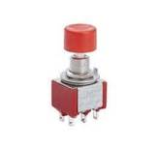
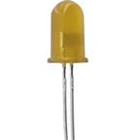
Messaging Patterns
device1
MQTT
Broker
Message
Router
device2

Slide 34
Messaging Patterns
Subscribe
device1
/device1/di/1
MQTT
Broker
Message
Router
device2
/device2/do/1
Subscribe

Slide 35
Messaging Patterns
Publish
/device1/di/1 true
device1
MQTT
Broker
Message
Router
device2

Slide 36
Messaging Patterns
Publish
/device1/di/1 true
Publish
device1
/device1/di/1 true
MQTT
Broker
Message
Router
device2

Slide 37
Messaging Patterns
Publish
/device1/di/1 true
Publish
device1
/device1/di/1 true
MQTT
Broker
Message
Router
device2

Slide 38
Messaging Patterns
Publish
/device1/di/1 true
Publish
device1
/device1/di/1 true
MQTT
Broker
Message
Router
device2
/device2/do/1 true
Publish

Slide 39
Messaging Patterns
Publish
/device1/di/1 true
Publish
device1
/device1/di/1 true
MQTT
Broker
Message
Router
device2
/device2/do/1 true
/device2/do/1 true
Publish
Publish

