Slide 1
Building an Internet Enabled Security System
Part 2 - The Lab
By: Michael Linnen
Twitter: @mlinnen
Blog: www.protosystem.net

Slide 2



Sponsors

Slide 3
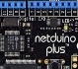


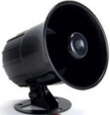


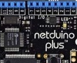
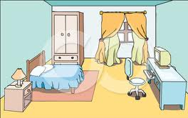






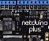
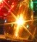
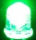
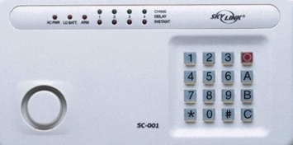






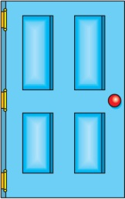


The Big Picture
Talk to me!
Message Broker
Master Control Panel
Worker
Web
Bedroom 1
Master Bedroom
Bedroom 2
Azure
 | Front | Side | Back | Master Bedroom | Bedroom 1 | Bedroom 2 | 1st Floor
Doors
Locked
Windows
Motion
Doorbell
Alarm
Front door
Sleep
Away
Back door
Side door
Master Control Panel Dashboard

Slide 4
Hardware
Netduino Plus – Micro
Ground Bus – Exposes more connections
LED’s – Indicators or simulates actuators
Switches – Keyboard, Window Door Motion sensors, Alarm mode

Slide 5
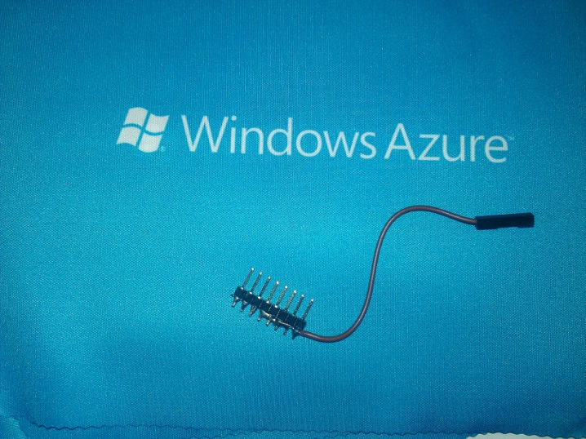
Ground Bus
Connect to LEDs or Switches
Connect to Netduino GND

Slide 6
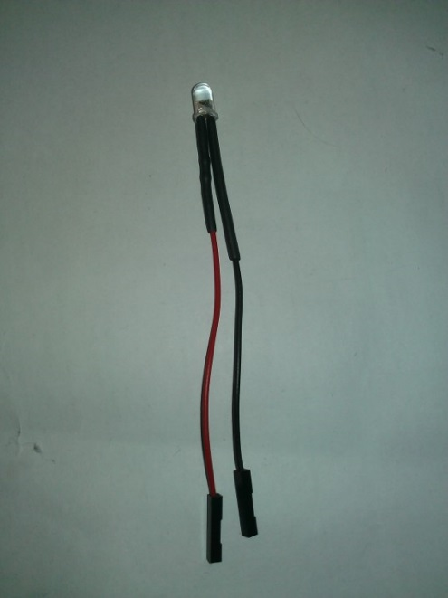
LED’s
Connect to Ground Bus
Connect to Netduino Digital Pin (or 3.3 volt pin to test)
Polarized

Slide 7
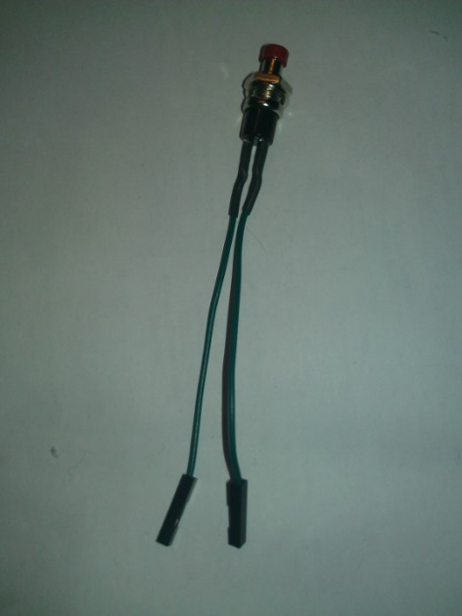
Switches
Connect to Ground Bus
Non Polarized
Connect to Netduino Digital Pin

Slide 8
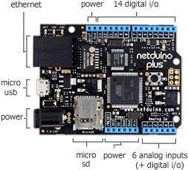
Netduino 3.3 V
Netduino GND

Slide 9
Let’s GET STARTED
Pick a device to build
Doorbell (easiest)
Alarm (a little harder)
External Door (a little harder)
Alarm Panel (hardest)
Fill out the signup sheet
Unique Client ID (use your initials)
Get your bag of parts
Follow the Lab
* Reference: HTTP://www.CloudHomeSecurity.com

Slide 10
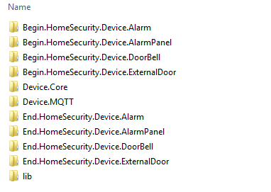
The CODE
Start Here
Final Solution

Slide 11
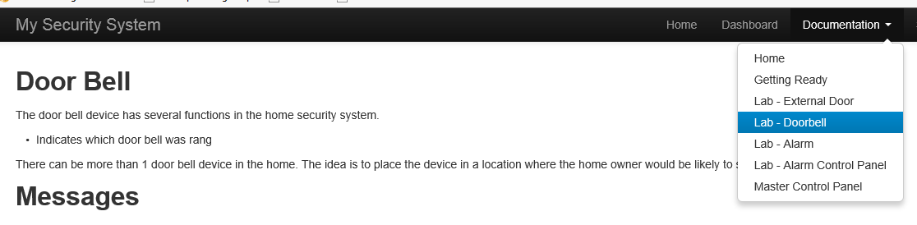
The LAB Instructions
HTTP://www.CloudHomeSecurity.com

Slide 12
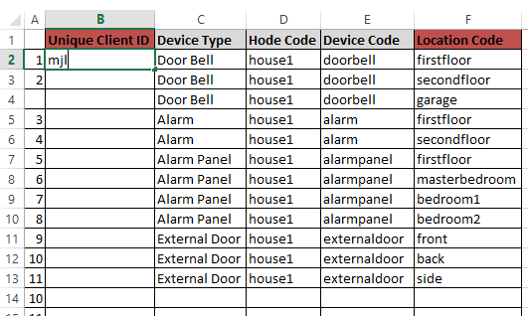
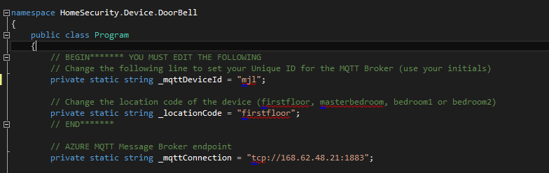
Device ID
Unique ID

