Slide 1
Hands on Hacknight Connecting Netduino's to an Azure cloud service
By: Michael Linnen
Twitter: @mlinnen
Blog: www.protosystem.net

Slide 2
Disclaimer!
This is not a real security system!
This is for education purposes only
Do not use this as your Home Security System

Slide 3
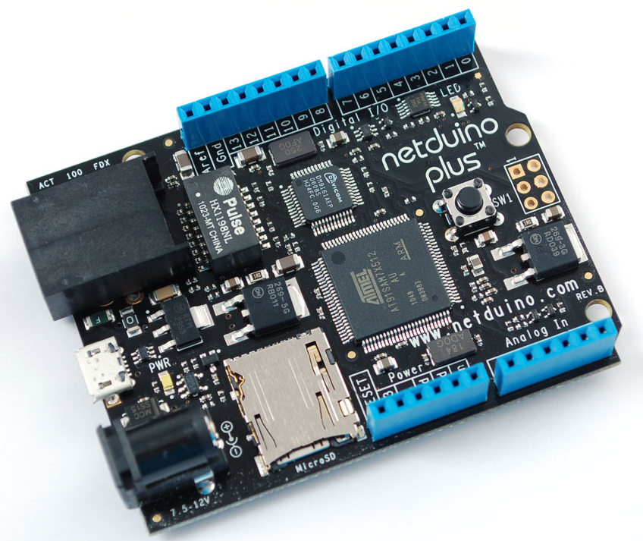
NETDUINO PLUS
Digital i/o Features
All 20 digital and analog pins: GPIO
Digital pins 0-1: UART 1 RX, TX
Digital pins 2-3: UART 2 RX, TX
Digital pins 5-6: PWM, PWM
Digital pins 7-8: UART 2 RTS, CTS
Digital pins 9-10: PWM, PWM
Digital pins 11-13: SPI MOSI, MISO, SPCK
Analog pins 4-5: I2C SDA, SCL
Processor and Memory
Atmel 32-bit microcontroller
Speed: 48MHz, ARM7
Code Storage: 64 KB
without networking: 128 KB
RAM: 42 KB
without networking: 60 KB

Slide 4
AZURE
Unlimited resources
Messaging
Storage
Computation
Web sites
Internet Of Things Enabler
50 billion devices in 2012

Slide 5
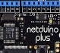


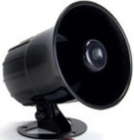


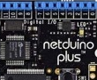
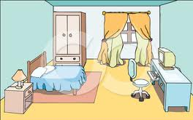






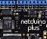
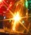
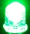
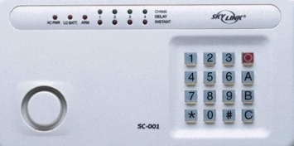




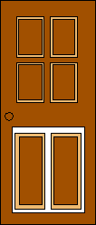

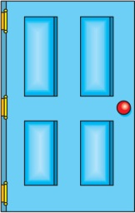


The Big Picture
Talk to me!
Message Broker
Master Control Panel
Worker
Web
Bedroom 1
Master Bedroom
Bedroom 2
Azure
 | Front | Side | Back | Master Bedroom | Bedroom 1 | Bedroom 2 | 1st Floor
Doors
Locked
Windows
Motion
Doorbell
Alarm
Front door
Sleep
Away
Back door
Side door
Master Control Panel Dashboard

