Slide 1
Scaling Fine-Grained MoE Beyond 50B Parameters
Jakub Krajewski, October 2025

Slide 2




The presentation will be based on the paper: Scaling Fine-Grained MoE Beyond 50B Parameters: Empirical Evaluation and Practical Insights
https://arxiv.org/pdf/2506.02890
The project was part of my internship at Nvidia Warsaw
This is a joint work with Marcin Chochowski and Daniel Korzekwa (Nvidia)

Slide 3
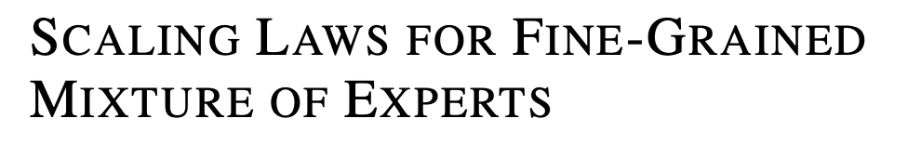

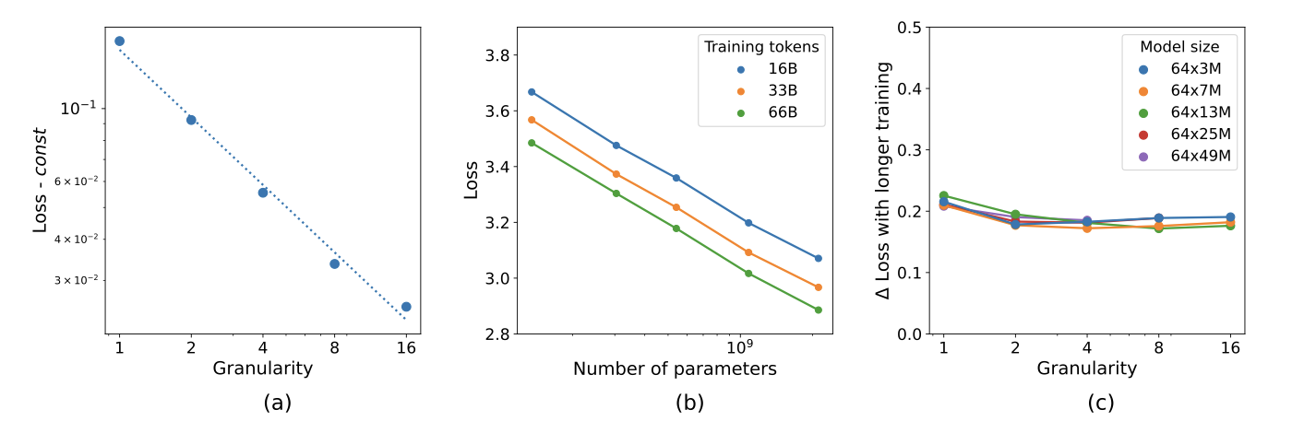

Fine-Grained MoE

Slide 4
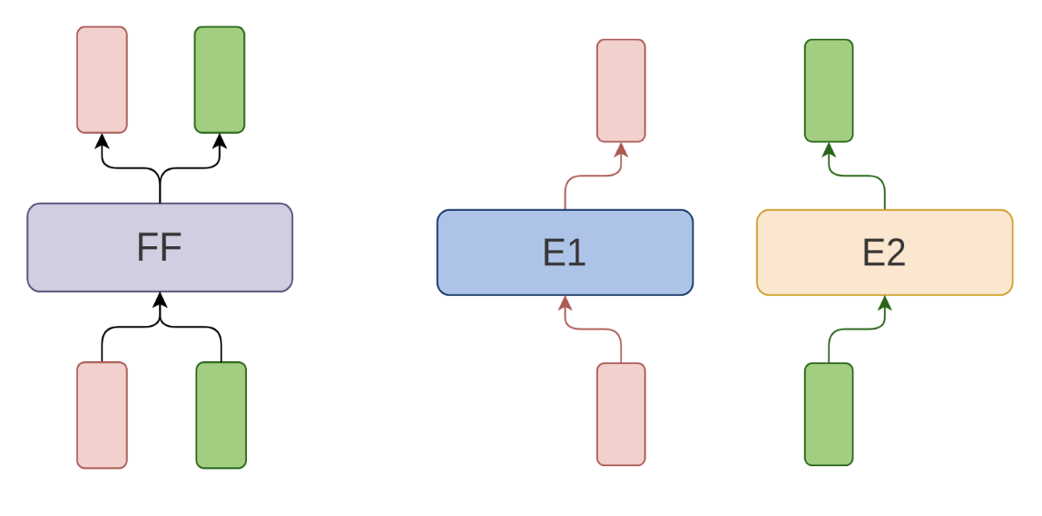
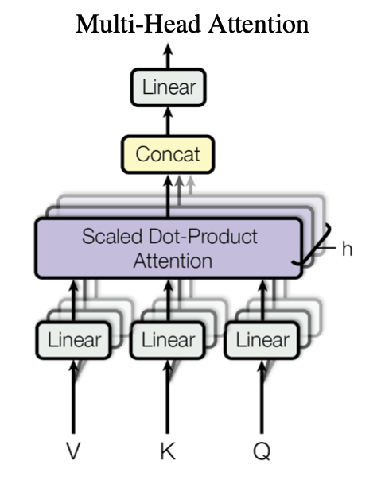
Mixture of Experts

Slide 5
Mixture of Experts

Slide 6
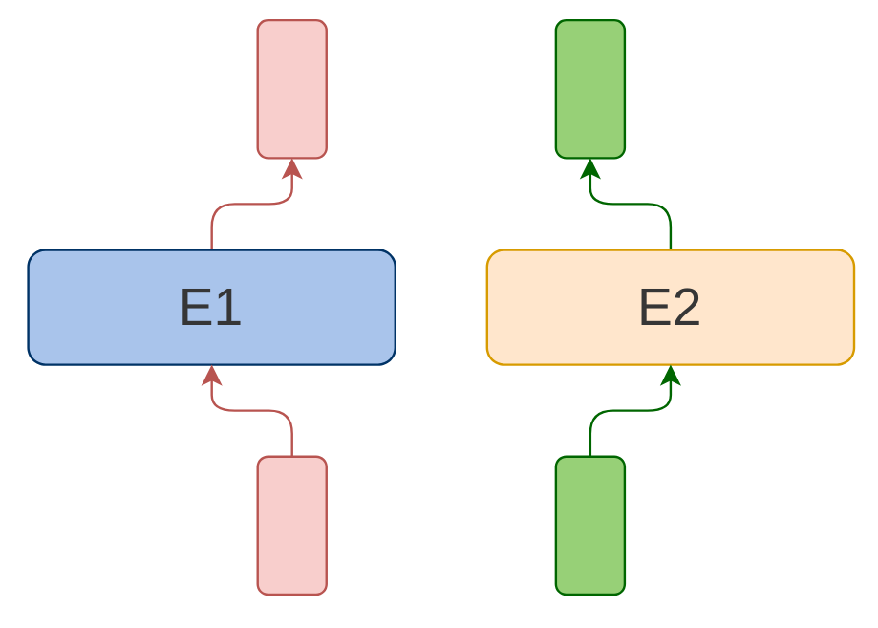
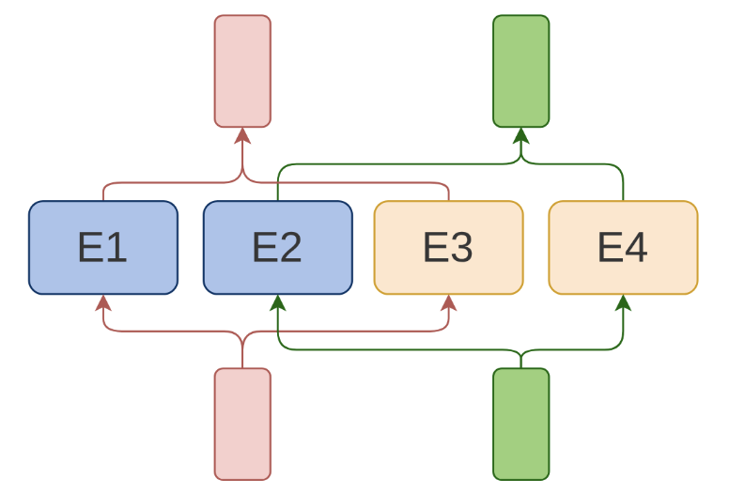
Fine-Grained Mixture of Experts

Slide 7
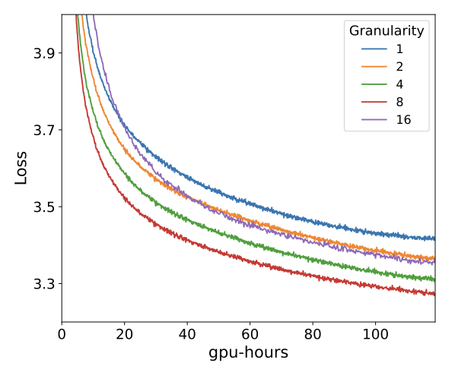
Fine-Grained Mixture of Experts

Slide 8
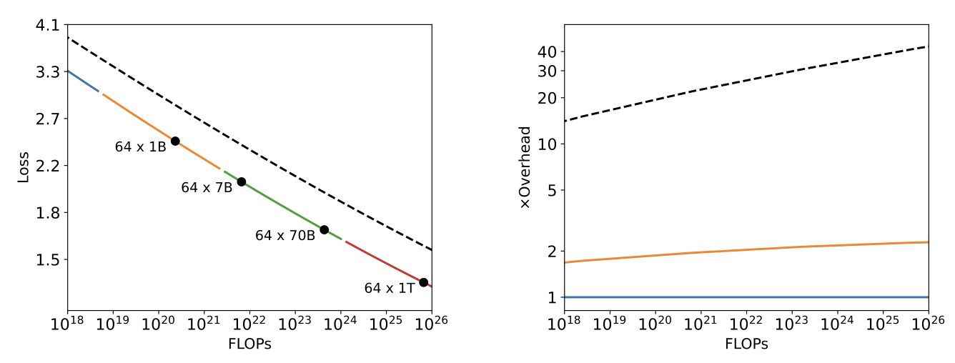
Fine-Grained Mixture of Experts

Slide 9
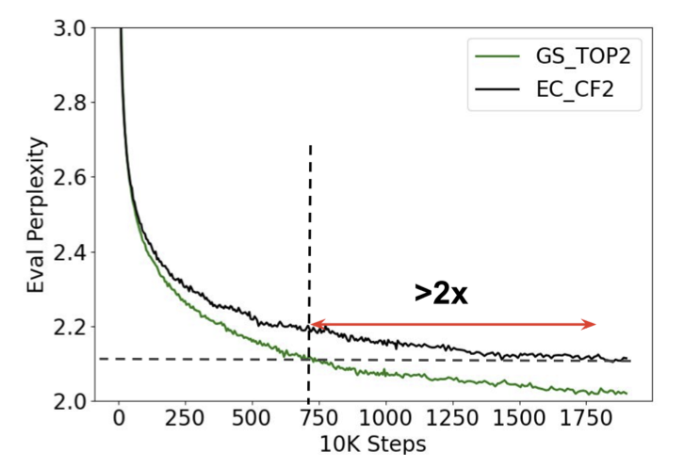
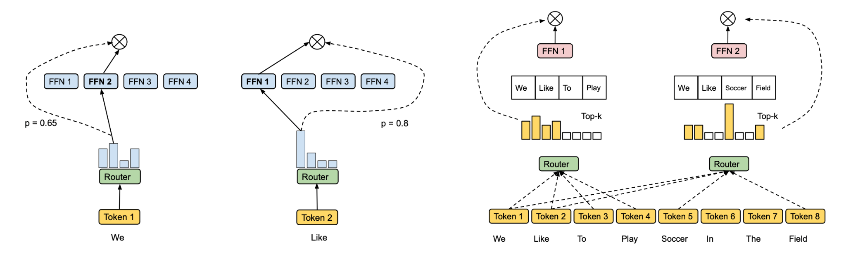
Caveats of the Original Paper
Expert Choice MoE - hard to apply to autoregressive decoding

Slide 10
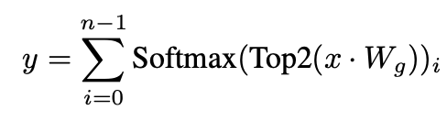

Caveats of the Original Paper
Focus on the Top-1 MoE as the baseline (Mixtral baseline not covered)

Slide 11
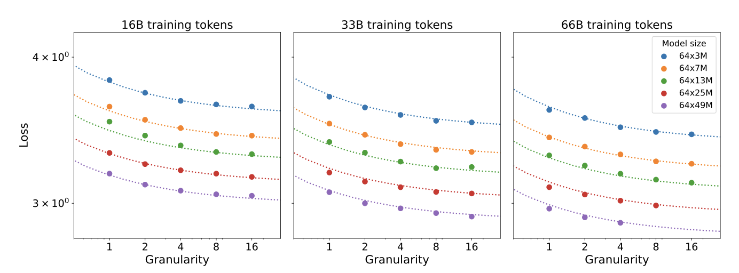
Caveats of the Original Paper
Focus only on perplexity

Slide 12
Goals of the Project
Compare fine-grained MoE to standard baseline on a larger scale
Consider both Top-1 and Top-2 baselines
Analyze load balance in this MoE variant

Slide 13
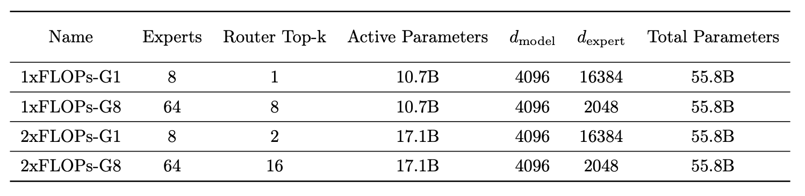
Setup
We consider two baseline MoE configurations: Switch-like and Mixtral-like, and their corresponding fine-grained variants.

Slide 14
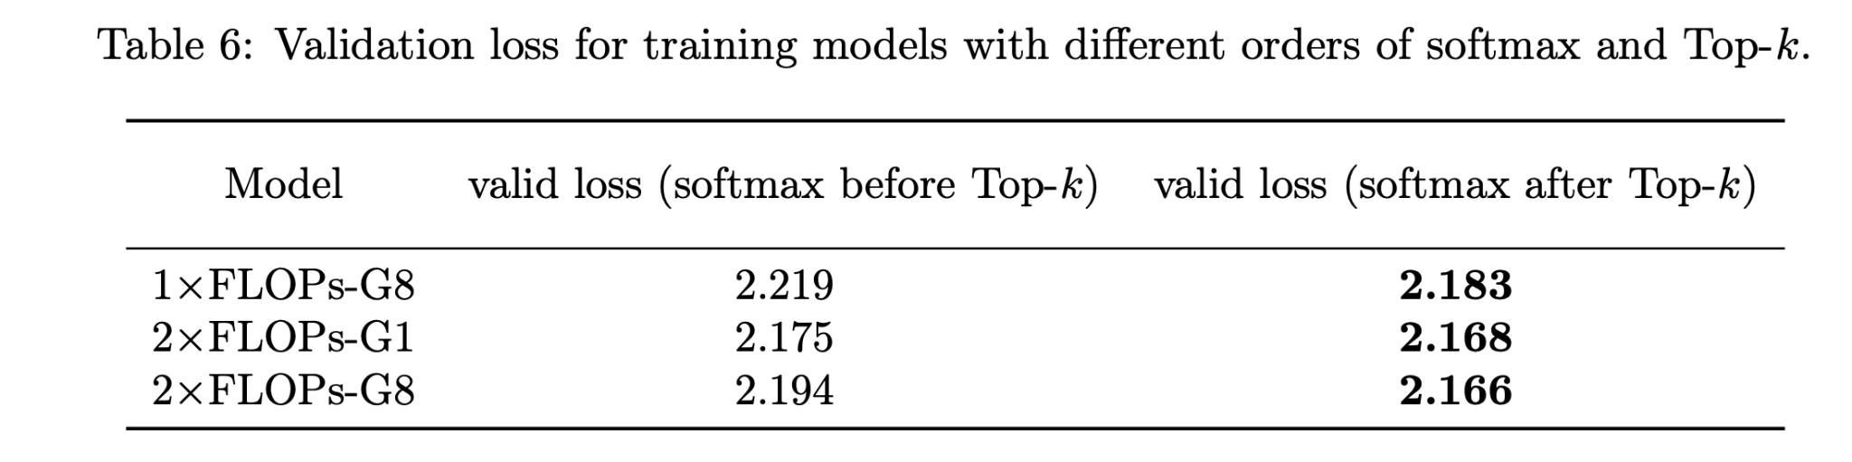
First Finding - Order of Softmax and Top-K
In the router, we observe that it is beneficial to perform the softmax after the top-k selection. This ensures that router outputs are normalized and sum up to 1 across the selected experts. This provides a small improvement for standard MoE but is very important for the fine-grained configuration.

Slide 15
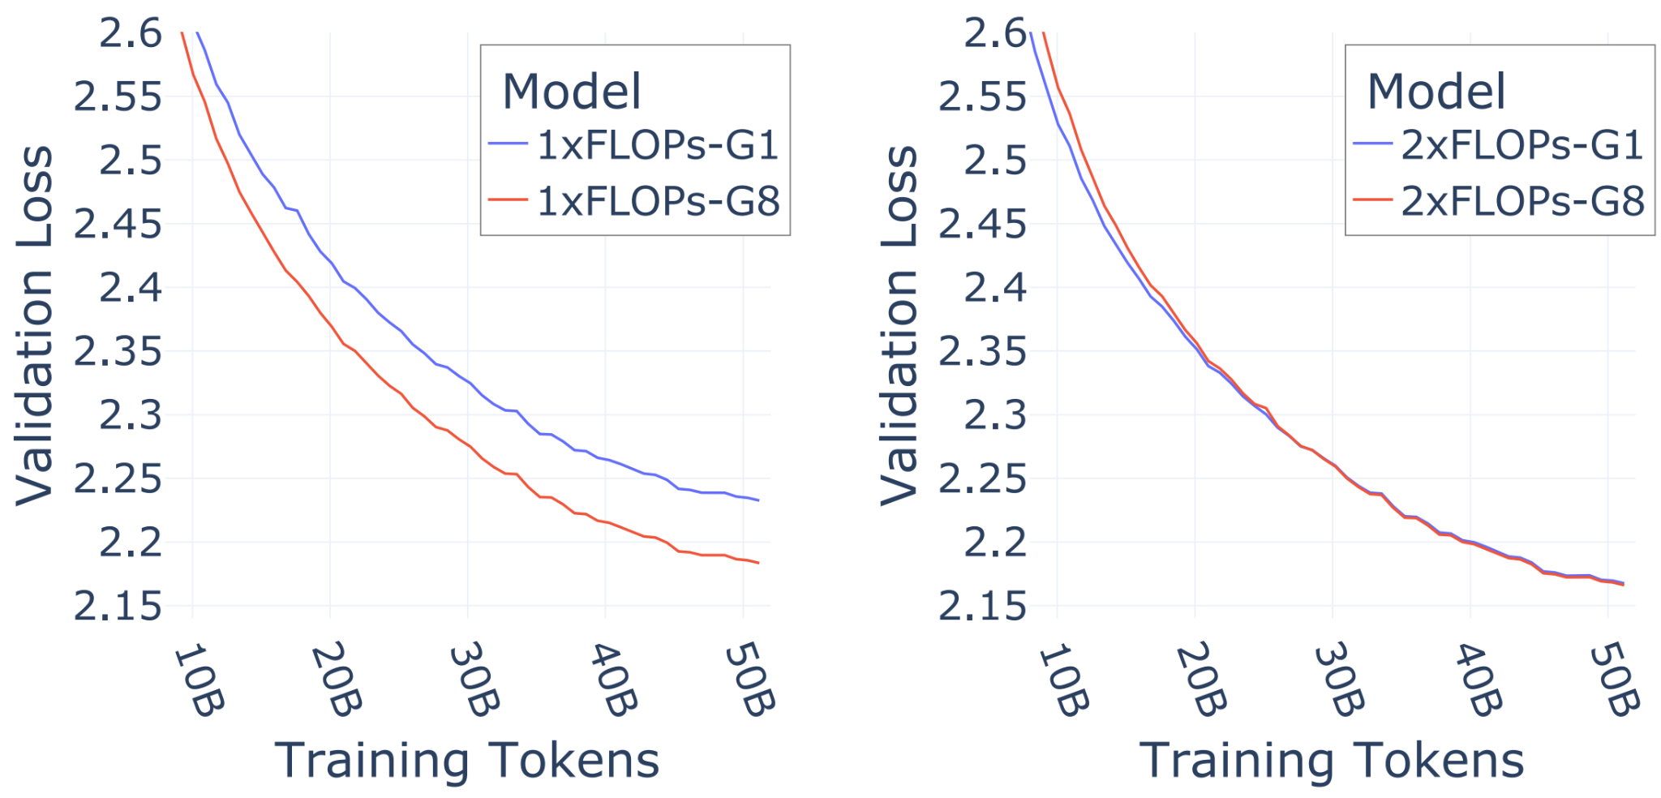
Initial Experiments - 10B Parameters Scale
At the 10B total parameter scale, we observe significant gains from introducing granularity in the Switch-like setup.
Interestingly, for the Mixtral-like configuration, losses are very similar, although the fine-grained model performs slightly better on most downstream benchmarks.

Slide 16
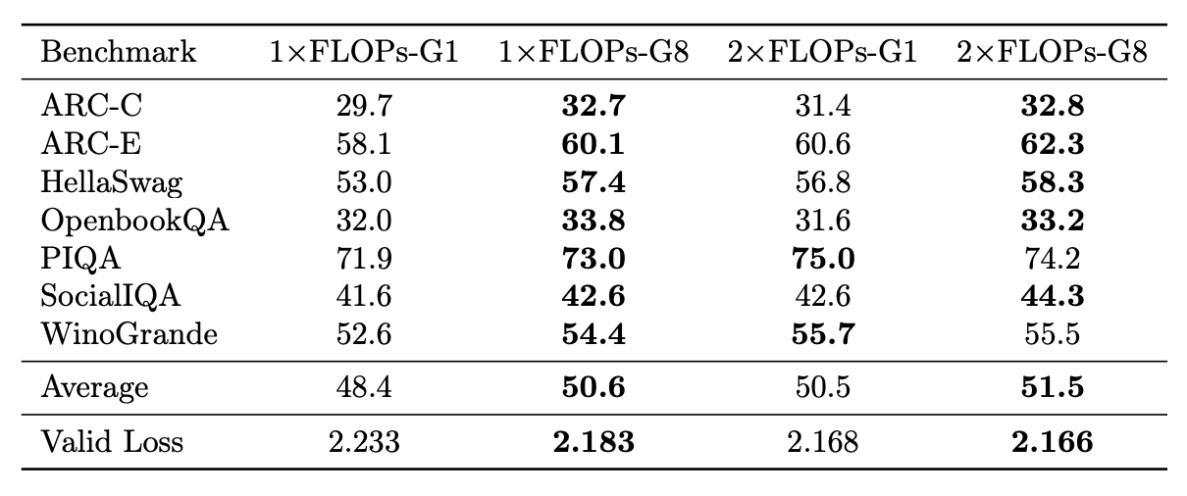
Initial Experiments - 10B Parameters Scale
At the 10B total parameter scale, we observe significant gains from introducing granularity in the Switch-like setup.
Interestingly, for the Mixtral-like configuration, losses are very similar, although the fine-grained model performs slightly better on most downstream benchmarks.

Slide 17
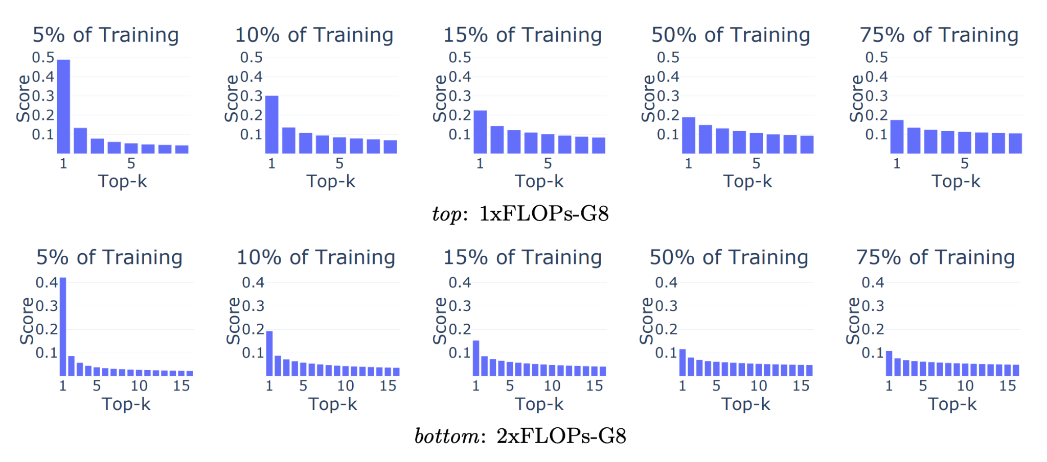
Router Logits Magnitude
We observe that initially, the router focuses solely on its top-1 choice, gradually learning to incorporate additional fine-grained experts over time.

Slide 18
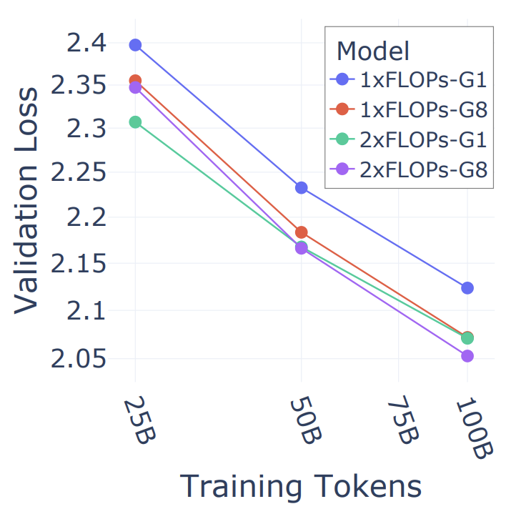
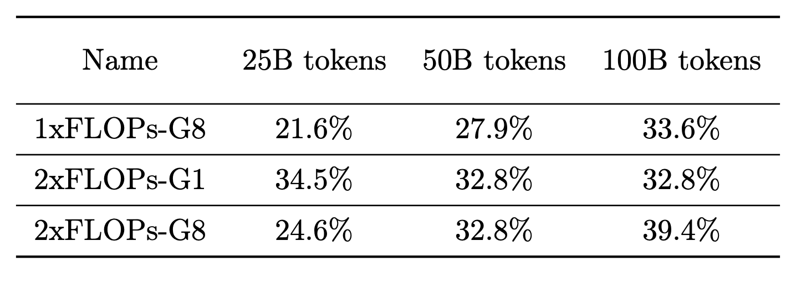
Extending the Dataset Size
We observe increasing gains from using fine-grained MoE when extending the training duration, in both Switch-like and Mixtral-like configurations.

Slide 19
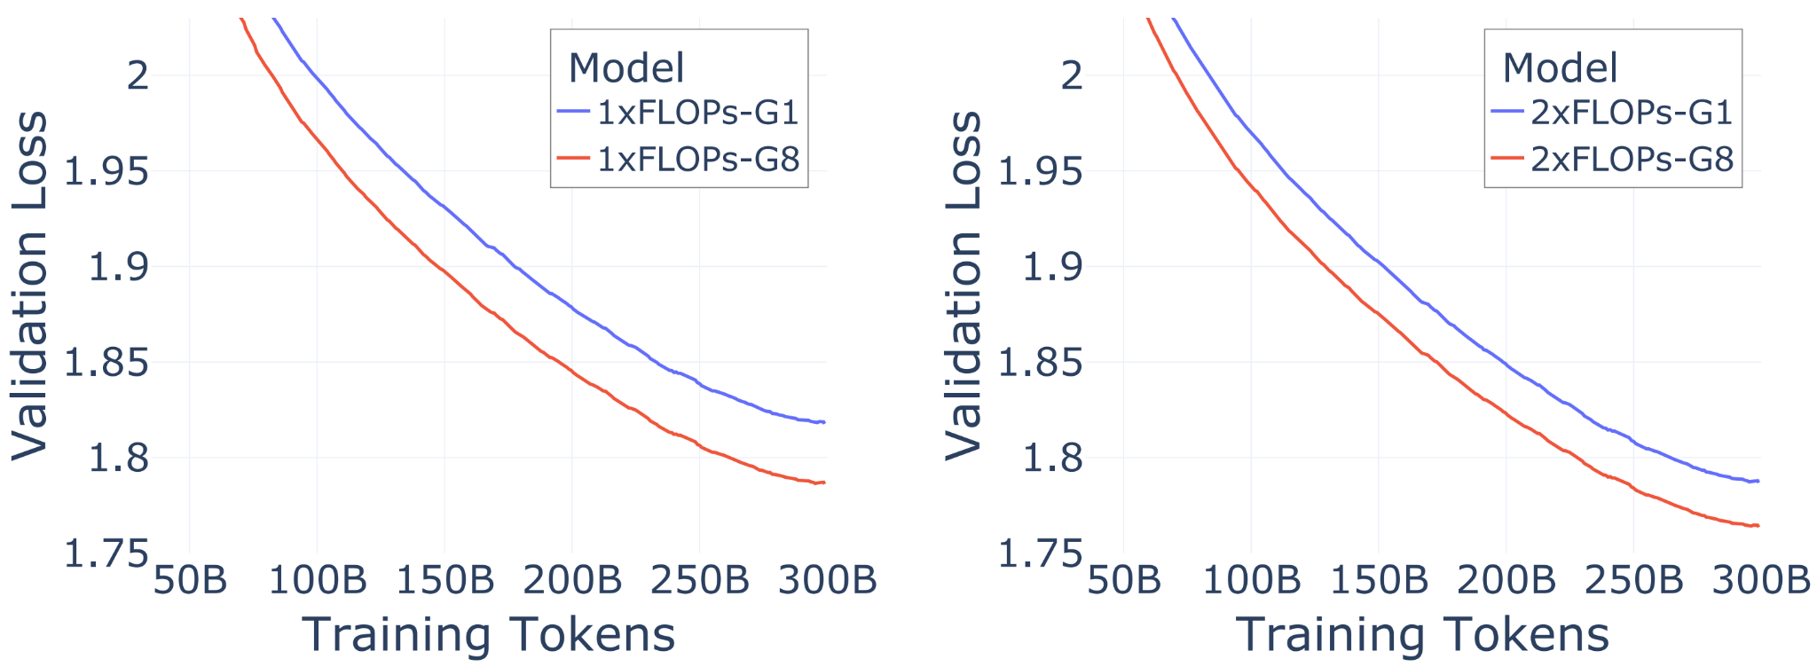
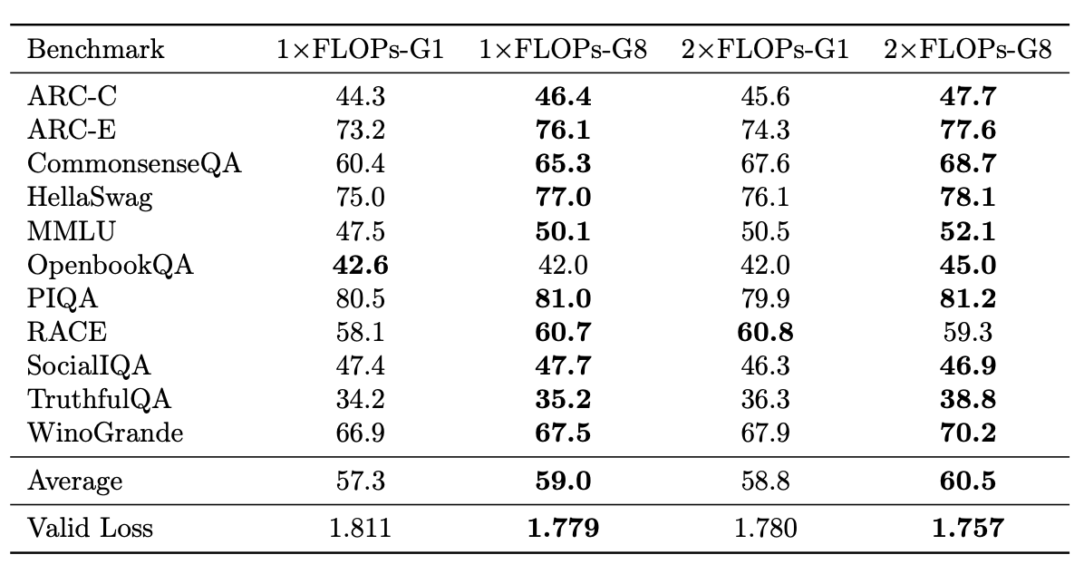
Scaling to 56B Params
At the scale of 56B total parameters, we observe significant advantages from switching to fine-grained MoE for both baseline variants. These improvements also translate into higher accuracy on downstream tasks.

Slide 20
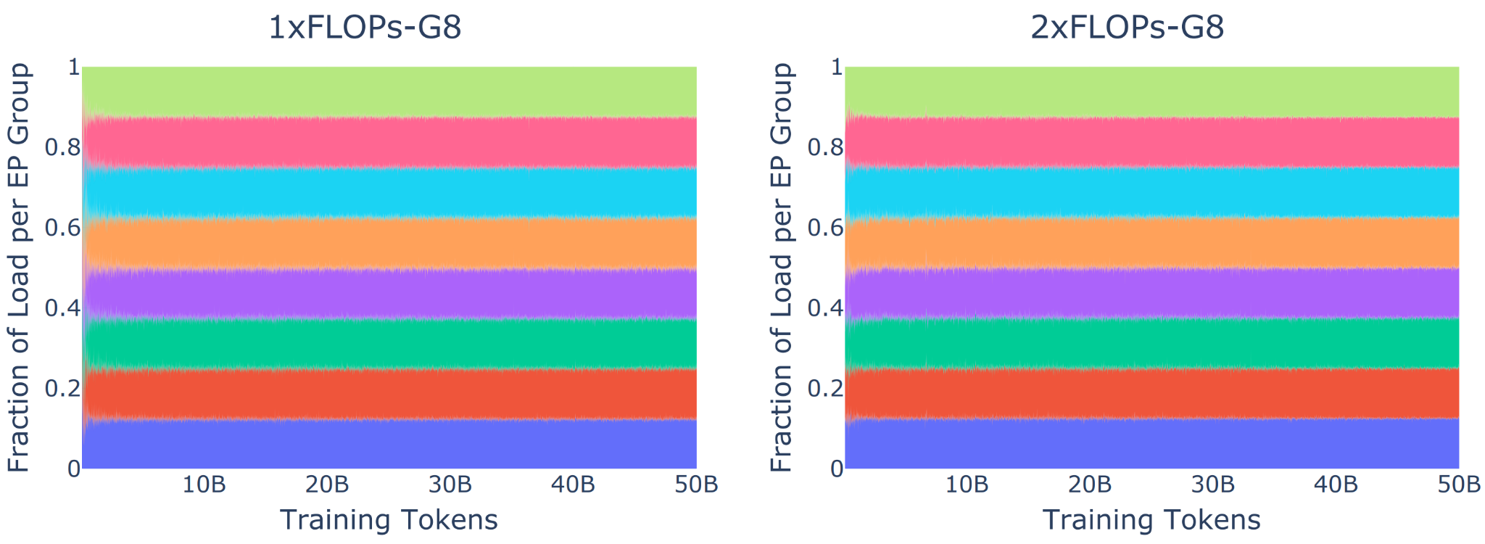
Load (Im)balance
We track the load of each of the 8 Expert Parallel devices and observe that the load balancing loss quickly induces balance between experts.

Slide 21
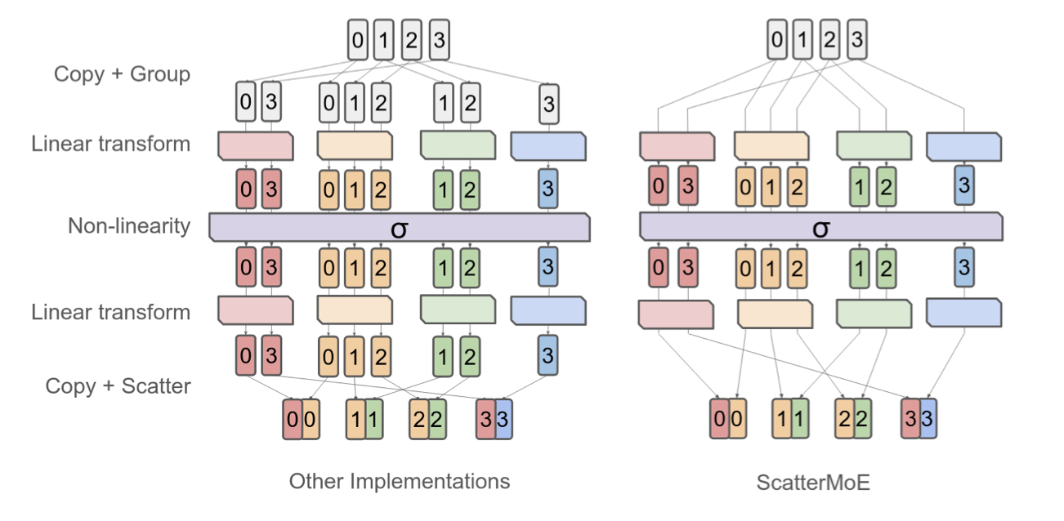
Future Work
Improving the hardware efficiency of granular MoE

Slide 22
Future Work
Why is the granular MoE more efficient?

Slide 23
Future Work
Why is the granular MoE more efficient?
Hypothesis 1: Our intuition - you get more flexibility in mapping tokens to experts
This way we would more easily approximate fully activated dense layer

Slide 24
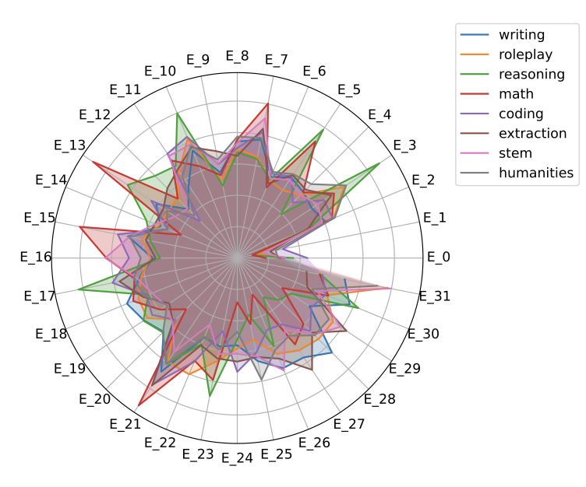
Future Work
Why is the granular MoE more efficient?
Hypothesis 2 (connected with 1): experts specialize more

Slide 25
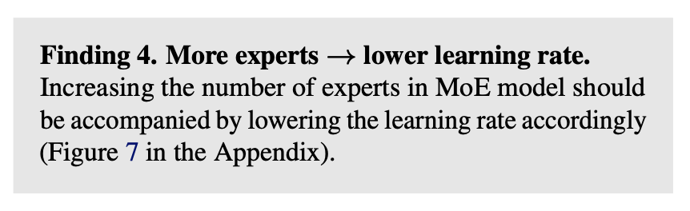
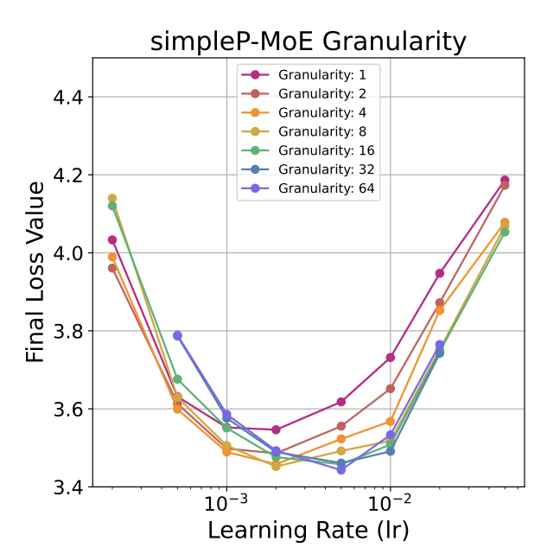
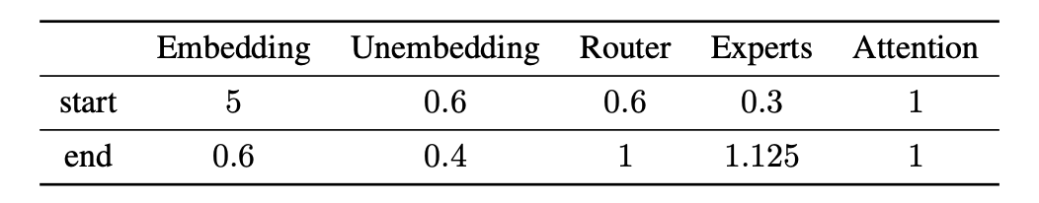
Future Work
Can we optimize hyperparameters better for standard and fine-grained MoE?
In another recent paper, we noticed lower learning rate for MoE with a lot of experts
This effect seems to vanish with higher granularity - why?
We have seen that relative, per-block lrs can improve performance
What about the optimal batch size and weight decay?

Slide 26
Advantages from Granularity Scale Well
The results from my Nvidia internship confirm the gains from granularity
The original (academic) paper was prepared when we only had access to limited compute (models trained on A100 on Athena cluster - but no very large setups)
Granularity, concurrently used in Deepseek-MoE model (predecessor of v2/v3), is now also applied to many SOTA OS LLMs: Qwen, GPT-OSS, Kimi…
There is no guarantee that small-scale results - but in our case they did…
…even without access to huge compute it is possible to do impactful research!

Slide 27
Thank you for your attention!

