Slide 1
Filling in the Blanks
Redefining Inpainting with a Novel Geometrical Latent Space VAE Architecture
Nikodem
Świerkowski
Mikołaj
Jastrzębski
Daniel Borkowski

Slide 2
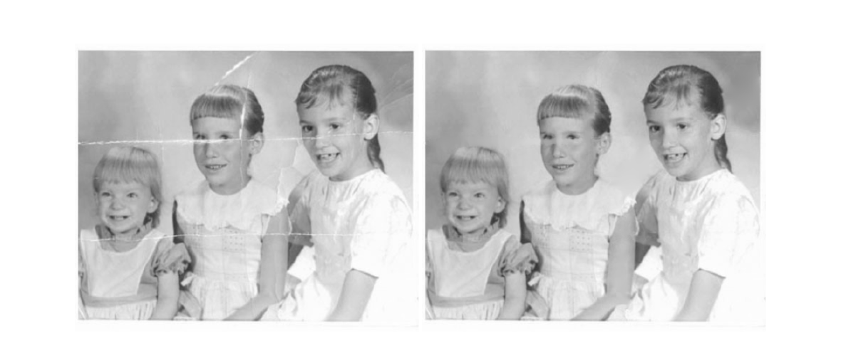
What is inpainting? Why would anyone need it?
Bertalmio, Marcelo & Sapiro, Guillermo & Ballester, C.. (2002). Image Inpainting. Proceedings of SIGGRAPH. 10.1145/344779.344972. Figure 8

Slide 3
Current state of inpainting
Diffusion
based inpainting
CNN+GAN foundations
Structure mask
aware inpainting
Scaling & robustness
2016
2017
2018
2019
2020
2021
2022
time
Notes:
dopisz to co chcesz powiedzieć

Slide 4
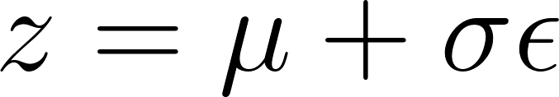
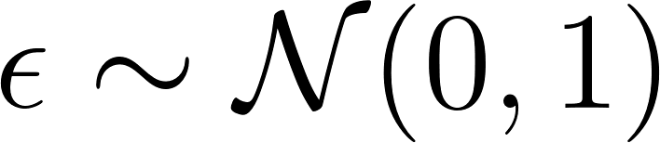
Introduction to VAE
x
x’
μ
encoder
z
decoder
σ

Slide 5
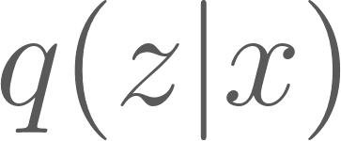
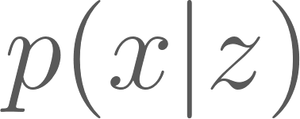
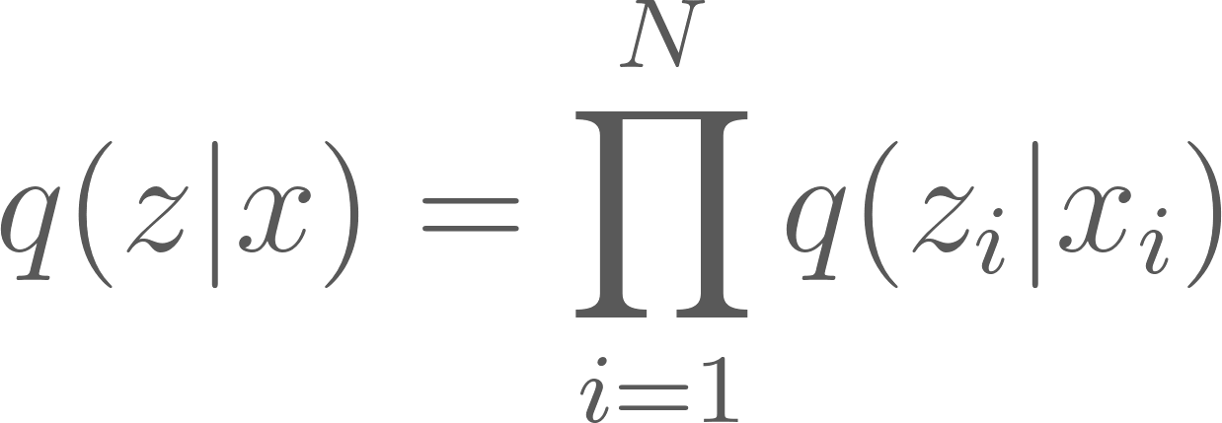
Introduction to VAE
x
z
x’
We assume that:
but under many circumstances complex relations among instances exist.

Slide 6









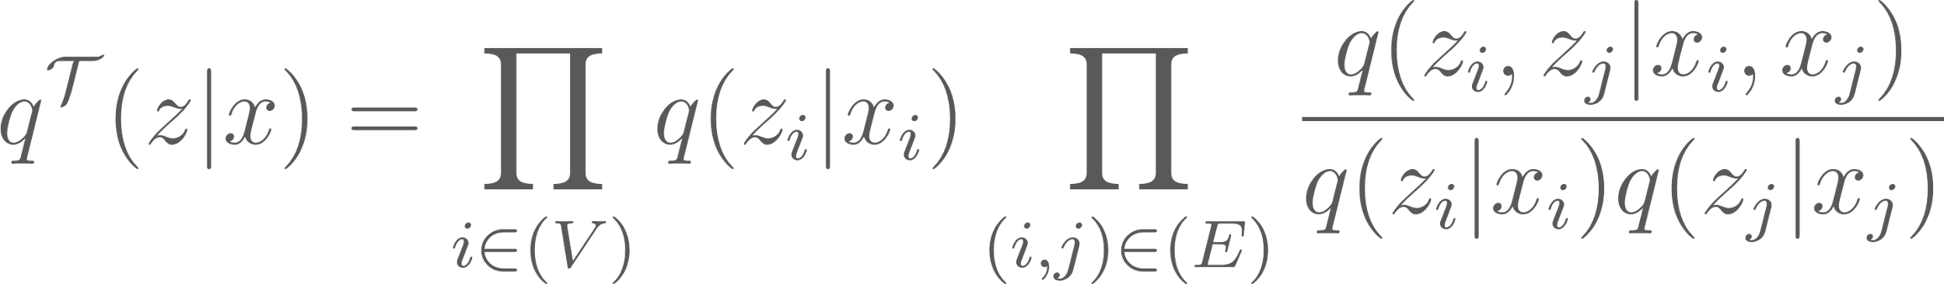
TreeVI
Fully connected graph of latent dims is mapped to MST
Fully Connected
TreeVI

Slide 7
TreeVI challenges
μ
σ
TreeVI
x’
x
init
encoder
decoder
optimize
reparameterize
z

Slide 8
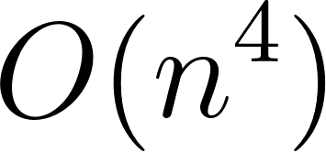
TreeVI challenges
μ
σ
TreeVI
x’
x
Init
encoder
decoder
optimize
reparameterize
z

Slide 9





Our solution
Fully Connected
The model assume correlation between dimension
Vector which represents latent space but each dim is similar to its neighbours from tree
Tree for approximating the correlations
Notes:
When not considering the existence of any relation among instances, we can write the model into a factorized form as p(X, Z) = Q i p(xi |zi)p(zi), where xi and zi denote the i-th data instance and latent variable. Thanks to the factorized form, we can reasonably use the mean-field posterior q(Z|X) = Q i q(zi |xi) for model inference and training. However, there are also many circumstances, under which complex relations among instances exist.

Slide 10
GeoVAE Architecture
μ
σ
x
x’
GeoVI
encoder
graph generator
decoder
dims assess
z

Slide 11
Evaluation I
Model | Epochs | MSE | SSIM | PSNR
VAE | 30 | 0.0910 | 0.5316 | 20.9098
VQ-VAE | 70 | 0.0056 | 0.7194 | 23.4073
TreeVI | 30 | 0.0278 | 0.2321 | 15.8793
GeoVAE | 30 | 0.0055 | 0.6959 | 23.2544
Notes:
When not considering the existence of any relation among instances, we can write the model into a factorized form as p(X, Z) = Q i p(xi |zi)p(zi), where xi and zi denote the i-th data instance and latent variable. Thanks to the factorized form, we can reasonably use the mean-field posterior q(Z|X) = Q i q(zi |xi) for model inference and training. However, there are also many circumstances, under which complex relations among instances exist.

Slide 12
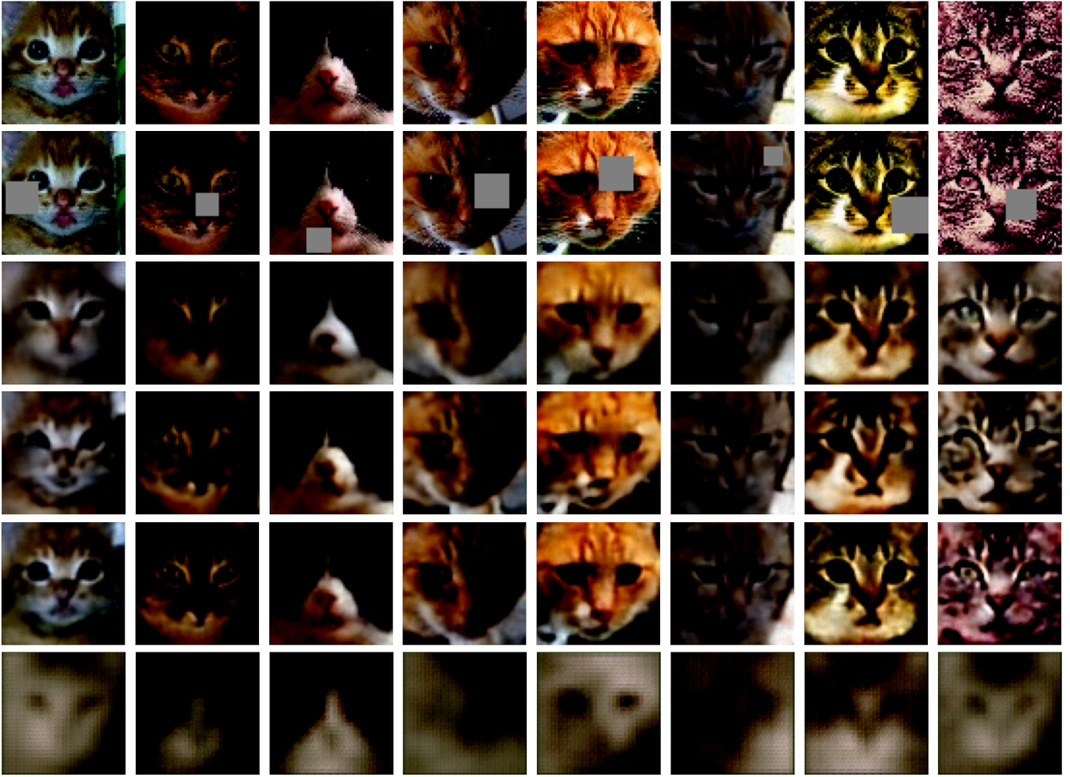
Evaluation II
Target
Input
VAE
VQVAE
GeoVAE
TreeVI
Notes:
When not considering the existence of any relation among instances, we can write the model into a factorized form as p(X, Z) = Q i p(xi |zi)p(zi), where xi and zi denote the i-th data instance and latent variable. Thanks to the factorized form, we can reasonably use the mean-field posterior q(Z|X) = Q i q(zi |xi) for model inference and training. However, there are also many circumstances, under which complex relations among instances exist.

Slide 13

Summary
Providing a relation between latent dimensions allows for achieving better results in the inpainting task.
Still, providing a fully connected graph between latent dims is tough.
Treating this as a geometric problem can be a solution for small, easily trainable generative models.
GeoVAE repository on github
Notes:
When not considering the existence of any relation among instances, we can write the model into a factorized form as p(X, Z) = Q i p(xi |zi)p(zi), where xi and zi denote the i-th data instance and latent variable. Thanks to the factorized form, we can reasonably use the mean-field posterior q(Z|X) = Q i q(zi |xi) for model inference and training. However, there are also many circumstances, under which complex relations among instances exist.

