Slide 1
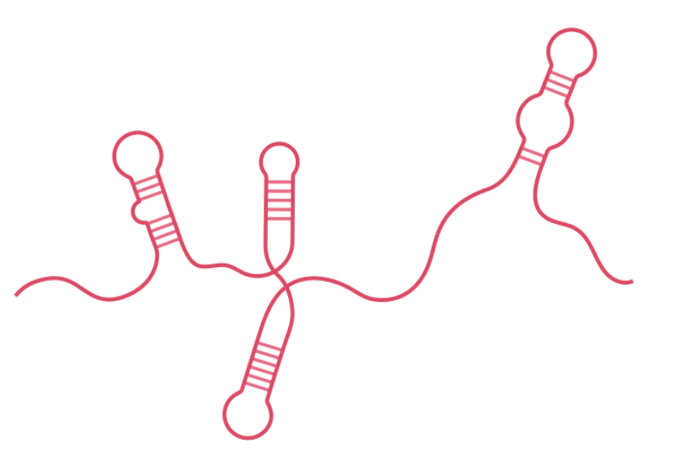
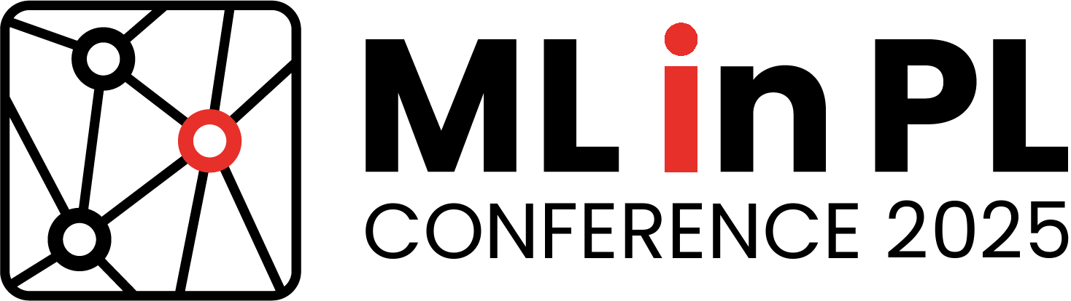
GraphaFold: Graph Neural Network for predicting non-canonical RNA base pairing
Paulina Hladki, Marek Justyna, Maciej Antczak, Marta Szachniuk
Poznan University of Technology

Slide 2

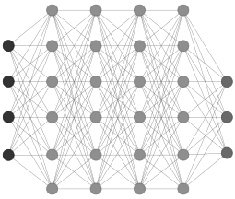

RNA secondary structure
2D structure = network of hydrogen-bonded base pairs
▸ 70-80 % canonical ▸ 20-30 % non-canonical
Sources:
experiment
annotation
prediction

Slide 3
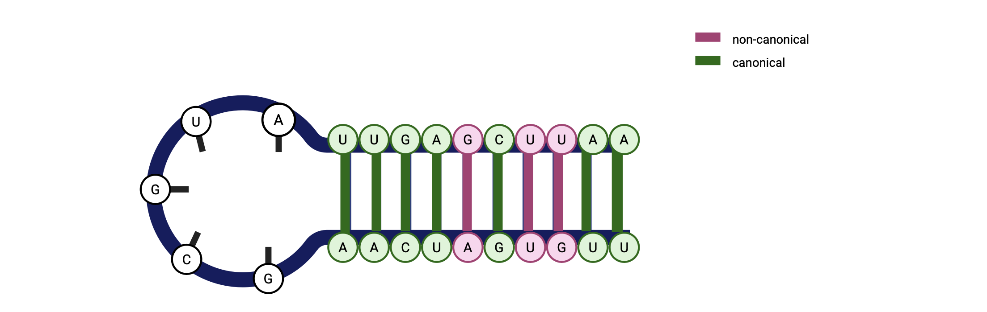
Canonical (70-80% of base pairs) : C–G, A–U
Non-canonical (20-30% of base pairs): e.g. G-U*, A-A, G-A, A-C… (12 Leontis–Westhof classes)

Slide 4
Why non-canonical matters
pairing geometry (hydrogen bonding patterns) | formed by any bases bases interact via Watson-Crick, Sugar, and Hoogsteen edges
abundance and diversity | >100 distinct types documented constitute 20–30% of RNA base pairs often clustered in functional regions
structural roles | enable structural flexibility in loops, bulges, and junctions mediate tertiary interactions stabilize recurrent 3D motifs (e.g., kink-turns, GNRA tetraloops, G4s)
functional roles | critical for RNA-protein recognition facilitate ligand binding enable long-range interactions in large RNAs drive dynamic transitions
prediction challenges | underrepresented in prediction due to data scarcity and diversity

Slide 5
Historical challenge of 2D prediction
1978 Nussinov ▸ 1981 Zuker → O(n³) dynamic programming
Heuristics, probabilistic, DL models (SincFold, SPOT-RNA, UFold)
Limitation: almost all output only canonical pairs

Slide 6
Research goal & hypothesis
Input: any canonical 2D map
Predict: missing non-canonical interactions
Hypothesis: Graph neural network can read context and infer non-canonical edges

Slide 7
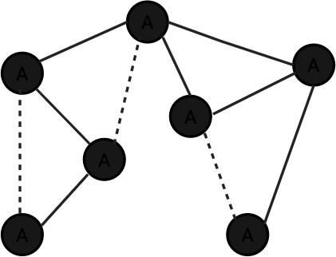
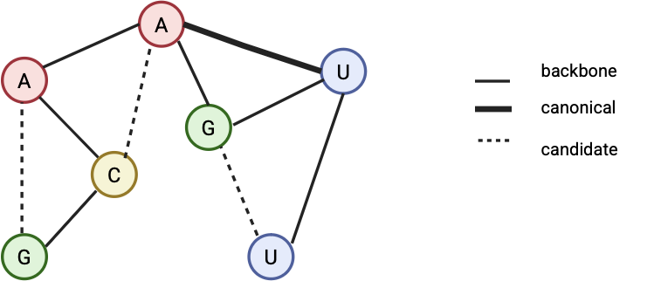
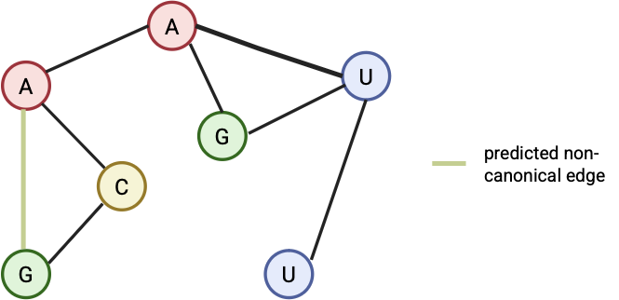
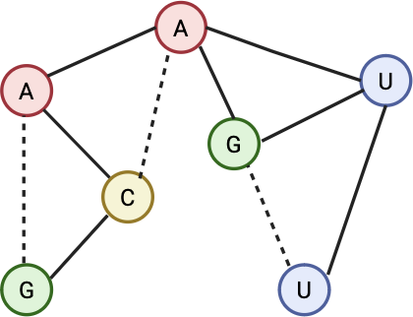
Link prediction

Slide 8
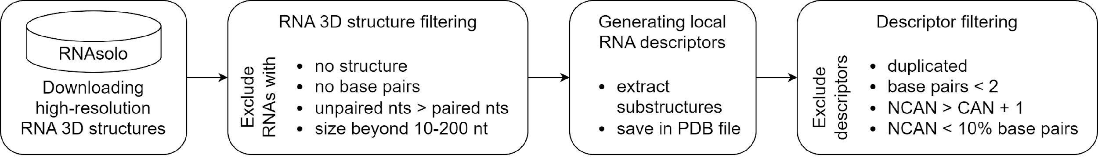
Training dataset
900 high-res RNAs (RNAsolo) ➜ 176 743 local descriptors
*
*Adamczyk et al., Bioinformatics 2022

Slide 9
Training strategy
Two-stage approach
Bi-encoder (Top-K candidate generation)
GNN
Negative sampling mix • Distance priors
Label smoothing • AdamW optimizer
BCEWithLogitsLoss

Slide 10
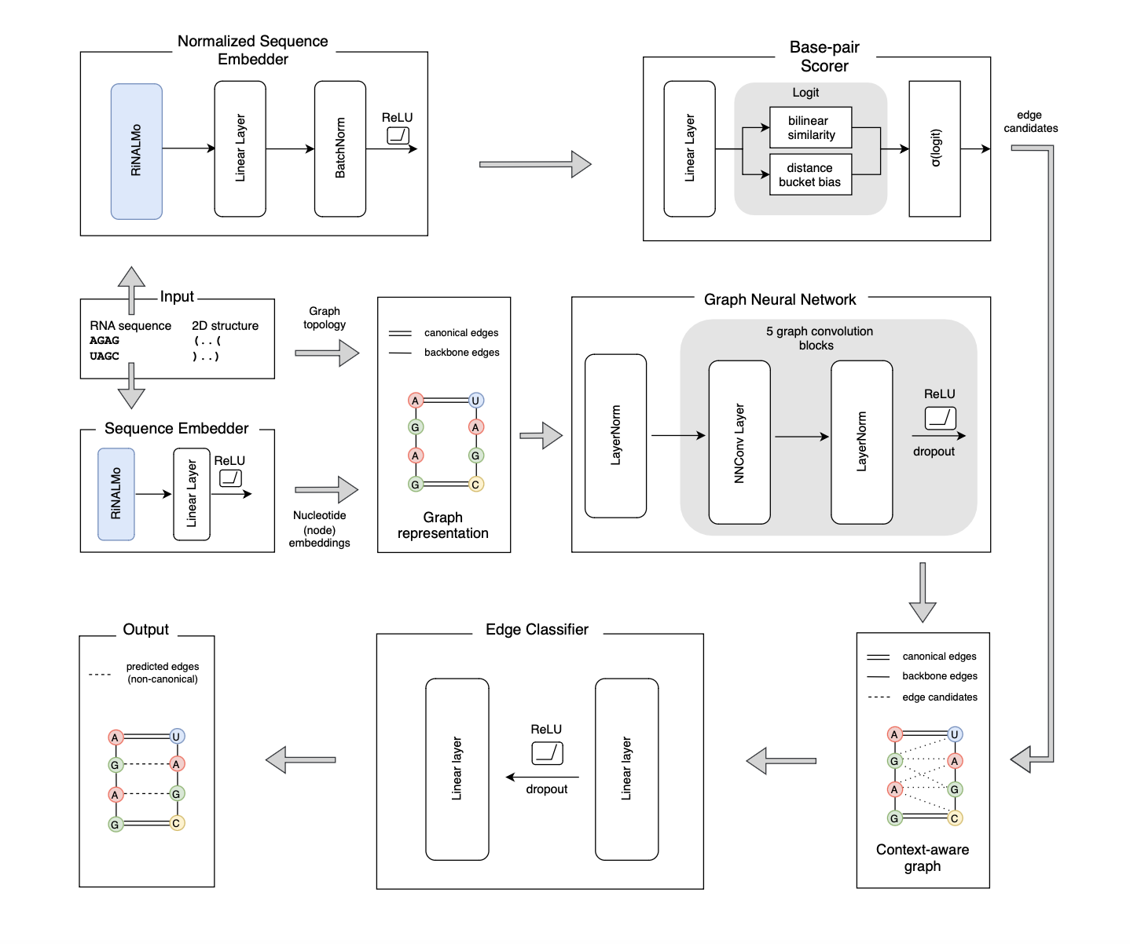



GraphaFold architecture & results
Mean INF = 0.55
Evaluation
Interaction Network Fidelity:
Precision (PPV):
Sensitivity (TPR):
Hladki et al., working paper

Slide 11
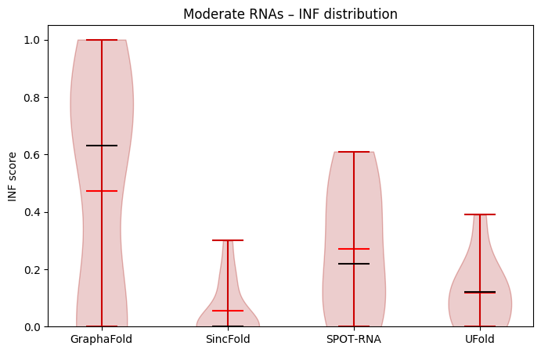
mean
median

Slide 12

End notes
Team:
P. Hladki
M. Justyna
M. Antczak
M. Szachniuk
GraphaFold:
An average INF score of 0.55 for now
Still being optimized
Working paper
Plug-in step after any canonical tool
Does not yet classify pair types (e.g., Leontis–Westhof), suggesting future development directions

