Slide 1
Introduction to careers and challenges in Quantitative Finance
Dr Charles Martinez
Charles.Martinez@gresearch.co.uk

Slide 2
Agenda
1
Introducing G-Research
2
What does a Quant look like?
The Black Box
3
Our recruitment processes and schemes

Slide 3
Introducing G-Research
G-Research is a quantitative research firm
We develop fully automated algorithmic trading strategies for global electronic markets
Our main focus is global equities but we also work in FX
Our group trades in over 40 markets globally, 24 hours/day, 6 days/week
CREATE
TODAY
Predict
Tomorrow

Slide 4
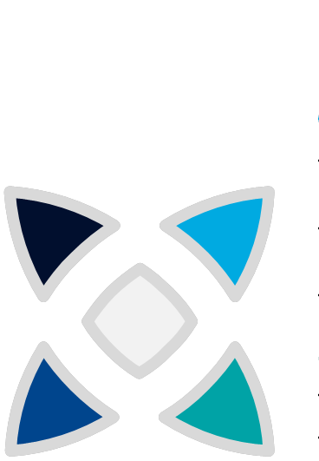
How do we work?
Close Partnership with Engineering
Platform takes care of services – quants focus on research
100s of developers and IT staff working directly with research
PBs of market data
Small Autonomous Teams
Areas of specialisation, working on part of the big machine
Lots of cross-collaboration
Focus on learning
Long term development
Machine learning College
Fundamentals College
Reading Groups
Conferences (ICML, NeurIPS)
Massive Compute Resource
Almost 10k A100 GPUs
Several 10s of PB storage
Several 100k CPU cores
We have 1,200+ employees: headquartered in London (where we have three main offices and a new one opened in 2023 on Oxford Street), as well as an engineering hub in Dallas, opened last year

Slide 5
Beating the Efficient Market Hypothesis
This sounds either impossible or illegal – “you can’t beat the market” – as this contradicts the efficient market hypothesis (EMH).
But EMH is wrong: there are hidden patterns that we can exploit, just about. But it takes lots of skill, cutting-edge ML, maths, data, and raw computing power.
All predictors can be represented mathematically – it really is a numbers game, and even in the present unusual circumstances: maths beats discretionary trading!
Being 51% right is enough – the law of large numbers is your friend!
Secrecy is key: the moment information leaks into the public domain, the trading signal quickly decays.

Slide 6
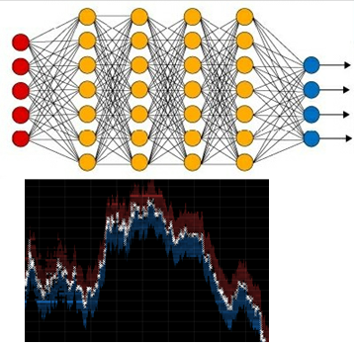
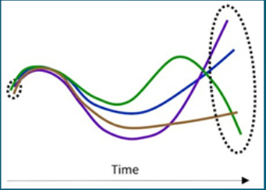
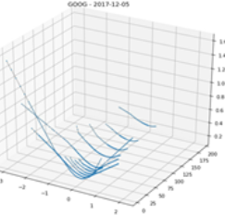
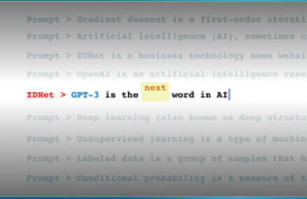
Lots of interesting Maths, ML, Data Science
Signal modelling: Machine learning using a wide range of advanced techniques
Portfolio construction: Stochastic Optimisation
Market impact: Multi-dimensional inverse problems
Feature construction: Order book microstructure to fundamental analysis
Textual and Audio-Visual analysis: NLP using ML techniques
Options books : PDEs

Slide 7
How do we use Machine Learning
Machine learning is core to our success: Machine learning is used by the bulk of our signals and is core to the past and future success of this business. If our ML models do not work, we do not make money
We work with petabytes of data and vast compute resources
We keep up with the latest research and apply recent developments at scale: We are currently using techniques published in ICML 2022 and NeurIPS 2022 in production
While I cannot go into specifics, some general methods we use heavily are:
Various deep learning techniques, transformers, reinforcement learning
Bespoke large scale distributed training of non-linear tabular modelling methods
State of the art Bayesian machine learning methods

Slide 8
How do we use Machine Learning
A selection of current tools we use are: XGBoost, LightGBM, Tensorflow, Pytorch, GPFlow, GPyTorch, Numba, Dask, Ray, Horovod, Pytorch Lightning, Modin
Signal research is broken down into teams: Each team focuses on different techniques and data sources
Thousands of features are shared between teams: There are inputs available to allow a machine learning researcher to be productive and hit the ground running from day 1
Researchers work closely with embedded developers in collaborative teams: This ensures our Researchers have the tools and support they need to be productive

Slide 9
What do Quants do at G-Research?
Forecasting Returns
Market Data, Signal Reconciliation
Portfolio and Optimisation
Optimisation, Mathematical Modelling
Execution
Optimisation, Mathematical Modelling
Forecasting: typically financial assets, but could be data from satellite imagery, twitter feeds, traffic analysis……
Signals: we take multiple signals for a given financial instrument and combine them
Execution: in a dynamic marketplace full of sophisticated competitors, our quants continuously optimize the execution of trading strategies

Slide 10
The Typical Quant
Is fresh from academia, in a maths, physics, stats, engineering or data science related field
Can articulate and test a hypothesis
Has experienced real-world messy data
Thinks creatively, is a problem solver
Is motivated and self directed
Has an aptitude for coding
Has very little finance knowledge

Slide 11
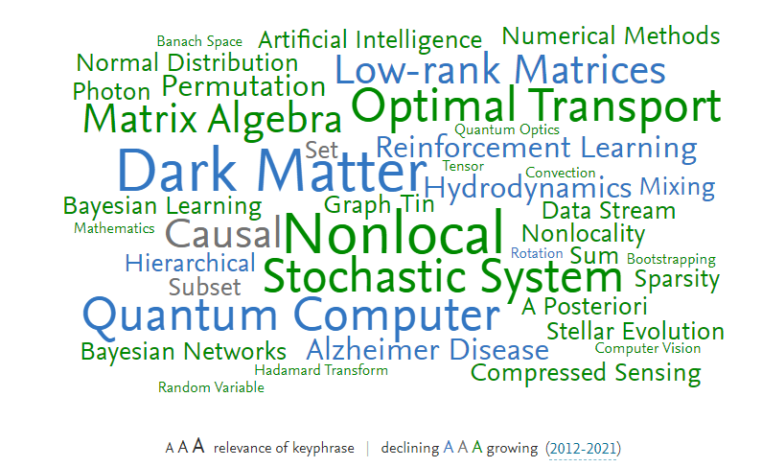
What does a Quant look like?
Extracted from SciVal database

Slide 12
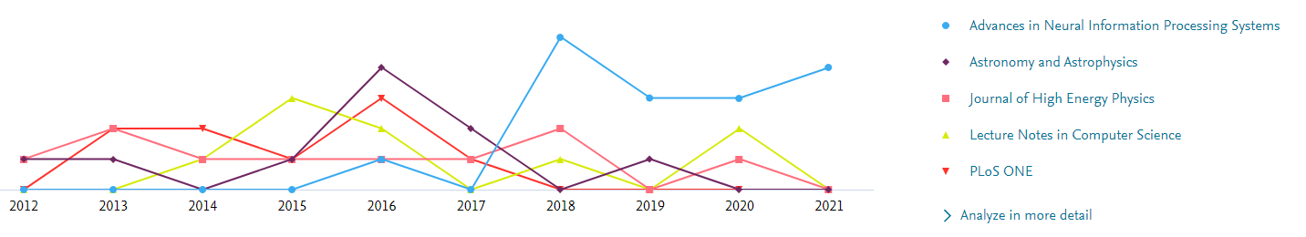
What does a Quant look like?
Extracted from SciVal database

Slide 13
What is needed?
Strong maths foundation
Calculus, Linear Algebra, Probability and Statistics
Advanced programming skills
Python inc libraries such as Numpy, pandas
Data analysis techniques
Time series analysis, Machine learning, Data manipulation
Communications
Hunger for learning

Slide 14
Your Work
Your work has a very clear, quantifiable impact on the business: Once a researcher has developed a model, it is back-tested extensively, and if it works it goes into production and contributes directly to the company’s success
We are incentivised to explore and utilise the cutting edge: We work on one very mature problem – predicting financial markets. Even tiny improvements have the potential to have huge value
We have a good track record: Our signals have consistently disproved the Efficient Market Hypothesis over many years
We have excellent work-life balance: Particularly compared to some of our competitors
We do not service clients: We can focus on ideas and execution, not keeping outside investors happy

Slide 15
Life at G-Research
Autonomy within your research projects
Managerial direction and support
Collegiate, collaborative environment
Structured development
Long term nurturing, no short term pressure
Low turnover, low stress

Slide 16
Our recruitment processes and schemes
Small Grants scheme
Spring Week
Summer Research Programme
Permanent Hires

Slide 17
Small Grants Scheme
Every month we give away £2,000 in grant money to early career researchers – and are especially interested in applications that are difficult to get funding for elsewhere (e.g. travel if you are caring for children; expenses for volunteer work related to your research).
Applying is easy: just send us an email at grants@gresearch.co.uk with your CV and a brief summary (no more than one page) of what you would use the grant for. You may include a letter of reference if you think it will help your case.

Slide 18
Spring into Quant Finance
15th April to 19th April 2024
Aimed at 2024 graduates and Masters PhD 2025 graduates
Hosted in the South of France (Nice)
5* hotel & £750 stipend
All expenses included
Hear talks about the industry
Talk to our CEO and Directors of Research
Undertake specialized training on ML, data science and finance
Network with our Quant team

Slide 19
Spring into Quant Finance
Quant Quiz (online)
Verification call (15 min)

Slide 20
Summer Research Program (Open for applications)
10 week programme 24th June – 30th August 2024
Aimed at 2025 PhD/Masters graduates
You will be paired with a mentor working on a specific project
Previous projects include:
Exploring how uncertainty in trading volume predictions can in turn be used to trade more effectively
Building a complex machine learning model to help predict upcoming earnings for businesses

Slide 21
Summer Research Program
£3,750 per week
Accommodation included
£2,000 stipend to spend on attending a conference, up to two years after internship
Many social activities

Slide 22
Summer Research Program
Quant Quiz (online)
Triage interview
Mentor technical interview x3
Interview with Deputy Head of Research

Slide 23
Permanent Hires
You can find our open positions under www.gresearch.co.uk/join-us/quant-research/
Starting salary of £200,000
Annual discretionary bonus
35 days annual leave
9% Employer pension contribution
Free lunches
Full company social calendar
In-house barista

Slide 24
Permanent Hires
Quiz (online)
Triage interview
Technical interviews (choice of 3 out of 4 )
Interview with Hiring manager
Interview with Head of Research
Interview with CEO

Slide 25
What do the Quiz and Interviews cover?
Be familiar with concepts such as: The Black Scholes equation, Sharpe ratio, portfolio optimisation, CAPM, time series analysis, PDEs, convex optimisation, securities markets 101, pairs trading strategies, trend following and mean reversion strategies, market microstructure, & Monte Carlo methods
1st and 2nd year undergraduate probability and statistics is sufficient. Please see below the course synopsis for these at University of Oxford and MIT, which contain a good overview. There also might also be useful exercise sheets and lecture notes on these pages.
Probability: https://courses.maths.ox.ac.uk/course/view.php?id=1044
https://courses.maths.ox.ac.uk/course/view.php?id=660
https://courses.maths.ox.ac.uk/course/view.php?id=678
Statistics: https://courses.maths.ox.ac.uk/course/view.php?id=1037
Introduction to probability & statistics: https://ocw.mit.edu/courses/mathematics/18-05-introduction-to-probability-and-statistics-spring-2014/
Maths of Data Science: https://ocw.mit.edu/courses/mathematics/18-s096-topics-in-mathematics-of-data-science-fall-2015/

Slide 26
Tips
One way of preparing for the quiz is to work through a book like Stefanica, Radoicic and Wang (1). It emphasises numerical methods more and statistics less. Its more advanced questions are closer to the level of our triage interview questions than of our quiz questions
We do not assume a detailed knowledge of finance. If you wanted a single source however, Narang (2) is a good, casual introduction to many of these concepts. If you were interested in getting some trading experience, Narang’s focus on trading strategies can help you assess and implement your understanding of the theory
If you want coding practice, ProjectEuler.net is a nice place to start: it provides bite-size maths problems that often require a computational solution. Codility, Kaggle and TopCoder have similar projects. Kaggle prediction problems are close to a lot of quant work.
Googling ‘programming brain teasers’ is also good preparation for the programming technical interview
Schwager (3) interviews successful fund managers about their trading strategies
For further reading on ML, take a look at Cracking the Coding Interview and The Elements of Statistical Learning
(1) Dan Stefanica, Radoš Radoicic and Tai-ho Wang. 150 Most Frequently Asked Questions on Quant Interviews. Pocket Book Guides for Quant Interviews. FE Press, 2013
(2) Rishi K. Narang. Inside the black box: A simple guide to quantitative and high frequency trading. 2nd. John Wiley & Sons, 2013.
(3) Jack D Schwager. Hedge fund market wizards: How winning traders win. John Wiley & Sons, 2012.

Slide 27
GR Open Source Software (GR-OSS)
In support of G-Research’s activities in quantitative research, the GR Open Source Software team contributes to a variety of projects in the open source ecosystem, with a focus on three fundamental and overlapping areas of research:
• Data science and machine learning tools
• The infrastructure to support those tools
• Security across those tools and infrastructure
GR-OSS also plays an active and public role in the larger open-source community, taking responsibility for maintaining public projects, supporting open-source foundations, and helping guide continued development of security and infrastructure projects.

Slide 28



Main Projects
Multi-kubernetes-cluster
batch job meta-scheduler.
JIT (just-in-time) compiler
for high-performance GPU programs
ML experimental data
tracker

Slide 29
GR Open Source Software (GR-OSS)
Additionally, GR-OSS is developing academic research collaborations with a broad focus on research methods, emerging hardware and infrastructure trends, and new Machine Learning tools.
Initial partners include UC Berkeley’s EPIC Data Lab and the i-SCALE IUCRC.
Learn more about our projects on our website: https://opensource.gresearch.com and follow us on Twitter and YouTube.
Expressions of interest can be sent to the G-Research Open-Source Software team at: admin@gr-oss.io.

Slide 30
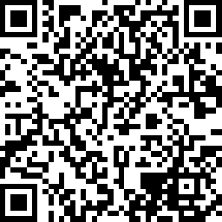
Win £100 Amazon Voucher
Please register via the QR code
You will be sent a short survey
We raffle a £100 Amazon voucher at the end of every month
Thankyou.

Slide 31
Contact
CREATE
TODAY
Predict
Tomorrow
CONTACT INFO
Phone: 020 7631 7500 Email: info@gresearch.co.uk Web: gresearch.co.uk
MAILING ADDRESS
G-Research Whittington House 19-30 Alfred Place London WC1E 7EA
SOCIAL MEDIA
facebook.com/gresearchcareers twitter.com/gresearchjobs linkedin.com/company/g-research

