Slide 1



TangoJS
– a web-based interface for TANGO Control System
Michał Liszcz¹, Włodzimierz Funika^{1,2}, Łukasz Żytniak³
¹ AGH, Faculty of Computer Science, Electronics and Telecommunication, Dept. of Computer Science
² AGH, ACC Cyfronet AGH
³ National Synchrotron Radiation Centre Solaris
KUKDM’16, Zakopane
March 16-18

Slide 2
Motivation and Goals
TANGO Control System is a CORBA-based solution for controlling hardware in scientific facilities;
Operators need GUIs – synoptic panels – to monitor hardware components;
Modern GUI applications are often built using web-based approach, due to fast prototyping, ease of deployment and great tooling support;
Unfortunately, CORBA – and TANGO – applications cannot run in web browser;
GOAL: allow for browser-based TANGO client applications.

Slide 3


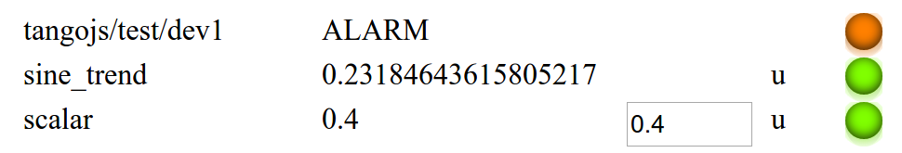
TangoJS solution
Web browser
Modular, extensible architecture
Core API written in Javascript / ES2015
partly generated from TANGO IDL;
Connector interface
abstracts-out server-side implementation details;
Widget toolkit
framework-agnostic solution based on Web Components spec;
Web Applications
TangoJS Web Components
(widget toolkit)
TangoJS Core
(API)
TangoJS Connector
(client)
HTTP(S)
TangoJS Connector
(server)
CORBA
TANGO Infrastructure

