Slide 1
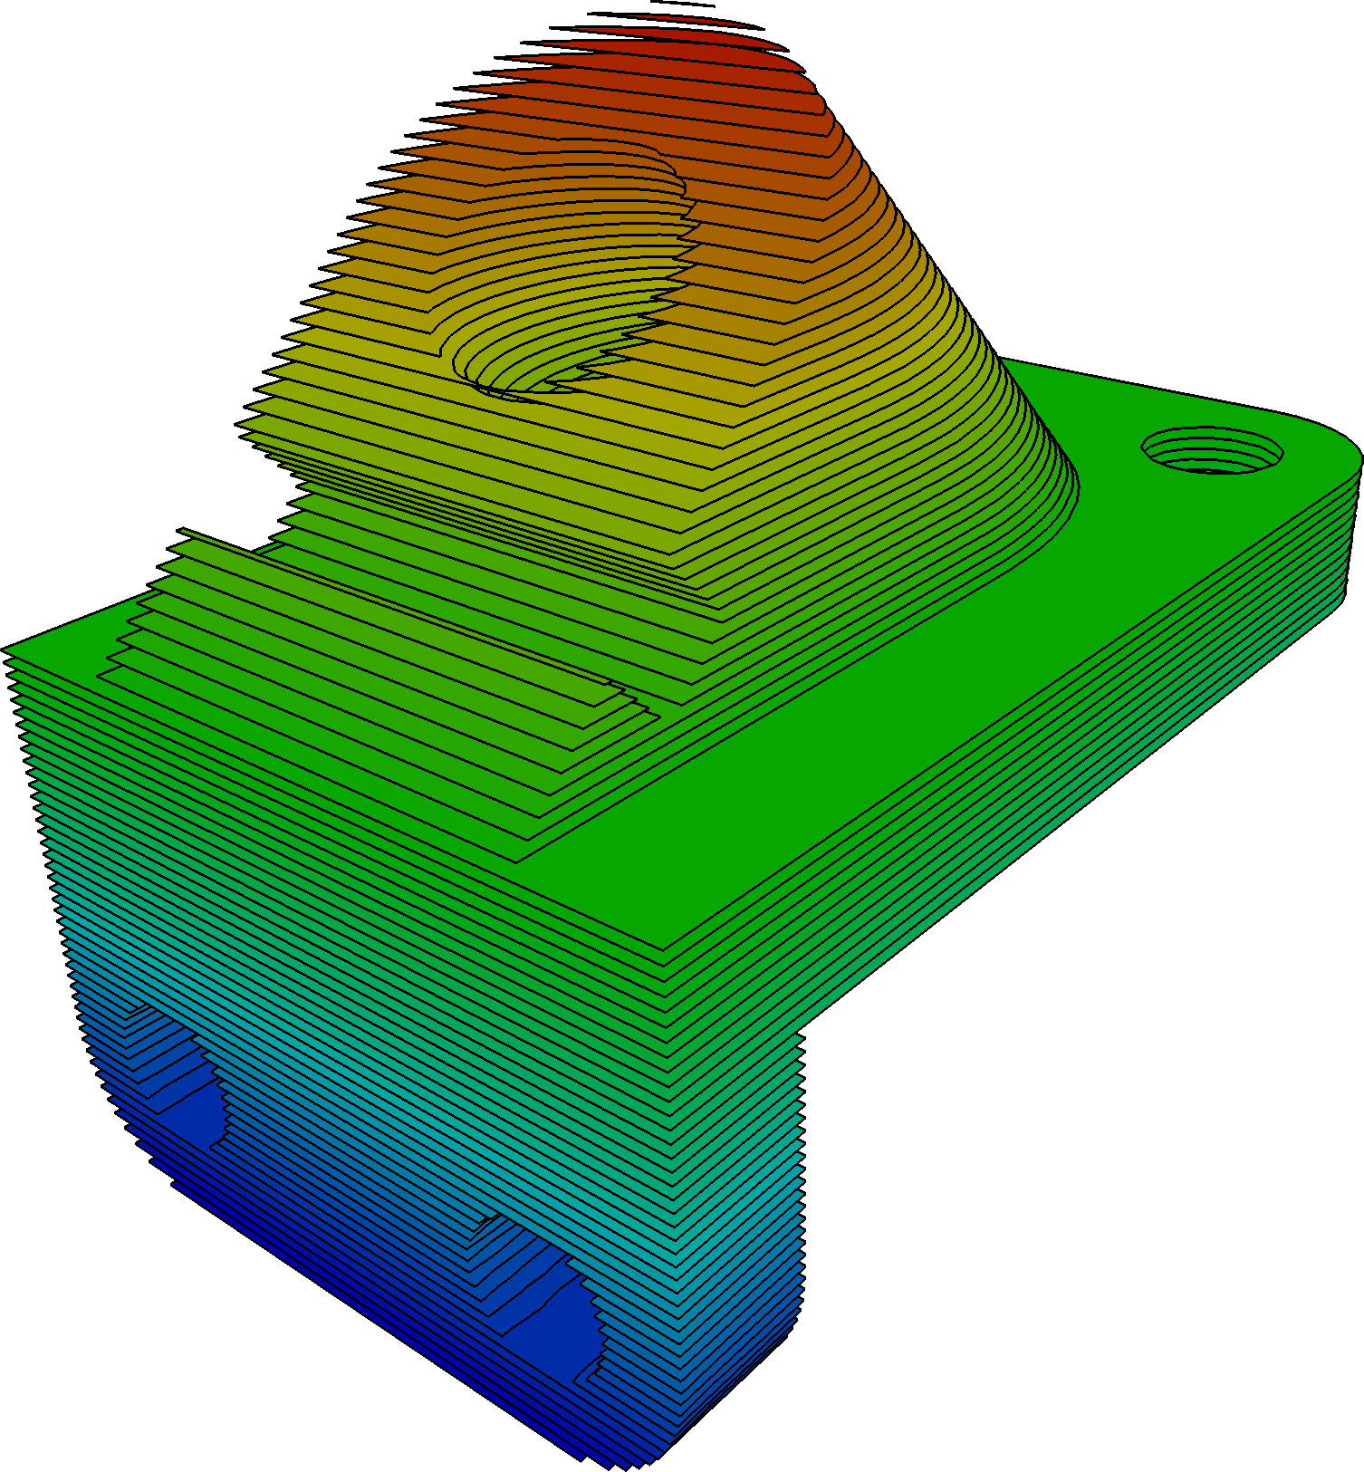
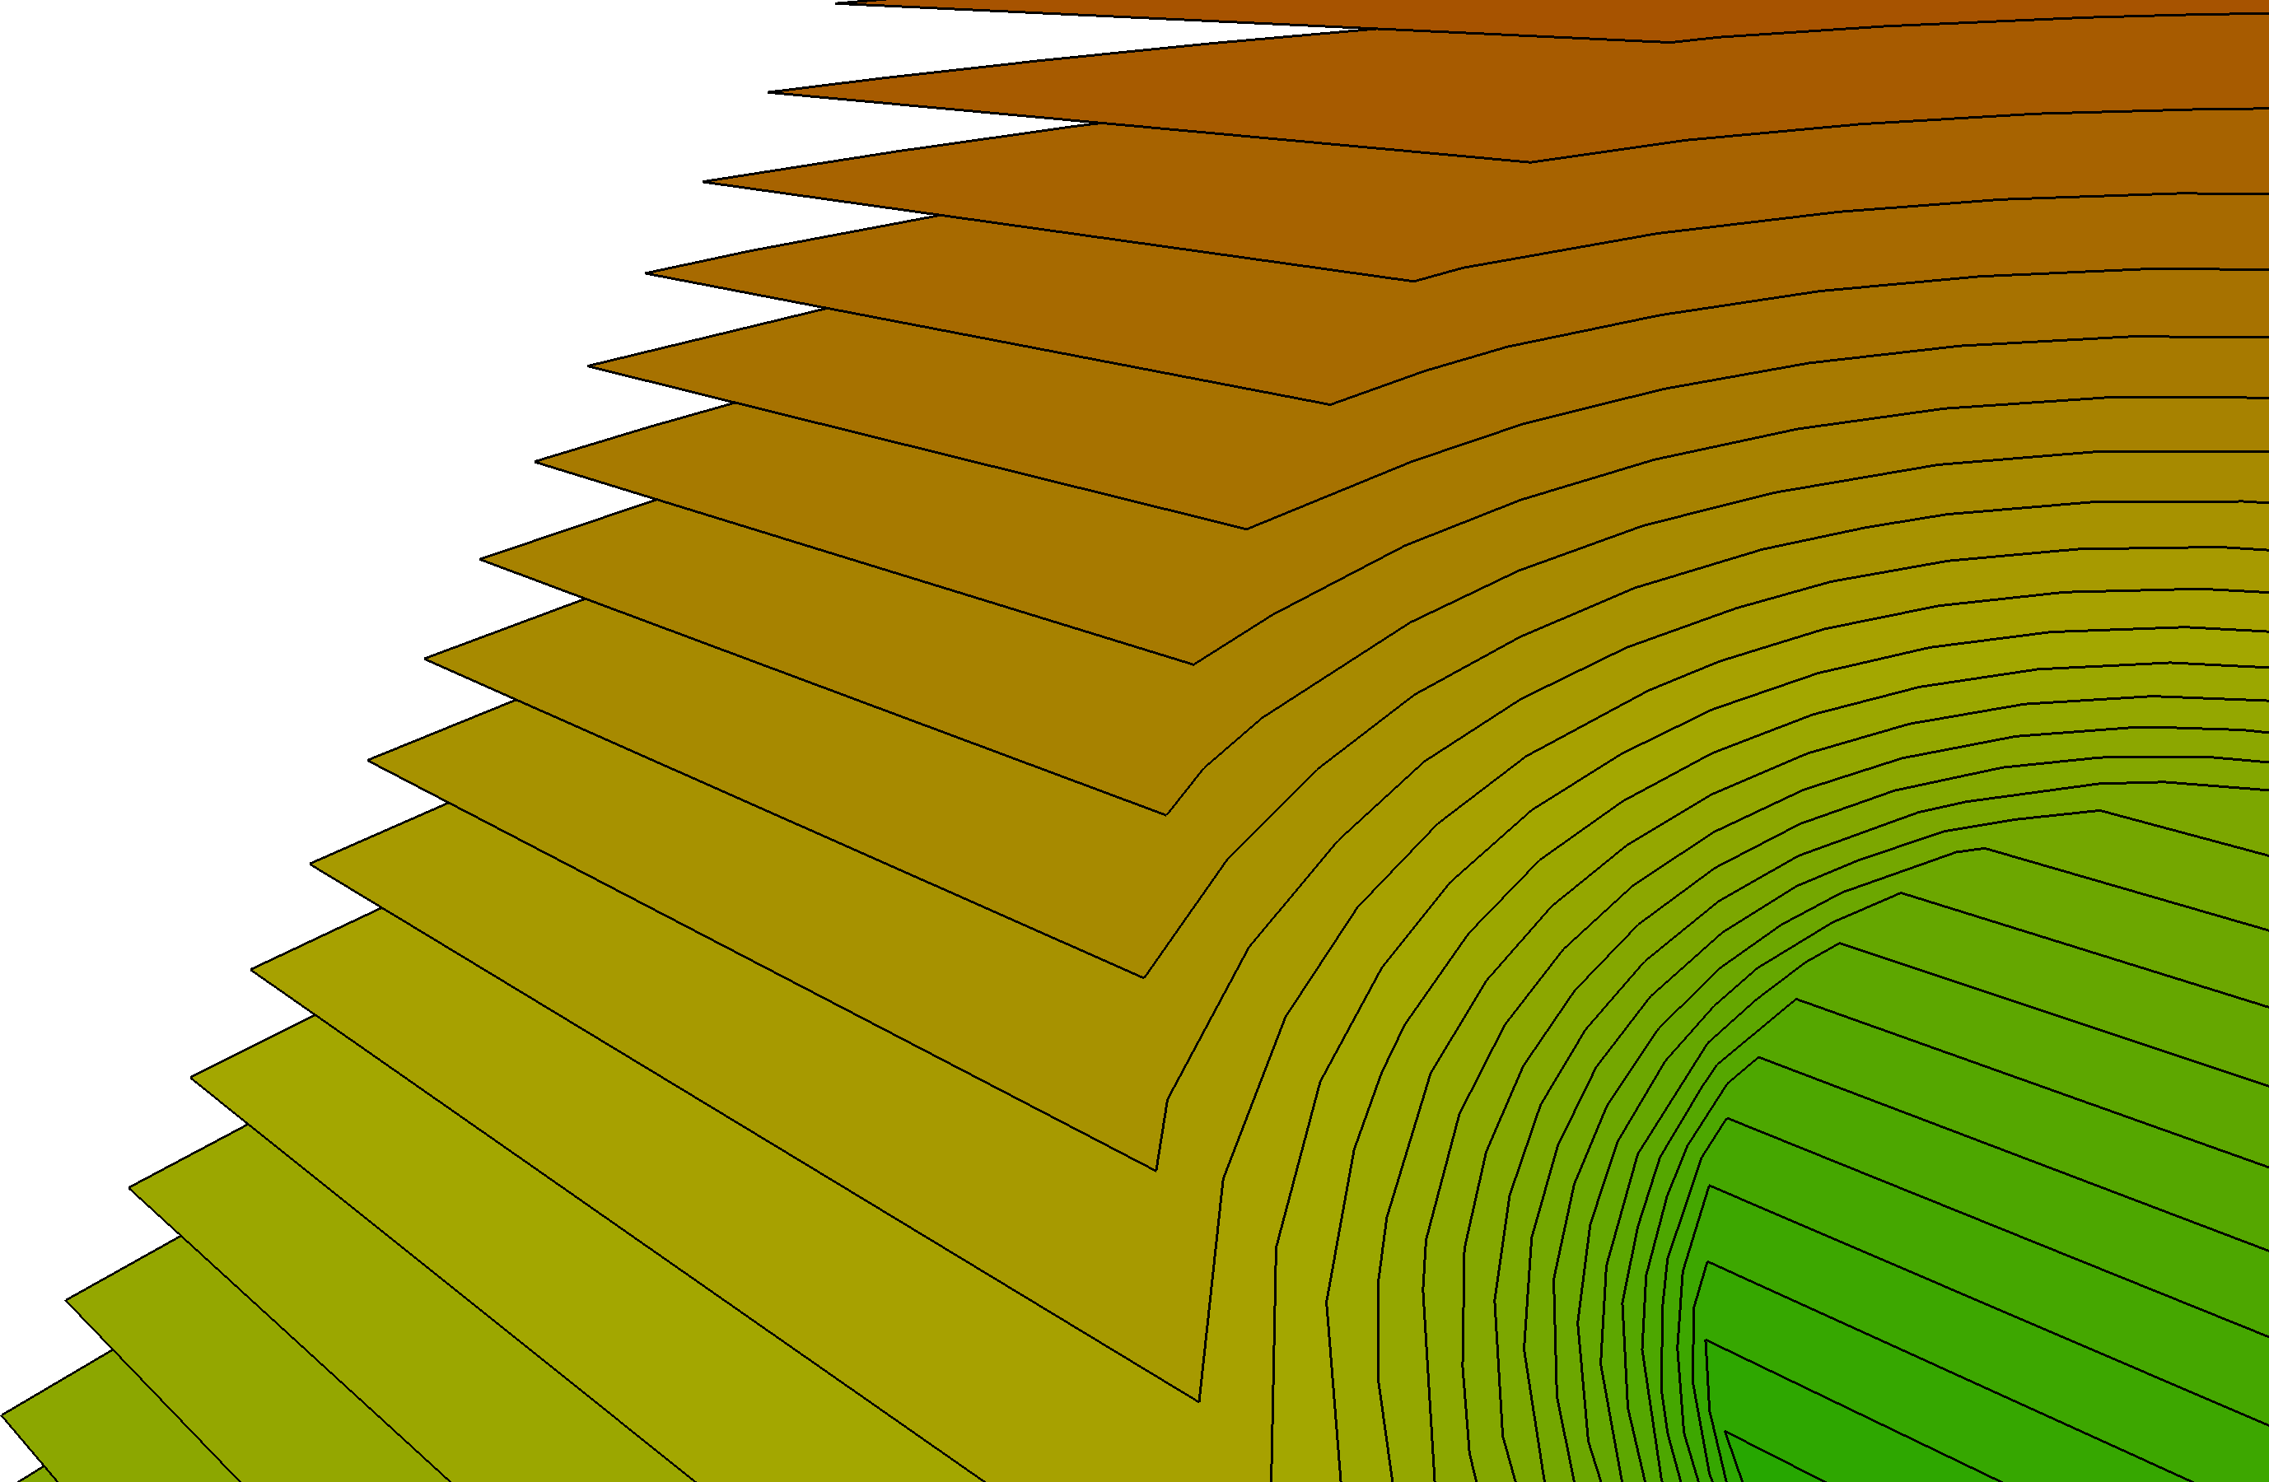
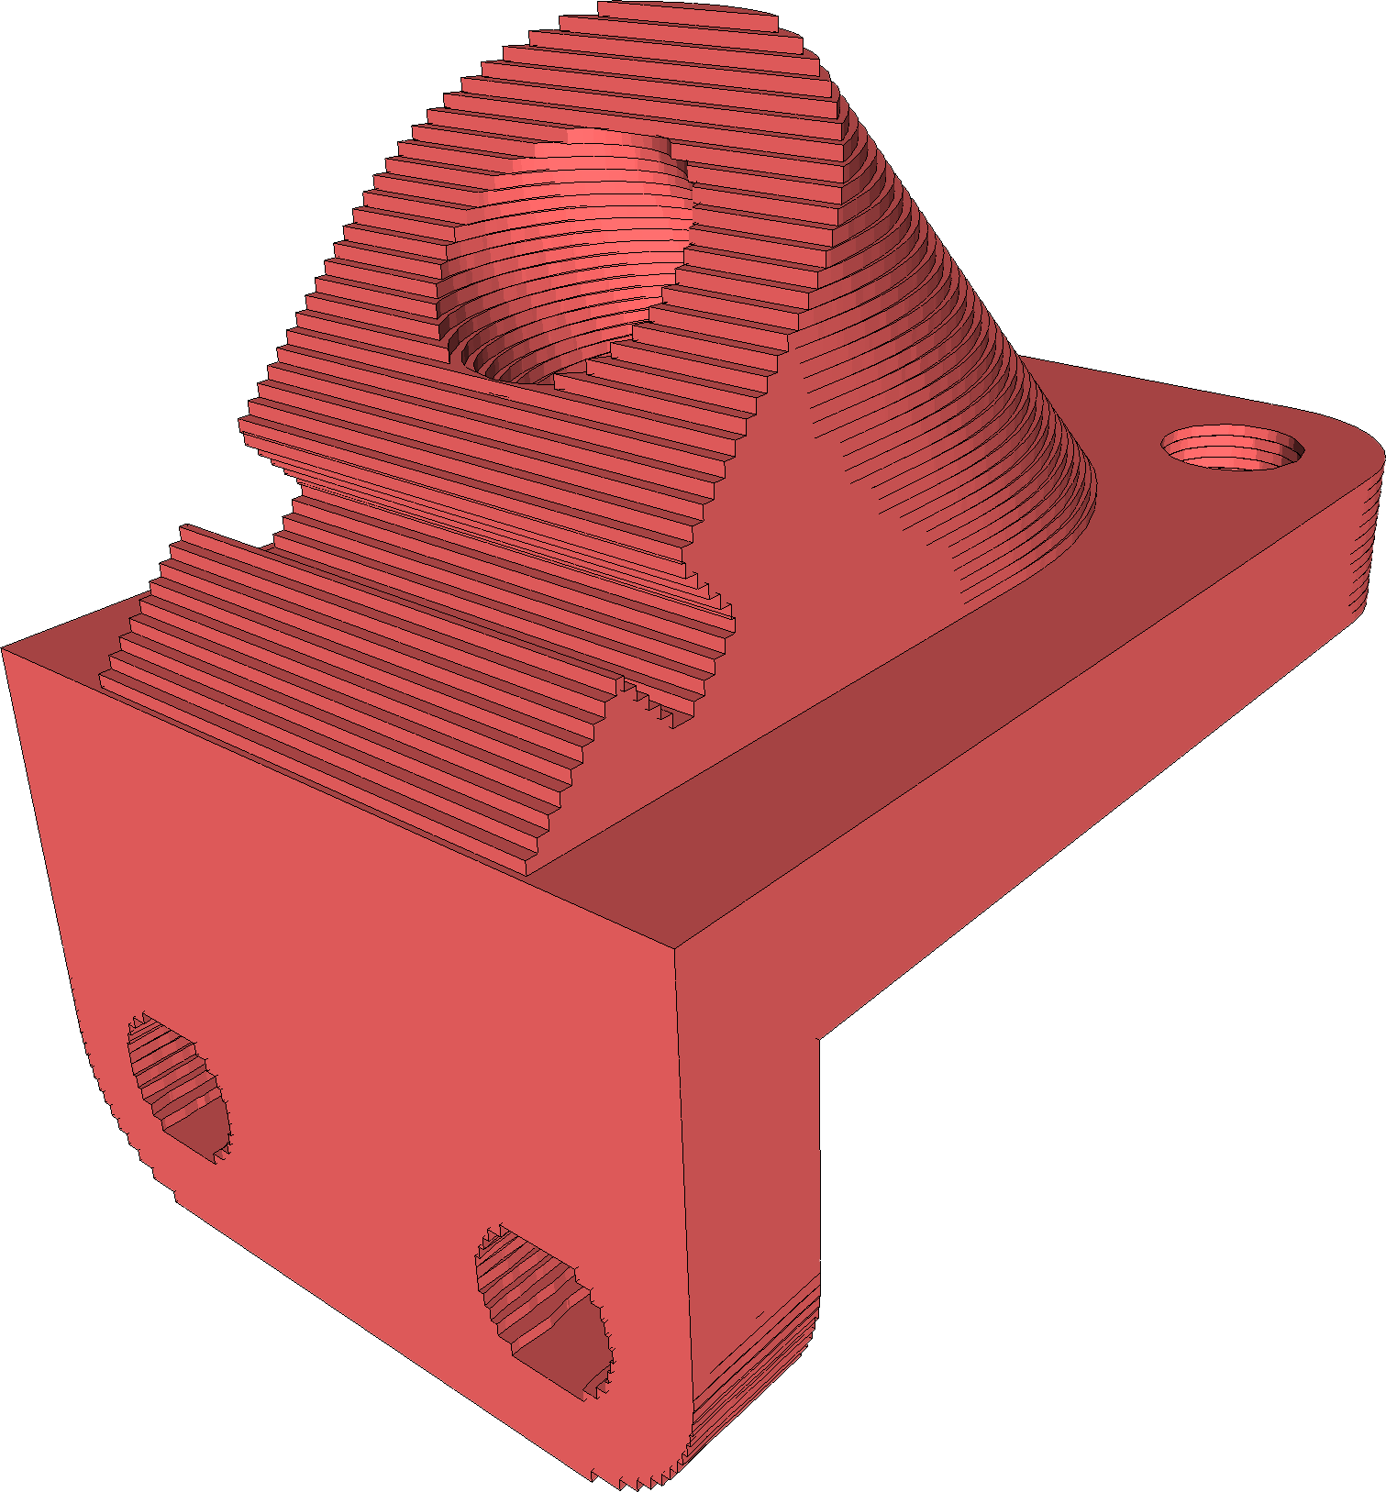

Slice2mesh: meshing sliced data for the simulation of AM processes
M. Livesu
D. Cabiddu
M. Attene

Slide 2
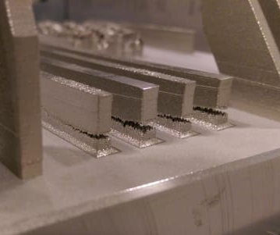
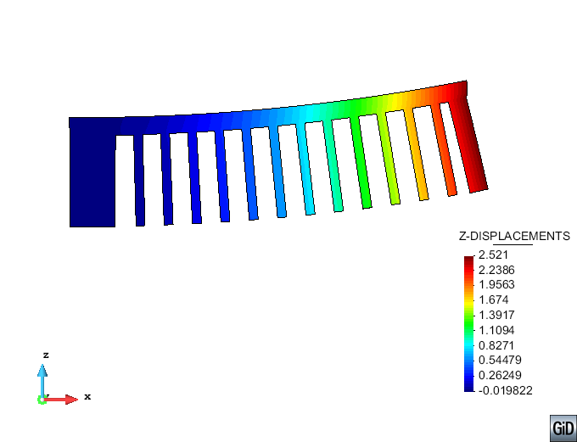
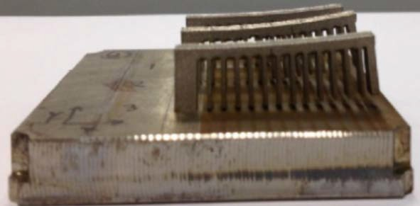
Motivation
  Simulation of AM processes is a mean to
PREVENT FAILURES
PREDICT QUALITY
    Cost: a failure is a waste of time and material
    Fidelity: objects should be design compliant

Slide 3
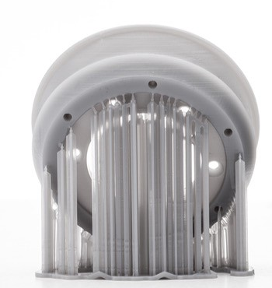
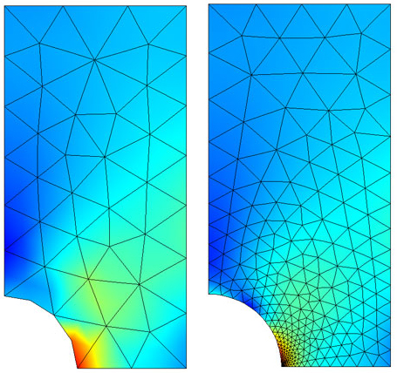
A meshing perspective
  Simulating AM requires a discrete representation of the domain
  Three major requirements
STANDARD TECHNIQUES FALL SHORT!
DYNAMIC
DOMAIN
SUPPORT
SYNTHESIS
LOCAL
REFINEMENT

Slide 4
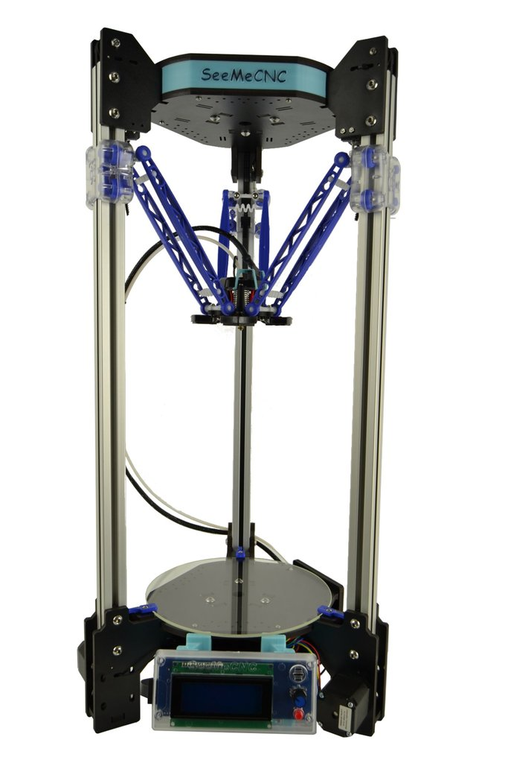
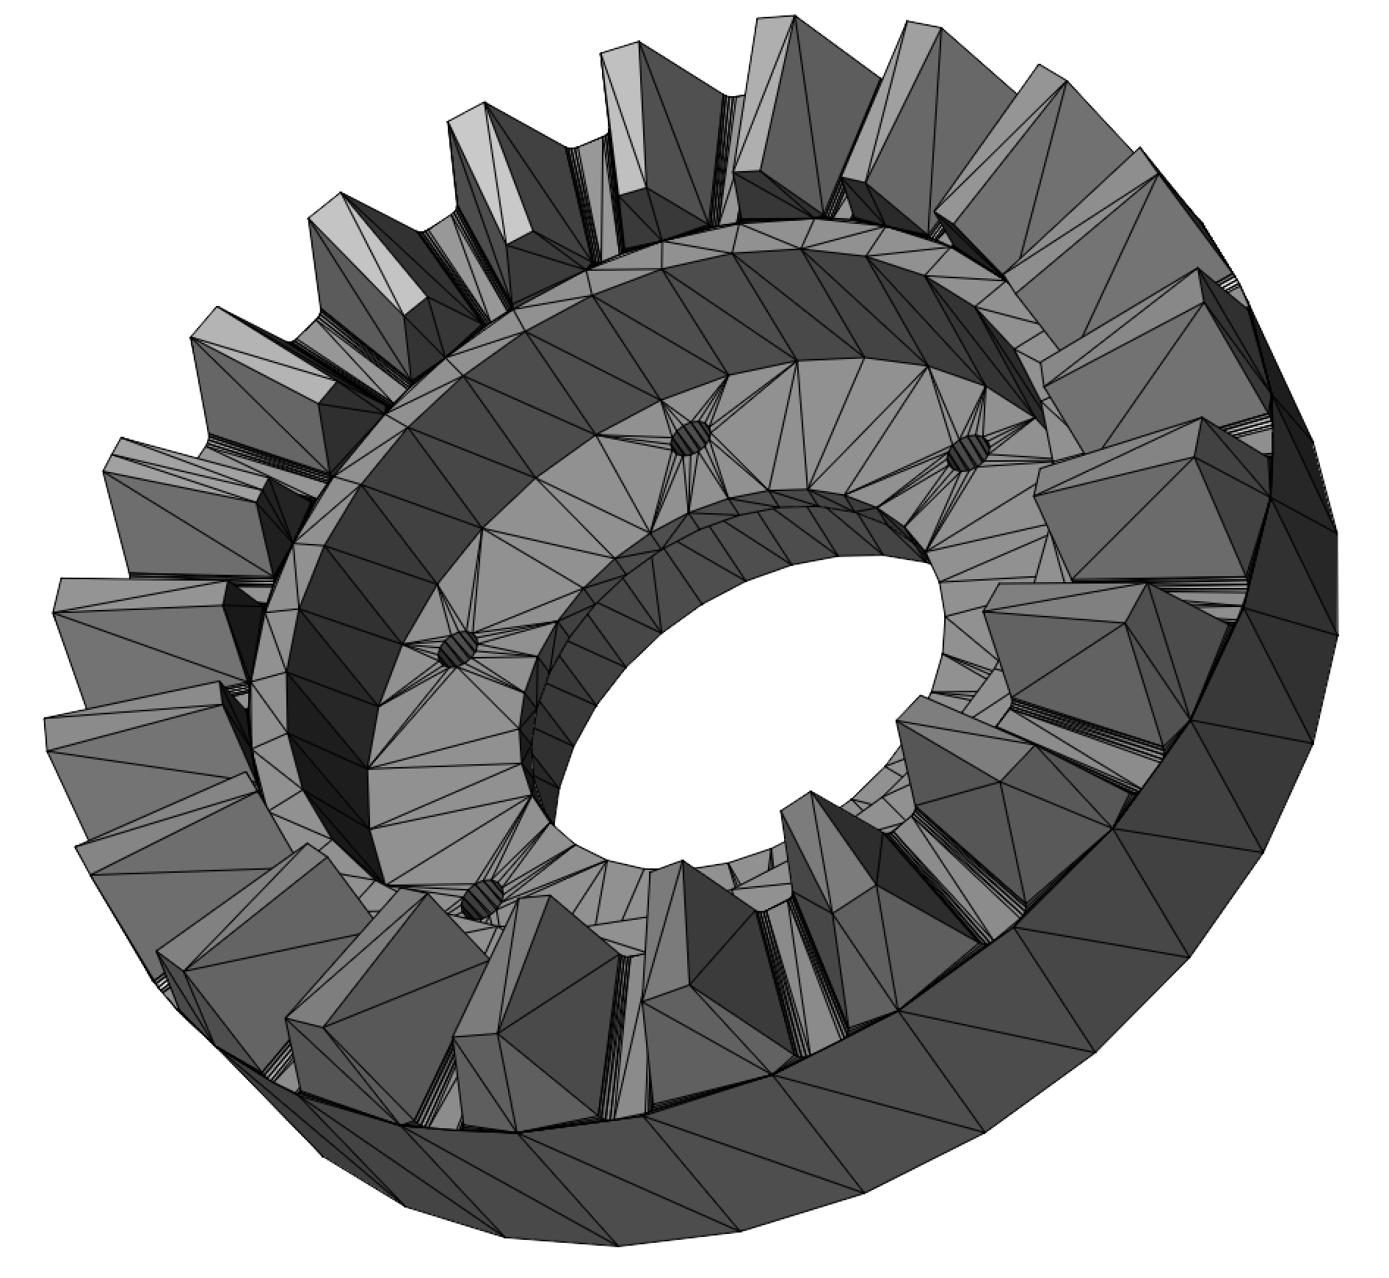

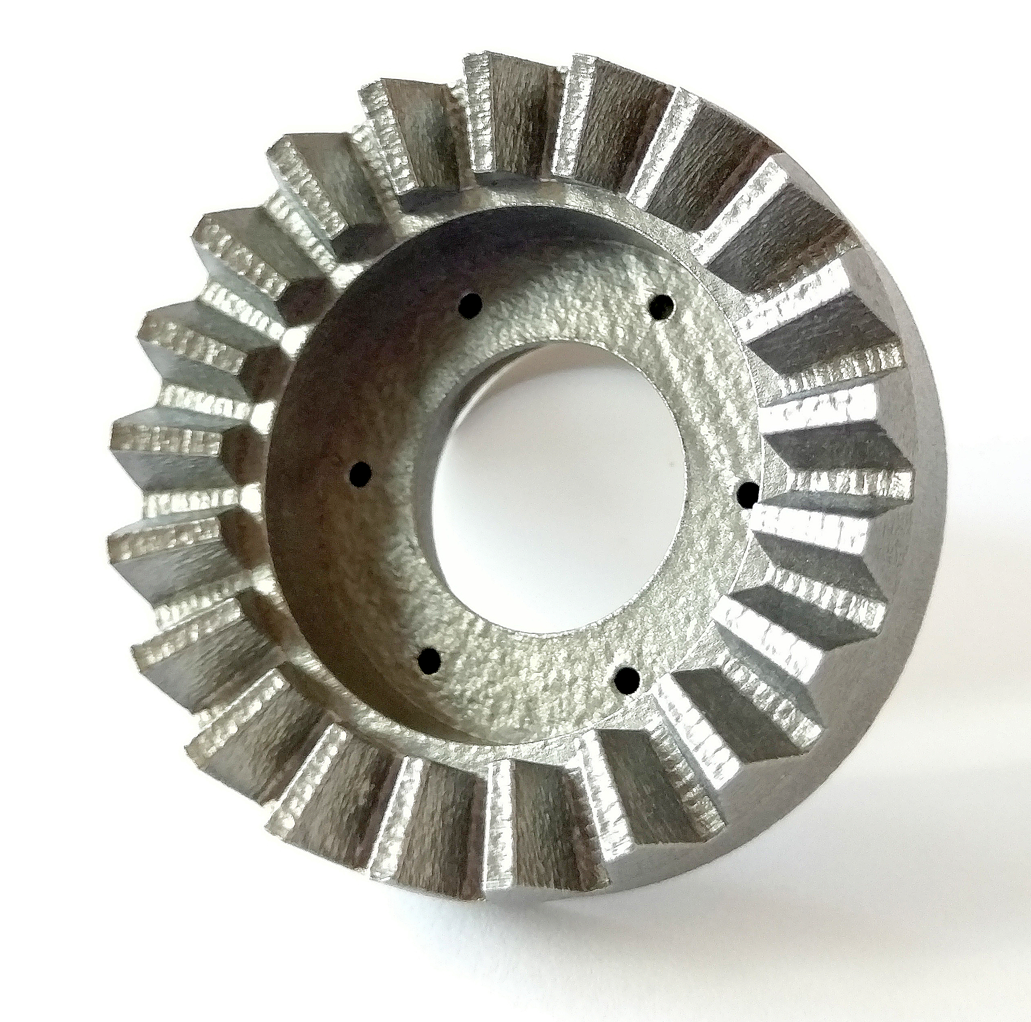
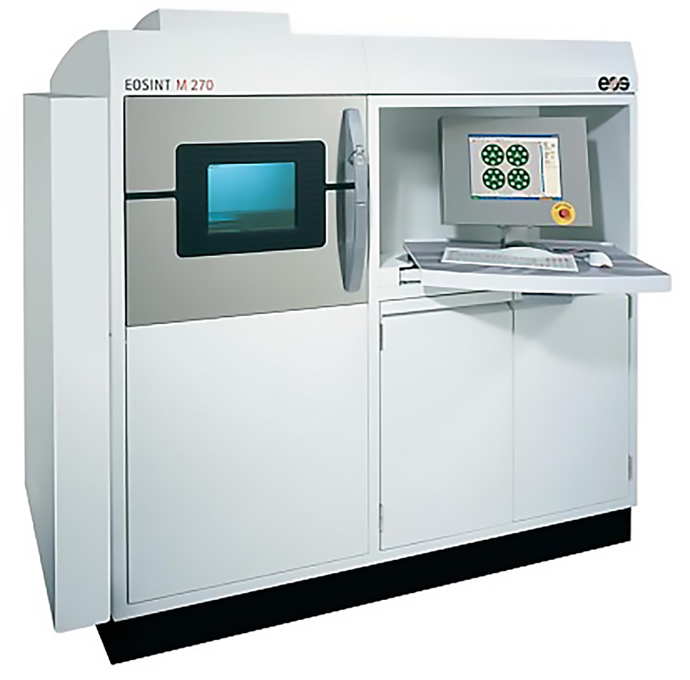
What input?
DESKTOP
PART
ORIENTATION
SUPPORT
STRUCTURES
MACHINE
TOOLPATH
SLICING
INDUSTRIAL
M 270
PART
ORIENTATION
SUPPORT
STRUCTURES
SLICING

Slide 5
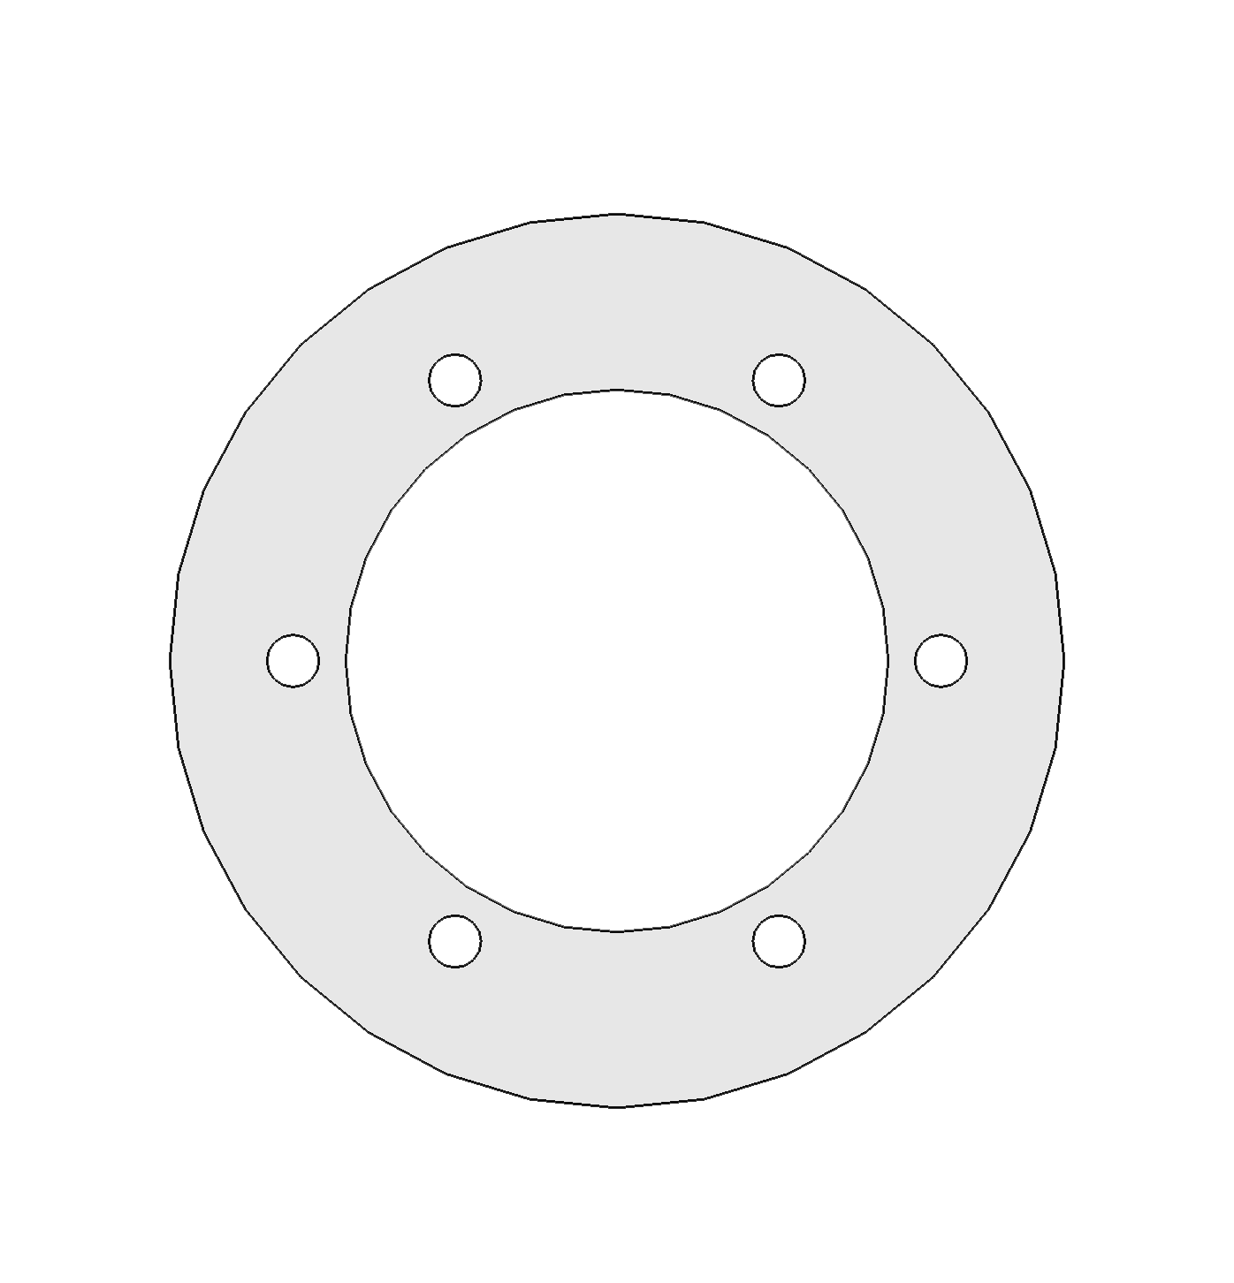
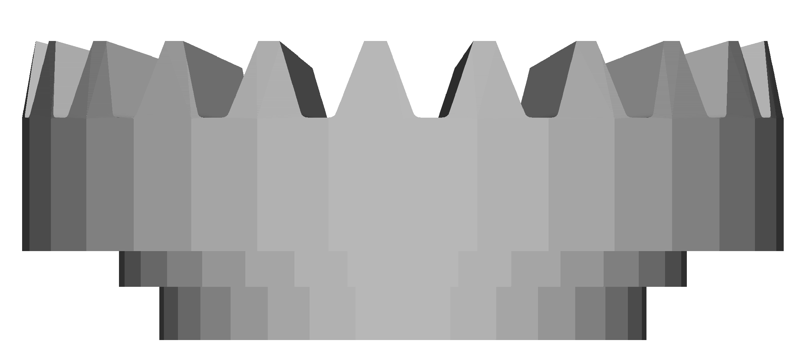
Anatomy of a slice
  Objects encoded as piece-wise linear open/closed curves
    Outer perimeter is a CCW closed curve
    Holes are CW closed curves
    Supports are open curves

Slide 6
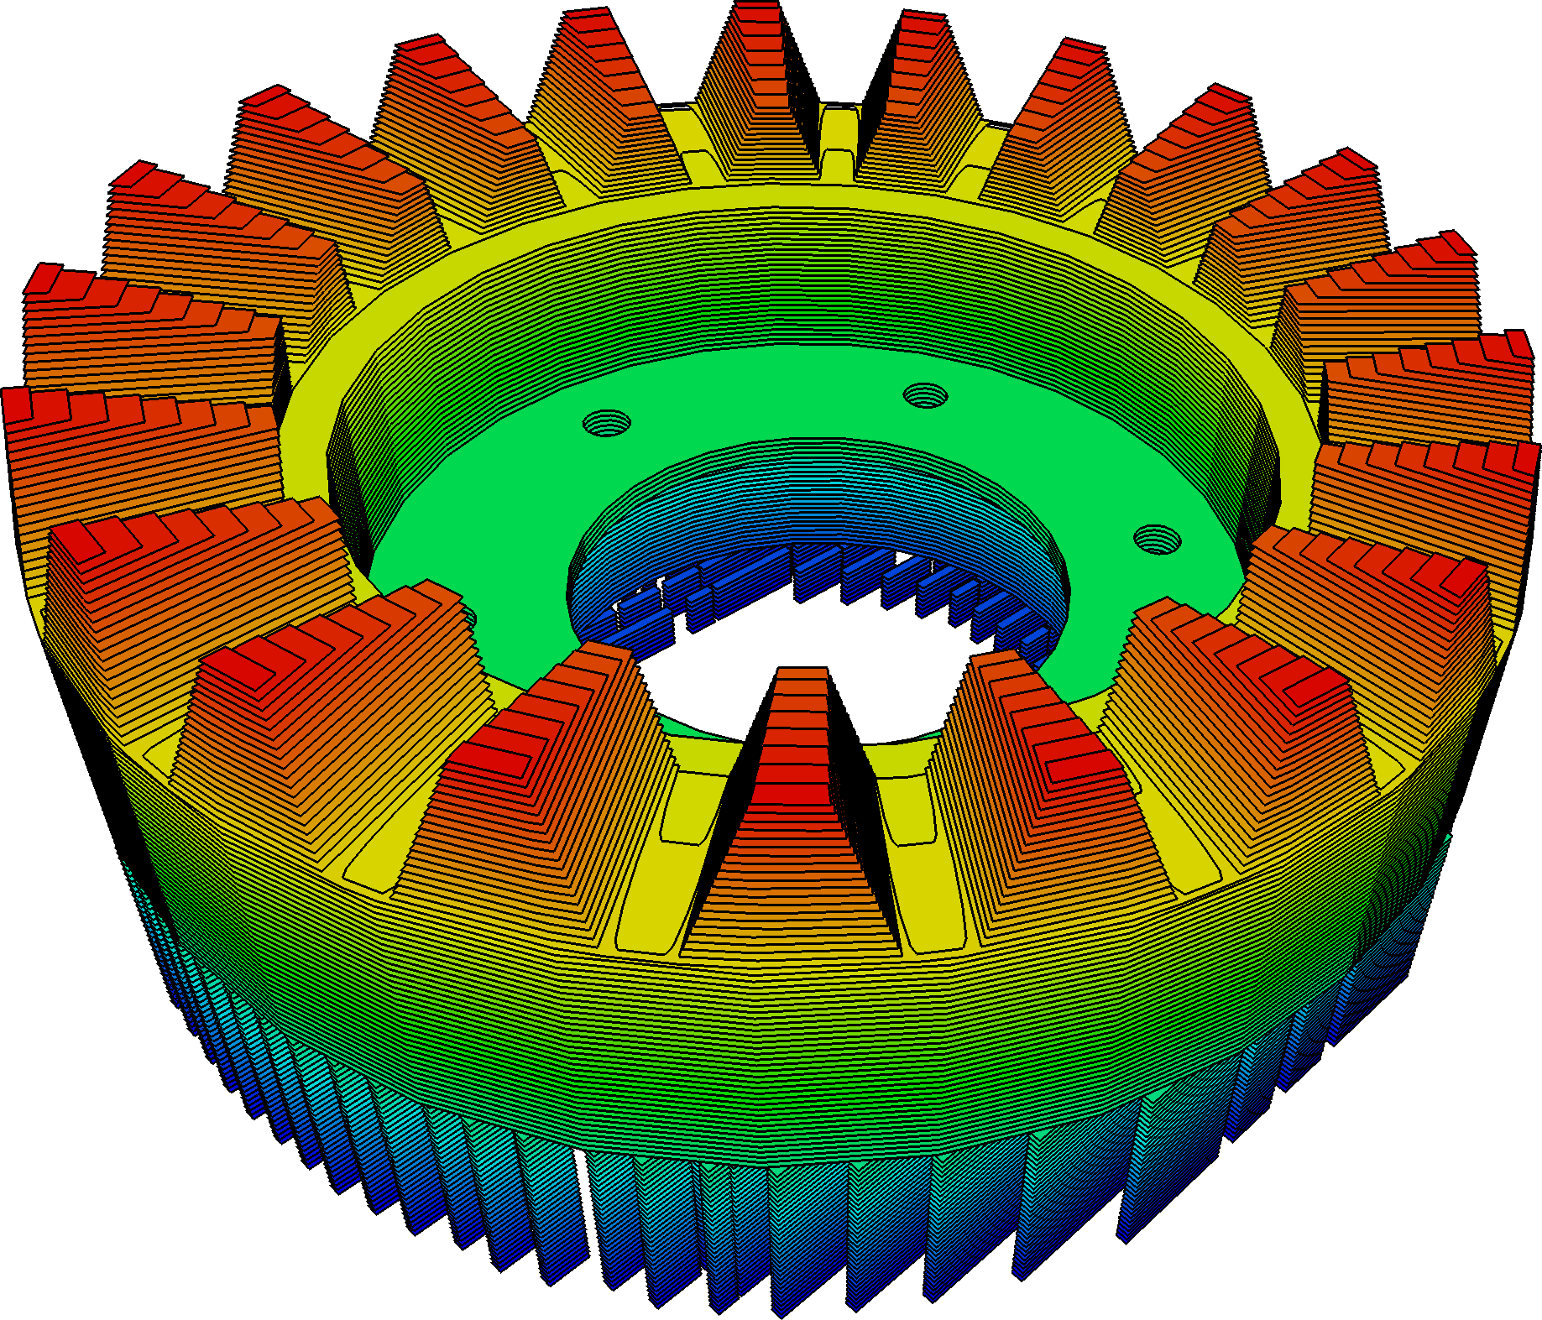
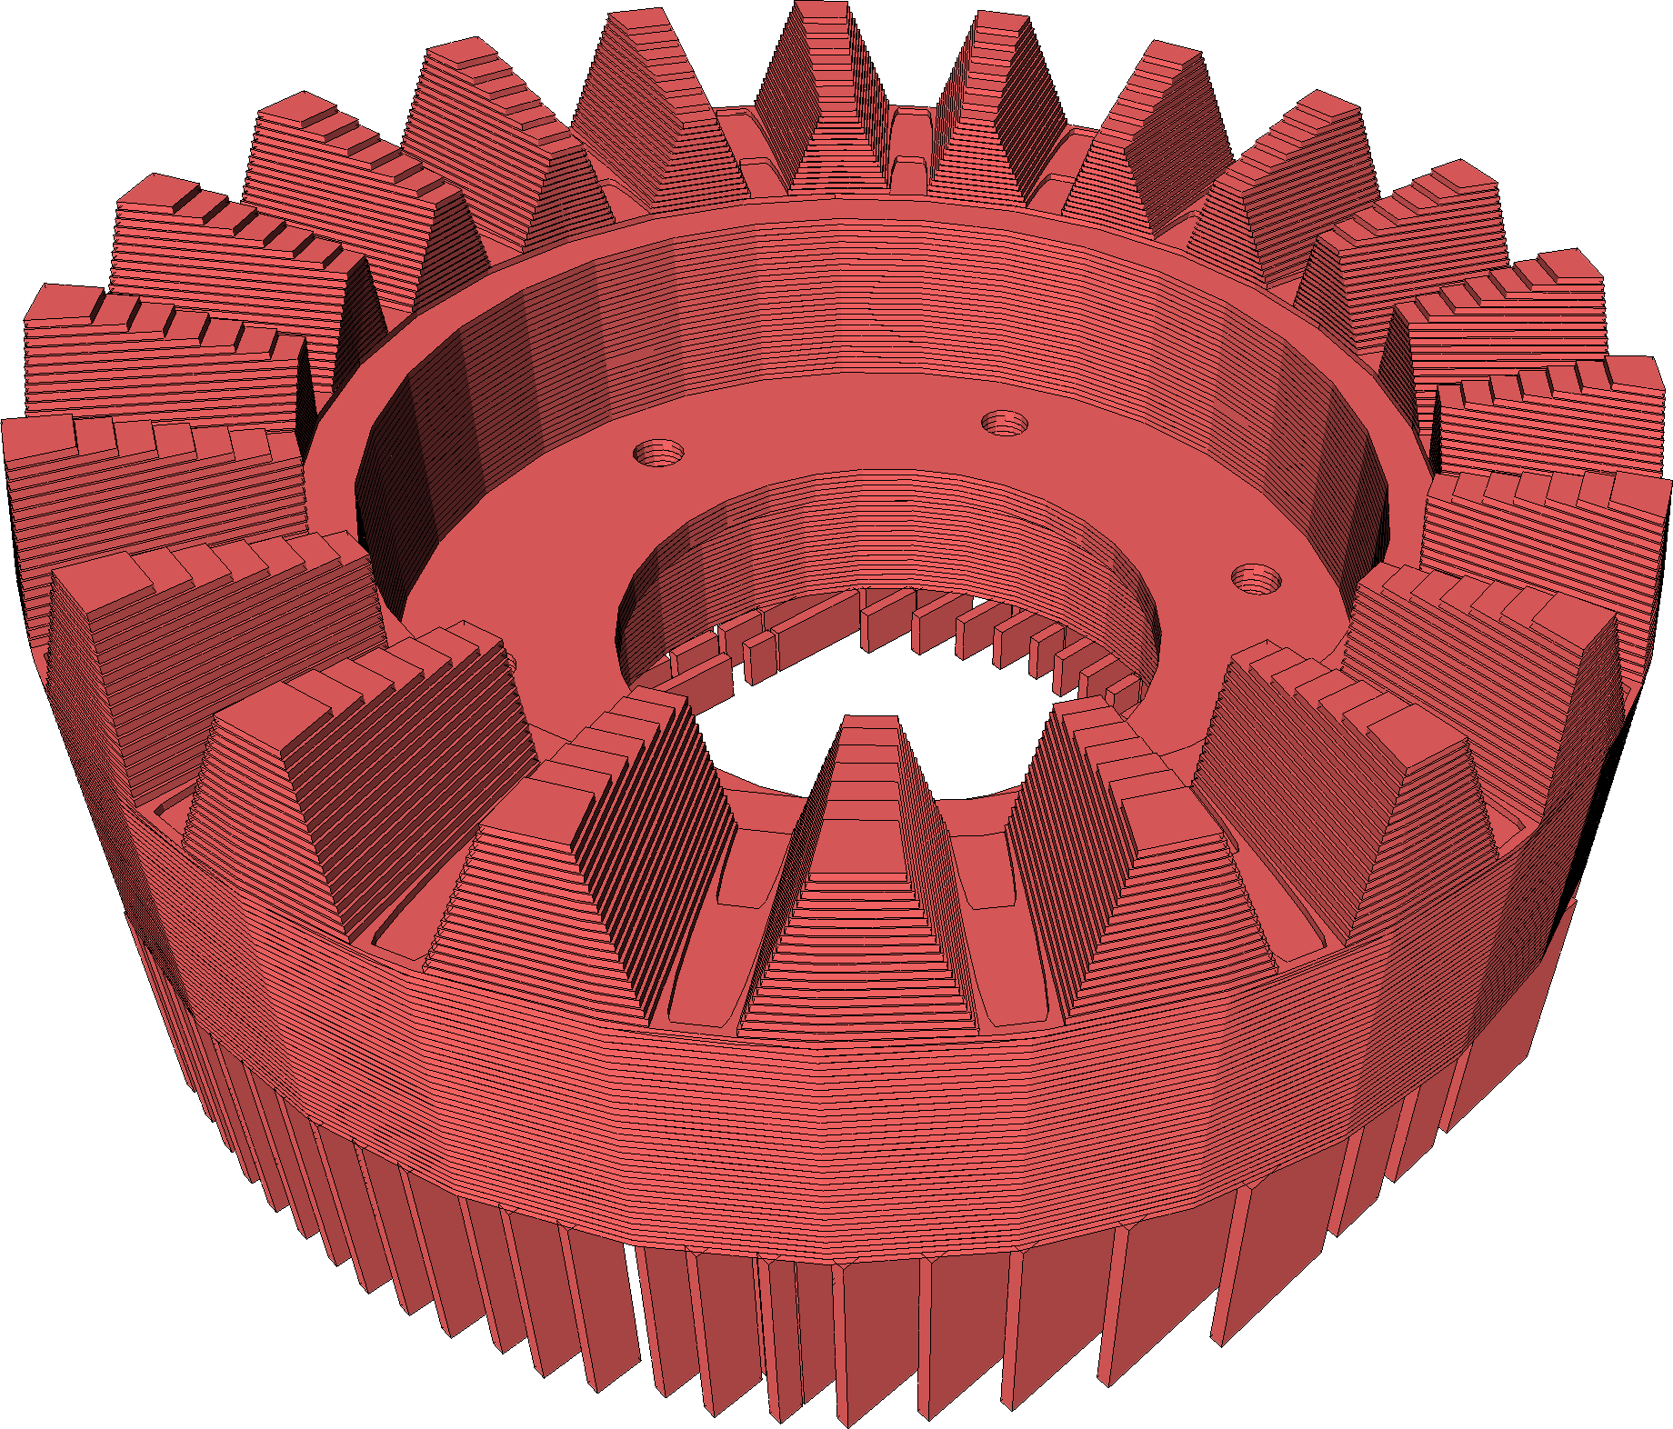
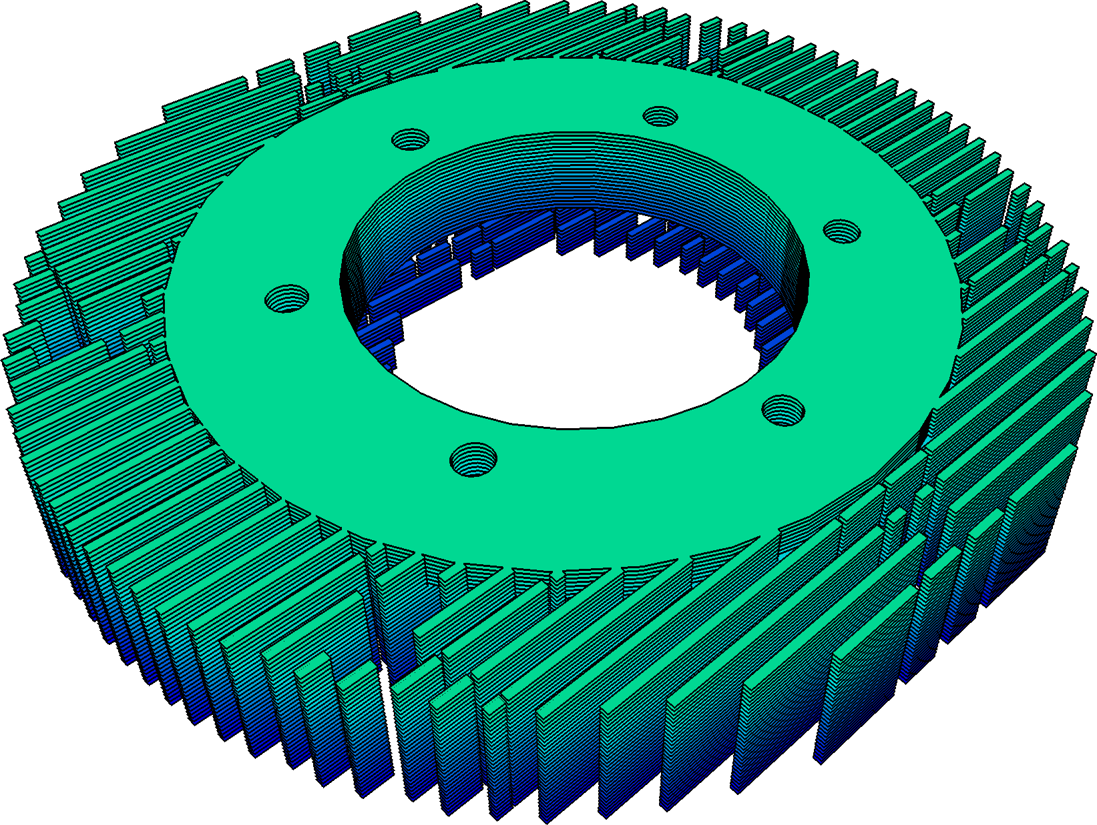
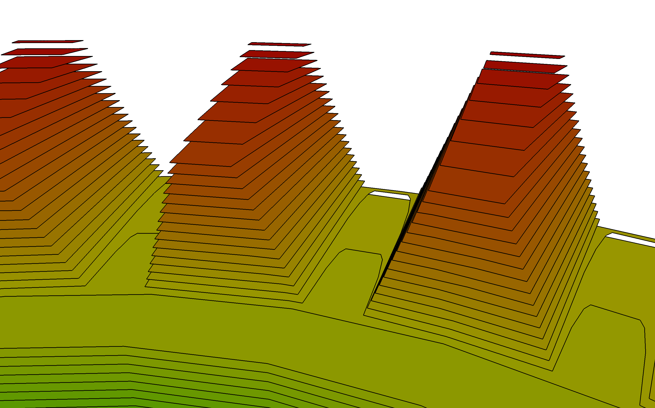
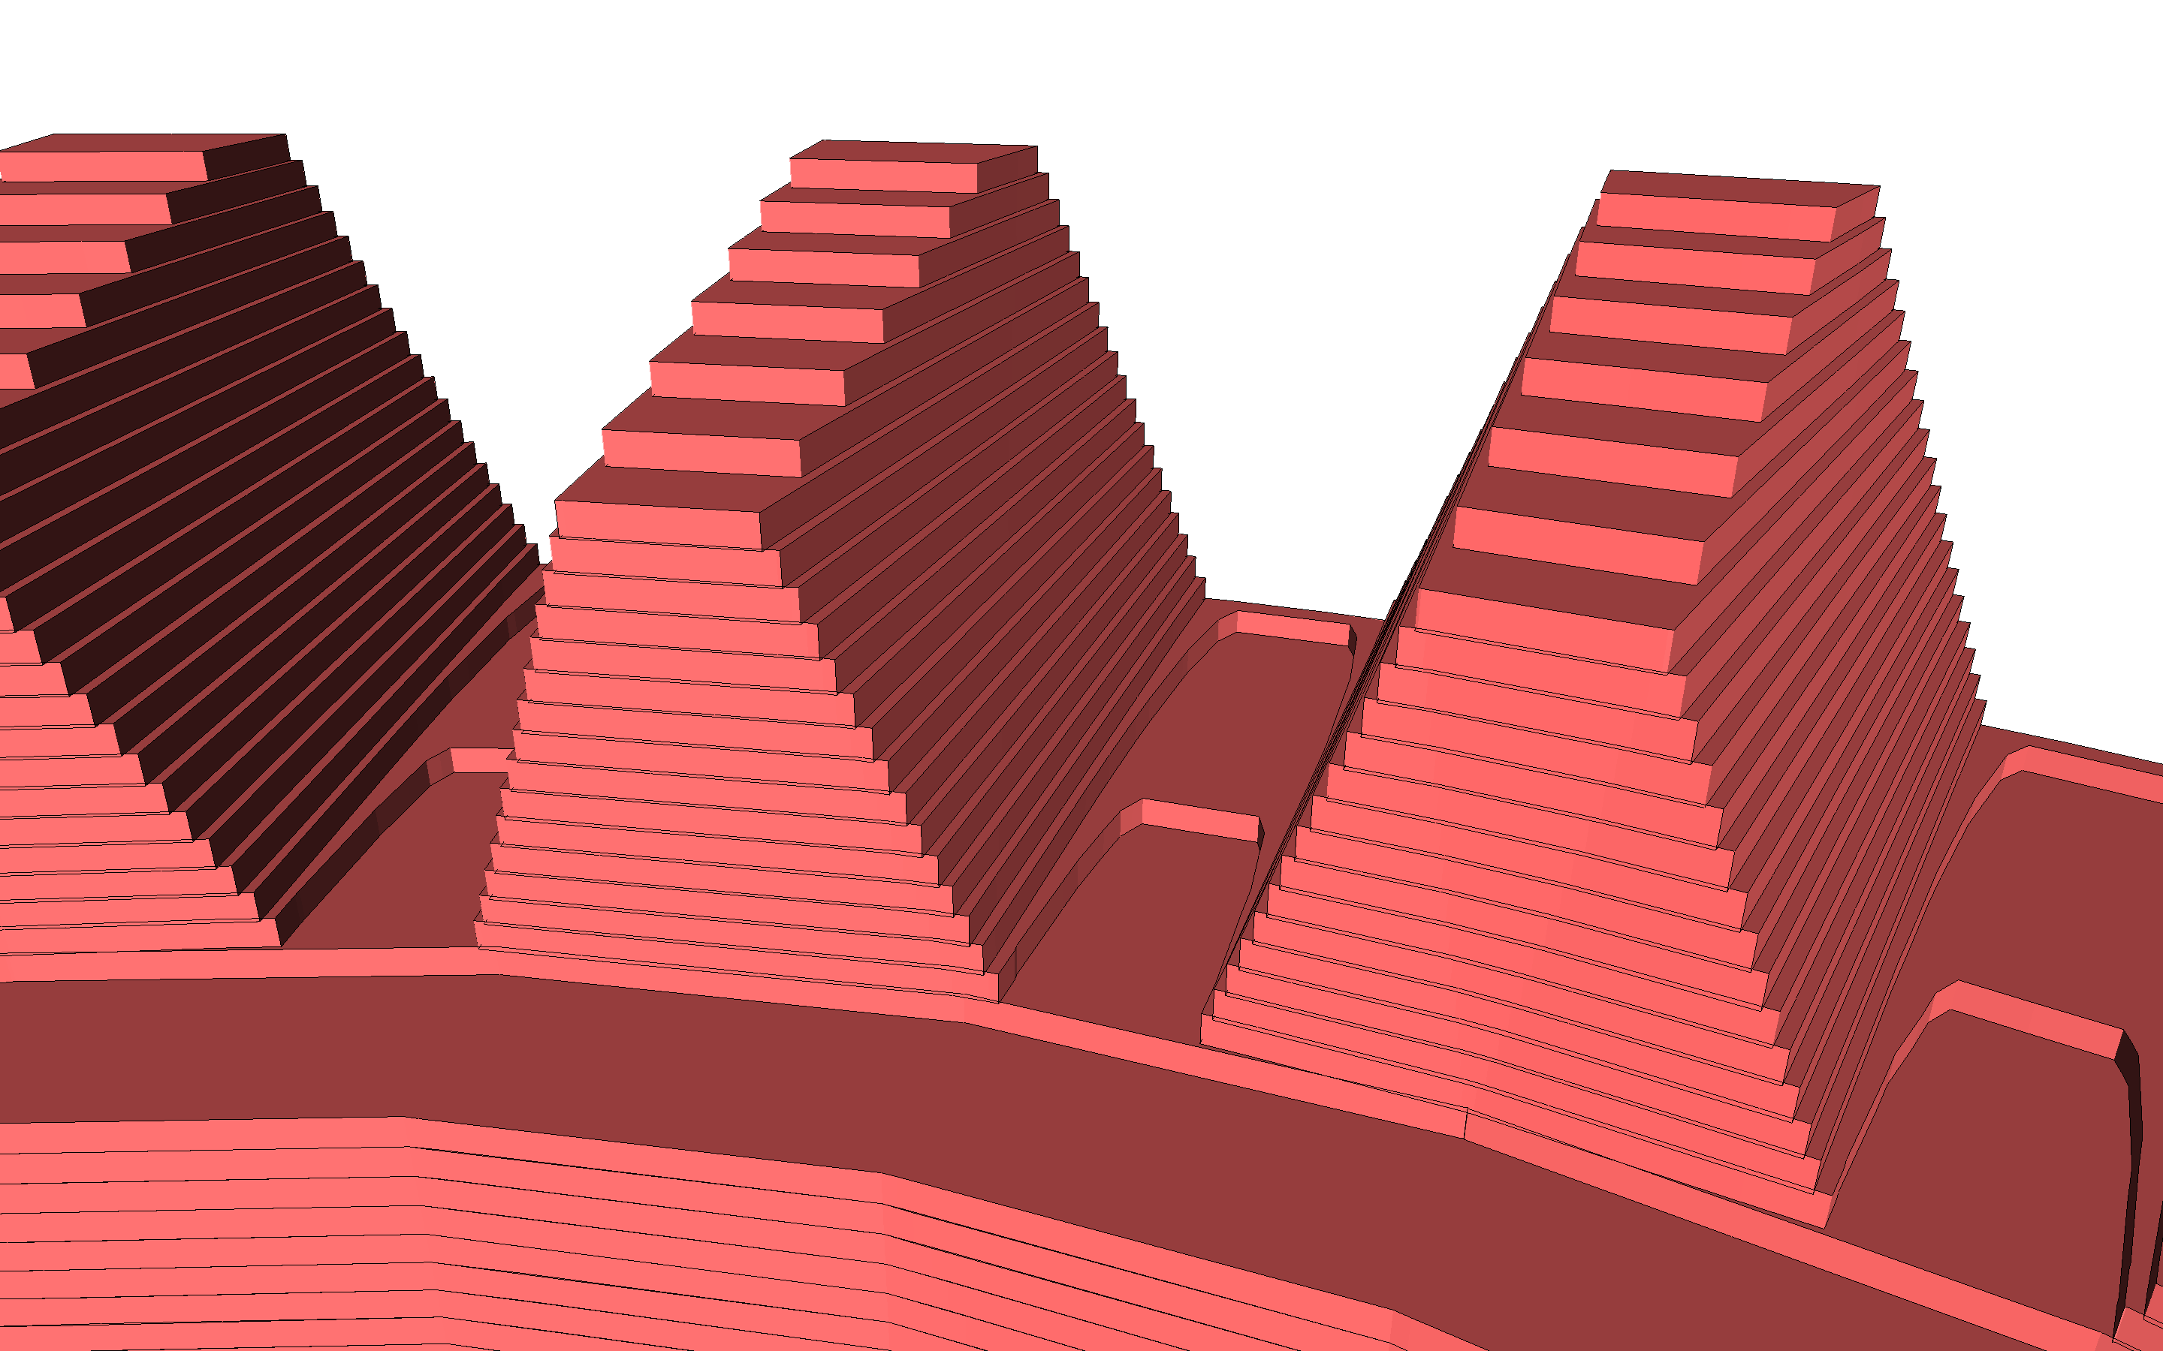
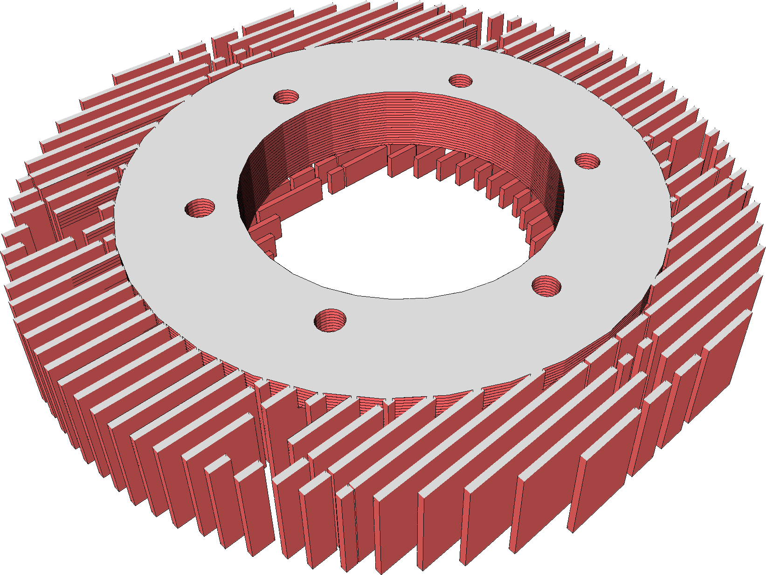
Slice2Mesh
  Transform slices into volumetric meshes
SLICE CONFORMING (INSIDE)
SLICE CONFORMING (OUTSIDE)

Slide 7
Basic idea
Extrude each slice along the build direction
Merge adjacent slices in a conforming way
Tetmesh the resulting PLC to produce a tetrahedral mesh

Slide 8
Basic idea
Extrude each slice along the build direction
Merge adjacent slices in a conforming way
Tetmesh the resulting PLC to produce a tetrahedral mesh
NON
CONFORMING

Slide 9
Basic idea
Extrude each slice along the build direction
Merge adjacent slices in a conforming way
Tetmesh the resulting PLC to produce a tetrahedral mesh
CONFORMING

Slide 10
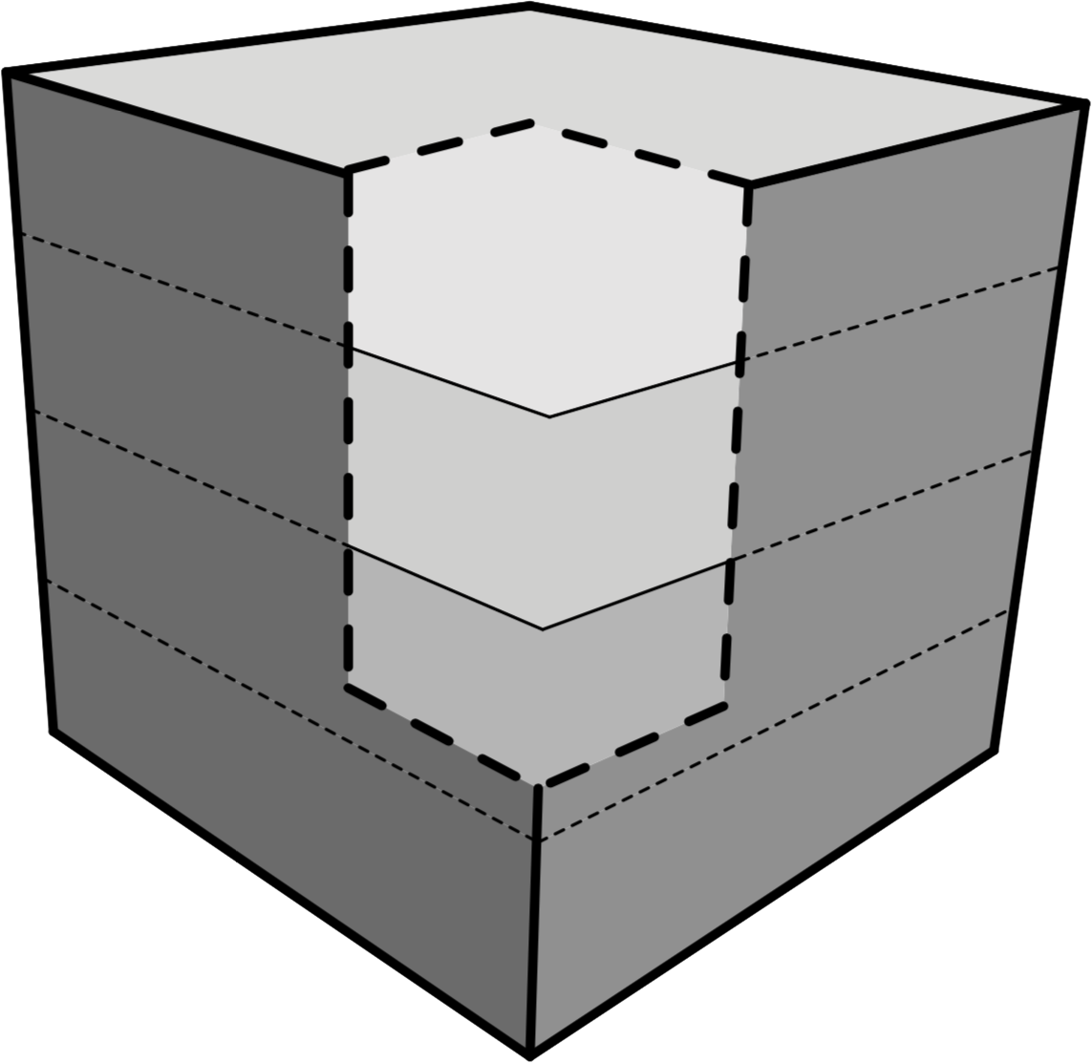
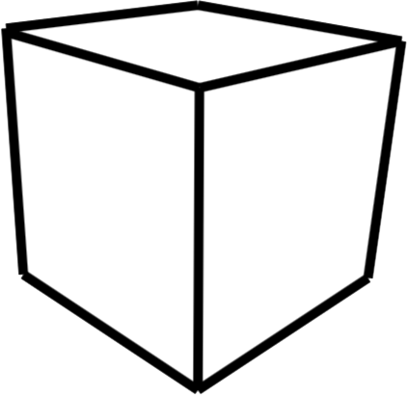
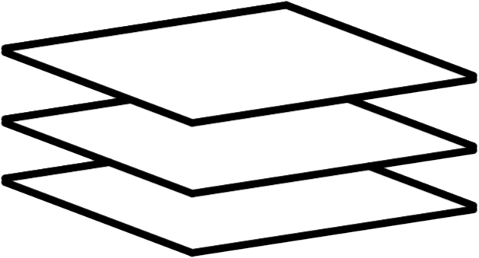
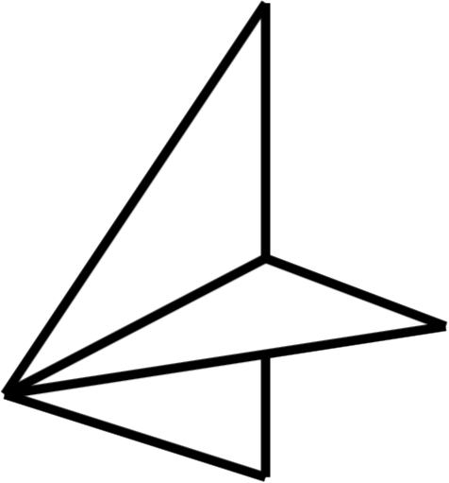
Basic idea
Extrude each slice along the build direction
Merge adjacent slices in a conforming way
Tetmesh the resulting PLC to produce a tetrahedral mesh
  Use standard tools (i.e. Tetgen)
  Tetrahedra do not span multiple slices
  Filtering tets reproduces the temporal evolution of the domain
OUTER
BOUNDARY
NON
MANIFOLD
EDGES
INNER SLICES

Slide 11
Lifting Algorithm
Input: a set of slices (s₀,…, s_{n} )
Output: a simulation ready tetrahedral mesh
For each edge e of each slice s_{i}
  Create a copy e’ and lift it to s_{i+1}
  Intersect e’ with all the edges in s_{i+1}
Triangulate the resulting “quads”
Run Tetgen on the resulting PLC
s₂
s₁
s₀

Slide 12
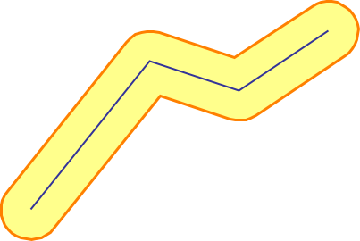
Support structures
  Support structures are 1D open curves replicated at each slice
  We use curve thickening. Thickening radius matches
    The filament cross-section in FDM
    The Laser beam in SLS/SLM
    …
Boost Polygon Library (buffer)

Slide 13
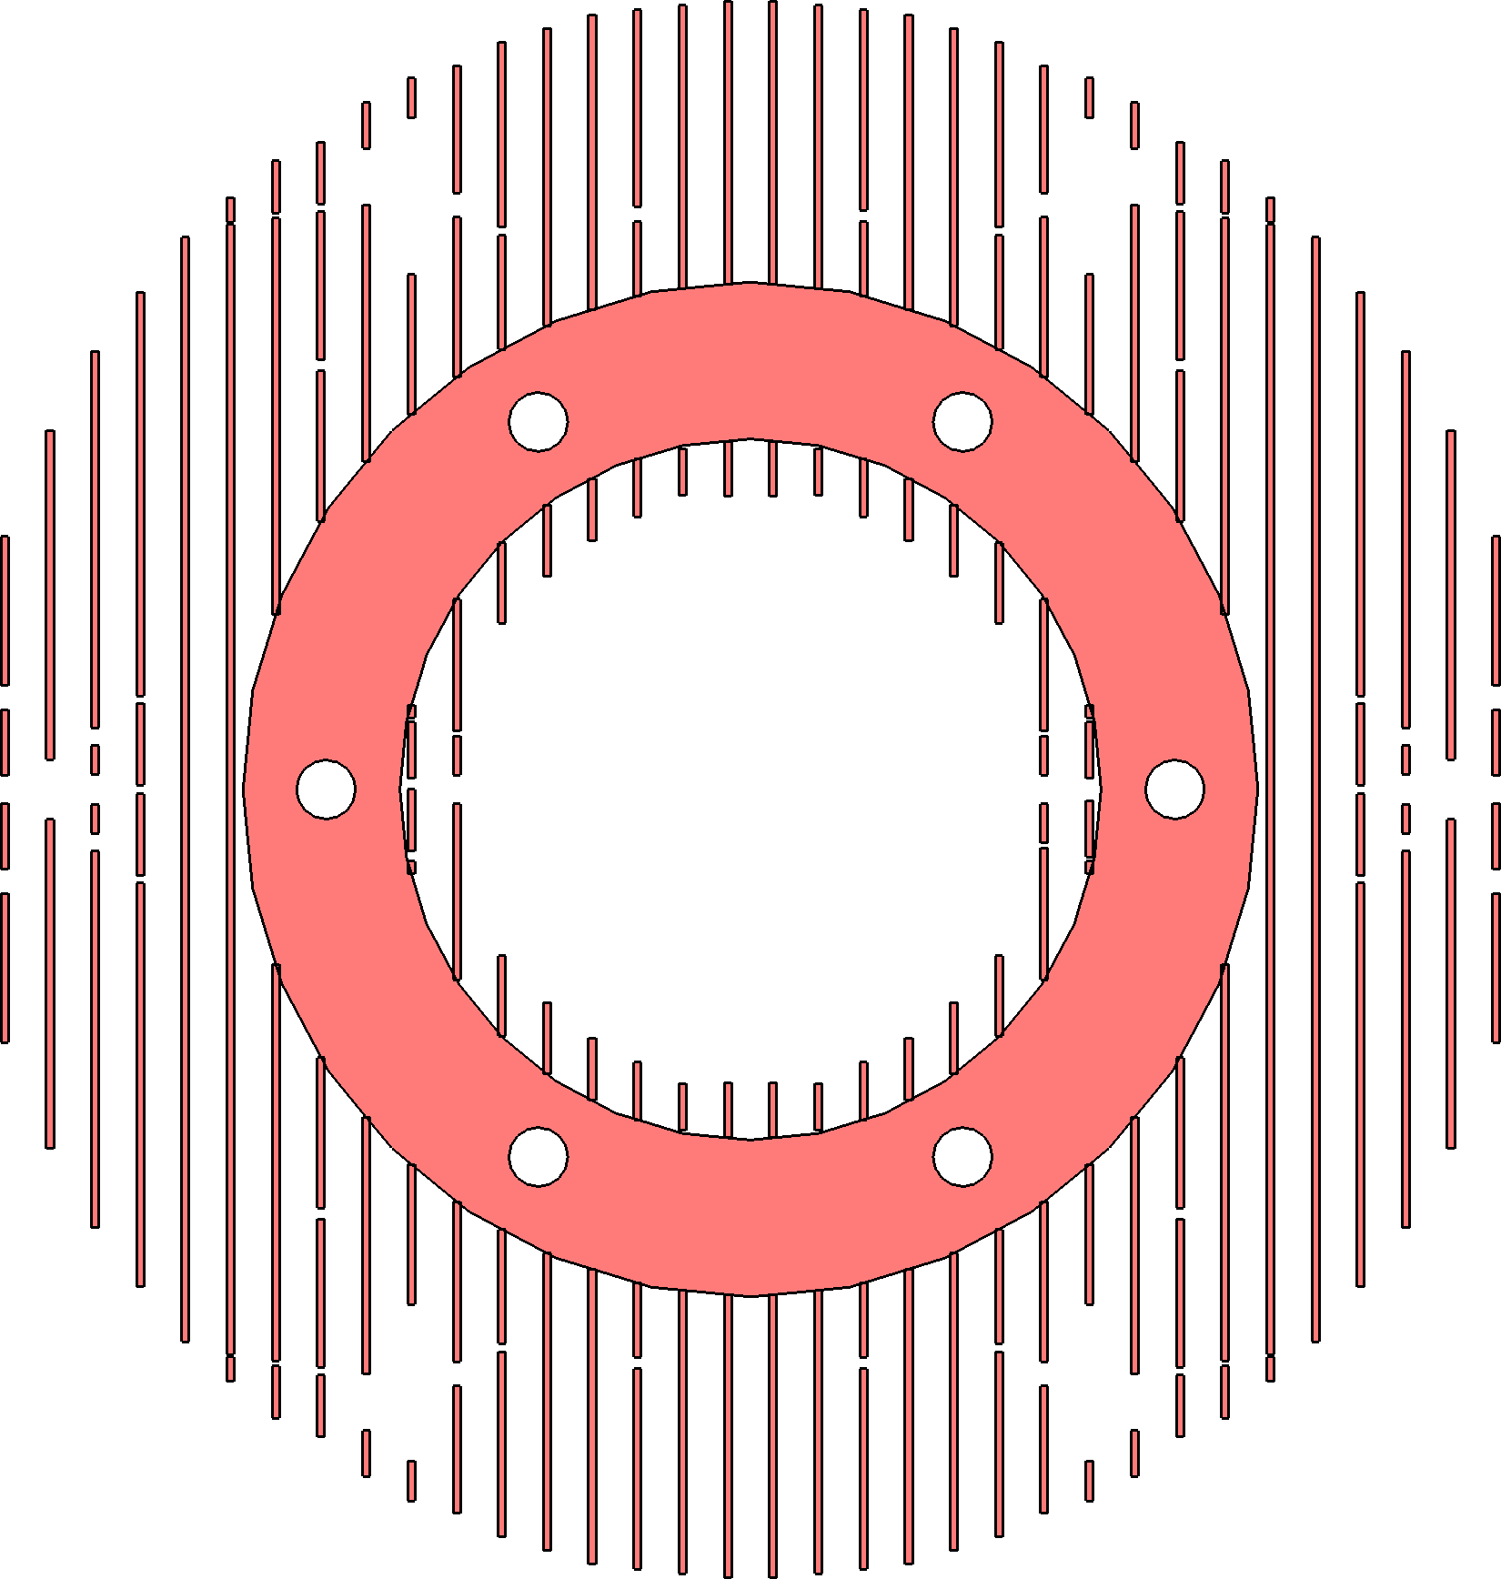
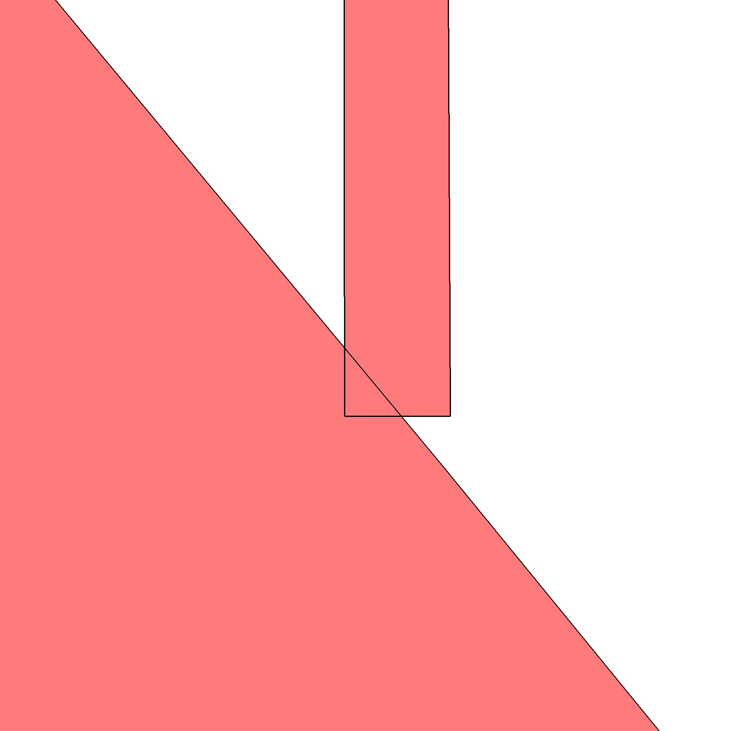
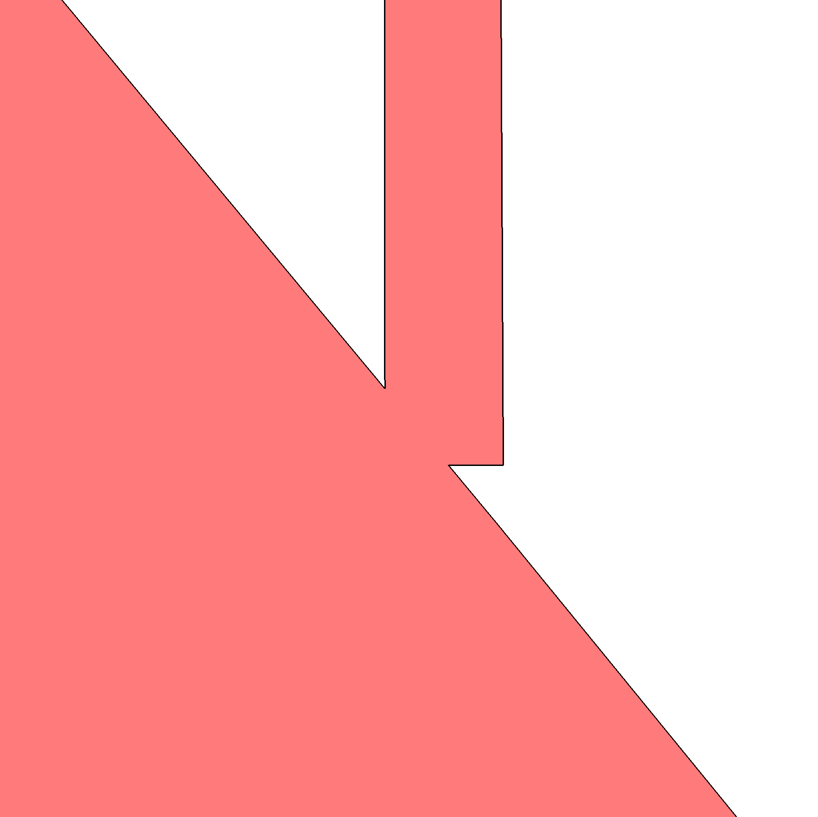
Support structures
  Support structures are 1D open curves replicated at each slice
  We use curve thickening. Thickening radius matches
    The filament cross-section in FDM
    The Laser beam in SLS/SLM
    …
Boost Polygon Library (buffer)

Slide 14
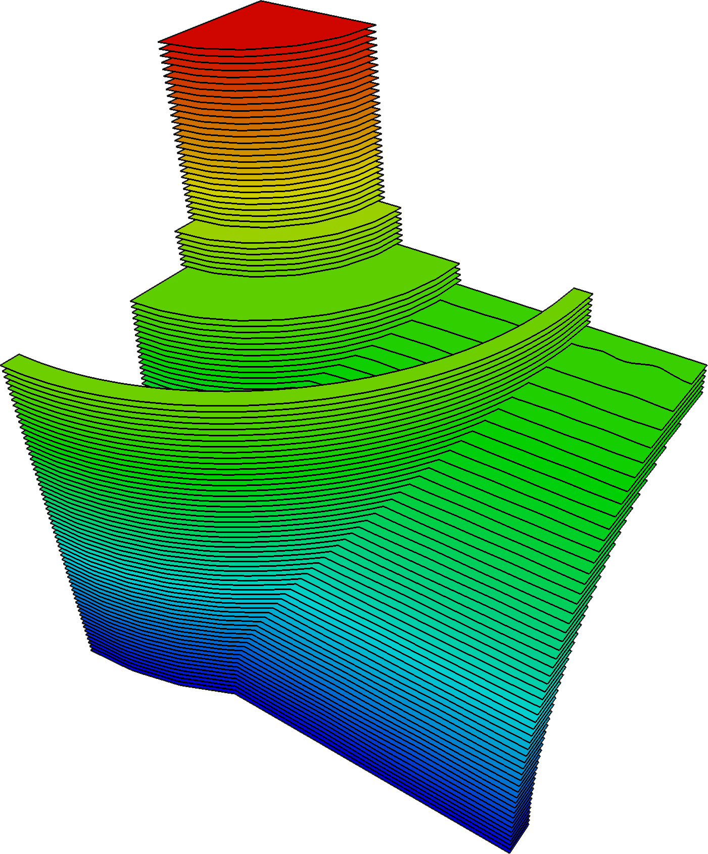
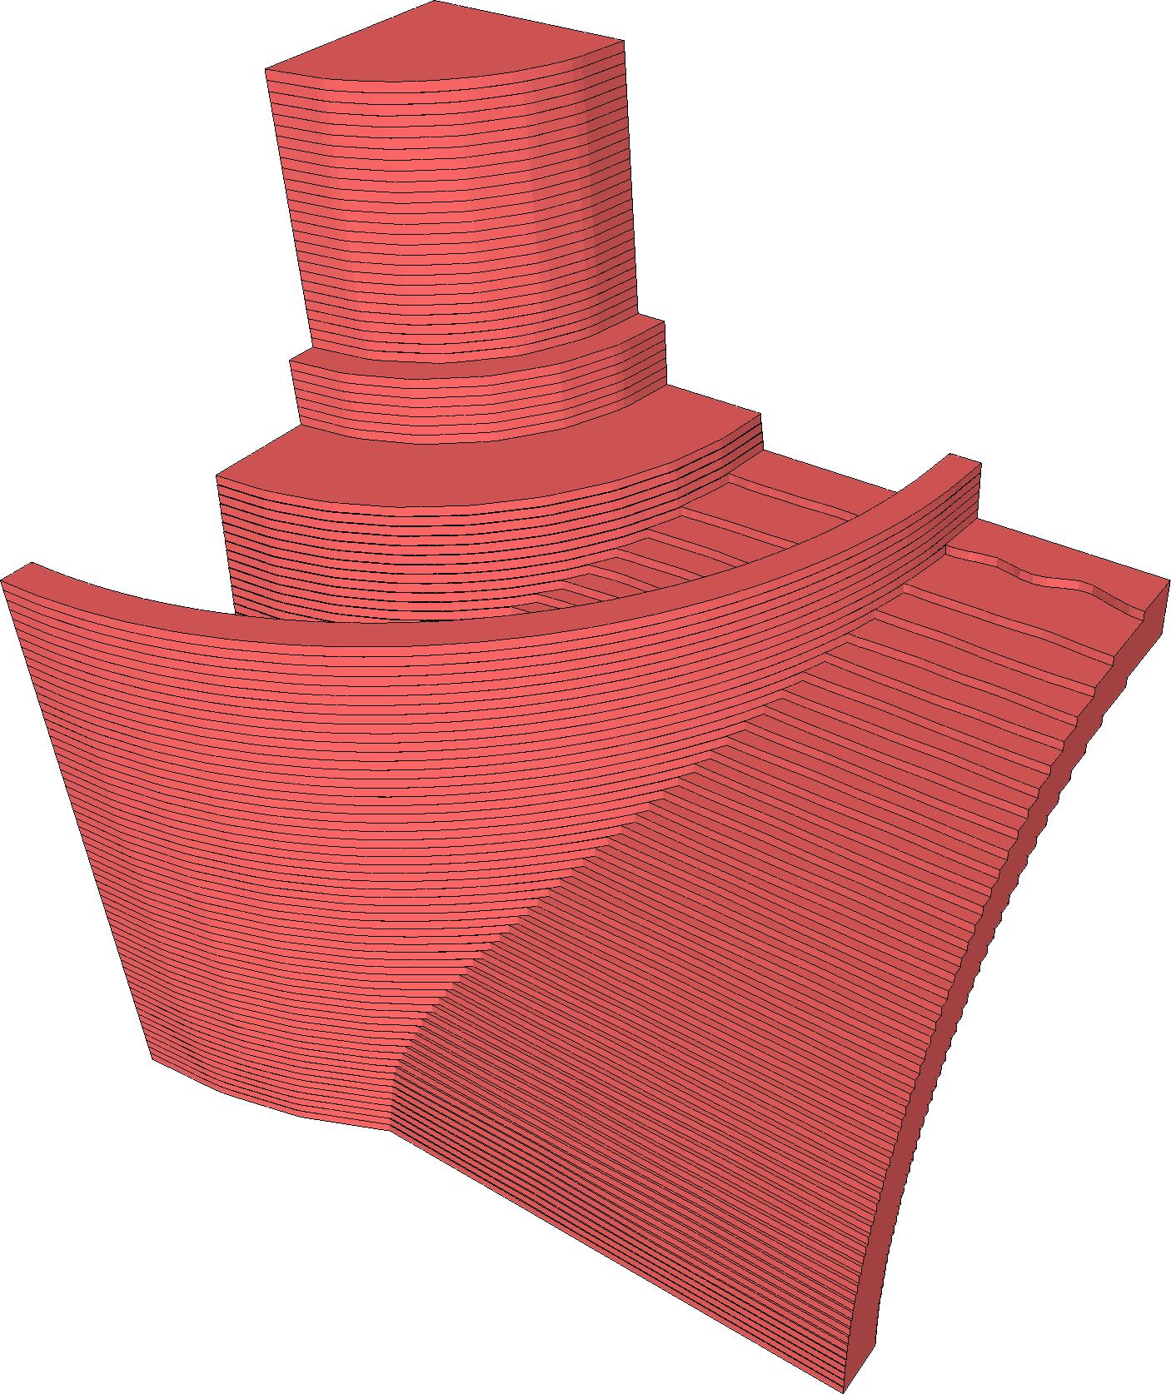
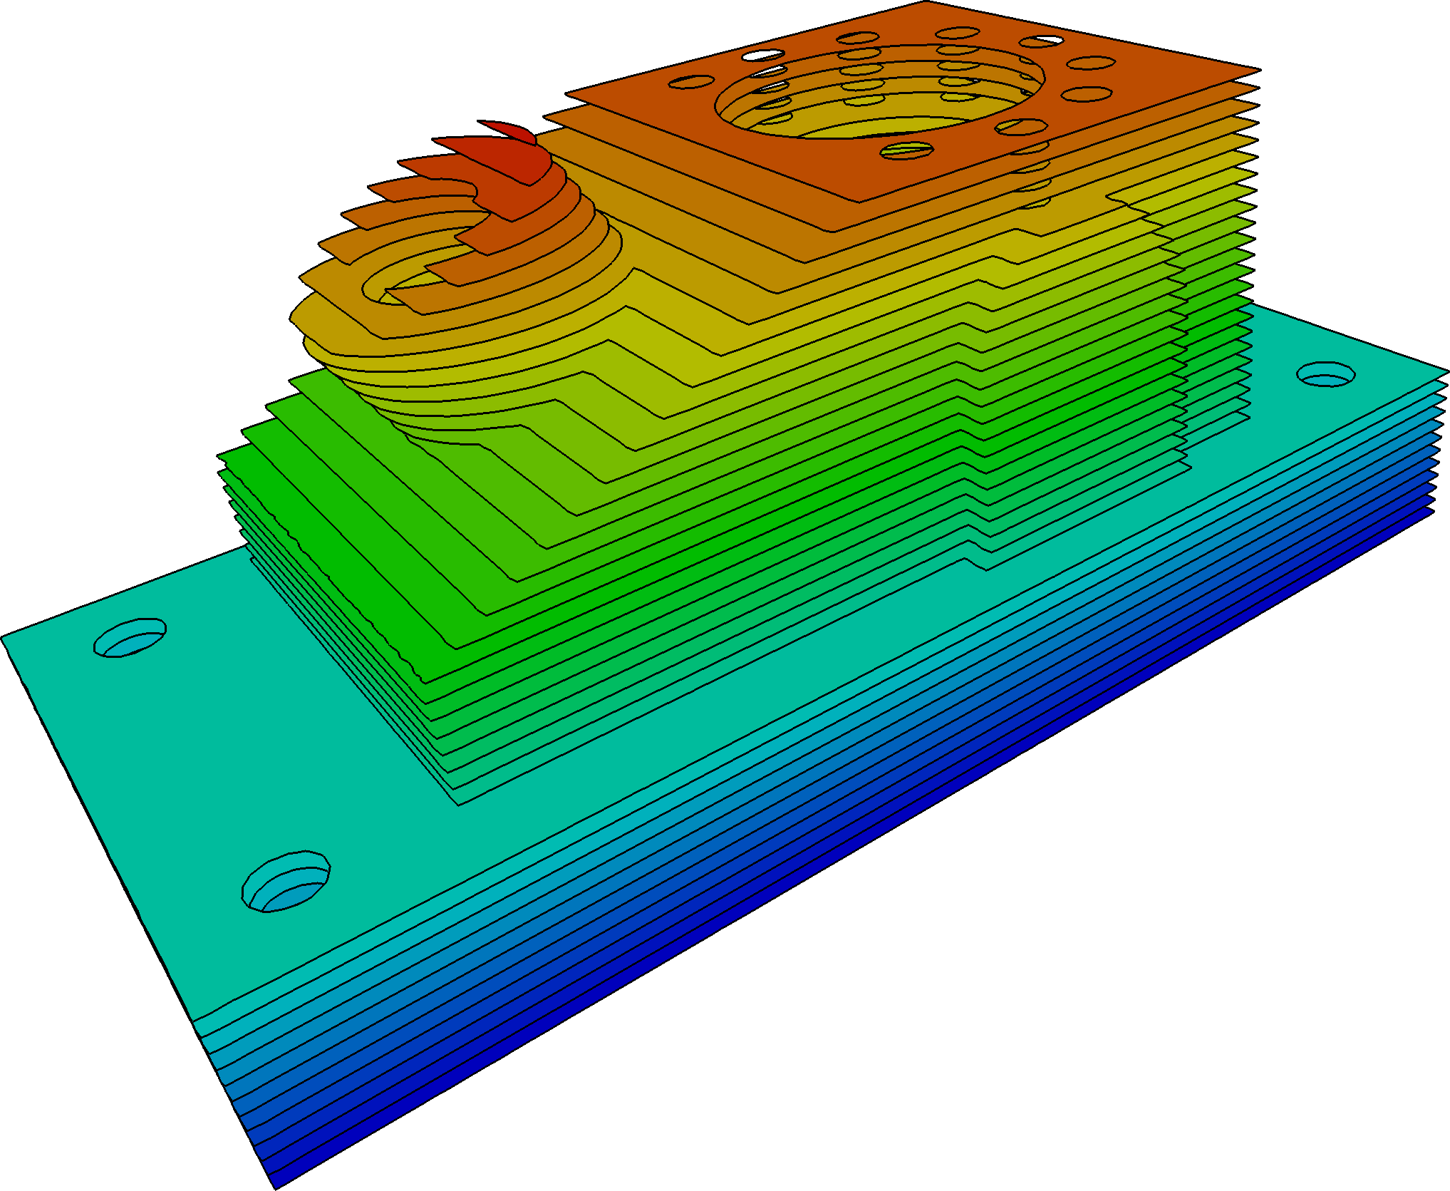
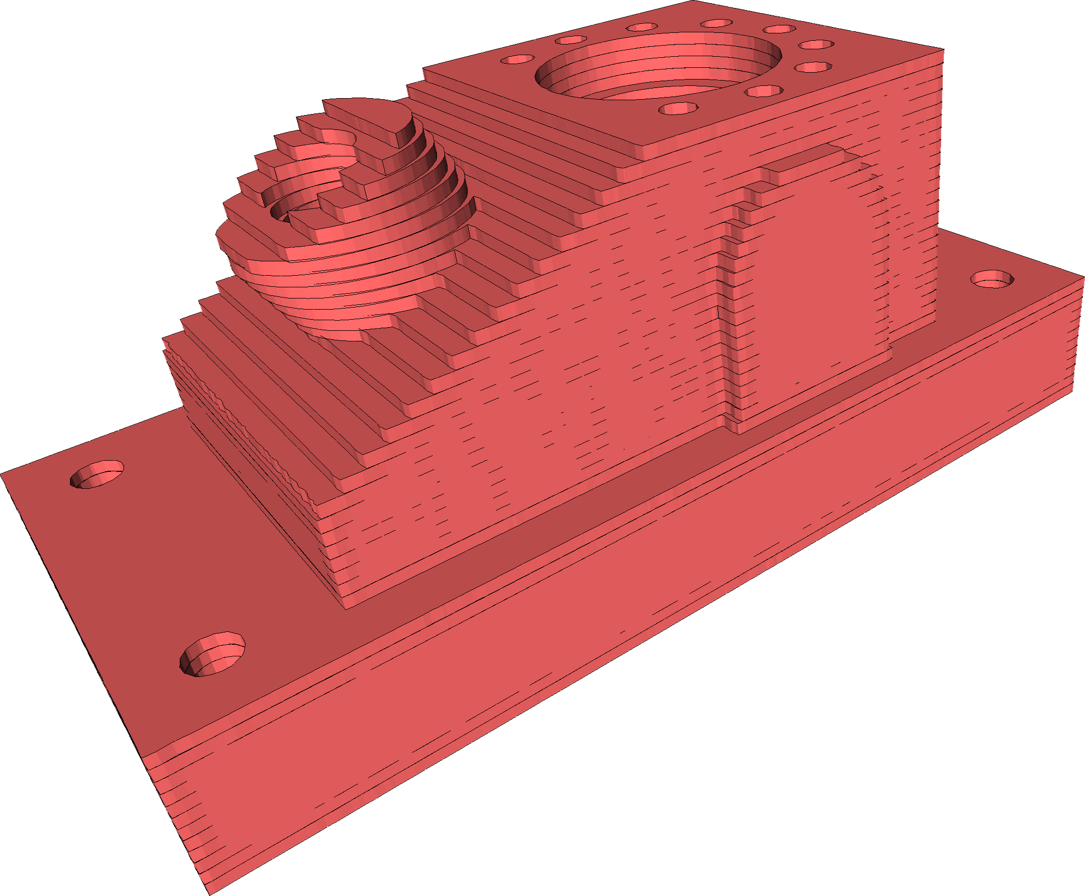
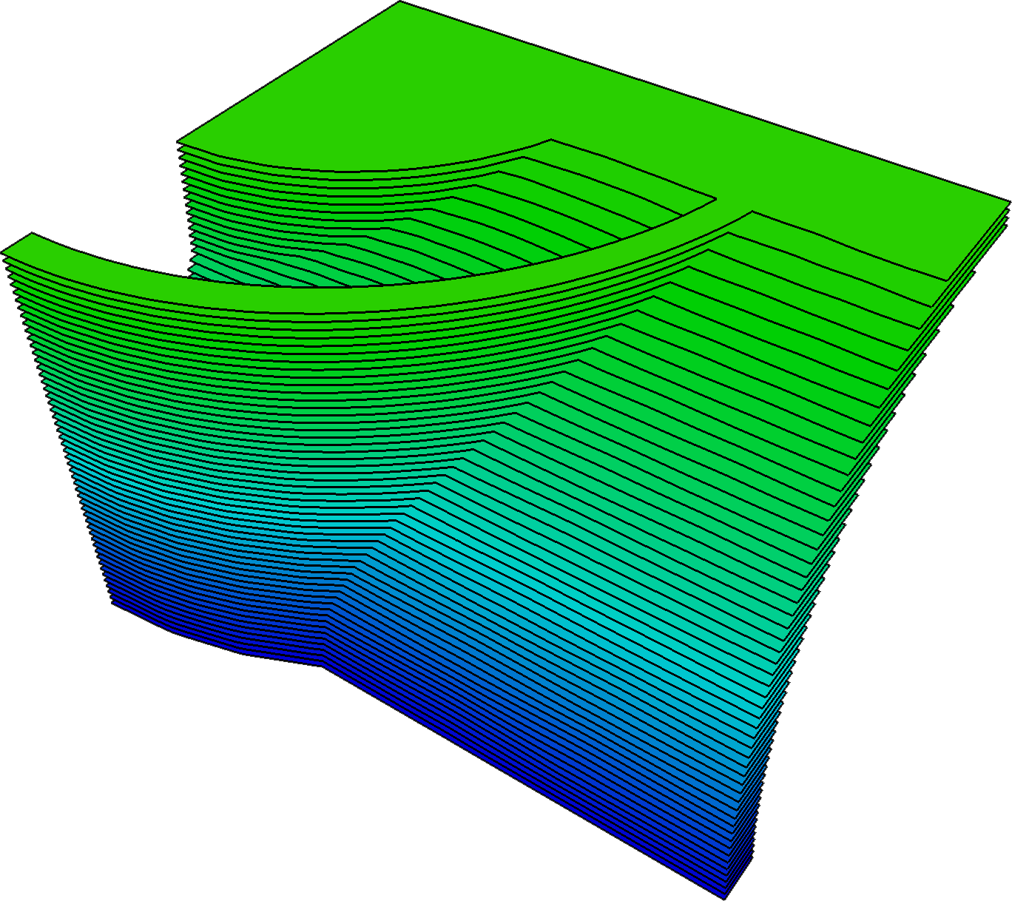
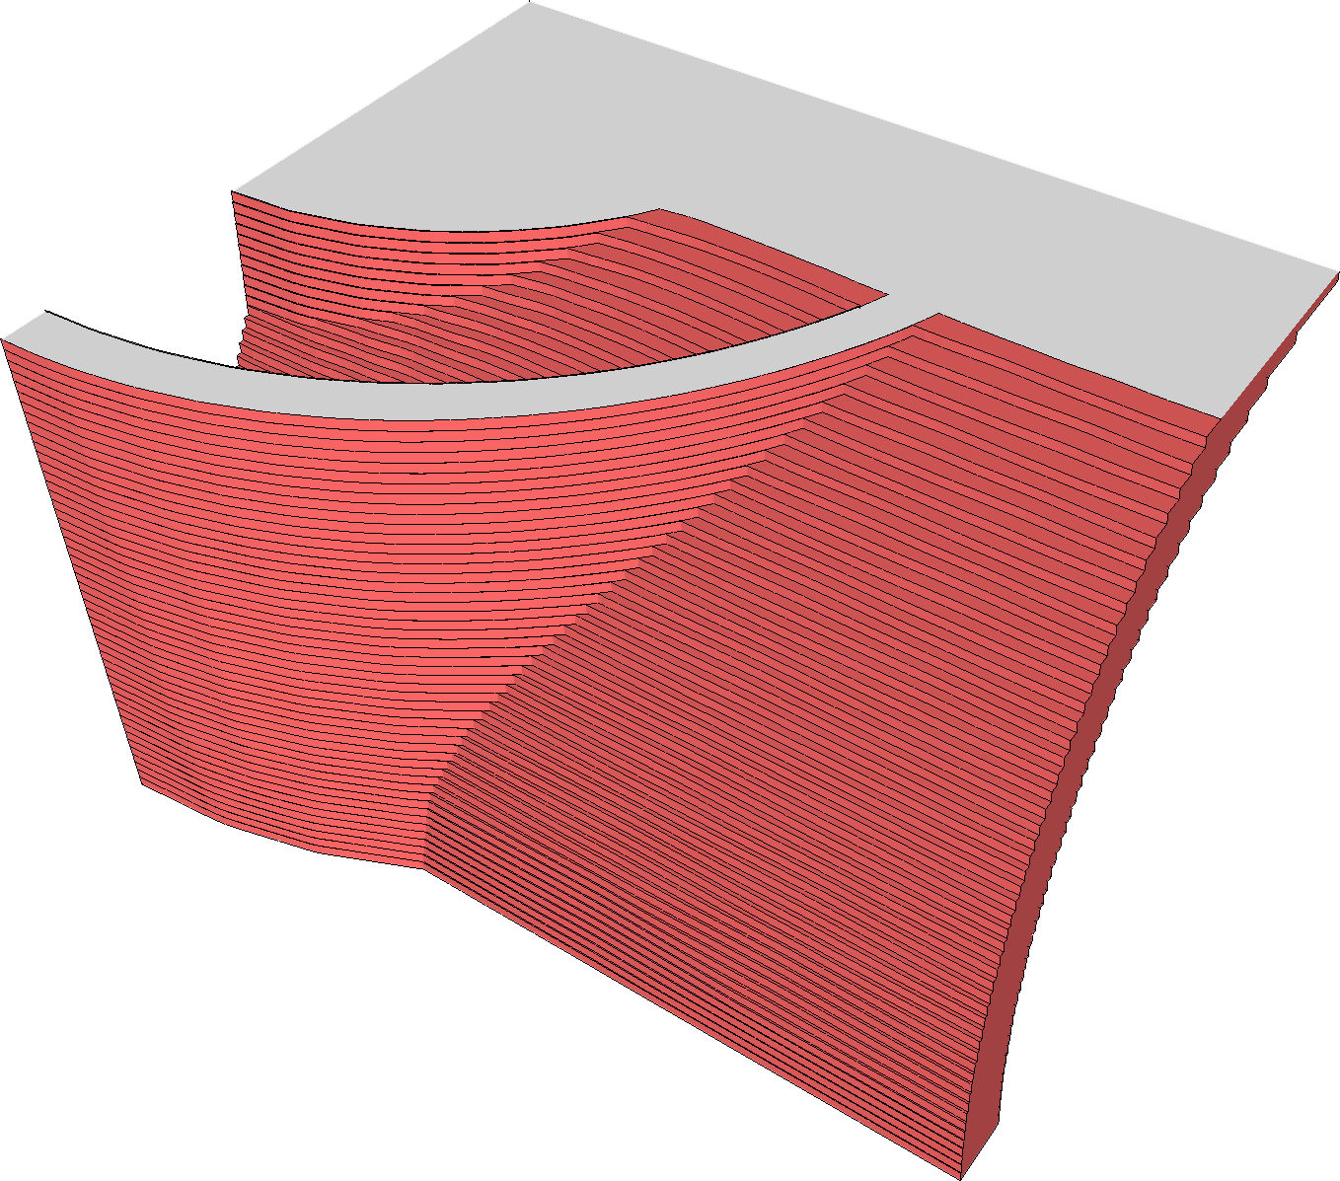
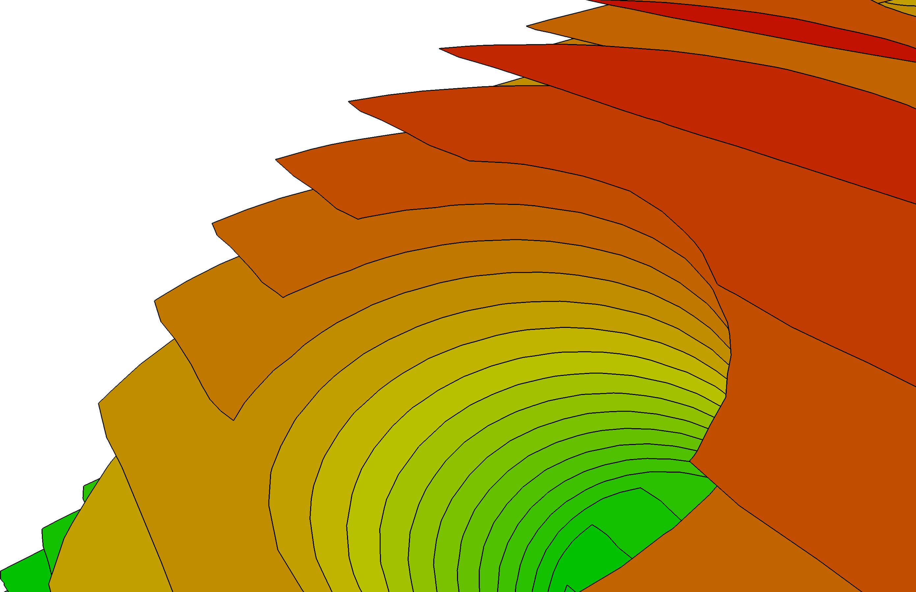
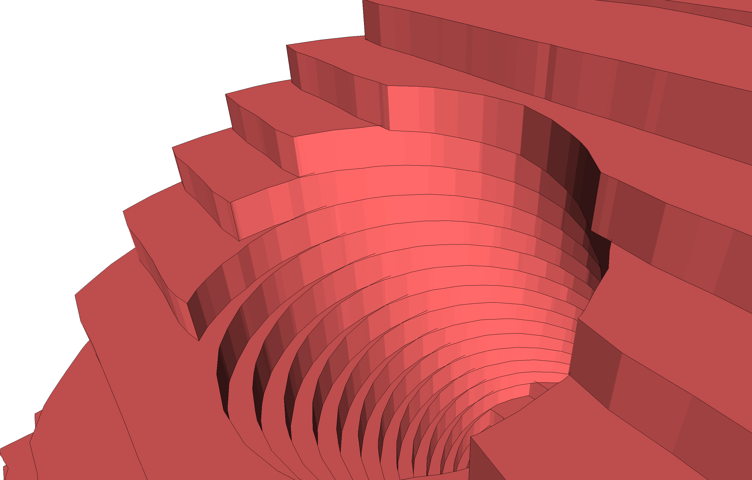
Considerations
  Working in slice space offers a number of advantages
    Complexity of 3D objects disappears: everything is 2D!
    Complex of supports/infills disappears as well: everything is 2D!

Slide 15
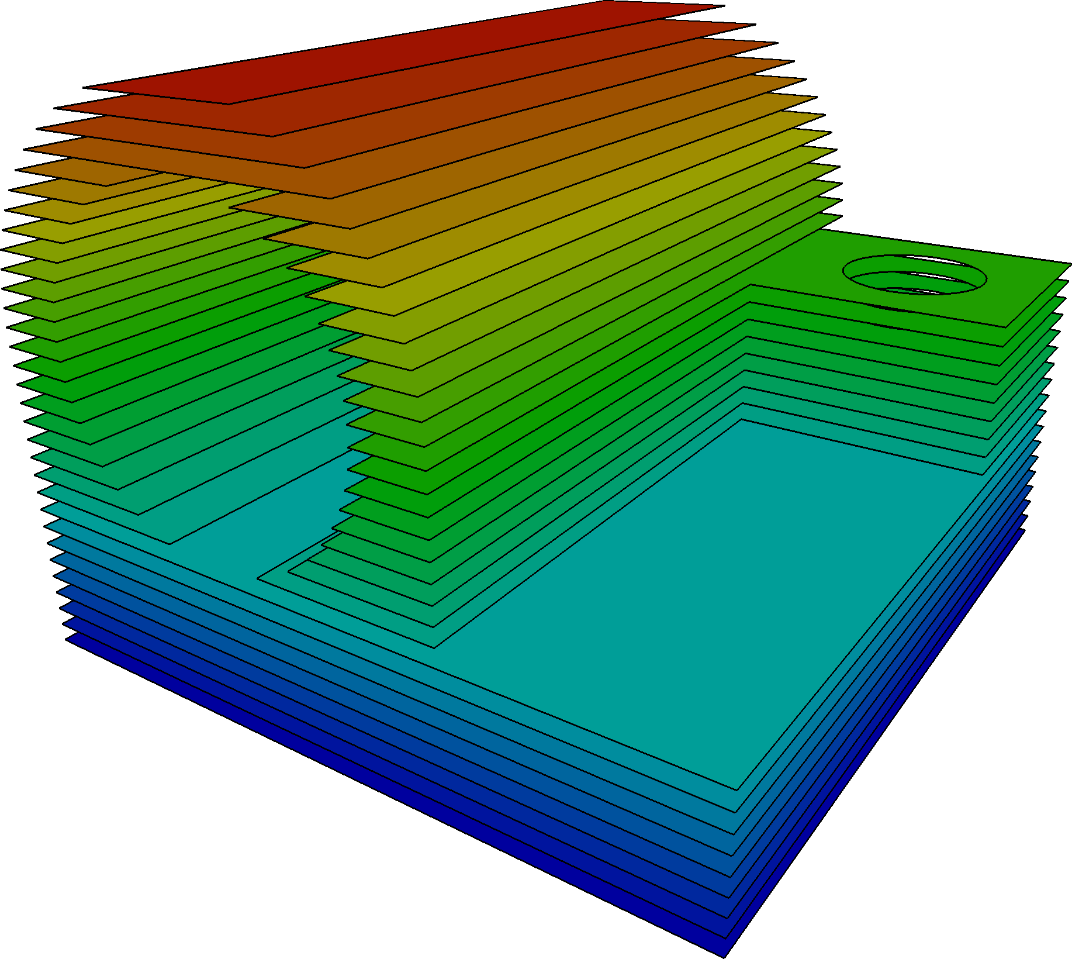
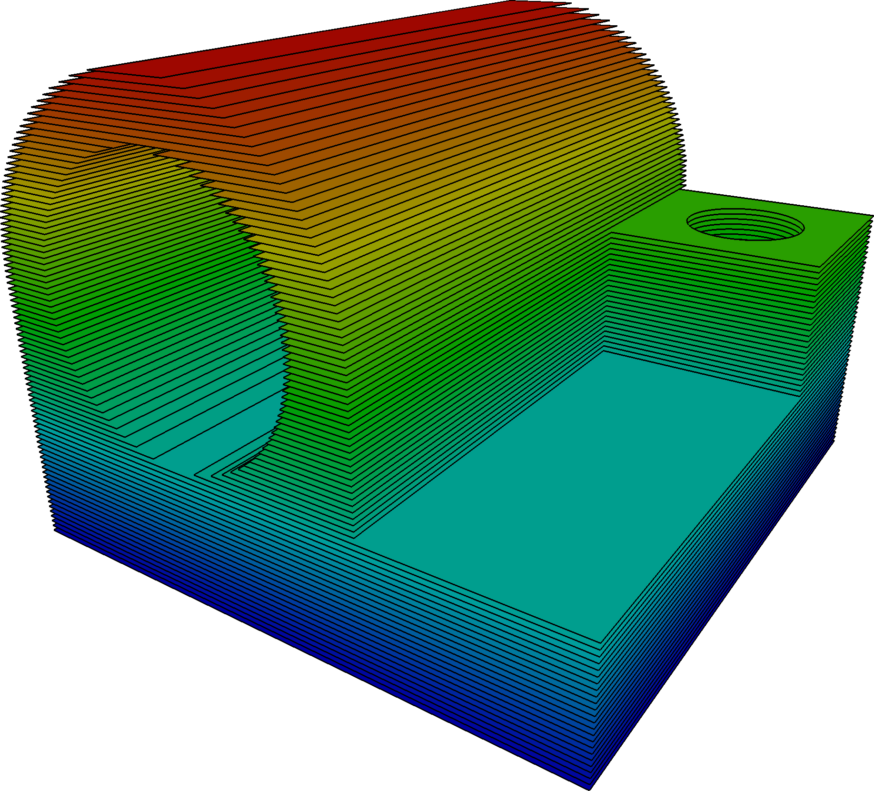
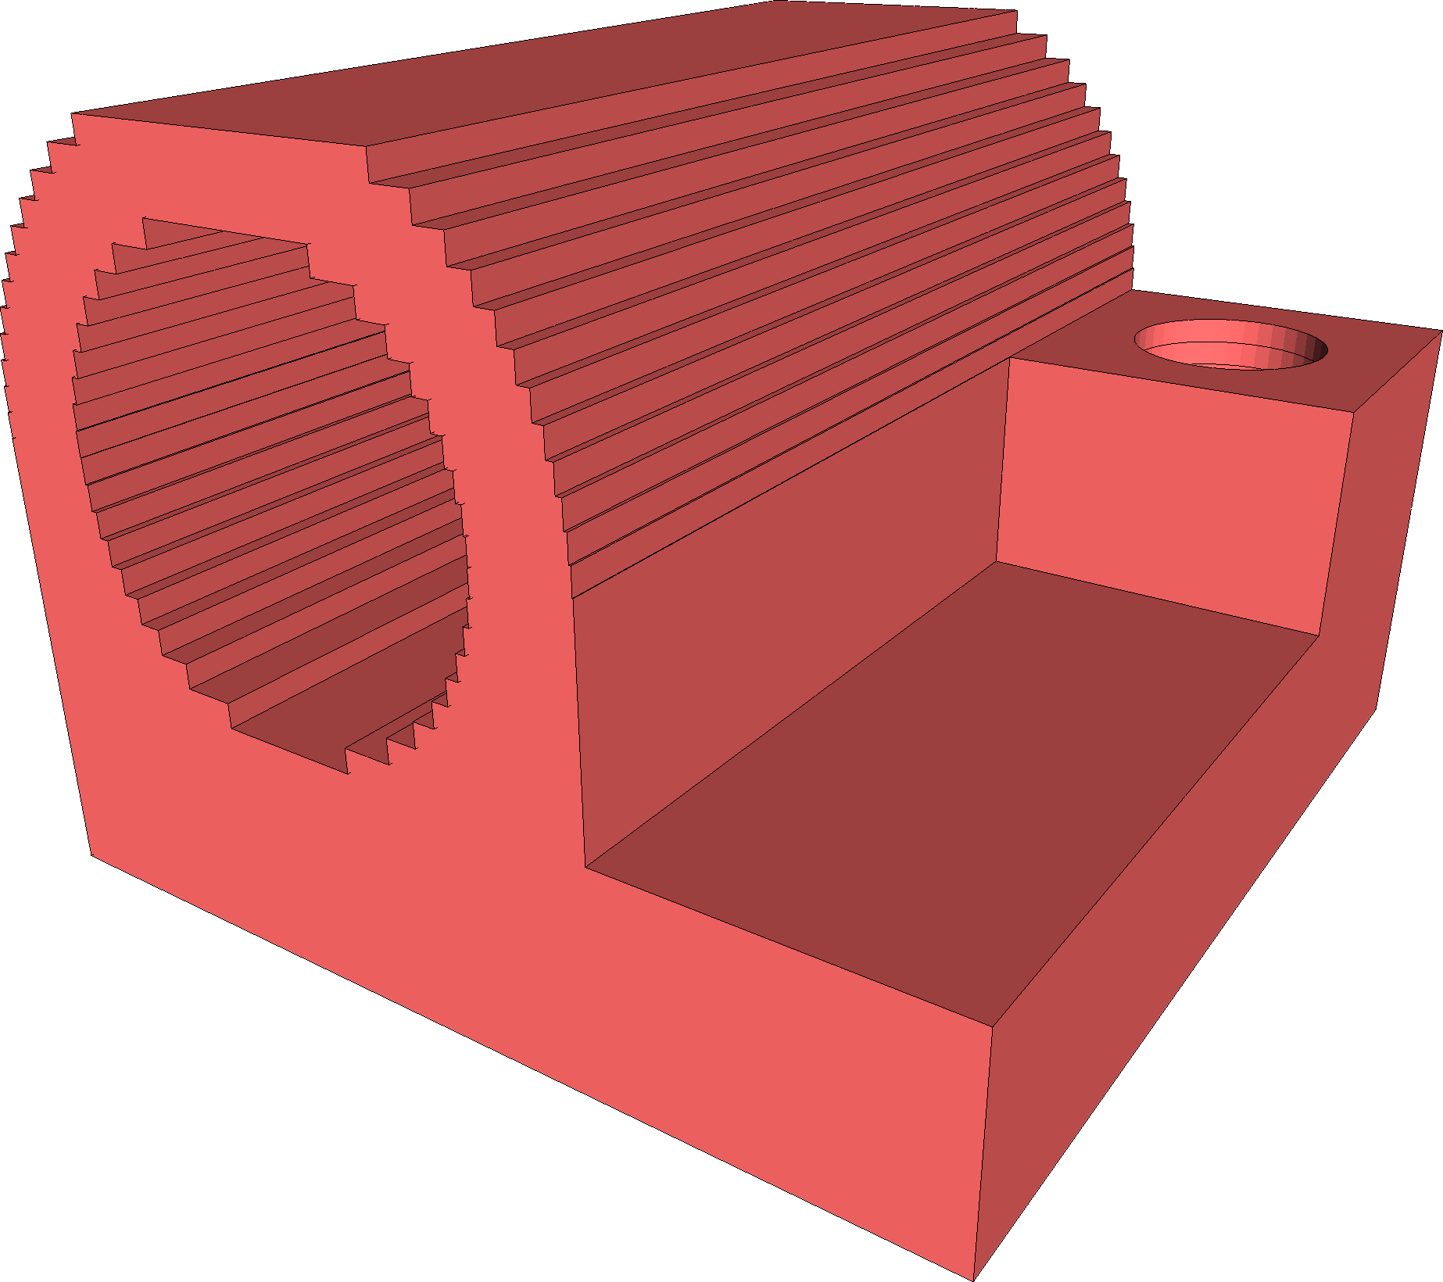
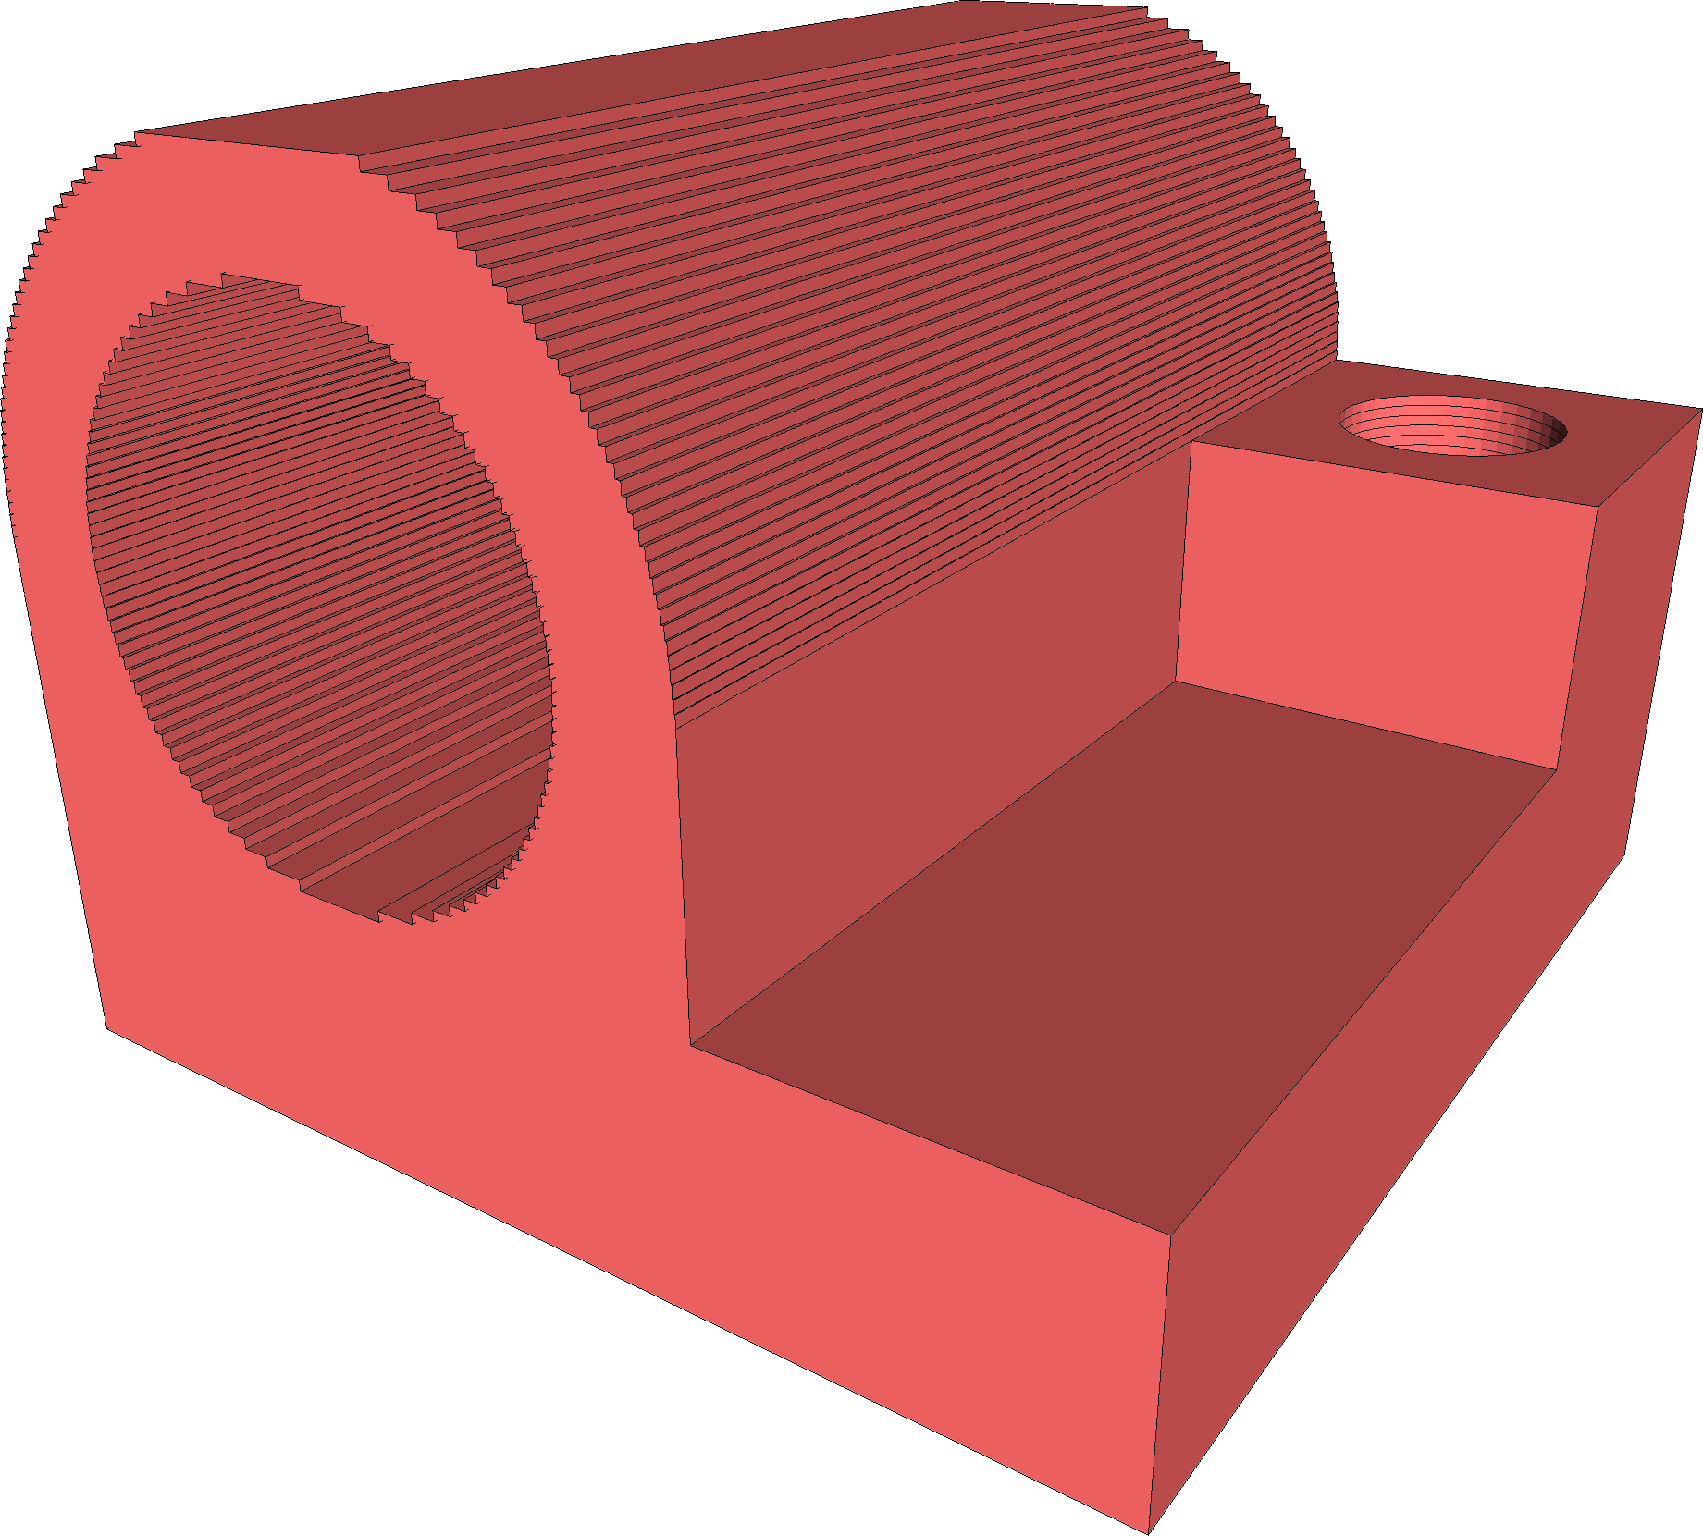
Considerations
  Working in slice space offers a number of advantages
    Complexity of 3D objects disappears: everything is 2D!
    Complex of supports/infills disappears as well: everything is 2D!
    Domain simplification for faster simulations is trivial (filter slices!)
~40 slices
~35K tetrahedra
~80 slices
~170K tetrahedra

Slide 16
Limitations
  More an academic prototype than a professional meshing tool
s₀
s₁
s₀
s₁

Slide 17
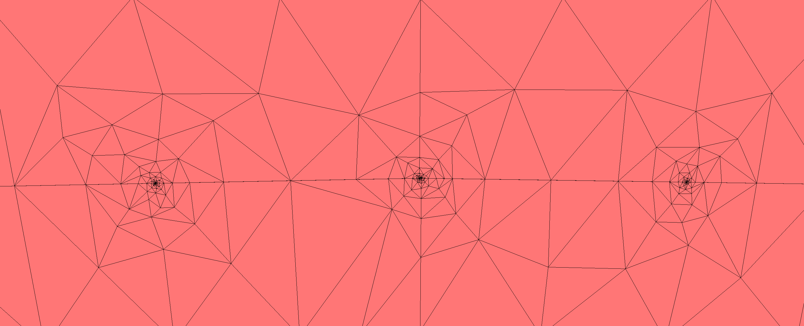
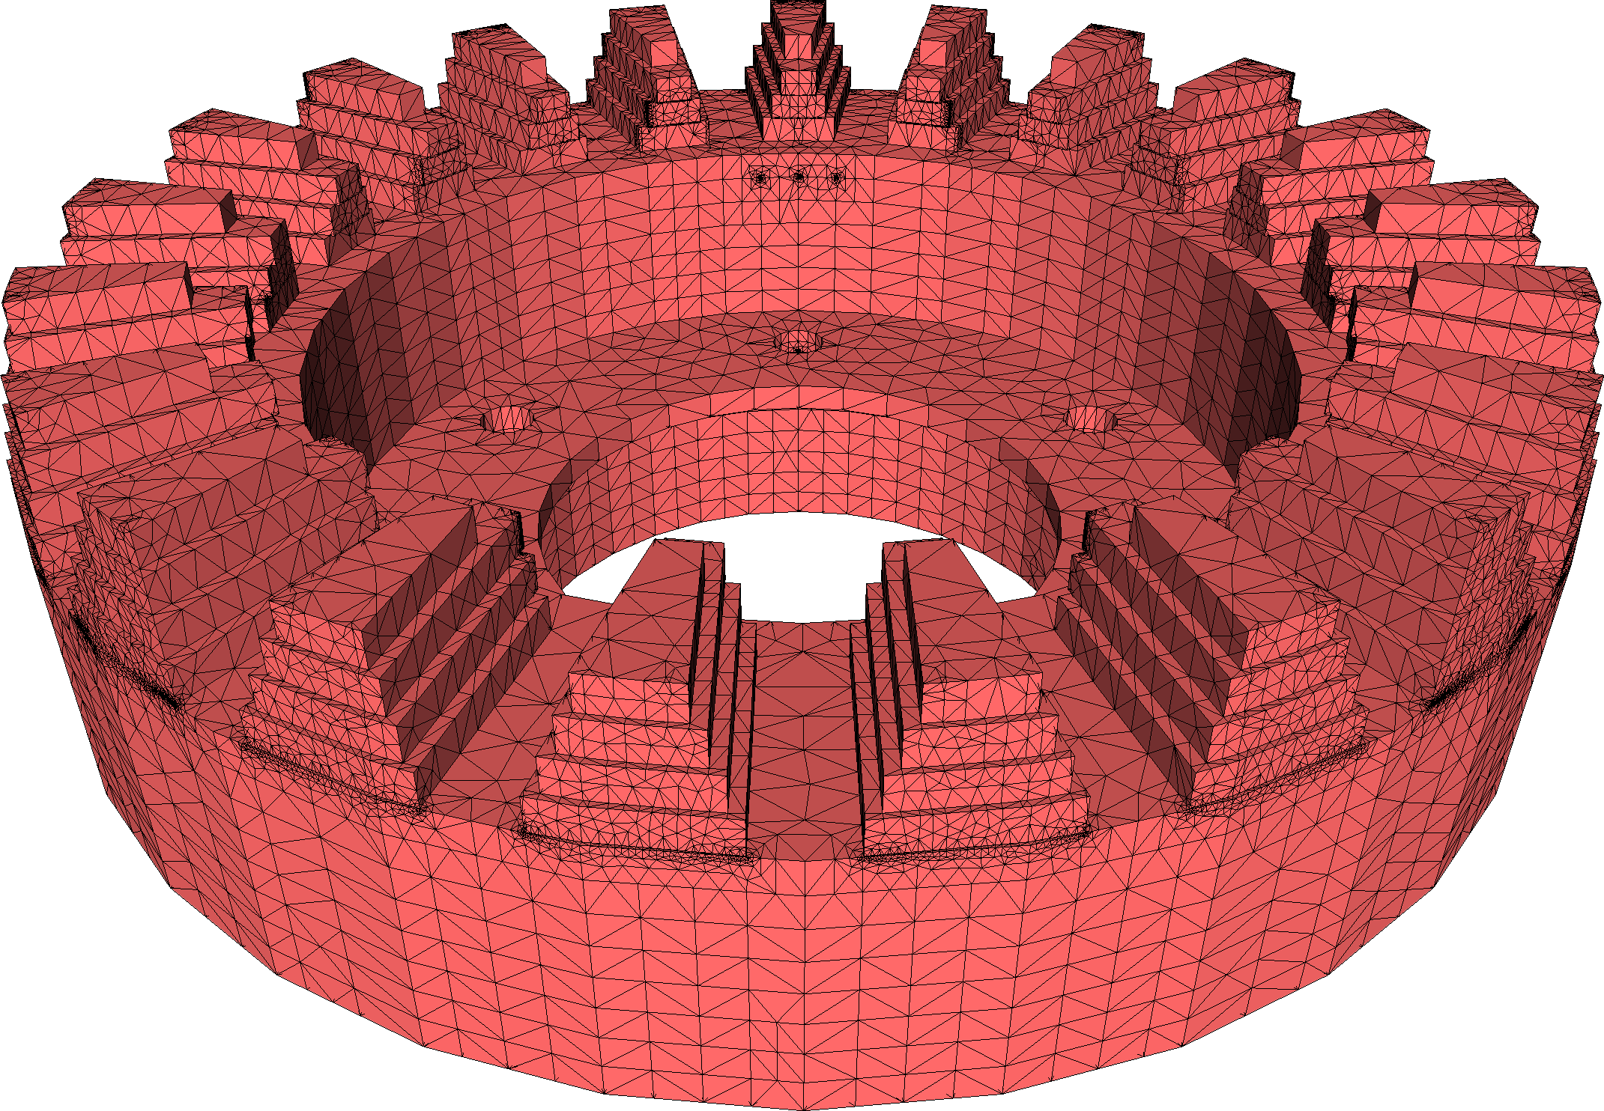
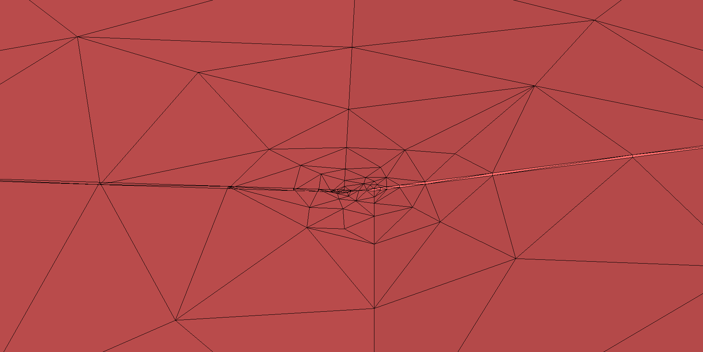
Limitations
  More an academic prototype than a professional meshing tool

Slide 18
^{Conclusions}
MESHING TO SIMULATE
3D PRINTING
NEW CHALLENGES, STANDARD TECHNIQUES FALL SHORT
A FIRST (RATHER TRIVIAL) SOLUTION
https://github.com/mlivesu/slice2mesh
SLICE2MESH
- ROBUSTNESS
- OVER REFINEMENT
LIMITATIONS
- VALIDATE MESHES IN REAL SIMULATIONS
- MESH ALONG TOOLPATHS
- USE HEXAHEDRA or PRISMS
FUTURE
WORKS

Slide 19
^{THANK YOU!}

