Slide 1

Reconstructing the Curve-Skeleton of 3D shapes
Using the Visual Hull
M. Livesu, F. Guggeri, R.Scateni
Università degli Studi di Cagliari

Slide 2
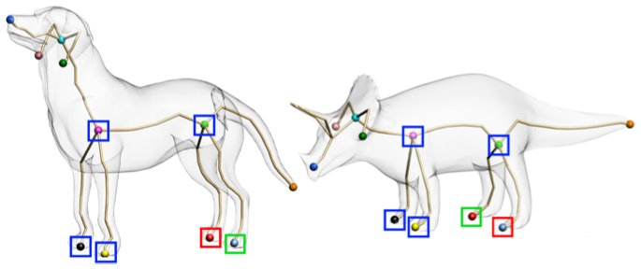
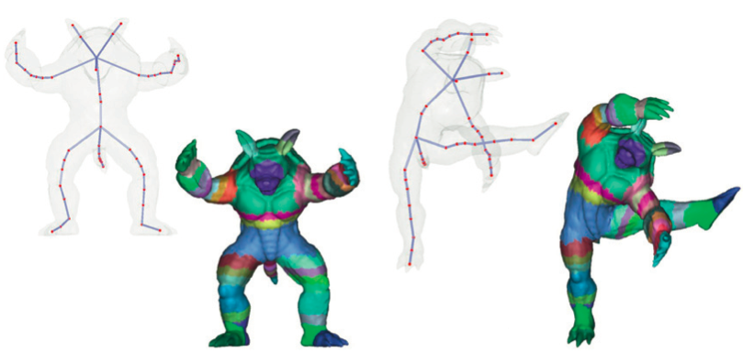
Why?
1D!
Graph-like structure
High-level representation
[Au et al, 2010]
[Jiang et al, 2012]
Notes:
COMPACTNESS: you can control a complex mesh with a lightweight structure!
GRAPHS: you can match two complex shapes just by matching two graphs: EASY!
TOPOLOGY: You can animate a complex shape just by specifying skeleton's movements

Slide 3
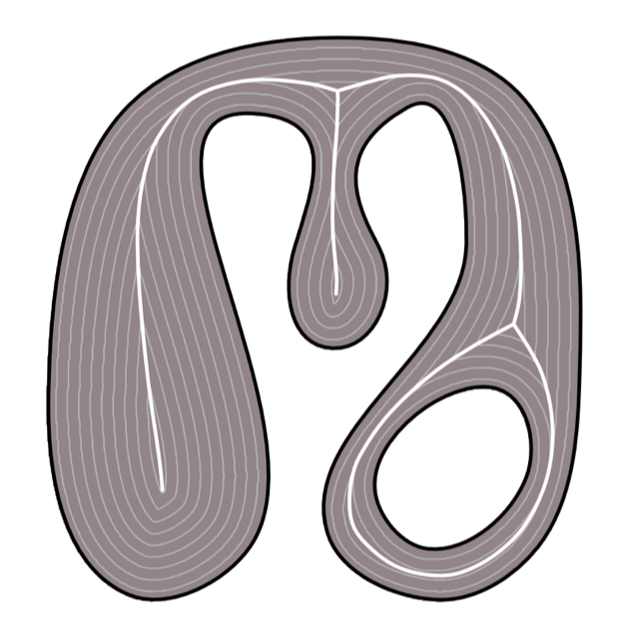
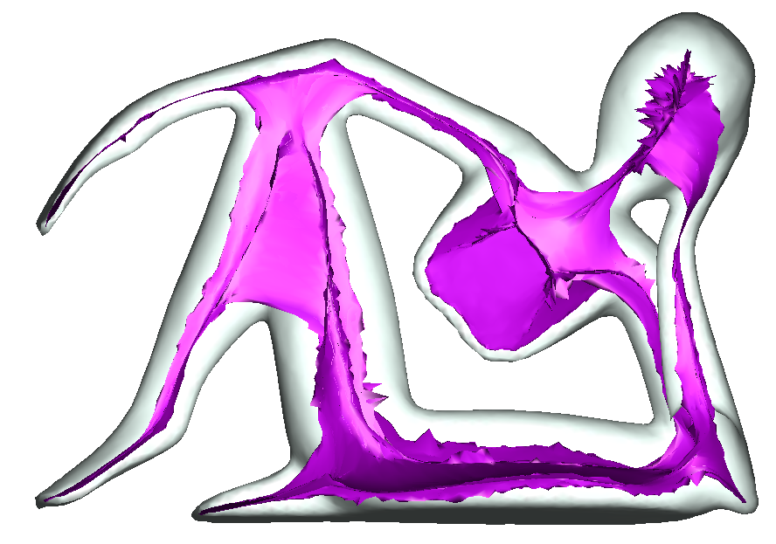
Computation
✓
  1D
  Graph-like structure
✗
  1D
  Graph-like structure
Notes:
SET OF CENTERS OF MAXIMAL DISKS
DISK WITH MAXIMUM RADIUS CONTAINED INTO THE SHAPE
----- Note riunione (27/04/13 20:08) -----
2D skeleton is defined by the set of centers of the maximal disks inscribed into the shape
it's a COMPACT and ELEGANT CHARACTERIZATION
MOVE TO 3D -> BAD

Slide 4
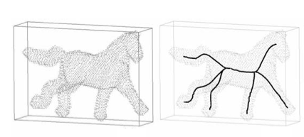
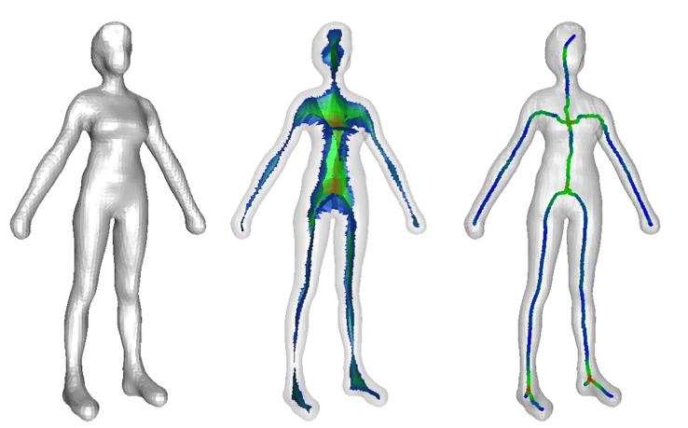
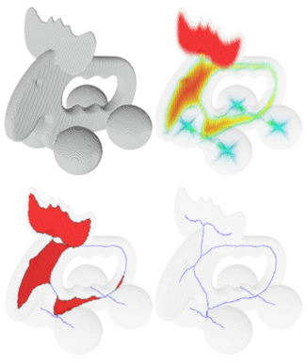
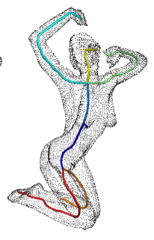
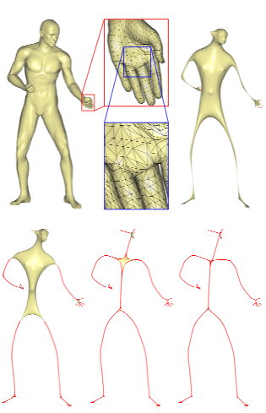
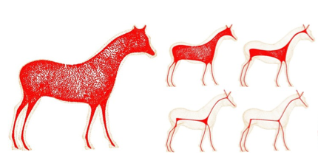

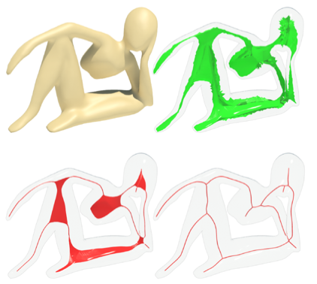
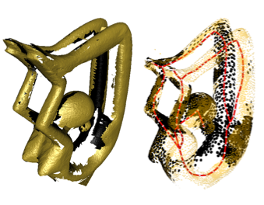
State of the art (input-wise)
Triangle meshes
Voxels
Polygon meshes
Polygon soups
Implicit surfaces
….
[Cornea et al, 2005]
[Dey and Sun, 2006]
[Liu et al, 2010]
Point clouds
[Sharf et al, 2007]
[Au et al, 2008]
[Cao et al, 2010]
[Tagliasacchi et al, 2012]
[Tagliasacchi et al, 2009]
Notes:
ALGORITHMS STRICTLY LINKED TO THE SHAPE REPRESENTATION
TRIANGLE MESHES: MOST POPULAR WAY OF DESCRIBING A 3D SHAPE
DISCRETE VOLUMES: MOSTLY USED IN MEDICINE
POINT CLOUDS: TIPICAL OUTPUT OF A RANGE SCANNER
----- Note riunione (27/04/13 20:08) -----
Triangle meshes => MOST POPULAR INPUT
Volumes => Medicine
Point clouds (oriented or not) => range scanners
FOR THE REST: CONVERSION TO THESE FORMATS

Slide 5
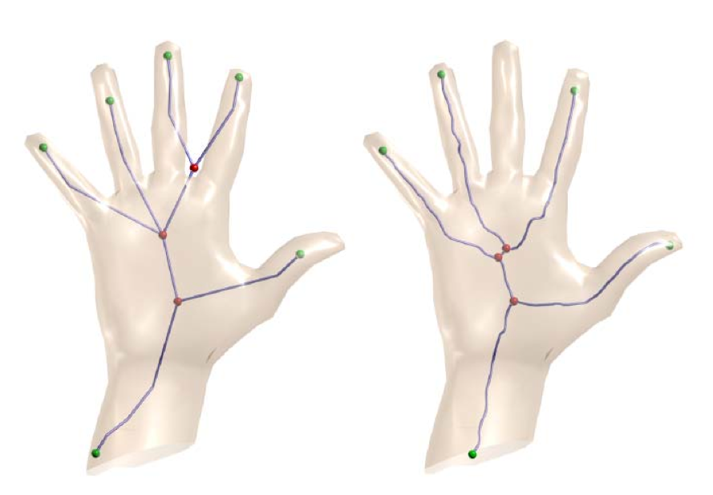
State of the art (resolution-wise)
Coarse hand (≈1k triangles)
Sometimes resolution is
more important than the
shape itself…
[Au et al, 2008]
[Dey and Sun, 2006]
Notes:
WHICH IS THE BEST RESOLUTION TO FEED AN ALGORITHM?
TRADDEOFF BETWEEN TIME AND ACCURACY
AS LONG AS VISUAL APPEARANCE IS PRESERVED SKELETONS SHOULD BE THE SAME
----- Note riunione (27/04/13 20:08) -----
WHAT IS THE BEST RESOLUTION? DUNNO!
WE EXPECT THE SAME SKELETON FROM COARSE AND REFINED MODELS, AS LONG AS APPEARANCE IS PRESERVED

Slide 6
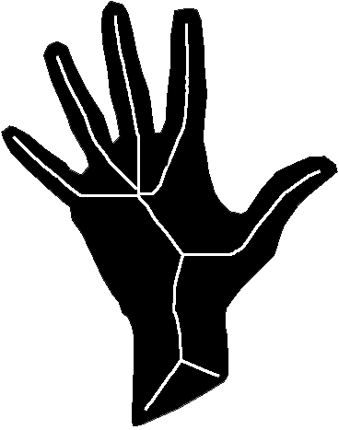
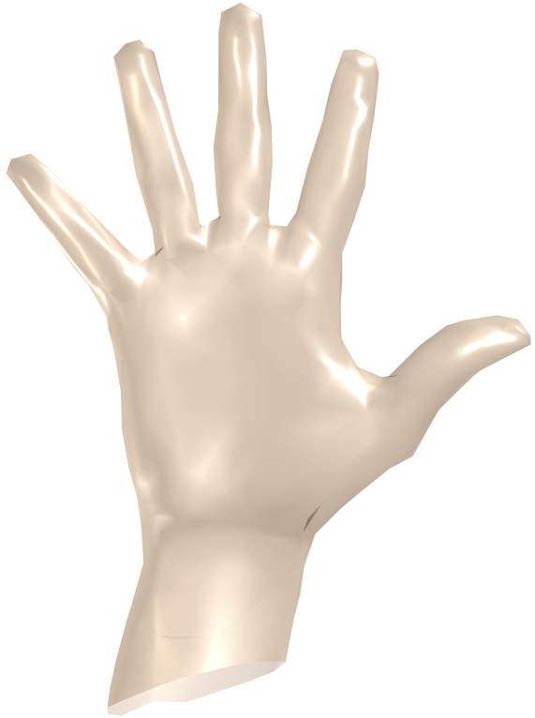
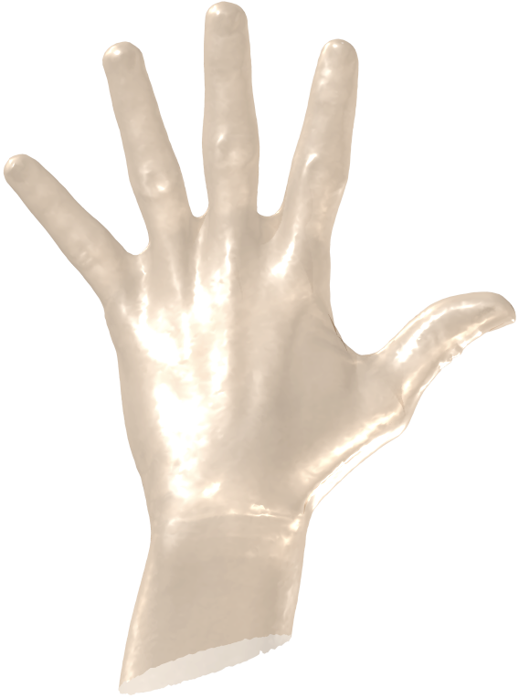

Perceptual approach
What are the alternatives? Focus on the appearance of the shapes
1K triangles
273K triangles
GOAL: resolution and format independence!
Notes:
CATCH: IF I AM ABLE TO COMPUTE A 3D SKELETON FROM A SET OF 2D SKELETONS
I CAN CREATE AN ALGORITHM WHICH IS REPRESENTATION AND RESOLUTION INDEPENDENT!!!
----- Note riunione (27/04/13 20:08) -----
OUR IDEA: WE FOCUS ON APPEARANCE BY EXPLOITING THE RELATION BETWEEN 2D MAT AND 3D SKELETONS
IN this way we create an algorithm which is REPRESENTATION and RESOLUTION INDEPENDENT!

Slide 7
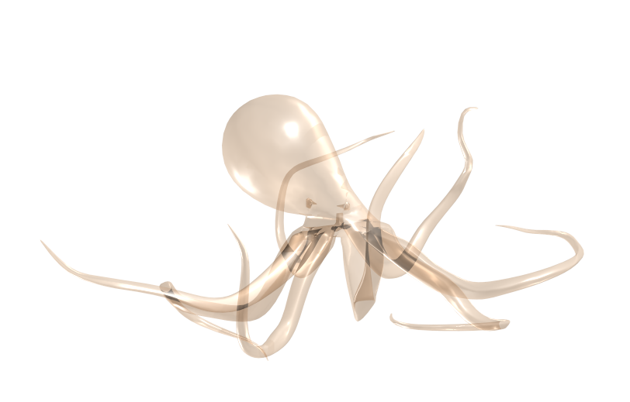

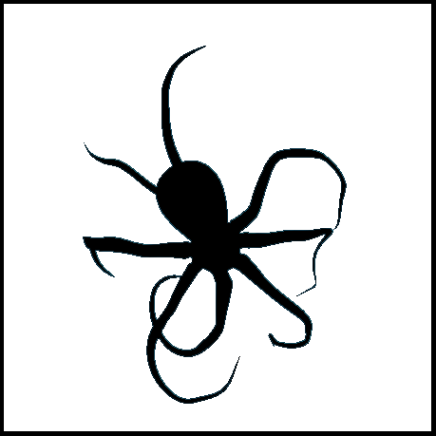
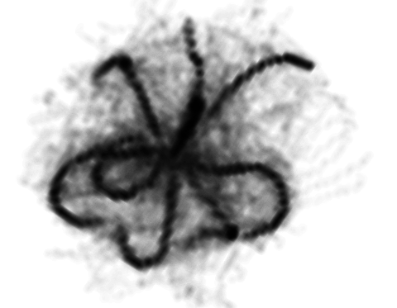
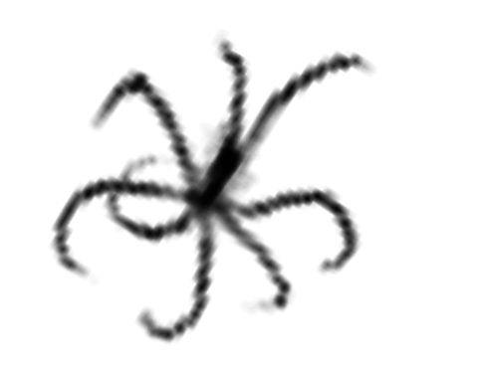
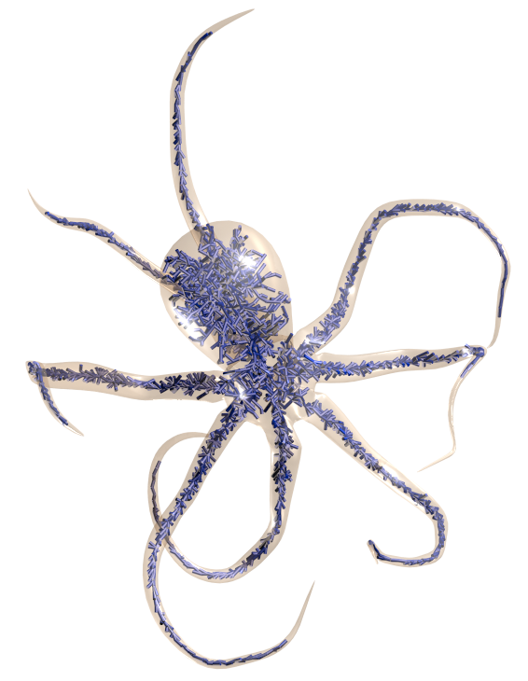
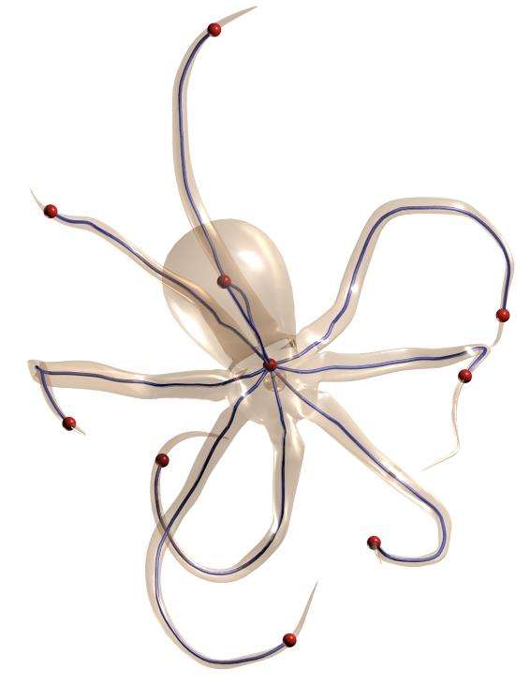
Our framework
Silhouette gathering
Grid voting
Visual Hull cleaning
Spanning tree
ST processing
Notes:
OUR PROPOSAL IS BASED ON THE FOLLOWING PIPELINE
WE COLLECT A SET OF SILHOUETTES AND WE COMPUTE THE MAT FOR ALL OF THEM
WE PROJECT THE MAT TO VOTE A DISCRETE 3D GRID
WE CLEAN THE VISUAL HULL BY KILLING EVERY POINT WHICH IS OUTSIDE AT LEAST ONE SILHOUETTE
WE COMPUTE A SPANNING TREE OF THE GRID
WE PERFORM TOPOLOGICAL OPERATIONS OVER THE SPANNING TREE TO GET TO THE FINAL SKELETON

Slide 8

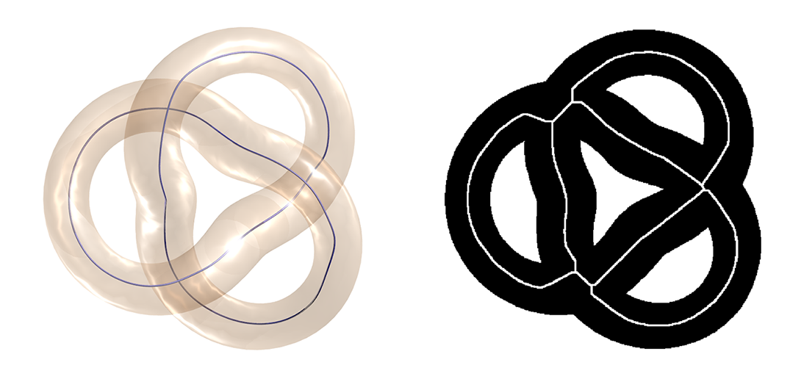
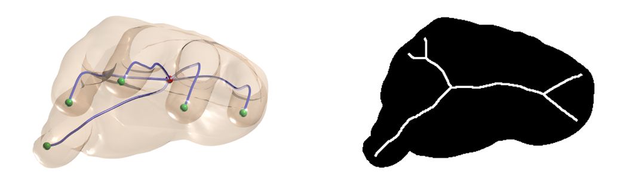
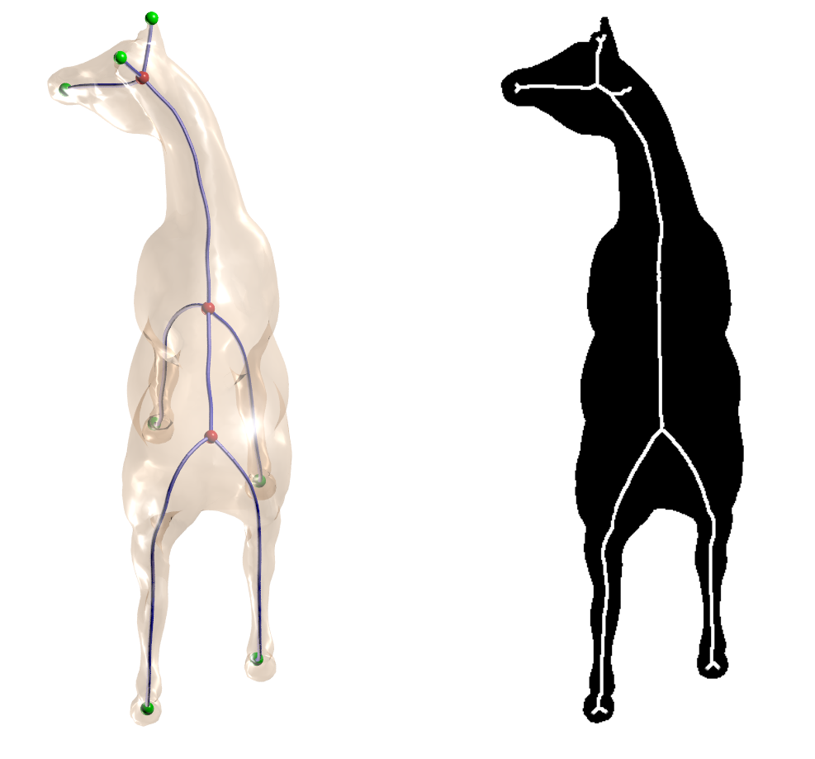
Silhouette gathering
MIN
OCCLUSION
MAX
OCCLUSION

Slide 9
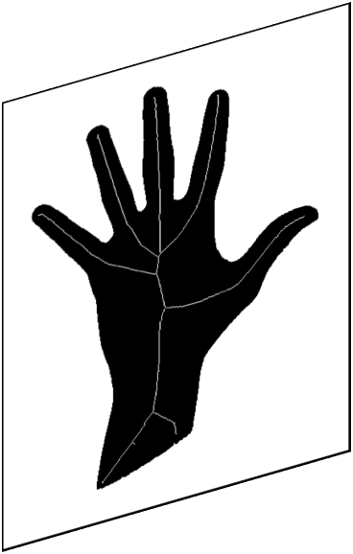
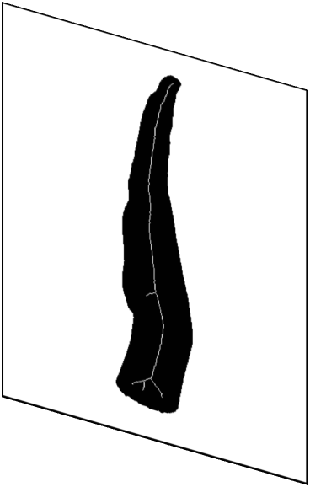


Grid voting
Notes:
WE COUPLE PAIR OF SILHOUETTES WITH ORTHOGONAL DIRECTION OF PROJECTION
WE MATCH MEDIAL AXIS POINTS TO LOCATE POINTS IN THE 3D SPACE AND VOTE THE GRID
WE USE THE RADIUS OF THE MAXIMAL DISKS TO ESTIMATE THE MAXIMAL BALL INSCRIBED INTO THE REAL SHAPE
SO FOR EVERY POINT IN THE GRID, WE HAVE 3D COORDINATES PLUS RADIUS OF THE MAXIMAL SPHERE

Slide 10
Visual Hull cleaning
✓
✗

Slide 11
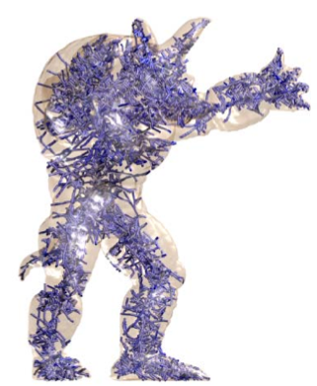
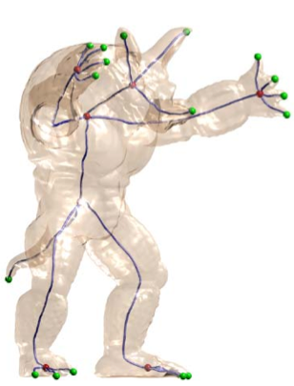
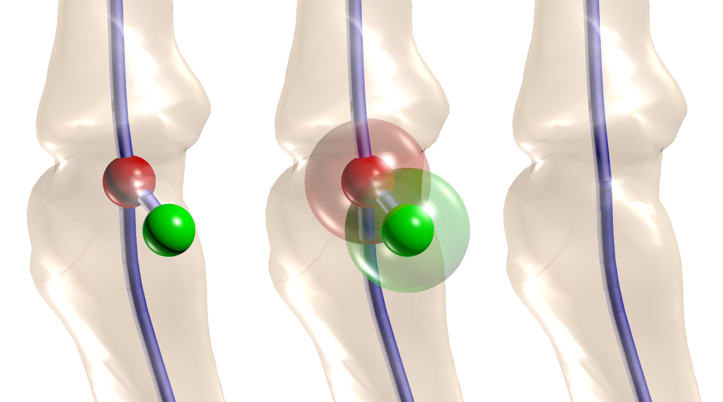
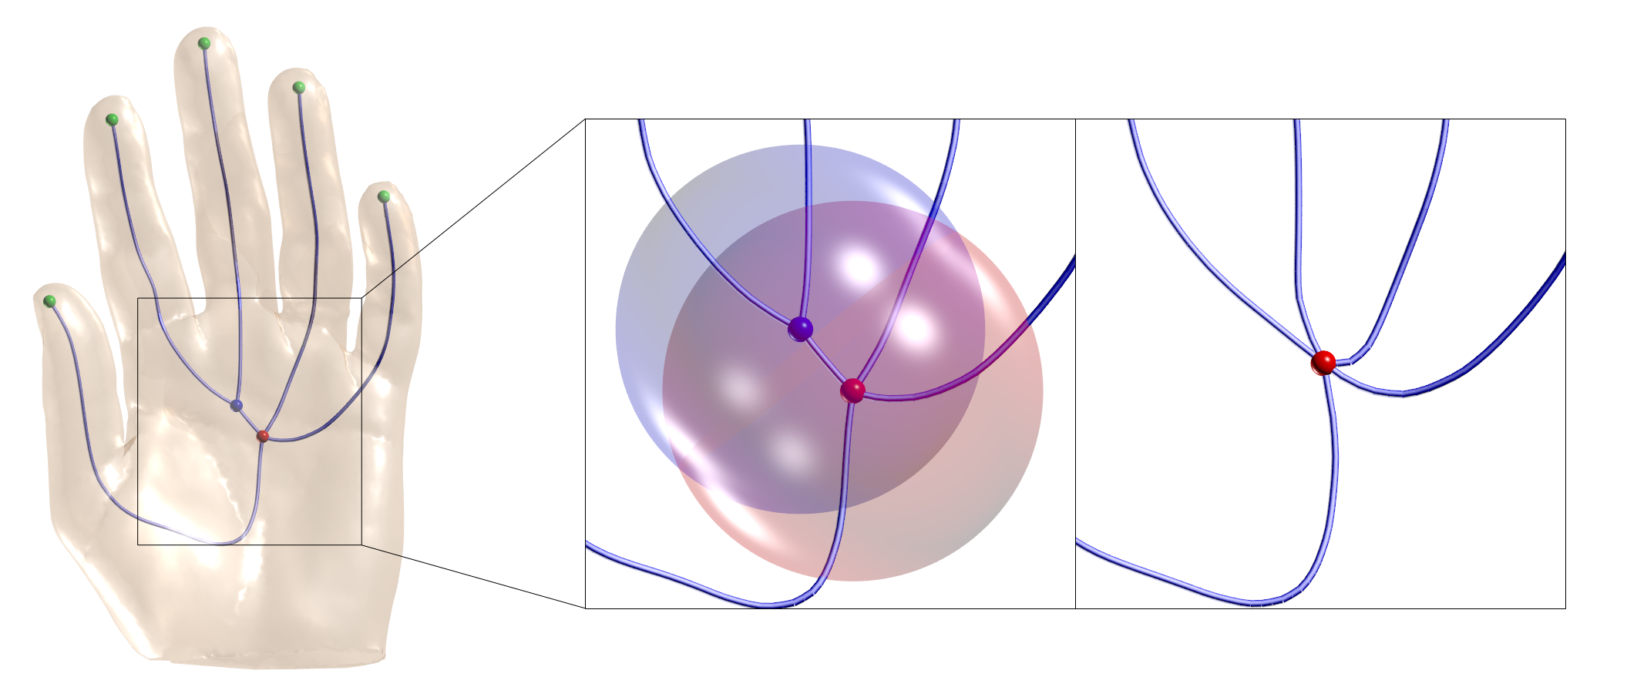
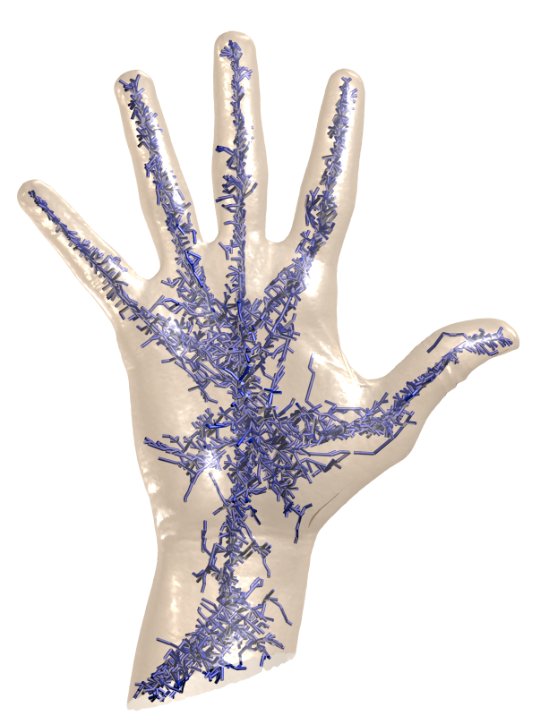
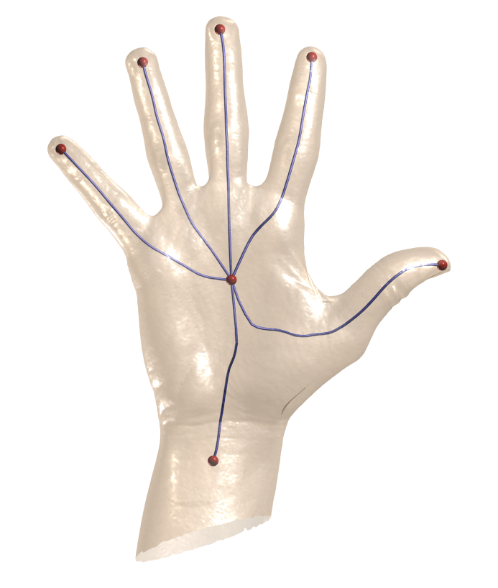
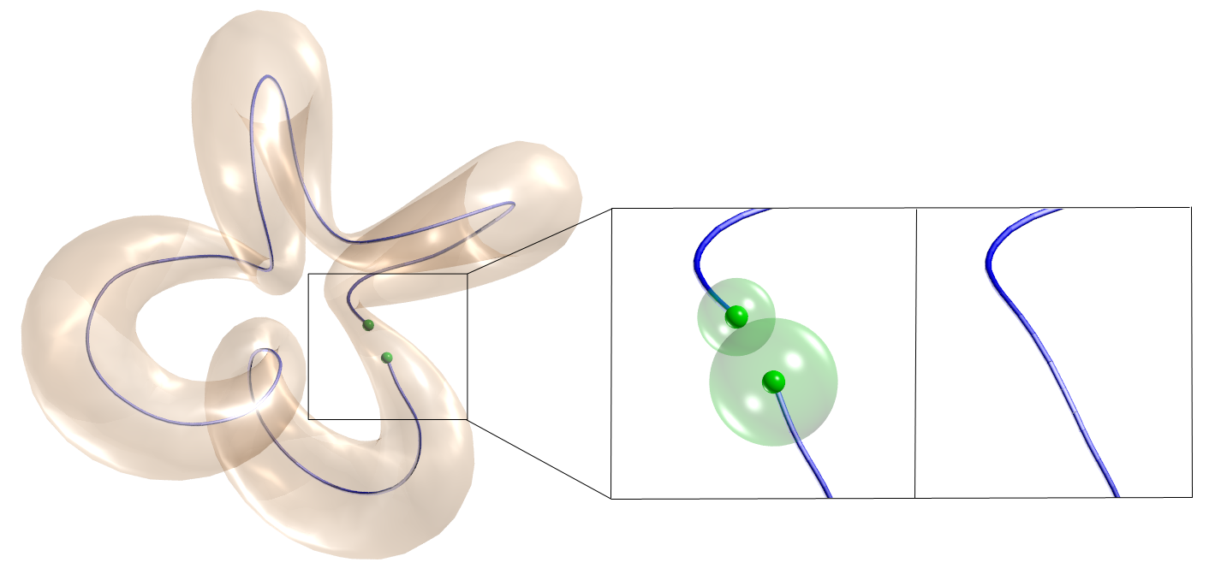
ST processing
LEAF PRUNING
BRANCH COLLAPSING
LOOP RECOVERY
[Yim et al, 2000]
Notes:
TO TURN THE SPANNING TREE INTO THE FINAL SKELETON WE USE THREE TOPOLOGICAL OPERATIONS
FOR EVERY TERMINAL BRANCH, EVERY TIME THERE IS INTERSECTION BETWEEN THE SPHERES LOCATED AT THE ENDPOINTS, KILL IT
FOR EVERY INNER BRANCH, EVERY TIME THERE IS INTERSECTION BETWEEN THE SPHERES LOCATED AT THE ENDPOINTS, COLLAPSE IT
FOR EVERY COUPLE OF LEAVES, EVERY TIME THERE IS INTERSECTION BETWEEN THE SPHERES LOCATED AT THE ENDPOINTS, MERGE THEM

Slide 12
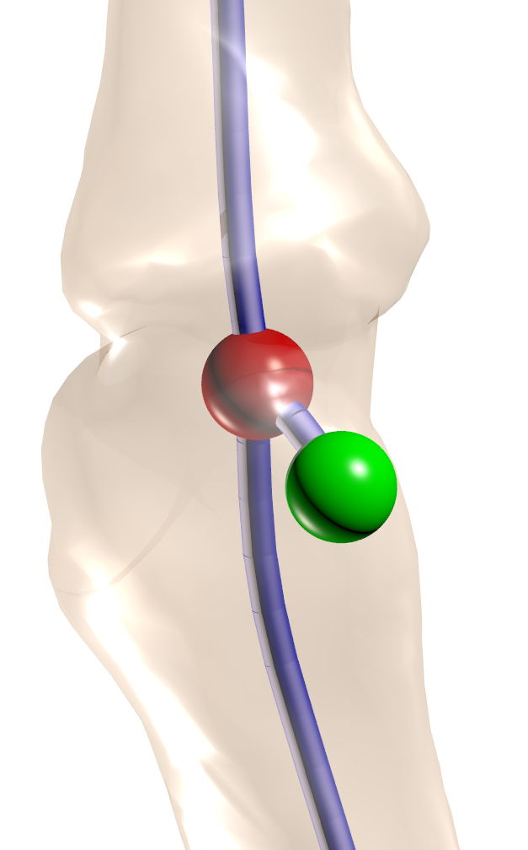
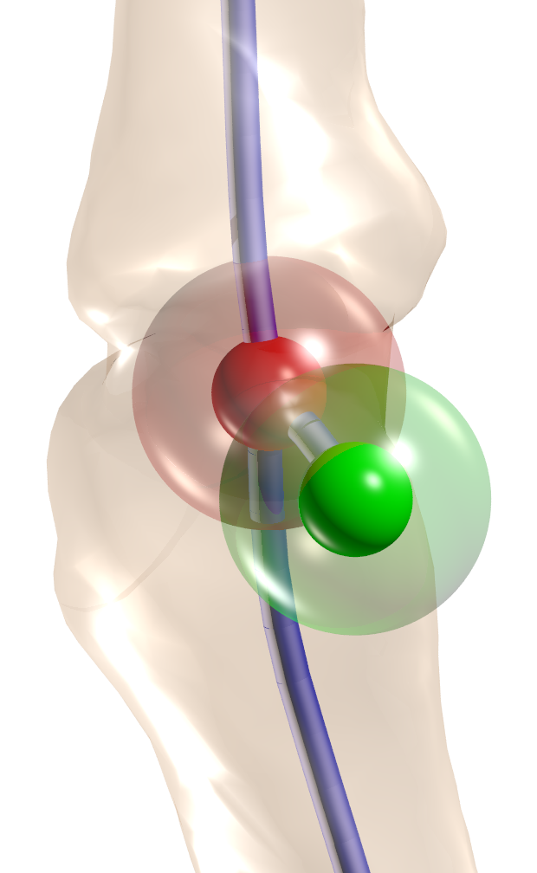
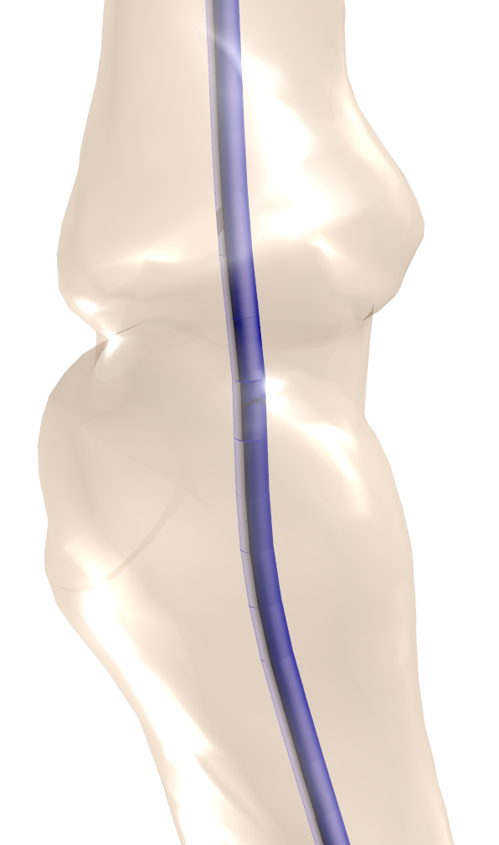
Leaf pruning
Notes:
----- Note riunione (29/04/13 00:56) -----
WE CALL THE VOLUME COVERED BY THE MAXIMAL SPHERE ZONE OF INFLUENCE!!!!!

Slide 13
Collapsing and
loop recovery

Slide 14
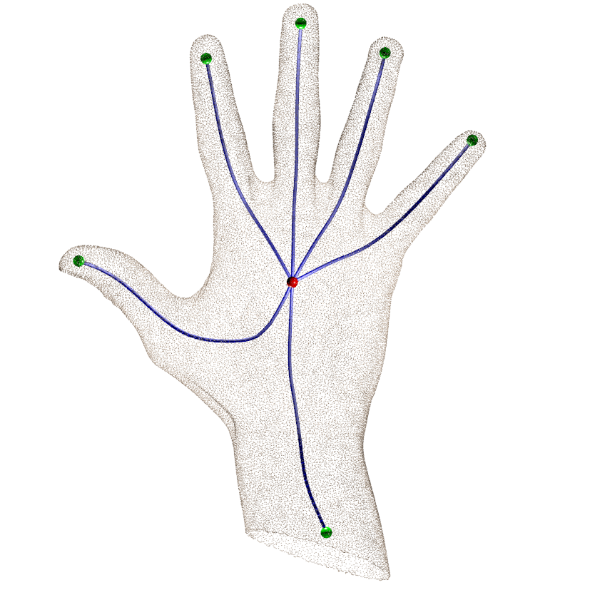
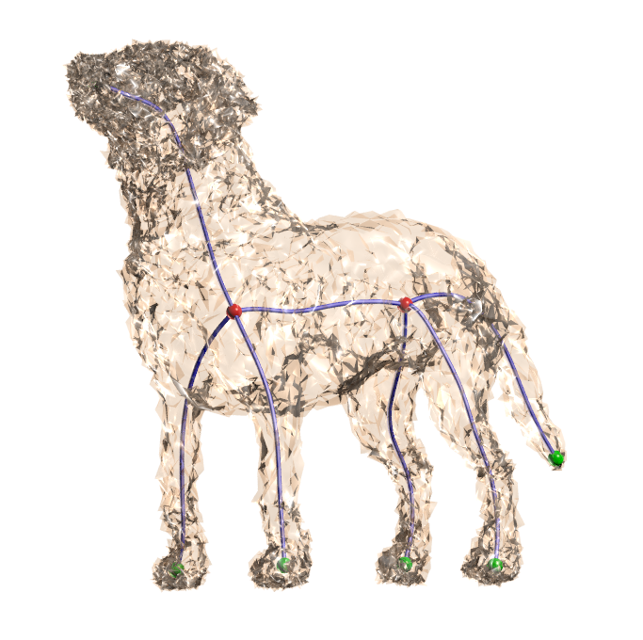
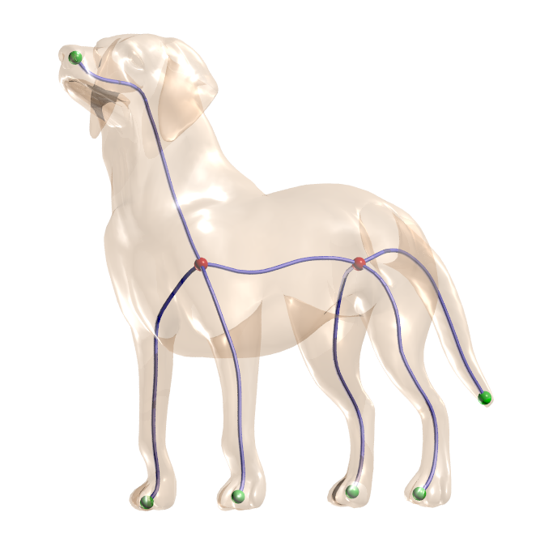
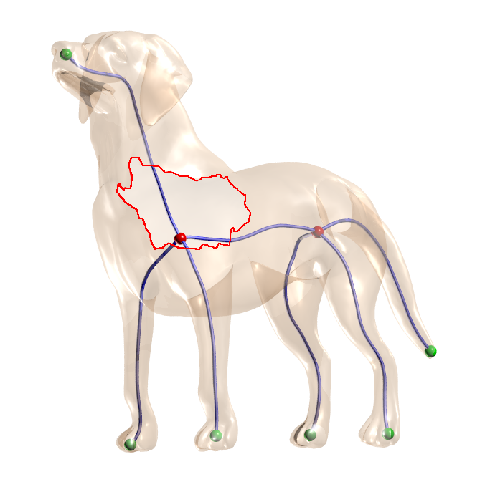
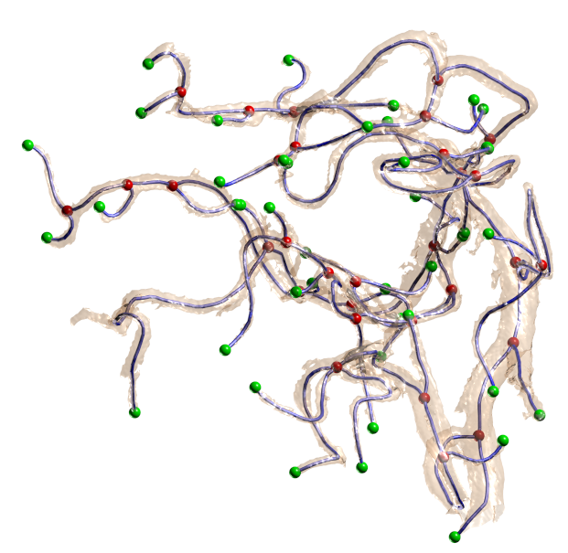
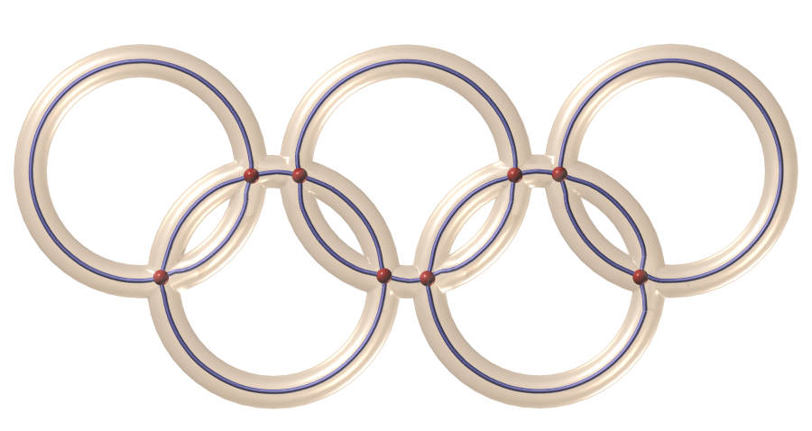
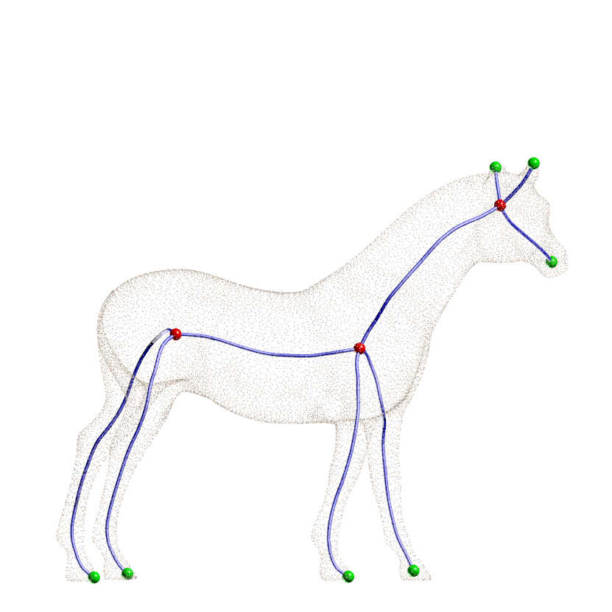
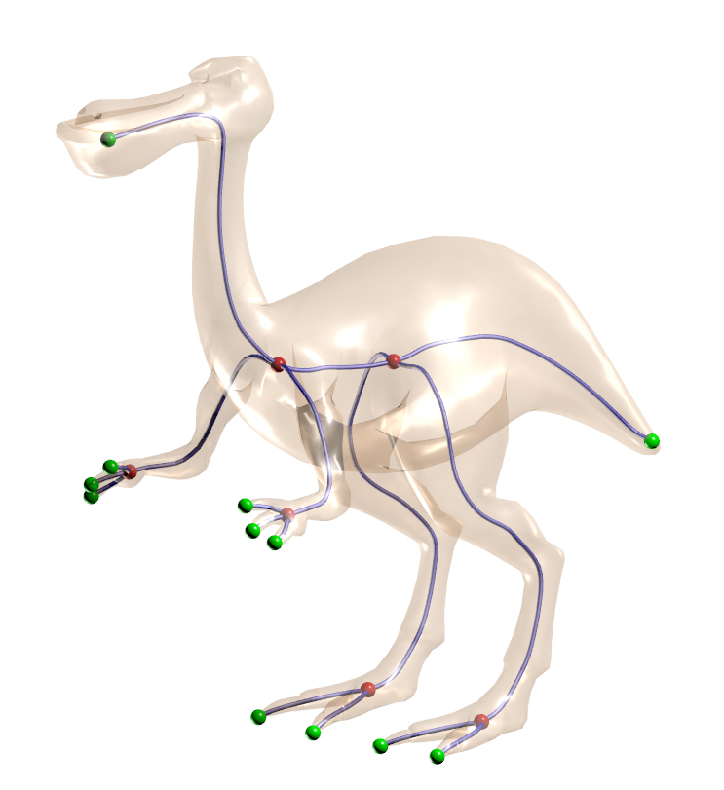
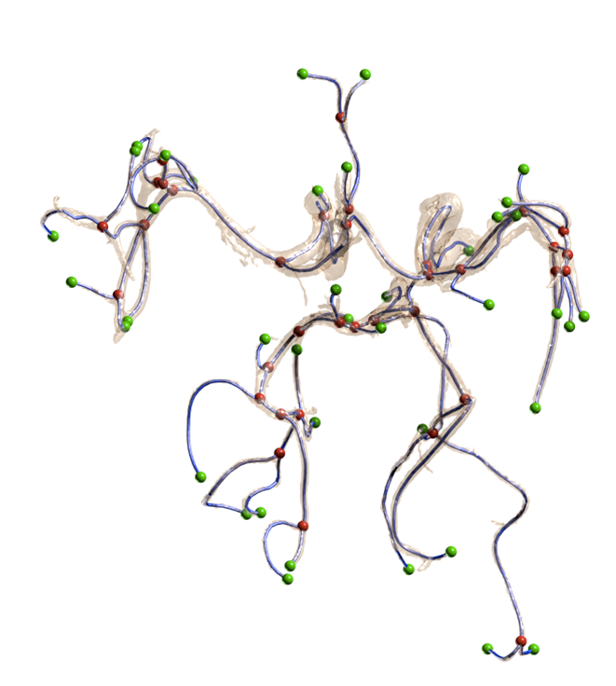
Results

Slide 15
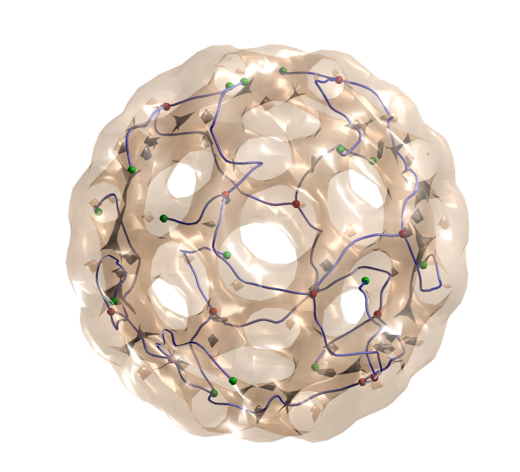
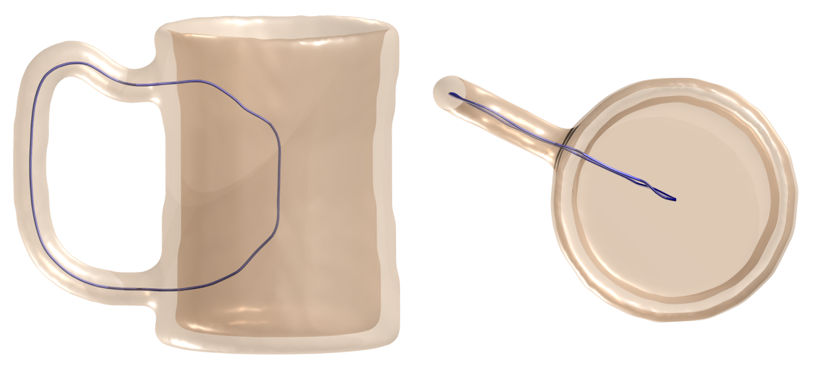
Limitations
Concavities as features
Too many occlusions

Slide 16
Grazie!

