Slide 1
Extracting Curve-Skeletons from Digital
Shapes Using Occluding Contours
M. Livesu and R. Scateni
Università degli Studi di Cagliari (Italy)

Slide 2
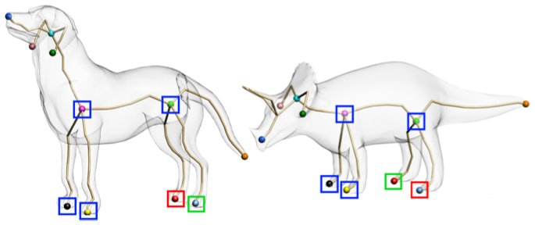
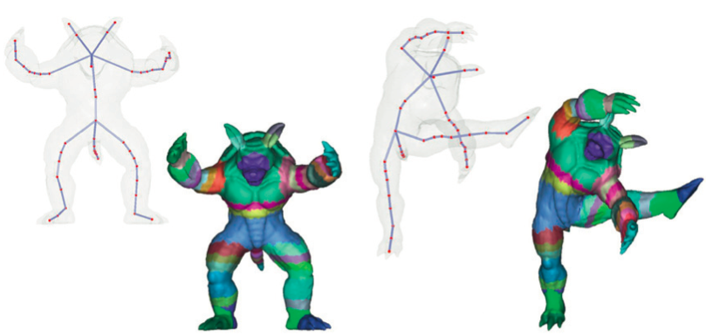
Why?
1D!
Graph-like structure
High-level representation
[Au et al, 2010]
[Jiang et al, 2012]

Slide 3
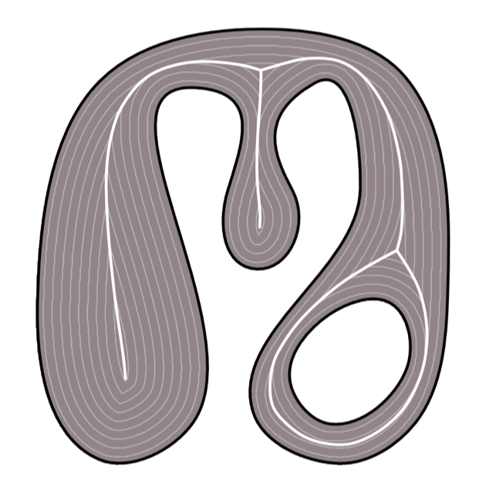
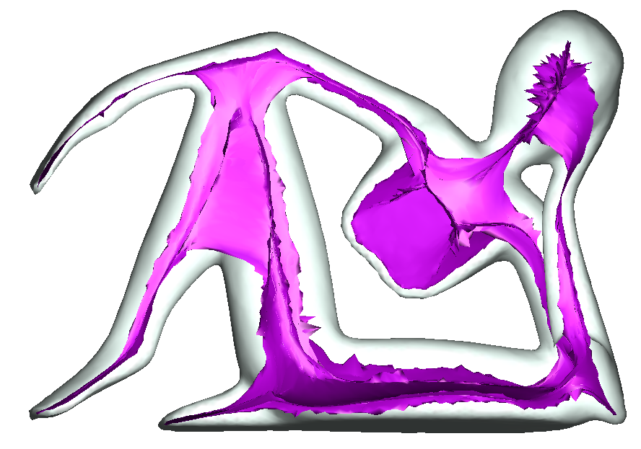
Computation
✓
  1D
  Graph-like structure
✗
  1D
  Graph-like structure

Slide 4
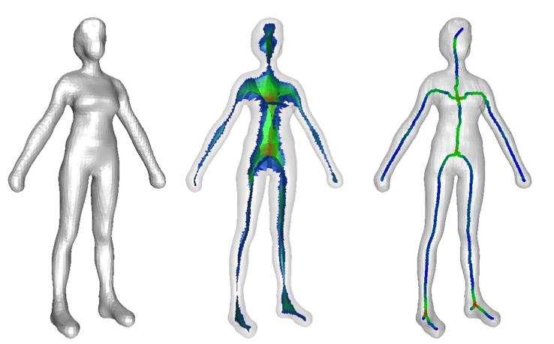
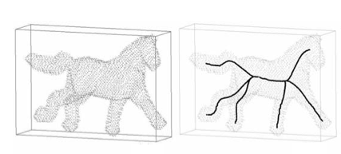
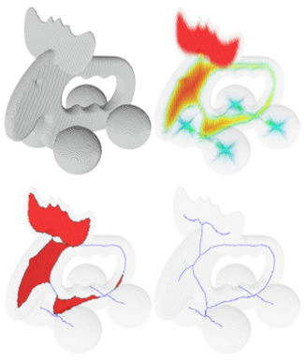
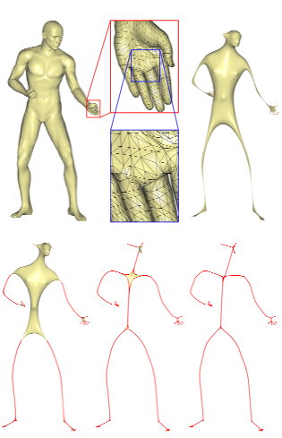
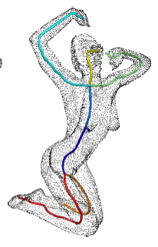
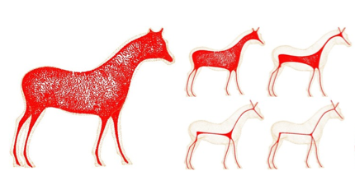

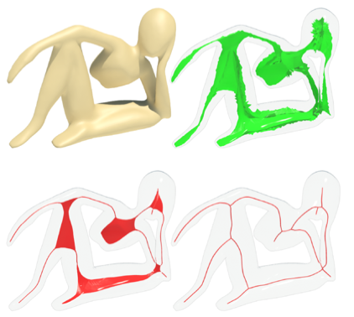
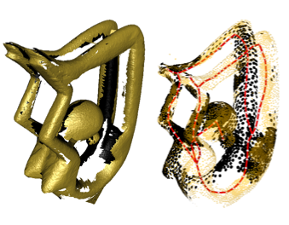
State of the art (input-wise)
Triangle meshes
Voxels
Polygon meshes
Polygon soups
Implicit surfaces
….
[Cornea et al, 2005]
[Dey and Sun, 2006]
[Liu et al, 2010]
Point clouds
[Sharf et al, 2007]
[Au et al, 2008]
[Cao et al, 2010]
[Tagliasacchi et al, 2012]
[Tagliasacchi et al, 2009]

Slide 5
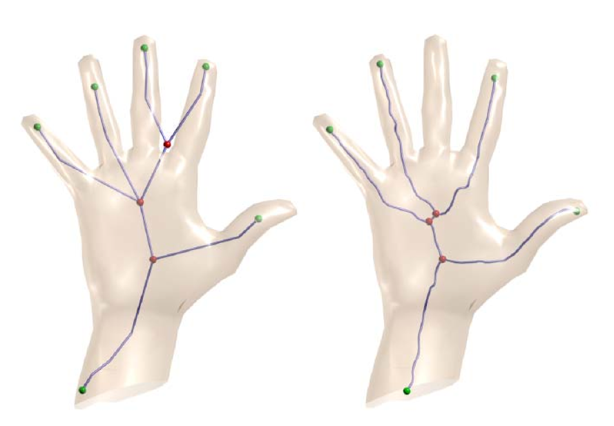
State of the art (resolution-wise)
Coarse hand (≈1k triangles)
Sometimes resolution is
more important than the
shape itself…
[Au et al, 2008]
[Dey and Sun, 2006]

Slide 6
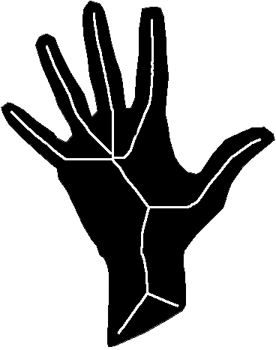
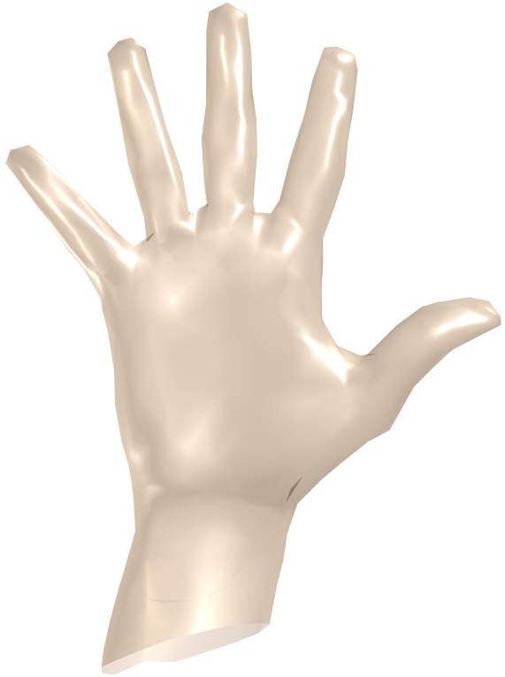
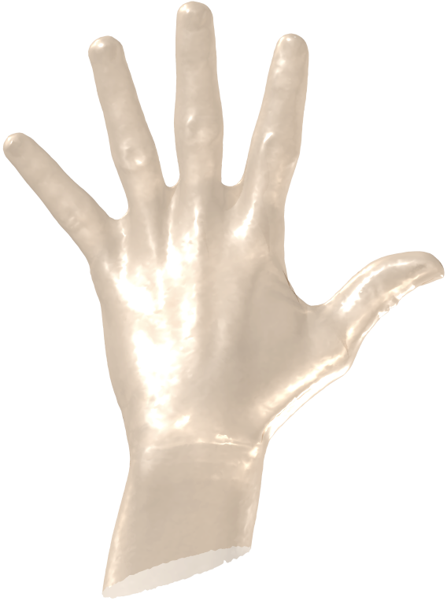

Perceptual approach
What are the alternatives? Focus on the appearance of the shapes
1K triangles
273K triangles
GOALS: resolution and format independence!

Slide 7
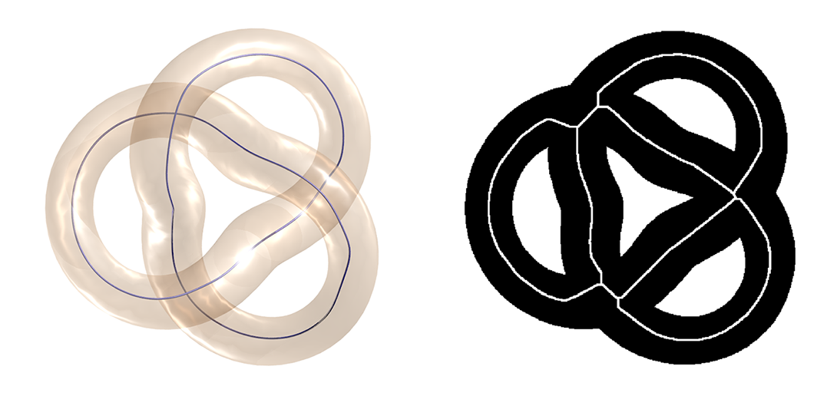
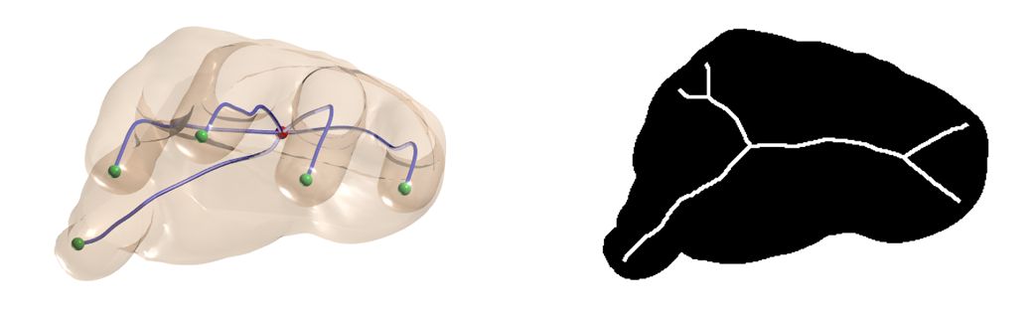
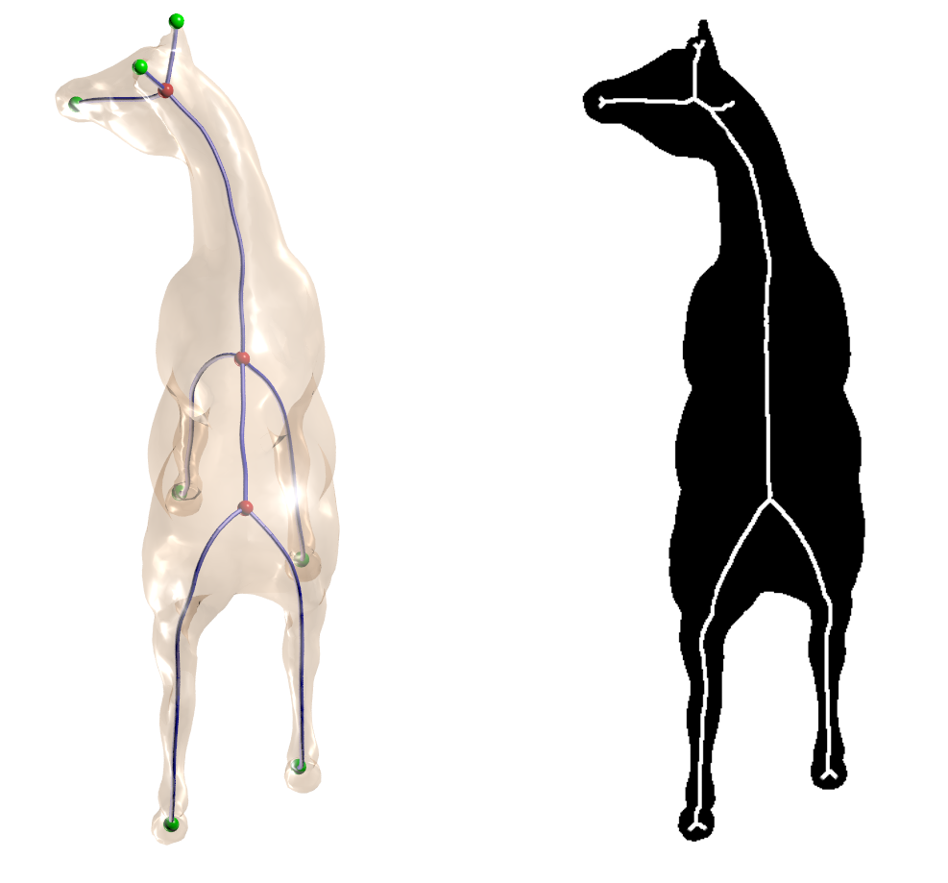
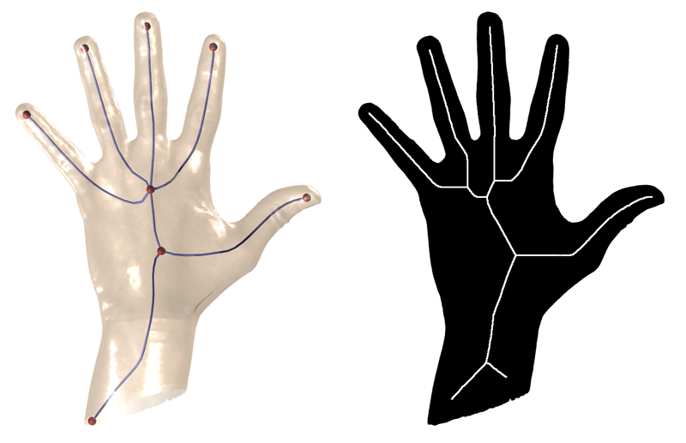
Occlusions
MIN
OCCLUSION
MAX
OCCLUSION

Slide 8
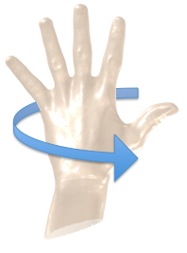
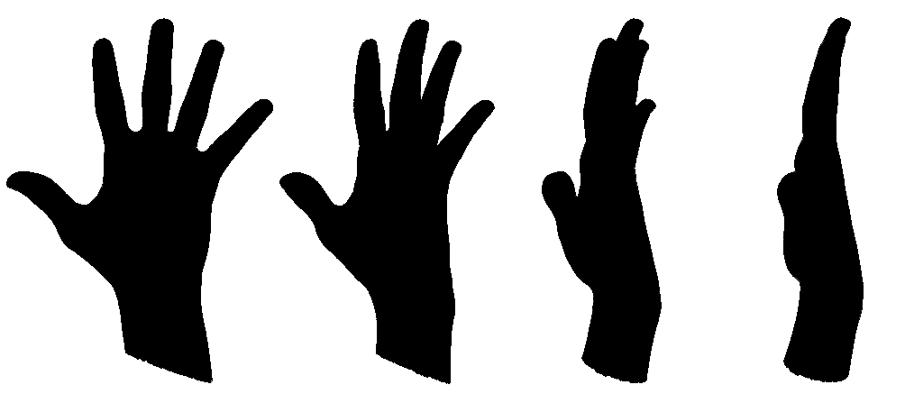
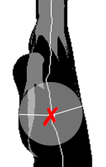
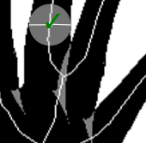
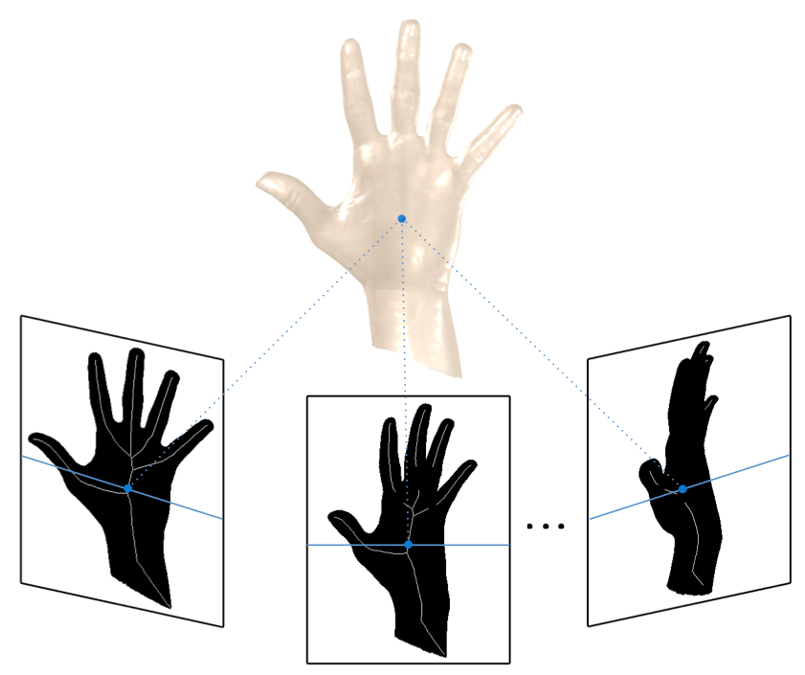
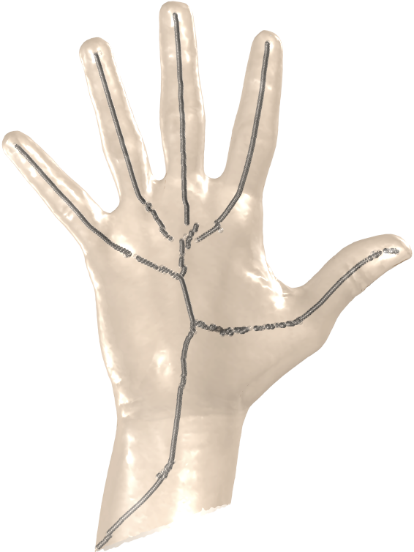
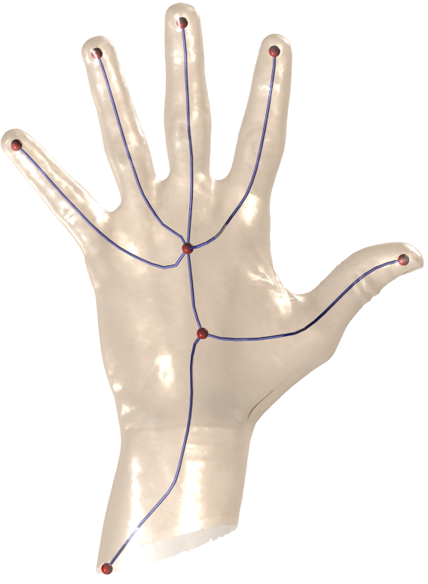
Pipeline
gather silhouettes
filter 2D skeletons
back-project medial points
Compute skeleton paths

Slide 9
Skeleton filtering

Slide 10
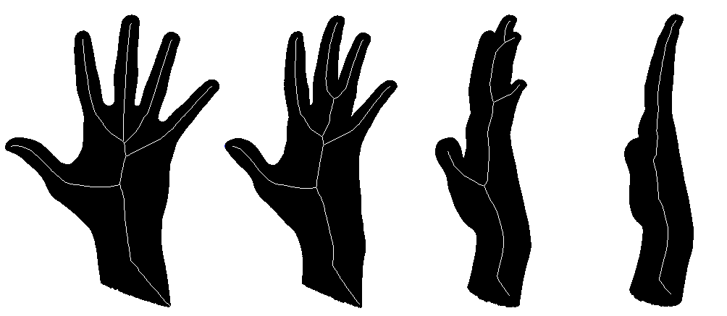
Skeleton filtering

Slide 11

Skeleton filtering

Slide 12
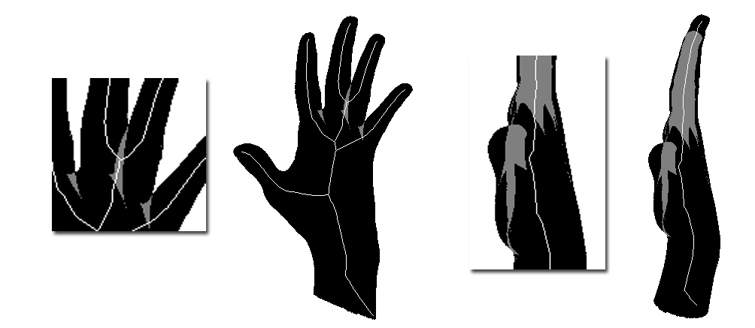
Skeleton filtering
✓
✗

Slide 13
Skeleton filtering

Slide 14
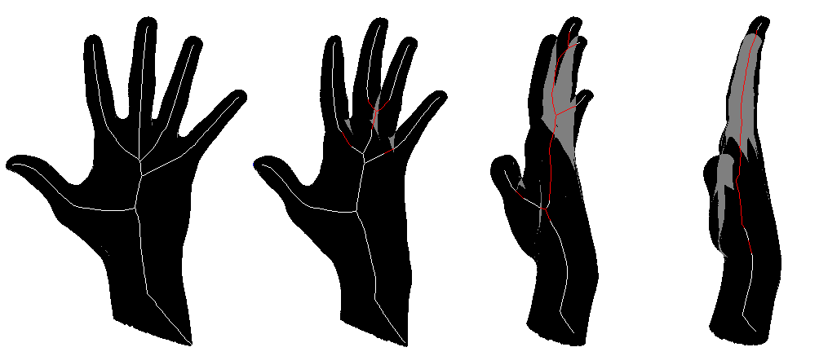
Skeleton filtering

Slide 15

Skeleton filtering
MIN
OCCLUSION
MAX
OCCLUSION

Slide 16
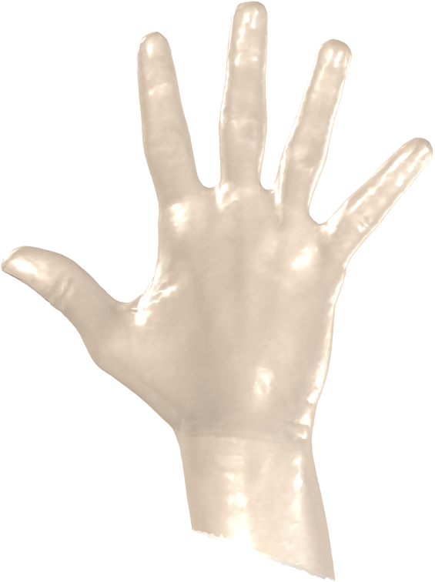
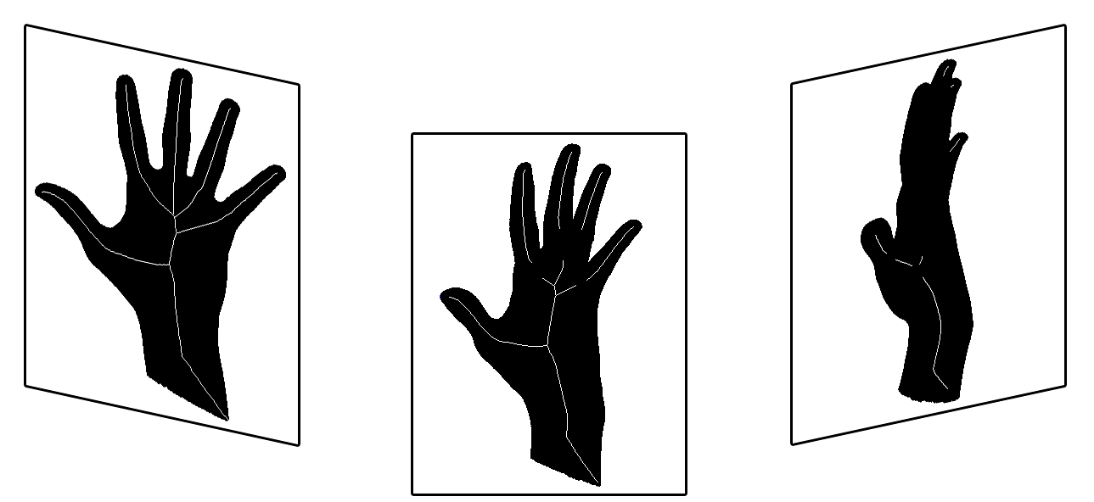
Back-projection

Slide 17
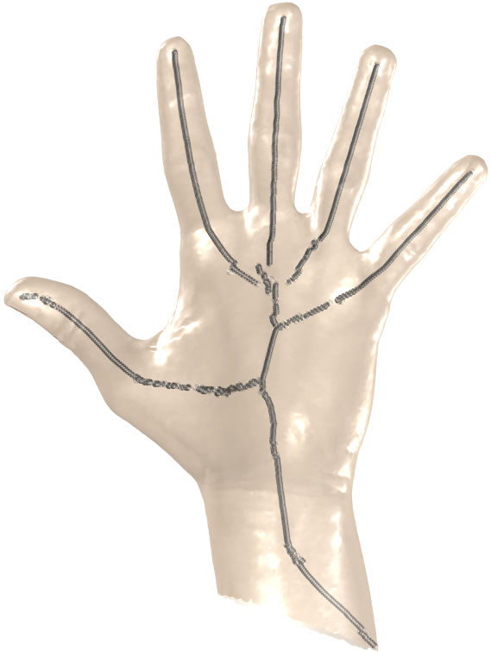
Back-projection

Slide 18
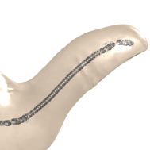
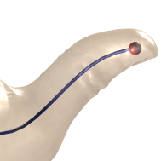
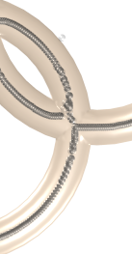
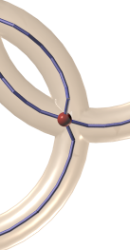
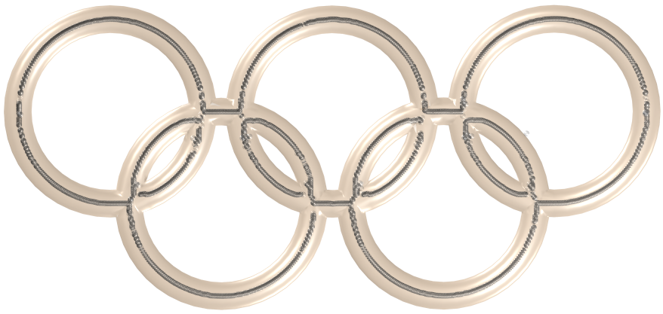
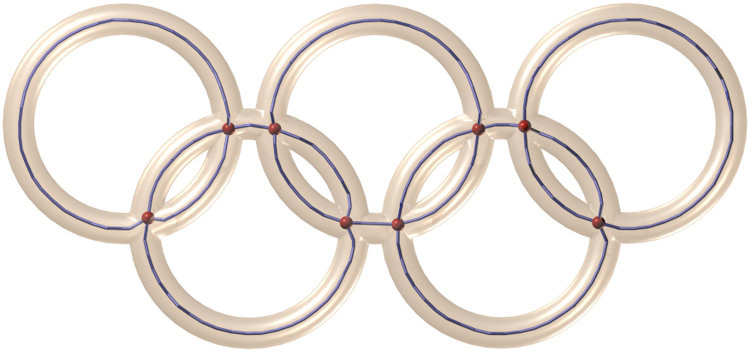
Curve Reconstruction
1D Moving Least Squares [Lee, 2000]

Slide 19
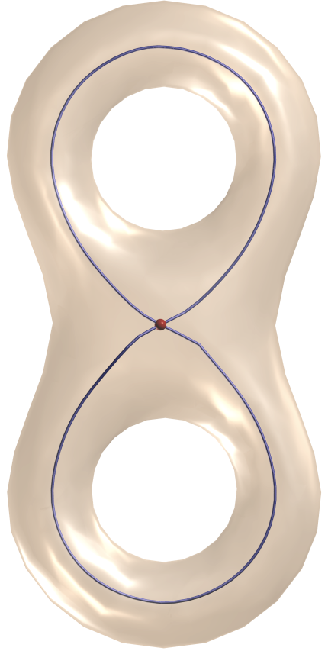
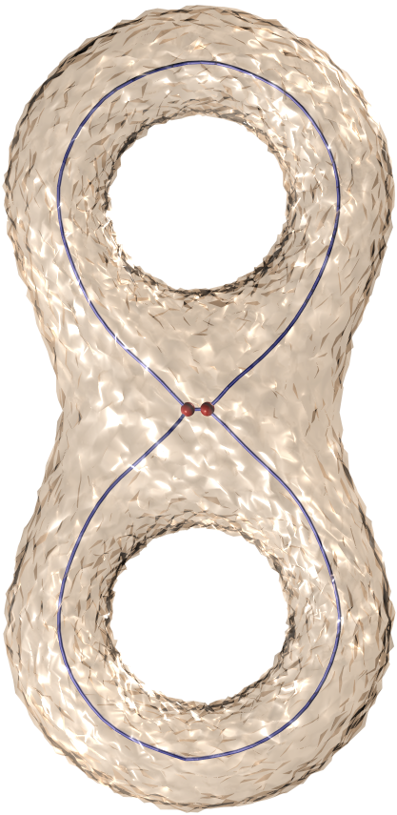
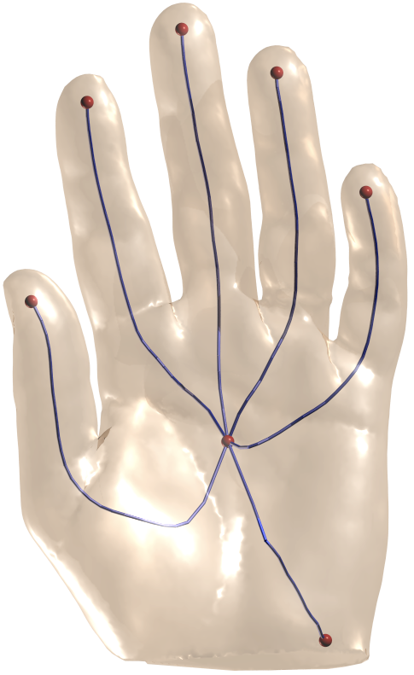
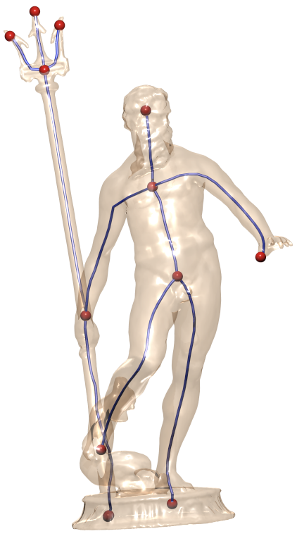
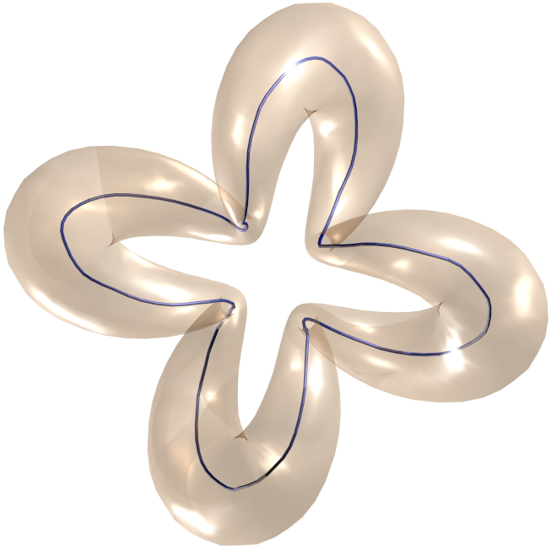
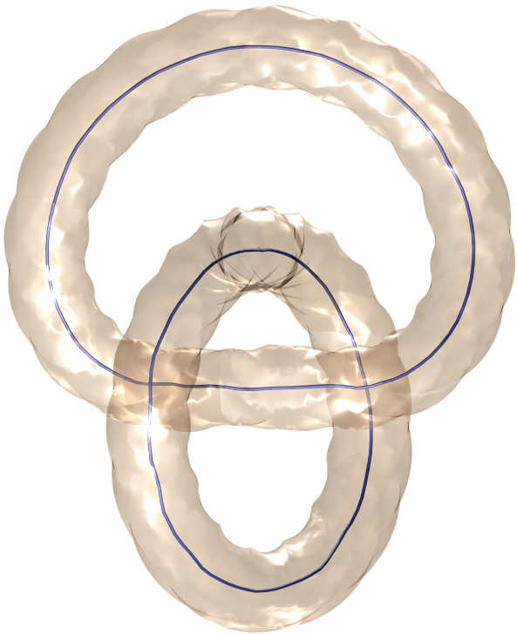
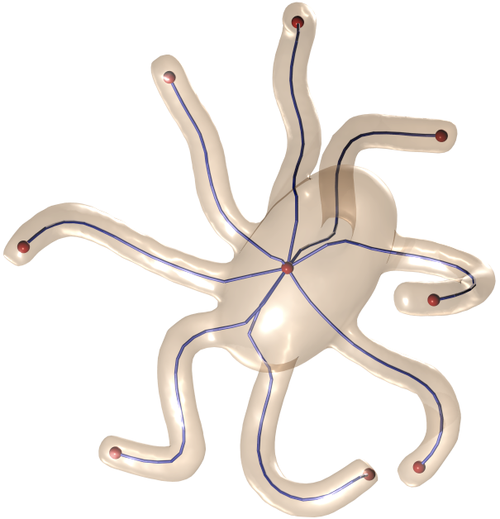
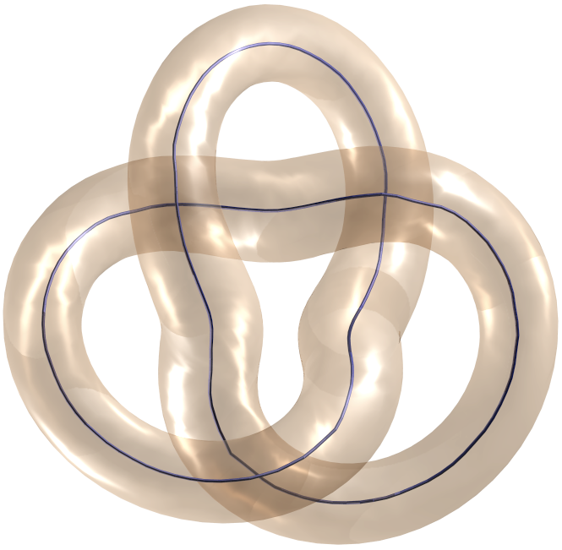
Conclusions
Silhouette space
Format independence
Resolution independence

Slide 20
Questions

