Slide 1
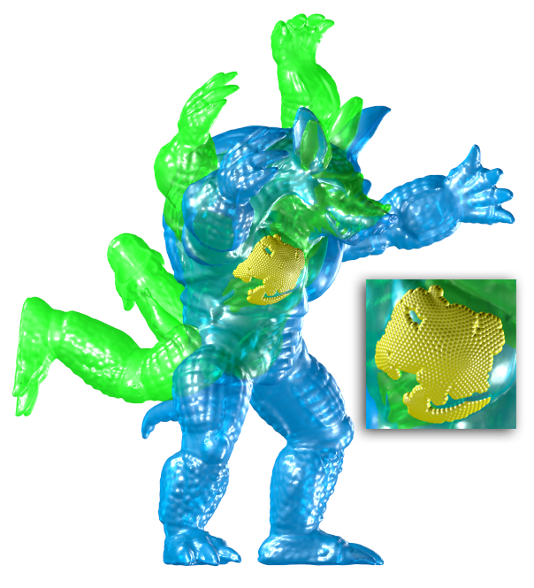
Rigid Registration of Different Poses
of Animated Shapes
M. Livesu and R. Scateni
University of Cagliari

Slide 2


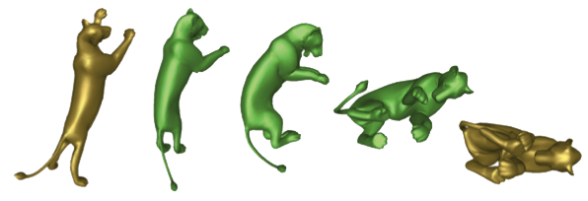
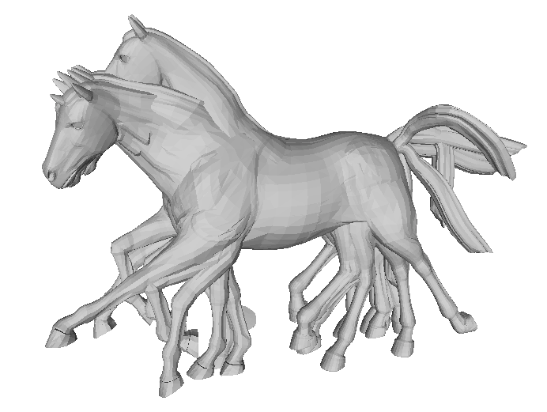
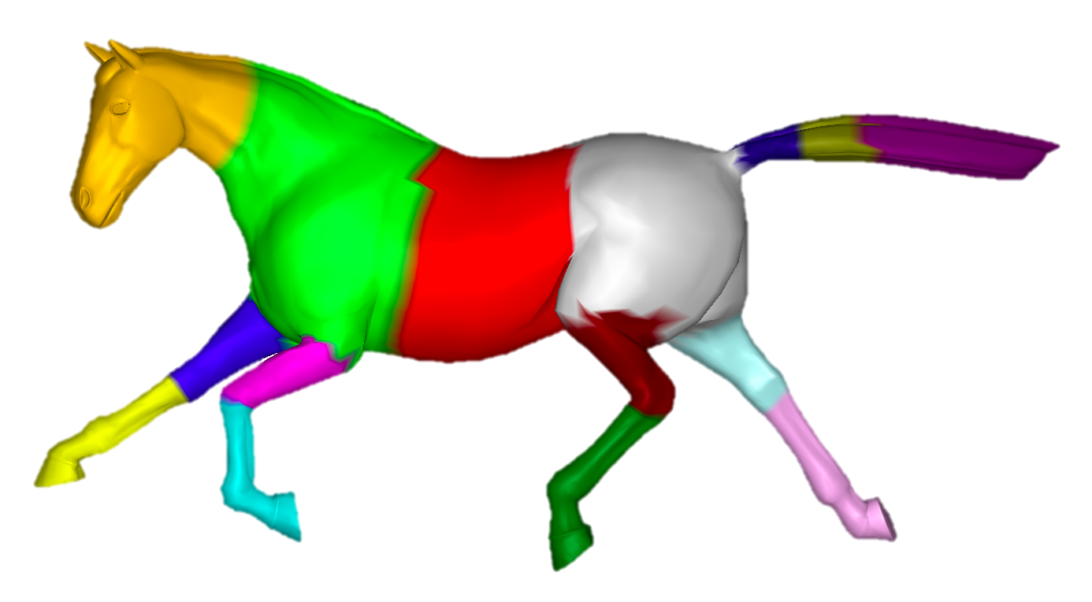

Motivation
[Sumner and Popovic, 2004]
[De Aguiar et al, 2008]
[Winkler et al, 2010]
[Marras et al, 2012]
[Thiery et al, 2013]

Slide 3
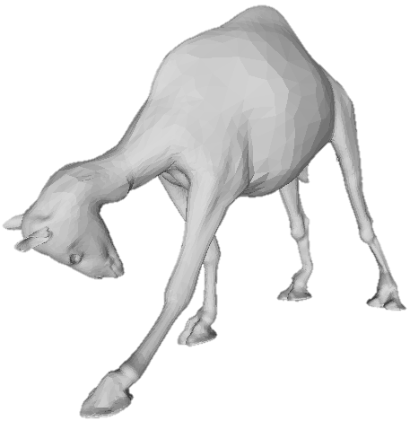
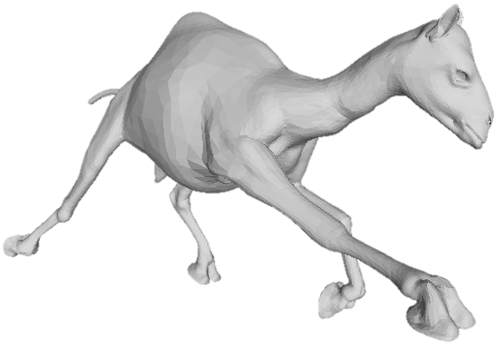
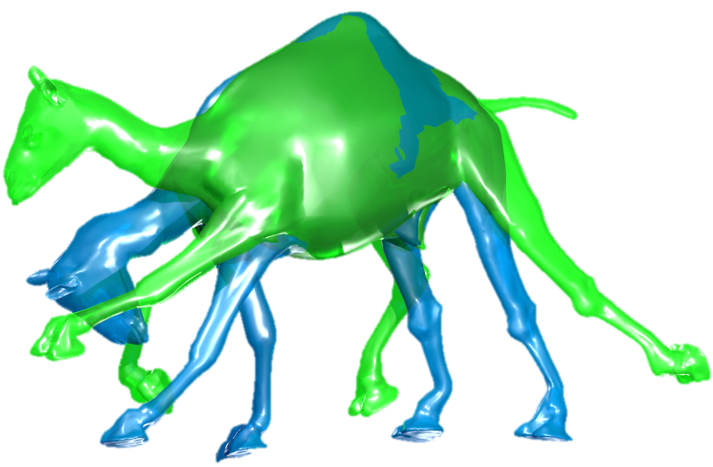
Problem statement
is an isometry

Slide 4
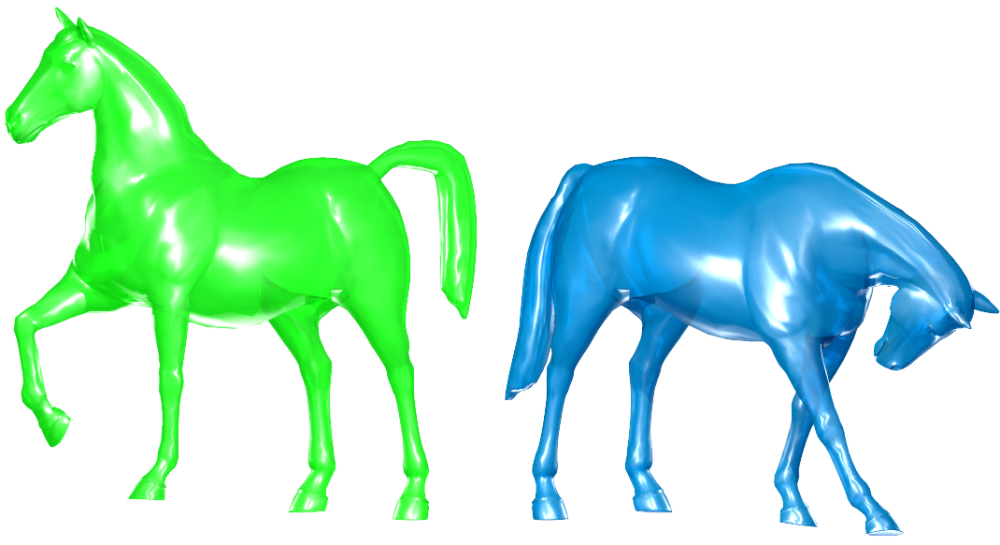
Challenges
Poses do not match perfectly
  Focus on rigid areas
  Focus on a compact area

Slide 5
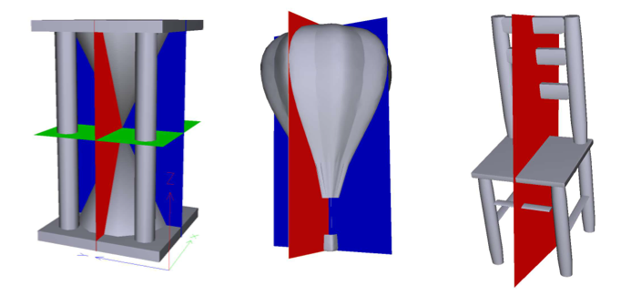

State of the art
ICP based algorithms
Global!
Require a good start solution!
PCA based algorithms
Global!
[Chaouch et al, 2008]
Randomized algorithms
Requires high overlapping (> 40%)!
[Aiger et al, 2008]

Slide 6
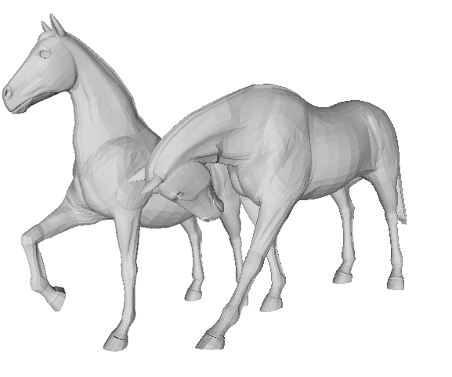
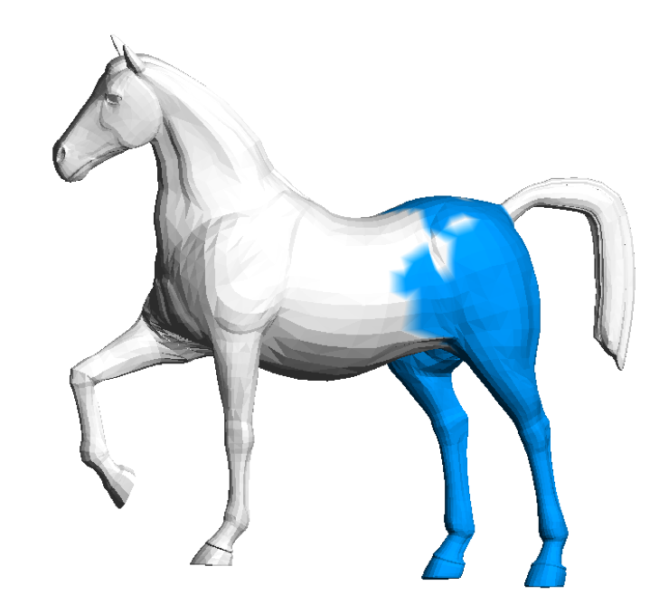
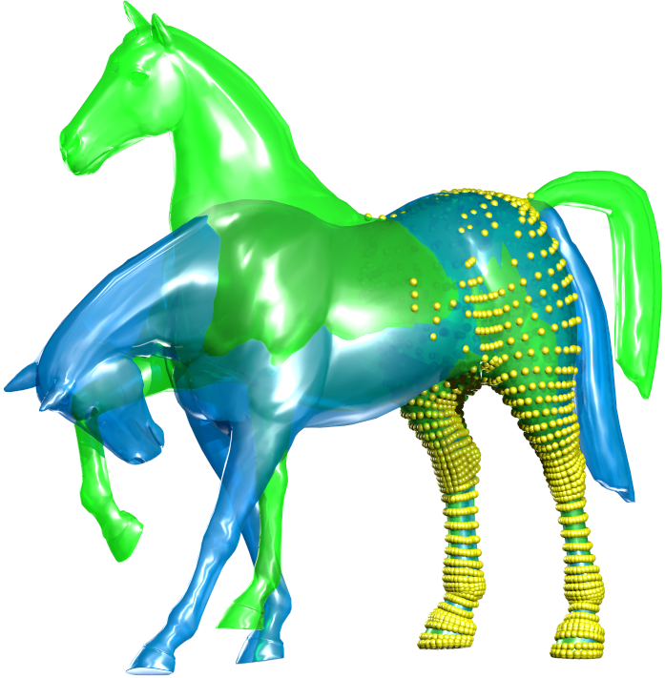
The algorithm
Select a Region of Interest (ROI)
Register poses by aligning ROIs

Slide 7
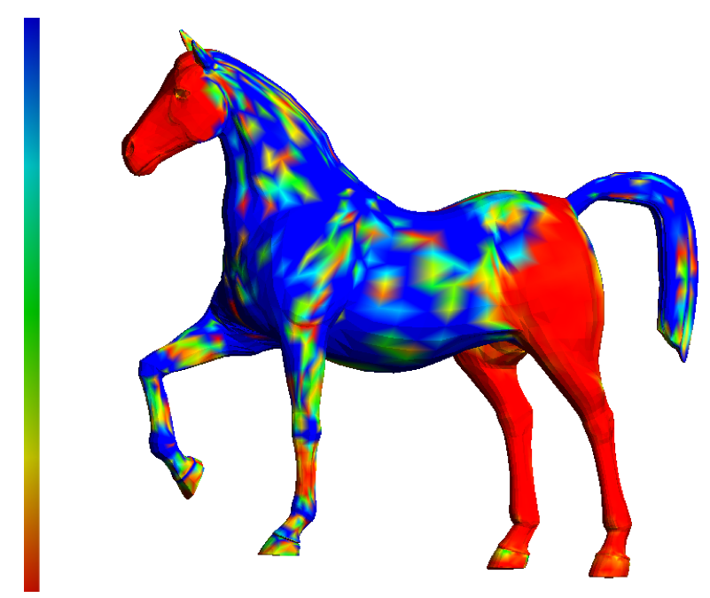
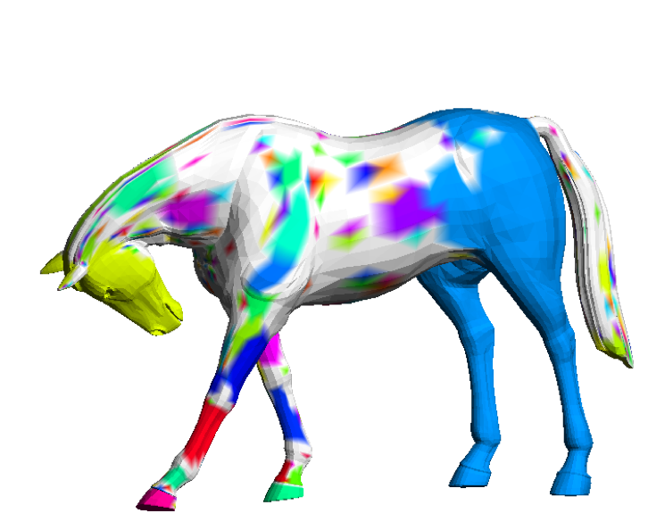
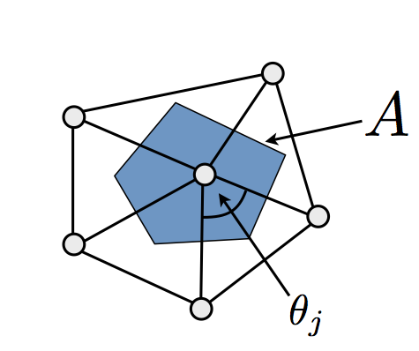
ROI detection
Detect seeds ( )
MAX
Region growing
Max surface
0
[Meyer et al, 2002]

Slide 8
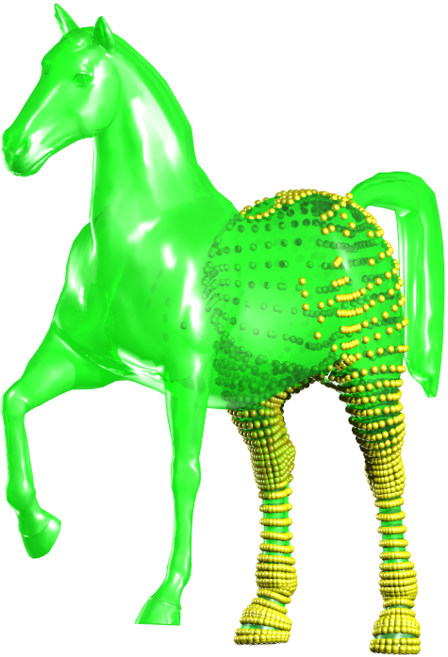
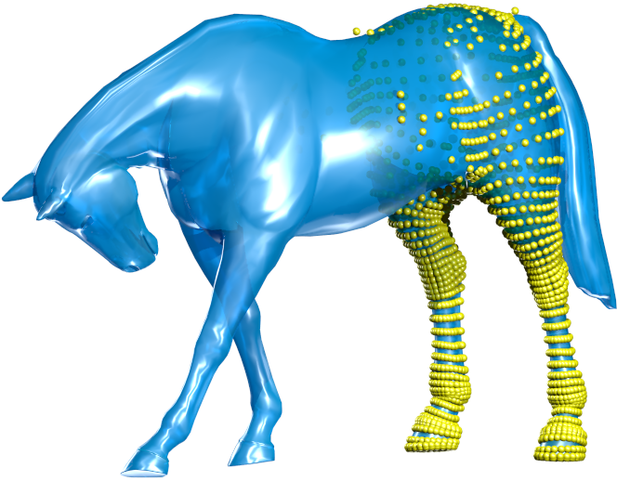
Registration
[Sorkine, 2007]

Slide 9
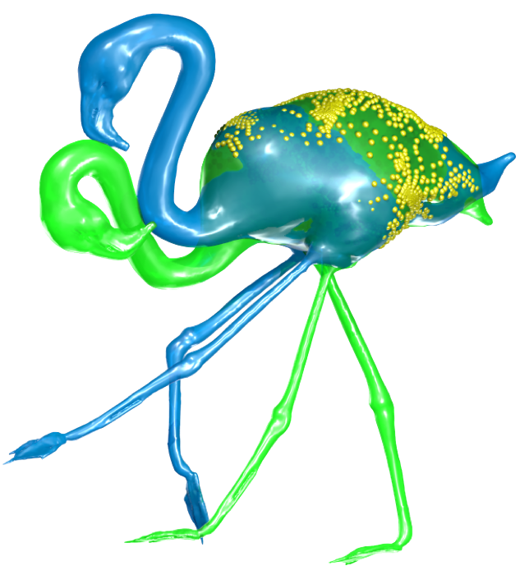
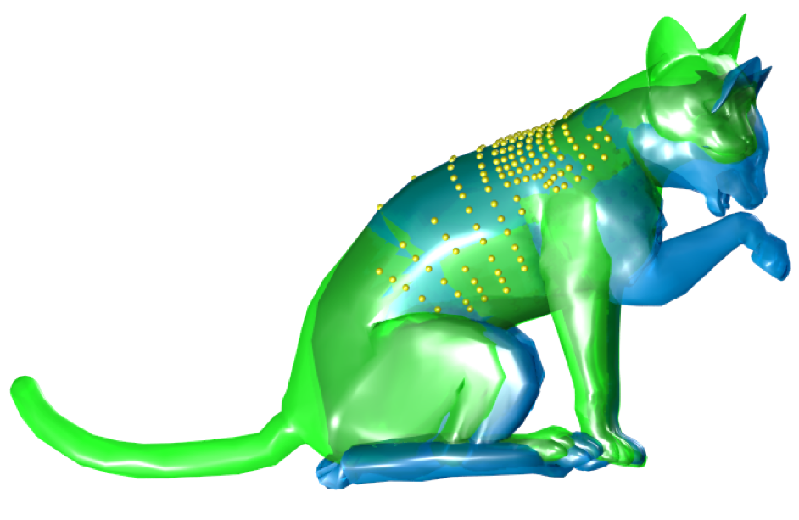
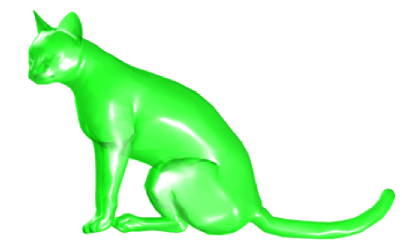
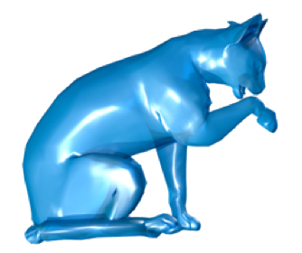
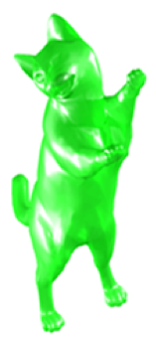
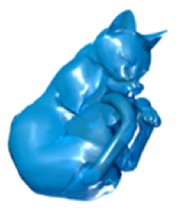
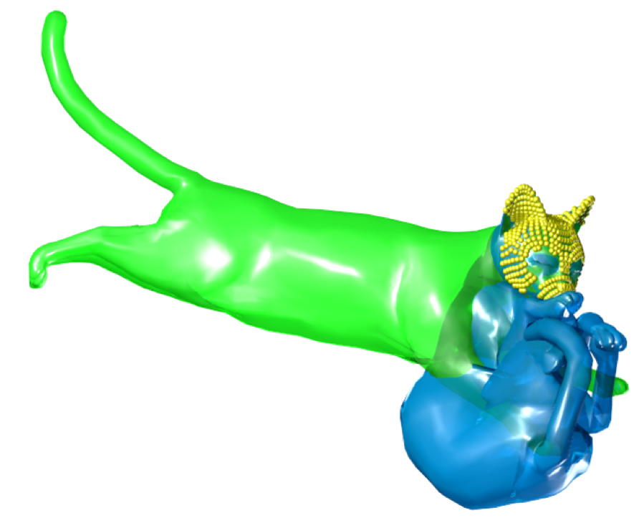
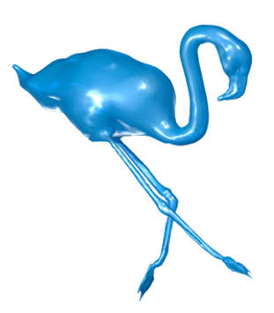
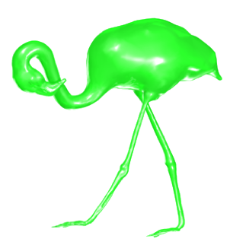
Results
7,207 TOT vertices
965 ROI vertices
59ms
26,907 TOT vertices
1,092 ROI vertices
174ms
7,207 TOT vertices
544 ROI vertices
56ms

Slide 10
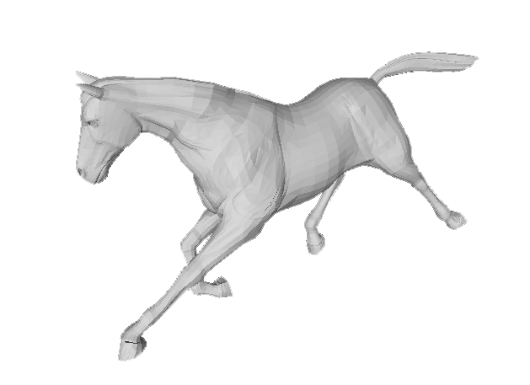
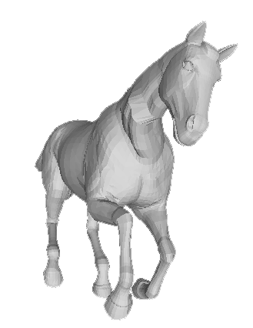
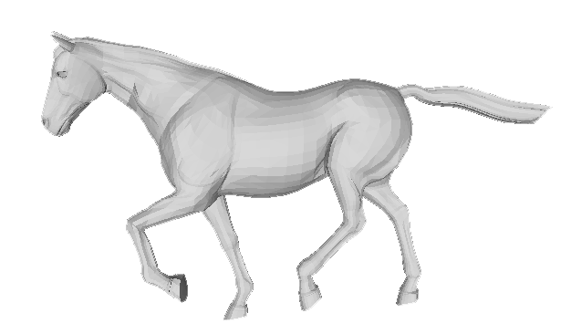
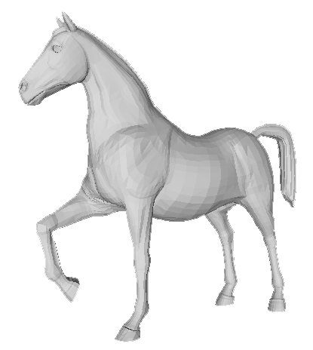
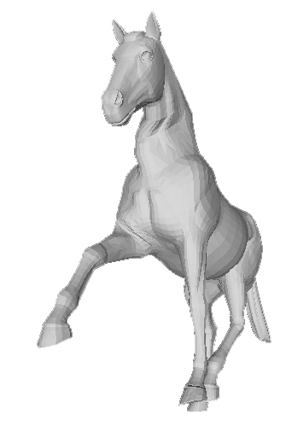
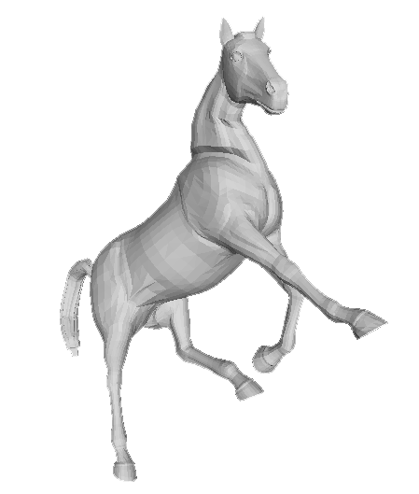
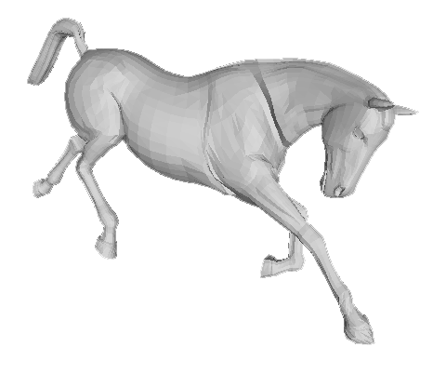
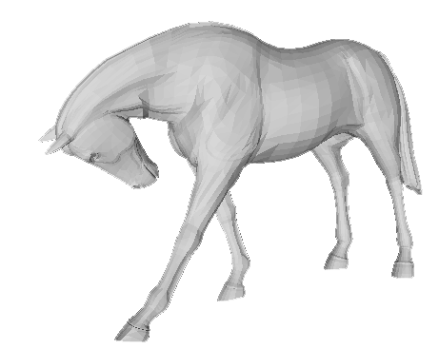
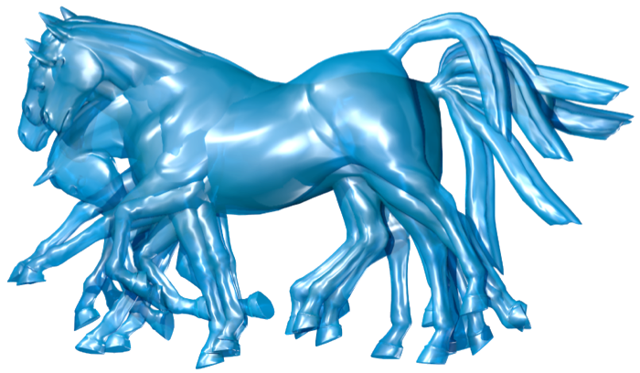
Multiple poses
All vs All
Chain
All vs 1

Slide 11
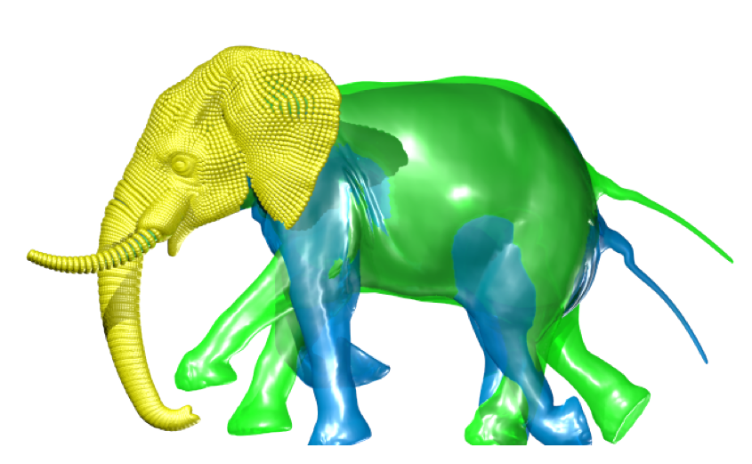
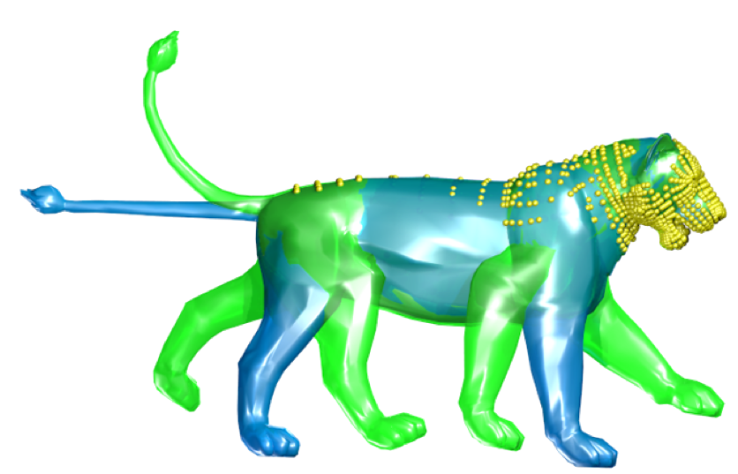
Conclusions
  Based on Gaussian Curvature
  Easy to implement
  Multiple poses
Download the source code at:
https://sites.google.com/site/marcolivesu/

Slide 12
Questions

