Slide 1
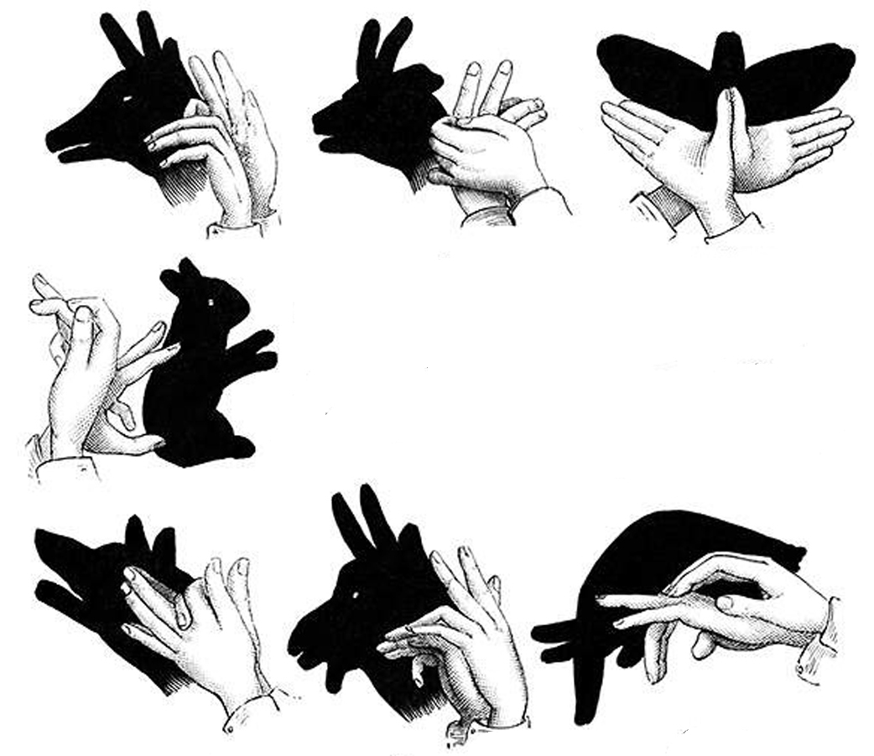
Practical Medial Axis Filtering for Occlusion-Aware Contours
M.Livesu, R.Scateni - Università degli Studi di Cagliari

Slide 2
^{3D from 2D}
Infer information about the 3D world through the analysis of 2D projections of it

Slide 3
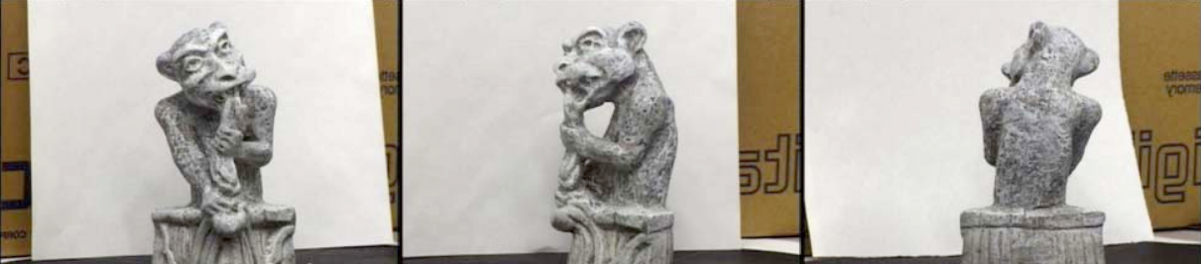
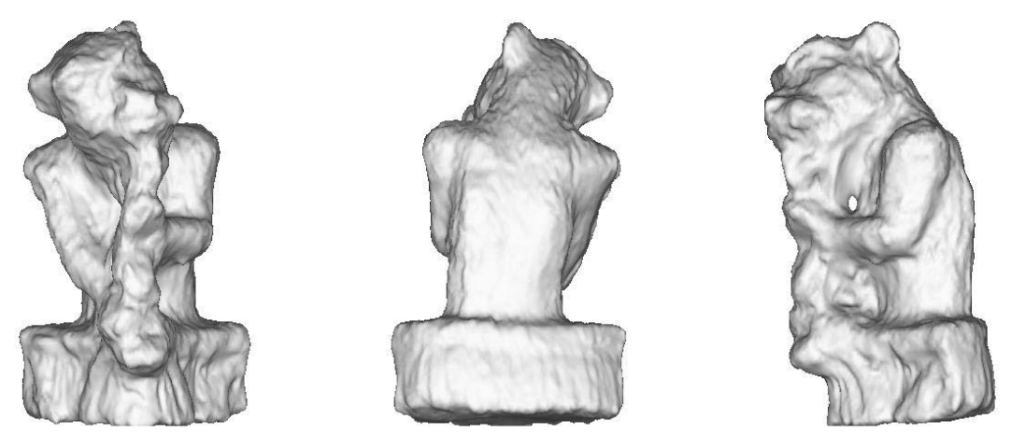
^{3D from 2D}
Infer information about the 3D world through the analysis of 2D projections of it
  Shape
(RECONSTRUCTION)
[Pons et. al, 2005]

Slide 4
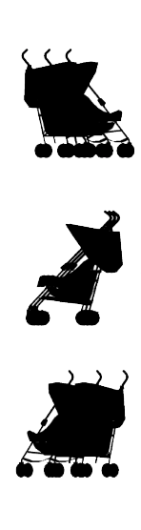
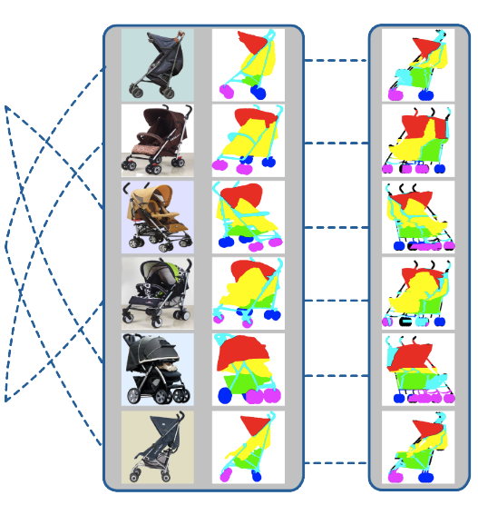
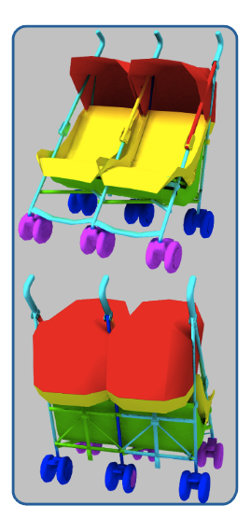
^{3D from 2D}
Infer information about the 3D world through the analysis of 2D projections of it
  Shape
  Semantics
(RECONSTRUCTION)
(SEGMENTATION)
[Wang et. al, 2013]

Slide 5
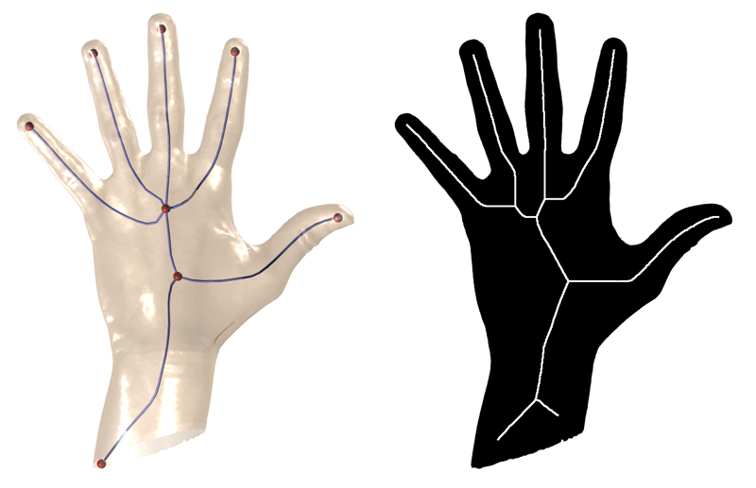
^{3D from 2D}
Infer information about the 3D world through the analysis of 2D projections of it
  Shape
  Semantics
  Structure
(RECONSTRUCTION)
(SEGMENTATION)
(SKELETONIZATION)
[Livesu et. al, 2012]

Slide 6

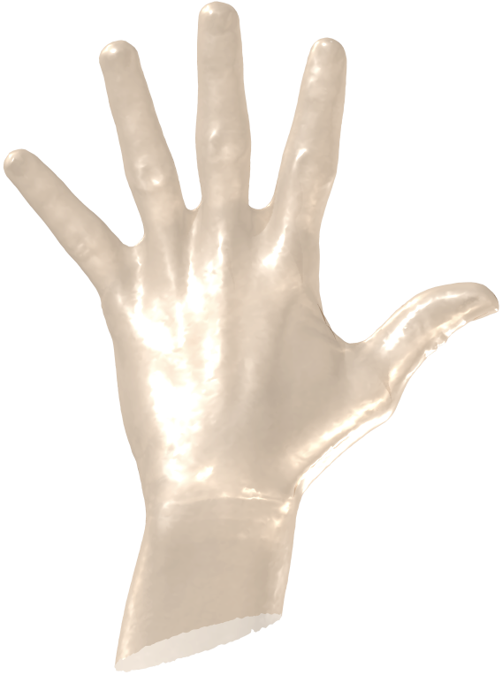
^{3D from 2D}
Infer information about the 3D world through the analysis of 2D projections of it
  Shape
  Semantics
  Structure
(RECONSTRUCTION)
(SEGMENTATION)
(SKELETONIZATION)
[Livesu et. al, 2012]

Slide 7
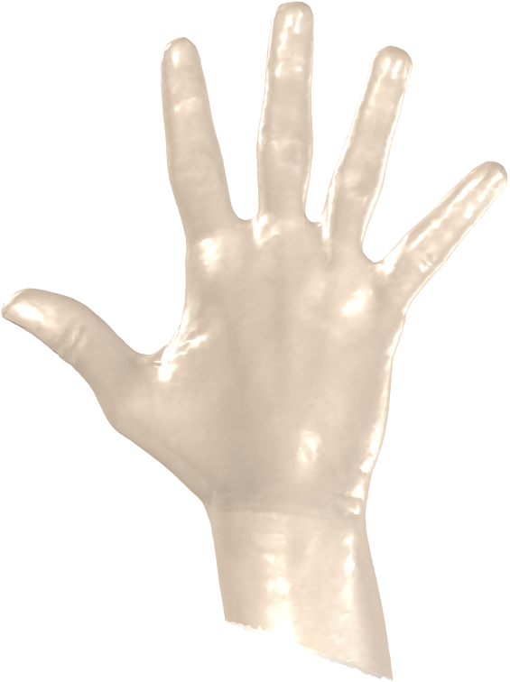
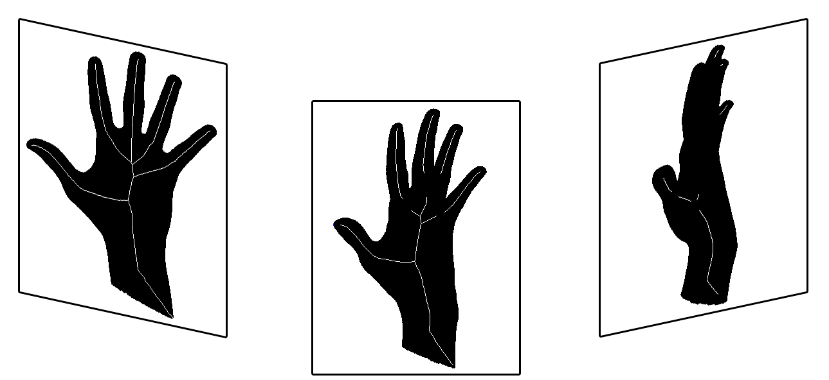
^{3D from 2D}
Infer information about the 3D world through the analysis of 2D projections of it
  Shape
  Semantics
  Structure
(RECONSTRUCTION)
(SEGMENTATION)
(SKELETONIZATION)
[Livesu et. al, 2012]

Slide 8
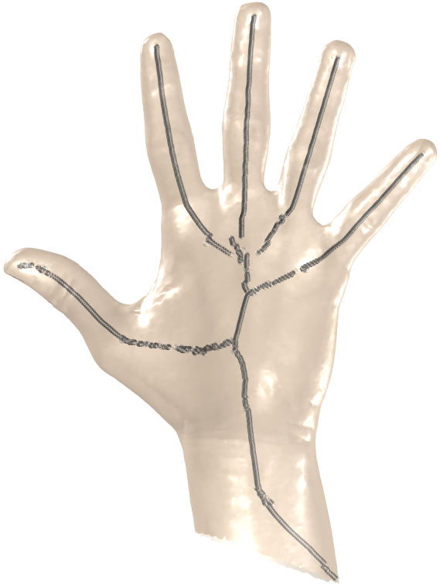
^{3D from 2D}
Infer information about the 3D world through the analysis of 2D projections of it
  Shape
  Semantics
  Structure
(RECONSTRUCTION)
(SEGMENTATION)
(SKELETONIZATION)
[Livesu et. al, 2012]

Slide 9
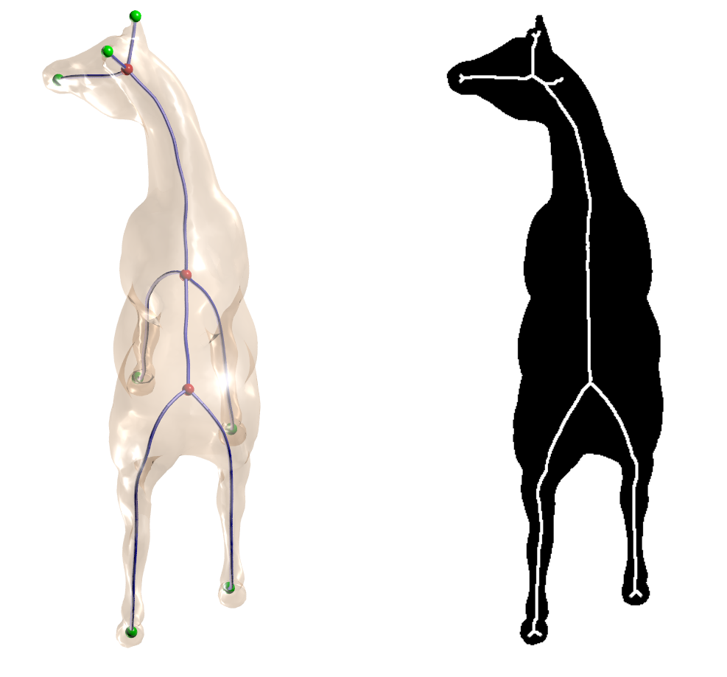


^{Robustness issues}
“Garbage in, garbage out”

Slide 10
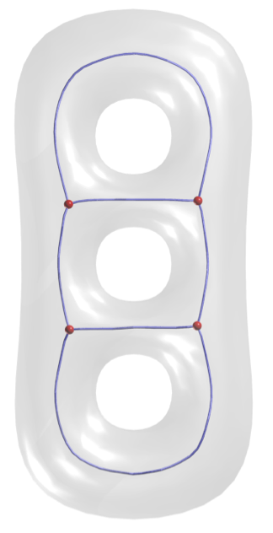
^{Occlusions}
Make silhouettes less evocative

Slide 11
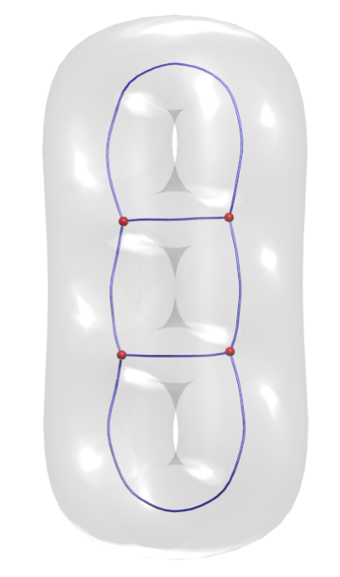

^{Occlusions}
Make silhouettes less evocative
✗

Slide 12
^{Occlusions}
Make silhouettes less evocative
OCCLUSIONS
< 5%
✗

Slide 13
^{Goal}
INPUT: silhouette + occlusion map
OUTPUT: medial points projection of the curve-skeleton
✗

Slide 14
^{Goal}
INPUT: silhouette + occlusion map
OUTPUT: medial points projection of the curve-skeleton
MAKE THE BEST
OF EACH CONTOUR

Slide 15
^{How do we do it?}
Discard points on occluded areas
MEDIAL PATHS
OUTSIDE OF OCCLUDED
AREAS

Slide 16
^{How do we do it?}
Discard points on occluded areas
Understand how occlusions affect medial axis
DOMAIN DECOMPOSITION LEMMA - [Choi et. al, 1997]

Slide 17
^{How do we do it?}
Discard points on occluded areas
Understand how occlusions affect medial axis
DOMAIN DECOMPOSITION LEMMA - [Choi et. al, 1997]

Slide 18
^{The actual filter}
FOR EACH medial point
FOR EACH point
IF is occluded THEN
discard
END
END
END

Slide 19
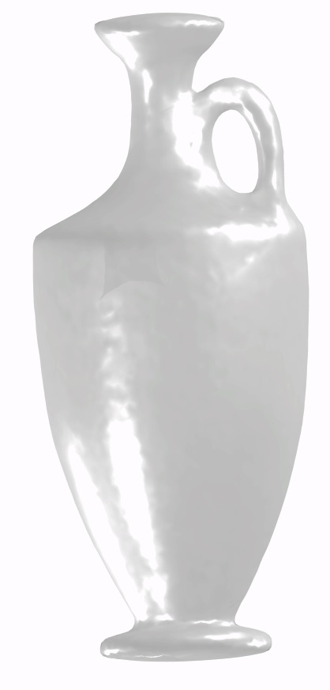
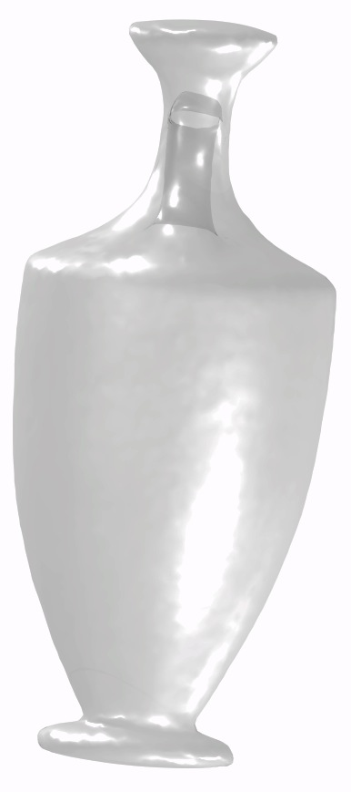
^{Some observations}
Retained points are guaranteed to belong to 3D medial axis
Discarded points are not guaranteed not to belong to it

Slide 20
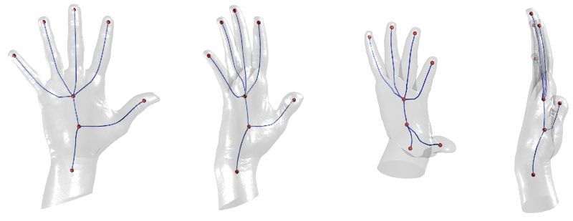
^{Examples}

Slide 21
^{Examples}

Slide 22
^{Conclusions}
Filtering system for occlusion-aware contours
Selects points that provably belong to 3D medial axis…
…and are likely to belong to the curve-skeleton!
Trivial to code (4 lines of C++)

Slide 23
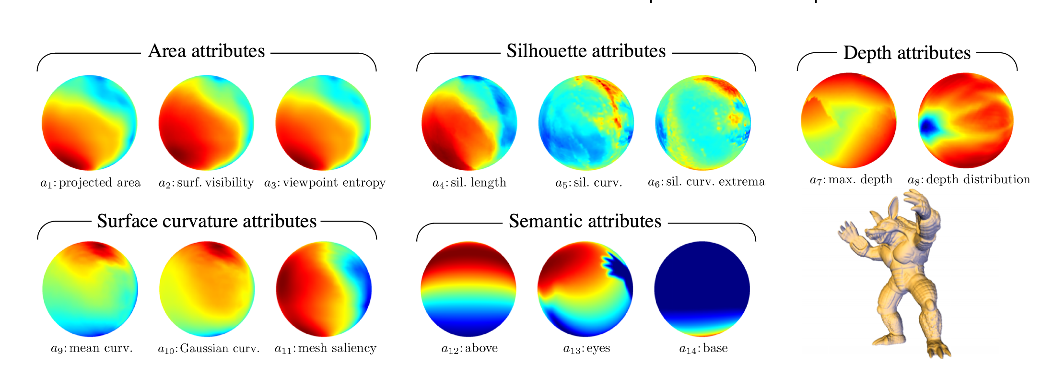
^{Future works}
Rank viepoints w.r.t. representativeness
  Global metrics, slow [Secord et. al, 2011]
Skeletonization from real world images
  Open problem: robustly estimate occlusions
  [Zhang et. al, 2012], [He et. al, 2010], …
0% FILTERED POINTS
95% FILTERED POINTS
0% OCCLUSIONS
4% OCCLUSIONS
PRE POST
PRE POST

Slide 24
Thank you!

Slide 25
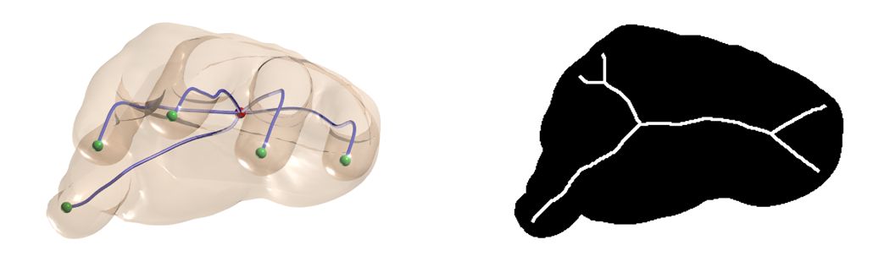
^{Medial Axis & Curve-Skeletons}
The curve-skeleton of a 3D shape projects over the medial axis of its silhouettes – Does it?
TOPOLOGY
NO CLUE
MORE
EVOCATIVE
LESS
EVOCATIVE
LIMBS MISSING
MISLEADING
Most likely YES - Iff the are no occlusions!

Slide 26
^{Medial Axis & Curve-Skeletons}
The curve-skeleton of a 3D shape projects over the medial axis of its silhouettes – Does it?
NO CLUE
MORE
EVOCATIVE
LESS
EVOCATIVE
LIMBS MISSING
MISLEADING
Most likely YES - Iff the are no occlusions!

