Slide 1

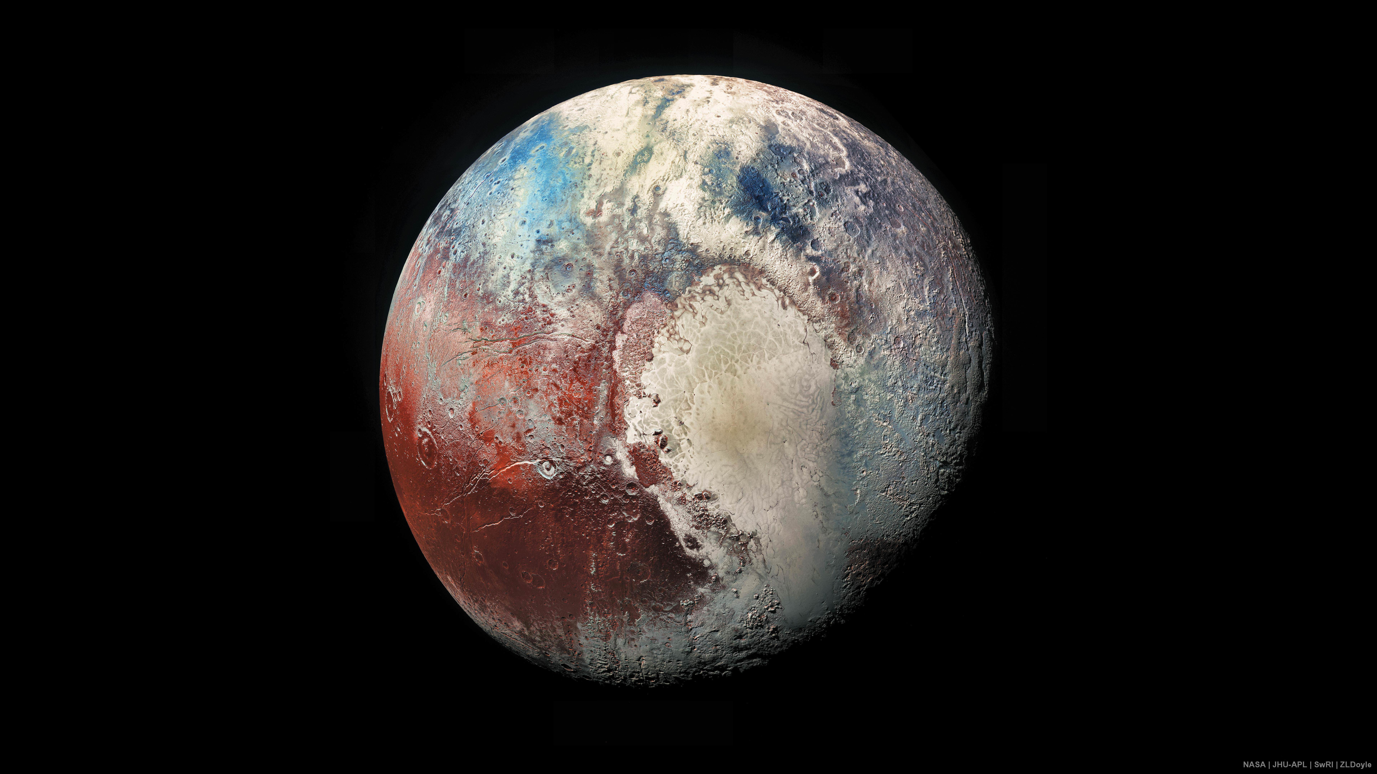
Absolute colors and phase coefficients of trans-Neptunian objects
Miles Logan Johnson
Abstract
Trans-Neptunian Objects, or TNOs, are distant objects in our Solar System that orbit our Sun at a distance greater than the orbital distance of Neptune. TNOs are leftovers from a ring of matter known to astronomers as the protoplanetary disk. All the planets in our Solar System formed from this disk shortly after the birth of the Sun approximately 4.6 billion years ago. Understanding the physical properties of TNOs is essential to understanding the formation and evolution of our Solar System. There exists around 2,300 known TNOs, but astronomers have only studied a few of them extensively.
Methodology
Astronomers use a technique called photometry to determine the physical characteristics of TNOs. Photometry involves observing the brightness and color of the objects being observed. Apparent magnitude is a concept in astronomy that measures the brightness of the observed object as seen from Earth. Measuring the brightness of TNOs allows astronomers to calculate the absolute magnitudes of these objects where the intrinsic brightness is a measure of brightness at a standard distance from the object. Astronomers are interested in the intrinsic brightness of TNOs because they can use them to approximate the size of the TNOs.
When light travels from the Sun to objects in our Solar System, it is reflected off these objects as a spectrum of light rather than one specific color. The color of trans-Neptunian objects can be determined by using special light filters in conjunction with very powerful telescopes. These filters allow a particular color of light through to the telescope, and astronomers can then measure the brightness of the TNOs at that color. The color of the TNO can then be determined through the comparison of these magnitudes through different filters. Different colors of TNOs imply different physical compositions.

