Slide 1
HW2 presentation
Malak Yehia
Zaher Qubien

Slide 2
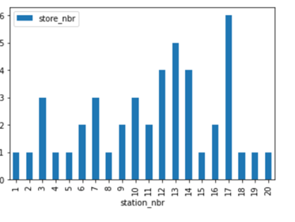
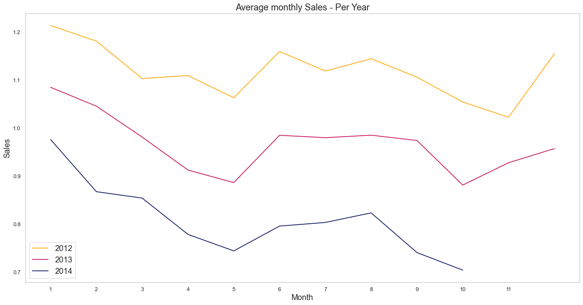

Data Exploration and Visualization
Show for each station number how many stores it includes
Average monthly sales per year

Slide 3
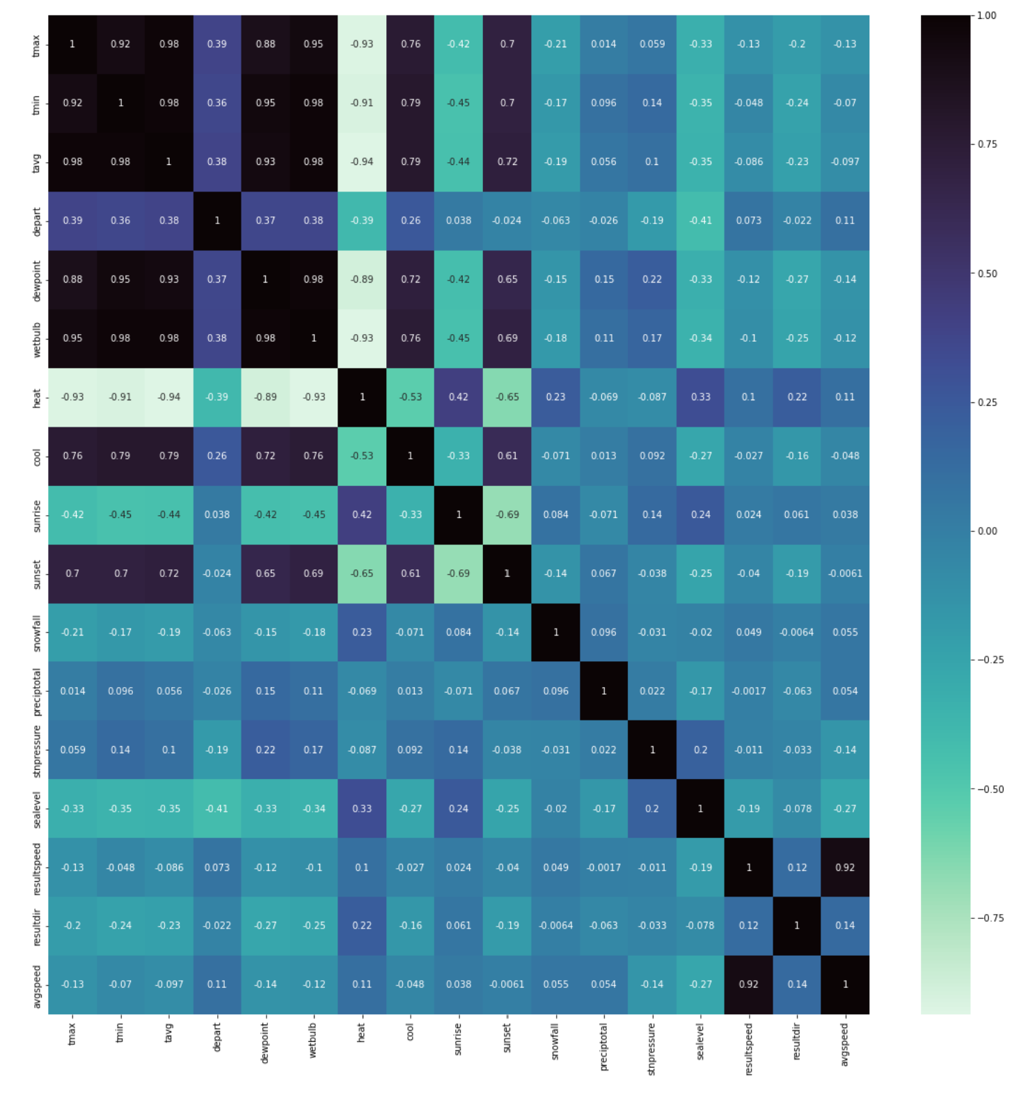
Pre processing
In addition to dropping columns that has null values in almost more than half of its values,
we decided to drop highly correlated features according to this heatmap, such that features that scored higher than 0.95 were dropped (we iterated through the upper triangle)

Slide 4
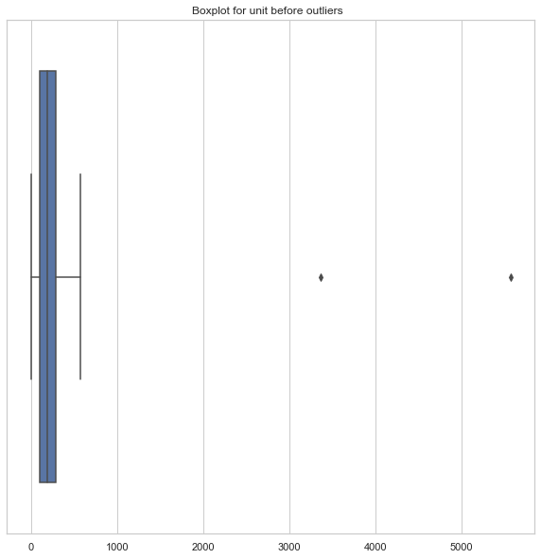
Outliers
In our box plot graph, we spotted two outliers in the ‘units’ feature.
Only two units sold above 2000, so we dropped them.

Slide 5
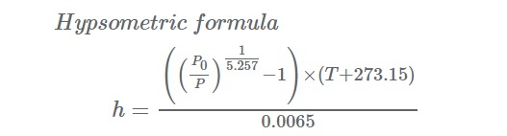
Elevation Estimation
In order to Calculate the Elevation Estimation we need to use this formula:
P0: is our Average SeaLevel
P is our Average Station Pressure
T is our weather Average

Slide 6
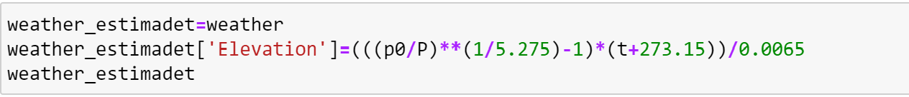
Then we added Elevation Column to our Weather csv and applied the formula
Interesting Findings: When the stnPressure and sea level values are closer together the Elevation value gets smaller and when the difference between stn pressure and sealevel is bigger we can see that the Elevation value gets way larger for example: Row 20512:stnPressure:29.9 and sea Level is 29.99 Elevation value 27.8 and for Row 1 : stnPressure: 28.82 and sea Level is 29.91 the Elevation Value is 341.33.

Slide 7
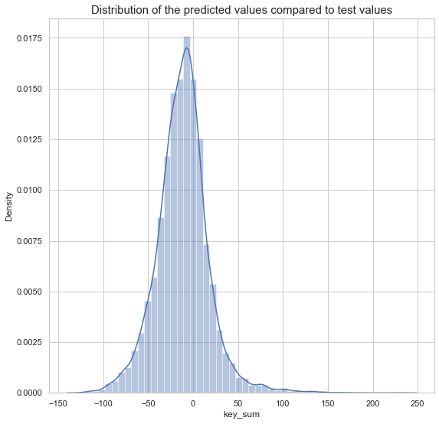
Section C
We got that predicted values are almost within the same range as true values, when we used gradient boost for predictions

Slide 8

Thank You!
No Offense Amanda ☺

