Slide 1
CULTURE
Chapter 3
Notes:
1

Slide 2
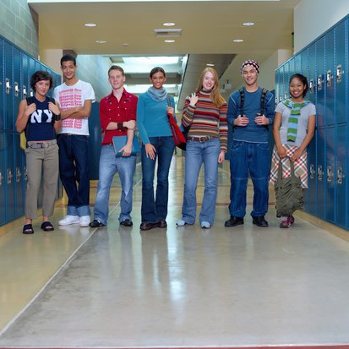
CULTURE AND SOCIETY
Culture—the learned and shared behaviors, beliefs, attitudes, values, and material objects that characterize a particular group or society
Notes:
2

Slide 3
Characteristics of Culture
Culture is learned.
Culture is taken for granted.
Culture is symbolic of our society.
Culture is transmitted from one generation to the next.
Culture is shared.
Culture is adaptive and always changing.
Notes:
3

Slide 4
Society
Society—a group of people that has lived and worked together long enough to become an organized population and to think of themselves as a social unit
Notes:
4

Slide 5
CULTURAL SIMILARITIES
Cultural Universals—customs and practices that are common to all societies.
All cultures include bodily adornments, dancing, food taboos, ideas about modesty, and expectations for mourning.
Cultures differ in the expression of the universals.
Notes:
5

Slide 7
Culture changes in a couple of ways
Innovation and Diffusion:
Innovation
Innovation is the process of introducing a new idea or object to a culture
2 forms of innovation: discovery and invention
Diffusion is the process by which culture spreads from one group/society to another
Technology and globalization also effect diffusion

Slide 8

Material Culture
Material culture consists of the tangible objects that members of a society make, use, and share.
Examples include tools, jewelry, pottery, clothing, and furniture.
Notes:
8

Slide 9
Nonmaterial Culture
Nonmaterial culture includes the shared set of meanings that people use to interpret and understand the world.
Examples include political opinions, religious beliefs, and marriage patterns.
Notes:
9

Slide 10
What do you think?
What is the material culture and nonmaterial culture of …?
Baseball
School
Shopping
Notes:
10

Slide 11

Cultural lag describes the gap when nonmaterial culture changes more slowly than material culture.
Cell phones were invented before our norms for when to use them.
Reproductive technologies are available but there is still confusion about the moral issues.
Notes:
11

Slide 12
THE BUILDING BLOCKS OF CULTURE
Symbol—anything that stands for something else and has a particular meaning for people who share a culture
Symbols include
Words—chair, tomorrow, hope
Gestures—wave, salute
Physical objects—cross, wedding ring
Notes:
12

Slide 13

Language—a system of shared symbols that enables people to communicate with one another.
Notes:
13

Slide 14
Language
Speech, yes
But also…
Symbolic languages such as:
Texting
Emoticons
Mathematics
American Sign Language

Slide 15
Language
Language is important.
It makes us human.
We are not born with it, we LEARN it.
It helps us interact.
It directs our thinking, controls our actions, and gives us a sense of belonging.
Notes:
15

Slide 16
Sapir Whorf Hypothesis
How language shapes our reality
Examples:
Language therefore colors the way we see our world

Slide 17
What do you think?
Think of these terms and the significance society has given to them over time:
What are some uses of the word black to mean something negative?
What are some uses of the word white to mean something positive?
Notes:
17

Slide 18
Language influences how we perceive genders, races, and ethnicities.
Words create and reinforce both positive and negative images.
Notes:
18

Slide 19
Another question?
Is it acceptable to use racist or sexist terms to describe oneself or one's group?
Notes:
19

Slide 20
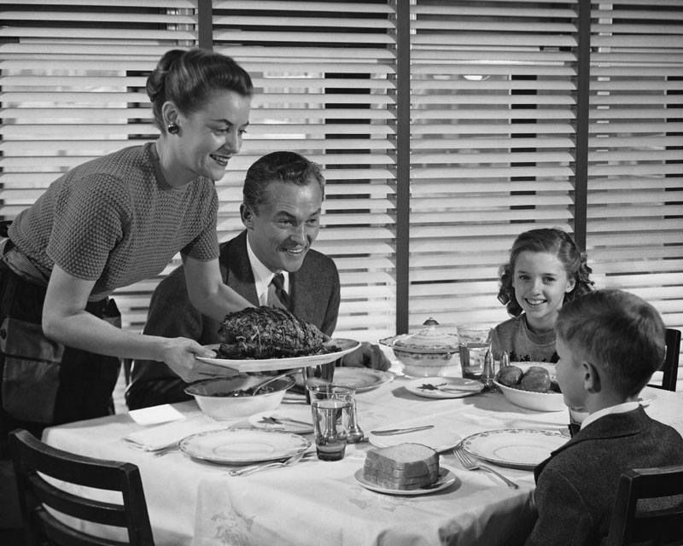
Norms
Norms are society's specific rules of right and wrong behavior.
They tell us what we should or should not do.
Notes:
20

Slide 21
Norms
What are some of the norms in our culture?

Slide 22
Characteristics of Norms
Most are unwritten.
They are instrumental.
Some are explicit while others are implicit.
They change over time.
Most are conditional.
Norms can be rigid or flexible.
Notes:
22

Slide 23
Three Types of Norms
Folkways: norms that members of a society look upon as not being critical and that may be broken without severe punishment
Mores: norms that society considers very important because they maintain morals and ethics
Laws: norms that are defined and enforced by a political authority
Notes:
23

Slide 24
What do you think?
Identify whether it is a folkway, more, or law.
Place your napkin in your lap.
Cover your genitals when you are in public.
Don't pick your nose in public.
Ensure the safety of children.
Notes:
24

Slide 25
Sanctions
Sanctions—rewards for appropriate behavior and penalties for inappropriate behavior.
Sanctions vary in strength and can be positive or negative – formal or informal
A hug
A prison term
Getting fired
Notes:
25

Slide 26
Values—the standards by which members of a particular culture define what is good or bad, moral or immoral, proper or improper, desirable or undesirable, beautiful or ugly.
Major U.S. values include:
Achievement and success
Activity and work
Morality
Humanitarianism
Efficiency and practicality
Progress
Equality
Individuality
Notes:
26

Slide 27
Values
Value Clusters: values that hold together
Achievement, success, progress, efficiency
Value Contradictions: values that seem in direct opposition to each other
Equality and efficiency

Slide 28
SOCIOLOGICAL PERSPECTIVES ON CULTURE
Functionalists focus on culture as a cement that binds society.
Conflict theorists argue that culture can generate enormous inequality.
Feminist scholars focus on gender differences.
Interactionists study how people interpret and transmit culture.
Notes:
28

Slide 29
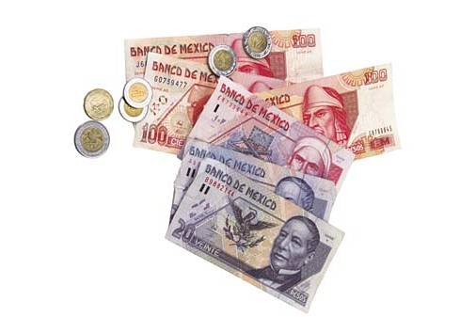
Multiculturalism
Multiculturalism refers to the coexistence of many cultures in the same geographic area, without any one culture dominating another.
Multiculturalism is also called cultural pluralism.
Notes:
29

Slide 30
CULTURAL DIVERSITY
A subculture is a group or category of people whose distinctive ways of thinking, feeling, and acting differ somewhat from those of the larger society.
Subcultures can be based on ethnicity, religion, politics, age, physical disability, or social class.
Notes:
30

Slide 31
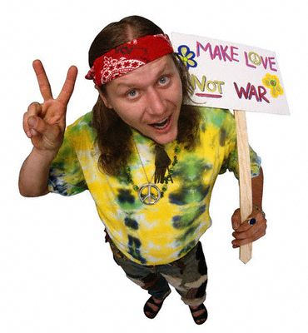
Counterculture
A counterculture deliberately opposes and consciously rejects some of the basic beliefs, values, and norms of the dominant culture.
Countercultures can range from the Ku Klux Klan to the Old Order Amish.
Notes:
31

Slide 32
Culture Shock
When an individual feels disoriented, uncertain, or even fearful when immersed in an unfamiliar culture
Example:

Slide 33
Ethnocentrism vs. Cultural Relativism
Ethnocentrism is the belief that one's culture and way of life are superior to those of other groups.
Cultural relativism involves recognizing that no culture is better than another and that a culture should be judged by its own standards.
Notes:
33

