Slide 1
Spring Cloud Config Server
Feb 2024

Slide 2
Agenda
What’s Spring Cloud Config Server?
Why Spring Cloud Config Server?
Spring Cloud Config Architecture
When to use Spring Cloud Config?

Slide 3
Agenda
What’s Spring Cloud Config Server?
Why Spring Cloud Config Server?
Spring Cloud Config Architecture
When to use Spring Cloud Config?

Slide 4
What’s Spring Cloud Config Server?
Configuration management mindset change
Centralized Config Server
Supporting Backend config storages (like Git, Vault, …)
Part of Spring Cloud Framework
Integrated with Java, Nodejs, Python, …
Designed for Microservices architecture

Slide 5
Agenda
What’s Spring Cloud Config Server?
Why Spring Cloud Config Server?
Decoupling Configuration from Deployment
Dynamic Configuration Updates
Enhanced Security
Centralized Configuration Management
Spring Cloud Config Architecture
When to use Spring Cloud Config?

Slide 6
Agenda
What’s Spring Cloud Config Server?
Why Spring Cloud Config Server?
Decoupling Configuration from Deployment
Dynamic Configuration Updates
Enhanced Security
Centralized Configuration Management
Spring Cloud Config Architecture
When to use Spring Cloud Config?

Slide 7
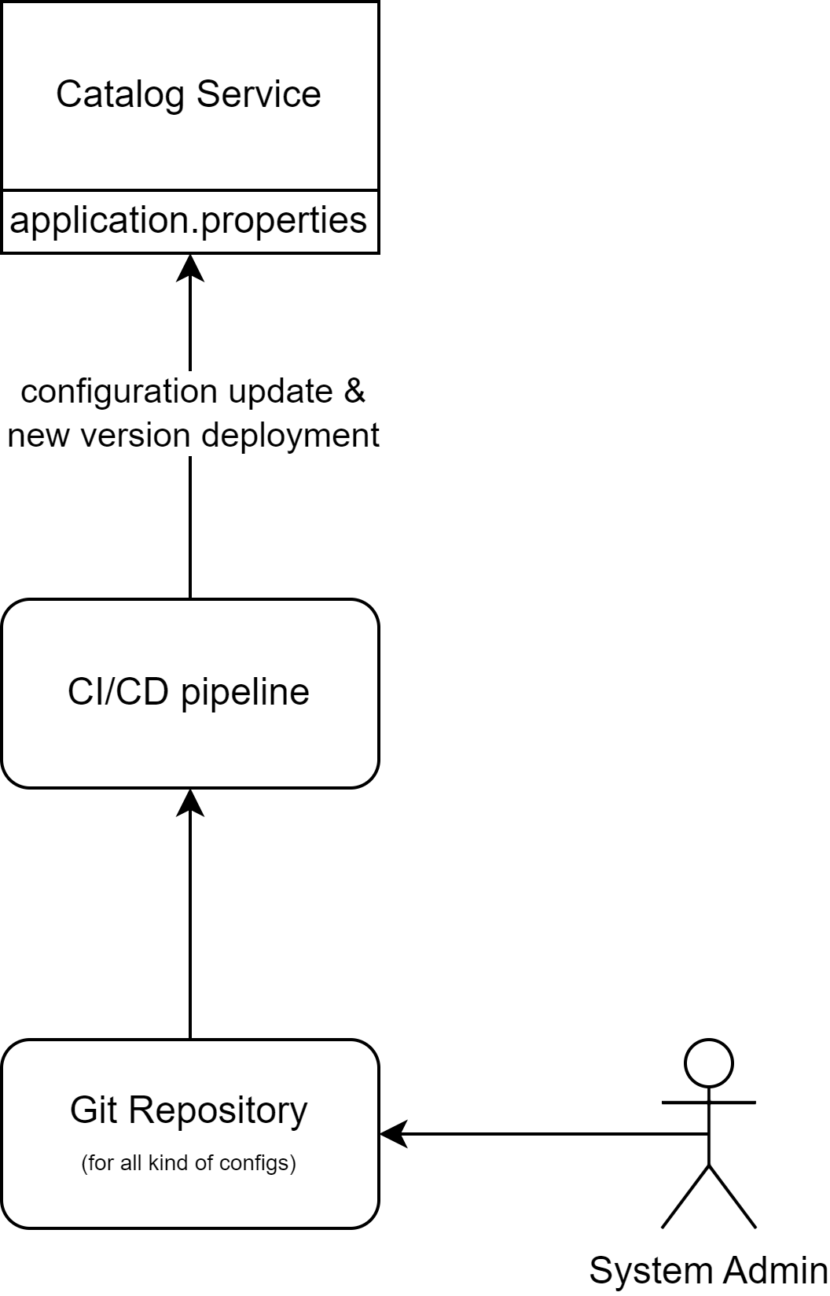
Coupling Configuration with Deployment (current status)
Run CI/CD pipeline per configuration changes
Less flexible & slow for configuration changes

Slide 8
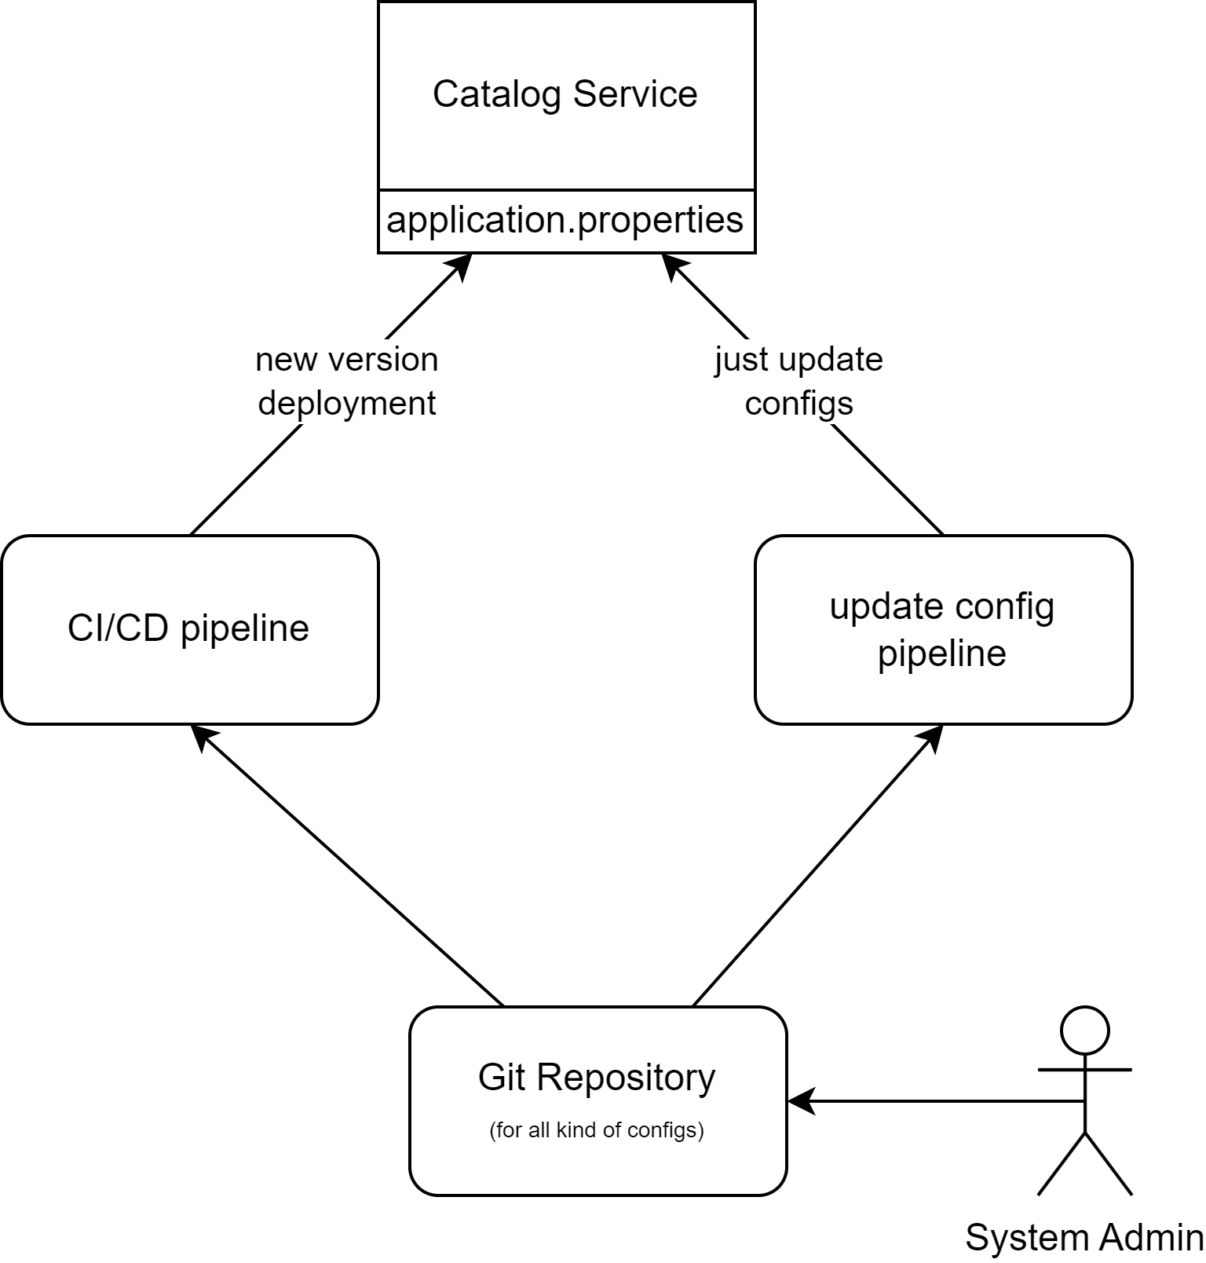
Decoupling Configuration from Deployment (current status)
Run CI/CD pipeline per configuration changes
Less flexible & slow for configuration changes

Slide 9
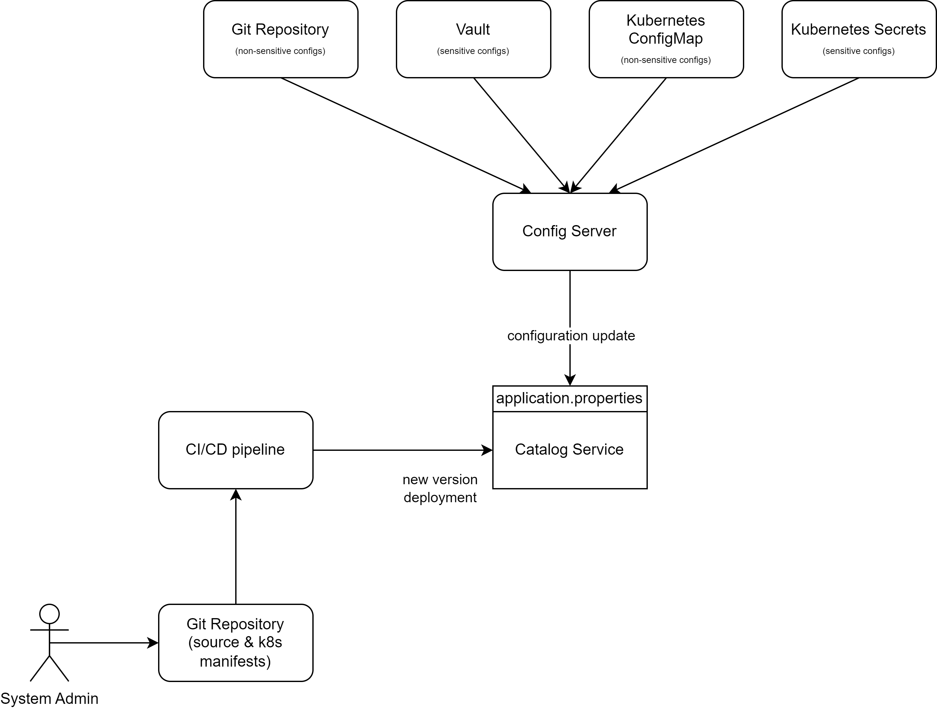
Decoupling Configuration from Deployment
- Faster & Flexible for high rate of configuration changes

Slide 10
Agenda
What’s Spring Cloud Config Server?
Why Spring Cloud Config Server?
Decoupling Configuration from Deployment
Dynamic Configuration Updates
Enhanced Security
Centralized Configuration Management
Spring Cloud Config Architecture
When to use Spring Cloud Config?

Slide 11
Dynamic Configuration Updates (Hot Reloading)
- Doesn’t need Rolling update for just configuration Changes

Slide 12
Agenda
What’s Spring Cloud Config Server?
Why Spring Cloud Config Server?
Decoupling Configuration from Deployment
Dynamic Configuration Updates
Enhanced Security
Centralized Configuration Management
Spring Cloud Config Architecture
When to use Spring Cloud Config?

Slide 13
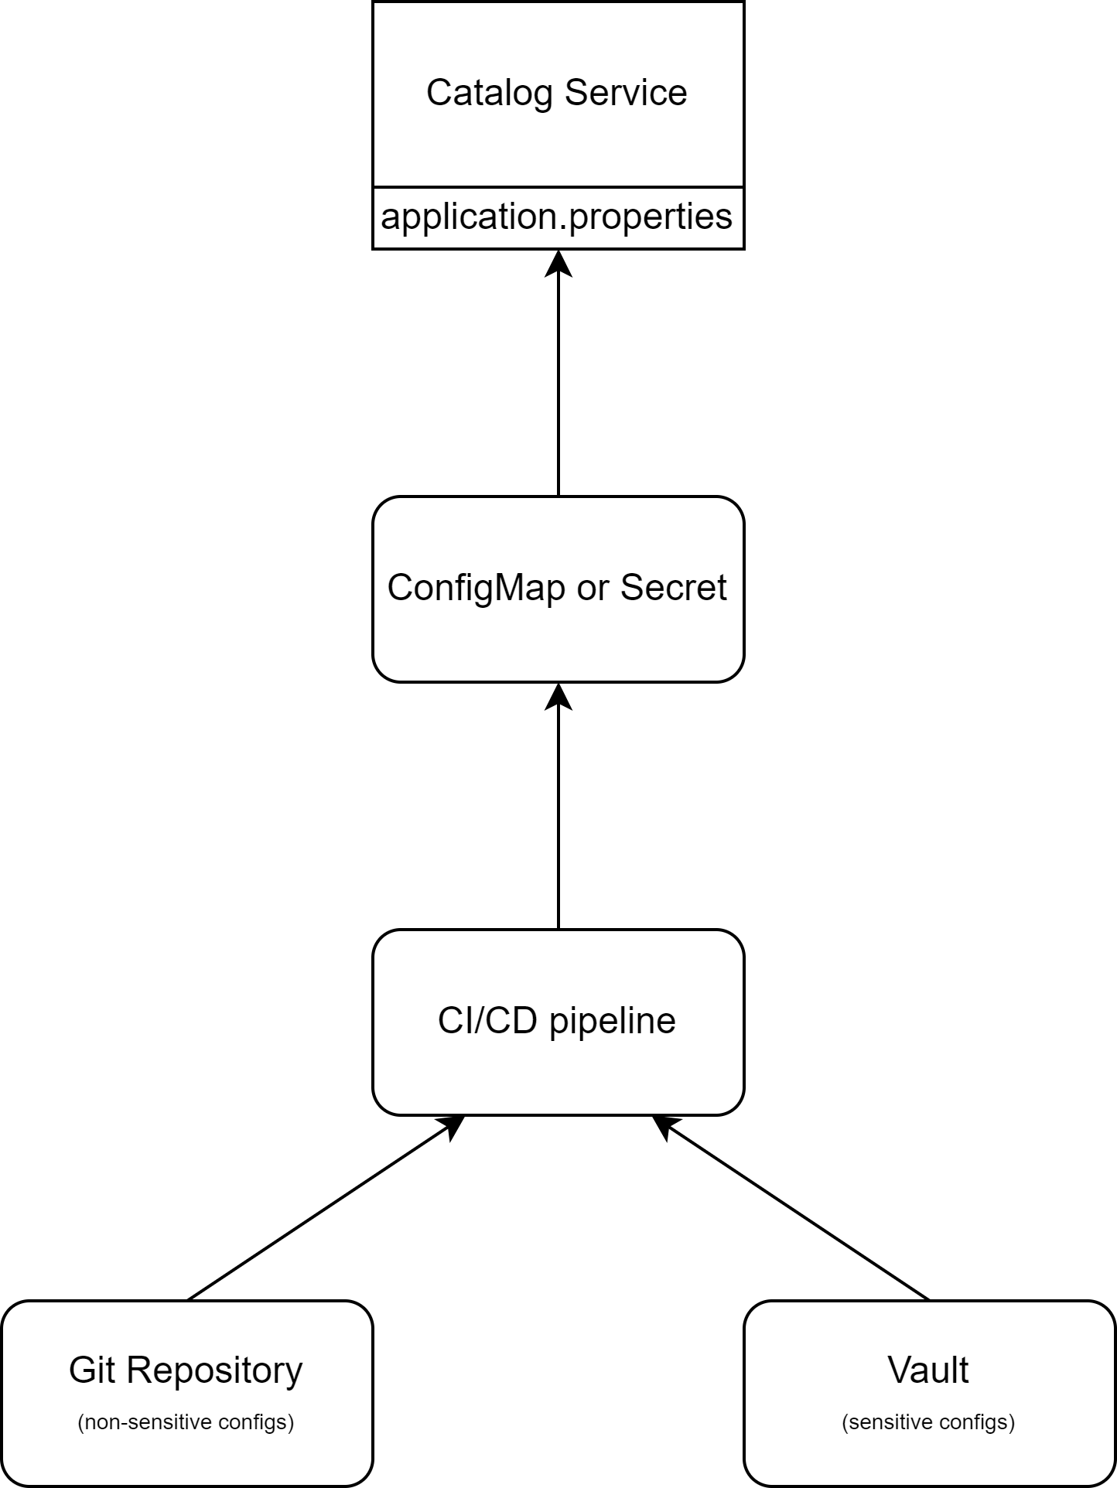
Enhanced Security
Unencrypted data inside the Configmap and Secrets of Kubernetes
Even Secrets in Kubernetes stores in plain text (base64 encoding)

Slide 14
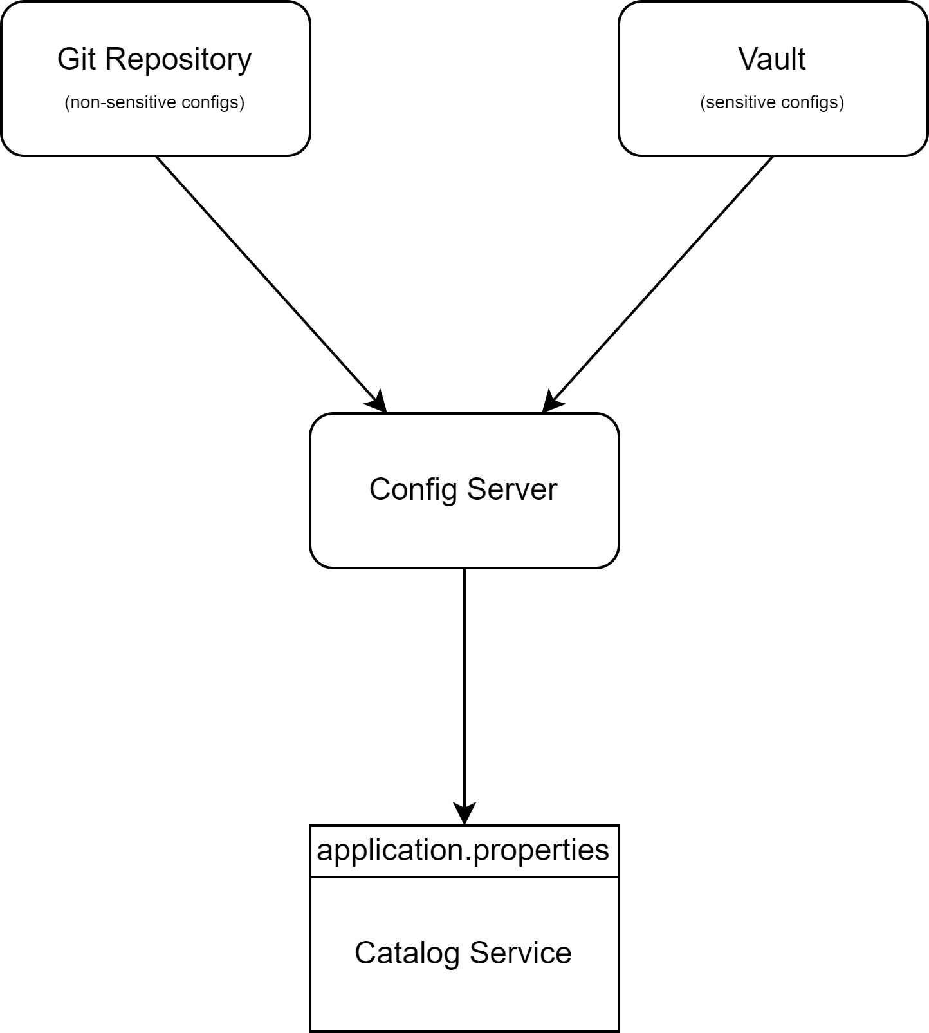
Enhanced Security
Not storing sensitive data (like database password) in the Kubernetes Secret
Reading sensitive data by REST API from Config Server

Slide 15
Agenda
What’s Spring Cloud Config Server?
Why Spring Cloud Config Server?
Decoupling Configuration from Deployment
Dynamic Configuration Updates
Enhanced Security
Centralized Configuration Management
Spring Cloud Config Architecture
When to use Spring Cloud Config?

Slide 16
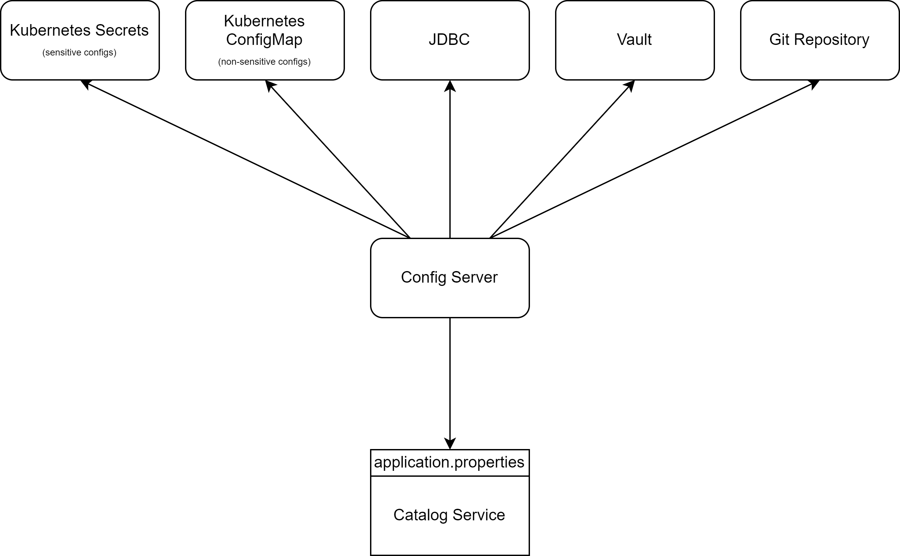
Centralized Config server
Single REST API for all configuration sources (Git, Vault, …)

Slide 17
Agenda
What’s Spring Cloud Config Server?
Why Spring Cloud Config Server?
Spring Cloud Config Architecture
Push-Based model
Pull-Based model
Push-Based VS Pull-Based
When to use Spring Cloud Config?

Slide 18
Agenda
What’s Spring Cloud Config Server?
Why Spring Cloud Config Server?
Spring Cloud Config Architecture
Push-Based model
Pull-Based model
Push-Based VS Pull-Based
When to use Spring Cloud Config?
How to use Spring Cloud Config?
Further investigation
Release Schedule

Slide 19
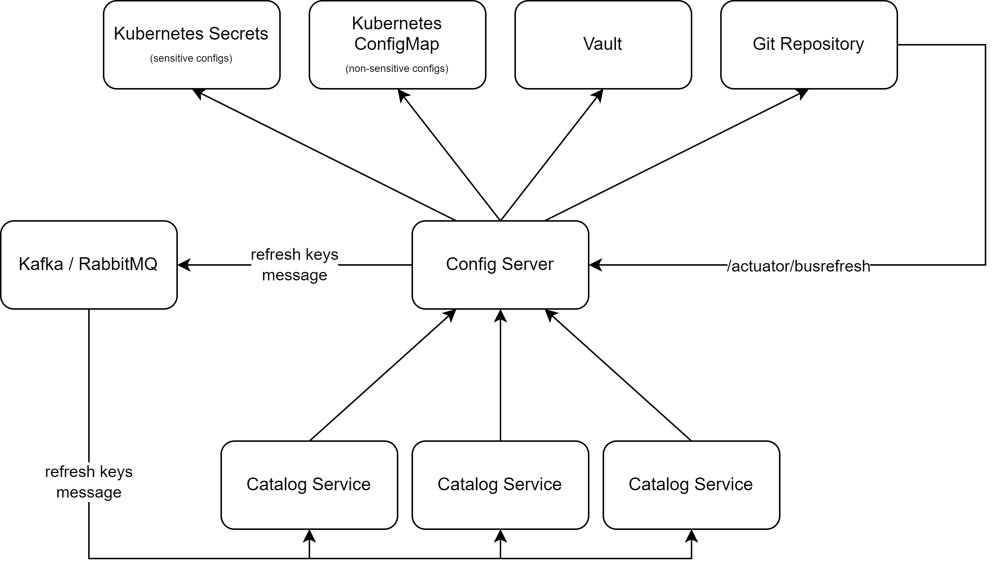
Spring Cloud config Architecture instant reloading (Push based)
- Connecting the Git webhook to /busrefresh endpoint for instant reloading
- vault doesn’t support webhook triggering

Slide 20
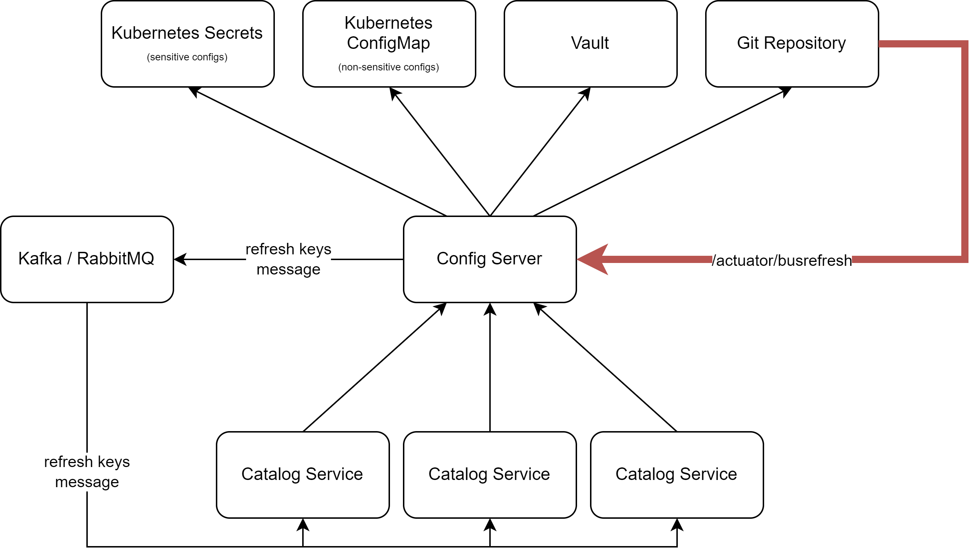
Spring Cloud config Architecture instant reloading (Push based)
- Connecting the Git webhook to /busrefresh endpoint for instant reloading
- vault doesn’t support webhook triggering

Slide 21
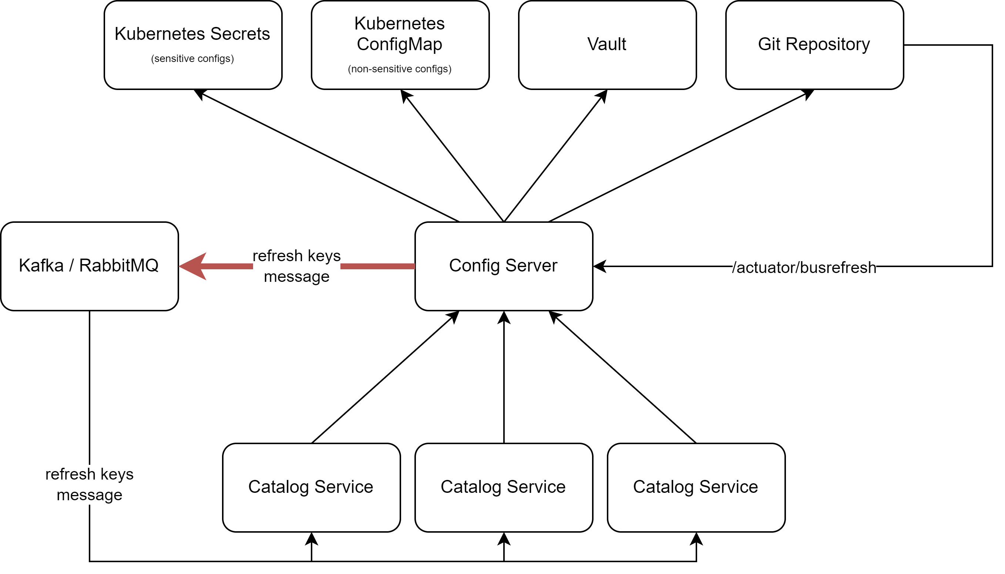
Spring Cloud config Architecture instant reloading (Push based)
- Connecting the Git webhook to /busrefresh endpoint for instant reloading
- vault doesn’t support webhook triggering

Slide 22
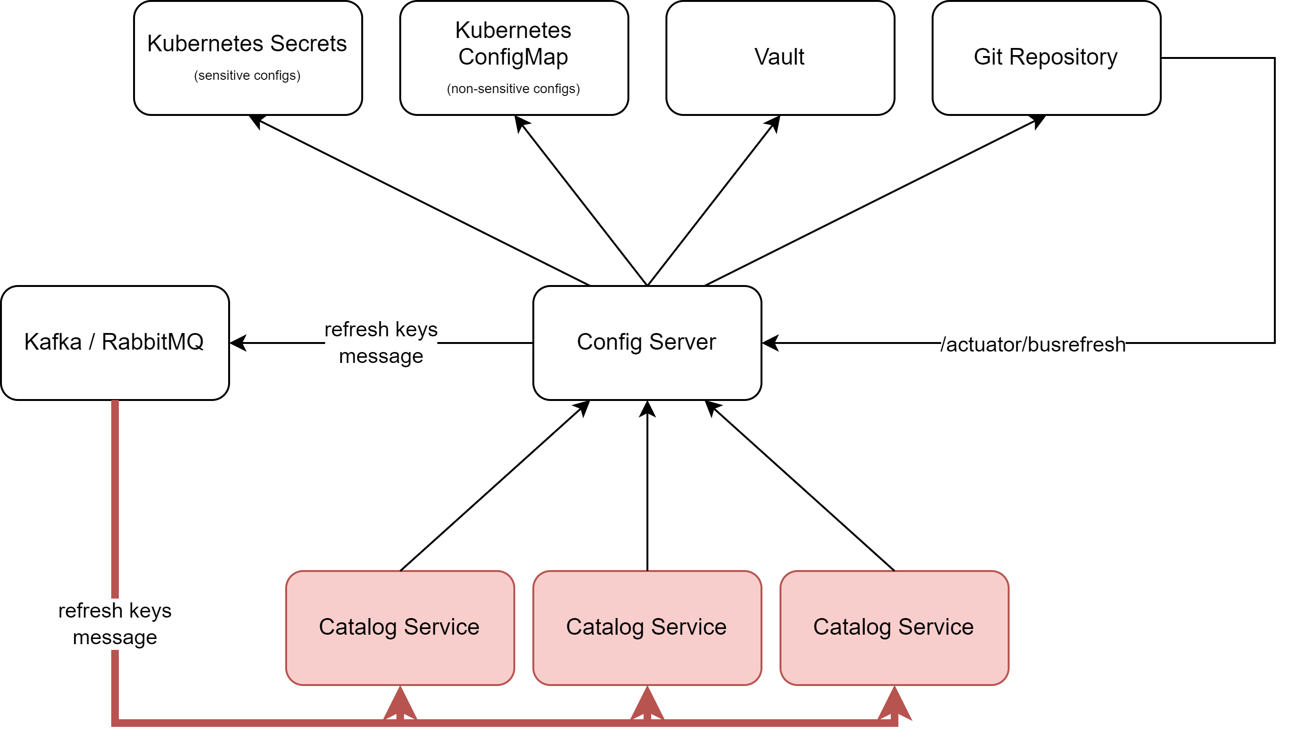
Spring Cloud config Architecture instant reloading (Push based)
- Connecting the Git webhook to /busrefresh endpoint for instant reloading
- vault doesn’t support webhook triggering

Slide 23
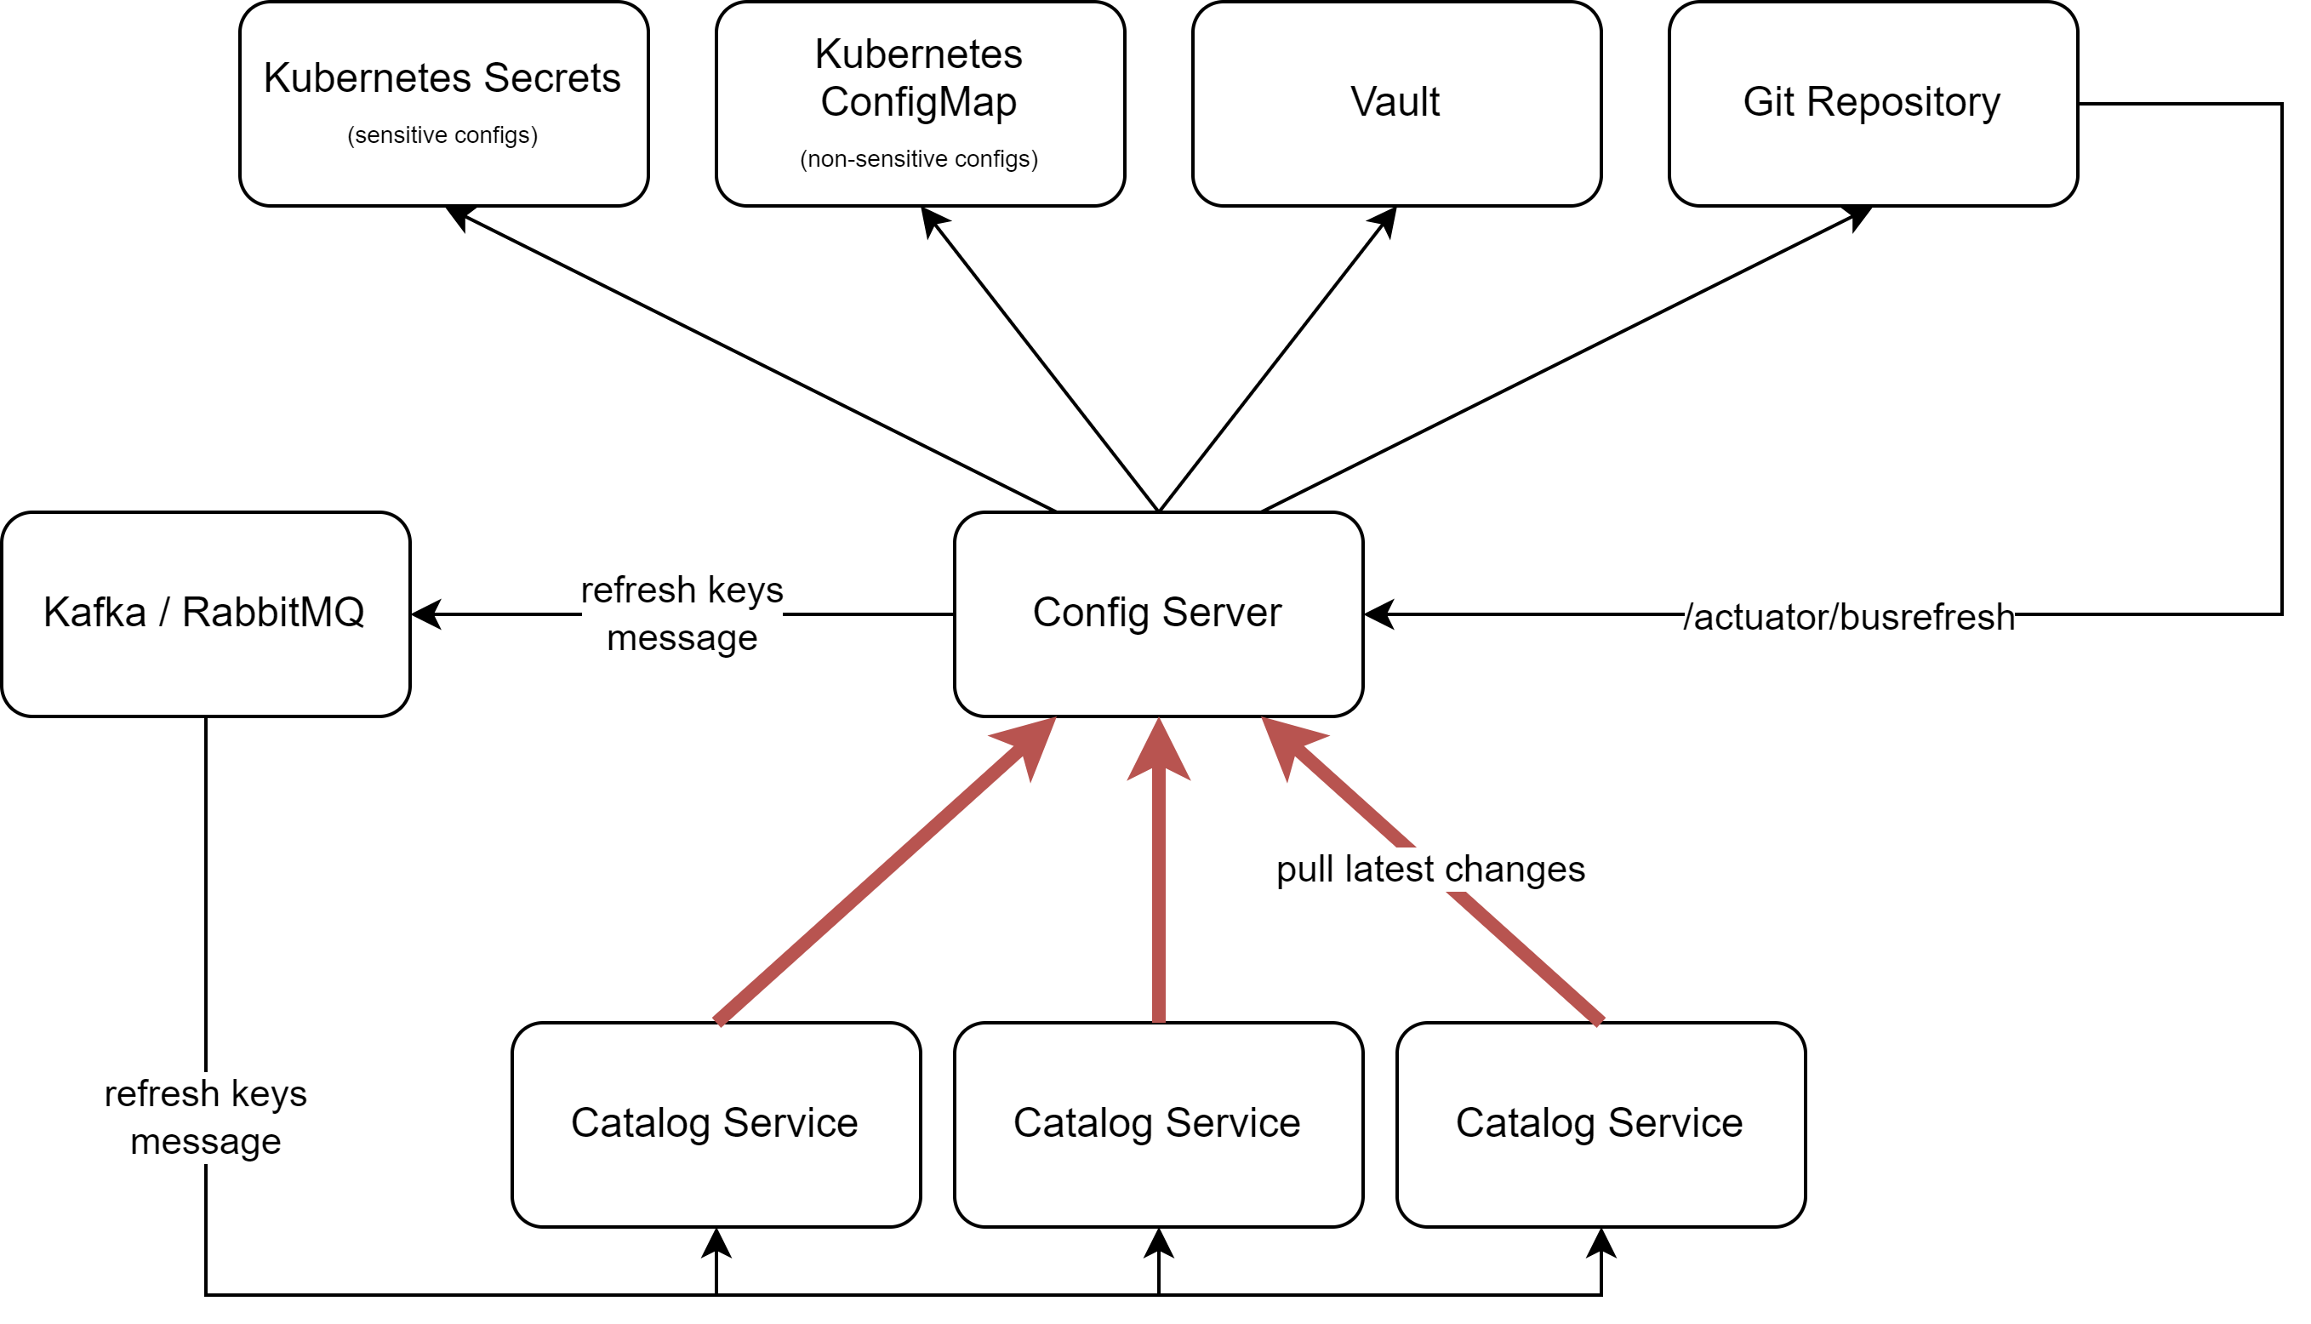
Spring Cloud config Architecture instant reloading (Push based)
- Connecting the Git webhook to /busrefresh endpoint for instant reloading
- vault doesn’t support webhook triggering

Slide 24
Agenda
What’s Spring Cloud Config Server?
Why Spring Cloud Config Server?
Spring Cloud Config Architecture
Push-Based model
Pull-Based model
Push-Based VS Pull-Based
When to use Spring Cloud Config?
How to use Spring Cloud Config?
Further investigation
Release Schedule

Slide 25
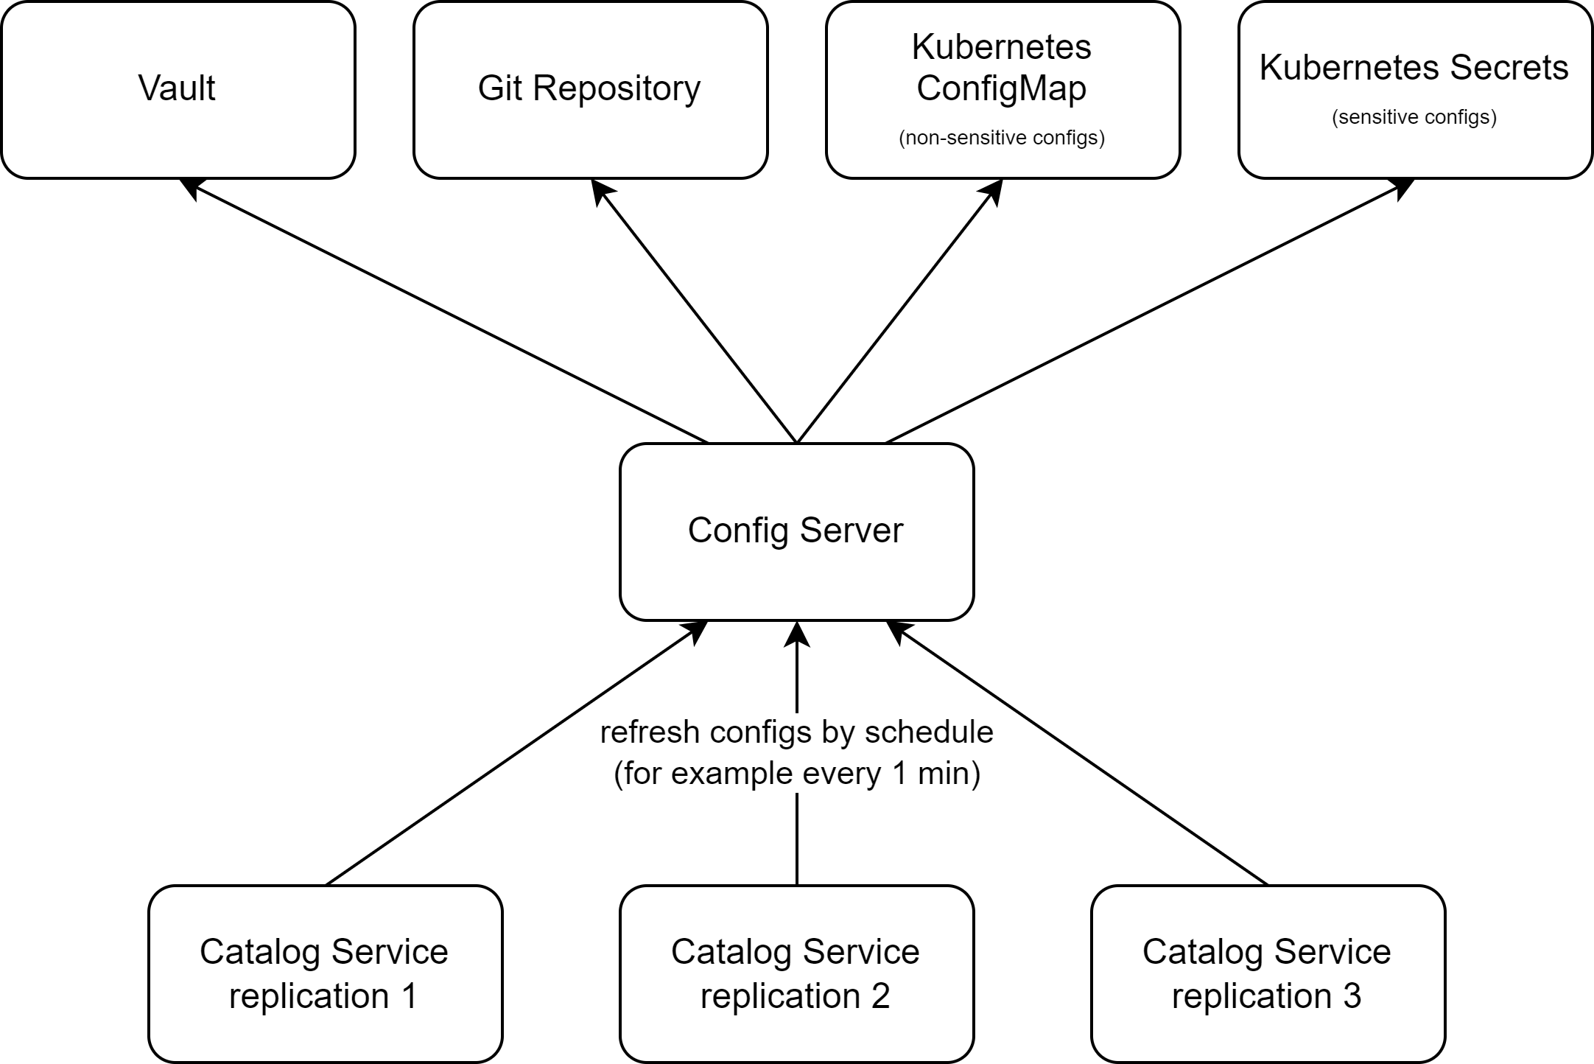
Spring Cloud config Architecture Scheduled reloading (Pull based)
Refresh the application configs by schedule, for example by crone schedule:
0 * * * * * (every minutes at 0 second)
0 0 2 * * * (every day at 2 AM)

Slide 26
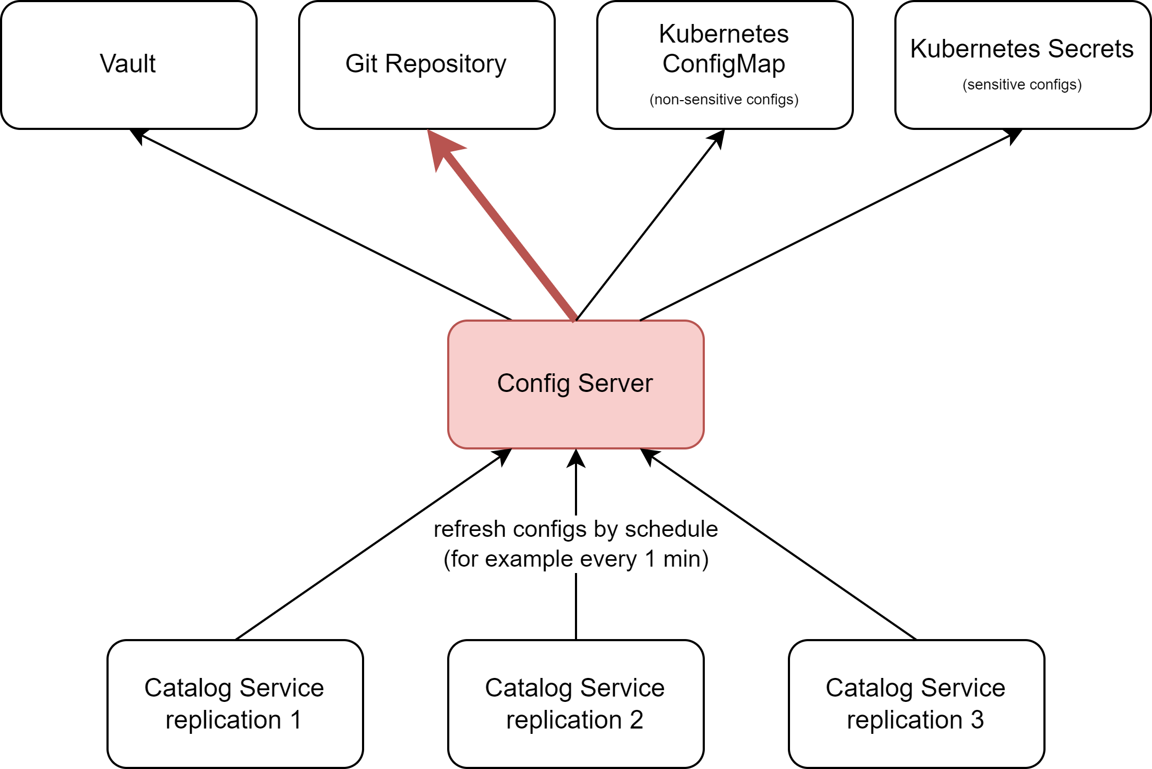
Spring Cloud config Architecture Scheduled reloading (Pull based)
Refresh the application configs by schedule, for example by crone schedule:
0 * * * * * (every minutes at 0 second)
0 0 2 * * * (every day at 2 AM)

Slide 27
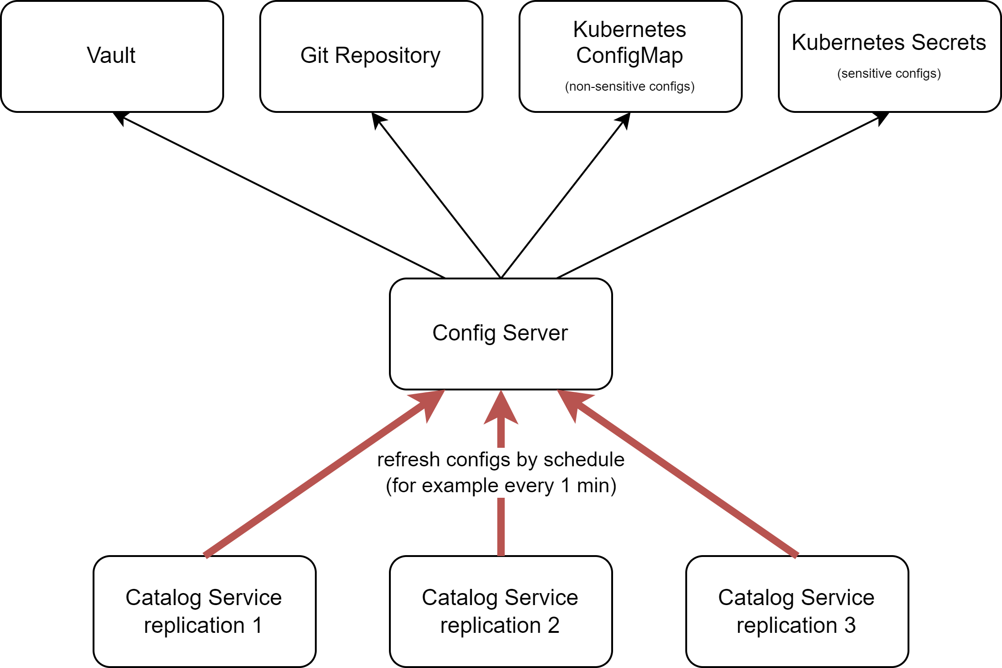
Spring Cloud config Architecture Scheduled reloading (Pull based)
Refresh the application configs by schedule, for example by crone schedule:
0 * * * * * (every minutes at 0 second)
0 0 2 * * * (every day at 2 AM)

Slide 28
Agenda
What’s Spring Cloud Config Server?
Why Spring Cloud Config Server?
Spring Cloud Config Architecture
Push-Based model
Pull-Based model
Push-Based VS Pull-Based
When to use Spring Cloud Config?

Slide 29
Push-Based VS Pull-Based
Push Based | Pull Based
Instant updating | Updating by schedule
Complicated Architecture | Simple Architecture

Slide 30
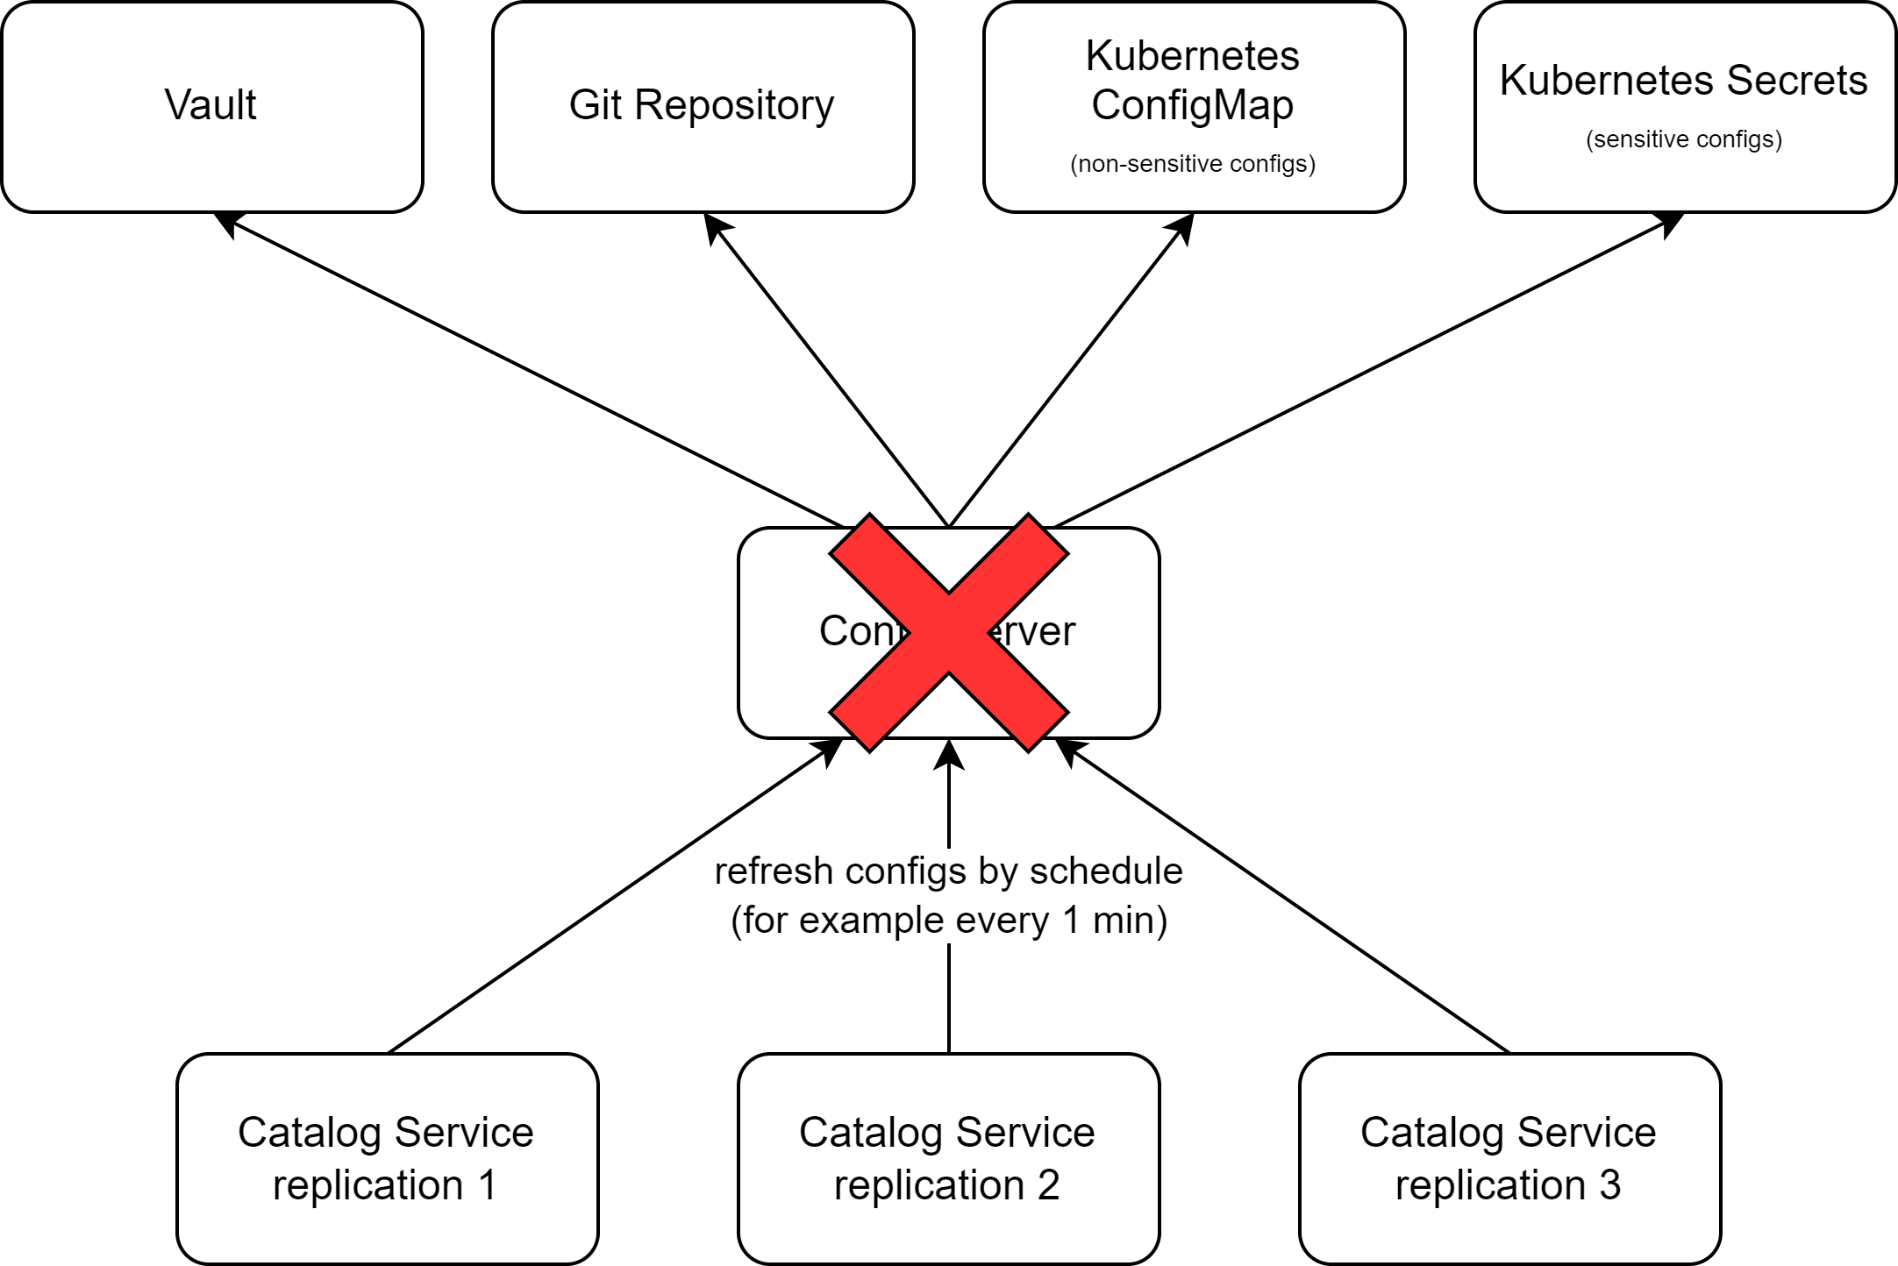
What happens if Config Server goes down?
Existing pods: Use last config, no updates
New pods: Fail without Config Server, may crash

Slide 31
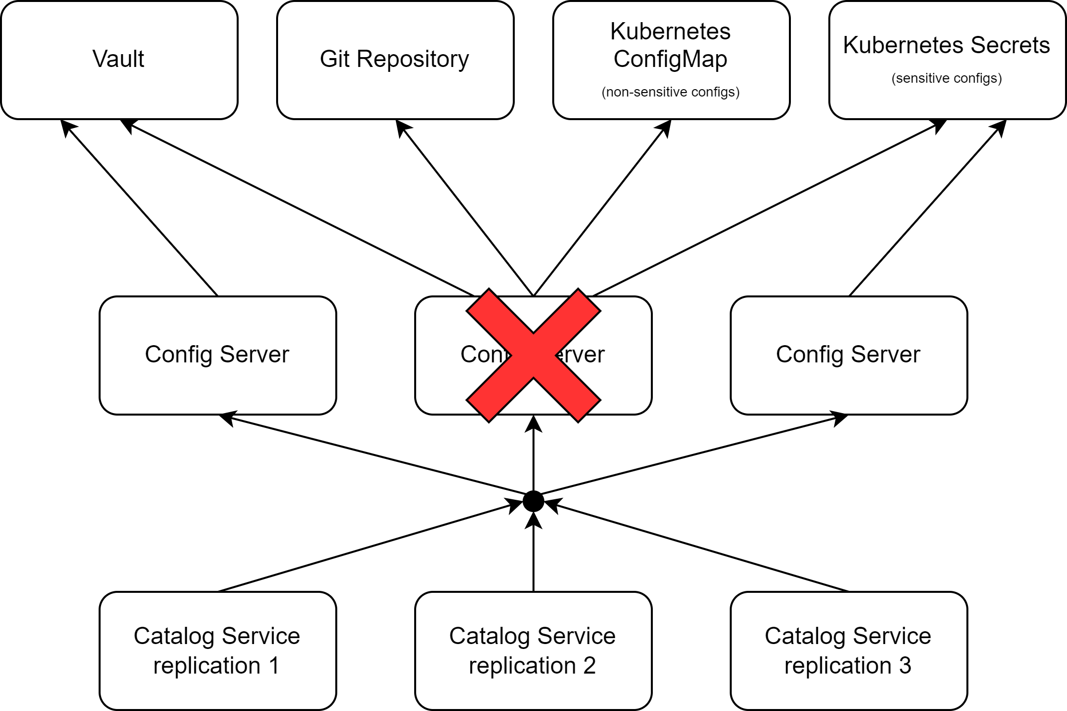
What happens if Config Server goes down?
Replicate the Config Server to increase sustainability

Slide 32
Agenda
What’s Spring Cloud Config Server?
Why Spring Cloud Config Server?
Spring Cloud Config Architecture
When to use Spring Cloud Config?

Slide 33


When to use Config Server?
Microservices Architecture
Dynamic Configuration Needs
Environment-Specific Configs
Version Control and Auditability
Security for Sensitive Configs
Simple or Monolithic Applications
Rapid Prototyping
Projects with Minimal Configuration Changes

