Slide 1
Лекция 15
Использование GPU при глубоком обучении.
Нейросети и глубокое обучение.

Slide 2
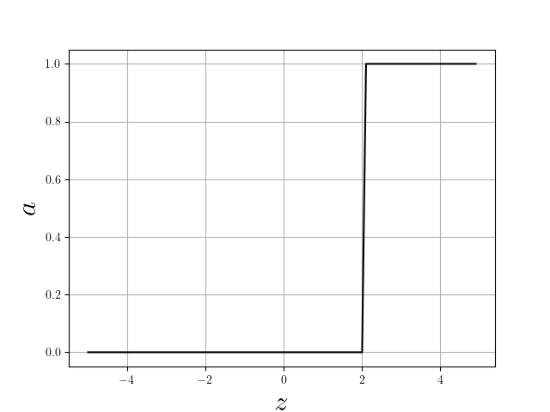
Искусственные нейроны.
Перцептроны и вентили. Логистические нейроны.
w₁
x₁
a
w₂
x₂
T
w₃
x₃
X₁, X₂, X₃ ∈ Z
T
z=x₁w₁+ x ₂w₂ + x ₂w₂
Функция активации: a(z)

Slide 3
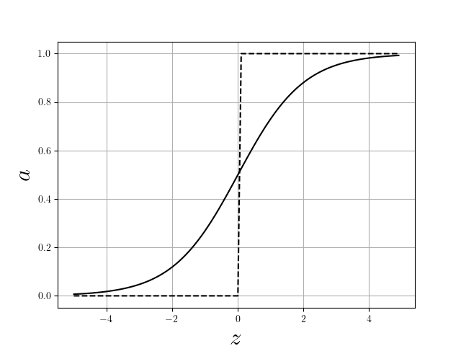

w₁
x₁
a
w₂
x₂
b
w₃
x₃
X₁, X₂, X₃ ∈ R
z=x₁w₁+ x ₂w₂ + x ₂w₂+ b

Slide 4

Нейронные сети: веса, смещения, слои.
w₁₁²
b₁²
a₁²
x₁
w₁₁¹
w₁₂²
w₁₂¹
b₁¹
a₁¹
x₂
w₂₁²
a₂²
w₂₂²
b₂²
x₃
a₂¹
w₃₁²
b₂¹
w₂₃¹
w₃₂²
a₃²
x₄
w₂₄¹
b₃²

Slide 5

Обучение НС: обучающие данные, функция потерь (затрат), [стохастический] градиентный спуск.
t₁
a₁², [ y₁ ]
t₂
W_{jk}^{l} , b_{j}^{l}
a₂², [ y₂ ]
t₃
a₃², [ y₃ ]
t₄

Slide 6
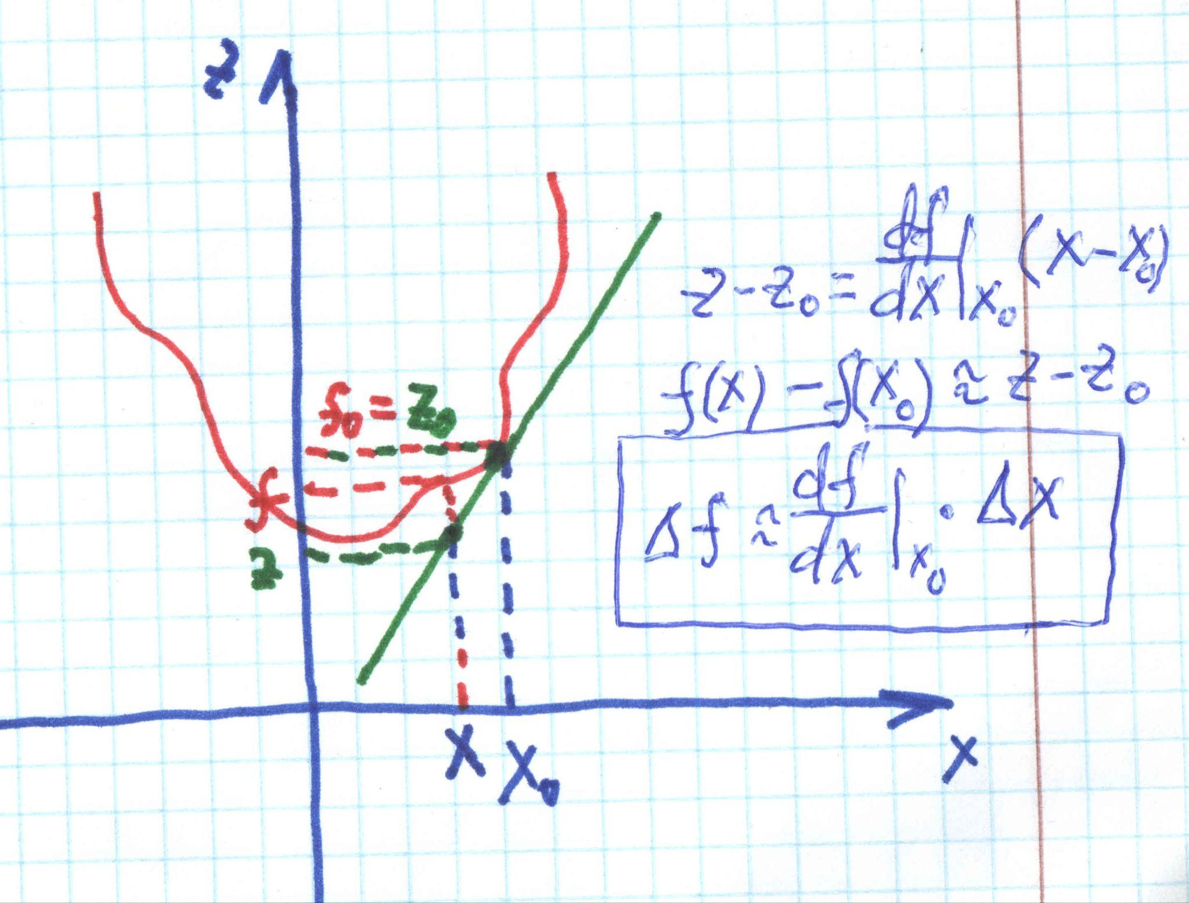
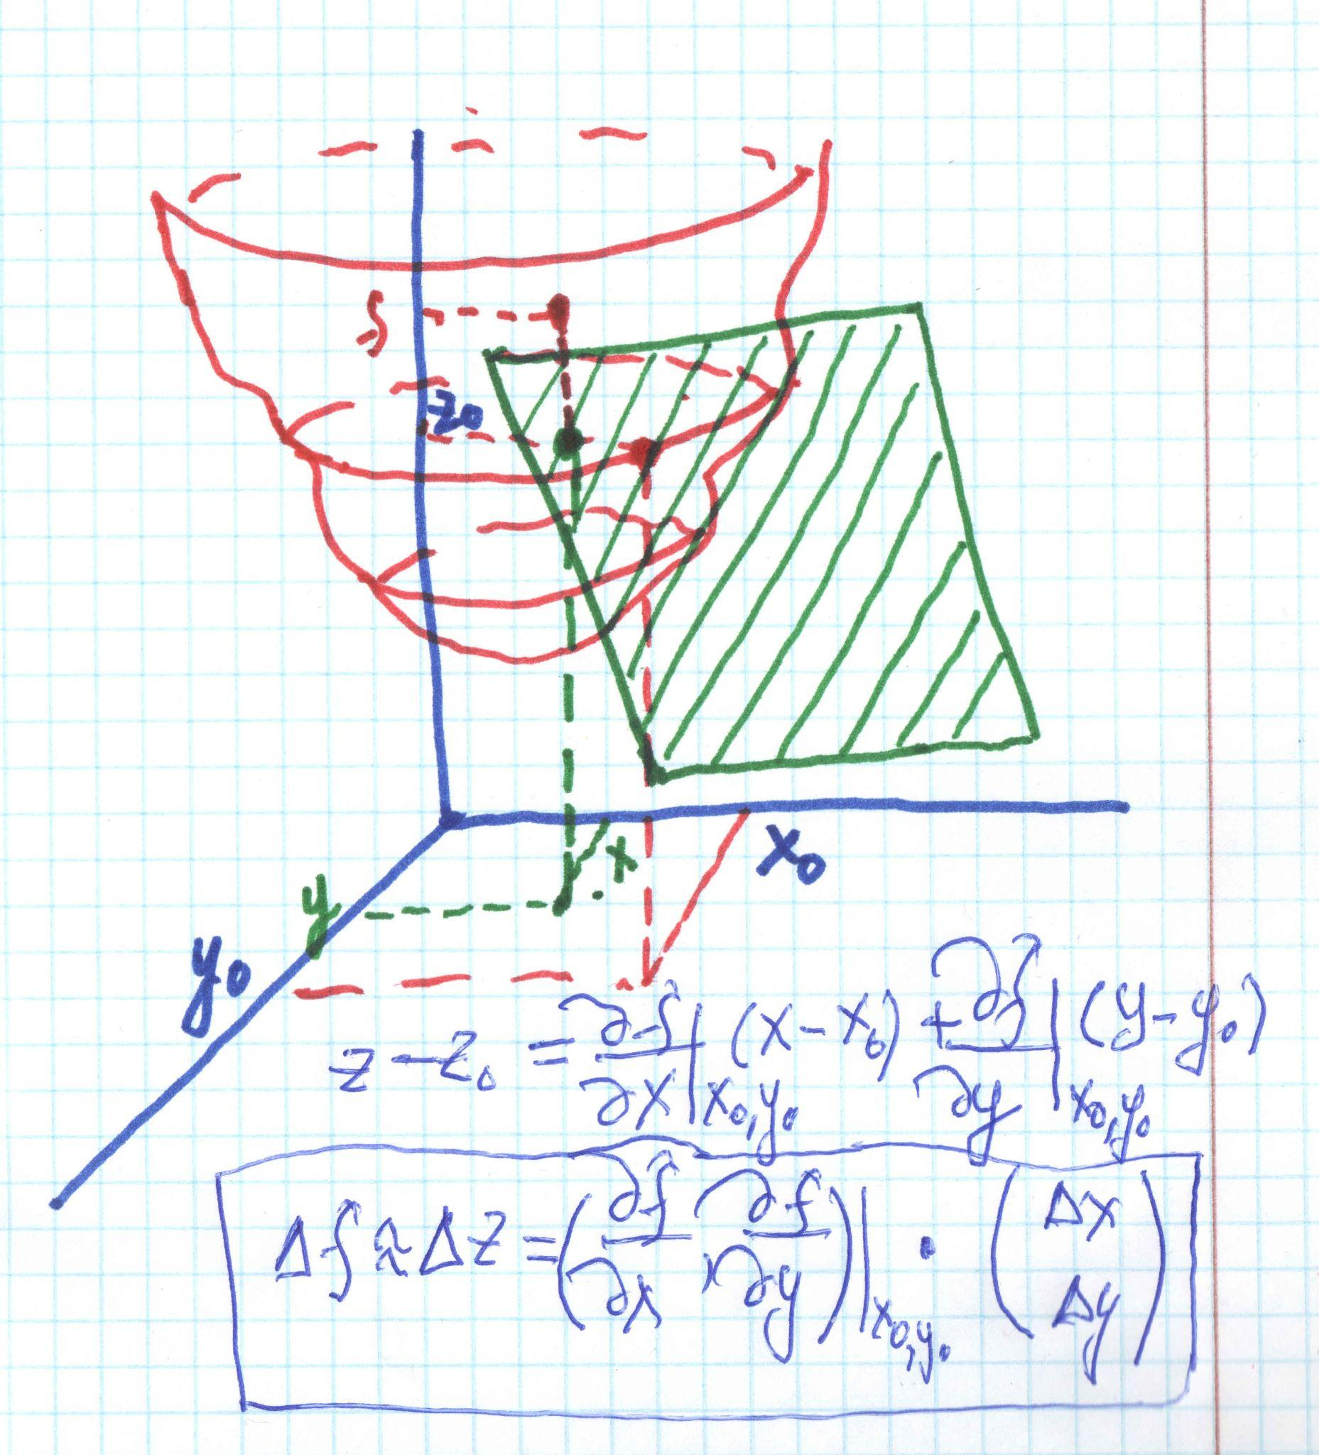



Slide 7
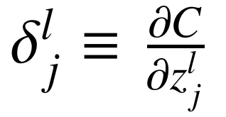
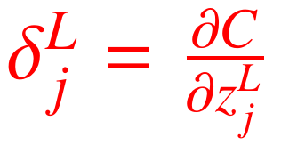
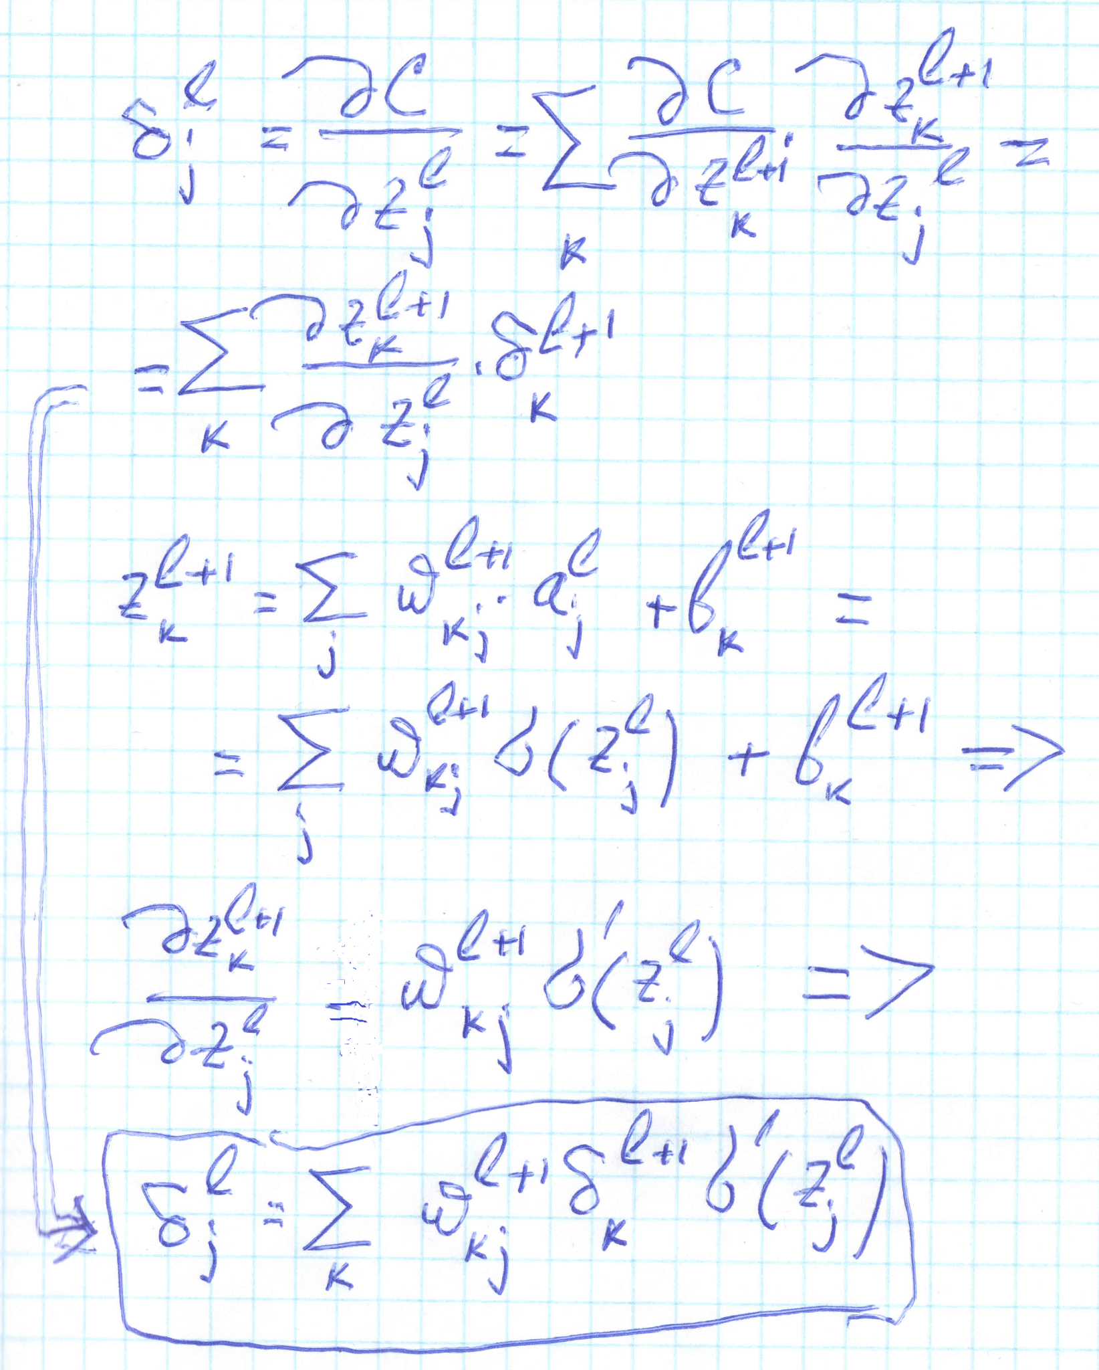
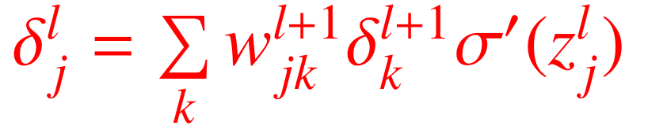
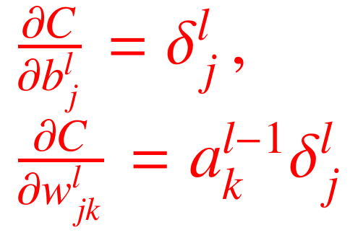
Обучение НС: алгоритм обратного распространения ошибки.
(I)
(II)
(II)
(III)
(IV)

Slide 8
Итак:
Задать активацию входного слоя
Прямое прохождение
Выходная ошибка
Обратное распространение ошибки
Вычисление градиента функции стоимости
Коррекция весов и смещений

Slide 9
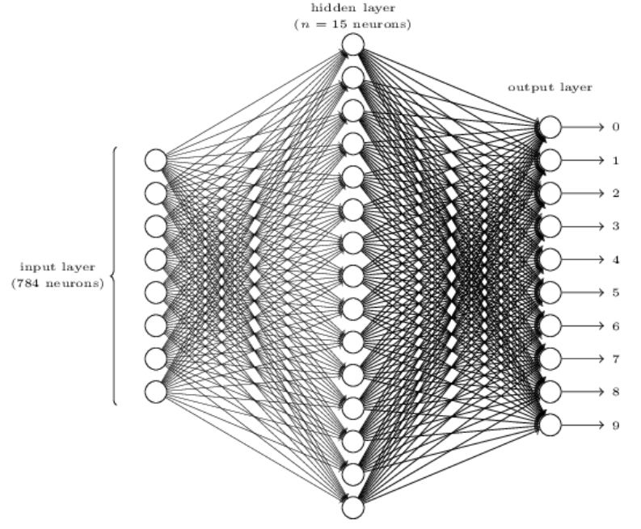

Пример: сеть для распознавания цифр,
Michael Nielsen, http://neuralnetworksanddeeplearning.com/index.html
28px
28px

Slide 10
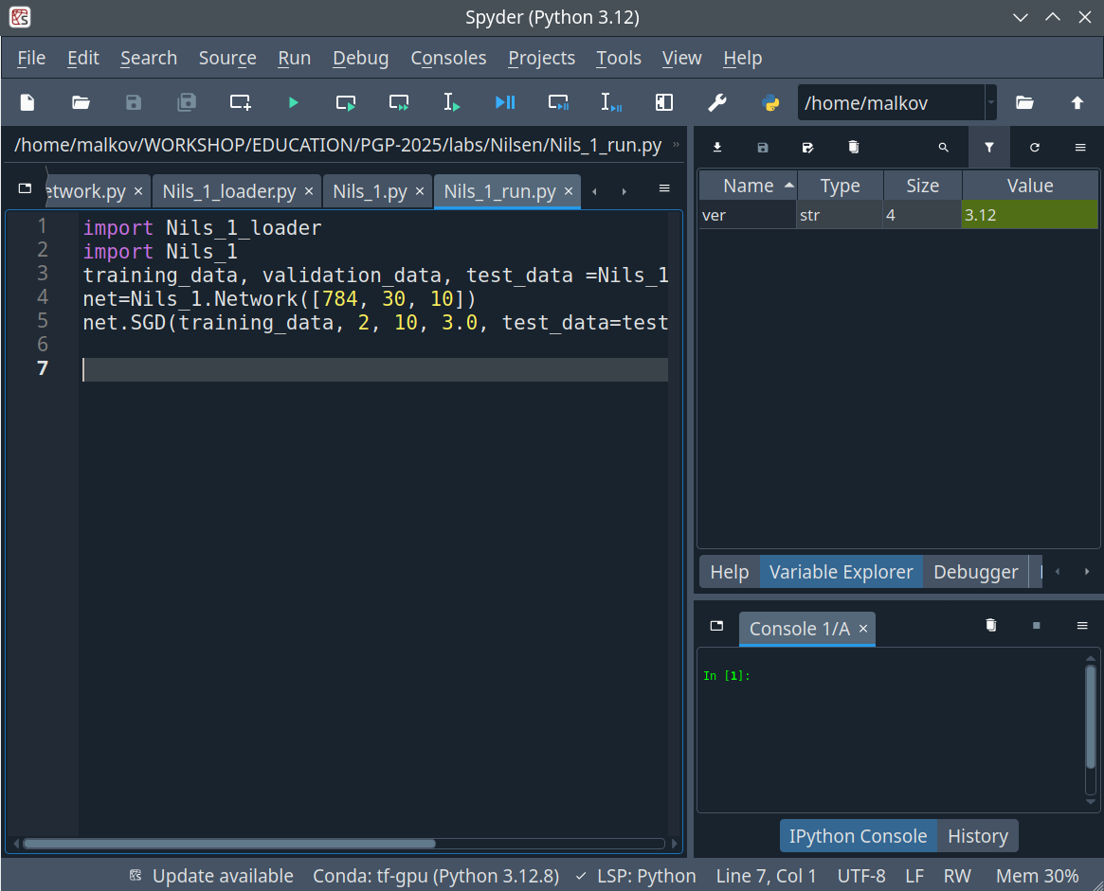
malkov@192:~/> conda create --name tf-gpu python=3.12 tensorflow-gpu
malkov@192:~/PGP-2025/labs/Nilsen> conda activate tf-gpu
(tf-gpu) malkov@192:~/PGP-2025/labs/Nilsen> spyder &
[ conda create --name tf-gpu2 python=2.7 tensorflow-gpu ]

Slide 11
Инициализация архитектуры сети, весов и смещений
import Nils_1
net=Nils_1.Network([784, 30, 10])
……………………………………………………………………………………………………..
Nils_1_run.py
class Network(object):
def __init__(self, sizes):
self.num_layers = len(sizes)
self.sizes = sizes
self.biases = [np.random.randn(y, 1) for y in sizes[1:]]
self.weights = [np.random.randn(y, x)
for x, y in zip(sizes[:-1], sizes[1:])]
………………………………………………………………………………………..
Nils_1.py

Slide 12
Загрузка данных для обучения
import Nils_1_loader
training_data, validation_data, test_data =Nils_1_loader.load_data_wrapper()
…………………………………………………………………………………………...
https://www.kaggle.com/datasets/pablotab/mnistpklgz
import pickle
import gzip
def load_data():
f = gzip.open('../data/mnist.pkl.gz', 'rb')
training_data, validation_data, test_data = pickle.load(f, encoding='latin1')
f.close()
return (training_data, validation_data, test_data)
Nils_1_loader.py

Slide 13

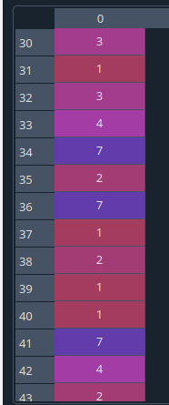
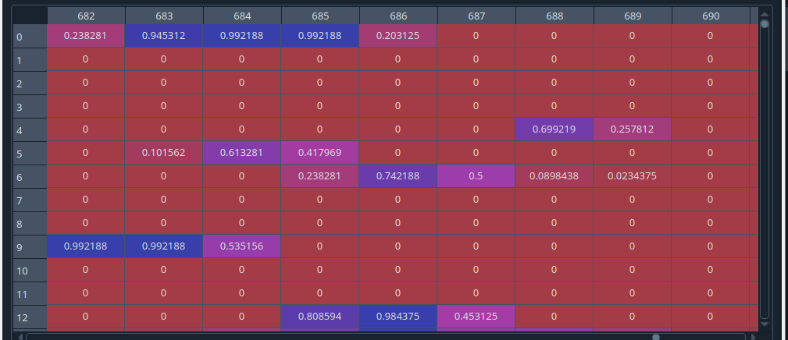
training_data
Кортеж из двух элементов:

Slide 14
import numpy as np
def load_data_wrapper():
tr_d, va_d, te_d = load_data()
training_inputs = [np.reshape(x, (784, 1)) for x in tr_d[0]]
training_results = [vectorized_result(y) for y in tr_d[1]]
training_data = list(zip(training_inputs, training_results))
validation_inputs = [np.reshape(x, (784, 1)) for x in va_d[0]]
validation_data = list(zip(validation_inputs, va_d[1]))
test_inputs = [np.reshape(x, (784, 1)) for x in te_d[0]]
test_data = list(zip(test_inputs, te_d[1]))
return (training_data, validation_data, test_data)
def vectorized_result(j):
e = np.zeros((10, 1))
e[j] = 1.0
return e
Реструктури - рование данных

Slide 15
0
0
training_results = [vectorized_result(y) for y in tr_d[1]]
0
0
def vectorized_result(j):
e = np.zeros((10, 1))
e[j] = 1.0
return e
0
0
7
0
0
0
1
0
0

Slide 16
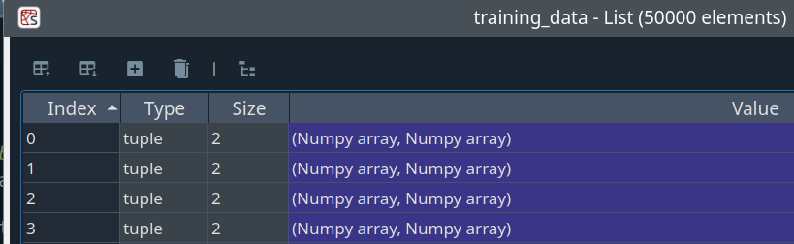
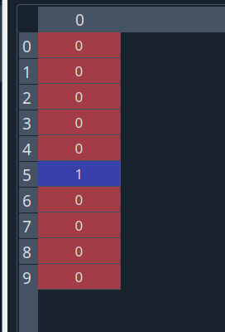
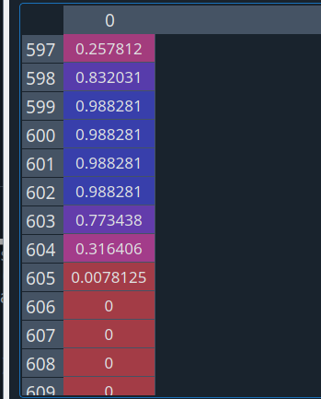
После реструктурирования данных.

Slide 17
Реализация градиентного спуска
net.SGD(training_data, 20, 10, 3.0, test_data=test_data)
def SGD(self, training_data, epochs, mini_batch_size, eta, test_data=None):
if test_data: n_test = len(test_data)
n = len(training_data)
for j in range(epochs):
random.shuffle(training_data)
mini_batches = [
training_data[k:k+mini_batch_size]
for k in range(0, n, mini_batch_size)]
for mini_batch in mini_batches:
self.update_mini_batch(mini_batch, eta)
if test_data:
print( "Epoch {0}: {1} / {2}".format(
j, self.evaluate(test_data), n_test))
else:
print( "Epoch {0} complete".format(j))

Slide 18
Тестовый прогон
if test_data:
print( "Epoch {0}: {1} / {2}".format(
j, self.evaluate(test_data), n_test))
else:
print( "Epoch {0} complete".format(j))
def feedforward(self, a):
for b, w in zip(self.biases, self.weights):
a = sigmoid(np.dot(w, a)+b)
return a
def evaluate(self, test_data):
test_results = [(np.argmax(self.feedforward(x)), y)
for (x, y) in test_data]
return sum(int(x == y) for (x, y) in test_results)

Slide 19
(tf-gpu) malkov@192:~/PGP-2025/labs/Nilsen> python Nils_1_run.py
Epoch 0: 9123 / 10000
Epoch 1: 9257 / 10000
Epoch 2: 9355 / 10000
Epoch 3: 9360 / 10000
Epoch 4: 9407 / 10000
Epoch 5: 9422 / 10000
Epoch 6: 9435 / 10000

Slide 20
def update_mini_batch(self, mini_batch, eta):
nabla_b = [np.zeros(b.shape) for b in self.biases]
nabla_w = [np.zeros(w.shape) for w in self.weights]
for x, y in mini_batch:
delta_nabla_b, delta_nabla_w = self.backprop(x, y)
nabla_b = [nb+dnb for nb, dnb in zip(nabla_b, delta_nabla_b)]
nabla_w = [nw+dnw for nw, dnw in zip(nabla_w, delta_nabla_w)]
self.weights = [w-(eta/len(mini_batch))*nw
for w, nw in zip(self.weights, nabla_w)]
self.biases = [b-(eta/len(mini_batch))*nb
for b, nb in zip(self.biases, nabla_b)]

Slide 21
def backprop(self, x, y):
nabla_b = [np.zeros(b.shape) for b in self.biases]
nabla_w = [np.zeros(w.shape) for w in self.weights]
activation = x
activations = [x]
zs = []
for b, w in zip(self.biases, self.weights):
z = np.dot(w, activation)+b
zs.append(z)
activation = sigmoid(z)
activations.append(activation)
delta = self.cost_derivative(activations[-1], y) * \
sigmoid_prime(zs[-1])
nabla_b[-1] = delta
nabla_w[-1] = np.dot(delta, activations[-2].transpose())

Slide 22
for l in range(2, self.num_layers):
z = zs[-l]
sp = sigmoid_prime(z)
delta = np.dot(self.weights[-l+1].transpose(), delta) * sp
nabla_b[-l] = delta
nabla_w[-l] = np.dot(delta, activations[-l-1].transpose())
return (nabla_b, nabla_w)
def cost_derivative(self, output_activations, y):
return (output_activations-y)
def sigmoid(z):
return 1.0/(1.0+np.exp(-z))
def sigmoid_prime(z):
return sigmoid(z)*(1-sigmoid(z))

