Slide 1
Лекция 10
Python+CUDA
● CUDA Python:
https://developer.nvidia.com/how-to-cuda-python
● [PyCUDA: https://documen.tician.de/pycuda]

Slide 2
Сравненние производительности кодов, генерируемых
компилятором Numba
import numpy as np
from pylab import imshow, show
from time import perf_counter_ns as timer
def mandel(x, y, max_iters):
c = complex(x, y)
z = 0.0j
for i in range(max_iters):
z = z*z + c
if (z.real*z.real + z.imag*z.imag) >= 4:
return i
return max_iters
http://nbviewer.jupyter.org/gist/harrism/f5707335f40af9463c43

Slide 3
def create_fractal(min_x, max_x, min_y, max_y, image, iters):
height = image.shape[0]
#размерности двумерного массива
width = image.shape[1]
pixel_size_x = (max_x - min_x) / width
pixel_size_y = (max_y - min_y) / height
#задание размеров пикселя
for x in range(width):
real = min_x + x * pixel_size_x
for y in range(height):
imag = min_y + y * pixel_size_y
color = mandel(real, imag, iters)
image[y, x] = color

Slide 4
#задание цвета пикселя
image = np.zeros((1024, 1536), dtype = np.uint8)
start = timer()
create_fractal(-2.0, 1.0, -1.0, 1.0, image, 20)
dt = timer() - start
dt/=1000000
print ("Mandelbrot created in %f ms" % dt)
imshow(image)
show()

Slide 5
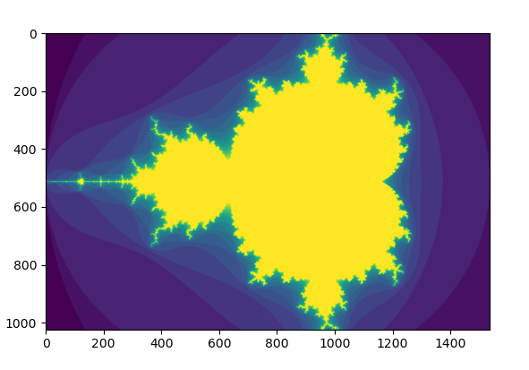
/Lab10> python mandel.py
Mandelbrot created in 3332.904220 ms

Slide 6
import numpy as np
from pylab import imshow, show
from time import perf_counter_ns as timer
from numba import jit
@jit
def mandel(x, y, max_iters):
c = complex(x, y)
z = 0.0j
for i in range(max_iters):
z = z*z + c
if (z.real*z.real + z.imag*z.imag) >= 4:
return i
return max_iters

Slide 7
@jit
def create_fractal(min_x, max_x, min_y, max_y, image, iters):
height = image.shape[0]
width = image.shape[1]
pixel_size_x = (max_x - min_x) / width
pixel_size_y = (max_y - min_y) / height
for x in range(width):
real = min_x + x * pixel_size_x
for y in range(height):
imag = min_y + y * pixel_size_y
color = mandel(real, imag, iters)
image[y, x] = color

Slide 8
image = np.zeros((1024, 1536), dtype = np.uint8)
start = timer()
create_fractal(-2.0, 1.0, -1.0, 1.0, image, 20)
dt = timer() - start
dt/=1000000
print ("Mandelbrot created in %f ms" % dt)
imshow(image)
show()

Slide 9
Lab10> python mandel_numba.py
Mandelbrot created in 250.150089 ms

Slide 10
import numpy as np
from pylab import imshow, show
#from timeit import default_timer as timer
from time import perf_counter_ns as timer
from numba import cuda
from numba import *
@cuda.jit('f8, f8, uint32', device=True)
def mandel(x, y, max_iters):
c = complex(x, y)
z = 0.0j
for i in range(max_iters):
z = z*z + c
if (z.real*z.real + z.imag*z.imag) >= 4:
return i
return max_iters

Slide 11
@cuda.jit('f8, f8, f8, f8, uint8[:,:], uint32')
def create_fractal(min_x, max_x, min_y, max_y, image, iters):
height = image.shape[0]
#размерности двумерного массива
width = image.shape[1]
pixel_size_x = (max_x - min_x) / width
pixel_size_y = (max_y - min_y) / height
startX, startY = cuda.grid(2) #threadIdx.x+blockDim.x*blockIdx.x,...
gridX = cuda.gridDim.x * cuda.blockDim.x;
gridY = cuda.gridDim.y * cuda.blockDim.y;
for x in range(startX, width, gridX): #если width>gridX
real = min_x + x * pixel_size_x
for y in range(startY, height, gridY):
imag = min_y + y * pixel_size_y
image[y, x] = mandel(real, imag, iters)

Slide 12
image = np.zeros((1024, 1536), dtype = np.uint8)
blockdim = (32, 8)
griddim = (32,16)
d_image = cuda.to_device(image)
create_fractal[griddim, blockdim](-2.0, 1.0, -1.0, 1.0, d_image, 20)
cuda.synchronize()
start = timer()
d_image = cuda.to_device(image)
create_fractal[griddim, blockdim](-2.0, 1.0, -1.0, 1.0, d_image, 20)
cuda.synchronize()
dt = timer() - start
dt/=1000000
print ("Mandelbrot created in %f ms" % dt)
imshow(d_image)
show()

Slide 13
/Lab10> python mandel_cuda.py
Mandelbrot created in 2.216281 ms
/Lab10> nvprof python mandel_cuda.py
Type Time(%) Time Calls Avg Min Max Name
GPU activities: 93.77% 4.3107ms 2 2.1554ms 2.1450ms 2.1657ms cudapy::__main__::create_fractal$242(double, double, double, double, Array<unsigned char, int=2, A, mutable, aligned>, unsigned int)

Slide 14
Технология | Время выполнения мс | Ускорение
Python интерпретатор | 3332.90 | 1
Numba jit | 250.15 | 13.32
CUDA | 2.16 | 1543.01

