Slide 1
Лекция 4
Инструменты профилирования:
nvprof
Nsight Compute CLI
nvvp
Nsight Compute

Slide 2
nvprof и Nsight Compute CLI
__global__ void gInit(float* a, float* b){
int i=threadIdx.x+blockIdx.x*blockDim.x;
a[i]=(float)2*i;
b[i]=(float)(2*i+1);
}
__global__ void gSum(float* a, float *b){
int i=threadIdx.x+blockIdx.x*blockDim.x;
a[i]+=b[i];
}
Тестовые ядра

Slide 3
ip-011@linux-47dw:/home/malkov/WORKSHOP/PGP-2023>
nvprof ./lab3c
Type Time(%) Time Calls Avg Min Max Name
GPU activities:
43.59% 2.1760us 1 2.1760us 2.1760us
2.1760us gSum(int*, int*)
41.67% 2.0800us 1 2.0800us 2.0800us
2.0800us gInit(int*, int*)
14.74% 736ns 1 736ns 736ns 736ns [CUDA memcpy DtoH]
API calls:
98.87% 131.54ms 2 65.772ms 6.9650us 131.54ms cudaMalloc
………………………………………………………………………………………………………………………..
0.09% 124.46us 2 62.229us 10.561us 113.90us cudaFree
…………………………………………………………………………………………………………………………………………
0.01% 14.599us 1 14.599us 14.599us 14.599us
cudaMemcpy

Slide 4
/Lecture3/Lab3-cuda-gdb # ncu --target-processes all ./lab3c
gInit(int *, int *), 2023-Feb-13 15:09:06, Context 1, Stream 7
Section: GPU Speed Of Light Throughput
--------------------------------------------------------
DRAM Frequency cycle/nsecond 6.40
SM Frequency cycle/nsecond 1.29
Elapsed Cycles cycle 3,327
Memory [%] % 1.10
DRAM Throughput % 0.02
Duration usecond 2.56
--------------- ------------------------------
WRN This kernel grid is too small to fill the available resources on this device, resulting in only 0.0 full
waves across all SMs. Look at Launch Statistics for more details.
………………………………………………………………………………………………………………………………………………………………

Slide 5
/Lecture3/Lab3-cuda-gdb # ncu
--metrics gpu__time_duration.sum ./lab3c
gInit(int *, int *), 2023-Feb-13 18:42:52, Context 1, Stream 7
Section: Command line profiler metrics
------ --------------- ------------------------------
gpu__time_duration.sum usecond 29.50 ------------------------------------------------------------
gSum(int *, int *), 2023-Feb-13 18:42:52, Context 1, Stream 7
Section: Command line profiler metrics ------------------------------------------------------------
gpu__time_duration.sum usecond 37.57 ---------------------------------------------------------------

Slide 6
/Lecture3/Lab3-cuda-gdb> nvprof --query-metrics
======== Warning: Skipping profiling on device 0 since profiling is not supported on devices with compute capability 7.5 and higher.
Use NVIDIA Nsight Compute for GPU profiling and NVIDIA Nsight Systems for GPU tracing and CPU sampling.
Refer https://developer.nvidia.com/tools-overview for more details.

Slide 7
ip-011@linux-47dw:/home/malkov/WORKSHOP/PGP-2023>
nvprof --query-metrics | less
Available Metrics: Name Description
Device 0 (GeForce GTX 1050):
inst_per_warp: Average number of instructions executed by each warp
warp_execution_efficiency: Ratio of the average active threads per warp to the maximum number of
threads per warp supported on a multiprocessor
……………………………………………………………………………………………………………………………………………….
gld_transactions_per_request: Average number of global memory load transactions performed for each global memory load.
gst_transactions_per_request: Average number of global memory store transactions performed for each global memory store
……………………………………………………………………………………………………………………..

Slide 8
ip-011@linux-47dw:/home/malkov/WORKSHOP/PGP-2023>
nvprof -m gst_throughput ./lab3c
Invocations Metric Name Metric Description Min Max Avg
Device "GeForce GTX 1050 (0)"
Kernel: gSum(int*, int*)
1 gst_throughput Global Store Throughput 40.582MB/s
40.582MB/s 40.582MB/s
Kernel: gInit(int*, int*)
1 gst_throughput Global Store Throughput 71.303MB/s
71.303MB/s 71.302MB/s

Slide 9
/Лекция4/lab4> ncu --list-sections
Identifier Display Name Enabled Filename
--------------------------------------------
ComputeWorkloadAnalysis Compute Workload Analysis yes ...2024.2.1/Sections/
ComputeWorkloadAnalysis.section
InstructionStats Instruction Statistics yes ...2024.2.1/Sections/
InstructionStatistics.section
LaunchStats Launch Statistics yes ...2024.2.1/Sections/
LaunchStatistics.section
MemoryWorkloadAnalysis Memory Workload Analysis yes …
………………………………………………………………………………………………

Slide 10
/Лекция4/lab4> ncu --section InstructionStats ./lab4c
gInit(float *, float *) (2, 1, 1)x(128, 1, 1), Context 1, Stream 7, Device 0, CC 7.5
Section: Instruction Statistics
---------------------------------------- ----------- ------------
Metric Name Metric Unit Metric Value
---------------------------------------- ----------- ------------
Avg. Executed Instructions Per Scheduler inst 0,93
Executed Instructions inst 112
Avg. Issued Instructions Per Scheduler inst 1,27
Issued Instructions inst 152
---------------------------------------- ----------- ------------
gSum(float *, float *) (2, 1, 1)x(128, 1, 1), Context 1, Stream 7, Device 0, CC 7.5
Section: Instruction Statistics
—--------------------------------------------------------

Slide 11
/Лекция4/lab4> ncu --section ComputeWorkloadAnalysis ./lab4c
gSum(float *, float *) (2, 1, 1)x(128, 1, 1), Context 1, Stream 7, Device 0, CC 7.5
Section: Compute Workload Analysis
-------------------- ----------- ------------
Metric Name Metric Unit Metric Value
-------------------- ----------- ------------
Executed Ipc Active inst/cycle 0,04
Executed Ipc Elapsed inst/cycle 0,00
Issue Slots Busy % 1,35
Issued Ipc Active inst/cycle 0,05
SM Busy % 1,35
-------------------- ----------- ------------
OPT Est. Local Speedup: 99.33%
All compute pipelines are under-utilized. Either this kernel is very small
or it doesn't issue enough warps per scheduler. Check the Launch Statistics and Scheduler Statistics sections for further details.

Slide 12
/Лекция4/lab4> ncu --query-metrics > metrics.txt
Device NVIDIA GeForce RTX 2060 (TU104)
--------------------------------------------------------------------------- --------------- ---------------
Metric Name Metric Type Metric Unit Metric Description
--------------------------------------------------------------------------- --------------- ---------------
dram__bytes Counter byte # of bytes accessed in DRAM
dram__bytes_read Counter byte # of bytes read from DRAM
dram__bytes_write Counter byte # of bytes written to DRAM
………………………………………………………………………………..
smsp__average_inst_executed_pipe_lsu_per_warp Ratio inst/warp
average # of instructions executed by pipe lsu per warp
……………………………………………………………………………………………………

Slide 13
/Лекция4/lab4> ncu --metrics l1tex__t_bytes_pipe_lsu_mem_global_op_st.sum.per_second ./lab4c
gInit(float *, float *) (2, 1, 1)x(128, 1, 1), Context 1, Stream 7, Device 0, CC 7.5
Section: Command line profiler metrics
------------------------------------------------------- ----------- ------------
Metric Name Metric Unit Metric Value
------------------------------------------------------- ----------- ------------
l1tex__t_bytes_pipe_lsu_mem_global_op_st.sum.per_second Mbyte/s 688,17
------------------------------------------------------- ----------- ------------
gSum(float *, float *) (2, 1, 1)x(128, 1, 1), Context 1, Stream 7, Device 0, CC 7.5
Section: Command line profiler metrics
------------------------------------------------------- ----------- ------------
Metric Name Metric Unit Metric Value
------------------------------------------------------- ----------- ------------
l1tex__t_bytes_pipe_lsu_mem_global_op_st.sum.per_second Mbyte/s 347,83
------------------------------------------------------- ----------- ------------

Slide 14
Кодирование метрики ncu:
l1tex__t_bytes_pipe_lsu_mem_global_op_st.sum.per_second ./lab4c
L1 cache
Тип данных
load/store unit (конвейер)
Глобальная память
Операция сохранения

Slide 15
ip-011@linux-47dw:/home/malkov/WORKSHOP/PGP-2023>
nvprof -m gld_throughput ./lab3c
Invocations Metric Name Metric Description Min Max Avg
Device "GeForce GTX 1050 (0)"
Kernel: gInit(int*, int*)
1 gld_throughput Global Load Throughput 0.0B/s 0.0B/s 0.0B/s
Kernel: gSum(int*, int*)
1 gld_throughput Global Load Throughput 87.694MB/s
87.694MB/s 87.694MB/s

Slide 16
/Lecture3/Lab3-cuda-gdb # ncu --metrics
l1tex__t_bytes_pipe_lsu_mem_global_op_ld.sum.per_second ./lab3c
gInit(int *, int *), 2023-Feb-13 15:25:41, Context 1, Stream 7
Section: Command line profiler metrics
---------------------------------------------------
l1tex__t_bytes_pipe_lsu_mem_global_op_ld.sum.per_second byte/second 0
------------------------------------------------
gSum(int *, int *), 2023-Feb-13 15:25:41, Context 1, Stream 7
Section: Command line profiler metrics
---------------------------------------------------------
l1tex__t_bytes_pipe_lsu_mem_global_op_ld.sum.per_second Mbyte/second 82.47
-------------------------------------------------------

Slide 17
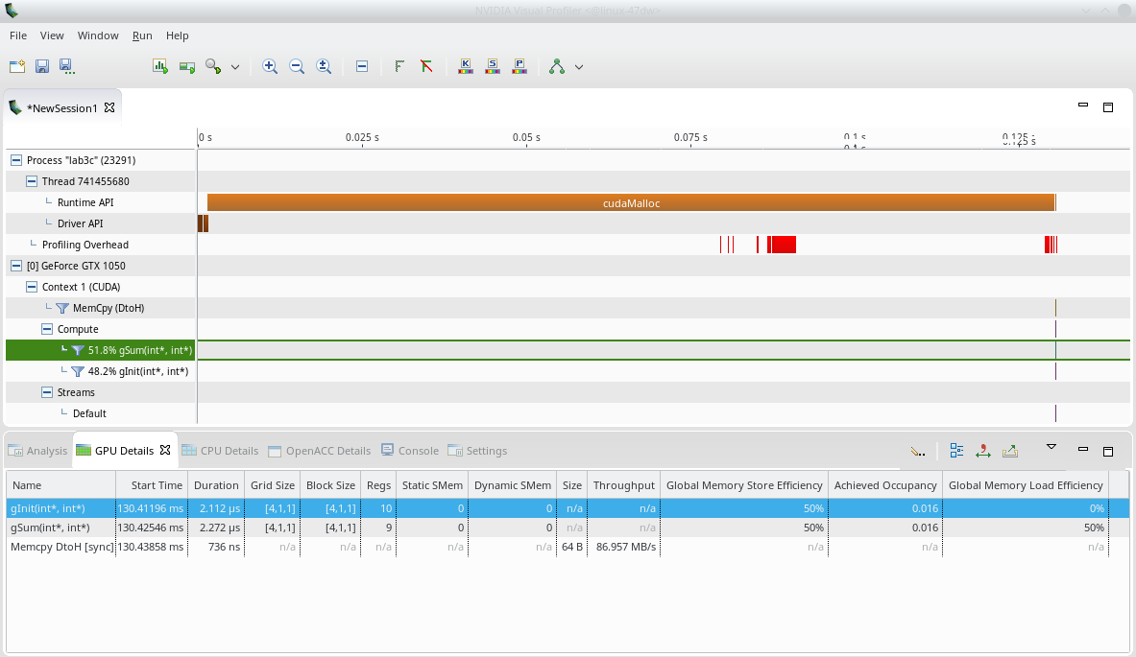
nvvp и Nsight Compute
ip-011@linux-47dw:/home/malkov/WORKSHOP/PGP-2023> nvvp ./lab3c

Slide 18
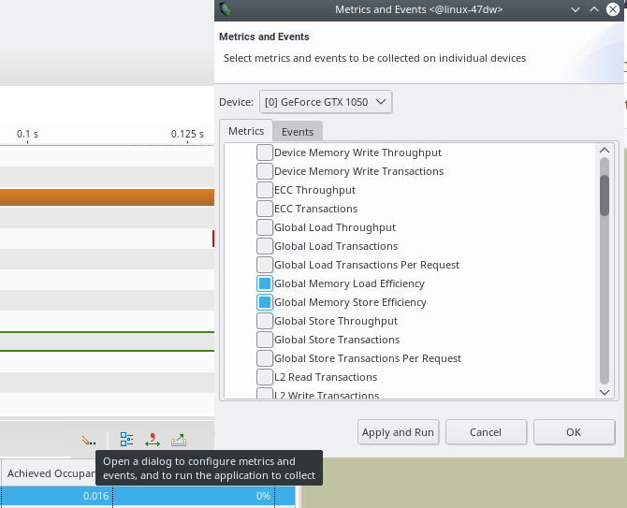

Slide 19
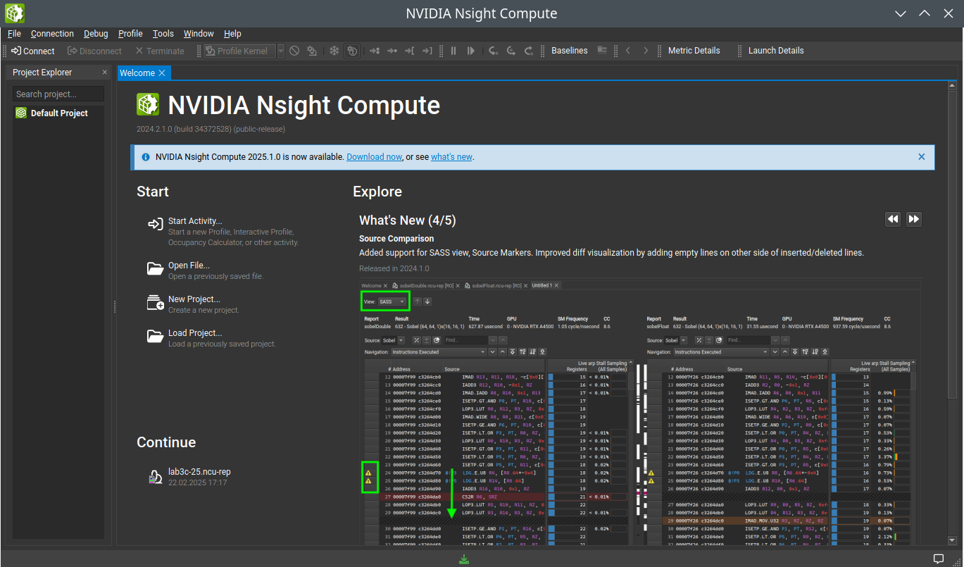
/Лекция4/lab4> ncu-ui &

Slide 20
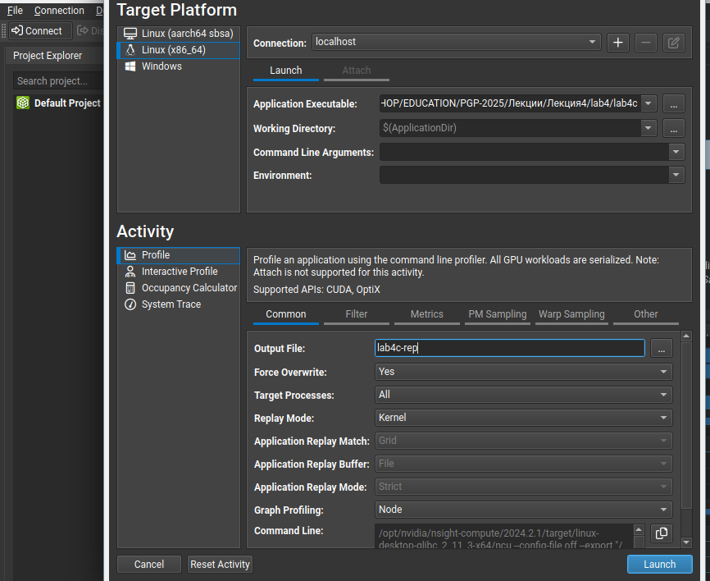

Slide 21
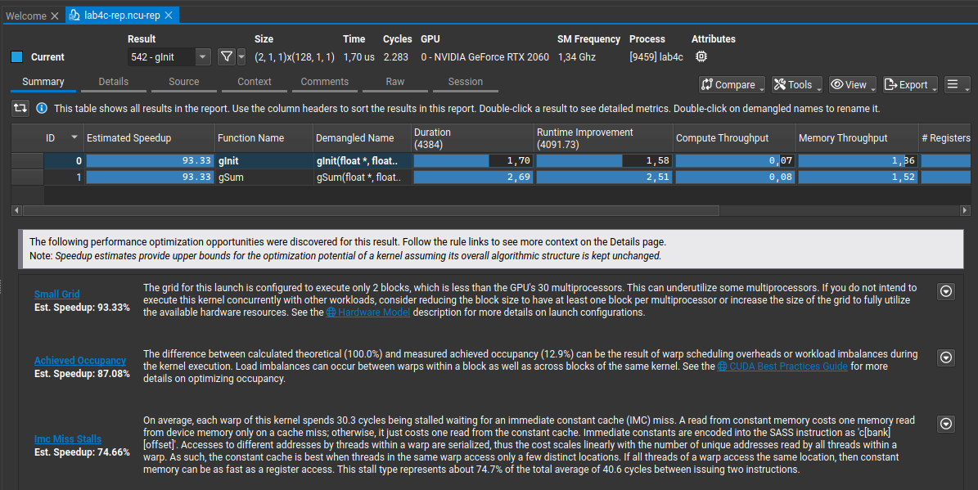

Slide 22
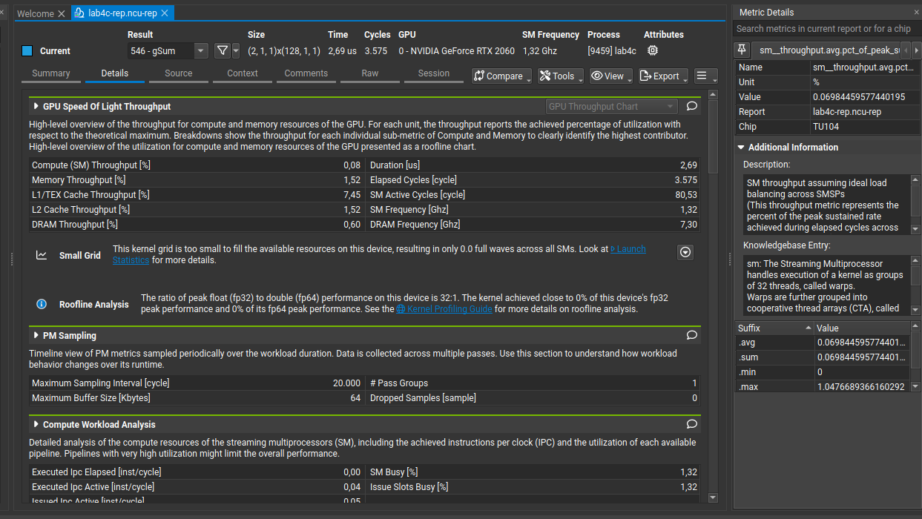

Slide 23
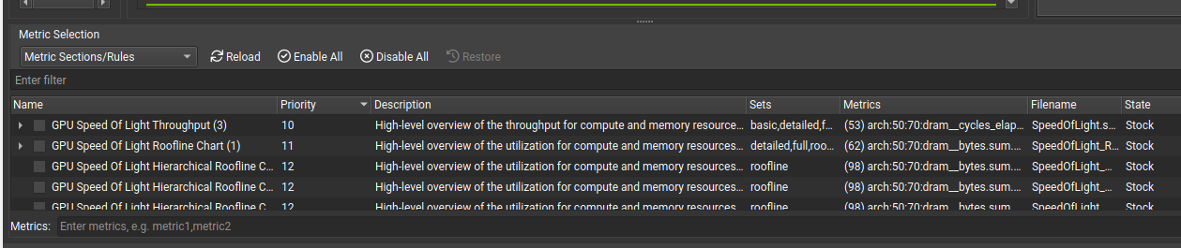

Slide 24
