Slide 1
Лекция 11
Параллелизм по задачам.
Потоки CUDA (CUDA Stream).
Одновременное выполнение ядер.
Одновременное копирование и выполнение ядра.
Использование нескольких GPU.

Slide 2
Потоки CUDA (CUDA Streams)
Stream 1
Kernel1
Stream 0
Kernel01
Kernel02
CPU
cudaMalloc
Kernel01
Kernel02
Kernel1
cudaMemcpy
cudaDeviceSynchronize или cudaStreamSynchronize(stream0) и cudaStreamSynchronize(stream1)
Время, t

Slide 3
#include <stdio.h>
#include <malloc.h>
__global__ void gTest(int step){
int n=threadIdx.x + blockIdx.x*blockDim.x;
printf("kernel, thIdx: %d\t%d\n", step, n);
}
int main(){
int NS=3;
for (int i = 0; i < NS; i++)
gTest<<< i+1, 32>>>(i);
cudaDeviceSynchronize();
return 0;
}

Slide 4
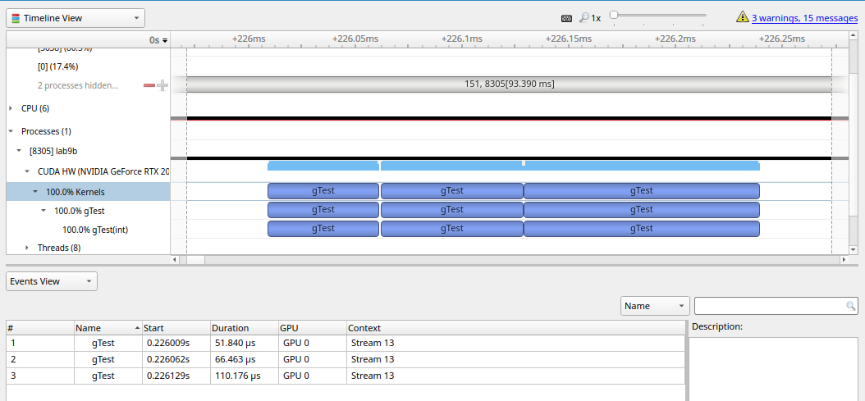

Slide 5
__global__ void gTest(int step){
int n=threadIdx.x + blockIdx.x*blockDim.x;
printf("kernel, thIdx: %d\t%d\n", step, n);
}
int main(){
int NS = 3;
cudaStream_t *streams;
streams = (cudaStream_t*)calloc(NS, sizeof(cudaStream_t));
for (int i = 0; i < NS; i++)
cudaStreamCreate(&streams[i]);

Slide 6
for (int i = 0; i < NS; i++)
gTest<<< i+1, 32, 0, streams[i] >>>(i);
cudaDeviceSynchronize();
for (int i = 0; i < num_streams; i++)
cudaStreamDestroy(streams[i]);
free(streams);
return 0;
}

Slide 7
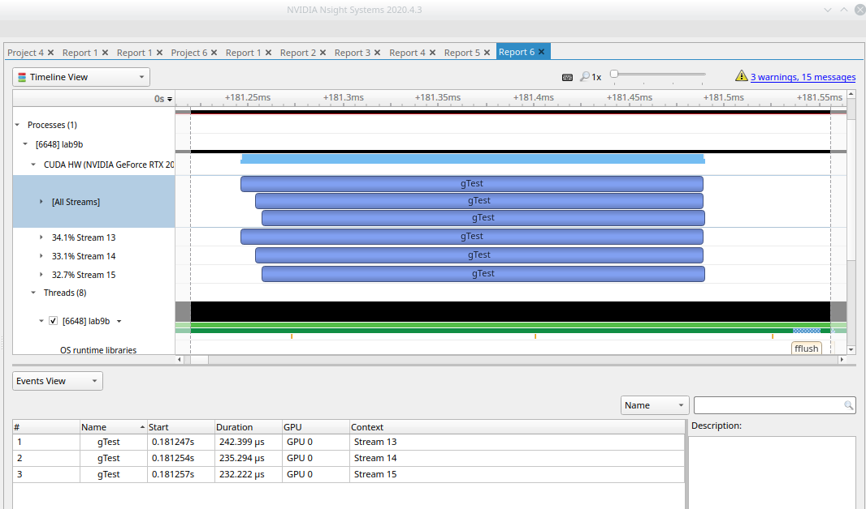

Slide 8
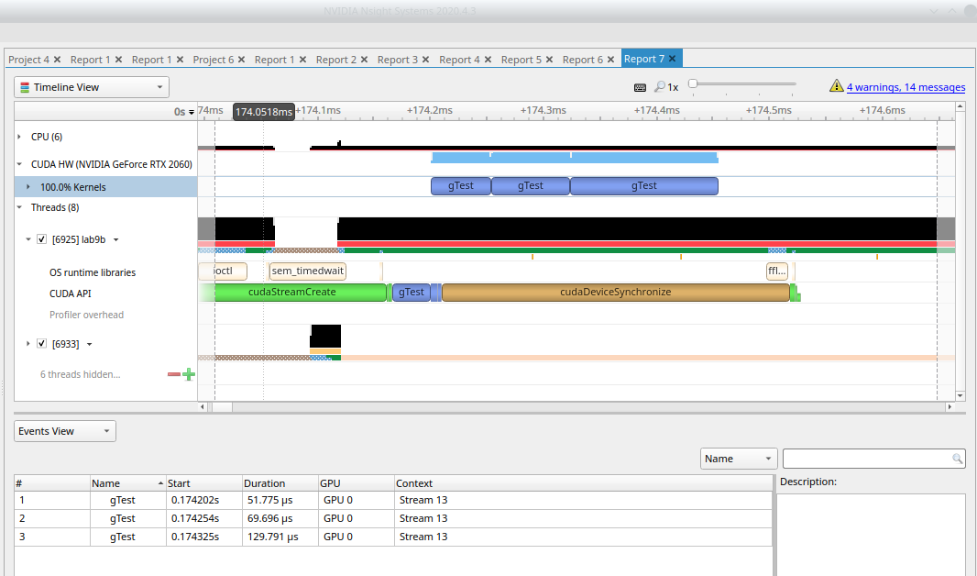

Slide 9
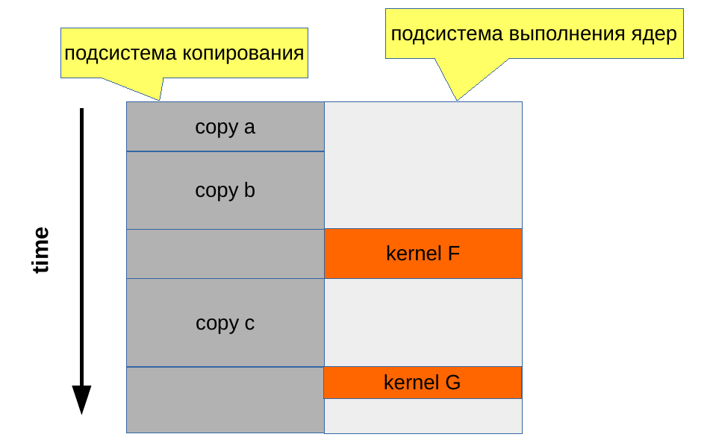
Device 0: "NVIDIA GeForce RTX 2060"
CUDA Driver Version / Runtime Version 12.0 / 11.1
CUDA Capability Major/Minor version number: 7.5
……………………………………………………………………..
Concurrent copy and kernel execution: Yes with 3 copy engine(s)

Slide 10
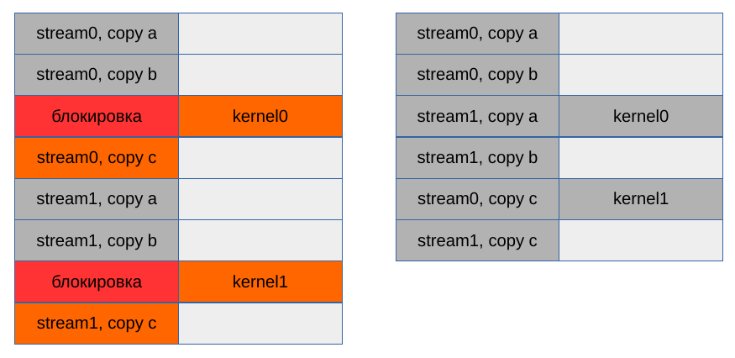
Потоки CUDA и разрешение зависимостей при
распараллеливании копирования и выполнения
Очередь копир. Очередь выполн.
Очередь копир. Очередь выполн.

Slide 11
#define N (1024*1024)
#define FULL_DATA_SIZE (N*20)
__global__ void kernel(int* a, int* b, int* c){
int idx=threadIdx.x+blockIdx.x*blockDim.x;
if(idx<N){
int idx1=(idx+1)%256;
int idx2=(idx+2)%256;
float as=(a[idx]+a[idx1]+a[idx2])/3.0f;
float bs=(b[idx]+b[idx1]+b[idx2])/3.0f;
c[idx]=(as+bs)/2;
}
}

Slide 12
int main(){
cudaDeviceProp prop;
int whichDevice;
cudaGetDevice(&whichDevice);
cudaGetDeviceProperties(&prop, whichDevice);
if(!prop.deviceOverlap){
printf("Device does not support overlapping\n");
return 0;
}

Slide 13
int *host_a, *host_b, *host_c;
int *dev_a, *dev_b, *dev_c;
cudaMalloc( (void**)&dev_a, N*sizeof(int)) ;
cudaMalloc( (void**)&dev_b, N*sizeof(int)) ;
cudaMalloc( (void**)&dev_c, N*sizeof(int)) ;
cudaMallocHost( (void**)&host_a, FULL_DATA_SIZE*sizeof(int)) ;
cudaMallocHost( (void**)&host_b, FULL_DATA_SIZE*sizeof(int)) ;
cudaMallocHost( (void**)&host_c, FULL_DATA_SIZE*sizeof(int)) ;
Выделение прикрепленной памяти (pinned memory) на хосте.

Slide 14
for(int i=0; i<FULL_DATA_SIZE;i++){
host_a[i]=rand();
host_b[i]=rand();
}
cudaStream_t stream;
cudaStreamCreate(&stream);
for(int i=0; i<FULL_DATA_SIZE; i+=N){
cudaMemcpyAsync(dev_a, host_a+i, N*sizeof(int),
cudaMemcpyHostToDevice, stream);
cudaMemcpyAsync(dev_b, host_b+i, N*sizeof(int),
cudaMemcpyHostToDevice, stream);
kernel<<<N/256, 256, 0, stream>>>(dev_a, dev_b, dev_c);
cudaMemcpyAsync(host_c+i, dev_c, N*sizeof(int),
cudaMemcpyDeviceToHost, stream);
}
cudaStreamSynchronize( stream );

Slide 15
cudaFreeHost(host_a);
cudaFreeHost(host_b);
cudaFreeHost(host_c);
cudaFree(dev_a);
cudaFree(dev_b);
cudaFree(dev_c);
cudaStreamDestroy(stream);
return 0;
}

Slide 16
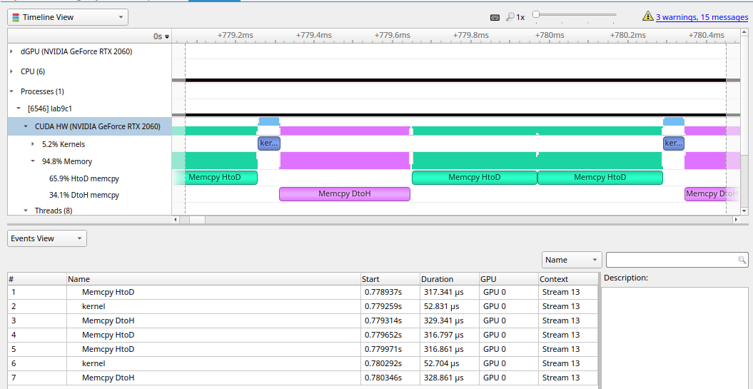

Slide 17
cudaStream_t stream0, stream1;
cudaStreamCreate(&stream0);
cudaStreamCreate(&stream1);
cudaStreamSynchronize( stream0) ;
cudaStreamSynchronize( stream1);
……..……………………………………….
cudaStreamDestroy(stream0);
cudaStreamDestroy(stream1);
……………………………………………….
for(int i=0; i<FULL_DATA_SIZE;...

Slide 18
for(int i=0; i<FULL_DATA_SIZE; i+=N*2){
cudaMemcpyAsync(dev_a0, host_a+i, N*sizeof(int),
cudaMemcpyHostToDevice, stream0);
cudaMemcpyAsync(dev_a1, host_a+i+N, N*sizeof(int),
cudaMemcpyHostToDevice, stream1);
cudaMemcpyAsync(dev_b0, host_b+i, N*sizeof(int),
cudaMemcpyHostToDevice, stream0);
cudaMemcpyAsync(dev_b1, host_b+i+N, N*sizeof(int),
cudaMemcpyHostToDevice, stream1);
kernel<<<N/256, 256, 0, stream0>>>(dev_a0, dev_b0, dev_c0);
kernel<<<N/256, 256, 0, stream1>>>(dev_a1, dev_b1, dev_c1);
cudaMemcpyAsync(host_c+i, dev_c0, N*sizeof(int),
cudaMemcpyDeviceToHost, stream0);
cudaMemcpyAsync(host_c+i+N, dev_c1, N*sizeof(int),
cudaMemcpyDeviceToHost, stream1);
}

Slide 19
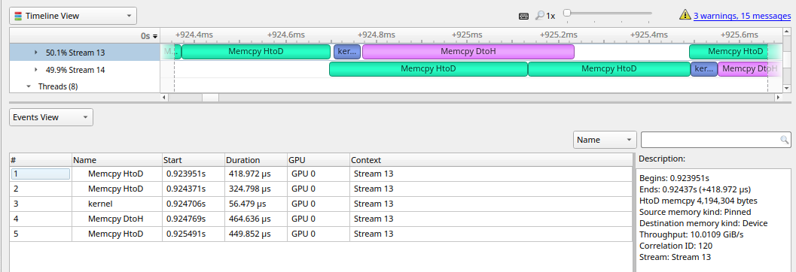

Slide 20
Использование нескольких GPU
#include <stdio.h>
#define REAL float
__global__ void initFun(int* nf, int devnum){
int n=threadIdx.x + blockIdx.x*blockDim.x;
nf[n]*=10;
}

Slide 21
int main(int argc, char* argv[]){
if(argc<4){
fprintf(stderr, "USAGE: <prog_name> <size_of_array> <num_of_devices>"
"<device_indices>\n");
return -1;
}
int N=atoi(argv[1]);

Slide 22
int* info_devs=(int*)calloc(argc-2, sizeof(int));
info_devs[0]=atoi(argv[2]);
for(int i=1;i<argc-2;i++){
info_devs[i]=atoi(argv[i+2]);
}
fprintf(stderr,"num of devices: %d\n",info_devs[0]);
for(int i=1;i<argc-2;i++)
fprintf(stderr,"i_d=%d\n",info_devs[i]);
int** nfd=(int**)calloc(info_devs[0], sizeof(int*));
int** nfh=(int**)calloc(info_devs[0], sizeof(int*));

Slide 23
cudaStream_t* streams;
streams=(cudaStream_t*)calloc(info_devs[0], sizeof(cudaStream_t));
for(int i=0;i<info_devs[0];i++){
cudaSetDevice(info_devs[i+1]);
cudaStreamCreate(&streams[i]);
cudaMalloc((void**)&nfd[i], (N/info_devs[0])*sizeof(int));
cudaMallocHost((void**)&nfh[i], (N/info_devs[0])*sizeof(int));
for(int n=0;n<N/info_devs[0]; n++)
nfh[i][n]=n+i*N/info_devs[0];

Slide 24
cudaMemcpyAsync(nfd[i],nfh[i],
(N/info_devs[0])*sizeof(int),
cudaMemcpyHostToDevice, streams[i]);
initFun<<<N/info_devs[0]/32, 32, 0, streams[i]>>>(nfd[i],i);
cudaMemcpyAsync(nfh[i],nfd[i],
(N/info_devs[0])*sizeof(int),
cudaMemcpyDeviceToHost,streams[i]);
}

Slide 25
for(int i=0;i<info_devs[0];i++){
cudaSetDevice(info_devs[i+1]);
cudaStreamSynchronize(streams[i]);
for(int n=0;n<N/info_devs[0];n++)
fprintf(stdout,"nfh[%d][%d]=%d\n",i,n, nfh[i][n]);
cudaFree(nfd[i]);
cudaFreeHost(nfh[i]);
cudaStreamDestroy(streams[i]);
cudaDeviceReset();
}
return 0;
}

Slide 26
> ./main6 1024 2 0 1 > tmp61
num of devices: 2
i_d=0
i_d=1
> vim tmp61
nfh[0][0]=0
nfh[0][1]=10
nfh[0][2]=20
nfh[0][3]=30
………………
nfh[0][510]=5100
nfh[0][511]=5110
nfh[1][0]=5120
nfh[1][1]=5130
……………………..
nfh[1][510]=10220
nfh[1][511]=10230

Slide 27
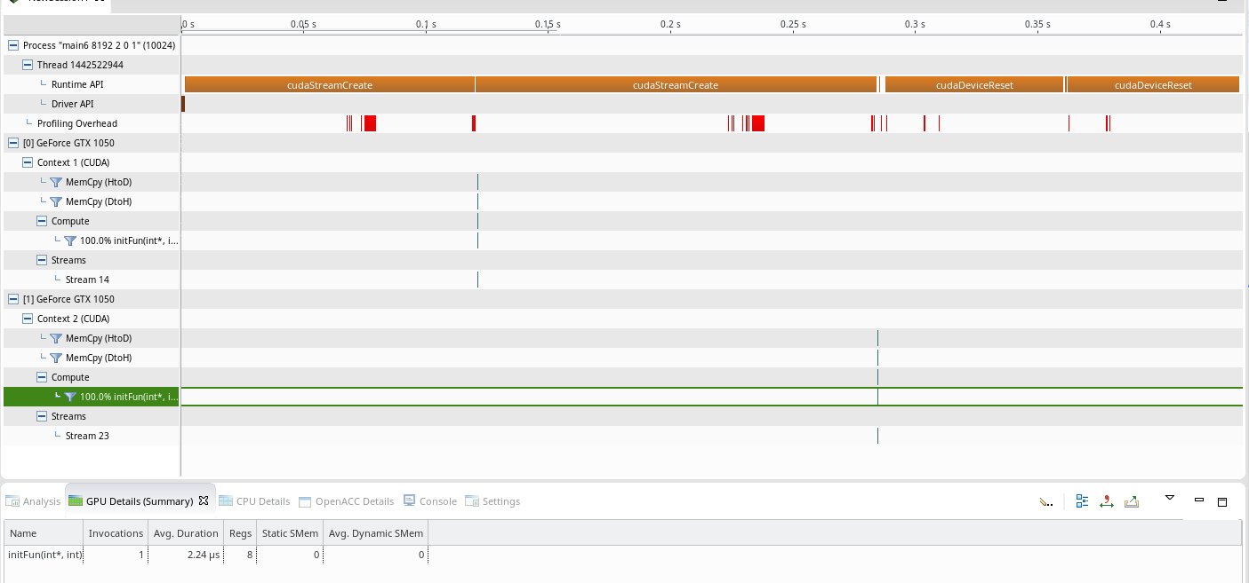

Slide 28
