Slide 1
Лекция 5
Объединение нитей в блоки и варпы.
Оптимальная конфигурация нитей.
Иерархия памяти.

Slide 2
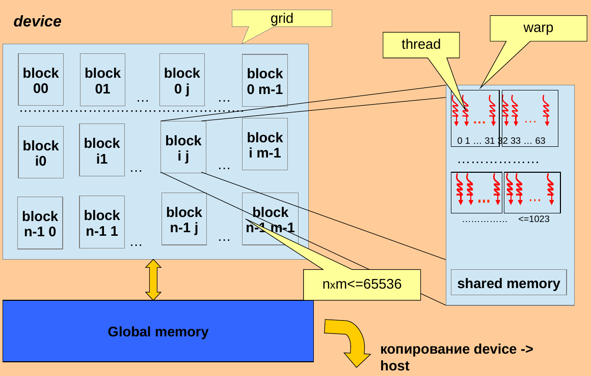

Slide 3
#include <stdio.h>
#include <stdlib.h>
__global__ void gShowIdx() {
int idx = blockIdx.x * blockDim.x + threadIdx.x;
int warp_idx = threadIdx.x / warpSize;
int lane_idx = threadIdx.x % warpSize;
printf(" %5d\t%5d\t %2d\t%2d\n",
idx, blockIdx.x, warp_idx, lane_idx);
}

Slide 4
int main(int argc, char** argv){
if(argc < 3){
fprintf(stderr,
"USAGE: <prog> <threads_per_block> <num_of_blocks>\n");
return -1;
}
int threads_per_block=atoi(argv[1]);
int num_of_blocks=atoi(argv[2]);
gShowIdx<<<num_of_blocks, threads_per_block>>>();
cudaDeviceSynchronize();
return 0;
}

Slide 5
./lab4a 64 2 | sort -g -k1,1 -k2,2 -k4,4 > stat.txt
Idx blk wrp lane
0 0 0 0
1 0 0 1
2 0 0 2
………………………
30 0 0 30
31 0 0 31
32 0 1 0
33 0 1 1
34 0 1 2
……………………
62 0 1 30
63 0 1 31
64 1 0 0
65 1 0 1
……………………
95 1 0 31
96 1 1 0
97 1 1 1
………………………..
127 1 1 31

Slide 6
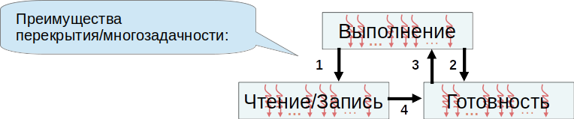
Оптимальное количество нитей в блоках
(сокрытие латентности)
Кол-во варпов % 32 ==0 && Кол-во варпов / 32 > 1
Кол-во блоков >= Кол-во мультипроцессоров

Slide 7
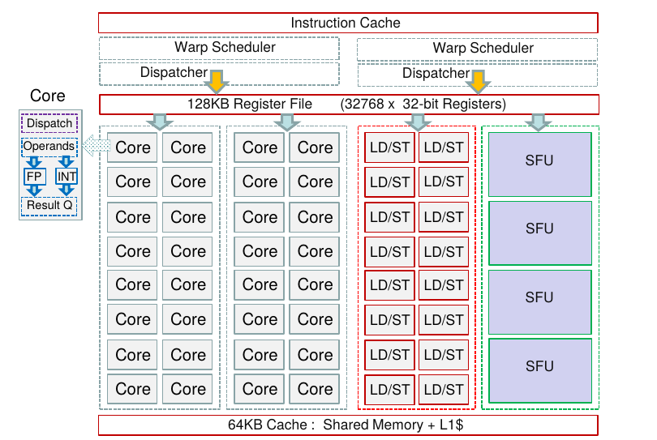

Slide 8
Detected 1 CUDA Capable device(s)
Device 0: "NVIDIA GeForce RTX 2060"
CUDA Driver Version / Runtime Version 12.0 / 11.1
CUDA Capability Major/Minor version number: 7.5
………………………………………………………………………………………………………………………..
(30) Multiprocessors, ( 64) CUDA Cores/MP: 1920 CUDA Cores
…………………………………………………………………………………………………………………………….
Memory Clock rate: 7001 Mhz
Memory Bus Width: 192-bit
L2 Cache Size: 3145728 bytes
………………………………………………………………………………………………………………………………………
Total amount of constant memory: 65536 bytes
Total amount of shared memory per block: 49152 bytes
Total shared memory per multiprocessor: 65536 bytes
Total number of registers available per block: 65536
Warp size: 32
Maximum number of threads per multiprocessor: 1024
Maximum number of threads per block: 1024

Slide 9
Detected 2 CUDA Capable device(s)
Device 0: "GeForce GTX 1050"
CUDA Driver Version / Runtime Version 9.1 / 9.1
CUDA Capability Major/Minor version number: 6.1
………………………………………………………………………………………………………………………………………………………………
( 5) Multiprocessors, (128) CUDA Cores/MP: 640 CUDA Cores
……………………………………………………………………………………………………………………………………………………..
Memory Clock rate: 3504 Mhz
Memory Bus Width: 128-bit
L2 Cache Size: 1048576 bytes
………………………………………………………………………………………………………………………………………………………………………
Total amount of constant memory: 65536 bytes
Total amount of shared memory per block: 49152 bytes
Total number of registers available per block: 65536
Warp size: 32
Maximum number of threads per multiprocessor: 2048
Maximum number of threads per block: 1024
………………………………………………………………………………………………………………………………………………………………….

Slide 10
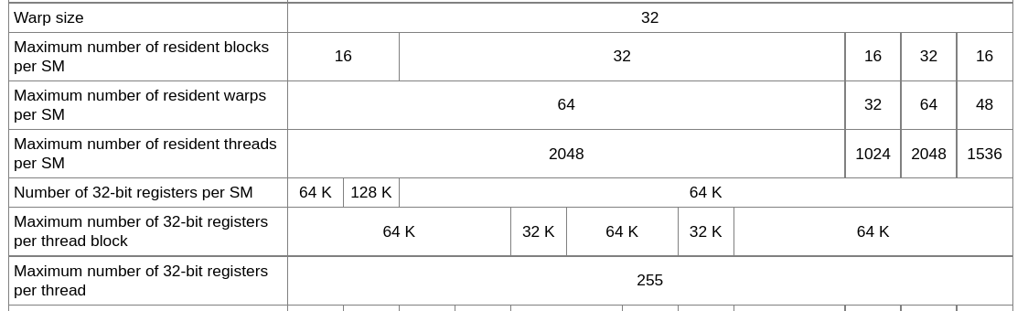
https://docs.nvidia.com/cuda/archive/11.2.0/cuda-c-programming-guide/
index.html#compute-capabilities

Slide 11
__global__ void gSum(int* a, int *b){
int i=threadIdx.x+blockIdx.x*blockDim.x;
a[i]+=b[i];
}
int N=1<<atoi(argv[1]);
int num_threads=atoi(argv[2]);
int num_blocks=N/num_threads;
gSum<<<num_blocks, num_threads>>>(a,b);
cudaDeviceSynchronize();
CUDA_CHECK_RETURN(cudaGetLastError());

Slide 12
/Lab4 # ncu --target-processes all -k gSum ./lab4 20 32
gSum(int *, int *), 2023-Feb-20 17:05:19, Context 1, Stream 7
Section: GPU Speed Of Light Throughput
--------------------------------------
Duration usecond 69.38
--------------------------------------
Section: Occupancy
----------------------------------------
Theoretical Occupancy % 50
Achieved Occupancy % 33.63
……………………………………………………………………………………………………………..

Slide 13
/Lab4 # ncu --target-processes all -k gSum ./lab4 20 64
gSum(int *, int *), 2023-Feb-20 17:05:19, Context 1, Stream 7
Section: GPU Speed Of Light Throughput
--------------------------------------
Duration usecond 42.78
--------------------------------------
Section: Occupancy
----------------------------------------
Theoretical Occupancy % 100
Achieved Occupancy % 79.17
……………………………………………………………………………………………………………..

Slide 14
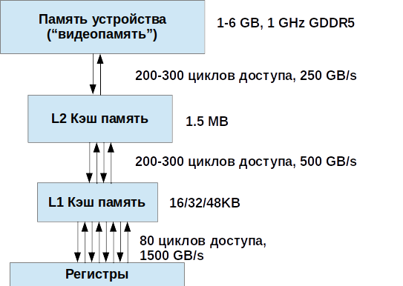

Slide 15
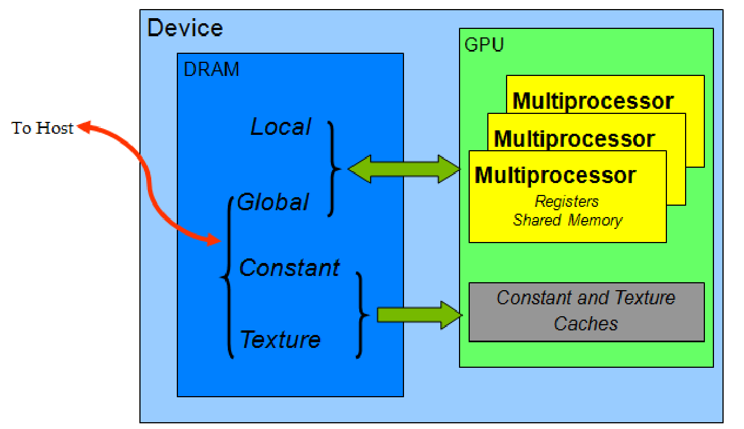

Slide 16
#define DUMMY_LENGTH 102
__global__ void gInit(int* a, int* b){
int i=threadIdx.x+blockIdx.x*blockDim.x;
int dummy[DUMMY_LENGTH];
for(int j=0;j<DUMMY_LENGTH;j++)
dummy[j]=j%2+1;
a[i]=dummy[DUMMY_LENGTH-2]*i;
b[i]=dummy[DUMMY_LENGTH-1]*i+1;
}
быдло-код😜

Slide 17
/PGP-2023> nvprof -m local_memory_overhead ./lab4 20 32
Invocations Metric Name Metric Description
Min Max Avg
Device "GeForce GTX 1050 (0)"
Kernel: gInit(int*, int*)
1 local_memory_overhead Local Memory Overhead
98.11% 98.11% 98.11%
Kernel: gSum(int*, int*)
1 local_memory_overhead Local Memory Overhead
0.00% 0.00% 0.00%

Slide 18
Type Time(%) Time Calls
Avg Min Max
Name
GPU activities: 83.15% 4.3196ms 1
4.3196ms 4.3196ms 4.3196ms
gInit(int*, int*)
4.67% 242.60us 1
242.60us 242.60us 242.60us
gSum(int*, int*)

Slide 19
#define DUMMY_LENGTH 101
/PGP-2023> nvprof -m local_memory_overhead ./lab4 20 32
Invocations Metric Name Metric Description
Min Max Avg
Device "GeForce GTX 1050 (0)"
Kernel: gInit(int*, int*)
1 local_memory_overhead Local Memory Overhead
0.00% 0.00% 0.00%
Kernel: gSum(int*, int*)
1 local_memory_overhead Local Memory Overhead
0.00% 0.00% 0.00%

Slide 20
Type Time(%) Time Calls
Avg Min Max
Name
GPU activities: 16.67% 173.67us 1
173.67us 173.67us 173.67us
gInit(int*, int*)
23.26% 242.25us 1
242.25us 242.25us 242.25us
gSum(int*, int*)

