Slide 1
Лекция 3
Инструменты отладки:
cuda-gdb
Data Display Debugger (ddd)
Nsight Eclipse Plugins
Nsight Visual Studio Code Edition

Slide 2
> ~Lecture3/Lab3-gdb> g++ lab3a.cpp -g3 -o lab3a
> ~Lecture3/Lab3-gdb> gdb lab3a
(gdb) list main
…………………………………………………………………………………………………….
36 gettimeofday(&t, NULL);
37 Start =(double)t.tv_sec*1000000.0 + (double)t.tv_usec;
38 hTest(N,a,b);
39 gettimeofday(&t, NULL);
40 Finish =(double)t.tv_sec*1000000.0 + (double)t.tv_usec;
……………………………………………………………………………………………………………
(gdb) b 38
Breakpoint 1 at 0x400865: file lab3a.cpp, line 38.

Slide 3
(gdb) run 256
Starting program: ~/Lecture3/Lab3-gdb/lab3a 16
(gdb) step
hTest (N=16, a=0x613e70, b=0x613ec0) at lab3a.cpp:7
7 for(int i=0; i<N;i++)
(gdb) list hTest
1 #include <malloc.h>
2 #include <stdio.h>
3 #include <stdlib.h>
4 #include <sys/time.h>
5
6 void hTest(int N, int* a, int* b){
7 for(int i=0; i<N;i++)
8 a[i]+=b[i];
9 }

Slide 4
(gdb) info args
N = 16
a = 0x613e70
b = 0x613ec0
(gdb) info locals
i = 0
(gdb) next 8
7 for(int i=0; i<N;i++)
(gdb) info locals
i = 3
(gdb) print b[2]
$1 = 5
(gdb) print a[2]
$2 = 9

Slide 5
gdb) break 8 if i==12
Breakpoint 3 at 0x400705: file lab3a.cpp, line 8.
(gdb) c
Continuing.
Breakpoint 3, hTest (N=16, a=0x613e70, b=0x613ec0) at lab3a.cpp:8
8 a[i]+=b[i];
(gdb) info locals
i = 12
(gdb) finish
Run till exit from #0 hTest (N=16, a=0x613e70, b=0x613ec0) at lab3a.cpp:8
main (argc=2, argv=0x7fffffffd9b8) at lab3a.cpp:39
39 gettimeofday(&t, NULL);

Slide 6
(gdb) x/16d b
0x613ec0: 1 3 5 7
0x613ed0: 9 11 13 15
0x613ee0: 17 19 21 23
0x613ef0: 25 27 29 31
(gdb) x/16d a
0x613e70: 1 5 9 13
0x613e80: 17 21 25 29
0x613e90: 33 37 41 45
0x613ea0: 49 53 57 61
(gdb) print a[2]-b[2]
$16 = 4

Slide 7
(gdb) c
Continuing.
Elapsed time: 9.57138e+06 ms
0 1 1
1 5 3
2 9 5
3 13 7
4 17 9
5 21 11
………………………………………………………………………………………………..
13 53 27
14 57 29
15 61 31
[Inferior 1 (process 4272) exited normally]
(gdb) quit

Slide 8
Отладка многопоточных программ
~/Lecture3/Lab3-gdb> gdb lab3b
(gdb) list hTest
16 void* hTest(void* arg){
17 struct targ* s_arg=(struct targ*)arg;
18 int length=s_arg->length;
19 int offset=s_arg->num_thread*length;
20 int i;
21 for(i=0;i<length;i++)
22 a[i+offset]+=/*1000*sin((double)*/b[i+offset];
23 return NULL;
25 }
(gdb) break lab3b.cpp:22
Breakpoint 1 at 0x40083f: file lab3b.cpp, line 22.

Slide 9
(gdb) run 4 16
Starting program: …/Lecture3/Lab3-gdb/lab3b 4 16
[Thread debugging using libthread_db enabled]
Using host libthread_db library "/lib64/libthread_db.so.1".
[New Thread 0x7ffff6ed1700 (LWP 10741)]
[New Thread 0x7ffff66d0700 (LWP 10742)]
[New Thread 0x7ffff5ecf700 (LWP 10743)]
[Switching to Thread 0x7ffff6ed1700 (LWP 10741)]
Thread 2 "lab3b" hit Breakpoint 1, hTest (arg=0x614e70) at lab3b.cpp:22
22 a[i+offset]+=/*1000*sin((double)*/b[i+offset];

Slide 10
(gdb) info threads
Id Target Id Frame
1 Thread 0x7ffff7fc0740 (LWP 10737) "lab3b" clone () at ../sysdeps/unix/sysv/linux/x86_64/clone.S:78
* 2 Thread 0x7ffff6ed1700 (LWP 10741) "lab3b" hTest (arg=0x614e70) at lab3b.cpp:22
3 Thread 0x7ffff66d0700 (LWP 10742) "lab3b" hTest (arg=0x614e7c) at lab3b.cpp:22
4 Thread 0x7ffff5ecf700 (LWP 10743) "lab3b" clone () at ../sysdeps/unix/sysv/linux/x86_64/clone.S:78

Slide 11
(gdb) print offset
$1 = 0
(gdb) thread 3
[Switching to thread 3 (Thread 0x7ffff66d0700 (LWP 10742))]
#0 hTest (arg=0x614e7c) at lab3b.cpp:22
22 a[i+offset]+=/*1000*sin((double)*/b[i+offset];
(gdb) print offset
$2 = 4

Slide 12
(gdb) break 22 thread 3
Note: breakpoint 1 (all threads) also set at pc 0x40083f.
Breakpoint 2 at 0x40083f: file lab3b.cpp, line 22.
(gdb) info breakpoints
Num Type Disp Enb Address What
1 breakpoint keep y 0x000000000040083f in hTest(void*) at lab3b.cpp:22
breakpoint already hit 1 time
2 breakpoint keep y 0x000000000040083f in hTest(void*) at lab3b.cpp:22 thread 3
stop only in thread 3
(gdb) delete 1

Slide 13
(gdb) x/16d a
0x614ee0: 0 2 4 6
0x614ef0: 8 10 12 14
0x614f00: 16 18 20 22
0x614f10: 24 26 28 30

Slide 14
(gdb) continue
Continuing.
Thread 3 "lab3b" hit Breakpoint 2, hTest (arg=0x614e7c) at lab3b.cpp:22
22 a[i+offset]+=/*1000*sin((double)*/b[i+offset];
(gdb) c
………………………………………………………………………………………………………………………………
(gdb) x/16d a
0x614ee0: 1 2 4 6
0x614ef0: 17 21 12 14
0x614f00: 33 37 20 22
0x614f10: 49 53 28 30

Slide 15
(gdb) c
Continuing.
[Thread 0x7ffff5ecf700 (LWP 10743) exited]
[Thread 0x7ffff66d0700 (LWP 10742) exited]
Thread-specific breakpoint 2 deleted - thread 3 no longer in the thread list.
[Thread 0x7ffff56ce700 (LWP 11167) exited]
[Thread 0x7ffff6ed1700 (LWP 10741) exited]
Elapsed time: 2.22941e+06 ms
0 1 1
1 3 5
2 5 9
…………………………………………………………………………………………
14 29 57
15 31 61
[Inferior 1 (process 10737) exited normally]

Slide 16
(gdb)print a[1]
………………………………………………………………….
(gdb)info locals
………………………………………………………………….
(gdb) info args
arg = 0x614e7c
(gdb) print ((struct targ*)arg)->length
$1 = 4

Slide 17
Отладка программ, выполняемых на GPU
https://docs.nvidia.com/cuda/archive/11.2.0/cuda-gdb/index.html
> nvcc -g -G …

Slide 18
~/Workshop/VSC> cuda-gdb lab3c
(cuda-gdb) list main
23 __global__ void gSum(int* a, int *b){
24 int i=threadIdx.x+blockIdx.x*blockDim.x;
25 a[i]+=b[i];
26 }
27
28 int main(){
29 int N=VECTOR_LENGTH;
30 int *a, *b;
31 int *a_h;
32
(cuda-gdb) break 25
Breakpoint 1 at 0x403fdd: file lab3c.cu, line 26.
(cuda-gdb) run

Slide 19
(cuda-gdb) info cuda threads
BlockIdx ThreadIdx To BlockIdx ThreadIdx Count VirtualPC
Filename Line
Kernel 0
* (0,0,0) (0,0,0) (0,0,0) (3,0,0) 4 0x00007fffe525c3e0
…/Lecture3/Lab3-cuda-gdb/lab3c.cu 9
(1,0,0) (0,0,0) (3,0,0) (3,0,0) 12 0x00007fffe525c2b0
…/Lecture3/Lab3-cuda-gdb/lab3c.cu 8

Slide 20
cuda-gdb) cuda block 2 thread 3
[Switching focus to CUDA kernel 0, grid 1, block (2,0,0), thread (3,0,0), device 0, sm 2, warp 0, lane 3]
8 b[i]=2*i+1;
(cuda-gdb) print i
$2 = 11
(cuda-gdb) n
9 }
(cuda-gdb) x/16d b
0x7fffecc00200: 1 3 5 7
0x7fffecc00210: 0 0 0 0
0x7fffecc00220: 0 0 0 0
0x7fffecc00230: 0 0 0 0

Slide 21
malkov@192:~> ssh cyber.sibsutis.ru
malkov@linux-47dw: ~/WORKSHOP/PGP-2023> cuda-gdb lab3c
(cuda-gdb) break 8
Breakpoint 1 at 0x403851: file lab3c.cu, line 8.
(cuda-gdb) run
Starting program: /home/malkov/WORKSHOP/PGP-2023/lab3c
……………………………………………………………………………………………………………………………………………………
[Switching focus to CUDA kernel 0, grid 1, block (0,0,0), thread (0,0,0), device 0, sm 0, warp 0, lane 0]
Thread 1 "lab3c" hit Breakpoint 1, gInit<<<(4,1,1),(4,1,1)>>> (a=0x7fffe6800000, b=0x7fffe6800200) at lab3c.cu:8
8 b[i]=2*i+1;

Slide 22
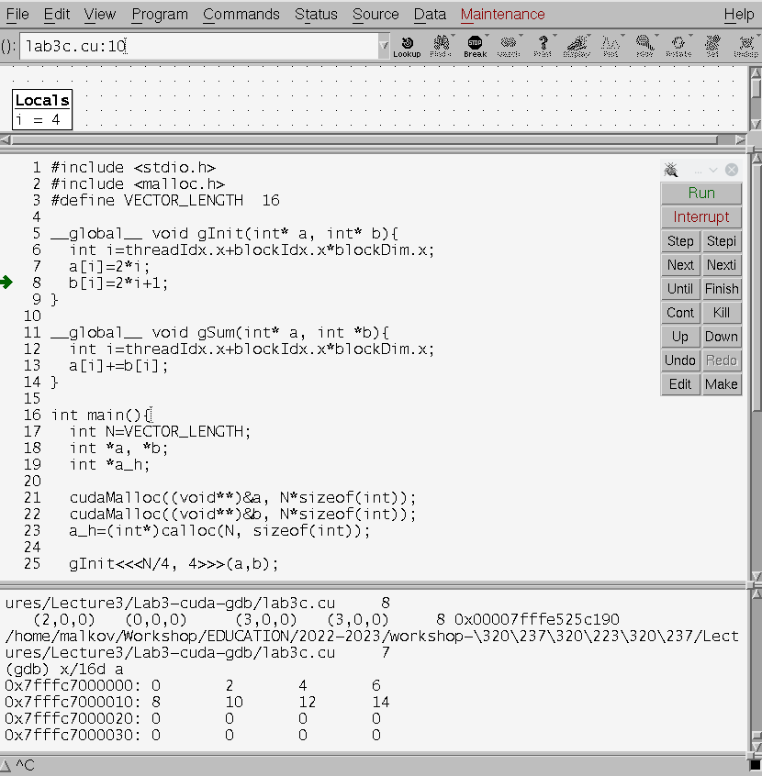
Data Display Debugger (ddd)
…/Lecture3/
Lab3-cuda-gdb>
ddd cuda-gdb lab3c
malkov@192:~> ssh cyber.sibsutis.ru -X
malkov@linux-47dw:
~/WORKSHOP/PGP-2023>
ddd cuda-gdb lab3c

Slide 23
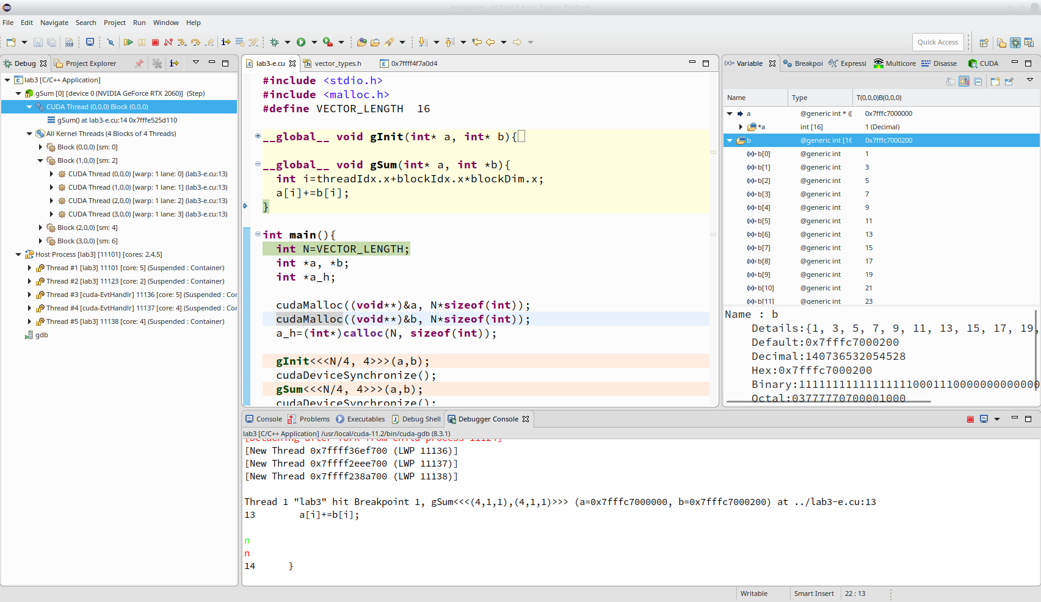
Nsight Eclipse Plugins

Slide 24
Nsight Visual Studio Code Edition

Slide 25
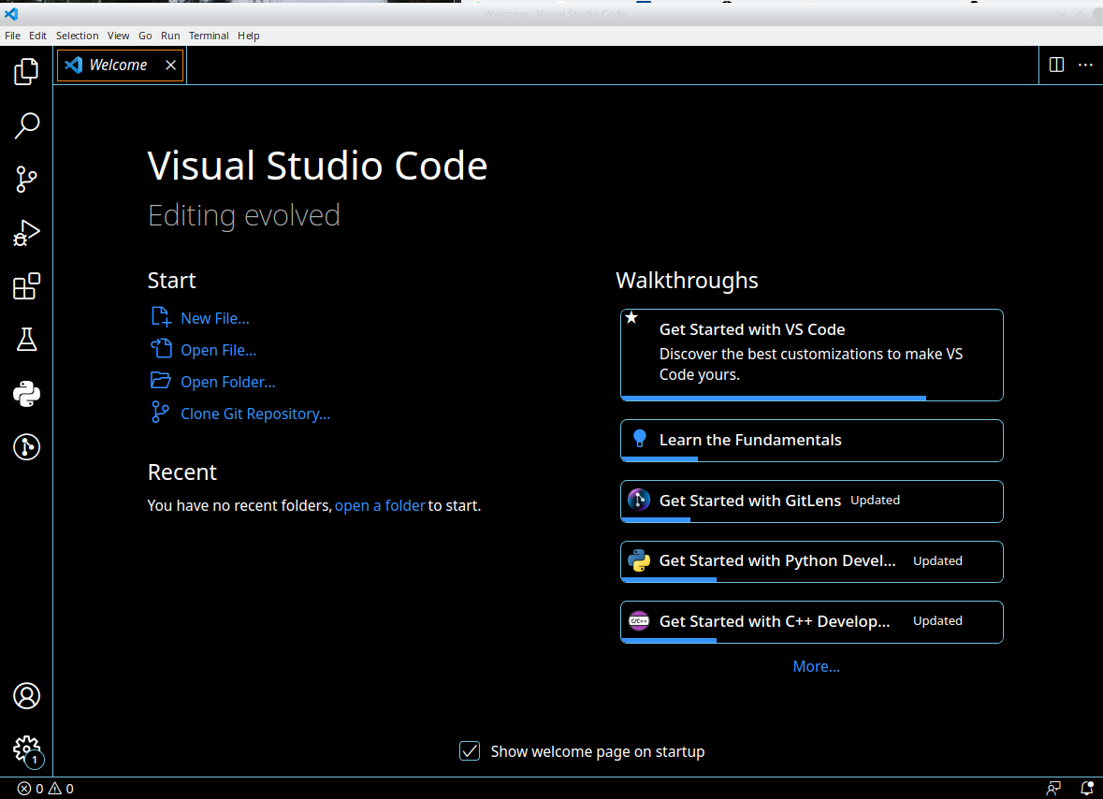
https://developer.nvidia.com/nsight-visual-studio-code-edition
https://docs.nvidia.com/nsight-visual-studio-code-edition/cuda-debugger/index.html

Slide 26
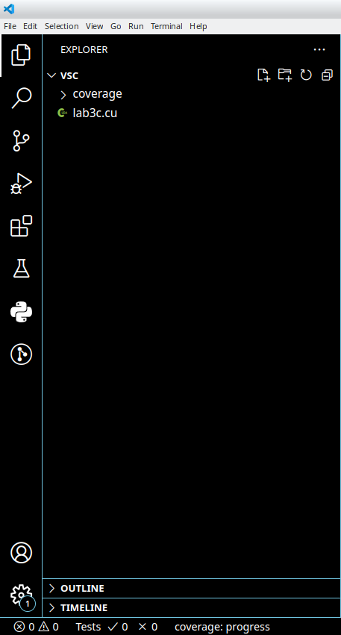
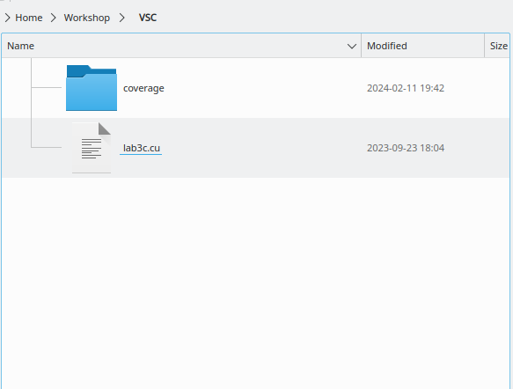

Slide 27
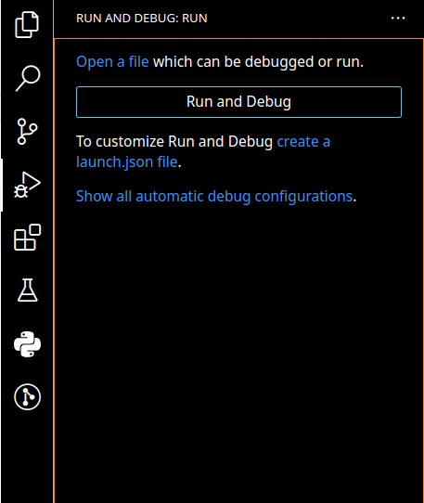
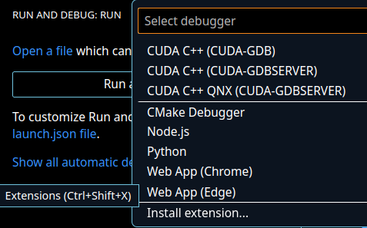

Slide 28
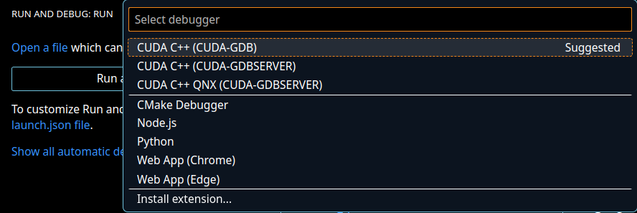

Slide 29
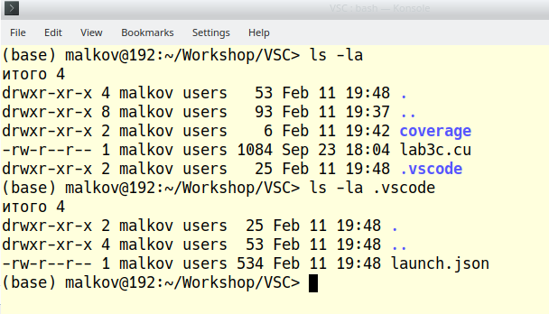

Slide 30
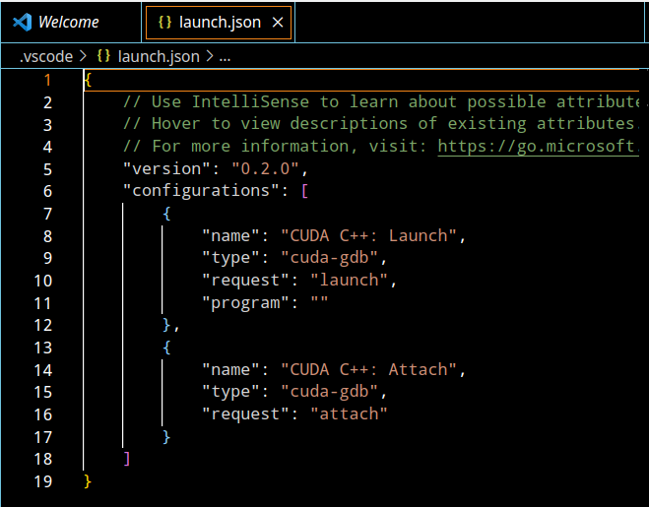

Slide 31
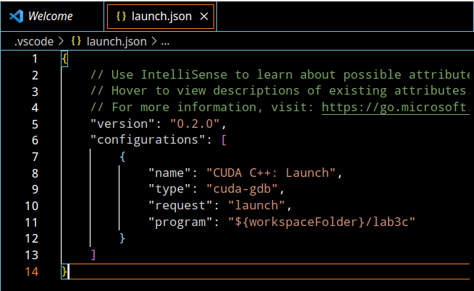

Slide 32
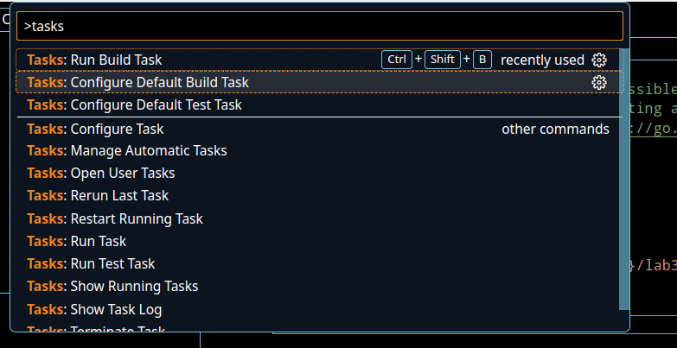

Slide 33
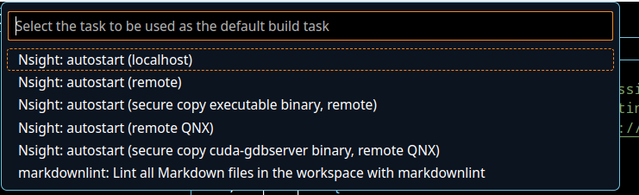

Slide 34
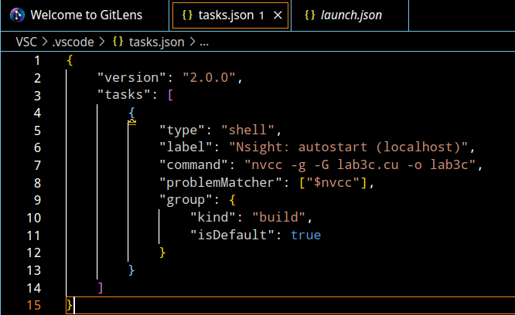

Slide 35
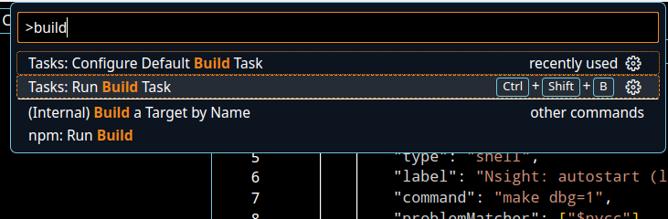

Slide 36
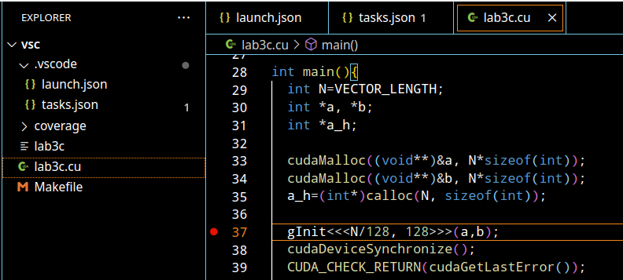

Slide 37
