Slide 1
Лекция 4
Инструменты профилирования:
nvprof
nvvp
Nsight Compute CLI
Nsight Compute

Slide 2
nvprof и Nsight Compute CLI

Slide 3
ip-011@linux-47dw:/home/malkov/WORKSHOP/PGP-2023>
nvprof ./lab3c
Type Time(%) Time Calls Avg Min Max Name
GPU activities:
43.59% 2.1760us 1 2.1760us 2.1760us
2.1760us gSum(int*, int*)
41.67% 2.0800us 1 2.0800us 2.0800us
2.0800us gInit(int*, int*)
14.74% 736ns 1 736ns 736ns 736ns [CUDA memcpy DtoH]
API calls:
98.87% 131.54ms 2 65.772ms 6.9650us 131.54ms cudaMalloc
………………………………………………………………………………………………………………………..
0.09% 124.46us 2 62.229us 10.561us 113.90us cudaFree
…………………………………………………………………………………………………………………………………………
0.01% 14.599us 1 14.599us 14.599us 14.599us
cudaMemcpy

Slide 4
/Lecture3/Lab3-cuda-gdb # ncu --target-processes all ./lab3c
gInit(int *, int *), 2023-Feb-13 15:09:06, Context 1, Stream 7
Section: GPU Speed Of Light Throughput
--------------------------------------------------------
DRAM Frequency cycle/nsecond 6.40
SM Frequency cycle/nsecond 1.29
Elapsed Cycles cycle 3,327
Memory [%] % 1.10
DRAM Throughput % 0.02
Duration usecond 2.56
--------------- ------------------------------
WRN This kernel grid is too small to fill the available resources on this device, resulting in only 0.0 full
waves across all SMs. Look at Launch Statistics for more details.
………………………………………………………………………………………………………………………………………………………………

Slide 5
/Lecture3/Lab3-cuda-gdb # ncu
--metrics gpu__time_duration.sum ./lab3c
gInit(int *, int *), 2023-Feb-13 18:42:52, Context 1, Stream 7
Section: Command line profiler metrics
------ --------------- ------------------------------
gpu__time_duration.sum usecond 29.50 ------------------------------------------------------------
gSum(int *, int *), 2023-Feb-13 18:42:52, Context 1, Stream 7
Section: Command line profiler metrics ------------------------------------------------------------
gpu__time_duration.sum usecond 37.57 ---------------------------------------------------------------

Slide 6
/Lecture3/Lab3-cuda-gdb> nvprof --query-metrics
======== Warning: Skipping profiling on device 0 since profiling is not supported on devices with compute capability 7.5 and higher.
Use NVIDIA Nsight Compute for GPU profiling and NVIDIA Nsight Systems for GPU tracing and CPU sampling.
Refer https://developer.nvidia.com/tools-overview for more details.

Slide 7
ip-011@linux-47dw:/home/malkov/WORKSHOP/PGP-2023>
nvprof --query-metrics | less
Available Metrics: Name Description
Device 0 (GeForce GTX 1050):
inst_per_warp: Average number of instructions executed by each warp
warp_execution_efficiency: Ratio of the average active threads per warp to the maximum number of
threads per warp supported on a multiprocessor
……………………………………………………………………………………………………………………………………………….
gld_transactions_per_request: Average number of global memory load transactions performed for each global memory load.
gst_transactions_per_request: Average number of global memory store transactions performed for each global memory store
……………………………………………………………………………………………………………………..

Slide 8
ip-011@linux-47dw:/home/malkov/WORKSHOP/PGP-2023>
nvprof -m gst_throughput ./lab3c
Invocations Metric Name Metric Description Min Max Avg
Device "GeForce GTX 1050 (0)"
Kernel: gSum(int*, int*)
1 gst_throughput Global Store Throughput 40.582MB/s
40.582MB/s 40.582MB/s
Kernel: gInit(int*, int*)
1 gst_throughput Global Store Throughput 71.303MB/s
71.303MB/s 71.302MB/s

Slide 9
/Lecture3/Lab3-cuda-gdb # ncu --list-sections
/Lecture3/Lab3-cuda-gdb # ncu --query-metrics
https://docs.nvidia.com/nsight-compute/NsightComputeCli/index.html#nvprof-metric-collection

Slide 10
/Lecture3/Lab3-cuda-gdb # ncu --metrics
l1tex__t_bytes_pipe_lsu_mem_global_op_st.sum.per_second ./lab3c
gInit(int *, int *), 2023-Feb-13 17:13:20, Context 1, Stream 7
Section: Command line profiler metrics ------------------------------------------------------
l1tex__t_bytes_pipe_lsu_mem_global_op_st.sum.per_second Mbyte/second 89.89 ---------------------------------------------------------------
gSum(int *, int *), 2023-Feb-13 17:13:20, Context 1, Stream 7
Section: Command line profiler metrics ---------------------------------------------------------------
l1tex__t_bytes_pipe_lsu_mem_global_op_st.sum.per_second Mbyte/second 41.24 ---------------------------------------------------------------

Slide 11
ip-011@linux-47dw:/home/malkov/WORKSHOP/PGP-2023>
nvprof -m gld_throughput ./lab3c
Invocations Metric Name Metric Description Min Max Avg
Device "GeForce GTX 1050 (0)"
Kernel: gInit(int*, int*)
1 gld_throughput Global Load Throughput 0.0B/s 0.0B/s 0.0B/s
Kernel: gSum(int*, int*)
1 gld_throughput Global Load Throughput 87.694MB/s
87.694MB/s 87.694MB/s

Slide 12
/Lecture3/Lab3-cuda-gdb # ncu --metrics
l1tex__t_bytes_pipe_lsu_mem_global_op_ld.sum.per_second ./lab3c
gInit(int *, int *), 2023-Feb-13 15:25:41, Context 1, Stream 7
Section: Command line profiler metrics
---------------------------------------------------
l1tex__t_bytes_pipe_lsu_mem_global_op_ld.sum.per_second byte/second 0
------------------------------------------------
gSum(int *, int *), 2023-Feb-13 15:25:41, Context 1, Stream 7
Section: Command line profiler metrics
---------------------------------------------------------
l1tex__t_bytes_pipe_lsu_mem_global_op_ld.sum.per_second Mbyte/second 82.47
-------------------------------------------------------

Slide 13
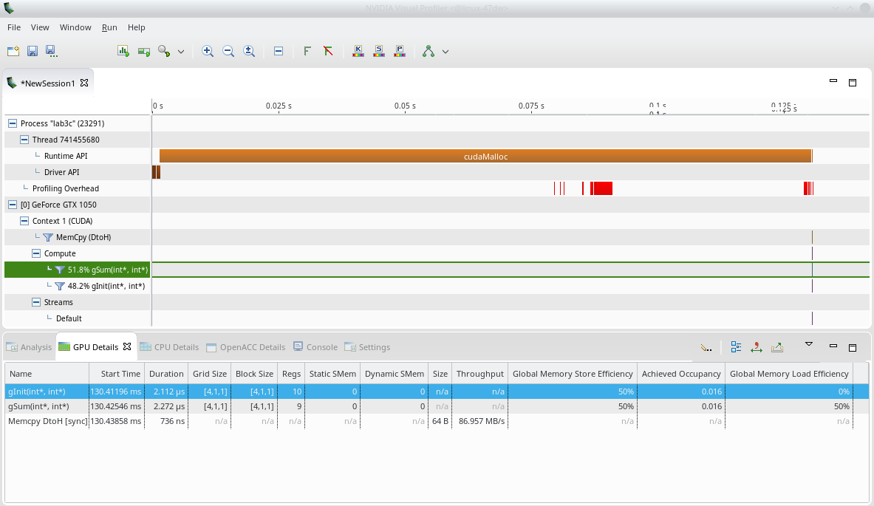
nvvp и Nsight Compute
ip-011@linux-47dw:/home/malkov/WORKSHOP/PGP-2023> nvvp ./lab3c

Slide 14
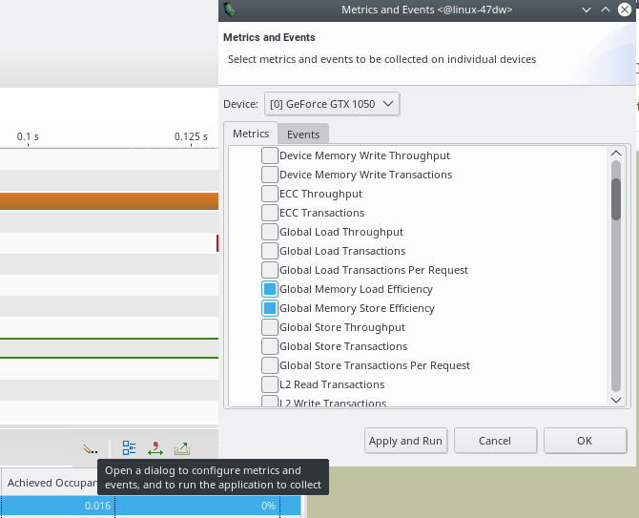

Slide 15
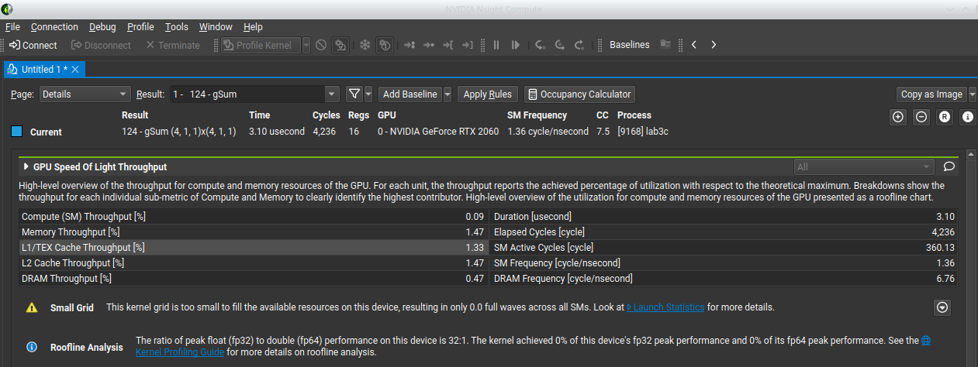
/Lecture3/Lab3-cuda-gdb # ncu-ui --target-processes all ./lab3c

