Slide 1
Лекция 7
Библиотека thrust
Контейнеры host_vector и device_vector.
Алгоритмы thrust.
Преобразование указателей и комбинированный код.
Алгоритм transform и функторы.
Кортежи и zip-итератор.

Slide 2
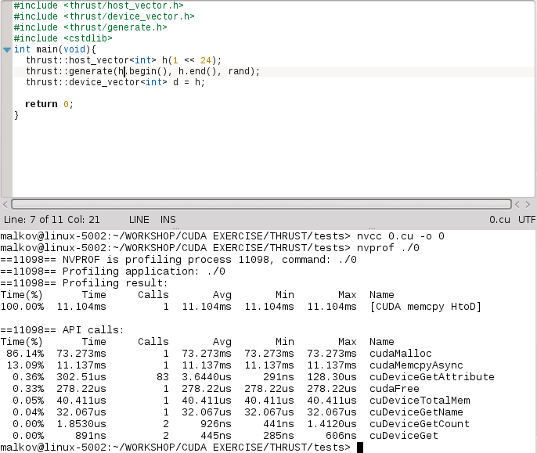

Slide 3
#include <thrust/host_vector.h>
#include <thrust/device_vector.h>
#include <thrust/generate.h>
#include <thrust/sort.h>
#include <thrust/copy.h>
#include <cstdlib>
int main(void){
thrust::host_vector<int> h(1 << 8);
thrust::generate(h.begin(), h.end(), rand);
thrust::device_vector<int> d = h;
thrust::sort(d.begin(), d.end());
thrust::copy(d.begin(), d.end(), h.begin()); //h=d;
for(int i=0;i<(1<<8);i++)
printf("%d\n",h[i]);
return 0;
}

Slide 4
#include <thrust/host_vector.h>
#include <thrust/device_vector.h>
#include <thrust/fill.h>
#include <thrust/copy.h>
#include <cstdio>
__global__ void gTest(float* d){
int idx=threadIdx.x+blockDim.x*blockIdx.x;
d[idx]+=(float)idx;
}
int main(void){
float *raw_ptr;
thrust::host_vector<float> h(1 << 8);
thrust::fill(h.begin(), h.end(), 3.1415f);
thrust::device_vector<float> d = h;
raw_ptr = thrust::raw_pointer_cast(&d[0]);//d.data());
gTest<<<4,64>>>(raw_ptr);
cudaDeviceSynchronize();
thrust::copy(d.begin(), d.end(), h.begin());
for(int i=0;i<(1<<8);i++)
printf("%g\n",h[i]);
return 0;
}

Slide 5
#include <thrust/host_vector.h>
#include <thrust/device_vector.h>
//#include <thrust/fill.h>
#include <thrust/transform.h>
#include <thrust/sequence.h>
//#include <thrust/generate.h>
#include <thrust/execution_policy.h>
#include <cstdio>
//#include <thrust/for_each.h>
#include <cmath>
struct range_functor
{
float h;
range_functor(float _h):h(_h){}
__host__ __device__
float operator()(float x){
return h*x;
}
};
struct sin_functor
{
__host__ __device__
float operator()(float x){
return sin(x);
}
};

Slide 6
int main(){
range_functor rfunc(0.02);
sin_functor sfunc;
thrust::host_vector<float> h1(1 << 8);
thrust::host_vector<float> h2(1 << 8);
thrust::device_vector<float> d1(1 << 8);// = h1;
thrust::device_vector<float> d2(1 << 8);// = h2;
thrust::sequence(thrust::device,d1.begin(), d1.end());
thrust::transform(d1.begin(), d1.end(), d1.begin(), rfunc);
thrust::transform(d1.begin(), d1.end(), d2.begin(), sfunc);
//thrust::for_each(thrust::device, d2.begin(), d2.end(), printf_functor());
h2=d2;
h1=d1;
for(int i=0;i<(1<<8);i++){
printf("%g\t%g\n",h1[i], h2[i]);
}
return 0;
}

Slide 7
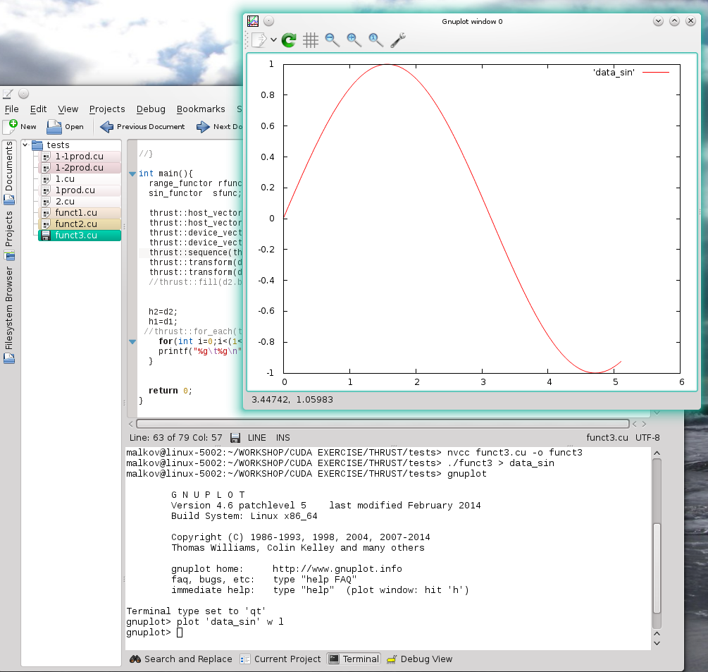

Slide 8
#include <thrust/host_vector.h>
#include <thrust/device_vector.h>
#include <thrust/fill.h>
#include <thrust/transform.h>
#include <thrust/sequence.h>
#include <cstdio>
struct saxpy_functor
{
const float a;
saxpy_functor(float _a) : a(_a) {}
__host__ __device__
float operator()(float x, float y){
return a*x+y;
}
};
void saxpy(float a,
thrust::device_vector<float>& x,
thrust::device_vector<float>& y){
saxpy_functor func(a);
// call transform
thrust::transform(x.begin(), x.end(), y.begin(), y.begin(), func);
}

Slide 9
int main(){
thrust::host_vector<float> h1(1 << 24);
thrust::host_vector<float> h2(1 << 24);
thrust::sequence(h1.begin(), h1.end());
thrust::fill(h2.begin(), h2.end(), 2.0);
thrust::device_vector<float> d1 = h1;
thrust::device_vector<float> d2 = h2;
saxpy(3.0, d1, d2);
h2=d2;
for(int i=0;i<(1<<8);i++){
printf("%g\n",h2[i]);
}
return 0;
}

Slide 10
КОРТЕЖИ
#include <thrust/tuple.h>
#include <cstdio>
int main(){
thrust::tuple<int, float, const char *> test_tuple(23, 4.5, "thrust");
printf("%d\t%g\t%s\n", thrust::get<0>(test_tuple),
thrust::get<1>(test_tuple),
thrust::get<2>(test_tuple));
return 0;
}
malkov@linux-5002:~/WORKSHOP/CUDA EXERCISE/THRUST/tests> ./tuple1
23 4.5 thrust

Slide 11
#include <thrust/tuple.h>
#include <thrust/device_vector.h>
#include <thrust/host_vector.h>
#include <thrust/transform.h>
#include <thrust/fill.h>
#include <thrust/iterator/zip_iterator.h>
#include <cstdio>
#define N 32
struct rotate_tuple{
__host__ __device__
thrust::tuple<float,float,float> operator()(thrust::tuple<float&,float&,float&>& t){
float x = thrust::get<0>(t);
float y = thrust::get<1>(t);
float z = thrust::get<2>(t);
float rx=0.36*x+0.48*y-0.80*z;
float ry=-0.80f*x+0.60*y+0.00f*z;
float rz=0.48f*x+0.64f*y+0.60f*z;
return thrust::make_tuple(rx,ry,rz);
}
};

Slide 12
int main(){
thrust::device_vector<float> x(N), y(N), z(N);
thrust::fill(x.begin(), x.end(), 2.0);
thrust::fill(y.begin(), y.end(), 3.0);
thrust::fill(z.begin(), z.end(), 5.0);
thrust::transform( thrust::make_zip_iterator( thrust::make_tuple(x.begin(), y.begin(), z.begin() )),
thrust::make_zip_iterator( thrust::make_tuple(x.end(), y.end(), z.end() )),
thrust::make_zip_iterator( thrust::make_tuple(x.begin(), y.begin(), z.begin() )),
rotate_tuple() );
thrust::host_vector<float> hx(N), hy(N),hz(N);
hx=x; hy=y; hz=z;
for(int i=0;i<N;i++)
printf("%g\t%g\t%g\n",hx[i], hy[i], hz[i]);
return 0;
}

