Slide 1
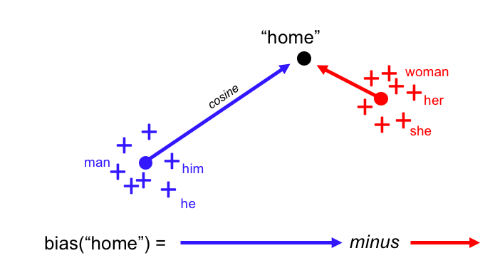
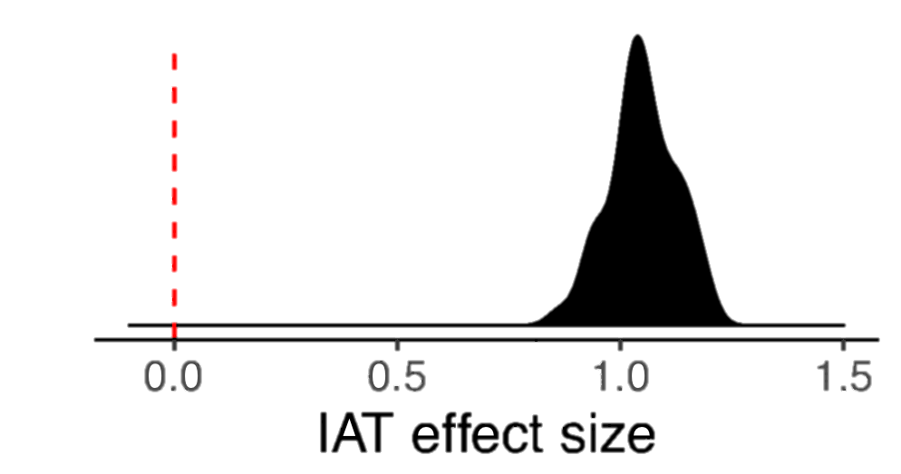
Language use shapes cultural norms: Large scale evidence from gender
Molly Lewis^{1,2} and Gary Lupyan¹
¹University of Wisconsin-Madison, ²University of Chicago
What role do word co-occurrences and grammatical structure play in shaping cultural norms?
Gender bias as a case study: an abstract domain,¹ that is culturally transmitted and often grammatically encoded.²
Hypotheses: (1) Language as a mere reflection of speakers’ gender biases, or (2) language as one of the causes?
Study 2: Gender bias and word meanings
Word embeddings capture
word genderness
We quantified gender bias in language using distributional semantic models (word-embeddings trained on Wikipedia.⁵)
Automatic gender scores from word embeddings
butcher
Female
Male
clean
In English, gender bias of a word in embedding model correlated strongly with explicit gender ratings⁶
(r = .59; p <. 001).
We then computed the linguistic analog to behavioral IAT using English word embedding models (replicating Caliskan, et al., 2017⁷) when trained on corpora from each of the languages. Target words were translated into 20 languages by native speakers.
Behavioral and language IAT measures positively correlated at the level of languages (r = .48; p = .03).
nurse
r = .59
Female
Male
Human produced gender ratings
Predicting by-language IAT
from word-embeddings
Study 1: Gender bias across cultures
Implicit Association Task (IAT) – behavioral measure of the strength of respondents’ implicit associations between two pairs of concepts.³
Male
Career
Female
Family
r = .48
Data collected by Project Implicit⁴ – 663,709 participants from 48 countries (d = 1.08; M = 1.05; SD = .07).
Implicit and explicit bias measures correlated (r = .15; p < .0001).
Study 3: Gender bias and grammar
Grammatically gendered languages show somewhat higher language gender biases, compared to languages without grammatical gender (d = .99 [-.02, 2.01]).
Participants who completed IAT in countries where the dominant language has grammatical gender showed a somewhat larger gender bias on the IAT (d = 0.68 [-0.08, 1.45]).
Predicting by-language IAT
from grammatical gender
Implicit Psychological Gender Bias Effect Size
Hindi
Hungarian
female-family
Conclusions
People exposed to languages that encode stronger gender biases (Study 2) and those with grammatical gender (Study 3) tend to show larger implicit gender biases on the (English) IAT.
A relationship between grammatical gender and IAT hints at a causal influence: input from language structure affects IAT performance.
References: [1] Boroditsky, L. (2001). Does language shape thought?: Mandarin and English speakers' conceptions of time. Cognitive Psychology, 43(1), 1-22.; [2] Master, A., Markman, E. M., & Dweck, C. S. (2012). Thinking in categories or along a continuum: Consequences for children’s social judgments. Child Development, 83(4), 1145-1163.; [3] Greenwald, A. G., McGhee, D. E., & Schwartz, J. L. (1998). Measuring individual differences in implicit cognition: the implicit association test. JPSP, 74(6), 1464.; [4] Nosek, B. A., Banaji, M. R., & Greenwald, A. G. (2002). Harvesting implicit group attitudes and beliefs from a demonstration web site. Group Dynamics: Theory, Research, and Practice, 6(1), 101.; [5] Bojanowski, P., Grave, E., Joulin, A., & Mikolov, T. (2016). Enriching word vectors with subword information.; [6] Scott, G. G., Keitel, A., Becirspahic, M., O’Donnell, P. J., & Sereno, S. C. (2017). The Glasgow Norms: Ratings of 5,500 words on 9 scales. [7] Caliskan, A., Bryson, J. J., & Narayanan, A. (2017). Semantics derived automatically from language corpora contain human-like biases. Science, 356(6334), 183-186.

