Slide 1
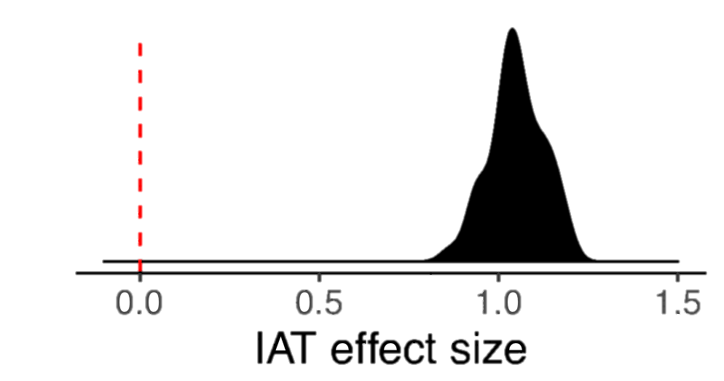
Language use shapes cultural norms: Large scale evidence from gender
Molly Lewis^{1,2} and Gary Lupyan¹
¹University of Wisconsin-Madison, ²University of Chicago
What role do word co-occurrences and grammatical structure play in shaping cultural norms?
Gender bias as a case study – abstract domain¹, grammatically encoded, and culturally transmitted.²
Hypotheses: (1) Language as reflection of speakers’ gender biases, or (2) language as causal?
Study 2: Gender bias and semantics
Measure bias in language using word-embedding models trained on Wikipedia.⁵
Bias = cos(male-words, target) – cos(female-words, target).
In English, gender bias of a word in embedding model strongly correlated with explicit gender ratings⁶ (r = .59; p <. 001).
Conducted linguistic analog to behavioral IAT using English word embedding models (replicating Caliskan, et al., 2017⁷).
Translated target words into 20 languages by native speakers, and conducted language IAT using model trained on each language.
Behavioral and language IAT measures positively correlated at the level of languages (r = .48; p = .03).
r = .59
Study 1: Gender bias across cultures
Implicit Association Task (IAT) – behavioral measure of the strength of respondents’ implicit associations between two pairs of concepts.³
Male
Career
Female
Family
r = .48
Data collected by Project Implicit⁴ – 663,709 participants from 48 countries (d = 1.08; M = 1.05; SD = .07).
Implicit and explicit bias measures correlated (r = .15; p < .0001).
Study 3: Gender bias and grammar
Implicit Psychological Gender Bias Effect Size
Grammatical gender languages tend to have speakers with greater psychological gender bias, compared to speakers of non-grammatical gender languages (d = 0.68 [-0.08, 1.45]).
Grammatical gender languages tend to have larger language IAT gender biases, compared to non-grammatical gender languages (d = .99 [-.02, 2.01]).
Hindi
Hungarian
female-family
Conclusion
Languages with larger gender biases in their semantics (Study 2) and grammatical gender markers (Study 3) tend to have speakers with larger implicit gender biases.
Studies 2 and 3 consistent with both hypotheses; Study 3 provides some evidence for causal hypothesis.
References: [1] Boroditsky, L. (2001). Does language shape thought?: Mandarin and English speakers' conceptions of time. Cognitive Psychology, 43(1), 1-22.; [2] Master, A., Markman, E. M., & Dweck, C. S. (2012). Thinking in categories or along a continuum: Consequences for children’s social judgments. Child Development, 83(4), 1145-1163.; [3] Greenwald, A. G., McGhee, D. E., & Schwartz, J. L. (1998). Measuring individual differences in implicit cognition: the implicit association test. JPSP, 74(6), 1464.; [4] Nosek, B. A., Banaji, M. R., & Greenwald, A. G. (2002). Harvesting implicit group attitudes and beliefs from a demonstration web site. Group Dynamics: Theory, Research, and Practice, 6(1), 101.; [5] Scott, G. G., Keitel, A., Becirspahic, M., O’Donnell, P. J., & Sereno, S. C. (2017). The Glasgow Norms: Ratings of 5,500 words on 9 scales. [6] Bojanowski, P., Grave, E., Joulin, A., & Mikolov, T. (2016). Enriching word vectors with subword information.; [7] Caliskan, A., Bryson, J. J., & Narayanan, A. (2017). Semantics derived automatically from language corpora contain human-like biases. Science, 356(6334), 183-186.

