Slide 1
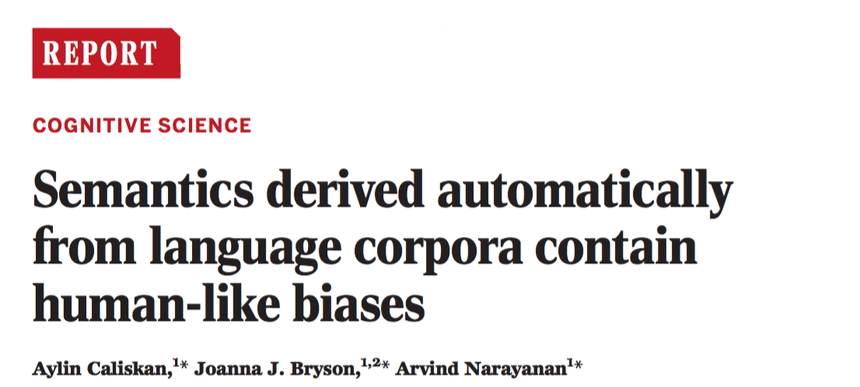
Notes:
This is a paper that came out a few weeks ago in Science – uses word-embeddings to meausre the same semantic biases that have been obsered in behavioral psychology experiments

Slide 2
Implicit Psychological Biases
Actions/judgments that are automatically activated without the performer's awareness (Greenwald & Banaji, 1995, pp. 6-8)
Types of biases:
Near-universal biases (flowers as pleasant vs. insects)
Consciously disavowed biases (European-American names as pleasant vs. African-American names, for self-described unprejudiced individuals)
Tested using the Implicit Association Test (IAT)
Notes:
In particular – they’re instered in what have been called “IMPLICIT pschological biasses” – “actions…..
Innocous biases:
Less – innocous
The way it is typically tested is in what’s called the implicit association test (IAT

Slide 3
Implicit Association Test (IAT)
Attributes
A = {cheer, freedom, health, love, peace}
B = {abuse, crash, filth, murder, sickness}
Categories
X = {marigold, poppy, azalea, crocus, iris}
Y = {ant, caterpillar, flea, bedbug, spider}
marigold
cheer
ant
abuse
marigold
cheer
ant
abuse
compare reaction time
Participants slower for incongruent mapping (right), suggesting bias to associate flowers with pleasantness
https://implicit.harvard.edu/implicit/takeatest.html
Notes:
* Task is nice because it measures implicit association, and so it resists people’s self-presentation strategies (prefer not to express)
* Can do this for lots of different associations

Slide 4
Word-Embedding Association Test (WEAT)
Replicate IAT findings with word embeddings in an analog measure
Method:
Pre-trained GloVe embeddings distributed by its authors
“Common Crawl” corpus (840 billion tokens)
300-d vector, 10 word window
Replicate with word2vec
Notes:
SO what they do in this paper then, is….
he similarity between a pair of vectors is related to the probability that the words co-occur with other words similar to each other in text (

Slide 5
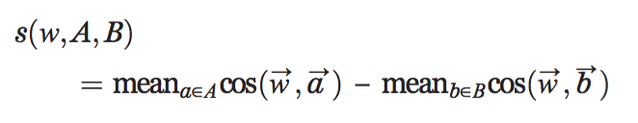
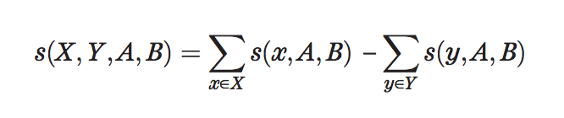
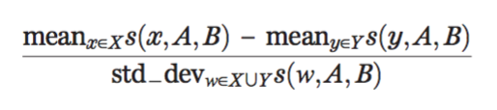
Measuring psychological biases with word embeddings
Given target words (X, Y) and attribute words (A, B), measure difference between X and Y in terms of their relative similarity to A and B
Effect size
Notes:
So the question then is, how do you get from 300d word embeddings to ameasure of the differenece in assocations between words, in a way that’s analog to the IAT
For each categoriy word, measure the difference in it’s association with attribute A attribute B – take the mean across all attirbutes
Better than raw co-occurrence statistics
s(w,A,B) = the association of w with the attribute,
s(X,Y,A,B) =differential association of the two sets of target words with the attribute
Cos(w,a) similariry- distance

Slide 6
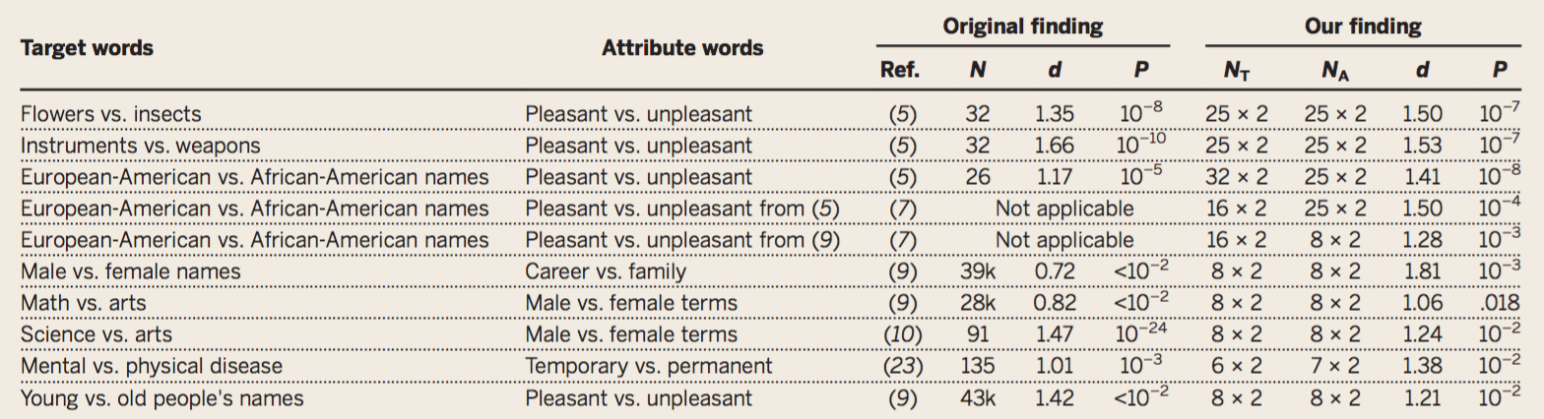
Results
X vs. Y
A vs. B
IAT
WEAT
Replicates all behavioral IAT findings tested on the WEAT
Notes:
-> Replicate netural and prejudeice baises
-> word embeddings “know” these properties of flowers, insects, musical instruments, and weapons with no direct experience of the world and no representation of semantics other than the implicit metrics of words’ co-occurrence statistics with other nearby words.

Slide 7
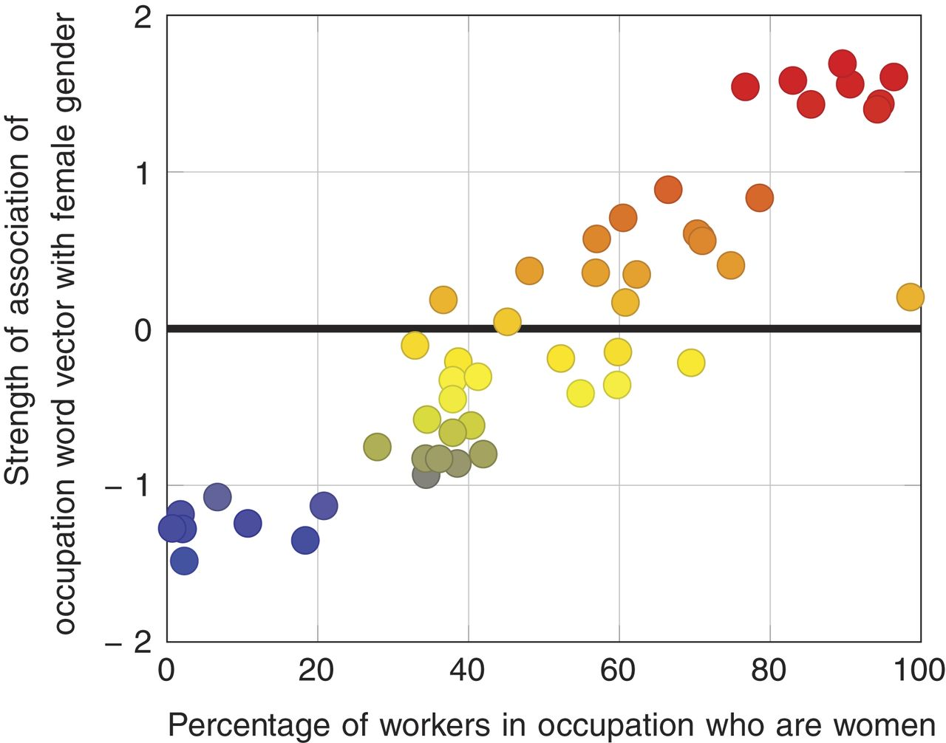
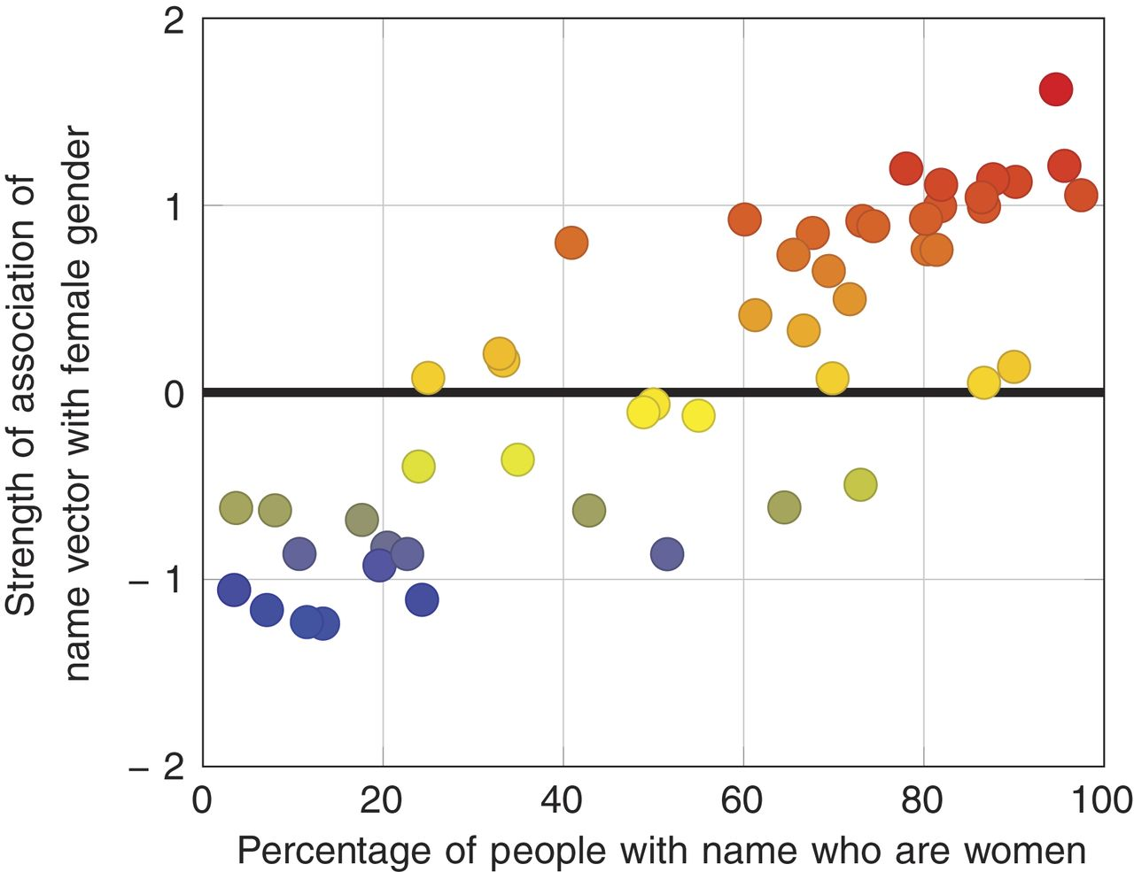
Do embeddings also encode veridical data?
Word-Embedding Factual Association Test (WEFAT)
Occupation ~ female-ness
Androgynous name ~ female-ness
(U.S. Bureau of Labor Statistics)
(1990 U.S. census)
Notes:
Here, they compare associations from word embeddings, and compare
Each dot is an occupation/name

Slide 8
Discussion
Implicit human biases are reflected in the statistical properties of language
Implications for origins of prejudices: Implicit transmission of ingroup/outgroup identity through language as null hypothesis for explaining origins of prejudice in humans
Methodological implications: Low-cost test for presence of bias in a group of people
Implications for machine learning: If an intelligent system learns enough about language to understand and produce it, will also acquire historical cultural associations, some of which can be objectionable
Notes:
Take-aways
explicit./institutional – reproducing statistics in language
Machinel learing, was used for, say, résumé screening -- we may be baking these biases into that process

