Slide 1
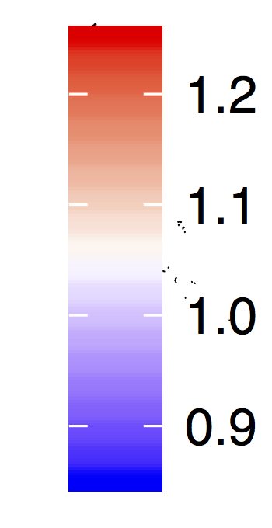
Language use shapes cultural norms: Large scale evidence from gender
Molly Lewis^{1,2} and Gary Lupyan¹
¹University of Wisconsin-Madison, ²University of Chicago
What role do word-co-occurrences and grammatical structure play in shaping cultural norms?
Gender bias as a case study – abstract domain (Boroditsky, 2001), grammatically encoded, and culturally transmitted (e.g., Master, Markman, & Dweck, 2012)
Hypotheses: (1) Language as reflection of speakers’ gender biases, or (2) language as causally related?
Study 2: Gender bias and semantics
Measure gender bias in language using word-embedding models trained on Wikipedia (Bojanowski, Grave, Joulin, & Mikolov, 2016)
In English, male-female gender association of a word strongly correlated with explicit gender ratings (r = .85; p <. 001; Scott et al., 2017)
Conducted linguistic analog to behavioral IAT using English word embedding models (replicating Caliskan, et al., 2017)
Translated target words into 35 languages by native speakers, and conducted language IAT using model trained on each language.
Behavioral and language IAT measures strongly correlated at the level of languages (r = .48; p = .03)
Study 1: Gender bias across cultures
Implicit Association Task (IAT) – behavioral measure of the strength of respondents’ implicit associations between two pairs of concepts (Greenwald, McGhee, & Schwartz, 1998)
Male
Career
Female
Family
Data collected by Project Implicit (Nosek, Banaji, & Greenwald, 2002) – 663,709 participants from 48 countries (d = 1.08; M = 1.05; SD = .07)
Implicit and explicit bias measures correlated (r = .15; p < .0001)
Study 3: Gender bias and grammar
Implicit psychological gender bias effect size
Languages with grammatical gender tend to have speakers with greater psychological gender bias, compared to speakers of non-grammatical gender languages (d = 0.68 [-0.08, 1.45]).
Grammatical gender languages have larger language IAT gender biases, compared to non-grammatical gender languages (t(17.68) = 2.18; p = 0.04).
female-family
Conclusion
Languages that have larger gender biases encoded in their lexical semantics (Study 2) and have grammatical gender markers (Study 3) tend to have speakers with larger implicit gender bias.
Studies 2 and 3 consistent with both language-as-reflection and language-as-causal hypotheses, while Study 3 provides some evidence in favor of the language-as-causal-hypothesis.
male-family

