Slide 1
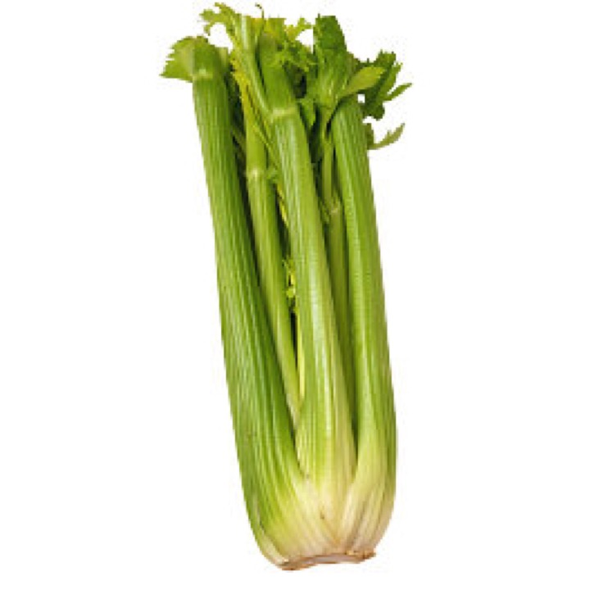
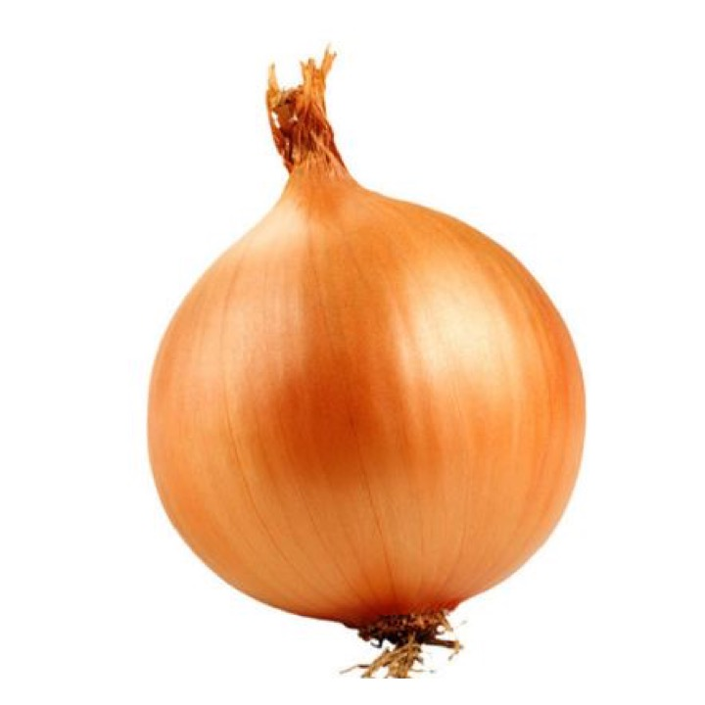
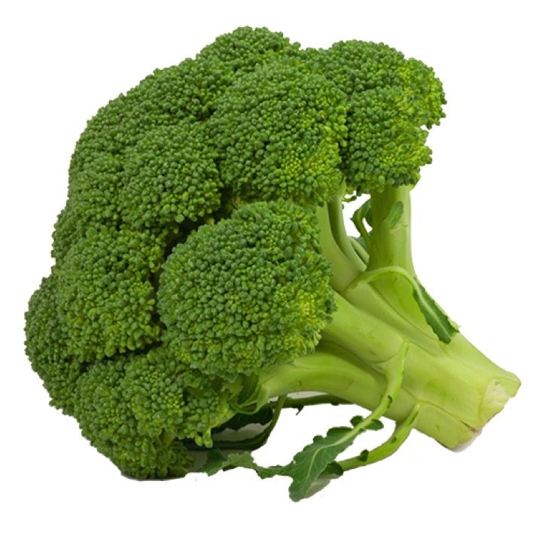






Superordinate
Basic
Subordinate

Slide 2



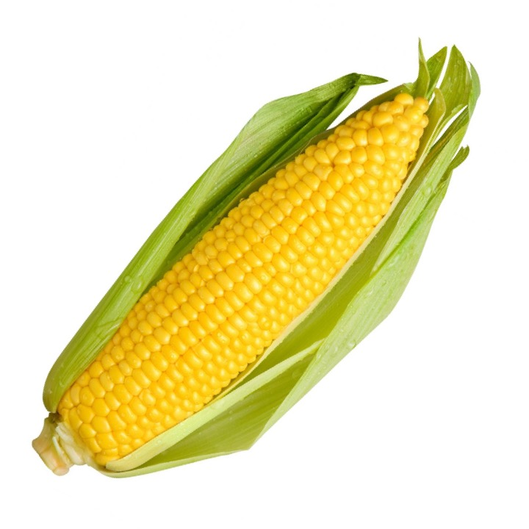
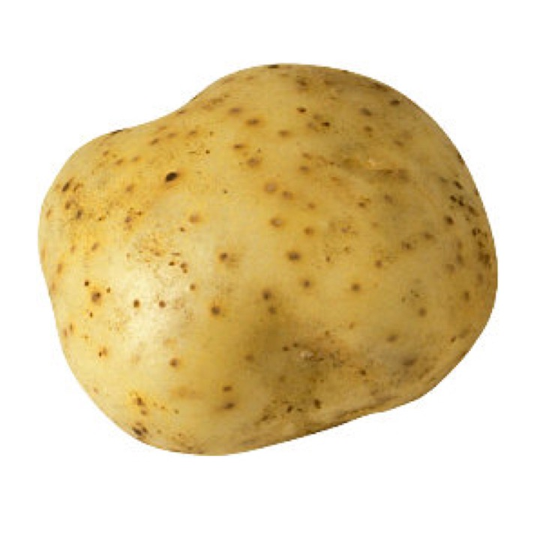
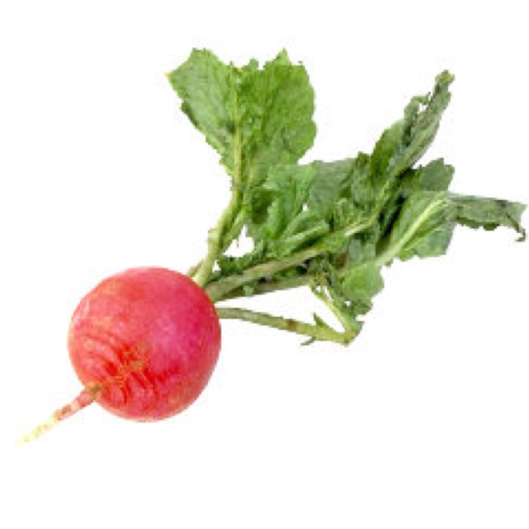
Learning Exemplars
Generalization Exemplars
One
Subordinate
Basic
Superordinate

Slide 3
Learning Exemplars
Generalization Exemplars
one
subordinate
basic
superordinate

Slide 4
Learning Exemplars
Generalization Exemplars
one
subordinate
basic
superordinate

Slide 5
Learning Exemplars
Generalization Exemplars
one
subordinate
basic
superordinate

