Slide 1
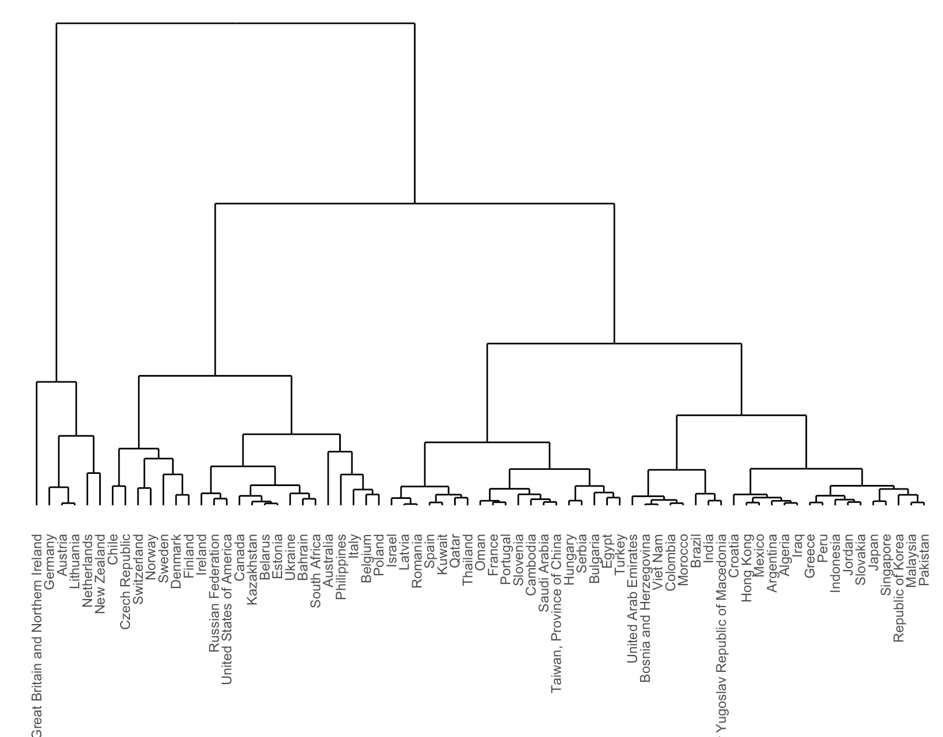
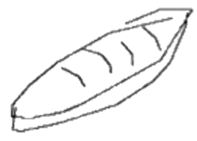

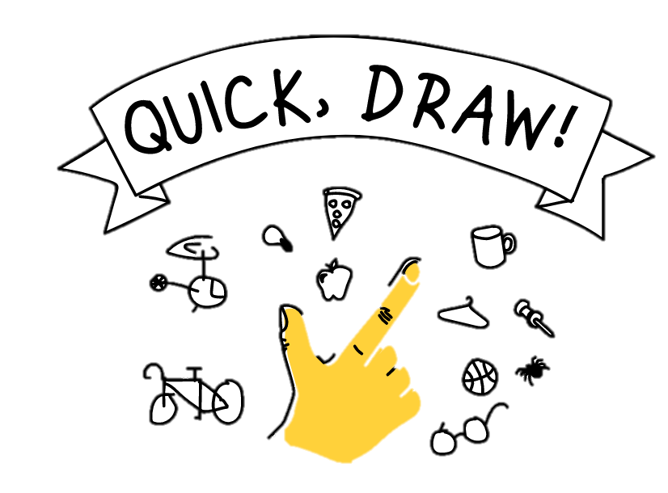
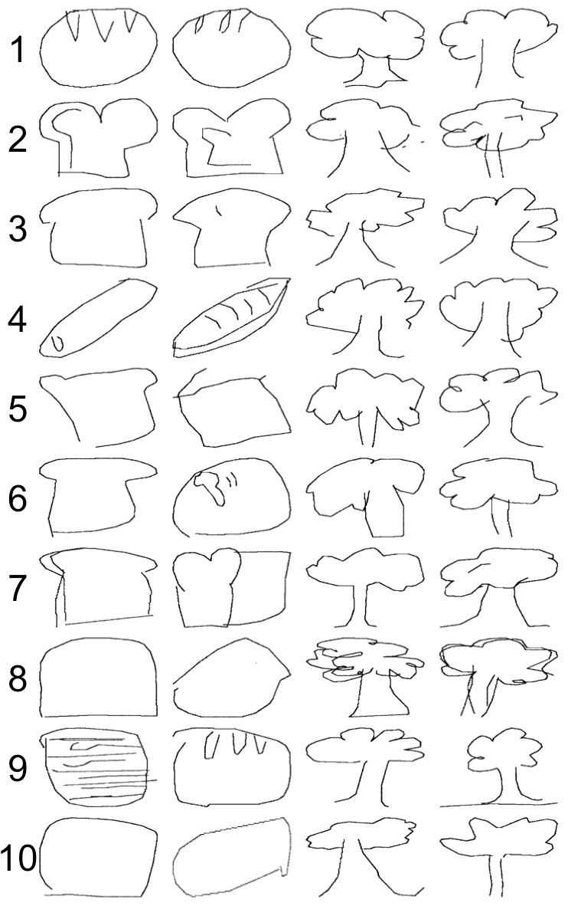
What 50 Million Drawings Tell Us About Shared Meaning
Molly Lewis and Gary Lupyan, University of Wisconsin-Madison
=
How do we interrogate shared meaning?
Cross-Cultural Variability
“bread”
Drawings as a window
50M drawings across 345 categories (N = 15M)
quickdraw.withgoogle.com
Predicting Variability with Language
Drawing Similarity:
50 drawings from each of 39 countries across 40 categories.
For each country pair, calculated mean drawing similarity for each item.
Linguistic Semantic Similarity:
Word embedding models (Fasttext Wikipedia)
Translated 40 category words into primary language of each country (Google Translate).
For each language, calculated distance between each word pair
For each language pair, calculated correlation of pairwise word distances.
Drawing Similarity
Quantifying Similarity
Hausdorff Distance— drawing similarity as the minimum Euclidean distance between two sets of points (Huttenlocher, Klanderman, & Rucklidge, 1993).
Measure Validation:
1500 drawing pairs from two categories (“bread” and “tree”) from participants across 72 countries
20 pairs from each decile of similarity (per item)
Rated similarity (1-7 Likert scale)
Each participant (N =100) rated 50 pairs/category
Human judgements highly correlated with Hausdorff Distance (r = .29; p < .0001)
Linguistic
Similarity
Conclusion and Next Directions
Non-linguistic representation predicted by linguistic community
Moving forward, characterize variability across different semantic domains, and compare linguistic predictors to other measures of cultural similarity.

Slide 2

Notes:
For tree – cosine similairites
Grouped by similarity
Hight of cluster -> degree of similarity

Slide 3
Notes:
For tree – cosine similairites
Grouped by similarity
Hight of cluster -> degree of similarity

